Slide 1
Mesovortices within the 8 May 2009 Bow Echo over the Central United States: Analyses of the Characteristics and Evolution Based on Doppler Radar Observations and a High-Resolution Model Simulation
Professor : Ming-Jen Yang
Student : Jyong-En Miao
Date : 2015/10/22
Xu, X., M. Xue, and Y. Wang, 2015b
Mon. Wea. Rev., 143, 2266–2290.

Slide 2
Introduction
Low-level, meso-γ-scale [2–20 km; Orlanski (1975)] mesovortices (MVs) are frequently observed at the leading edge of quasi-linear convective systems (QLCSs) like squall lines and bow echoes.
MVs could produce damaging straight-line winds [i.e., derechoes; Johns and Hirt (1987)] near the surface.
Moreover, bow echo MVs have been observed to spawn tornadoes.

Slide 3
Introduction
The production of damaging winds within QLCSs has long been linked to the descent to the surface of a rear-inflow jet (RIJ) at the bow apex.
However, the strongest straight-line wind damage may not be directly associated with the RIJ itself, but with low-level MVs along the bow echo, sometimes away from the bow apex.
Low-level MVs were found to originate from downward or upward tilting of baroclinic horizontal vorticity generated along the cold outflow boundary and in general intensify as a result of vertical stretching.
Moderate-to-strong vertical wind shear at low to midlevels was found conductive to the formation of strong, deep, and long-lived MVs.

Slide 4
Introduction
the initial storms of the MCS were initiated in an environment of weak synoptic-scale forcing and limited thermodynamic instability, with its structure and strength controlled by many factors.
In the post-MCS stage, however, the system evolved in an environment of large thermodynamic instability.
In this paper, we focus on the mature stage of the MCS of the 8 May 2009 over the central United States, in particular between 1200 and 1500 UTC when the MCS evolved into a well-defined bow echo.
The emphasis of this study is on documenting the existence of low-level MVs in this bow-echo system and examining their general characteristics (e.g., lifetime and intensity) based on radar observations and a real-data numerical simulation.

Slide 5
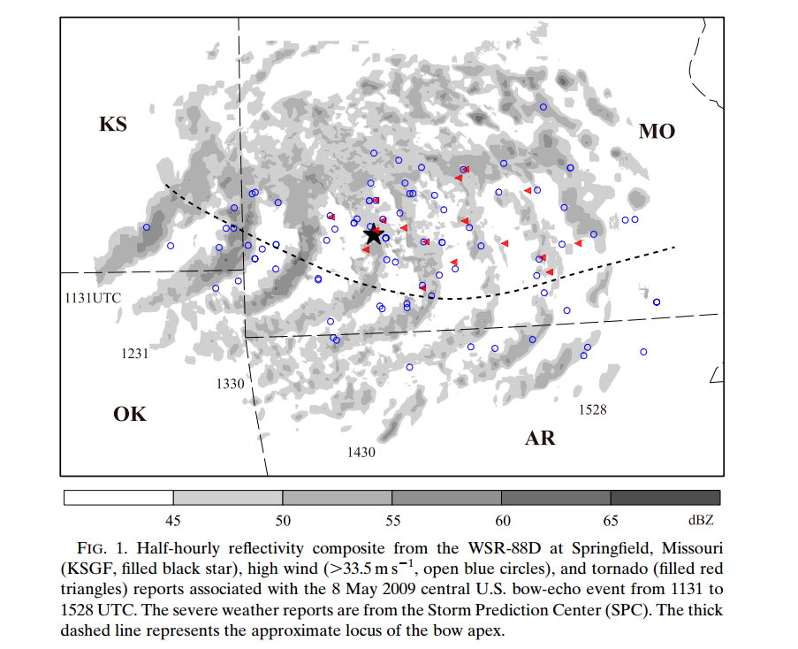

Slide 6
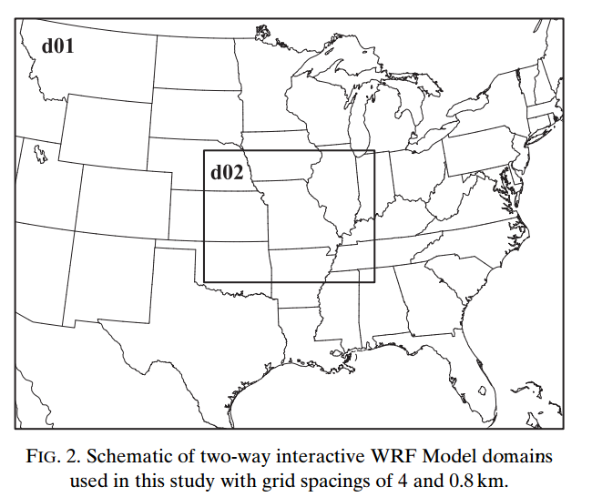

Slide 7
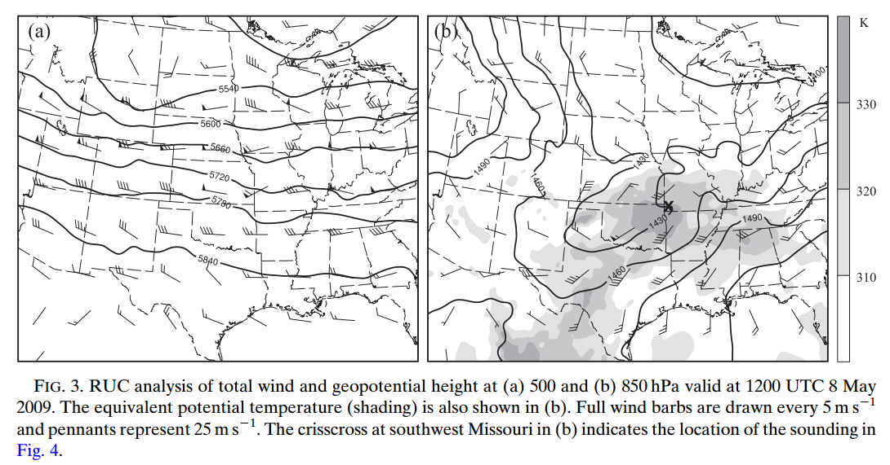

Slide 8
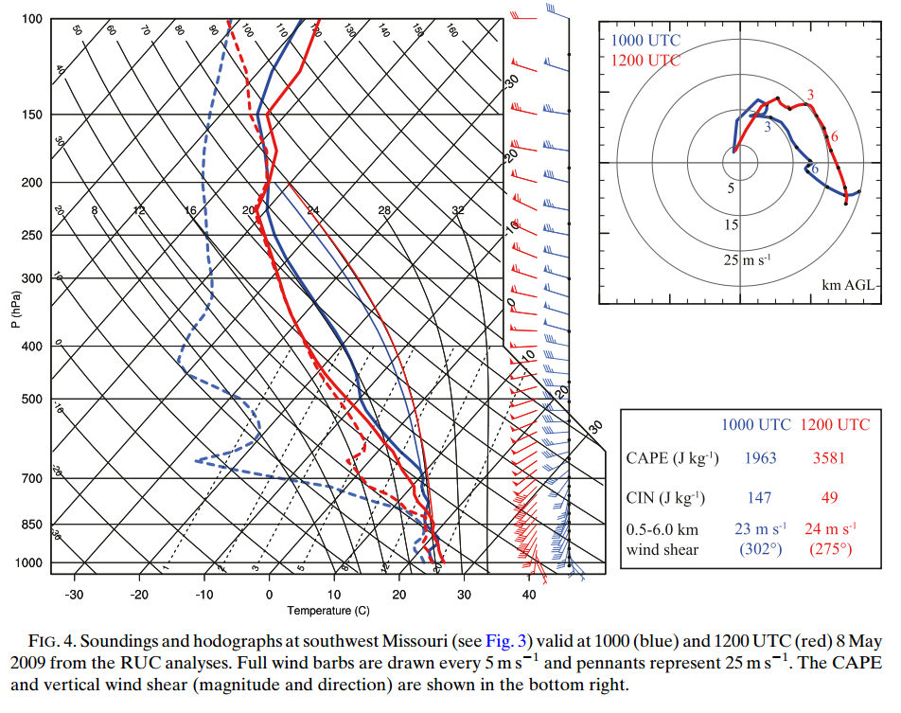

Slide 9
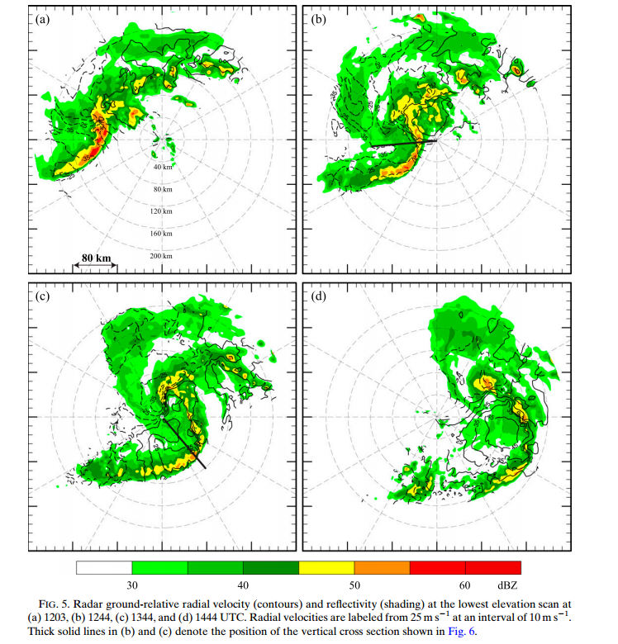

Slide 10
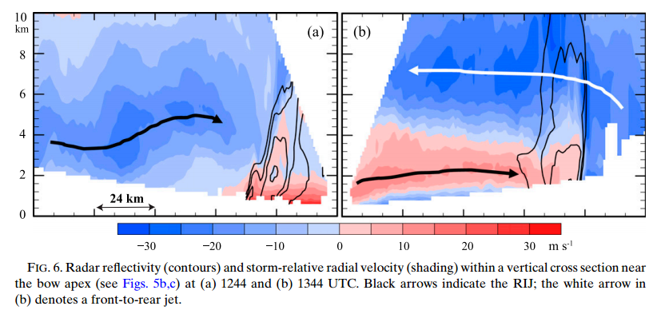

Slide 11
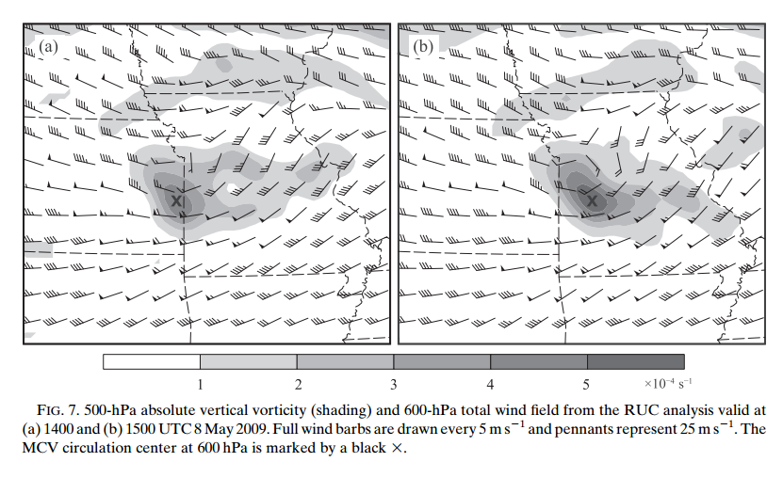

Slide 12
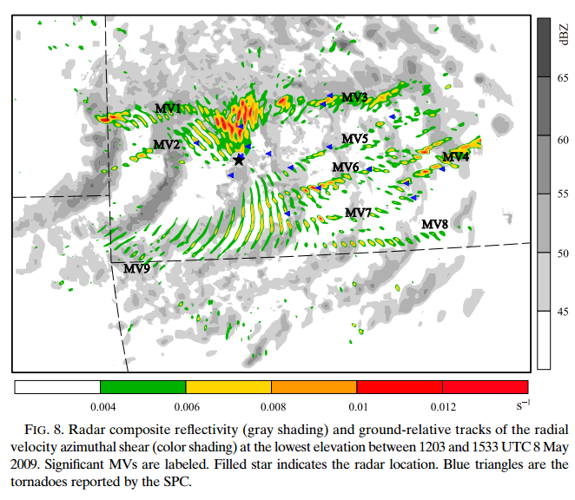

Slide 13
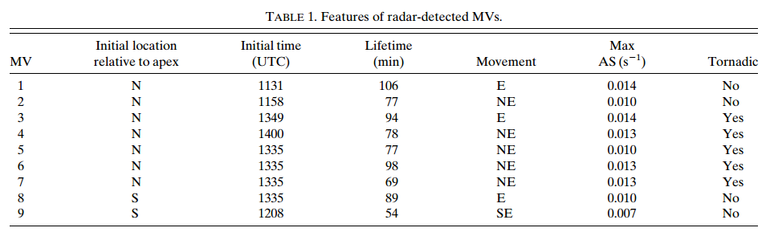

Slide 14
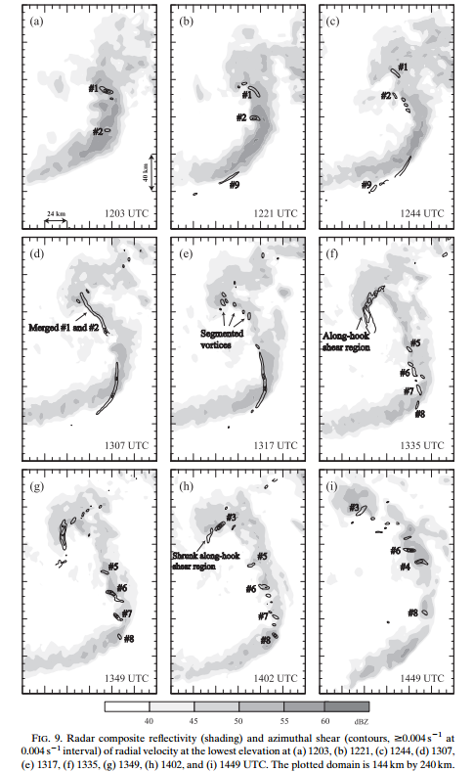

Slide 15
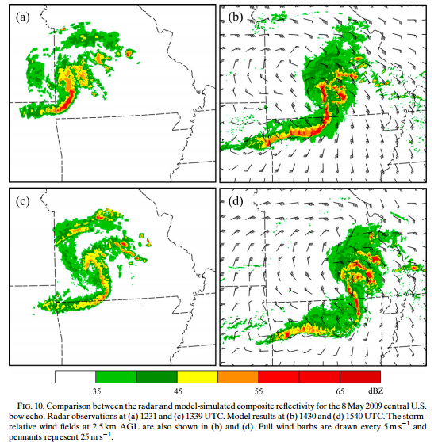

Slide 16
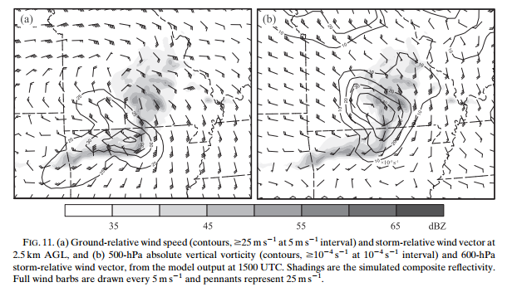

Slide 17
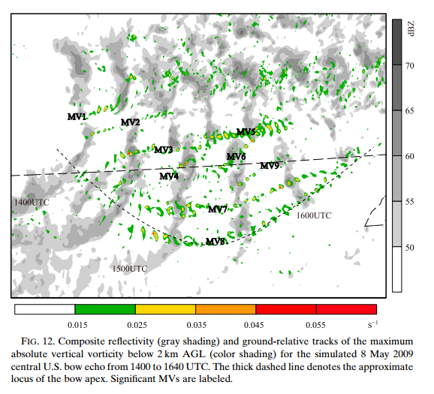

Slide 18
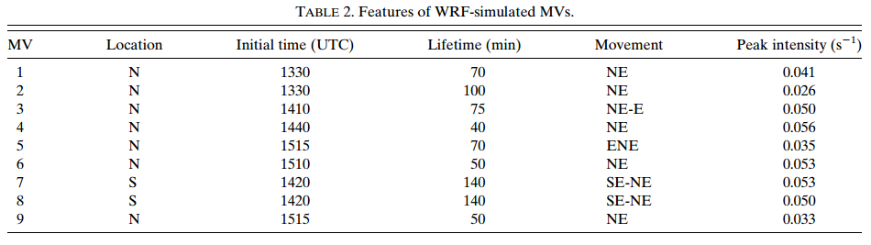

Slide 19
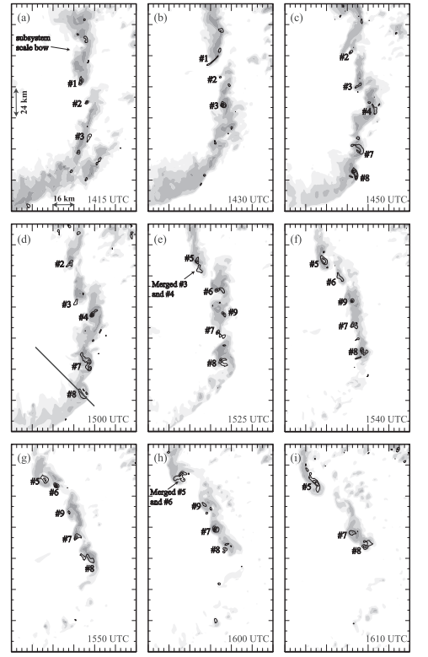

Slide 20
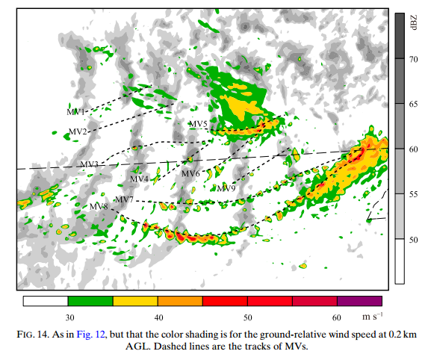

Slide 21
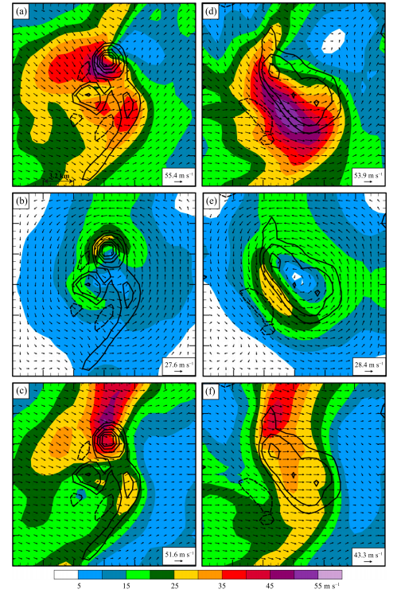

Slide 22
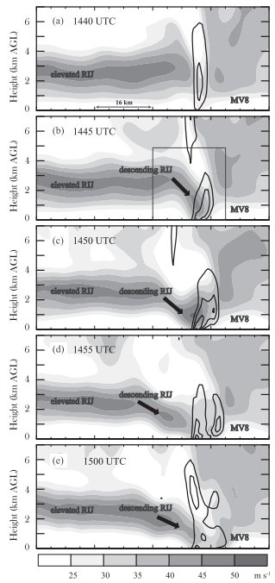

Slide 23
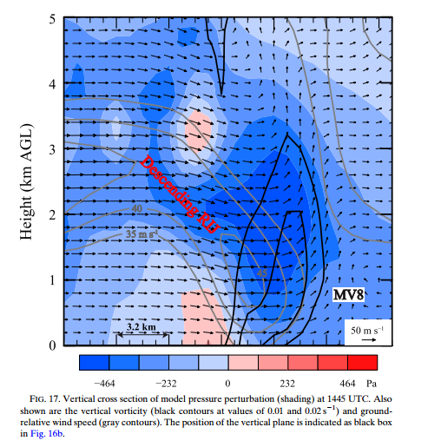

Slide 24
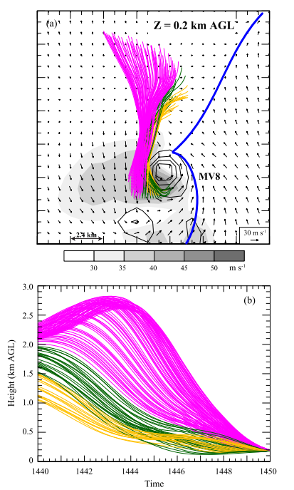

Slide 25
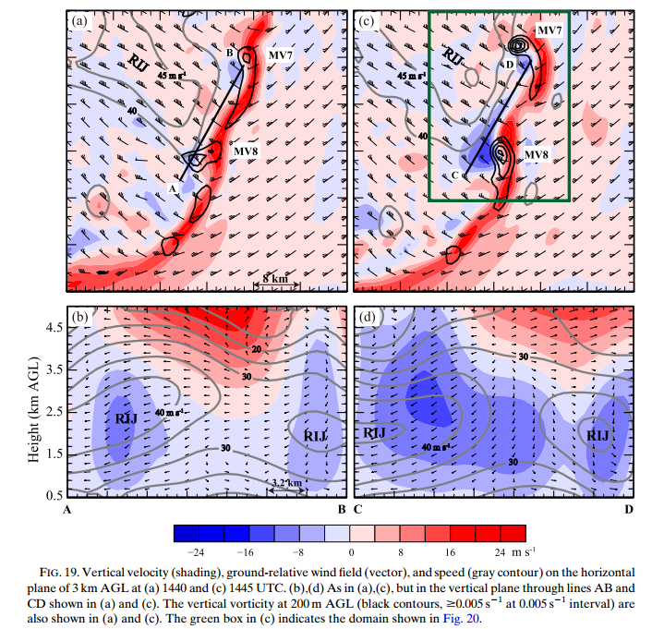

Slide 26
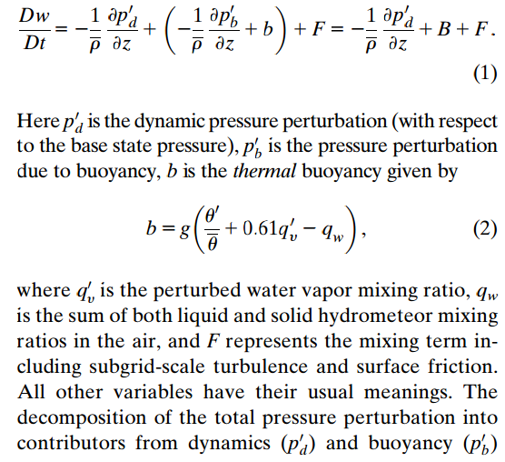
vertical momentum budgets

Slide 27
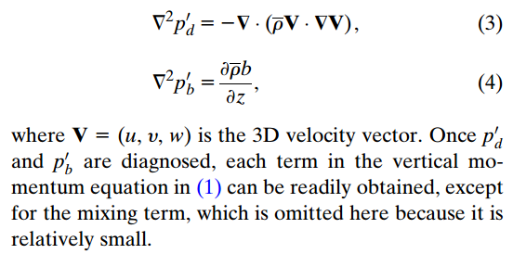
Poisson equations

Slide 28
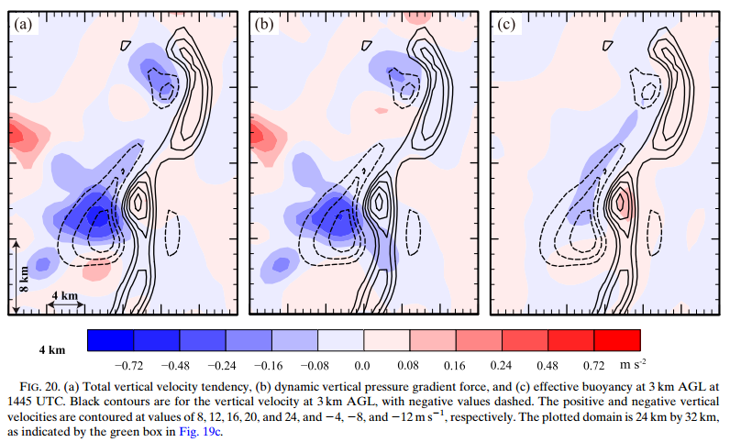

Slide 29
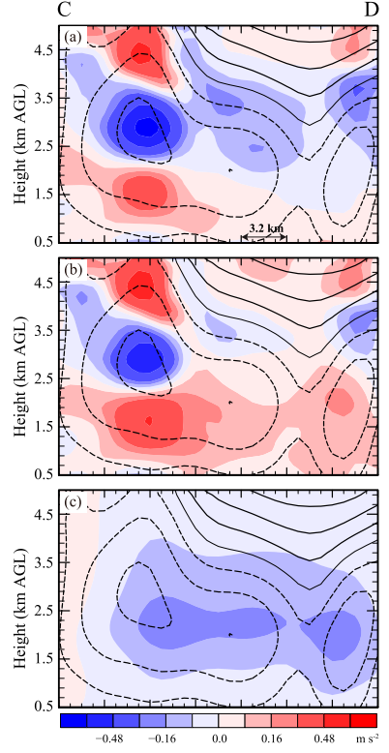

Slide 30
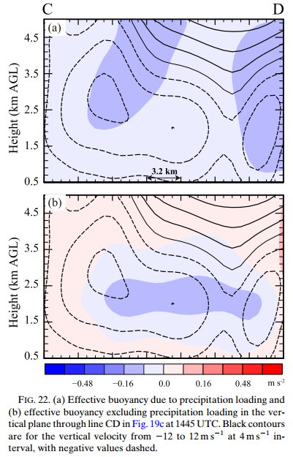

Slide 31
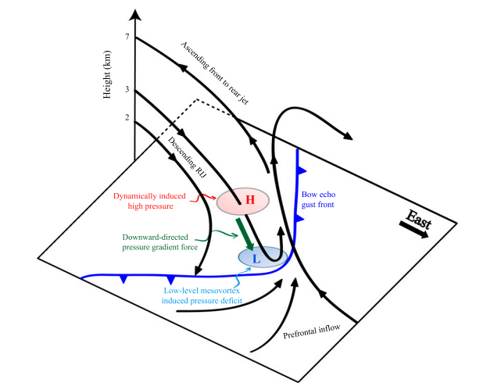

Slide 32
Thanks for your attention.

