Slide 1
Influence of Mesoscale Topography on Tropical Cyclone Tracks: Further Examination of the Channeling Effect
CHUN-CHIEH WU, TSUNG-HAN LI, AND YI-HSUAN HUANG
Department of Atmospheric Science, National Taiwan University, Taipei, Taiwan

Slide 2
Outline
Introduction
Model description and experimental design
The control experiment
Sensitivity experiments
Impact of channeling effect
Concluding remarks and issues to be further addressed
Reference

Slide 3
Introduction
Haitang’s southward deflection
could be attributed to the channeling effect, which is
characterized by low-level wind acceleration over the
confined region between the storm center and the terrain
where air parcels of the swirling wind are forced to
converge. These accelerated low-level winds between
the storm center and the terrain thus contribute to the
formation of the northerly steering flow near the inner
core of the TC and push the TC southward. The investigation
on the southward track deflection of Typhoon
Krosa (2007) in Huang et al. (2011) showed
results generally consistent with findings of Jian and Wu
(2008).
Jian and Wu(2008)
Wu et al.(2015): Ideal vortex
Huang et al.(2011)
It is noteworthy
that the southward TC track deflection documented in
observations or captured in the numerical simulations is
mostly for more intense TCs, suggesting that tracks of
intense TCs could also be profoundly affected by the
presence of mesoscale topography, such as the terrain
of Taiwan.
Huang et al.(2011) Fig.1
Swirling wind
Jian and Wu(2008) | Huang et al.(2011) | Wu et al.(2015)
Terrain height | Terrain height | Terrain height
Initial vortex tangential wind speed | Initial latitudinal position of vortex | Initial latitudinal position of vortex
 | Microphysics scheme | Initial vortex tangential wind speed
 |  | Typhoon radius
 |  | Incident angle
 |  | Translation speed
Simulated and best tracks of Super Typhoon Haitang(2005)
Convergence
Low level
Channeling effect
While Huang et al. (2011) only examined the
sensitivity to the initial latitudinal position of the
vortex, this study investigates sensitivities to more
parameters and flow regimes, such as the terrain
height, incident angle of TC movement toward the
terrain, TC intensity, and translation speed. A series
of idealized simulations are conducted to investigate
how the terrain impacts TC motion under different
configurations of mountain range, height and shape,
vortex intensity and structure, the incident angle of a
moving vortex toward the mountain, initial latitudinal
position of the vortex center, and storm translation
speed.
Jian and Wu(2008) Fig.4
CWB’s best track of Haitang (2005) and Krosa (2007).
Simulated track of CTRL and OC for Krosa(2007).

Slide 4
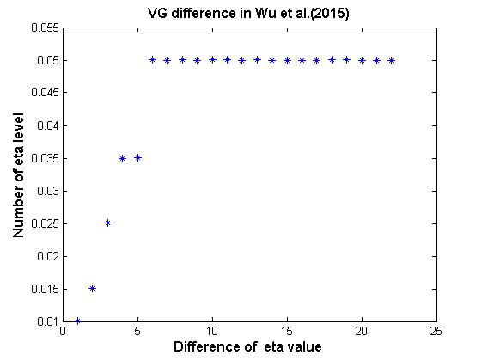
Model description and experimental design(1/3)
Domain design
Model: MM5 V3.7.3
Initial Condition: NCEP GFS (1∘× 1∘)
Model top: 10hPa(23 layers)
Sounding: mean West Indies from Jul. to Oct.
Horizontal resolution: 27km, 9km, 3km
Parameterization:
PBL: Blackadar scheme (Blackadar 1976,
1979; Zhang and Anthes 1982)
Radiation: simple longwave cooling scheme
Microphysics: Dudhia scheme(1989)
Cumulus: Grell scheme(1995) for d01
All of the experiments are simulated on f plane
located on 15$°N$
d01
d02
d03

Slide 5
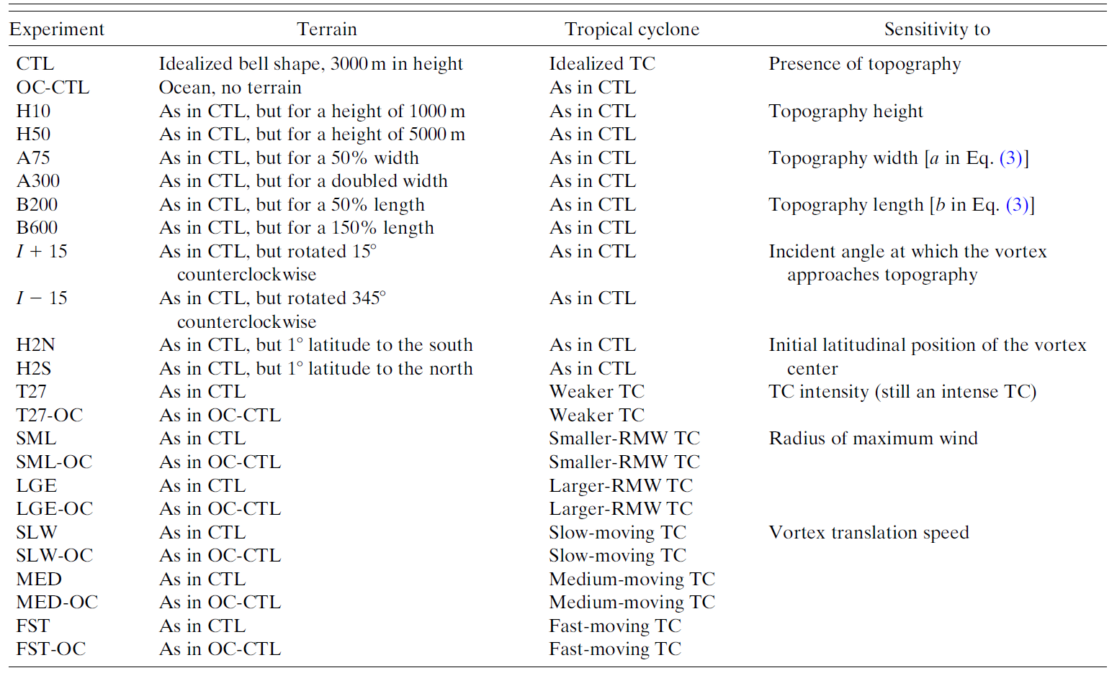
Model description and experimental design(2/3)
Control experiment: CTL and OC-CTL
Environment: 5 m/s easterly flow.
Terrain:
$h\left(x,y\right)= \frac{h_{max}^{′}}{{\{{\left[(x−x_{c})/a\right]}^{2}+{\left[(y−y_{c})/b\right]}^{2}+1\}}^{\frac{3}{2}}}−{2^{\frac{3}{2}}∗h}_{max}^{′}$
$h_{max}^{′}$=$h_{max}^{}(1+2^{\frac{3}{2}})$ , $h_{max}^{}=3km, a=75km, b=200km,$
$$x_{c}=24.0°N, y_{c}=121.1°E$$
Land use: Mixed forest.
24$°$N
800

Slide 6
Model description and experimental design(3/3)
Sensitivity experiments:
Terrain:
$h\left(x,y\right)= \frac{h_{max}^{′}}{{\{{\left[(x−x_{c})/a\right]}^{2}+{\left[(y−y_{c})/b\right]}^{2}+1\}}^{\frac{3}{2}}}−{2^{\frac{3}{2}}∗h}_{max}^{′}$
$h_{max}^{′}$=$h_{max}^{}(1+2^{\frac{3}{2}})$ ,$x_{c}=24.0°N, y_{c}=121.1°E$
$h_{max}^{}$: CTL(3km), OC-CTL, H50(5km), H10(1km)
$a$: CTL(75km) , A75(37.5km) , A300(150km)
$b$: CTL(200km) , B200(100km) , B600(300km)
Vortex:
$V_{max}^{}$: CTL(35m/s), T27(27m/s)
$r_{}^{}$: CTL(36km), SML(20km) ,LGE(50km)
$Rotating the island:$ I+15, I-15
$Initial latitudinal position:$ H2S, H2N
$Translation speed:$ SLW(2.5m/s) , MED(3.3m/s) , FST(4.9m/s)
Terrain
TC Vortex
$${,r}_{max}=50km , b=0.5$$
$$(Similar to Typhoon Korsa)$$
$$V_{max}=35m/s$$

Slide 7
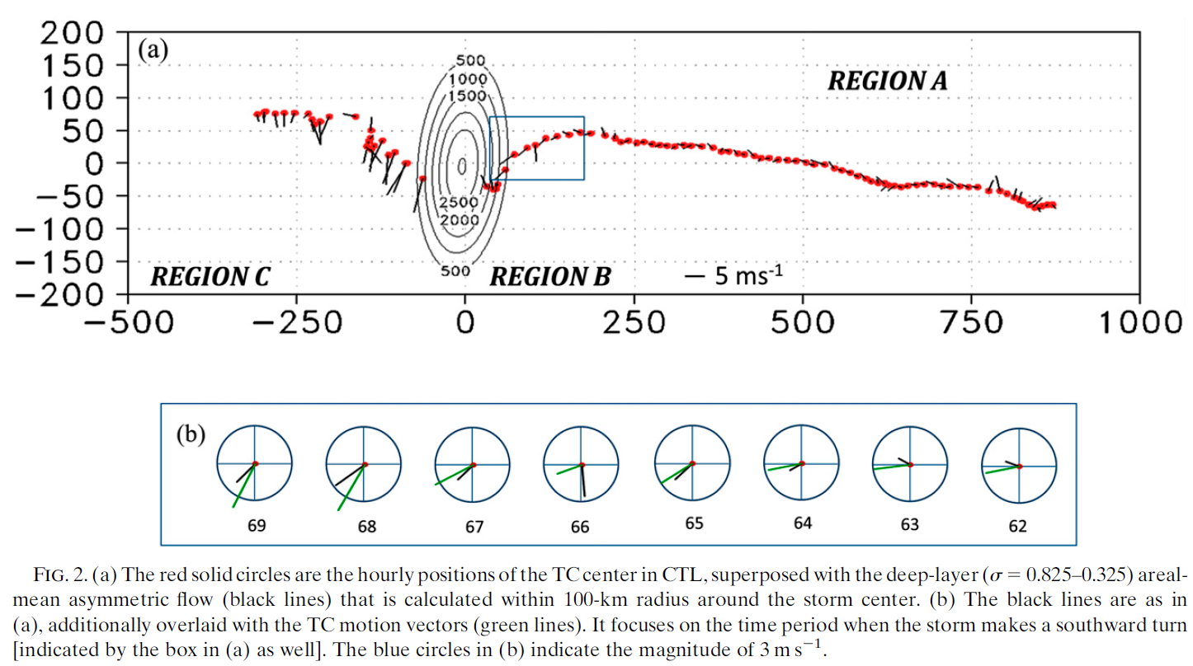
The control experiment(1/2)
CTL and OC-CTL at 66h(800hPa)(850 hPa wind speed.).
Lin and Savage (2011)
Jian and Wu (2008)
REGION A
REGION C
REGION B
Jian and Wu (2008)
Huang et al. (2011)
Notes:
FIG.2

Slide 8
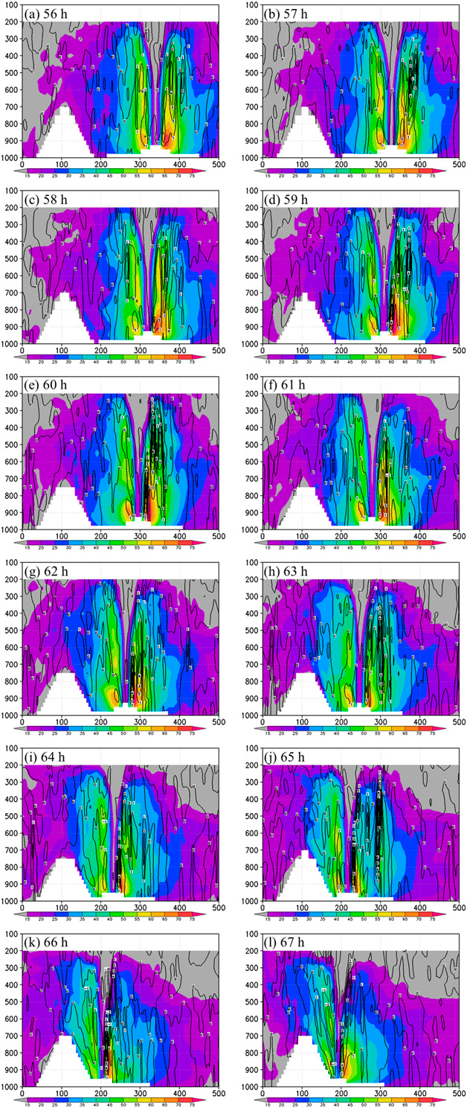
The control experiment(2/2)
CTL run: Vertical cross sections of the meridional wind (shading; m/s) and the vertical velocity (contours;m/s)
CTL- OCCTL: area-mean(50km) asymmetric flow.
the southward deflection in CTL is identified from 62 to 71 h

Slide 9
Sensitivity experiments(1/3)
Influence of mountain height
H10- OCCTL: area-mean(50km) asymmetric flow.
H10
H50- OCCTL: area-mean(50km) asymmetric flow.
H50
Influence of mountain height
Consistent with Lin et al.(2005)

Slide 10
Sensitivity experiments(2/3)
Sensitivity to TC incident angle and TC initial position
H2N- OCCTL: area-mean(50km) asymmetric flow.
H2N
Consistent with Huang et al.(2011)

Slide 11
Sensitivity experiments(3/3)
H50- OCCTL: area-mean(50km) asymmetric flow.
H50
2.5m/s
Consistent with Lin et al.(2005)
Sensitivity to TC intensity and
TC translation speed
3.3m/s
4.9m/s

Slide 12
Impact of channeling effect
CTL and H2N simulation at 66h.
Features of H2N simulation:
Broader space to the north of the
storm.→ Stronger channeling effect.
Confluence elevation(low-level winds)

Slide 13
Concluding remarks and issues to be further addressed
In CTL experiments: What makes the southward turn of a TC is the azimuthal asymmetry of tangential winds at middle levels, not the asymmetry caused by channeling winds at lower levels(weaken to the east and strengthen/remain unchanged to the west of the TC center).
In sensitivity experiments: The southward track deflection prior to landfall is a common phenomenon among intense TCs under various flow regimes(higher mountain, SLW, MID and H2N).
Small $R/L_{y}$ value and initial position are favored southward deviation TCs as in
Lin et al.(2005)
Necessary and further examination:
- Microphysics and surface processes.
- Weak and moderate intensity TCs.

Slide 14
Reference
Huang, Y.-H., C.-C. Wu, and Y. Wang, 2011: The influence of island topography on typhoon track deflection. Mon. Wea. Rev., 139, 1708–1727, doi:10.1175/2011MWR3560.1.
Jian,G.-J., and C.-C.Wu, 2008:Anumerical study of the track deflection of Supertyphoon Haitang (2005) prior to its landfall in Taiwan. Mon. Wea. Rev., 136, 598–615, doi:10.1175/2007MWR2134.1.
Lin, Y.-L., S.-Y. Chen, C. M. Hill, and C.-Y. Huang, 2005: Control parameters for the influence of a mesoscale mountain range on cyclone track continuity and deflection. J. Atmos. Sci., 62, 1849–1866, doi:10.1175/JAS3439.1.

Slide 15
Thanks for your listening

