Slide 1
Attributing tropical cyclogenesis to equatorial waves in the western North Pacific
Lin Ching
2013/12/17
Schreck, C.J. III, J. Molinari, and K.I. Mohr, 2011: Attributing tropical cyclogenesis to equatorial waves in the western North Pacific. J. Atmos. Sci., 68, 195-209.

Slide 2
Introduction
Convectively coupled equatorial waves, included Madden–Julian oscillation (MJO), equatorial Rossby (ER) waves, mixed Rossby–gravity (MRG) waves, Tropical depression (TD)-type disturbances, and Kelvin waves, have been frequently associated with western North Pacific (WNP) tropical cyclogenesis in many studies.
Tropical cyclones (TCs) themselves produce large local anomalies that significantly contribute to the mean and variance for a variety of meteorological fields.
Tropical cyclone–related anomalies can also project onto the filter bands typically used to identify equatorial waves. (Frank and Roundy 2006; Hsu et al. 2008)

Slide 3
Data
Tropical cyclone tracks: National Climate Data Center’s (NCDC’s) International Best Track Archive for Climate Stewardship (IBTrACS; Knapp et al. 2009)
Tropical cyclogenesis in the present study will be defined as the first time a storm achieves maximum 10-min sustained winds of at least 13 m s⁻¹ (25 kt).
The current study will focus on cyclogenesis in the WNP during the warm seasons (May–November) from 1998 to 2007.
The domain encompasses the region from the equator to 20 ° N and 120 ° E to the date line.
The domain also excludes the South China Sea westward of 120 ° E where land–ocean contrasts can influence convection and cyclogenesis.
The equatorial waves will be identified using the Tropical Rainfall Measuring Mission (TRMM) Multisatellite Precipitation Analysis (TMPA; TRMM product 3B42; Huffman et al. 2007).
The TMPA data are available from 1998 onward on 3-hourly 0.25 ° latitude–longitude grids, but they have been averaged to 6-hourly 1 ° latitude–longitude grids to improve computational efficiency.
°
Notes:
Poleward of 20 ° N is excluded because tropical cyclogenesis in those regions is more likely to be associated with tropical transition (Davis and Bosart 2001) and upper-level troughs (Sadler 1976) than with equatorial waves.

Slide 4
TRMM Multi-satellite Precipitation Analysis
wavenumber-frequency power spectrum for rainfall rates
Warm season (MJJASON), 1998 – 2007
Notes:
Total spectrum is followed by Wheeler and Kiladis 1999
Red noise is followed by Roundy and Frank 2004

Slide 5
Time–longitude composite of WNP tropical cyclogenesis
Shaded
: rainfall rate > 1 mm/day
MJO
Kelvin
ER
MRG
TD
time–longitude composite of all western North Pacific cyclone formations during the 1998–2007 warm seasons, then filtered for each equatorial wave.
(only the +1 mm day⁻¹ contours are shown)
Prescribed stationary precipitation maximum
→ this intense rainfall projects onto the filtered fields
Notes:
左
波動對應的降雨場很弱 大約8-16mm/day
不過在生成中心，降雨達到89mm/day
右
只留下生成中心達到89mm/day的最大降雨量，再濾波
這固定的降雨應該不跟任何赤道波動有關，但除了MJO，其他波動都可以濾出訊號，而且pattern相似
尤其MRG跟TD不只在中心有投影的訊號

Slide 6
TC-related signal removed method
A_{t} : total fields
A_{c} : climatological fields
A = w (A_{t} - A_{c}) + A_{c}
Example:
0000 UTC 21 Aug. 2000
Tropical storm Kaemi & Typhoon Billis
Climatological rainfall rates < 10 mm/day
TC-related signals is obtained by using a weighting function:
261 to 8 mm/day
TY Billis
Gaussian function (Aiyyer 2007)
TS Kaemi
r: distance to the center
R: radius at half maximum
= 500 km
Notes:
氣候場是取annual cycle的前四個harmonics
真實降水跟氣候場的差值乘上權重
r=0 所有超過氣候場的降水都被移除，移除的部分隨著半徑增加而減少
超過3R (>1500km)後就沒有移除了
所有超過13m/s(25knots)的TC都移除，不只是生成時刻

Slide 7
Mean rainfall rate
Rainfall variance
Notes:
a 原始降雨場的暖季平均跟variance，都從中太平洋ITCZ往西北延伸，TY都在這個區域跟其北邊生成
b TC的mean跟variance分布很像，除了variance在菲律賓東邊較小，主要顯示TC造成的對流降水從ITCZ往西北延伸
c 移除場
d TC/total 在西北這個區域，平均降雨TC占了20%，variance則可以達到50%

Slide 8
Difference of spectrum between the original fields and the TC-removed fields
Percentage of the TC-removed spectrum in original spectrum
TCs produce power in nearly all of the equatorial wave filter bands.
However, the variance are smaller than in the total spectrum:
MJO, MRG, Kelvin < 15%
ER < 21% ; TD < 27%
TC-related variance propagates westward at roughly 5 m/s
Notes:
如果R增加兩倍，即1500km，則TC占的%最多可達34%
所以他們的結論是

Slide 9
Case: Typhoon Lingling
0000 UTC 6 Nov. 2001
shaded: TC-removed rainfall contour: MRG waves
The MRG filter produces an anomaly of 3.97mm/day in the 1 ° grid box containing Lingling’s genesis.
MRG wave appears to contribute favorably to genesis
But, it is unclear whether that anomaly is sufficient to attribute Lingling’s formation to these waves

Slide 10
Threshold
percentage of all warm season WNP data points
percentage of TCs
Even those are calculated after removing the TC-related signals, the genesis points are still associated with greater filtered rainfall anomalies than the nongenesis points.
The better thresholds is 2 – 4 mm/day
3 mm/day threshold is adopted in the following discussion
Notes:
左圖 整個WNP只有145個TC生成，所以基本上圖是顯示沒生成的點，超過6 mm/day所有的波都只剩下不到4%的資料了
右圖 145個TC的%，%和可以超過100%是因為TC可能跟一個以上的波動有關
0mm TD:79% others>62% 不過沒生成的點也有大約50% 而且每個TC都跟至少一個wave有關 其中16%跟全部wave都有關(no figure)
所以0mm不適合做門檻值
6mm 則有68%的TC跟wave無關，TD有19%，但其他wave都不到10%，不符合前人研究的結果
如果2-4mm， TD有47%-64%，跟Ritchie and Holland 1999和Fu et al. 2007的結果一致，但其他wave有些偏少

Slide 11
percentage of all warm season WNP data points
percentage of TCs
Sensitivity to the removal method
51%
76%
the attribution results are not overly sensitive to the details of the tropical cyclone removal

Slide 12
Number of TCs attributed to each wave type
99/145
18/145
51%
26%
29%
23%
13%
Number of TCs attributed to each combination of two equatorial wave types
65%
50%
33%
42%
Dickinson and Molinari (2002) showed that tropical cyclogenesis could occur when MRG waves transitioned to TD-type structures. These transitioning systems could explain the relatively large fraction of storms attributed to both wave types.
Notes:
145個TC中只有18個跟三個以上wave有關，沒有任何TC跟五個wave都有關
超過2/3的TC (99/145) 跟一個或兩個wave有關
下圖 超過兩個wave有關的TC個數都會算

Slide 13
Genesis locations for TCs attributed to each wave
Notes:
這些wave的variance沒有往西北延伸，主要是因為西北方跟TC有關的訊號被移除了
TD 跟ER的分布跟之前total場的分布類似
MRG主要在中太平洋，這跟MRG會轉換成TD的研究結果吻合
MJO集中在赤道附近，訊號大約到換日線，也跟觀測結果一致
Kelvin則從中太平洋開始訊號增強，也跟前人研究一致，MJO傳到換日線後轉為Kelvin繼續傳遞
跟MRG有關的TC生成較靠近赤道，全部平均的緯度是13.4N，而MRG有關的TC生成緯度則是11.8N，而MJO有關的TC緯度是10.4N (無解釋)
沒wave的TC只有一個生成在10N以內，且平均生成位置為15.4N，表示赤道波動主要在靠近赤道的區域影響氣旋生成

Slide 14
Discussion and conclusions
TCs can contribute more than 20% of the warm-season rainfall and 50% of its total variance.
TCs themselves contribute significantly to the convective variability in the WNP.
The current study mitigates this contamination by removing the TC–related signals before filtering.
The relative importance of each wave type is consistent for a range of thresholds from 2 to 4 mm/day.
Roughly twice as many TCs are attributed to TD-type disturbances as to ER waves, MRGwaves, or Kelvin waves.
The influence of the MJO is even smaller.
The storms with no equatorial wave precursor typically originated farther poleward than other storms
For shorter wavelength ER waves, MRG waves, and TD-type disturbances, the TC–related signals should be removed before calculating the rainfall spectrum.
Notes:
MJO is known to influence cyclogenesis by modulating low-level vorticity (Hall et al. 2001), low-level convergence (Liebmann et al. 1994), vertical wind shear (Maloney and Hartmann 2000), and midlevel relative humidity (Camargo et al. 2009). The MJO also affects cyclogenesis by modulating the amplitudes of higher-frequency waves (Nakazawa 1988; Aiyyer and Molinari 2003).
The influence of tropical cyclones on the equatorial wave spectrum is generally small.

Slide 16
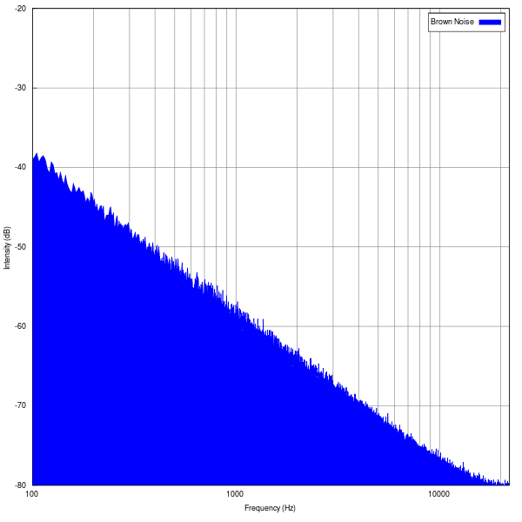
Red noise:
also known as Brownian noise or Brown noise, a kind of signal noise produced by Brownian motion
Brownian motion:
random motion of particles suspended in a fluid

Slide 17
Madden–Julian oscillation (MJO)
Phase 1
Phase 2
Phase 3
Phase 4
Phase 5
Phase 6
Phase 7
Phase 8
Wheeler and Hendon 2004

Slide 18
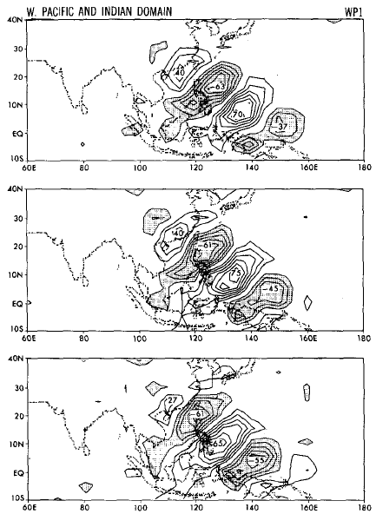
Kelvin wave
Rossby wave
Kiladis et al. 2009
Mixed Rossby-gravity wave
TD-type disturbance
+
_
+
_
Lau and Lau 1990

