Slide 1
Observing Strategy and Observation Targeting for Tropical Cyclones Using Ensemble-Based Sensitivity Analysis and Data Assimilation
Chen, Deng-Shun
3 Dec, 2013
Xie, Baoguo, Fuqing Zhang, Qinghong Zhang, Jonathan Poterjoy, Yonghui Weng, 2013: Observing Strategy and Observation Targeting for Tropical Cyclones Using Ensemble-Based Sensitivity Analysis and Data Assimilation. Mon. Wea. Rev., 141, 1437–1453.

Slide 2
Outline
Introduction
Ensemble-based sensitivity and observation targeting
Model and targeting strategy for OSSEs
  Model configuration
  Simulated observations
  Targeting strategy
Predicted observation impacts based on ensemble-sensitivity analysis
Simulated impacts from forecasts with EnKF assimilation of each dropsonde
  Simulated impacts through single deterministic forecasts
  Simulated impacts through ensemble forecasts initialized with EnKF members
  Impact of random error in the dropsonde observations
Conclusions

Slide 3
Introduction(I)
The accuracy of typhoon track and intensity forecasts is impaired in part by the lack of observations over the ocean, where tropical cyclones (TCs) form and intensify.
One strategy that is used to alleviate the deficiencies in tropical cyclone forecasts is observation targeting.
Berliner et al. 1999
  Strategies for identifying the targeted locations depend on
    the flow-dependent dynamics,
    forecast model accuracy,
    background and observation errors,
    and the data assimilation technique.

Slide 4
Introduction(II)
One targeting strategy, called sensitivity analysis, tries to determine how a numerical weather model behaviors in the presence of small changes in initial conditions.
Anderson (2001)
  Using an ensemble-based targeting method in which sample statistics are used to estimate relationships between the initial observation quantities and a forecast variable or function of forecast variables.
Ancell and Hakim (2007)
  showed that ensemble sensitivity analysis accurately estimated the changes of a forecast metric given the initial conditions.

Slide 5
Introduction(III)
There are currently two agencies using the ensemble based targeting strategy to identify sensitivity regions
  National Oceanic and Atmospheric Administration (NOAA; Aberson and Franklin 1999)
    The dropsonde data improved the 24- and 48-h NCEP global model TC track forecasts during 2003 by an average of 18%–32%.
  Dropsonde Observations for Typhoon Surveillance near the Taiwan Region mission (DOTSTAR;Wu et al. 2007)
    The average 72-h track error reduction of the three global models was 22%

Slide 6
Introduction(IV)
These results raise several questions regarding the predictability of this event:
  If additional dropsondes were to be added to reduce the initial condition and forecast uncertainties, which observations would yield the largest impacts to the forecast metrics?
  Is the ensemble sensitivity analysis effective at identifying the correct observations during the targeting?
  How should the effectiveness of a targeting method be evaluated?
    The effectiveness of the ensemble sensitivity method is verified by assimilating the observations of interest and running deterministic and ensemble forecasts from the corresponding EnKF analyses.

Slide 7
Model and targeting strategy for OSSEs
Model configuration
  Model : WRF V3.1.0
  Resolution : 13.5 km(D1), 4.5 km(D2), 34 vertical levels
  IC: comes from real-time global ensemble data assimilation system
  BKER: Using 60 members to approximated flow-dependent background error covariance. (EN60_GOOD)
Simulated observations
  A deterministic forecast from the ensemble mean predicted a maximum 72-h rainfall forecast of 2762 mm, which is close to observations (EN60_GOOD)
  the forecast from the ensemble mean of EN60_GOOD as the true state.
  Synthetic dropsonde observations of zonal and meridional winds, temperature, dewpoint temperature, and geopotential height are extracted from the truth with every 270 km (total 90 dropsoundes).
Targeting strategy
  A member 54 selected from EN60_GOOD is used as the initial mean for a new ensemble.
  Perturbations from members 10 to 60 of EN60_GOOD are used to produce the new ensemble (EN50_POOR)
  The deterministic forecast from the ensemble mean of EN50_POOR at 0000 UTC 5 August will be denoted by NoDA.

Slide 8
Ensemble
Mean
Ensemble
Mean
Ensemble (EN60_GOOD)
96 h ensemble forecast
Ensemble (EN60_GOOD)
Ensemble
perturbation
Ensemble
perturbation
Ensemble
Mean
Member 54 of EN60_GOOD
Member 10 to 60, but 54 omitted
Ensemble
Mean
Ensemble
Mean
Ensemble (EN50_POOR)
96 h ensemble forecast
Ensemble (EN50_POOR)
Ensemble
perturbation
Assimilating observation for the testing observation targeting technique.
OBS
0000 UTC 5 Aug 2009
0000 UTC 6 Aug
0000 UTC 9 Aug

Slide 9
OSSE description
CTRL : The member 54 of EN60_GOOD
Deterministic forecast
TRUTH : The ensemble mean of EN60_GOOD
NODA : The ensemble mean of EN50_POOR
CTRL
Ensemble (EN50_GOOD)
Member 54
72 h
deterministic fcst
NODA
Ensemble mean
72 h
deterministic fcst
Ensemble (EN50_POOR)
TRUTH
72 h
Ensemble perturbation
Ensemble mean
deterministic fcst
Ensemble (EN50_GOOD)
Ensemble perturbation

Slide 10
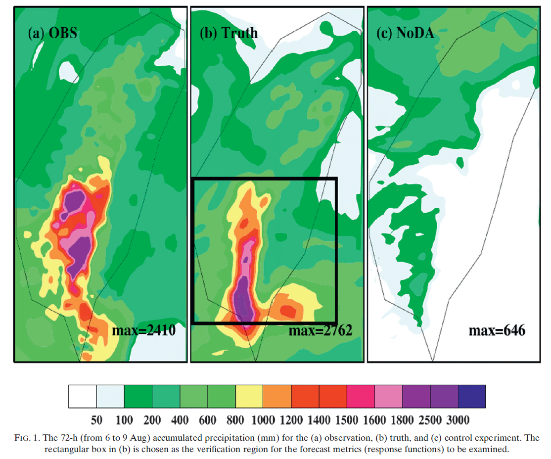
Model and targeting strategy for OSSEs

Slide 11
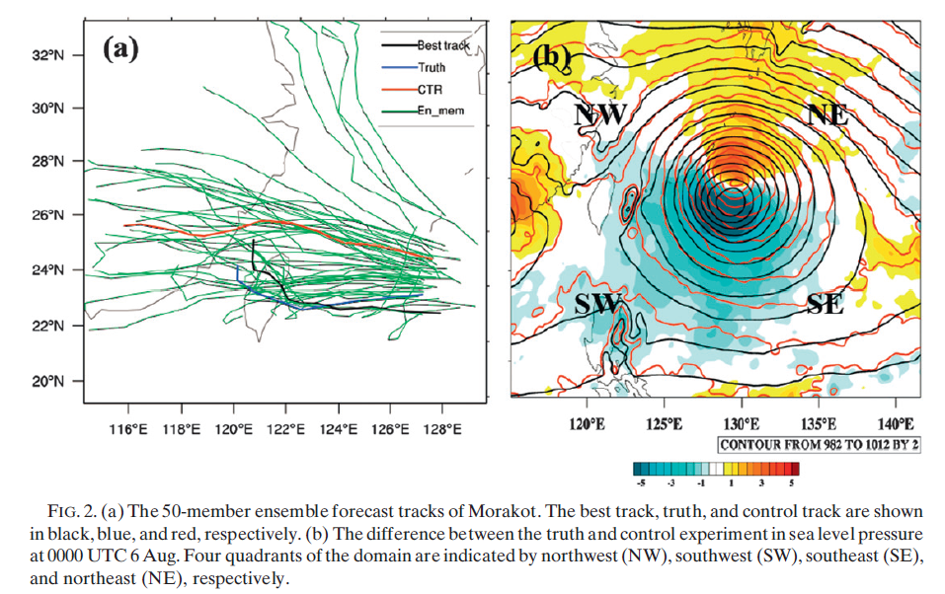
Model and targeting strategy for OSSEs
TRUE-CTRL
in SLP at 00Z 6 Aug.
Member 54 of EN60_GOOD

Slide 12










Ensemble-based sensitivity and observation targeting
The Reduction of Forecast Variance
The Change in Forecast metric
=
=
=
Notes:
One advantage of ensemble sensitivity analysis is that it does not require actual observations to calculate the impact factor, only the observation operator and observation error covariance.
To evaluate the performance of ensemble sensitivity analysis, the predicted change in the ensemble mean of the forecast metric, given the known observation value, should be calculated.

Slide 13
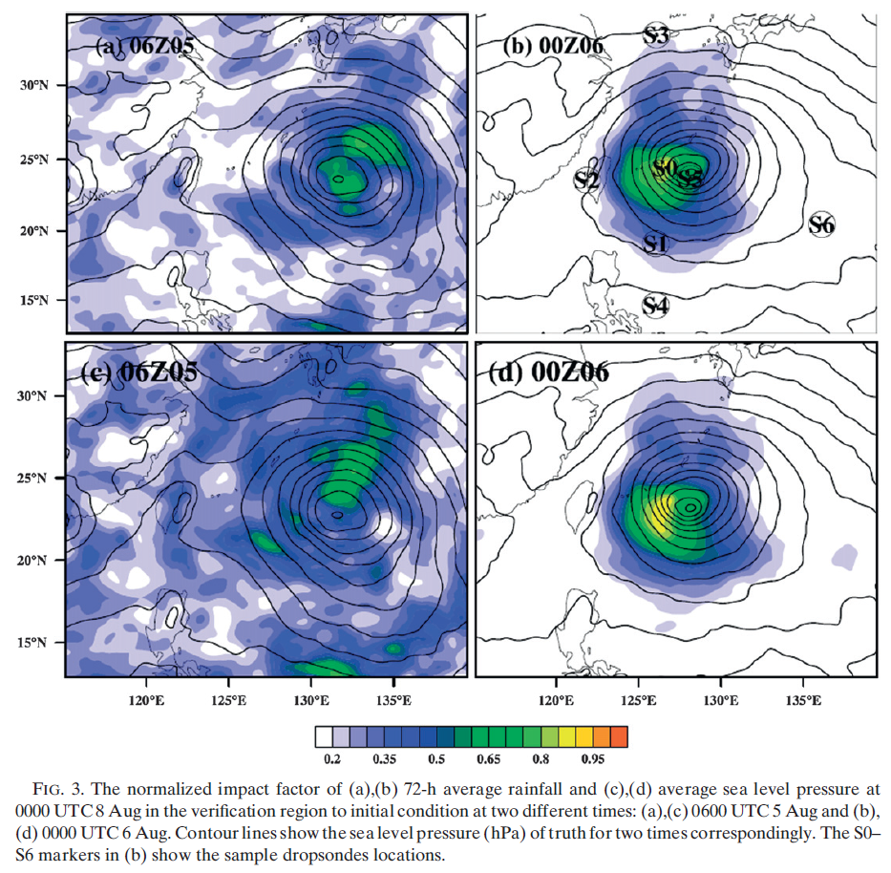
Predicted observation impacts based on ensemble-sensitivity analysis
Ensemble mean
72 h
deterministic fcst
72-h rainfall
Ensemble (EN50_POOR)
24 h
Ensemble (EN50_POOR)
Ensemble perturbation
Assimilating observation for the testing observation targeting technique.
SLP
OBS
00Z 5 Aug. 2009
00Z 6 Aug. 2009
00Z 9 Aug. 2009

Slide 14
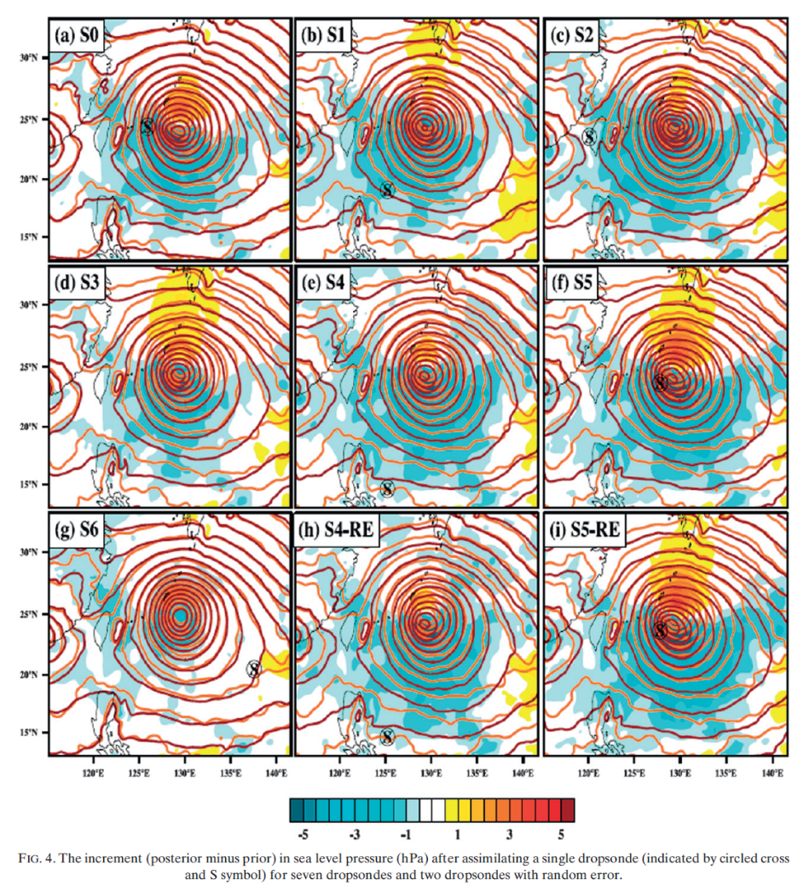

  Simulated impacts through single deterministic forecasts
Position | Incr. SLP min. | Incr. SLP min
S0 | 2.5 | -6.8
S1 | 1.7 | -8.1
S2 | 1.8 | -9.2
S3 | 1.7 | -7.3
S4 | 2.2 | -6.7
S5 | 3.7 | -8.3
S6 | 2.2 | -6.7
For all dropsondes, including those located outside the inner core, information failed to propagate to synopticscale features of the environment, such as the subtropical high and southwest monsoon.
Analysis increment
Notes:
the exception of S6 (Fig. 4), the spatial pattern of the SLP increments from each of the EnKF analyses is qualitatively similar to the difference between the truth and NoDA (Fig. 2b), implying that each of the dropsondes extracted from the truth simulation are assimilated properly by the EnKF to improve the initial analysis

Slide 15
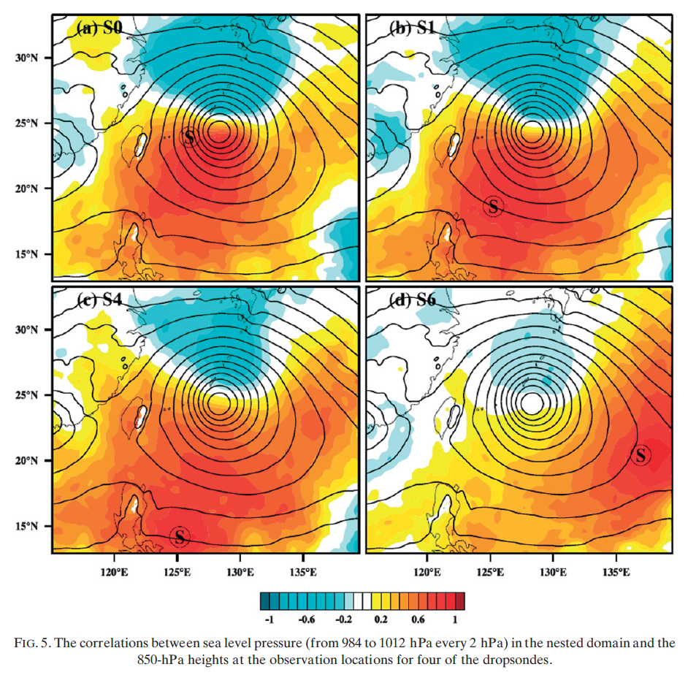
  Simulated impacts through single deterministic forecasts
All updates made by the EnKF assimilation of dropsonde observations must come from the ensemble-estimated covariance between the model-predicted value of the observed quantity and the remaining state vector..
The correlations between SLP and geo-potential height at 850 hPa.
The reason why large pressure increments are not seen outside the inner core, is likely due to the lack of background correlations in the environment.
Notes:
All updates made by the EnKF assimilation of dropsonde observations must come from the ensemble-estimated covariance between the model-predicted value of the observed quantity and the remaining state vector.
The spatial distribution of correlations is similar for all four dropsondes, except that the maximum correlation value for a dropsonde outside of the inner core is much smaller than those estimated for dropsondes near the inner core.

Slide 16
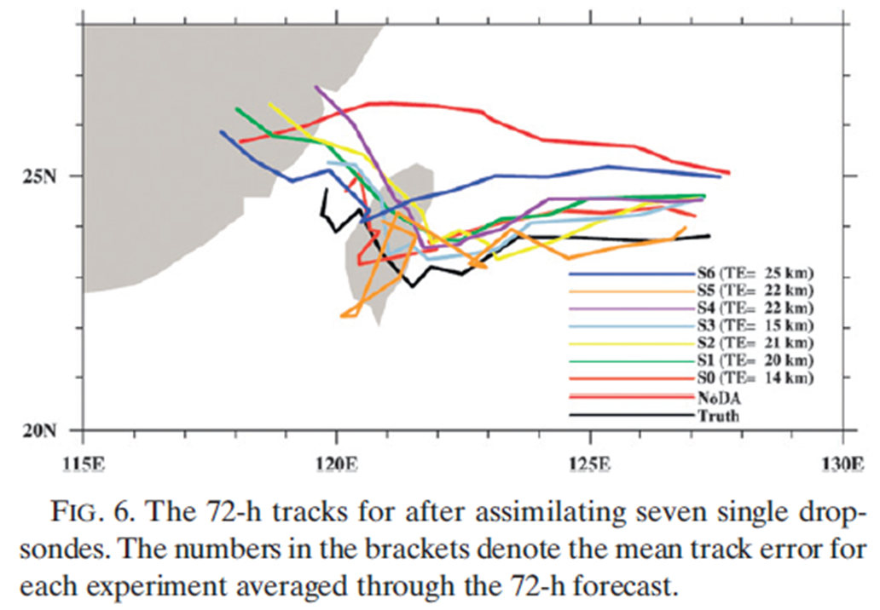
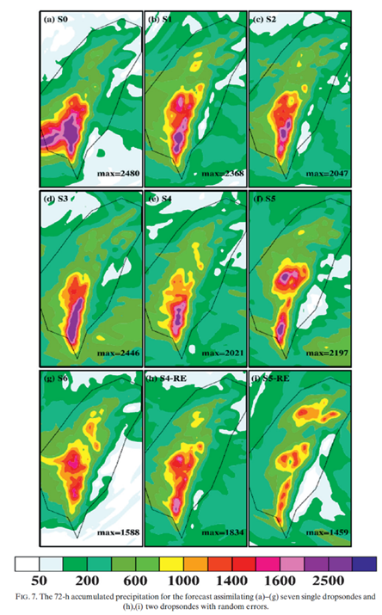
  Simulated impacts through single deterministic forecasts
Experiments | s0 | s1 | s2 | s3 | s4 | s5 | s6
Track error(km) | 79 | 113 | 114 | 85 | 119 | 124 | 139
Max. Rainfall (mm) | 2480 | 2368 | 2407 | 2460 | 2021 | 2197 | 1588
Notes:
The experiment for S0, a dropsonde located in the maximum impact factor region, has the largest improvement in forecast track and rainfall.

Slide 17
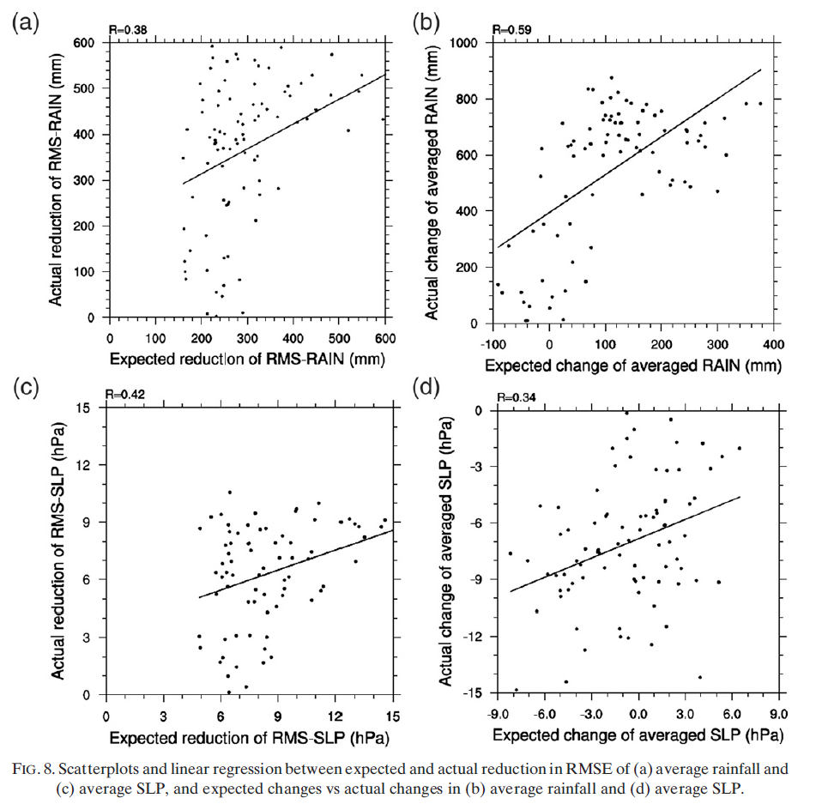
Expected reduction
Expected change
Expected reduction
This suggests that there are strong limitations in the effectiveness of using ensemble-based impact factors for observation targeting
Expected change
show that the linear relationship between the expected and actual change are not as good as expected in the linear theory
0.38
0.59
72-h rainfall
0.42
0.34
SLP
Notes:
This suggests that there are strong limitations in the effectiveness of using ensemble-based impact factors for observation targeting to improve tropical cyclone forecasting that are deeply rooted in the assumptions used in deriving (7)

Slide 18
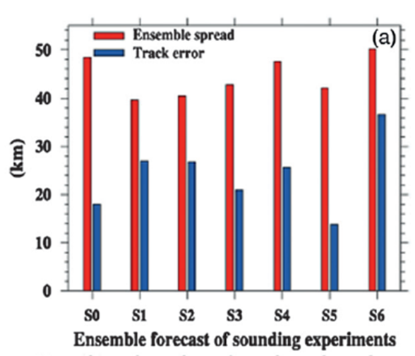
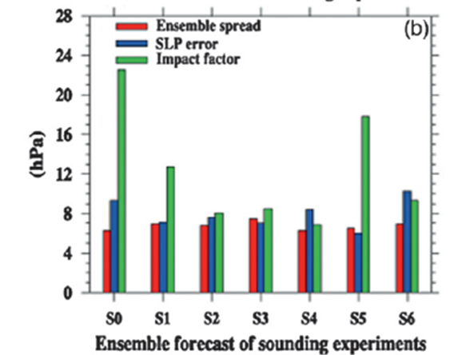
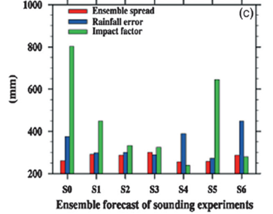
  Simulated impacts through ensemble forecasts initialized with EnKF members
Ensemble (EN50_POOR)
96 h ensemble forecast
Ensemble (EN50_POOR)
Assimilating observation for the testing observation targeting technique.
OBS
00Z 5 Aug
00Z 6 Aug
00Z 9 Aug
Notes:
In general, dropsondes located in the larger impact regions have more accurate track forecasts and smaller ensemble spread.
Nevertheless, the forecast error variance of average rainfall over Taiwan for each of the single-dropsonde experiments is larger than the case without data assimilation, which is inconsistent with the track forecast and sensitivity analysis.
The ensemble reveals complex relationships between storm track and the amount of total rainfall.
For example, a heavy rainfall forecast for Morakot depends on both the accuracy of the simulated track and physical processes that lead to the topographically forced rainfall over Taiwan (Xie and Zhang 2012).
This case provides a scenario in which the ensemble has a higher-than-average probability of underestimating the true forecast error near the time of landfall, which may decrease the effectiveness of the targeting system.

Slide 19
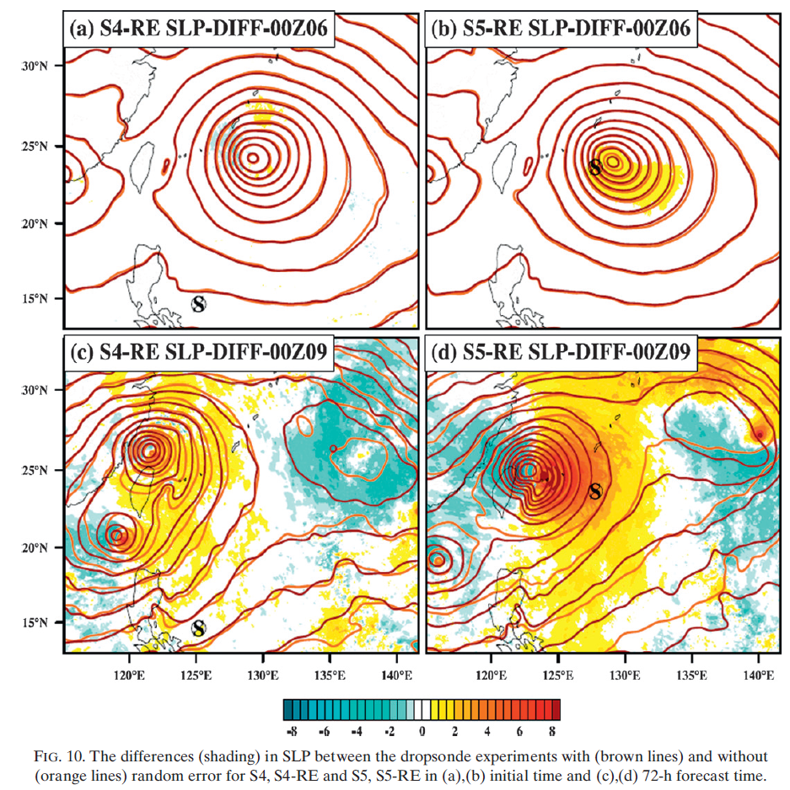
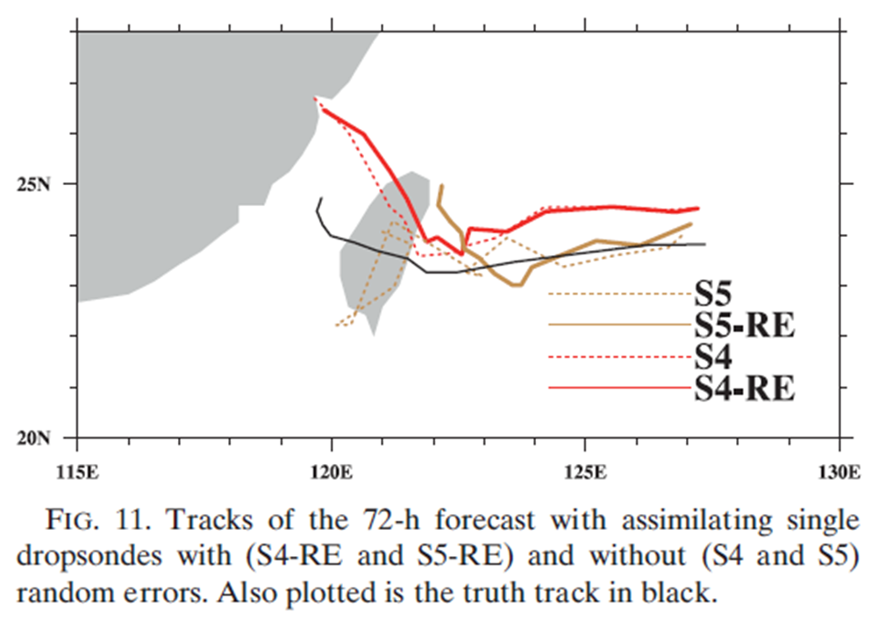
  Impact of random error in the dropsonde observations
Initial time
72-h fcst
With minus without random error
Notes:
The single-dropsonde assimilation experiments show that neighboring dropsondes with different impact factors have similar effects on the forecast metric.
These calculations examine the sensitivity of the targeting to observation errors and further demonstrate how nonlinear forecast error growth violates the linear assumption made in deriving the sensitivity analysis equations.
These small initial differences grow much larger over the 72-h forecast (Fig. 10c), but cause only marginal changes to the track (Fig. 11), intensity (Fig. 10c), and rainfall (Figs. 3e,h) forecasts.
The sensitivity experiments with and without random observation errors in the dropsondes further suggest the error growth is strongly nonlinear and the predictability of tropical cyclones can be limited,
which is consistent with the ensemble sensitivity experiments shown in privous slides.
These limitations reduce the effectiveness of using ensemble sensitivity analysis, particularly for observation targeting.

Slide 20
Conclusions
The 72-h deterministic forecasts initialized from the EnKF analyses show that the selected dropsondes are capable of improving the track and precipitation forecasts, but with varying impacts.
Generally, dropsondes near the typhoon center have a greater impact than dropsondes in the environment.
Regressions suggest that the relationship between the expected and actual changes in forecast metrics is nonlinear, which is not consistent with the linear theory of ensemble sensitivity.
Ensemble sensitivity cannot resolve errors that grow nonlinearly, the actual simulated error variance from the EnKF ensemble forecasts differs from the predicted forecast error variance.
In summary, the current study demonstrates serious limitations(error grows nonlinearly) in using the current-generation ensemble-based linear-sensitivity targeting strategies for tropical cyclones.

Slide 21
Thanks for your patient listening !!
Questions ?

