Slide 1
A Comparison of the Water Budgets between Clouds from AMMA and TWP-ICE
Professor : Ming-Jen Yang
Student : Yi-Chuan Chung
Date : 2013/11/15
Zeng, X., W.-K. Tao, S. W. Powell, R. A. Houze Jr., P. Ciesieslki, N. Guy, H.
Pierce, and T. Matsui, 2013: A comparison of the water budgets
between clouds from AMMA and TWP-ICE. J. Atmos. Sci., 70, 487–503.

Slide 2
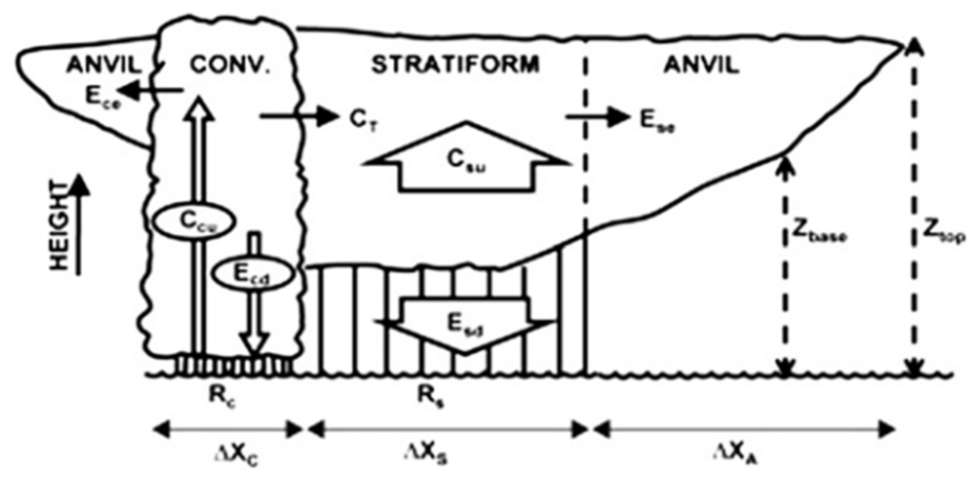
Introduction
Mesoscale convective systems (MCSs), a common weather phenomenon in the tropics, consist of convective, stratiform, and anvil clouds.
Two field campaigns, the AMMA and the TWP-ICE, took place in 2006, providing extensive observations of mesoscale convective systems (MCSs) near a desert and a tropical coast, respectively.
This two climatological regimes possess different cloud ensembles
a. West African(AMMA) anvils tending to be closely tied to the convective
regions of MCSs .
b. The frequency of ice cloud occurrence is much lower over Niamey(AMMA)
when compared to Darwin(TWP-ICE).
The modeled AMMA and TWP-ICE
MCSs offer an opportunity to
understand the structure and
mechanism of MCSs.
Notes:
(Under the constraint of the observations, cloud-resolving model (CRM) simulations are
carried out first to characterize, as examples, the differences between MCSs from the
two campaign locations and then to infer the possible factors that impact the geographic
distribution of MCSs.)

Slide 3
Introduction
Stratiform clouds | Convective clouds
Extend over hundreds of kilometers in the horizontal. | Horizontal and vertical extents are comparable.
The updrafts and downdrafts are in the order of centimeters per second. | The updrafts and downdrafts are in the order of meters per second.
Growth process dominated by condensation. | Might have collided and joined with each other to form fewer but larger drops.
A pixel is made convective if Cloud water exceeds a threshold of 0.88 g /kg below the melting level or 1.76 g /kg above the melting level. The updraft exceeds 3 m/s .
Notes:
Stratus clouds can extend over hundreds of kilometers in the horizontal, and can be thin and nonprecipitating or thick enough to produce substantial widespread rain.

Slide 4
Outline
Key-words
a. AMMA
b. TWP-ICE
Setup for the AMMA and TWP-ICE simulations
Water budget analysis
Discussion
a. Vertical wind shear
b. Ice crystal concentration
Conclusions
References

Slide 5
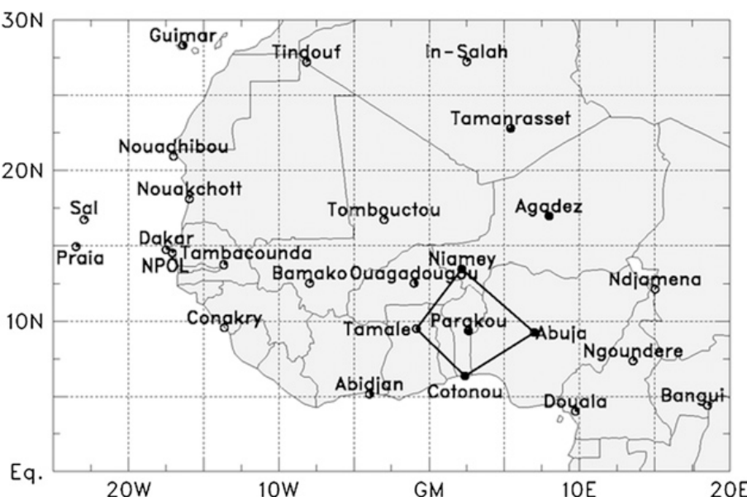
Key words
AMMA (African Monsoon Multidisciplinary Analysis)
A large international project undertaken to improve the understanding of the West African monsoon.
Its special observing period (SOP) focused on specific processes and
weather systems between 1 June and 15 September 2006.
Sahara
The results for AMMA presented in this paper focus on the budget network consisting of five sounding stations:
Niamey, Tamale, Cotonou,
Abuja, and Parakou.
Notes:
This sounding budget array encloses an area of about 600 km with its center near (98⁰N, 2.58⁰E).

Slide 6
Key words
TWP-ICE (Tropical Warm Pool–
International Cloud Experiment)
In January and February of 2006
during the northern Australian
monsoon
TWP-ICE was conducted around Darwin, Northern Territory, Australia.
Frederick and Schumacher(2008)
Notes:
Its sounding network enclosed a region with a scale of 210 km centered at 12⁰S, 131⁰E .
The thick solid circles indicate the 120-km radius from C-POL
In January and February of 2006 during the northern Australian monsoon.(此篇PAPER)

Slide 7
Observations of AMMA
The two MCSs chosen for study in this paper swept westward over the sounding network on 18–19 July and 10–11 August 2006, respectively.
The MCS on 10–11 August is described here briefly to summarize the basic characteristics of MCSs in the AMMA region. This MCS had an anvil that
extended on the order of 400 km.
Meteosat-8 infrared brightness temperature at 0319 UTC 11 Aug 2006.
Notes:
The two systems were well organized and had a distinct structure with deep convective clouds accompanied by stratiformclouds and nonprecipitating ice anvil clouds.
The dust concentrations near Niamey in summer are much higher than those near Darwin in spring, the MCSs observed in AMMA and TWP-ICE are modeled here with a CRM to investigate the effects of aerosols on the MCSs. .(p491)

Slide 8
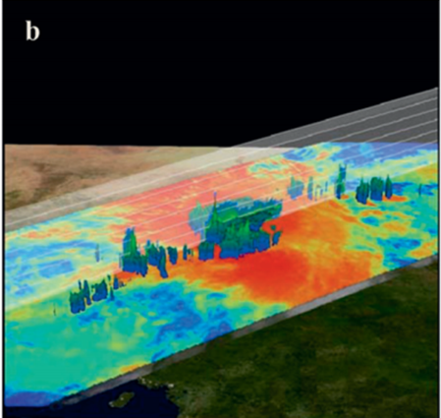
Observations of AMMA
Three-dimensional images from TRMM satellite PR data at 0433UTC 11Aug 2006.
15 dBZ
30 dBZ
40 dBZ
The MCS was generated by horizontally separated convective cells. This separation in convective cells resembles ‘‘connected active MCSs’’
Active convective systems are separated but their precipitation areas are connected
Notes:
received at about 0433UTC 11Aug 2006

Slide 9
Observations of TWP-ICE
Several squall lines, which occur in a typical monsoon break period, crossed the sounding network from 4 to 12 February 2006.
Radar observations show that the MCSs during this period had a scale of about 100 km, which is much smaller than those from AMMA.
C-POL horizontal cross sections on 10 Feb 2006

Slide 10
Model setup
The Goddard CRM is used in this study to simulate the MCSs.
Microphysic scheme : Kessler-type two- category liquid water scheme
and a three-category ice-phase scheme. with the
addition of ice crystal concentration .
Using a 1-km horizontal grid spacing.
Three numerical experiments analyzed in the paper
4-12 Feb 2006
M0811MH and M0719MH start at 0600 UTC 18 July and 10 August 2006, respectively, and last for 30 h.
T06MH was initialized at 2100 UTC 4 February 2006 and run for 8 days.
Notes:
Their initial condition is chosen based on satellite observations.(AMMA)

Slide 11
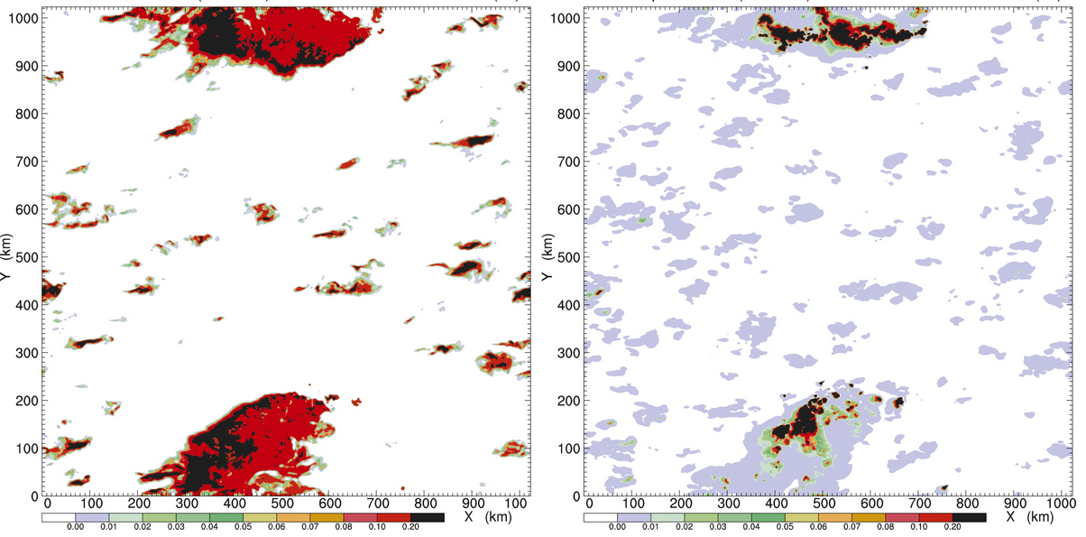
AMMA numerical simulation
Mixing ratio in M0811MH at 0400 UTC 11 Aug 2006 (22hr)
Cloud ice mixing ratio (z=8.6km)
Graupel mixing ratio (z=5km)
Cloud anvil
Convective core

Slide 12
AMMA numerical simulation
Mixing ratio in M0811MH at 0400 UTC 11 Aug 2006 (22hr)
Cloud ice mixing ratio (z=8.6km)
Graupel mixing ratio (z=5km)
Cloud anvil
Convective core
400 km
400 km

Slide 13
AMMA numerical simulation
The modeled AMMA clouds in M0811MH at 0400 UTC 11 Aug 2006 (22hr)
Volumes of cloud ice
anvil clouds
Volumes of
precipitating particles
(rainwater, snow, graupel)
Convective clouds
Stratiform clouds

Slide 14
TWP-ICE numerical simulation
The modeled TWP-ICE clouds in T06MH at 1424 UTC 11 Feb 2006
Volume of nonprecipitating water particles
(cloud water and ice)
100km
Volume of precipitating water particles
(rainwater, snow, and graupel)

Slide 15
Water budget analysis
Houze et al. (1980)
Notes:
The water budget for an MCS describes the transport of water between convective, stratiform, and anvil cloud regions as well as water source(s)/sink(s) from micro-physical processes.

Slide 16
Water budget analysis
AMMA
TWP-ICE
convective
stratiform
Non-Srf Raining
convective
stratiform
Non-Srf Raining
48.6％
51.4％
58.6％
41.4％
The model domain is divided into convective , stratiform, and anvil cloud regions.
Two isothermal surfaces at temperatures of 0 and –35⁰C are used to divide the troposphere into three layers: warm, mixed-phase, and ice cloud layers.

Slide 17
Convective water budgets
AMMA
TWP-ICE
convective
stratiform
Non-Srf Raining
convective
stratiform
Non-Srf Raining
(0.01)
(0.01)
0.08
0.16
(0.40)
(0.49)
0.10
0.10
(0.53)
(0.92)
Deep convection in T06MH is stronger than in M0811MH.

Slide 18
Convective water budgets
Probability density functions (PDFs) of vertical velocity w
Stronger vertical velocities in the TWP-ICE convective clouds than those in
the AMMA MCSs.

Slide 19
Stratiform water budgets
The frequency of ice cloud occurrence is much larger over Darwin than over Niamey. (Protate et al 2010)

Slide 20
Stratiform water budgets
The frequency of ice cloud occurrence is much larger over Darwin than over Niamey. (Protate et al 2010)
The mesoscale ascent around deep convection is stronger in M0811MH than in T06MH.
(0.15)
(0.00)
Deep convection near Darwin is relatively strong and is associated with
extensive anvil area, whereas stratiform clouds around deep convection
near Niamey are relatively stronger in terms of vertical velocity.

Slide 21
Discussion
Vertical
wind shear
Ice crystal
concentration

Slide 22
Vertical wind shear
T06MH1S | T06MH2S
Vertical wind shear of zero above 290 hPa (10 km) | Vertical wind shear is decreased by half
Upper-troposphere(UT) | Middle and lower troposphere
Convective cloud ➔ Slightly small Stratiform cloud ➔ Smaller | Convective cloud ➔ Larger Stratiform cloud ➔ Obviously larger
The UT vertical wind shear favors the formation of wide stratiform clouds. | The vertical wind shear in the middle and lower troposphere does not favor the formation of wide stratiform clouds.

Slide 23
Vertical wind shear
Vertical profiles of the zonal and meridional wind.
Notes:
Vertical wind shear between 2 and 11 km in the 11 August MCS is larger than that in the 19 July MCS.
The vertical wind shear between 2 and 11 km in TWP-ICE is smaller than those in the two AMMA MCSs.

Slide 24
Ice crystal concentration
The ice nuclei concentrations (or ICC) in the AMMA clouds were higher than in those from TWP-ICE.
M0811L | Follows the same setup as M0811MH except for using a low ICC. | The effects of ICC on MCSs are revealed in the differences in MCS sizes.
Mixing ratio in M0811L at 0400 UTC 11 Aug 2006 (22hr)
Cloud ice mixing ratio (z=8.6km)
Graupel
mixing ratio
(z=5km)
Notes:
The effects of ICC on MCSs are revealed in the differences in MCS sizes and water budgets between AMMA and TWP-ICE.

Slide 25
Ice crystal concentration
Cloud ice mixing ratio (z=8.6km)
Graupel mixing ratio (z=5km)
M0811MH
The ice nuclei concentrations (or ICC) in the AMMA clouds were higher than in those from TWP-ICE.
M0811L | Follows the same setup as M0811MH except for using a low ICC. | The effects of ICC on MCSs are revealed in the differences in MCS sizes.
M0811L
Cloud ice mixing ratio (z=8.6km)
Graupel
mixing ratio
(z=5km)

Slide 26
Ice crystal concentration
5⁰
M0811MH
5⁰
Abundant ice nuclei, such as was observed in AMMA, is one of the factors contributing to extensive MCSs over West Africa.
T06MH
2⁰
2⁰

Slide 27
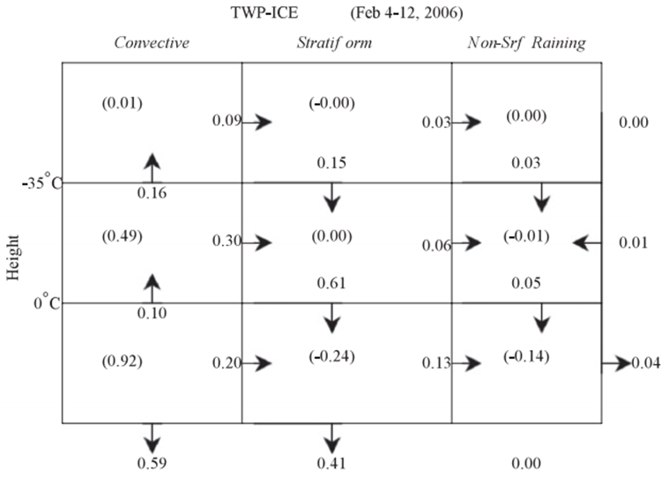
Ice crystal concentration
AMMA
TWP-ICE
convective
stratiform
Non-Srf Raining
convective
stratiform
Non-Srf Raining
(0.15)
(0.00)
Mesoscale ascent around deep convection becomes stronger with increasing ICC, which is consistent with the difference in water budgets

Slide 28
Conclusions

Slide 29
Conclusions
If the corresponding CRM simulations can duplicate the cloud characteristics observed in the two climatological regimes, they can then be used to infer the factors that cause the difference in clouds between the two regimes.
Water Budget
Ascent in TWP-ICE convective clouds is stronger while the mesoscale ascent
outside of convective clouds in AMMA is stronger
Sensitivity Experiments
Vertical wind shear
Strong vertical wind shear in the upper troposphere and weak shear in the
middle and lower troposphere favor the formation of wide stratiform clouds.
Ice crystal concentration
An increase in ice crystal concentration can bring about an increase in cloud
shield area.
Mesoscale ascent in stratiform clouds becomes stronger with increasing ICC.

Slide 30
Conclusions
TWP-ICE
➔ Strong vertical wind shear in the upper troposphere and weak shear in the middle and lower troposphere in TWP-ICE can explain the high frequency of ice clouds observed at Darwin.
AMMA
➔ An increase in ice crystal concentration can bring about an increase in cloud shield area, which implies that high ice crystal concentrations are one of the key factors that contribute to the large MCSs in AMMA.

Slide 31
References
Protat, A., J. Delanoe¨ , A. Plana-Fattori, P. T. May, and E. J.O’Connor, 2010: The statistical properties of tropical ice clouds generated by the West African and Australian monsoons, from ground-based radar–lidar observations. Quart.J. Roy. Meteor. Soc., 136, 345–363.
Powell, S. W., R. A. Houze Jr., A. Kumar, and S. A. McFarlane,2012: Comparison of simulated and observed continental tropical anvil clouds and their radiative heating profiles.J. Atmos. Sci., 69, 2662–2681.
Redelsperger, J.-L., C. D. Thorncroft, A. Diedhiou, T. Lebel,D. J. Parker, and J. Polcher, 2006: African Monsoon Multidisciplinary Analysis: An international research project and field campaign. Bull. Amer. Meteor. Soc., 87, 1739–1746.
Cetrone, J., and R. A. Houze Jr., 2009: Anvil clouds of tropical mesoscale convective systems in monsoon regions. Quart.J. Roy. Meteor. Soc., 135, 305–317.
THE CLOUDSAT MISSION AND THE A-TRAIN A New Dimension of Space-Based Observations of Clouds and Precipitation
Zeng, X. and Coauthors, T. Matsui, S. Xie, S. Lang, M. Zhang, D. Starr, and X. Li, 2011: Estimating the ice crystal enhancement factor in the tropics. J. Atmos. Sci., 68, 1424–1434.
——, W.-K. Tao, and R. A. Houze Jr., cited 2010: Modeling mesoscale convective systems in a highly simplified environment.
Tao, W.-K., 2003: Goddard Cumulus Ensemble (GCE) model: Application for understanding precipitation processes. Meteor. Monogr., No. 51, Amer. Meteor. Soc., 107–138.
Frederick, K., and C. Schumacher, 2008: Anvil characteristics as seen by C-POL during the Tropical Warm Pool International Cloud Experiment (TWP-ICE). Mon. Wea. Rev., 136, 206–222.
May, P. T., J.H.Mather,G. Vaughan, C. Jakob,G.M.McFarquhar, K. N. Bower, and G. G. Mace, 2008: The Tropical Warm Pool International Cloud Experiment. Bull. Amer. Meteor. Soc., 89, 629–645.

Slide 32
END

Slide 34
Convective water budgets
AMMA
TWP-ICE
convective
stratiform
Non-Srf Raining
convective
stratiform
Non-Srf Raining
0.01
0.08
0.06
0.01
0.09
0.08
0.16
0.13
0.40
0.24
0.49
0.30
0.10
0.10
0.20
0.20
0.53
0.92
0.48
0.59
Stronger vertical velocities in the TWP-ICE convective clouds than those in
the AMMA MCSs.
About one quarter of deep convection comes from isolated storms.(TWP-ICE)
Isolated storms contribute little to precipitation.(AMMA)

Slide 35
AMMA numerical experiments
The two numerical experiments start at 0600UTC18 July and 10August 2006, respectively, and last for 30 h. Their initial condition is chosen based on satellite observations.
To mimic the advection of convective systems into the sounding network, four warm bubbles are introduced into the model with a scale of 50 km in the right part of the domain. The bubbles are introduced gradually within the first 14 h with accumulated temperature perturbations of 4K.

Slide 36
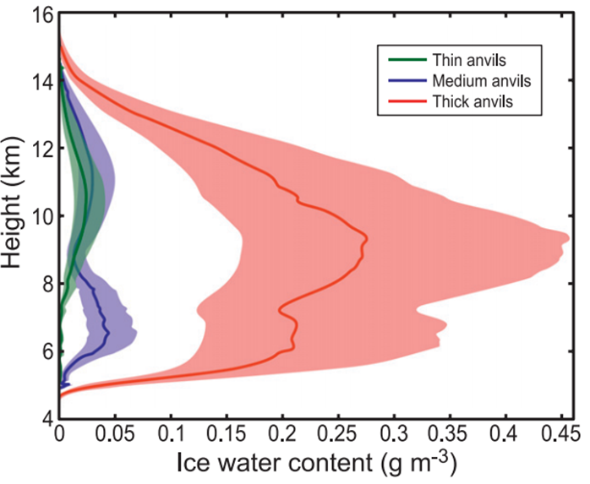
b. Comparison with W-band radar observations
Vertical profiles of ice water content(IWC) in thick , medium , and thin anvils.
Modeled IWC in M0811MH
Observational IWC derived from WARC
Powell et al.(2012)

Slide 37
Water budget analysis
Ccu : convective region condensation
Rc : the portions of the convective region condensation that are rained out
Ecd : evaporated in the convective downdrafts
Ece : detrained to an anvil
CT:transported into the stratiform region
Csu : The amount of condensate generated by the stratiform updraft
Rs : Part of (CT+Csu) is rained out
Esd: Part of (CT+Csu) is evaporated into the downdraft
Ese : Part is detrained to or left aloft in a thick anvil or ice cloud
Notes:
The water budget for an MCS describes the transport of water between convective, stratiform, and anvil cloud regions as well as water source(s)/sink(s) from micro-physical processes.

Slide 38
Vertical wind shear
Deep convection brings about longlasting stratiform clouds.
The length of stratiform clouds is directly proportional to the relative horizontal displacement of an UT air parcel with respect to deep convective cores .
Vu and Vm : The horizontal wind in the upper
and middle troposphere.
Vd : The propagation velocity of deep
convective cores
A
B
C
A: The relative horizontal displacement of an UT air parcel with respect to
deep convective cores.
B: The effect of vertical wind shear on stratiform clouds.
(Its effect is shown by the contrast between T06MH and T06MH1S.)
C: The propagation speed (or stratiform cloud area) of MCSs increases with decreasing
vertical wind shear in the middle (and lower) troposphere.

Slide 39
Computing Water Budget
(A1)
ρ : Air density
Vh : Horizontal wind vector
W : Vertical velocity of a water species that includes its terminal velocity
: Mixing ratio of a water species
(m=1,2,3,4,5 for cloudwater, rainwater, cloud ice,snow, and graupel, respectively)
: The source from microphysical processes

Slide 40
Computing Water Budget
Integrating (A1) over a given volume and a period yields the equation for the water budget.
(A2)
The first term on the left-hand side of (A2) is negligible for long-term integration.
Dividing (A2) by TR gives the normalized equation for the water budget.
Vertical transport of water
at the top and bottom
of a given volume.
(A4)
Horizontal transport of water
from the given volume.
The water source from
microphysical processes.

Slide 41
Computing Water Budget
The total precipitation amount that reaches the ground R is expressed as
(A3)

Slide 42
TRMM-Precipitation Radar
The Precipitation Radar was the first space borne instrument designed to provide three-dimensional maps of storm structure.
These measurements yield invaluable information on the intensity and distribution of the rain, on the rain type, on the storm depth and on the height at which the snow melts into rain.
One of its most important features is its ability to provide vertical profiles of the rain and snow from the surface up to a height of about 12 miles (20 kilometers).
http://trmm.gsfc.nasa.gov/overview_dir/pr.html
http://science-edu.larc.nasa.gov/SCOOL/pdf/TRMM.pdf
Notes:
PR的波長 應為2.1cm

Slide 43
TRMM / CloudSat
TRMM (Simpson et al. 1996) has quantified how much precipitation falls in the tropical atmosphere. We cannot estimate within a factor of 2 the mass of water and ice in these clouds (e.g., Stephens et al. 1998) let alone how much of this water and ice is converted to precipitation. We also cannot say with any certainty what fraction of global cloudiness produce precipitation that falls to the ground.
A new satellite-based cloud experiment, hereafter the CloudSat mission, aims to provide observations necessary to advance our understanding of these issues.
Stephens, G. L

Slide 44
CloudSat
A new satellite-based cloud experiment.
The CloudSat satellite flies as part
of a constellation of satellites.
This constellation is referred to
as the A-Train.
CloudSat will fly the first spaceborne millimeter wavelength radar.
The CloudSat mission was selected under NASA ESSP Program with a scheduled launch for 2004.
The concept of the A-Train constellation and its
members.
Stephens, G. L
Notes:
1. The unique feature of this radar lies in its ability to observe jointly most of the cloud condensate and precipitation within its nadir field of view and its ability to provide profiles of
these properties with a vertical resolution of 500 m.
2.Combining the observations of the different sensors of the A-Train with the millimeter radar observations is a key aspect of the observing philosophy of the CloudSat mission.

Slide 45
Goddard CRM
Cloud resolving (or cumulus ensemble) models (CRMs) are one of the most important tools used to establish quantitative relationships between diabatic heating and rainfall.
The cloud microphysics includes a parameterized Kessler-type two-
category liquid water scheme (cloud water and rain), and a three-
category ice phase scheme(cloud ice, snow and hail/graupel)
Rutledge and Hobbs(1984)

Slide 46
AMMA radar observation
WACR reflectivity (dBZ) observed during the passage of an MCS over Niamey on 19 Jul 2006
Gray areas in each panel represent times during which WACR was partially attenuated by precipitation.
Powell et al.(2012)

Slide 47
AMMA(Observational IWC )
Derived vertical profiles of ice water content present in columns that contain anvil clouds detected by WACR(W-band Atmospheric Radiation Measurement cloud radar ).
The solid lines represent the mean ice water content for thin (green), medium (blue), and thick (red) anvils.
The shaded area spans the rmse of the cloud retrieval estimate of ice water content.
Powell, S. W., R. A. Houze Jr., A. Kumar, and S. A. McFarlane,2012: Comparison of simulated and observed continental tropical anvil clouds and their radiative heating profiles. J. Atmos. Sci.,69,2662–2681.
Notes:
WARC
1.Atmospheric Radiation Measurement Program(ARM)W-band vertically pointing cloud radar(WARC)--(Powell)
2.WARC=ARM W-band radar--(此篇paper)
Fifteen MCSs passing over Niamey during 1 July–27 September 2006(上述平均的結果是不是此15個MCSs做出的平均?!)
the profiles of mean IWC shown in Fig. 4 are derived from the echo seen by WACR only.

Slide 48
TWP-ICE(環境描述)
The following section discusses radar data analyzed from 19 January to 11 February 2006. During TWP-ICE there were three distinct weather regimes:
19 January through 25 January was classified as the active or “wet” monsoon. This regime was characterized by westerly monsoon flow and large mesoscale convective systems (MCSs).
From 26 January through 2 February was classified as the“dry”monsoon. During this regime the monsoon low was inland and deep, and although the westerlies were very strong during this time they were of drier origin contributing to less convection over Darwin.
From 3 February through 11 February was classified as the“break”period. During this time, the monsoonal trough had moved out of the region and an inland heat trough dominated northern Australia accompanied with easterly winds. Storms formed along both trough and seabreeze boundaries and often came in the form of squall lines.
Frederick and Schumacher(2008)
Notes:
TWP-ICE的環境

Slide 49
TWP-ICE(Observation)
C-POL horizontal cross sections on 10 Feb 2006 at (a) 0800 UTC at 2.5 km MSL, (b) 0800 UTC at 10 km MSL, (c) 1300 UTC at 2.5 km MSL, (d) 1300 UTC at 10 km MSL. Range rings are every 20 km.
Frederick and Schumacher(2008)

Slide 50
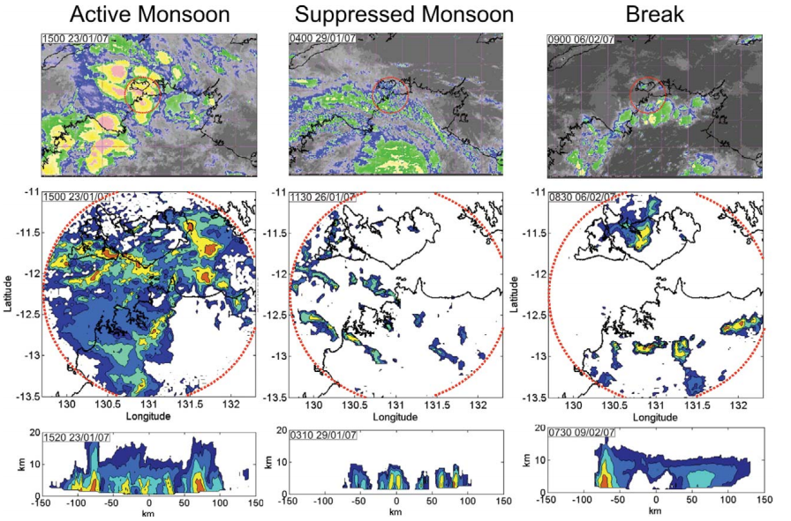
TWP-ICE(Observation)
May et al.(2008)
Notes:
Sample IR satellite images from MTSAT1-R of northern Australia, radar reflectivity maps of the experiment area and typical radar cross sections for the three rain regimes. These were (left) active monsoon, (middle) suppressed monsoons, and (right) break period. The red circles show the main experiment domain. Note that these panels are not necessarily at the same dates and times, but were rather chosen as representative of typical structure and organization observed in these periods. The IR enhancement T> 250 K is grayscale, 250 ~230 K are blue shades, 230–210 K are green shades, 210–190 K are yellow shades, and T< 190 are red shades. Radar contours are drawn every 10 dBZ from 10 dBZ. Dates and times are in UTC

Slide 51
TWP-ICE(T06MH)
T06L, T06M, and T06H, are carried out using low, moderate, and high ice crystal concentrations, respectively.
To better match the retrieved vertical profile in the upper troposphere, a new TWP-ICE simulation, T06MH is carried out that uses a moderately high ice crystal concentration.
Figure 4 shows that the modeled ice profile from T06MH is close to the retrieved profile above 350 hPa.
Zeng et al(2011)
Notes:
Since there are no observations of IN and aerosol particles in the field campaigns, the model uses the simplest IN formula (Fletcher 1962) to
compute the active IN concentration in the mixed-phase region as a function of air temperature T.

Slide 52
OBS AMMA/TWP-ICE ARM ground-based radar-lidar
Ground-based continuous active and passive remote sensing (cloud radar, lidar, radiometers) observations such as those conducted in the framework of the US Department of Energy Atmospheric Radiation Measurement program (ARM: Stokes and Schwartz, 1994) are most relevant to the previous objectives of characterizing the statistical properties of tropical ice clouds, because they are the only sets of instruments capable of describing the high-resolution vertical variability of the ice cloud properties, and because long time series of such observations are already available at a number of tropical sites.(p346)
In the present paper we exploit the unique opportunity offered by the most recent ARM ground-based radar – lidar observations to characterize the statistical properties of tropical ice clouds over two sites (Niamey, Niger, West Africa, and Darwin, northern Australia) which are both under the influence of a monsoonal large-scale forcing.
(Protate et al 2010)
The W-band Atmospheric Radiation Measurement (ARM) Program Cloud Radar (WACR)
Millimeter wavelength cloud radar (MMCR)
Notes:
Unlike the millimeter wavelength cloud radar (MMCR), the WACR does not use pulse coding and operates in only copolarization and cross-polarization modes

Slide 53
Frequency of ice cloud occurrence Radar-lidar observation (Protate et al 2010)

Slide 54
Frequency of ice cloud occurrence
Frequency of cloud occurrence
defined as the ratio of the number of ‘cloudy’ radar and/or lidar gates to the total number of radar–lidar gates.
Non-precipitating tropical ice clouds
deep ice anvils resulting from deep convection and cirrus clouds.
The frequency of ice cloud occurrence is found to be much larger over Darwin when compared to Niamey, and with a much larger diurnal variability, which is well correlated with the diurnal cycle of deep convective activity.
The diurnal cycle of the ice cloud occurrence over Niamey is also much less correlated with that of deep convective activity than over Darwin

Slide 55
AMMA vs TWP-ICE---stability
The African temperature sounding is nearly dry adiabatic in the lower troposphere, while the maritime profiles are nearly moist adiabatic.
Greater buoyancy can be
achieved in the West Africa
environment, if parcels can
overcome significant
convective inhibition at
the lower levels
Cetrone and Houze(2009)
The 75th percentile of buoyancy is plotted here
Notes:
Buoyancy here is described as the difference between the environmental temperature and the temperature of a parcel lifted from the 1000 mb level.
West African MCSs result from greater buoy-ancy (Figure 2). Consequently, the precipitating cores are deeper and have heavier rain (Figure 4),
and stronger convective updraughts almost cer-tainly produce copious graupel--------??是指整個TWP-ICE的時期吧?!

Slide 60
Microphysics parameterization for cold clouds and warm clouds
Zeng et al(2010)
Notes:
Rutledge, S. A., and P. V. Hobbs, 1984: The mesoscale and microscale structure and organization of clouds and precipitation in mid-latitude clouds. Part XII: A diagnostic modeling study of precipitation development in narrow cold frontal rainbands.J. Atmos. Sci., 41, 2949–2972.

Slide 61
a. Comparison with satellite observations
Modeled(M0719MH) and observed AMMA rainfall rates

Slide 62
Key words
TWP-ICE (Tropical Warm Pool–
International Cloud Experiment)
In January and February of 2006 during the northern Australian monsoon.
TWP-ICE was conducted around Darwin, Northern Territory, Australia.
Notes:
Its sounding network enclosed a region with a scale of 210 km centered at 128S, 1318E .

Slide 63
Ice crystal concentration
Hovmöller (x-t) diagram
for the surface rainfall rate
Clouds are organized well when the microphysics parameterization for cold clouds (with ‘‘high’’ ICC) is used and are organized weakly (or isolated) when the parameterization for warm clouds (with zero ICC) is used.
Zeng et al(2010)
Notes:
the contrast between the two diagrams indicates that ice physics dominate cloud envelope formation.
Fig. 3 Hovmöller (x-t) diagram for the surface rainfall rate, averaged in y-direction, from experiment RCE2 (left) and RCE 1 (right). Precipitation intensity is directly proportional to shading density.

Slide 64
Vertical wind shear
T06MH1S | T06MH2S
Vertical wind shear of zero above 290 hPa (10 km) | Vertical wind shear is decreased by half
Upper-troposphere(UT) | Middle and lower troposphere
Convective cloud ➔ Slightly small Stratiform cloud ➔ Smaller Anvil cloud ➔ Almost the same | Convective cloud ➔ Larger Stratiform cloud ➔ Obviously larger Anvil cloud ➔ Slightly smaller
The UT vertical wind shear favors the formation of wide stratiform clouds. | The vertical wind shear in the middle and lower troposphere does not favor the formation of wide stratiform clouds.

Slide 65
Stratus clouds vs Cumulus clouds
Stratus clouds can extend over hundreds of kilometers in the horizontal.
Cumulus clouds’ horizontal and vertical extents are comparable.
In cumulus, the updrafts and downdrafts are in the order of meters per second.
In stratus, the updrafts and downdrafts are in the order of centimeters per second.
Stratus clouds | Cumulus clouds
Extend over hundreds of kilometers in the horizontal. | Horizontal and vertical extents are comparable.
The updrafts and downdrafts are in the order of centimeters per second. | The updrafts and downdrafts are in the order of meters per second.
Notes:
Stratus clouds can extend over hundreds of kilometers in the horizontal, and can be thin and nonprecipitating or thick enough to produce substantial widespread rain.

