Slide 1
Impact of Graupel Parameterization Schemes on Idealized Bow Echo Simulations
Rebecca D. Adams-Selin Adams-Selin, R. D., S. C. van den Heever, and R. D. Johnson, 2013: Impact of grapuel parameterization schemes on idealized bow echo simulations. Mon. Wea. Rev., 141, 1241–1262. 2013/10/23

Slide 2
Introduction
A key component to the strength, structure, and longevity of bow echoes is the cold pool (Rotunno et al. 1988; Weisman 1992, 1993; Weisman and Rotunno 2005). ➔ a large effect on the shape and strength of the cold pool (Lin et al. 1983; Fovell and Ogura 1988; James et al. 2006) and hence the eventual storm structure, longevity, and development.
The buoyancy gradient and the warm outflow from the updraft aloft increases, resulting in a strengthened midlevel low pressure perturbation (low-level microphysical cooling) .
RTF (rear-to-front) flow to be easily transported to the surface, and enhance evaporation by entraining additional unsaturated air, further cooling the cold pool.

Slide 3
Introduction
Changes in the microphysical characteristics ➔ cold pool and vorticity balance. The additional intensification of the updraft due to latent heat from freezing ➔ best simulations that include ice have resultant system front-to-rear flow (Nicholls 1987; Tao and Simpson 1989; Fovell and Ogura 1988; Szeto and Cho 1994) and realistic stratiform precipitation structure (Fovell and Ogura 1988). The cold pool strength due to cooling by melting ➔ a much narrower stratiform precipitation region, weaker midlevel buoyancy and pressure perturbation, and resulting weaker rear-inflow jet with the inclusion of hail (Yang and Houze 1995).
A cloud-resolving model is used to examine the impacts of microphysics specifically on bow echoes.
The sensitivity of new bowing frequency and intensity to changes in microphysical heating and cooling rates will be investigated.

Slide 4
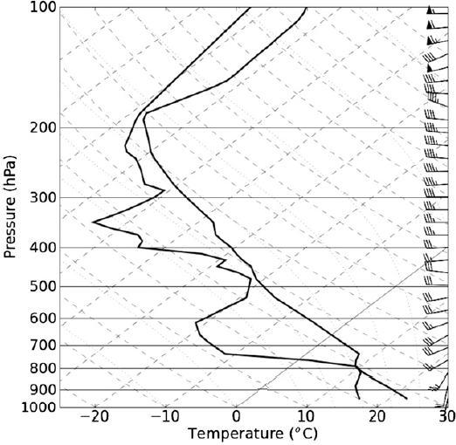
a. Model description
The Advanced Research Weather Research and Forecasting Model (ARW-WRF) V3.2.1
600 km
dx = dy = 1km
cold dam
50~350
400 km
0~200
72 stretched vertical levels
Ptop = 100 hPa
WRF Single-Moment 5- and 6-class scheme (WSM5 & WSM6)
Initial time: 0000 UTC
13 Mar 2003
Integration length: 6 h
Norman, Oklahoma (KOUN) @ 2003/03/13 0000UTC CAPE=3752 J kg⁻¹

Slide 5
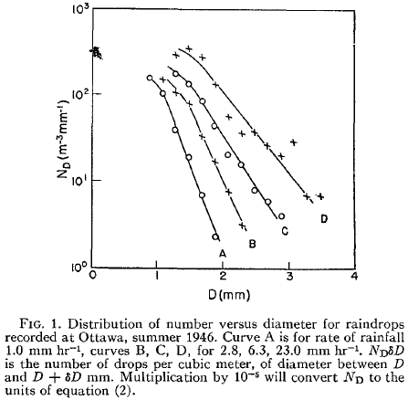
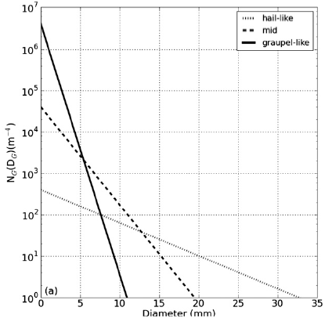
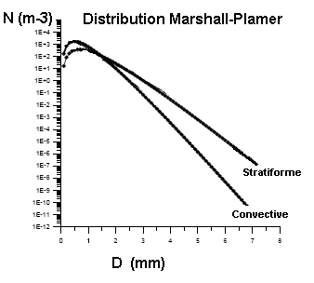
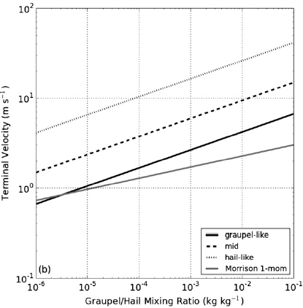
b. Model microphysics and experiment design
Marshall and Palmer 1948
: the number of hydrometeors between : the distribution intercept : the slope : the mass-weighted mean terminal velocity : empirically determined coefficients

Slide 6
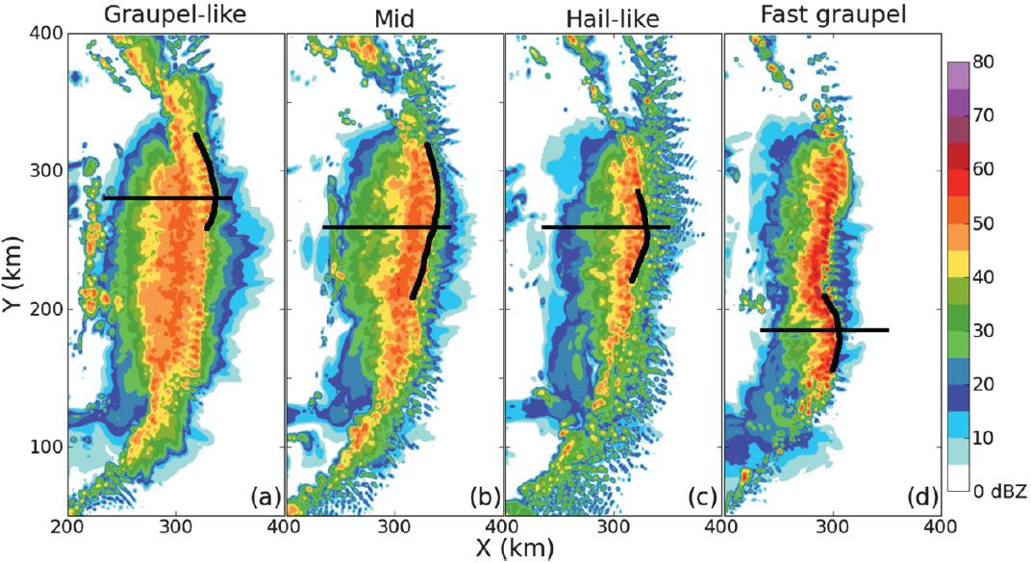
Results from hail-graupel comparison
-0240
-0250
-0300
-0220

Slide 7
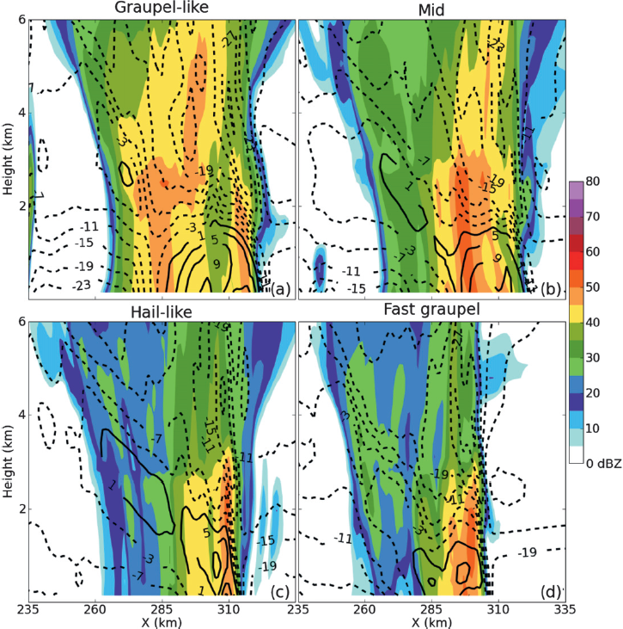
a. System-relative real-to-front flow
V=21.4 ms⁻¹
V=18.7 ms⁻¹
values are averaged 5 km storm-relative line-normal winds V: the mean system speed
V=16.7 ms⁻¹
V=23.1 ms⁻¹

Slide 8
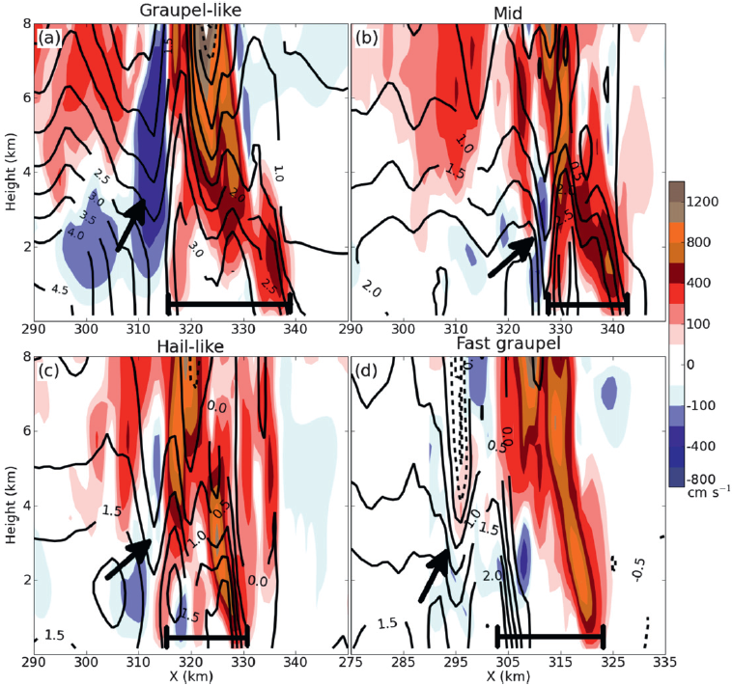
b. Midlevel pressure and buoyancy perturbations
Vertical motion (cm s⁻¹) and pressure perturbation (hPa)

Slide 9
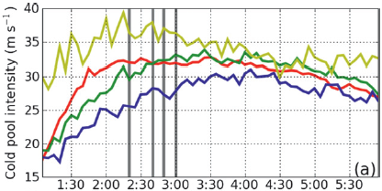
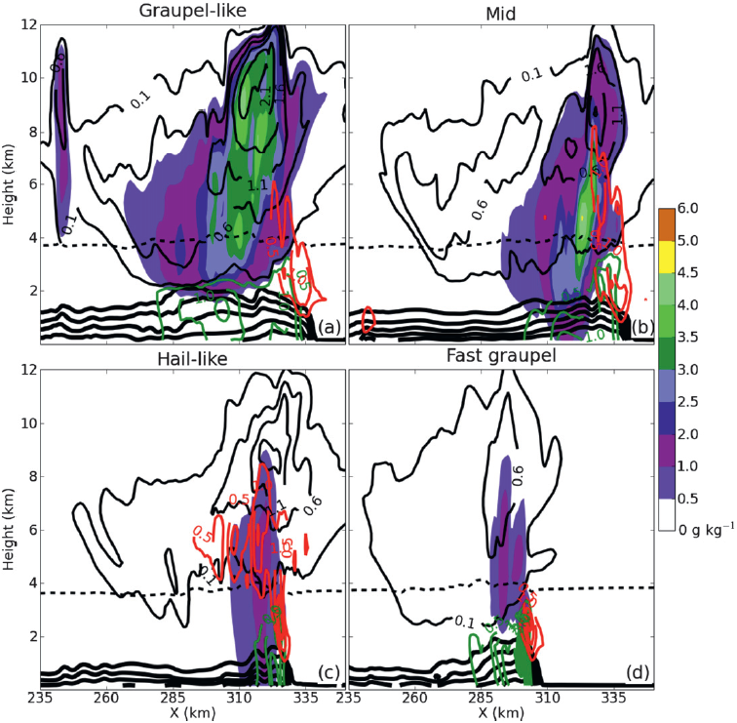
Hydrometeor mixing ratios (g kg⁻¹)
0240
0300
0250
0220
cloud water and ice rain water snow cold pool

Slide 10
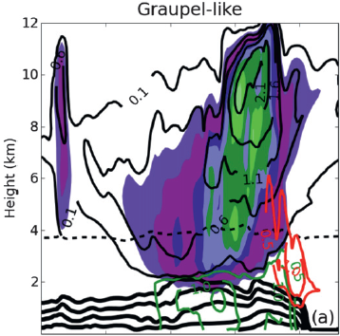
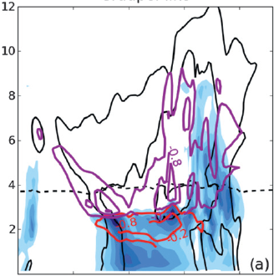
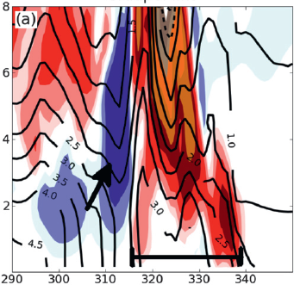
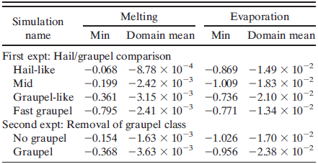
qc+qi rain water snow cold pool
melting sublimation 25,40, & 50 dBZ

Slide 11
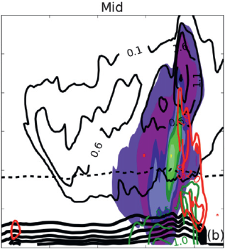
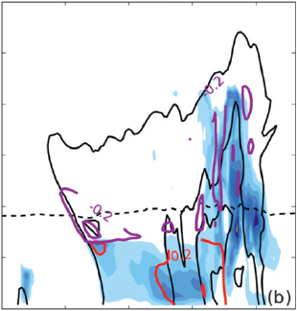
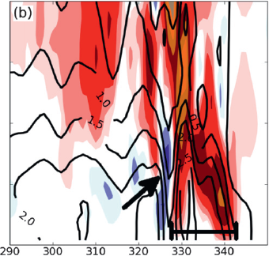
qc+qi rain water snow cold pool
melting sublimation 25,40, & 50 dBZ

Slide 12
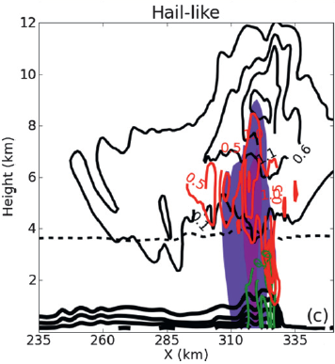
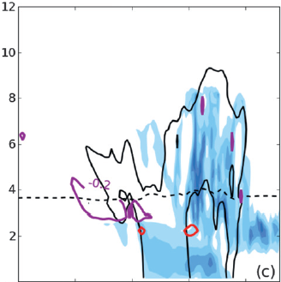
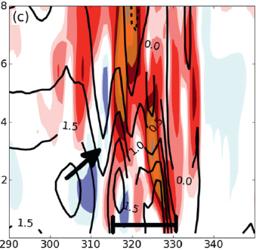
qc+qi rain water snow cold pool
melting sublimation 25,40, & 50 dBZ

Slide 13
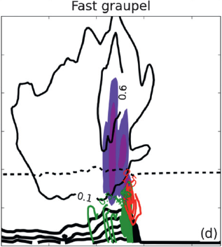
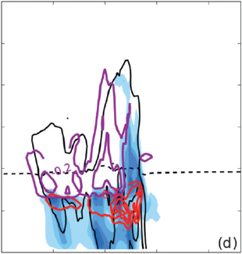
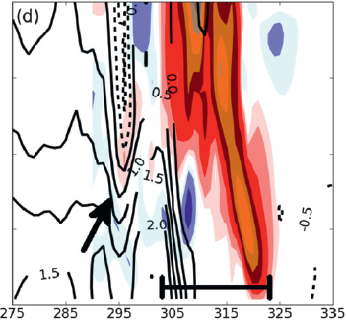
qc+qi rain water snow cold pool
melting sublimation 25,40, & 50 dBZ

Slide 14
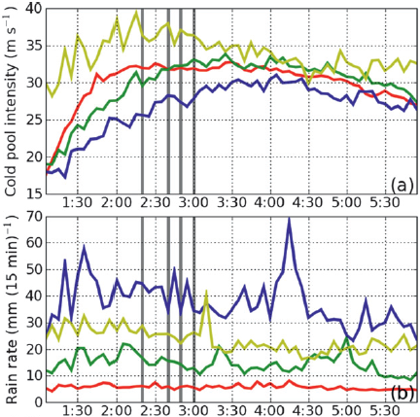
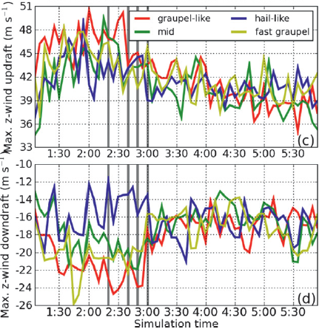
c. Microphysical effects on bowing
0240
0300
0250
0220

Slide 15
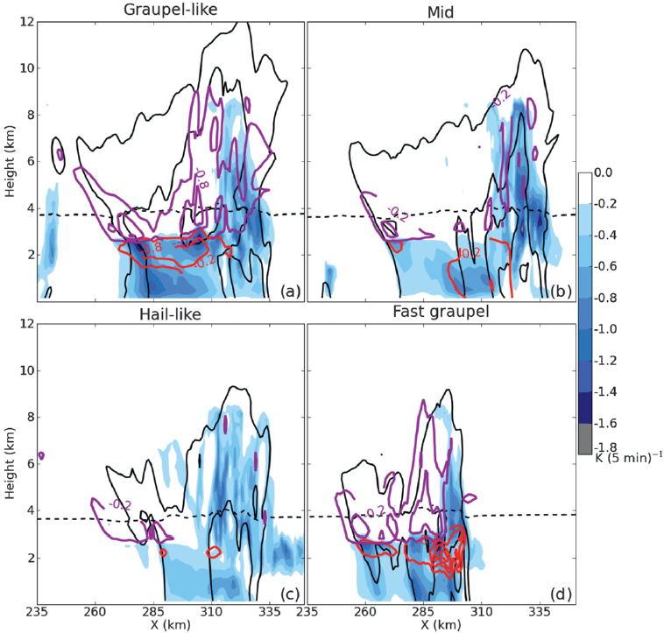
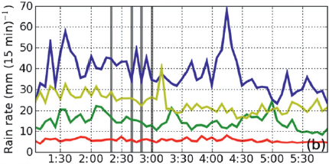
Cooling rates [K (5 min)⁻¹]
melting sublimation 25,40, & 50 dBZ
Peak precipitation rate was more sensitive to hydrometeor fall speed than mean size.
0240
0300
0250
0220

Slide 16
d. Comparison to other studies
Graupel-like is in contrast to Giolmore et al (2004a), van Weverberg et al. (2011, 2012b), and Morrison and Milbradt (2011), which found the hail system created more intense cold cools.
The slow graupel fall speeds relatively of their fast hail fall speeds; lower CAPE of their study; higher deep-layer shear values
Graupel-like agree with van den Heever and Cotton (2004), and Bryan and Morrison (2012), which have higher CAPE and weaker shear.

Slide 17
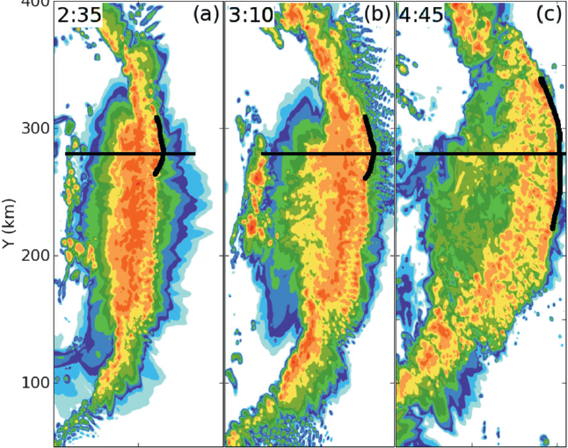
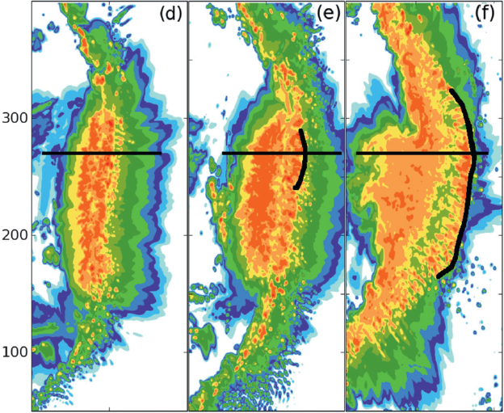
Results from removal of graupel class
Graupel (WSM6)
No graupel (WSM5)
Graupel propagated faster speed than the no graupel

Slide 18
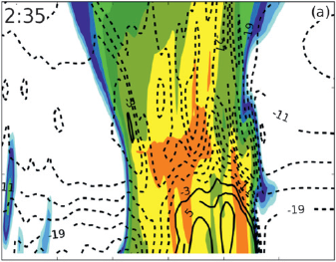
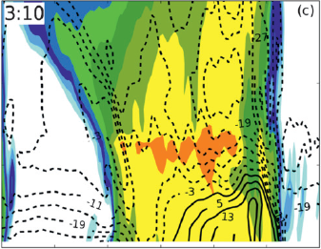
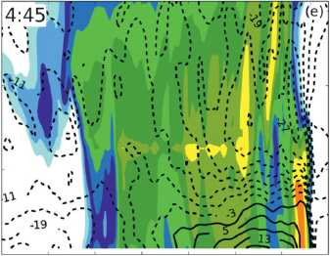
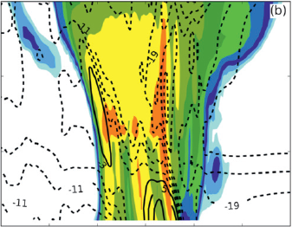
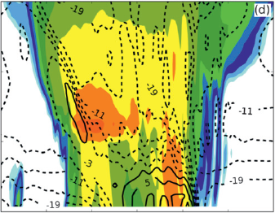
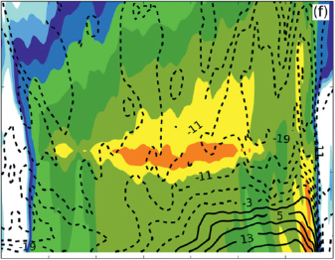
Graupel (WSM6)
No graupel (WSM5)

Slide 19
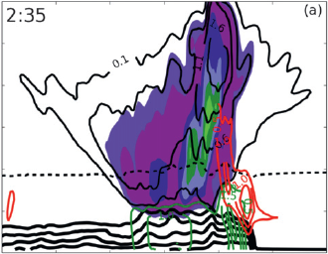
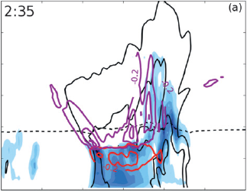
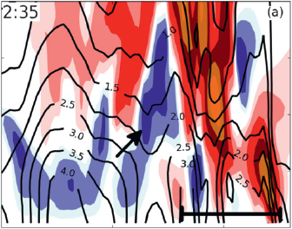
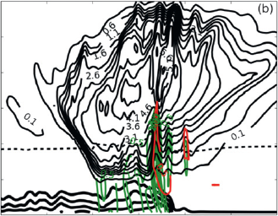
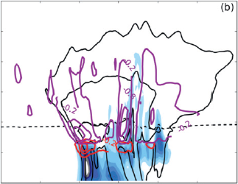
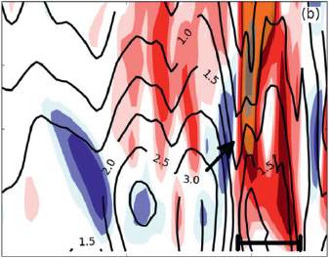
Graupel (WSM6)
No graupel (WSM5)
qc+qi rain water snow cold pool
melting sublimation 25,40, & 50 dBZ

Slide 20
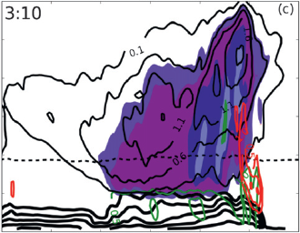
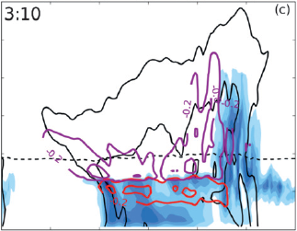
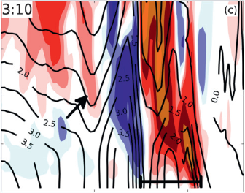
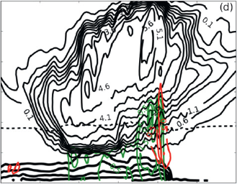
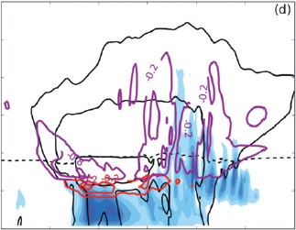
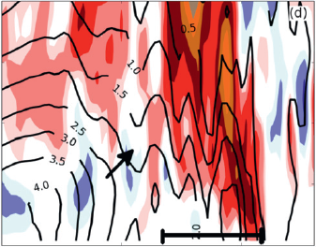
Graupel (WSM6)
No graupel (WSM5)
qc+qi rain water snow cold pool
melting sublimation 25,40, & 50 dBZ

Slide 21
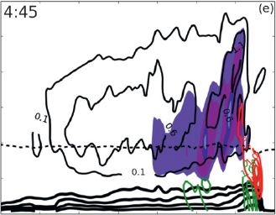
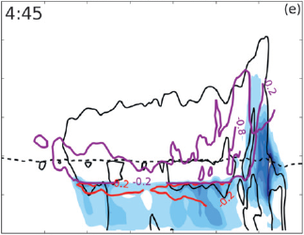
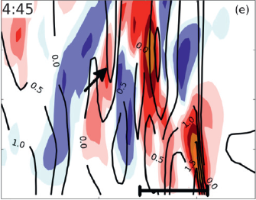
Graupel (WSM6)
No graupel (WSM5)
qc+qi rain water snow cold pool
melting sublimation 25,40, & 50 dBZ

Slide 22
No-graupel: with reduced freezing rates ➔ updrafts were weaker

Slide 23
Summary
The effect of changes in microphysical cooling rates on bow echo generation, specifically through the connections among cold pool strength, rear-to-front flow, and convective updraft tilt.
Hail-like: hydrometeors fall out of the updraft almost immediately (convective line) for little melting or evaporation; a minimal stratiform precipitation; convective line minimally updraft tilted (15 km).
Graupel-like: hydrometeors were slower to fall for more melting and evaporation; a wide stratiform precipitation; farther rearward updraft tilted (25 km).
WSM6: a stronger cold pool, the faster-falling graupel hydrometeors more quickly reached the melting level, result stronger midlevel pressure perturbation and rear-to-front flow.

