Slide 1

Ensemble Forecasting of Typhoon Rainfall and Floods over a Mountainous Watershed in Taiwan
Hsiao, L.-F., M.-J. Yang, et all, 2013: Ensemble forecasting of typhoon rainfall and floods over a mountainous watershed in Taiwan. J. Hydrology, doi: http://10.1016/j.jhydrol.2013.08.046, in press.
Keywords:
Ensemble forecast ; runoff prediction

Slide 2
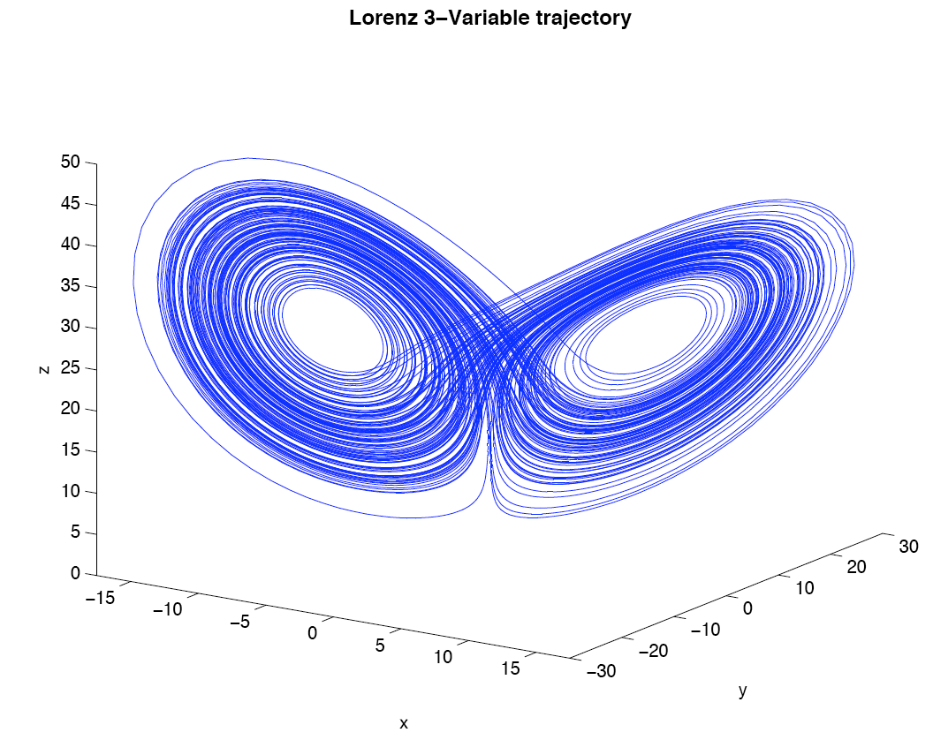
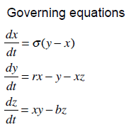
Ensemble forecast

Slide 3
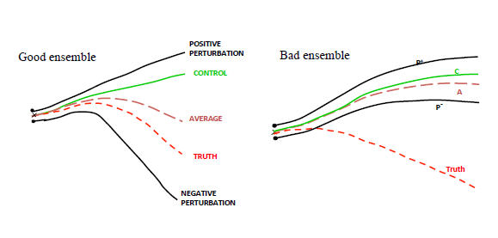
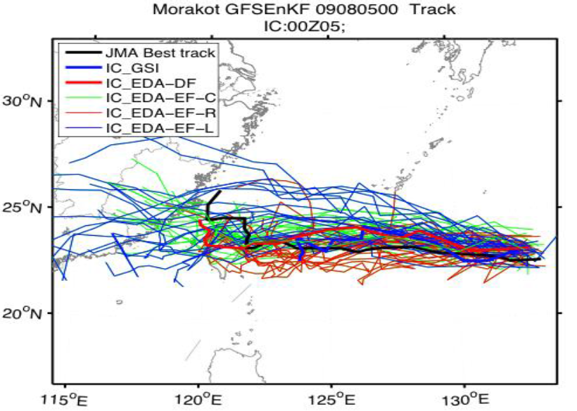
By Bob Gell ,NOAA

Slide 4
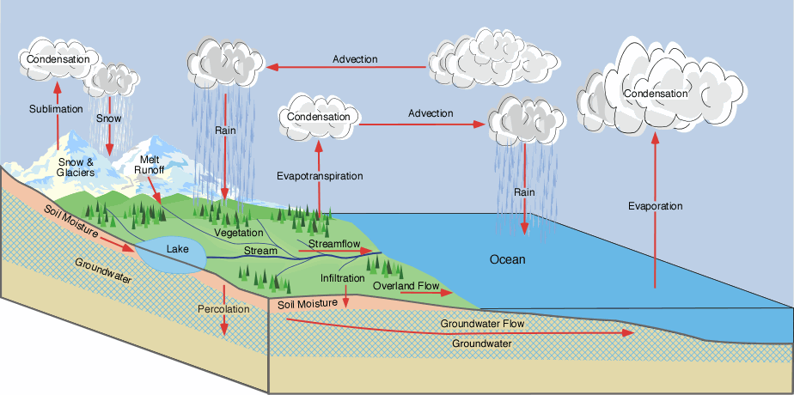
Runoff prediction
WASH123D (Yeh et al.)
  1-D Stream-River Network
  2-D Overland Regime
  3-D Subsurface

Slide 5
Outline
Introduction
Data and methods
Meteorological verification
Hydrological verification
Conclusions

Slide 6
Introduction
Regional scale ensemble prediction systems have been developed to address the need for detailed and high-impact weather forecasting with higher spatial resolution (Du et al., 2009, Yamaguchi et al., 2009 and Clark et al., 2010).
2010 results find that cumulus scheme can effectively provide physics perturbations (25 % track error difference in 36-km WRF)
The one-way coupled hydrometeorological approach with rainfall forcing from an ensemble mesoscale modeling system was used in this study to predict rainfall and flooding during the landfall of Typhoon Nanmadol (2011).
Notes:
An ensemble forecast that explicitly represents these uncertainties would provide useful quantitative information regarding the probability of the weather systems (Murphy, 1990).
Kain et al., 2008 and Weisman et al., 2008, and Clark et al. (2010) indicated that the convection-allowing NWP models with fine horizontal grid spacing provide value-added predictions for severe convective storms and their associated heavy rainfall.
Regional scale ensemble prediction systems have been developed in research and operational modes to address the need for detailed and high-impact weather forecasting with higher spatial resolution (Du et al., 2009, Yamaguchi et al., 2009 and Clark et al., 2010).
Yamaguchi et al. (2009) showed that the ensemble mean track forecasts for typhoons in the western North Pacific in 2007 had a 40-km error reduction in the 5-day forecasts compared to the deterministic model forecast.

Slide 7
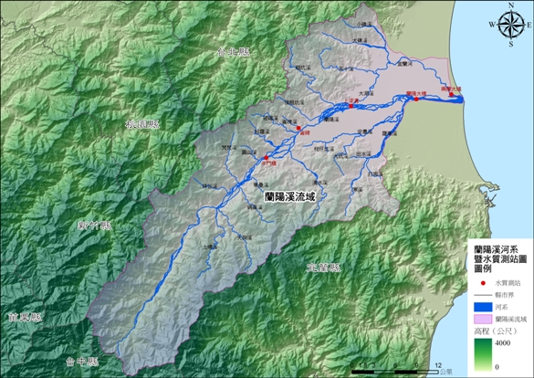
The hydrological responses of most watersheds in Taiwan are fast and complicated due to the steep slopes of the Central Mountain Range (CMR).
In this study, the Lanyang creek basin was selected as the target area for watershed modeling .
圖片來源 : Environmental Protection Administration Executive Yuan, R.O.C

Slide 8
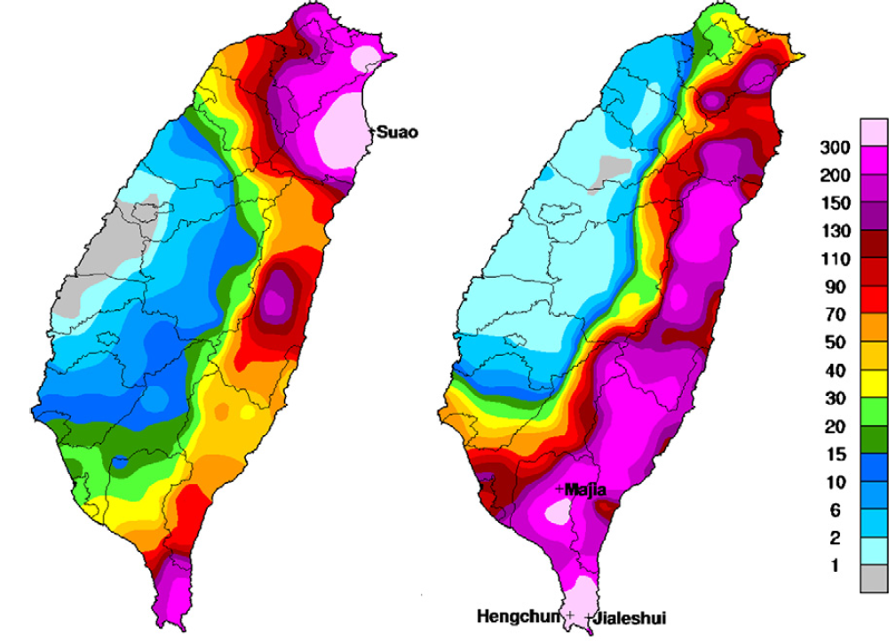
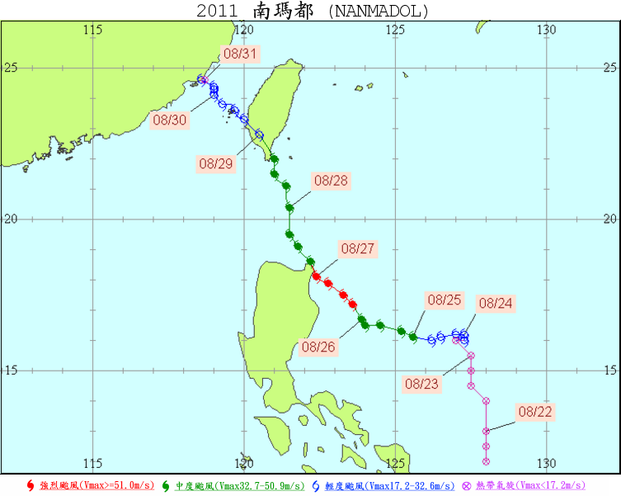
Nanmadol became a tropical storm at 1200 UTC 23 August 2011 , and then moved north–northwestward before making landfall in southeastern Taiwan on 28 August.
After Nanmadol passed over Taiwan, it rapidly weakened before dissipating over the Taiwan Strait.
圖片來源 : 中央氣象局CWB
Notes:
Typhoon Nanmadol produced heavy rainfall that resulted in agricultural and industry damage and the loss of many lives. Nanmadol became a tropical storm at 1200 UTC 23 August 2011 as it moved westward to northwestward along the southern edge of the subtropical high.
Following landfall in the northeastern Philippines at 0000 UTC 27 August, its intensity was reduced from category 3 to category 2 [based on the Saffir–Simpson hurricane scale (Simpson, 1974)].
Nanmadol then moved north–northwestward due to the westward extension of the subtropical high before making landfall in southeastern Taiwan on 28 August (Fig. 1). After Nanmadol passed over Taiwan, it rapidly weakened before dissipating over the Taiwan Strait.
From 1200 UTC 27 August to 0000 UTC 30 August, the Central Weather Bureau (CWB) of Taiwan issued typhoon warnings for heavy rainfall and strong winds.
In Taiwan, a total property loss of 100 million Taiwan dollars (3.3 million US dollars) resulted from Typhoon Nanmadol.

Slide 9
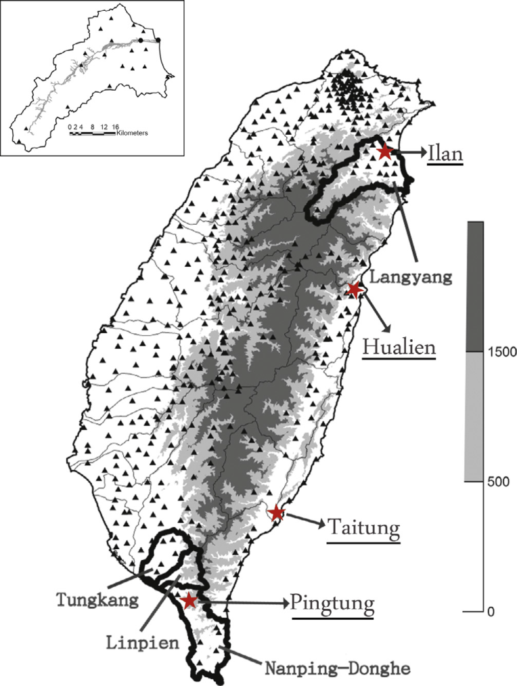
Data and methods-Observations
Lanyang stream watershed
512 automatic rain-gauge stations
Rainfall forecast interpolated to each stations using the Kringing technique (Bras and Rodriguez-Iturbe, 1985)

Slide 10
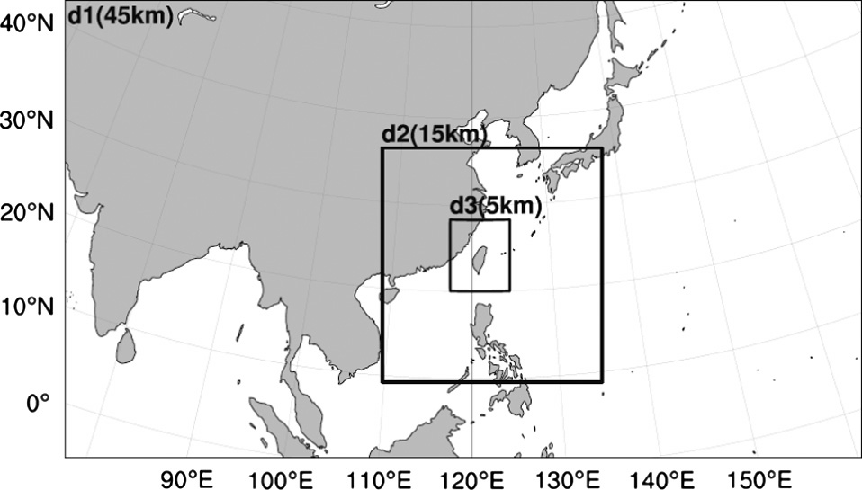
Data and methods-Model setups
Three nested domains with 51 vertical levels
18 ensemble members in WRF and MM5
221*127
183*195
150*180
Notes:
三層巢狀網格
垂直51層以高解析度解析邊界層

Slide 11
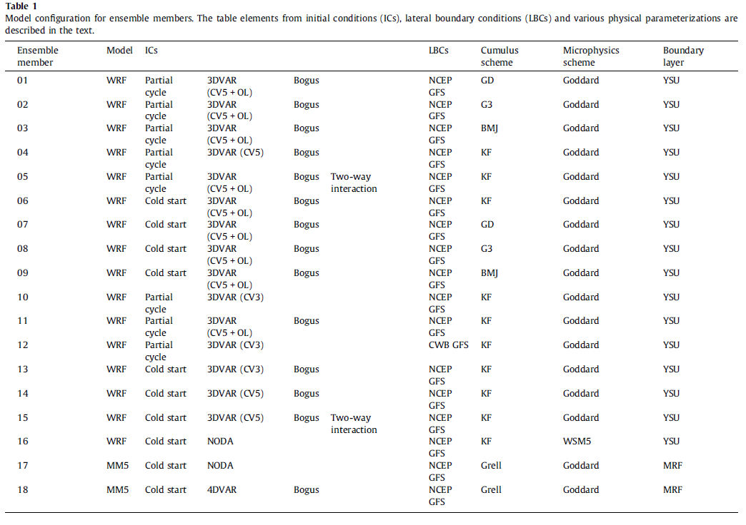
Notes:
解釋
Cold start :以GFS的大尺度預報場做初始化 ，做在解析時間前做12小時cold stat以及六小時資料同化循環
CV3 CV5 : 使用3DVAR同化時，使用的error covariance matrices
OL : 使用3DVAR時的outer loop，藉由將算好的Xa帶回去計算以穩定非線性的H
Bogus vortices : 給予假渦旋做初始場
MM5的模擬使用4DVAR和noda的模擬
LBCs : provided every 6 hours from NCEP GFS and CWB gfs
積雲參數化主要使用前兩個domain
Grell-Devenyi
對於深對流和環境的閉合，為對每個grib都用不同的閉合
Grell 3D ensemble
同Grell 只是對3維每個grib都給予不同的閉合
Betts-Miller-Janjic
藉由柱狀的溼調整來調整成完全混和的profile
Kain-Fritsch
對於次網格的深淺對流系統 使用質量通量的向下傳遞和CAPE 來移除時間尺度的影響
Grell scheme
為MM5中較舊版本的Grell scheme
主要是要看基雲參數話對颱風路徑的影響
微物理參數化為了清楚解系對流，在5km也使用
使用Goddard 和 WSM5
Goddard 主要是對冰 雪 grapel有高解析度模擬
WESM5則是對混相位過程和過冷水有較多著墨
PBL使用YSU和MRF
系集結果每六小時輸出一次

Slide 12
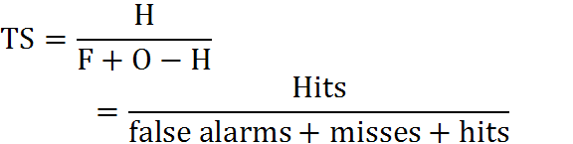
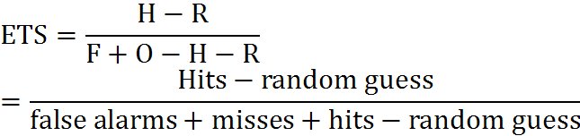

Data and methods- Skill score
 |  | Observed
 |  | Yes | no
Forecast | Yes | Hits | False alarms
 | no | Misses | Correct negatives
Threat score (TS)
Equitable threat score (ETS)
H : Hits
F : Forecast yes
O : Observed yes

Slide 13


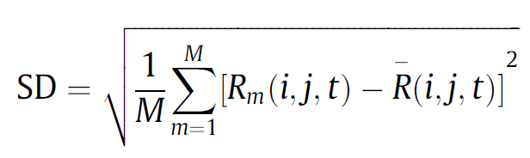
Data and methods- Skill score
 |  | Observed
 |  | Yes | no
Forecast | Yes | Hits | False alarms
 | no | Misses | Correct negatives
Bias score (BS)
False alarm rate (FAR)
Standard deviations (SD)
H : Hits
F : Forecast yes
O : Observed yes

Slide 14
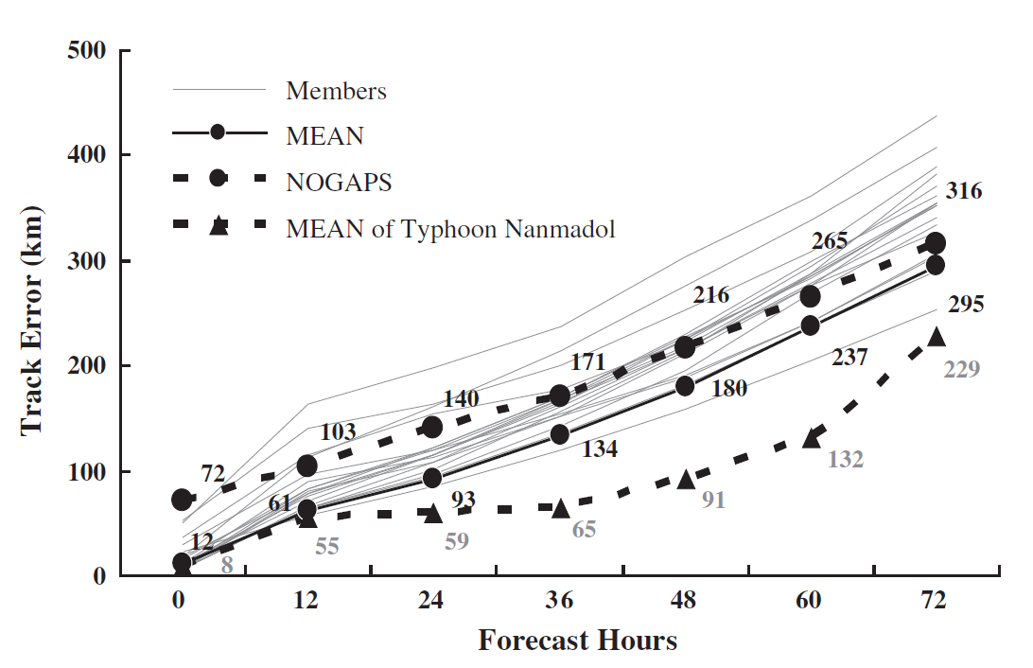
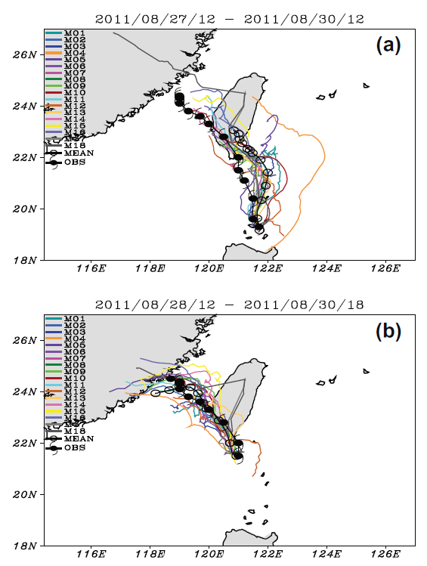
Meteorological verification
To establish the veracity of the track forecast ensemble system,219 forecasts from 21 typhoons in 2011 were verified relative to the observed (CWB best-track analysis) TC positions.
The ensemble track forecasts of Nanmadol were better than the average for the 21 typhoons in 2011.
Notes:
F4
The ensemble mean track errors for the 21 typhoons were 93,
180, 295 km at 24, 48, and 72 h forecasts, respectively.
These track
error values were superior to the Navy Operational Global
Atmospheric Prediction System (NOGAPS) values of 140, 216, and316 km.
In the next section, these ensemble rainfall
forecasts for Typhoon Nanmadol and the flood simulations
from the WASH123D hydrological model are evaluated.

Slide 15
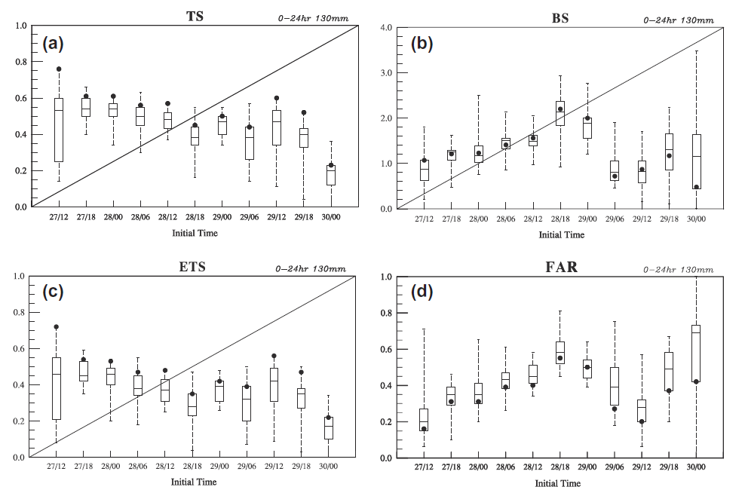
Rainfall forecast skill parameters
Extremely heavy rain (豪雨) : 24-hour accumulated rainfall exceeds 130 millimeters
Notes:
Fig. 5.
Box-and-whisker plot of (a) threat score (TS), (b) bias score (BS), (c) equitable threat score (ETS), and (d) false alarm rate (FAR) for 24-h accumulated rainfall forecast of the 18 individual members at the 130-mm threshold for Typhoon Nanmadol from 1200 UTC 27 to 0000 UTC 30 August during which the CWB issued typhoon warnings.
Values of the ensemble mean of rainfall forecast are indicated with dots.
The box-and-whisker plot is interpreted as follows: the middle line shows the median value; the top and bottom of the box show the upper and lower quartiles (i.e., 75th and 25th percentile values); and the whiskers show the minimum and maximum values.
可以看到系集平均比單一member的預報分數來的高
BS分數隨著颱風登陸台灣(1800UTC AUG28) 而上升並在離開後下降(0000UTC AUG29)
系及預報的降水大部分是高估的，主要是因為颱風接近時迎風面地形和颱風環流的交互作用的不確定性
颱風的離開帶動了FAR的下降 以及ETS的上升但隨後FAR就更多
因為台灣離開陸地後開始減弱且結構被破壞，使得模擬的不確定性增加，以及海上觀測少

Slide 16
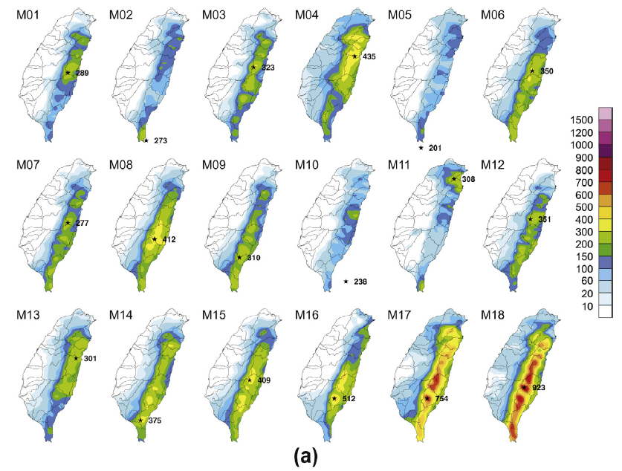
0-24 h fcst rainfall by each member
Obs
Ensemble mean
probability distribution
Notes:
F8a
The 18 individual ensemble members for the 0–24 h accumulated
rainfall forecasts are provided in Fig. 8a.
In these ensemble forecasts, the maximum 24-h rainfall occurs over eastern Taiwan, except for the M02 and M05 members.
except for the M02 and M05 members. The forecast tracks for these two members were two outliers
2. The two MM5 ensemble members (M17 and M18) predicted that more rainfall would occur in eastern Taiwan than the two members (M14 and M15) that were based on the WRF model with similar 0–24 h forecast tracks.
=>This early rainfall forecast from the two MM5 members
resulted from a more rapid translation speed. Thus, the interaction
between the typhoon circulation and the Central Mountain
Range occurred earlier

Slide 17
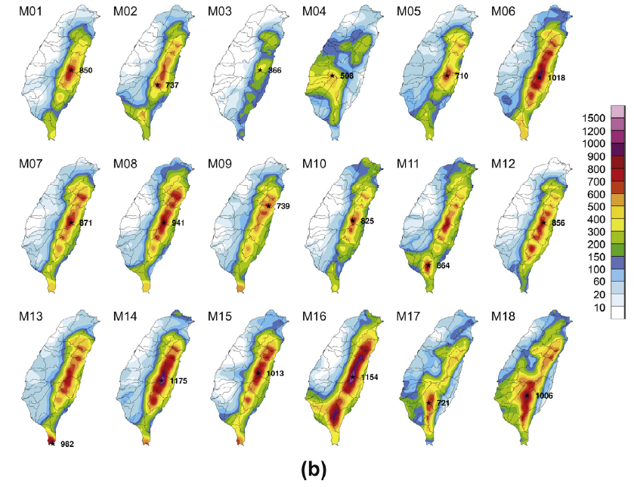
24-48 h fcst rainfall by each member
Obs
Ensemble mean
probability distribution
Notes:
F8b
因為系集TC的移動緩慢，造成中央山脈東側累積降雨高估 南部的降雨低估
且主要降雨區及中在東部 而非屏東的488mm

Slide 18
Forecasted tracks by ensemble members and the observed track
Compared two cases :
  Initiated at 1200 UTC 27 August
  Initiated at 1200 UTC 28 August
∵rainfall variability are sensitive to typhoon track
Notes:
F6
To examine the improvements in the ensemble rainfall forecasts
and runoff simulations, two cases for the forecasts that were
initiated at 1200 UTC 27 August and at 1200 UTC 28 August (Fig. 6)
were selected. These forecasts contained large and small rainfall
variabilities that likely result from large and small typhoon track
forecasts variabilities, respectively.

Slide 19
  Initiated at 1200 UTC 27 August
  Initiated at 1200 UTC 28 August
(a)Obs. 24-h rainfall
(b)Fcst. 24-h rainfall by ensemble mean
(c)Probability of 24-h rainfall >130mm
(a,b,c) 0-24h
(d,e,f) 24-48h
Notes:
F7
Fig. 7. The 0–24-h accumulated rainfall from the forecast initiated at 1200 UTC 27 August:
(a) observed rainfall, (b) ensemble mean from 18 members, and (c) the rainfall
probability distribution (%) exceeding the threshold of 130 mm for 18 ensemble members.
The observed rainfall at the 130-mm threshold is shown by the black solid lines.
(d,e, and f) as in panels (a, b, and c), except for the 24–48-h accumulated rainfall.
0-24 h 觀測到的豪大雨在東台灣地區
而24-48h 則在東及南台灣
從左圖c中，看到可能性50%以上的0-24h豪大雨降水都及中在東部地區
而對於24-48h預測 則70%以上豪大雨降水都在東部，只有30%在南部
這表示台灣的降雨預測受地形效應影響很深
而比較游28日開始模擬的系集結果，因為路徑預報較為準確的關係，對於各時段的降雨pattern上掌握的準確，
看到圖c的豪大雨區基本上都跟觀測相符
但是雨量則高估許多

Slide 20
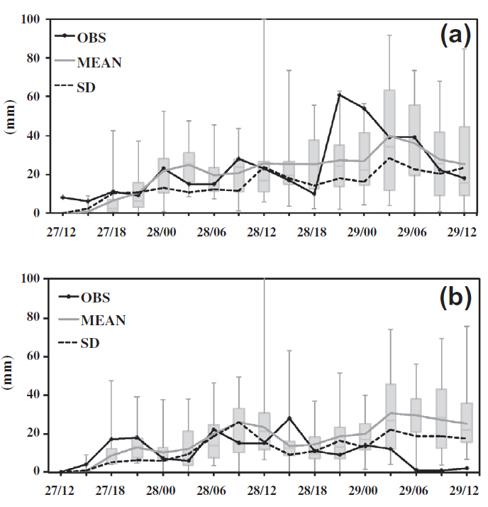
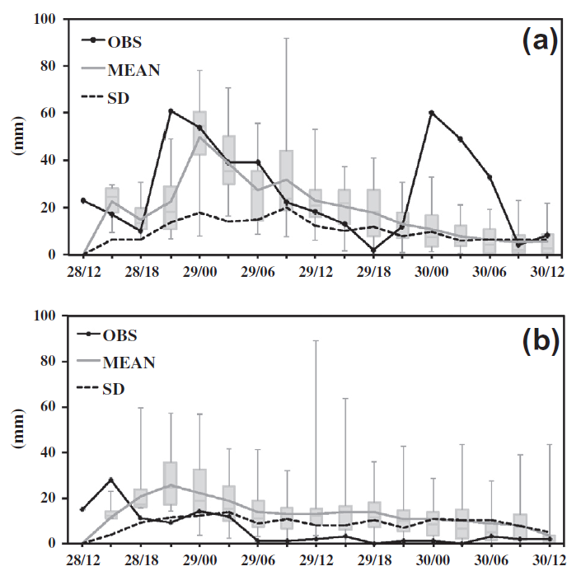
Time series of 3-h rainfall for
(a) three basins over southern Taiwan and (b) Lanyang basin
  Initiated at 1200 UTC 27 August
  Initiated at 1200 UTC 28 August
Notes:
F9
aug27
Time series of areal-average 3-h rainfall (in units of mm) for (a) three basins
over southern Taiwan and (b) Lanyang basin from the ensemble members with
minimum, lower quartile, median, upper quartile, and maximum depicted by boxand-
whiskers plot from the forecast initiated at 1200 UTC 27 August, and the
ensemble mean (MEAN; gray solid line), the rainfall observations (OBS; black solid
line), and standard deviation (SD; black dash line).
看到27日開始模擬的降雨 在南部地區三個集水區的雨量上，28 1800和29 0300過小外
其他的趨勢都有抓到，
而對蘭陽溪集水區的降雨則略有所高估
而28日開始模擬的降雨，在28日2100和30日0000的高值沒有抓得很精準
雖然前一個峰直有抓到，但第二個卻完全沒有
以系集平均來說再第二個peak也過於低估
而在蘭陽溪流域的模擬，在第一個峰值的部分延遲了六了小時，但若降雨的峰值還是有抓到

Slide 21
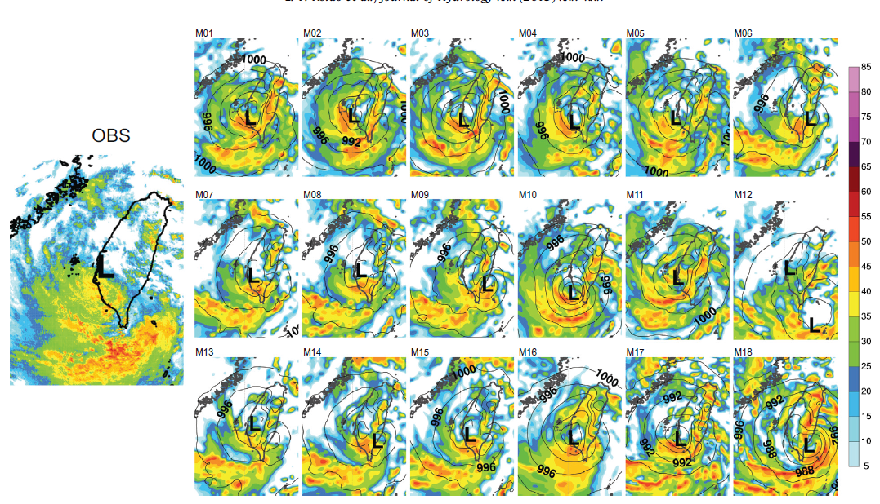
Horizontal distribution of radar reflectivity at 00 UTC 29 August
  Initiated at 1200 UTC 28 August
(12h )
Notes:
F11
Aug28
Fig. 11. Spatial distribution of radar reflectivity (dBZ) from observations (OBS) at 0000 UTC 29 August (left panel) for the 18 ensemble members (right panels) at 12 h in the
forecast initiated at 1200 UTC 28 August.
從雷達迴波圖可以發現，大部分member的回波形狀都相似，但相較於觀測回波則略偏東北
但因為中央山脈地形的關係而在贏風處產生了系統性的高估
MM5的迴波更是明顯

Slide 22
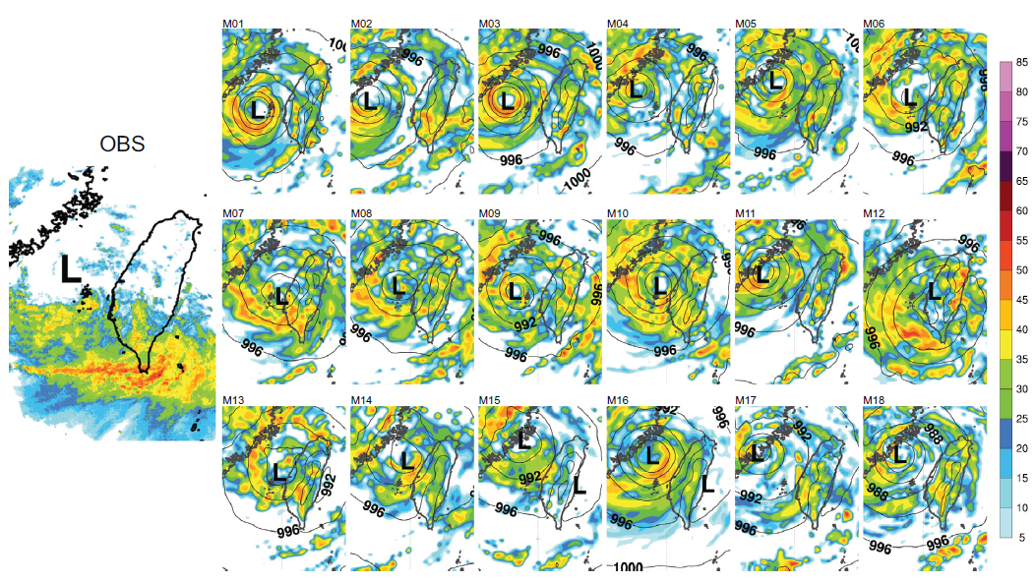
Horizontal distribution of radar reflectivity at 00 UTC 30 August
  Initiated at 1200 UTC 28 August
(36h )
Notes:
F12
aug28
Fig. 12. As in Fig. 11, except for the observations (OBS) at 0000 UTC 30 August (left panel) and for the 18 ensemble members at 36 h in the forecast initiated at 1200 UTC 28
August.
從30號的迴波可以清楚地看到，在中央山脈南側地區有一條狹長的雨帶，
但是在模擬中都沒辦法抓到這一條回波，
因為grid size最小網格為5公里無法解析的關係

Slide 23
Data and methods-Hydrological model
WASH123D (Yeh et al.1998)
Finite-element approach
Terrain spatial resolution 400m*400m
Finer grids : 40m*40m
Interpolated 5-km rainfall from atmospheric model using nearest neighbor interpolation.
River and overland: Diffusive wave equations
Infiltration : Green–Ampt model
Notes:
Coastal inundations : semi-Lagrangian and Galerkin finite-element methods
An integrated watershed simulation that includes groundwater
calculations for flood forecasting has not been considered as a
practical alternative in Taiwan due to its steep terrain and the
resulting short hydraulic response times. Therefore, groundwater
routing was ignored in this WASH123D hydrological model.

Slide 24
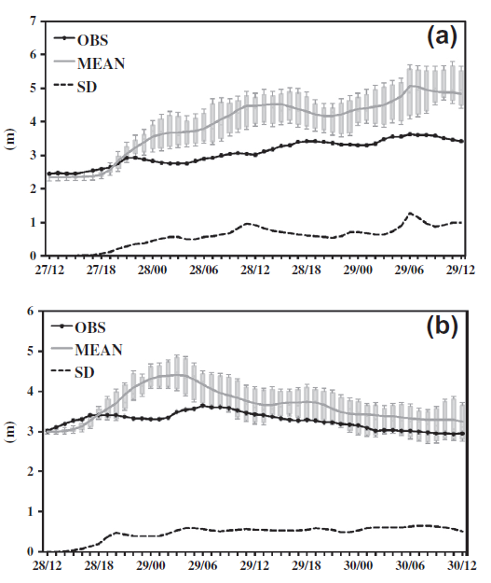
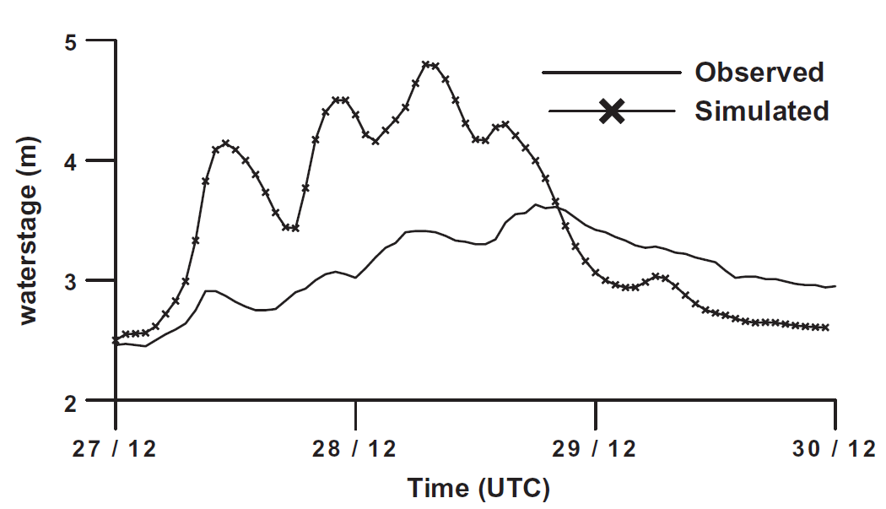
Hydrological verification
  Initiated at 1200 UTC 27 August
During Typhoon Nanmadol, most of the rainwater was presumed to have infiltrated into the groundwater.
Thus, excess overland flow was assumed to move slowly due to the dry soil conditions.
  Rain gauge observations
  Initiated at 1200 UTC 28 August
Notes:
F14
Comparison of water stages (m) between the measurements and the
WASH123D simulation driven by rain gauge observations starting from 1200 UTC
27 August.
看到觀測水位實際上是緩慢上升，而預報水位則是快速上升後，就變得低估
F16
Hourly time series of the areal-averaged water stage (in units of m) for the
Lanyang basin estimated from the ensemble members with minimum, lower
quartile, median, upper quartile, and maximum depicted by box-and-whiskers
plots for the ensemble forecasts initiated at (a) 1200 UTC 27 August and (b) 1200
UTC 28 August, and hourly water stage from ensemble mean (MEAN; gray solid
line), the observation (OBS; black closed circles), and standard deviation (SD; black
dash line).
Just as the WASH123D model over-predicted the water stage when driven by the rain gauge data, river runoff was
over-forecasted when driven by the ensemble rainfall forecast.
When the river water stage was high, more precipitation directly
affects rainfall because the soil is moist. In general, this integrated
hydrometeorology modeling system is useful for predicting
(albeit a likely over-forecast) the occurrence of extreme
floods during typhoon events in the mountainous watersheds
on the windward side of Taiwan. This result can be used in other
mountainous watersheds by using hydrological models that are
familiar based on local soil conditions.

Slide 25
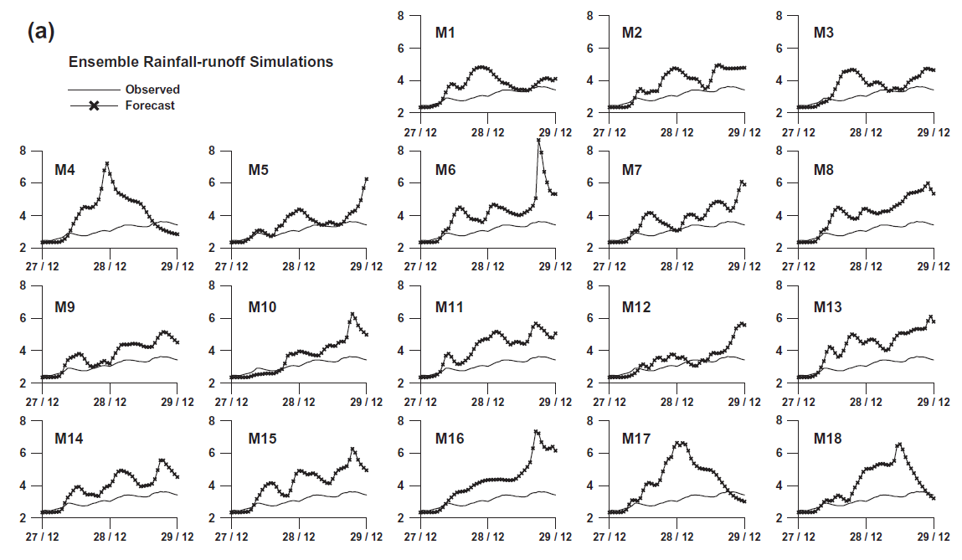
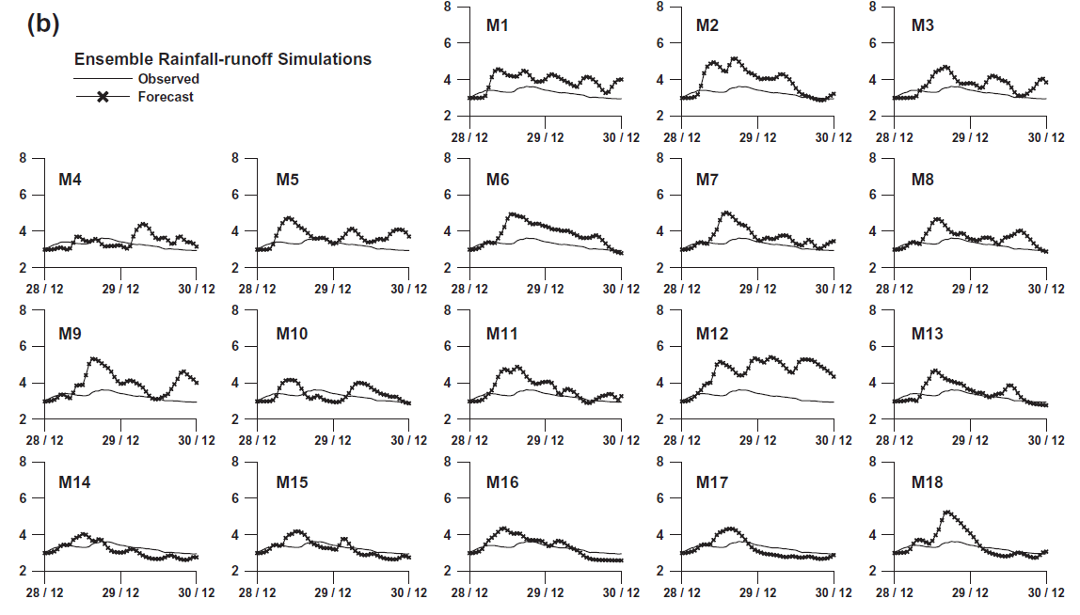
The 48-h simulations by 18 ensemble members
  Initiated at 1200 UTC 28 August
  Initiated at 1200 UTC 27 August
Notes:
F15a water stage was over-predicted by the ensemble members.
F15b water stages were lower and were closer to the observed water stages.

Slide 26
Conclusions
In 2011, the ensemble provide a better track prediction than those of operational centers.
90% probability that accumulated rainfall exceeded 130mm for 0-24 h forecast at 1200 UTC 28 August is in good agreement with the distribution of observed 130-mm rainfall.
Ensemble forecasting system adequately estimated the topographic locations where rainfall may occur.

Slide 27
In this case, the river runoff patterns were reasonably predicted despite the mismatch between the runoff maximum and the actual time and quantity of flooding.
The omission of a ground water routing component in the watershed model contributed to the over-prediction of river runoff.
Despite the systematic over-prediction of rainfall and water stage in the watershed on the windward side of Taiwan, the coupled hydrometeorological modeling system can potentially improve the accuracy and timing of flood predictions.

Slide 28
References
Hsiao, L.-F., M.-J. Yang, et all, 2013: Ensemble forecasting of typhoon rainfall and floods over a mountainous watershed in Taiwan. J. Hydrology, doi: http://10.1016/j.jhydrol.2013.08.046, in press.
Environmental Protection Administration Executive Yuan, R.O.C
Nasrollahi, Nasrin, Amir AghaKouchak, Jialun Li, Xiaogang Gao, Kuolin Hsu, Soroosh Sorooshian, 2012: Assessing the Impacts of Different WRF Precipitation Physics in Hurricane Simulations. Wea. Forecasting, 27, 1003–1016.
Wandishin, Matthew S., Steven L. Mullen, David J. Stensrud, Harold E. Brooks, 2001: Evaluation of a Short-Range Multimodel Ensemble System.Mon. Wea. Rev., 129, 729–747.
Clark, Adam J., and Coauthors, 2011: Probabilistic Precipitation Forecast Skill as a Function of Ensemble Size and Spatial Scale in a Convection-Allowing Ensemble. Mon. Wea. Rev., 139, 1410–1418.
Hamill, Thomas M., 1999: Hypothesis Tests for Evaluating Numerical Precipitation Forecasts. Wea. Forecasting, 14, 155–167.
《李天浩，2009：應用克利金法建立高解析度網格》

Slide 29
Thanks for your attention

Slide 30
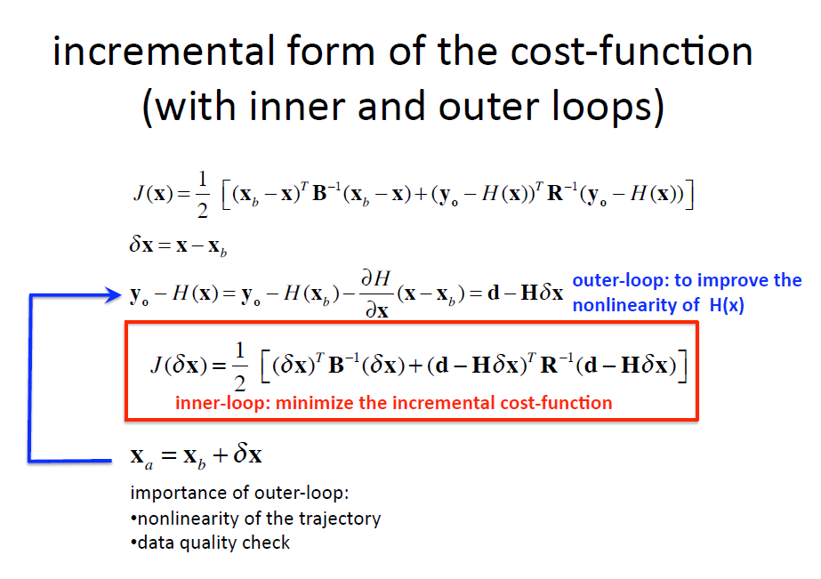
Outer loop

Slide 31
Cold start
The spin-up problem : “warm start” or “cold start.”
In a warm start, the model uses a data assimilation system to incorporate data, such as surface observations and soundings, over a long time to help create the analysis.
cold start typically uses the analysis from some other source, such as a global model run with a coarser grid, to start the mesoscale model running.
Notes:
Warm start會每次資料輸入都使用觀測資料同化，使分析場資料不會完全匹配模式，經長時間後已穩定分析
Cold start 則是直接使用全球分析場的資料
前者的好處是不用處理太多spin-up的問題
模式會自行建立天氣系統
後者則是直接生成，可能會產生不穩定震盪
但是後者的好處是直接使用真實資料，你的分析場不是模式做出的預報場
且比較省預報資源
http://www.meted.ucar.edu/mesoprim/models/print.htm

Slide 32
Physics schemes
積雲參數化主要使用前兩個domain
  Grell-Devenyi (GD) 對於深對流和環境的閉合，為對每個grib都用不同的閉合
  Grell 3D ensemble (G3) 同Grell 只是對3維每個grib都給予不同的閉合
  Betts-Miller-Janjic (BMJ) 藉由柱狀的溼調整來調整成完全混和的profile
  Kain-Fritsch (KF) 對於次網格的深淺對流系統 使用質量通量的向下傳遞和CAPE 來移除時間尺度的影響
  Grell scheme (Grell ) 為MM5中較舊版本的Grell scheme
微物理參數化為了清楚解系對流，在5km也使用
  Goddard 主要是對冰 雪 grapel有高解析度模擬
  WESM5則是對混相位過程和過冷水有較多著墨

Slide 33

Momentum Equation
Water
Surface
Slope
Friction
slope
Bed
Slope
Convective Acceleration
Temporal Acceleration
Kinematic Wave
Diffusion Wave
Full Dynamic Wave

Slide 34
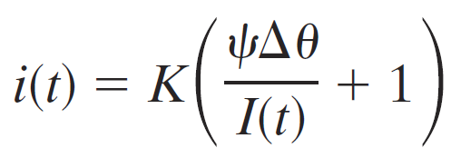

Green-Ampt equation
To compute the cumulative infiltration (I),
we should know K, ψand θ
K: saturated hydraulic conductivity
ψ: soil suction at wetting front
(as 1/K ,Chow et al.1998)
θ: initial fractional water content
, and

Slide 35
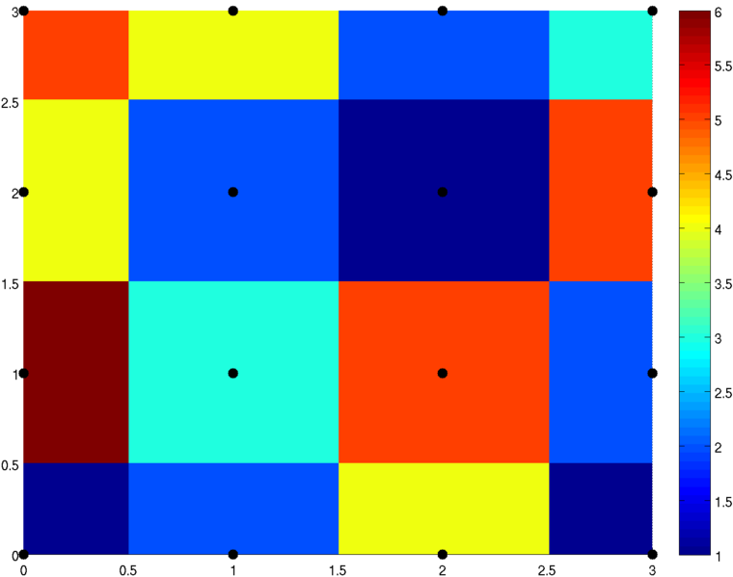
nearest neighbor interpolation
http://en.wikipedia.org/wiki/Nearest-neighbor_interpolation

Slide 36
Kriging technique
Kriging is a method to build an approximation of a function from a set of evaluations of the function at a finite set of points.
The method originates from the domain of geostatistics and is now widely used in the domain of spatial analysis and computer experiments.
The technique is also known as Gaussian process regression, Kolmogorov Wiener prediction, or Best Linear Unbiased Prediction.
ref:
《李天浩，2009：應用克利金法建立高解析度網格》

Slide 37

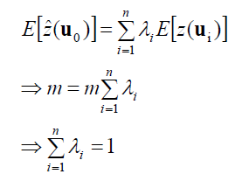

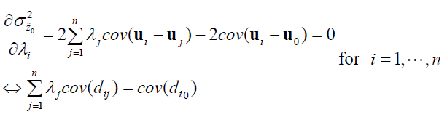
Ordinary kriging
假設空間隨機變數距常定性，平均數為常數且未知，內差估計值可假定為
Unbias 條件
由變異數 得最小化偏估誤差的條件

Slide 38
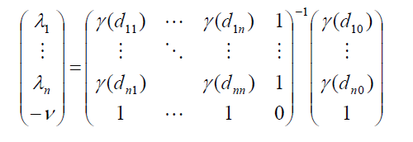

由以上兩式，可求解權重係數矩陣
以及誤差變異數為

Slide 39
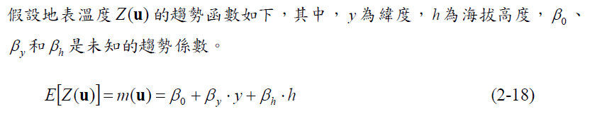
通用 Kriging technique
以下截取自文章 :
《李天浩，2009：應用克利金法建立高解析度網格》
假設空間中的隨機變數具有常定性，平均數為常數但未知。
台灣山區地表溫度隨海拔高度變化的趨勢為主控因子，必須去除半變異圖中的趨勢函數，才能突顯真實的地表溫度協變異圖。
若要避免迭代求取協變異圖過程中，趨勢函數係數值可能偏估的問題，且直接使用測站溫度觀測值權重估計，乃使用Kitanidis (1993)要求權重係數使各個趨勢函數係數乘的座標值權重組合都等於0 的不偏估條件設計。

Slide 40
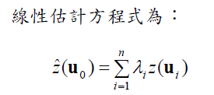
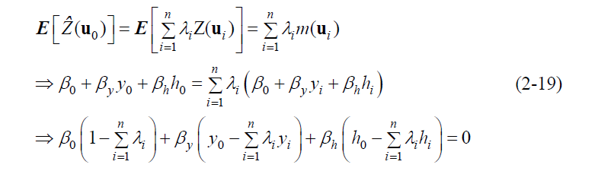
Unbias 條件

Slide 41
