Slide 1
On the geographic asymmetry of typhoon translation speed across the mountainous island of Taiwan
Data: 2013/10/16
Student: Yi-Lin,Lin
Advisor: Ming-Jen,Yang
Hsu, L.-H., H.-C. Kuo, and R. G. Fovell, 2013: On the geographic asymmetry
of typhoon translation speed across the mountainous island of Taiwan.
J.Atmos. Sci., 70, 1006–1022.
Notes:
徐理寰 學長

Slide 2
Outline
Keywords
Introduction
Observations
Model settings and potential vorticity tendency diagnosis
Numerical results
Discussion and summary
Reference

Slide 3
Keywords
Beta-Effect
PV Tendency Diagnosis Equation

Slide 4
Beta-Effect
Global β –Effect(N.H.)
$f$ increases
$$ζ decreases$$
$f$ decreases
$$ζ increases$$
$$β= \frac{df}{d∅}$$
$$\frac{d(ζ+f)}{dt} =0$$
Notes:
NO friction, Barotropic(NO divergence ) → absolute vorticity conserved.

Slide 5
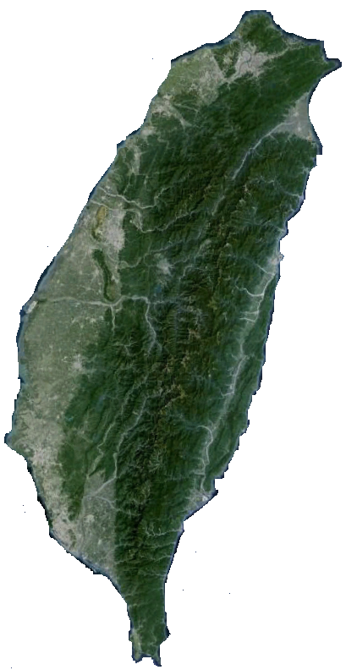
Topographic β –Effect(N.H.)
H
L
Taiwan topography originate from Google earth.
Notes:
Kuo et al. (2001)以地形β效應
來詮釋渦旋在地形上的運動，渦旋氣流過山時感受到地形位渦水平梯度，渦管因
為拉伸作用(vertical stretching)受到正位渦平流引導而產生在渦旋最大風速外圍
的不對稱渦度，進而影響渦旋運動方向，實驗中渦旋會以反氣旋式路徑繞地形行
走，移速為渦旋最大風速及地形β效應乘積的平方根，此結果與 Smith (1993)、
Smith et al. (1997)提出颱風移速的冪次率一致。
陳(2004) 也以地形β效應來解釋颱風在接近台灣地形時路徑偏折的情形。

Slide 6
PV Tendency Diagnosis Equation
Inviscid PV tendency equation [WW00(5)(B-13);WW01 (1) ]
PV tendency
Horizontal
Advection (HA)
Vertical
Advection (VA)
Diabatic Heating (DH)
DH can be expanded as

Slide 7
Introduction
The annual precipitation of Taiwan is approximately 2500 mm, with most of the heavy rainfall resulting from landfalling typhoons, when and where the air is forced to rise over the range(Chang 1982).
The typhoon rainfall pattern is phase locked with the CMR, with its southwestern slope receiving especially large amounts (Chang et al. 1993).
Notes:
Tracks with cyclonic deflections sometimes appear before landfall, accompanied with along-track (Bender et al. 1987). Yeh and Elsberry (1993a) showed
that the Taiwan terrain may enhance the southward flow
on the western side of the typhoon circulation via the
channel effect and thus further influence the typhoon
track, a result also reported by Jian and Wu (2008).
Kuo et al. (2001)以地形β效應
來詮釋渦旋在地形上的運動，渦旋氣流過山時感受到地形位渦水平梯度，渦管因
為拉伸作用(vertical stretching)受到正位渦平流引導而產生在渦旋最大風速外圍
的不對稱渦度，進而影響渦旋運動方向，實驗中渦旋會以反氣旋式路徑繞地形行
走，移速為渦旋最大風速及地形β效應乘積的平方根，此結果與 Smith (1993)、
Smith et al. (1997)提出颱風移速的冪次率一致.

Slide 8
Numerous studies have examined the impact of the CMR on landfalling tropical cyclones (TCs).
-The Taiwan terrain may enhance the southward flow on the western side of the typhoon circulation via the channel effect and thus further influence the typhoon track . (Yeh and Elsberry (1993a) ,Bender et al. 1987, Jian and Wu (2008))
- The topographic β effect on tropical cyclone motion has also been shown to be important in other areas with a large-scale topography. (Zehnder 1993).
- In summary, the southward deflection track or looping before landfall for NLT, in general, may lead to a larger rainfall event in Taiwan before the typhoon landfall(Su et al. 2012).
Notes:
副低壓

Slide 9
Herein, we pursue a different and/or complementary approach and hypothesize that convective activity forced by the CMR has a material impact on the track of a typhoon as it approaches and passes the island, which we will demonstrate using a potential vorticity (PV) tendency analysis following Wu and Wang (2000, hereafterWW00).
Notes:
Typhoons represent local maxima of PV and tend to move toward the maximum of the azimuthal wavenumber-1 part of PV tendency (WW00). The net tendency reflects
contributions from horizontal and vertical PV advection as well as friction and gradients of diabatic heating.

Slide 10
Observations
CWB - Hourly typhoon center positions. (Wang 1980; Shieh et al. 1998)
Radar and satellite information - help refine the landfall/departure positions and times of typhoons. (1977~2010)
61 continuous-track cases
84 TC
(1960-2010)
23 discontinuous-track cases (DIS)
linear distance
Overland translation speed =
duration time
Notes:
福祿數（Froude number,Fr）為流體力學中無量綱的純量，為慣性力和重力效應之比，公式如下： U/(gh)^(1/2)
式中U為流體速度，L為物體特徵長度，g為重力加速度。
明渠流和波浪力學中都常用到福祿數。在明渠流中，長度L為水深 h。在波浪力學中，福祿數代表平均流速與重力波（Gravity wave）的波速之比。
當Fr > 1，表示慣性力對流動之影響較重力為大，稱為超臨界流（Supercritical flow），為水深小，流速急湍的流況。
當Fr < 1為亞臨界流（Subcritical flow），為流速緩慢，水深大的流況。
當Fr = 1為臨界流（Critical flow）。
(wiki)

Slide 11
Observations
CWB - Hourly typhoon center positions. (Wang 1980; Shieh et al. 1998)
61 continuous-track cases :
61 continuous-track cases
84 TC
(1960-2010)
23 discontinuous-track cases (DIS)
Landfall position(23.5∘N) | NLT |  | SLT
Overland translation speed | SLOW (<3.3m/s) | MEDIUM |  | FAST (>9.1 m/s)
Mean : 6.2m/s ; σ = 2.9 m/s
Overland
translation speed
SLOW
MEDIUM
FAST

Slide 12
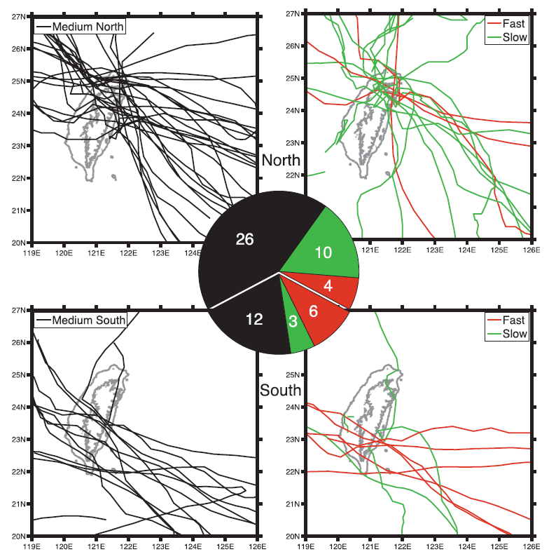
1960~2010 61 continuous-track cases
 | NLT | SLT
SLOW 77% (10 of 13) | 25% (10 of 40) | 14% (3 of 21)
FAST 60% (6 of 10) | 10% (4 of 40) | 28% (6 of 21)

Slide 13
5 times

Slide 14
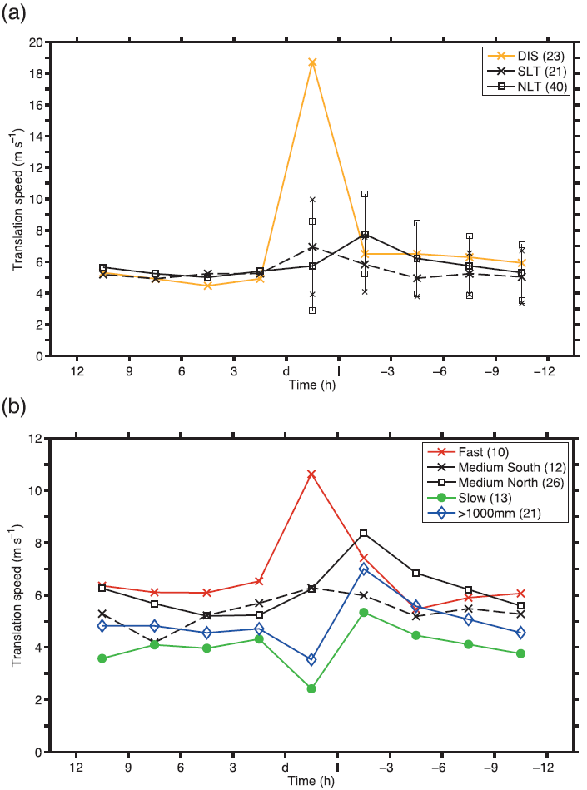
3-hourly mean translation speed (l: landfall; d: departure)
Stratified by landfall latitude
Before landfall,
Continuously tracking typhoons accelerate
as they approach Taiwan’s eastern coast.
(Yeh and Elsberry 1993a)
While overland,
the average NLT speed decreases;
the average SLT continue to speed up;
Stratified by translation speed
Before landfall,
Velocity increase.
While overland,
the average SLOW and Medium north
speed decreases.
Fast speed increase.
>1000mm decrease comparable to SLOW.

Slide 15
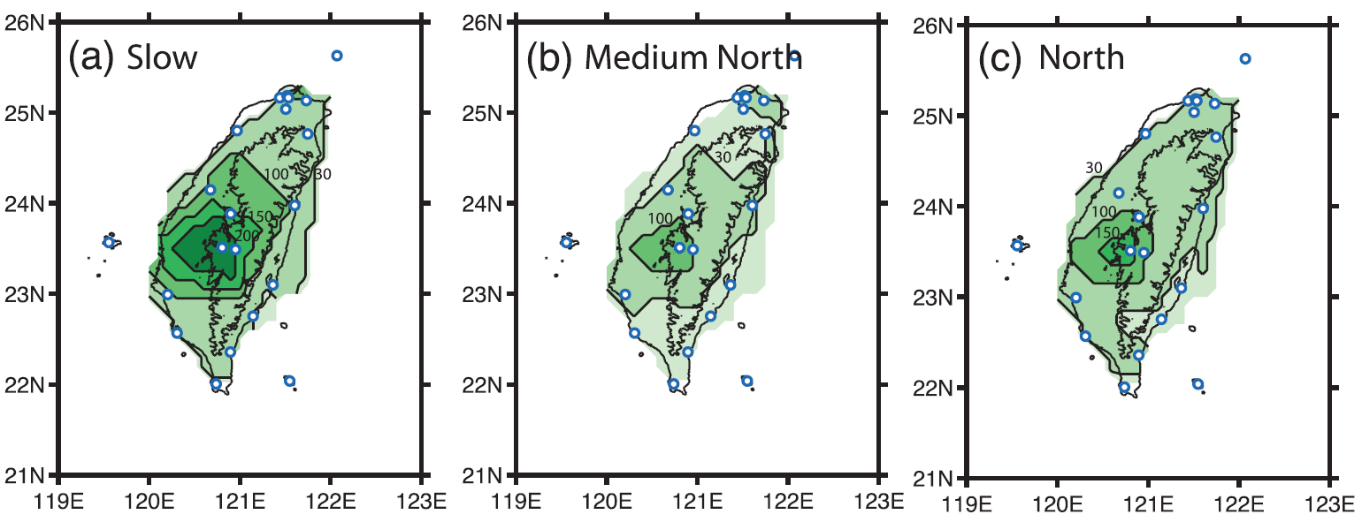
Composite rainfall(mm) data by 21 CWB station, also 1 and 1000 m height contour are shown.
Alishan
(325 mm)
Alishan
(162 mm)
Sum = 2128 mm
Sum = 809 mm

Slide 16
Less than 50 mm
The pattern is phase locked with the topography,
reflecting the interaction of the typhoon circulation and
the CMR. (Chang et al. 1993)
Diabatic heating
associated with
(terrain-induced)
convection
PV tendency
Typhoon’s motion
NLT slow-moving cases – large rainfalls;
SLT pre-landfall acceleration.
Notes:
Through Semi-idealized simulations.

Slide 17
Model settings and potential vorticity tendency diagnosis
A “semi-idealized” variant of the “real data” WRF model(V 3.1.1)
For consistency with previous
“semi-idealized” studies….
Basic state
Jordan’s(1958) Caribean hurricane-season composite T and humidity sounding.
SST = 29∘C
Initialized with uniform easterly flow
Beta effect
Parameterization
PBL - YSU
Sub-grid mixing - Smagorinsky option
Microphysics - Lin et al.(1983)
Radiation – Rapid Radiative Transfer Model(RRTM; Mlawer et al. 1997) and
Dudhia(1989) radiation package.
Typhoon initialization
WRF tropical cyclone bogus scheme.
With Rankine wind profile.
Terrain
Only Taiwan topography.
(by 30-s resolution USGS database.)
Give the same roughness length and moisture availability as the ocean.
One square domain
1500 km
Model top = 10 hPa. (35 levels)
Horizontal resolution = 5 km
Vt
R
1500 km
Notes:
Previous studies have suggested that the land–sea
contrast by itself will induce asymmetric convection
and affect the typhoon track as it approaches landfall
(Tuleya and Kurihara 1978; Tuleya et al. 1984; Wong
and Chan 2006, 2007).
The roughness length is used in numerical models to express the roughness of the surface. It affects the intensity of mechanical turbulence and the fluxes of varies quantitities above the surface. The 'roughness length' z_{o}, depends on the frontal area of the average element (facing the wind) divided by the ground width it occupies. Vertical sub-gridscale heat exchange (by turbulent eddies) can be expressed as the vertical gradient of potential temperature times the roughness length. A lower roughness length implies less exchange between the surface and the atmosphere, but also stronger wind near the ground (e.g. at the standard height of 10 m).
http://www-das.uwyo.edu/~geerts/cwx/notes/chap14/roughness.html

Slide 18
Inviscid PV tendency equation [WW00(5)(B-13);WW01 (1) ]
DH can be expanded as

Slide 19
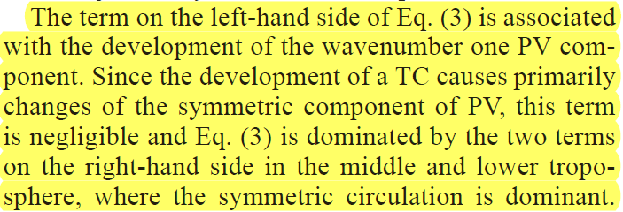
[WW00 eq.(3)]
Notes:
Now we
consider a vortex as a symmetric PV anomaly. The vortex
motion is only related to the wavenumber one component
of the PV tendency. Therefore, we will focus on
the wavenumber one component of the PV tendency
[(]P/]t)1]. In the cylindrical coordinates moving with a
TC center, the movement vector C consists only of
wavenumber one component (Wang et al. 1997).
(the eq.)
The term on the left-hand side of Eq. (3) is associated
with the development of the wavenumber one PV component.
Since the development of a TC causes primarily
changes of the symmetric component of PV, this term
is negligible and Eq. (3) is dominated by the two terms
on the right-hand side in the middle and lower troposphere,
where the symmetric circulation is dominant.

Slide 20
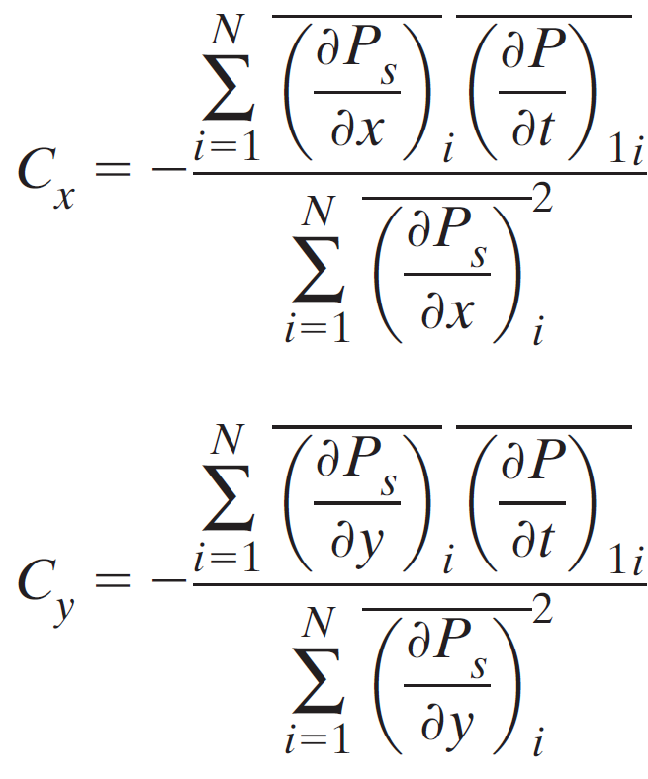
[WW00 eq.(6)]
PV tendency
Apply least square method,
,
Notes:
Why symmetric only concerns Cx Cy?
How to make sure DH influence motion the most?

Slide 21
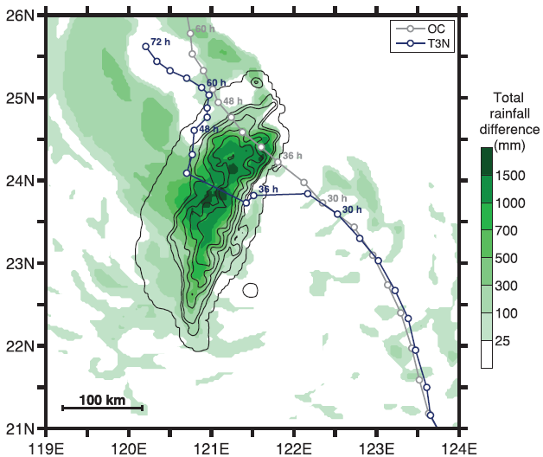
Numerical results
a. Overview of the OC and T3N experiments
3-hourly tracks
T 3 N
T 3 N
72h
1.2 m/s
5437mm
-3 m/s
NLT
2.4 m/s
4.2 m/s
3.0 m/s
5.2 m/s
4.0 m/s
O C
3887mm
50km, 50m/s

Slide 22
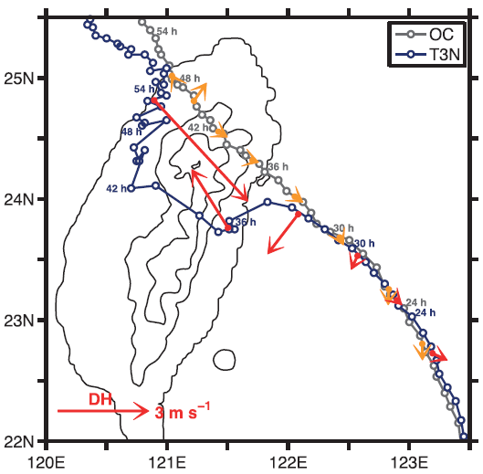
b. Motion of the OC and T3N typhoons

Slide 23
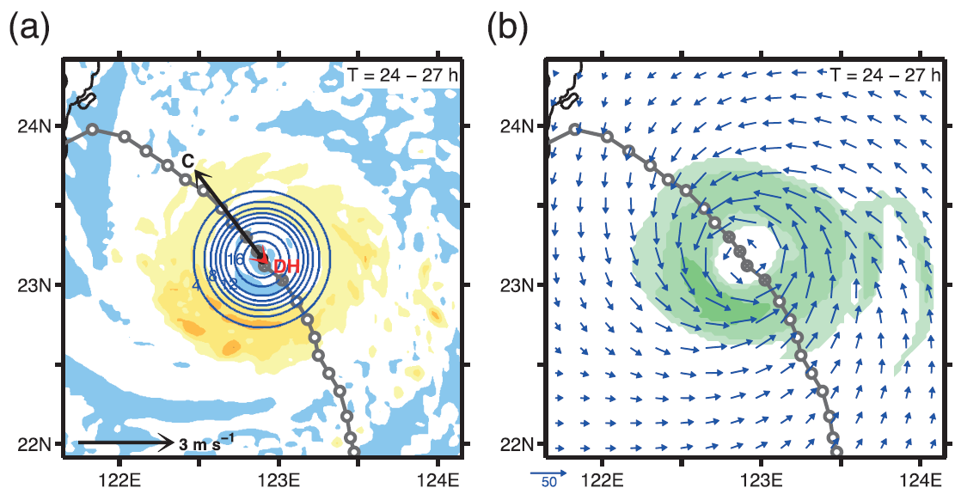
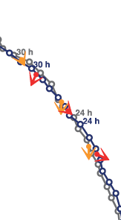
24-27 hr
Vertically averaged Q
Symmetric PV structure
(PVU = 10^(-6) m^2*K/(kg*s))
Motion vector(C) , DH
Rainfall(mm)
1st level wind vector
Notes:
[Symmetric over ocean]
How to calculate Symmetric PV structure (PVU = 10^(-6) m^2*K/(kg*s)) ??

Slide 24
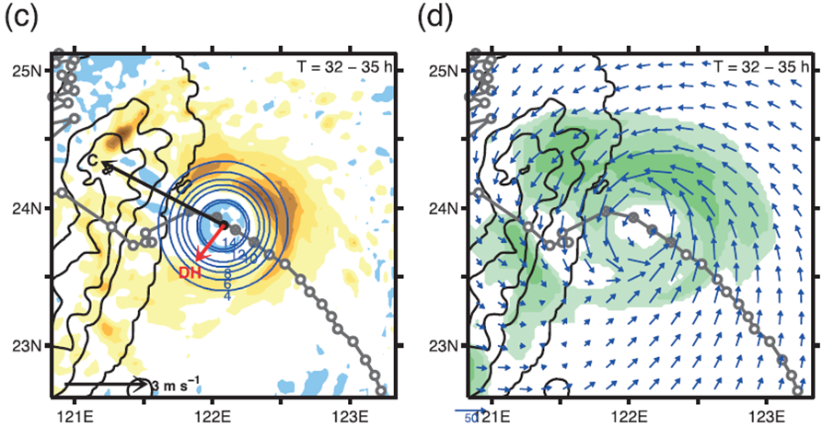
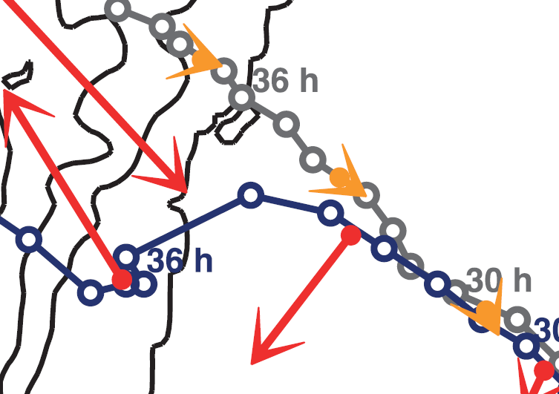
32-35 hr
Accelerate landfall
Vertically averaged Q
Symmetric PV structure
(PVU = 10^(-6) m^2*K/(kg*s))
Motion vector(C) , DH
Rainfall(mm)
1st level wind vector
Notes:
[Before landfall to not passed CMR(35hr)]
How to calculate Symmetric PV structure (PVU = 10^(-6) m^2*K/(kg*s)) ??
the DH term depends not on Q, but rather on its gradients, and specifically on the WN1 component.

Slide 25
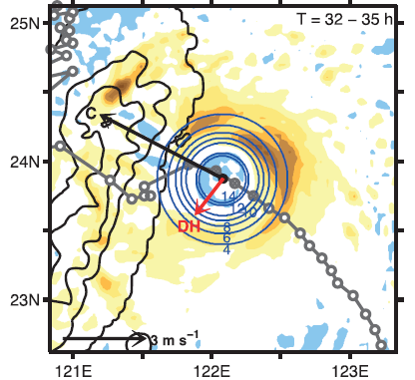
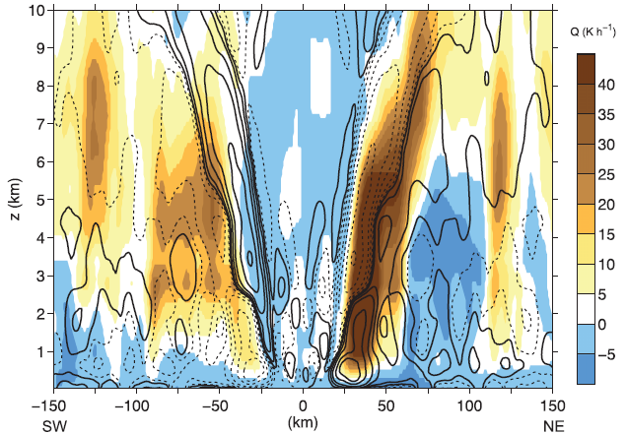
32-35 hr
$$\frac{∂Q}{∂z}\sim 0$$
$$\frac{∂Q}{∂z}<0$$

Slide 26
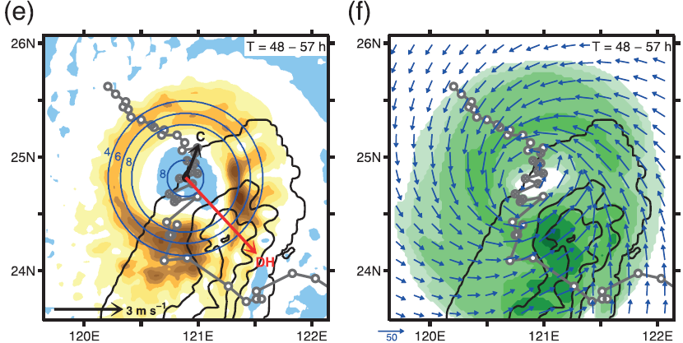
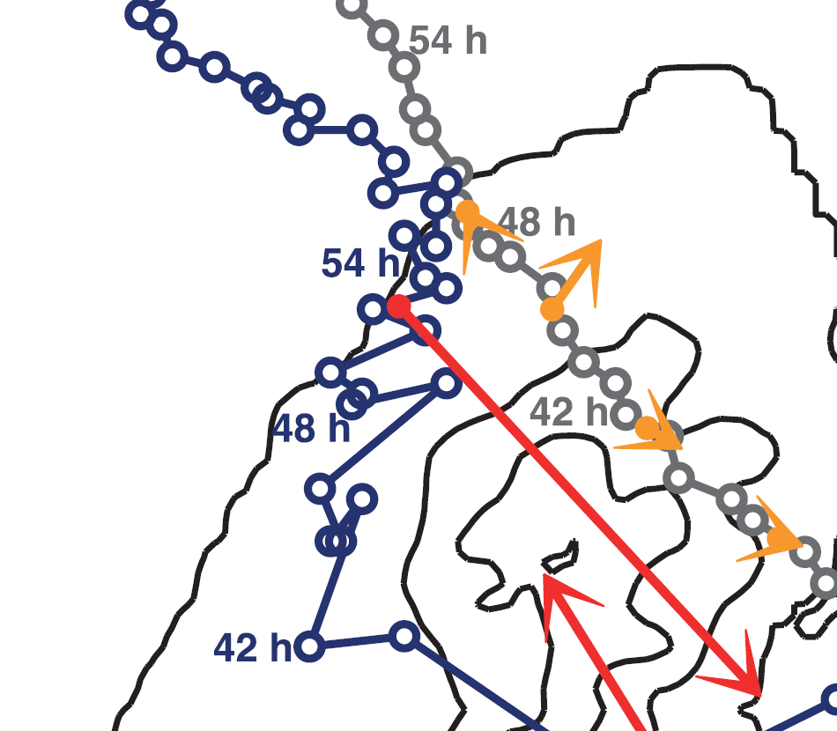
48-57 hr
Larger rainfall
Enlarged T.C.
β -EFFECT
STEERING
FLOW
DH
Vertically averaged Q
Symmetric PV structure
(PVU = 10^(-6) m^2*K/(kg*s))
Motion vector(C) , DH
Rainfall(mm)
1st level wind vector
Notes:
[Symmetric over ocean]
How to calculate Symmetric PV structure (PVU = 10^(-6) m^2*K/(kg*s)) ?? How does beta-effect works ??

Slide 27
c. Sensitivity tests
T 5 N
-Steering flow intensity
strongly steered
typhoons
T 10 N
asymmetric diabatic
heating
Notes:
Our interpretation is that asymmetric diabatic heating is less capable of slowing down typhoons that are strongly steered.

Slide 28
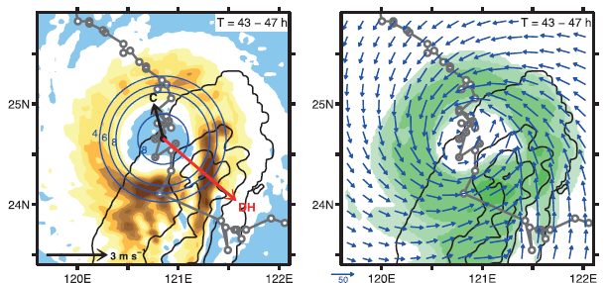
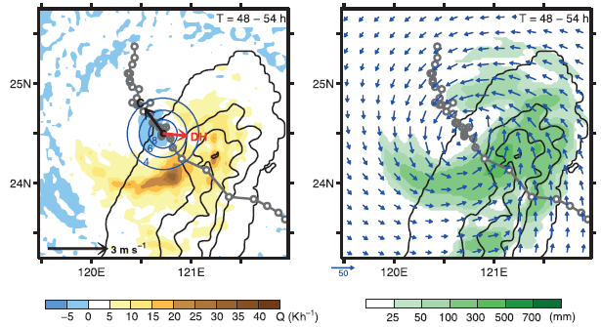
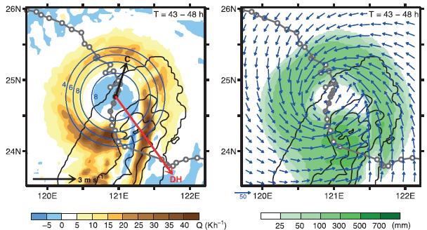
c. Sensitivity tests
-Initial vortex strength or size
T 3 N V25
C
T 3 V 65
DH
-3 m/s
Vmax =65m/s
T 3 N
C
T 3 R 75
-3 m/s
RMW = 75 km
DH
Notes:
Q rainfall patterns same as NLT.
Duration time and rainfall shorter and smaller than NLT.

Slide 29
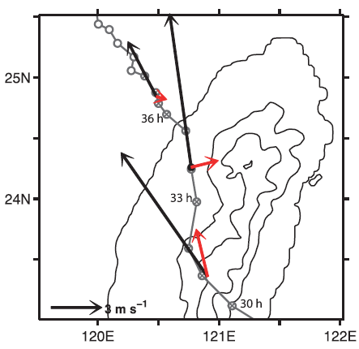
c. Sensitivity tests
-Approaching angle and latitude
T 5 S
Notes:
It can be anticipated that, depending on its angle of approach and latitude of landfall, PV generation by asymmetric diabatic heating may also help hasten the passage of a typhoon across the island. → T5S

Slide 30
Discussion and summary
Data from 61 continuous-track typhoons that made landfall on the eastern coast of Taiwan between 1960 and 2010 are analyzed.
As in the observations, the NLT storms in our tend to turn toward the island and accelerate in the hours preceding landfall, only to slow down substantially while over land.
FAST (60% SLT) typhoons accelerate
during landfall period.
SLOW (77% NLT) typhoons decelerate

Slide 31
PV-based analysis suggests that asymmetric diabatic heating(DH) associated with topography can also help explain the complex motions of these TCs as they approach and pass over the island.
v
€€
€€
Notes:
PV-based analysis suggests that asymmetric diabatic heating(DH) associated with topography can also help explain the complex motions of these TCs as they approach and pass over the island.
This is revealed by the PV equation’s diabatic heating (DH) term, which is based on gradients of diabatic heating Q and absolute vorticity q and not on Q itself (or even the surface rainfall field).

Slide 32
NLT (T3N)
NLT (T3N) | SLT(T5S)
phase-locked
convection
NLTs linger
much longer
over land
large
rainfall amount
Notes:
The upshot is that the topographically phase-locked convection tends to causes the NLTs to linger much longer over land, permitting them to produce an impressively large rainfall amount.

Slide 33
Reference
Wu, L., and B. Wang, 2000: A potential vorticity tendency diagnostic approach for tropical cyclone motion. Mon. Wea. Rev., 128, 1899–1911.
Wu, L., and B. Wang, 2001: Effects of convective heating on movement and vertical coupling of tropical cyclones: A numerical study. J. Atmos. Sci., 58, 3639–3649.
Fiorino, M. J., and R. L. Elsberry, 1989: Some aspects of vortex structure related to tropical cyclone motion. J. Atmos. Sci., 46, 975–990.
Yeh, T.-C., and R. L. Elsberry, 1993a: Interaction of typhoons with the Taiwan orography. Part I: Upstream track deflections.Mon. Wea. Rev., 121, 3193–3212.
Zehnder, J. A., 1993: The influence of large-scale topography on barotropic vortex motion. J. Atmos. Sci., 50, 2519–2532.
Yeh, T.-C., and R. L. Elsberry, 1993b: Interaction of typhoons with the Taiwan torography. Part II: Continuous and discontinuous tracks across the island. Mon. Wea. Rev., 121, 3213–3233.
Wikipedia
http://www-das.uwyo.edu/~geerts/cwx/notes/chap14/roughness.html
http://rammb.cira.colostate.edu/wmovl/vrl/tutorials/satmanueumetsat/satmanu/basic/parameters/pv.htm
www.weather.com.hk
https://www.e-education.psu.edu/meteo241//files/meteo241/flash/Section8/beta_drift0704.swf
https://courseware.e-education.psu.edu/simsphere/workbook/ch03.html
薛正峰，2004：地形及渦旋初始化對類似納莉颱風路徑及環流變化之影響 。國立中央大學，大氣物理研究所，碩士論文，共 134 頁

Slide 34
Thanks for your listening!

Slide 35
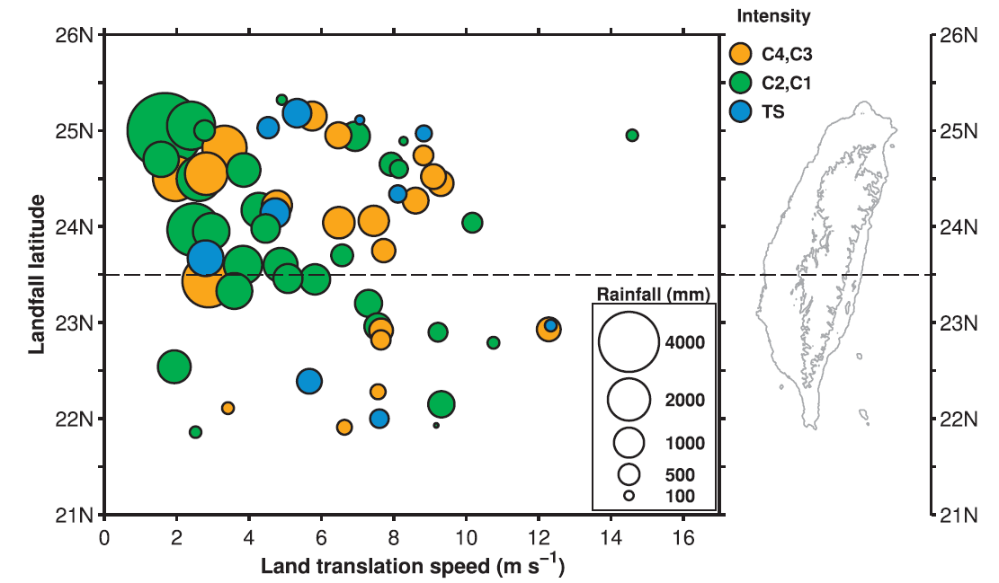
1960~2010 61 continuous-track cases, Saffir-Simpson hurricane scale(TS, C1~C4).
Data from 21 CWB surface stations(overland).

Slide 36
Why do we use PV?
$$PV= \frac{(ζ+f)}{H}$$
$$Ertel PV= −g(ζ+f)\frac{∂θ}{∂p}$$
Conservation
- Adiabatic stream (no diabatic heating or cooling)
- No friction
Invertibility
PV anomoly

Slide 37
Least-square method
$$E= y_{i}−y= y_{i}−(ax_{i}+b)$$
$$E^{2}=\sum_{i=1}^{N}{{(y_{i}−ax_{i}−b)}^{2}}$$
y
y = ax +b
$$(x_{i},y_{i})$$
x
$${(\frac{∂P}{∂t})}_{1}= −C_{x}\frac{∂P_{s}}{∂x}− C_{y}\frac{∂P_{s}}{∂y}$$

Slide 38
Beta-Effect
$$β= \frac{df}{d∅}$$
Radial
Tangential

Slide 39
Roughness length
Originated from Laura Bianco(2008)
http://cires.colorado.edu/science/groups/pielke/classes/at7500/Bianco_SFC.pdf

Slide 40
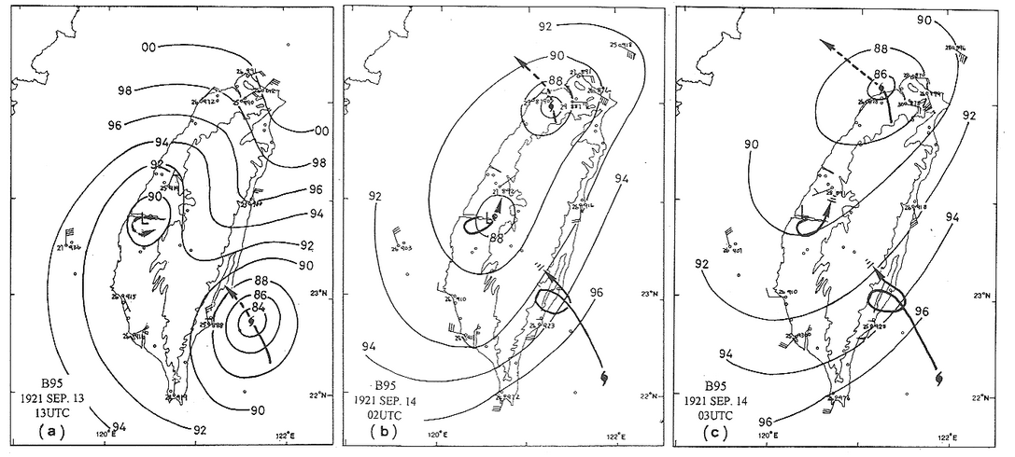
Continuous-track/Discontinuous-track
Discontinuous-track (Wang (1980) and Shieh et al. (1998) )
Continuous-track
Plot originate from Wang, S. T., 1980: Prediction of the behavior and intensity of typhoons
in Taiwan and its vicinity (in Chinese). Chinese National Science Council Research Rep. 108, 100 pp.
Plot originate from CWB
Notes:
Wang (1980) and Shieh et al. (1998) studied the Taiwan orography effect on the movement with more than 200 landfalling typhoons between 1897 and 1996. They further suggested that the leeside secondary low could sometimes fully replace the original typhoon center, resulting in ‘‘discontinuous tracks.’’
When translation speed is defined based on the surface vortex signature, a discontinuous motion may appear as a very fast translation speed. Yeh and Elsberry (1993a,b) studied upstream deflections as well as continuous and discontinuous tracks for westward-moving tropical cyclones passing Taiwan. They found that, in agreement with the observations (e.g., Shieh et al. 1998), typhoons tend to track continuously across the northern end of the island but that discontinuous tracks dominate for weaker typhoons that made landfall at central or southern Taiwan. More intense and rapidly moving storms may cross directly over the barrier. It is likely that the greater frequency of discontinuous tracks in the south contributes to the fast speed of the SLT class.
颱風渦旋位於地形東側並於中心位置南方逐漸形成另一渦旋，且地形背風處亦有一渦旋生成，此時原本的低壓中心強度已較先前減弱。於積分48 小時時，原本的低壓中心消失，而東南方之擾動低壓，由於受地形阻擋持續減弱，地形東北方之背風低壓則增強，且取代原本的颱風渦旋中心，成為新的低壓中心，呈一不連續路徑。高層擾動氣壓場3500 公尺，由於高過地形高度，因此颱風渦旋呈一連續性的移動，越過山脈。若由低層流線場，亦可明顯看到於山脈東西側各有一渦旋存在，而高層流線場之渦旋路徑則呈現連續行情形。

