Slide 1
Developing and non-developing TC on positive and negative phase of Rossby wave
Lin Ching
24 Sep 2013

Slide 2
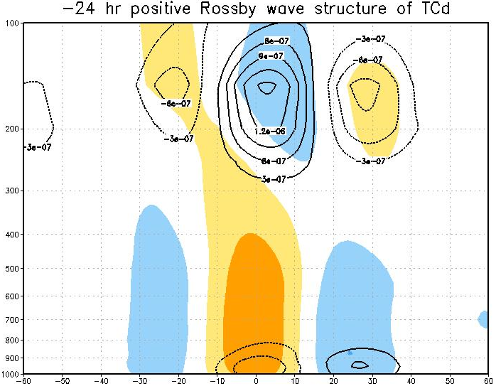
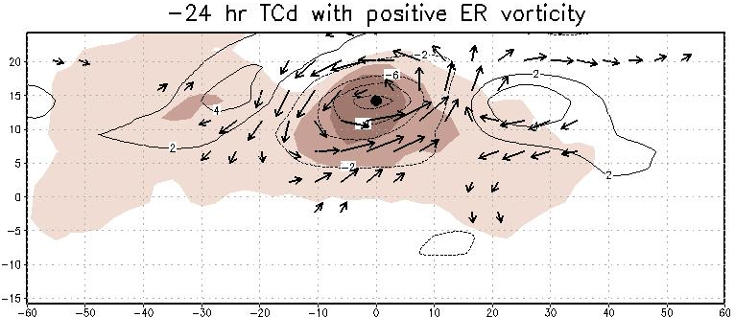
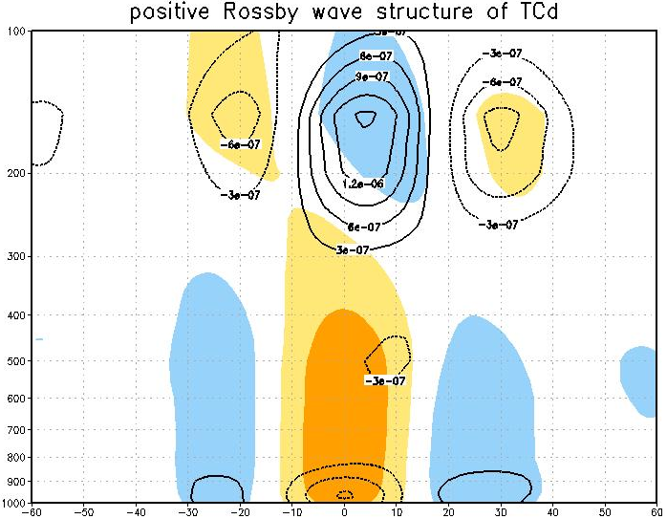
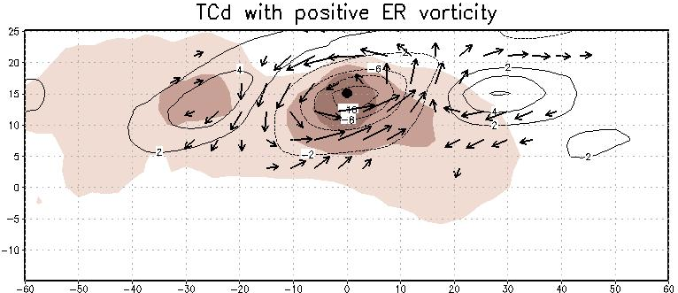


Day -1
Day 0
Day 1

Slide 3
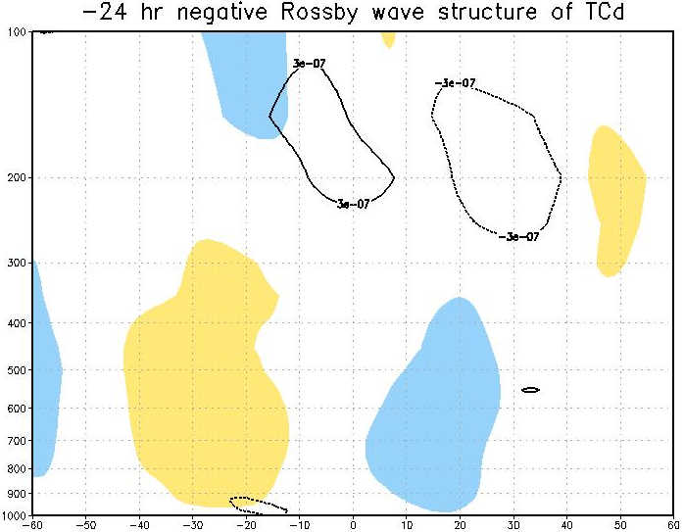
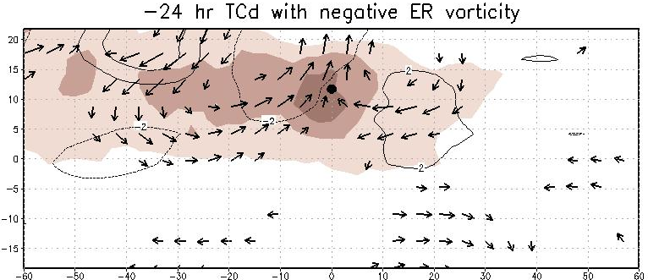
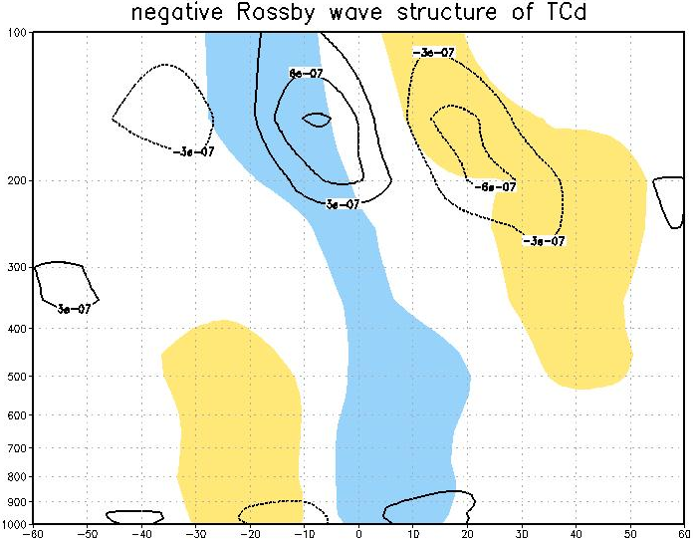
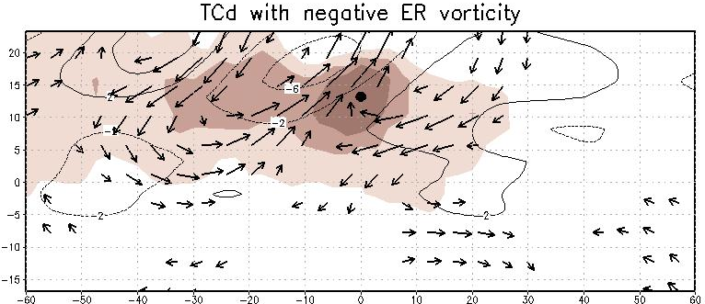
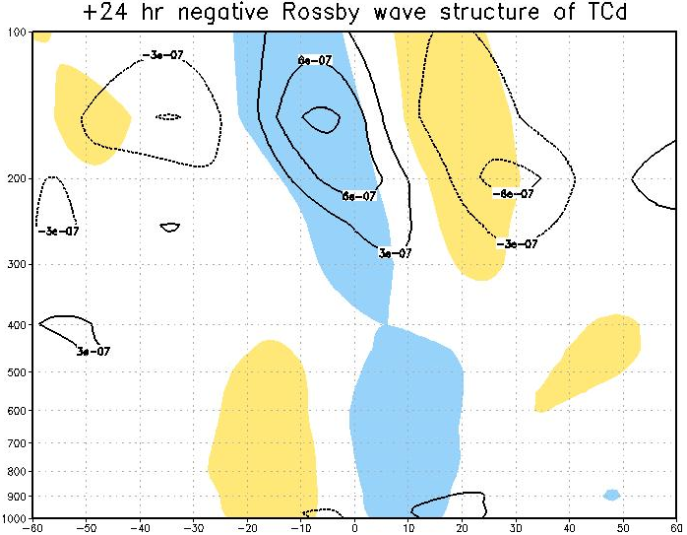
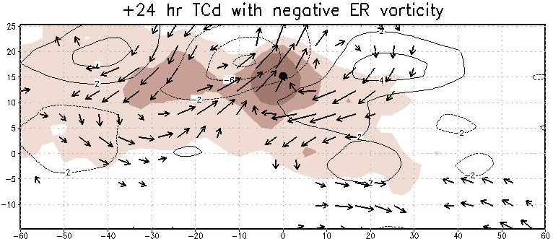
Day -1
Day 0
Day 1

Slide 4
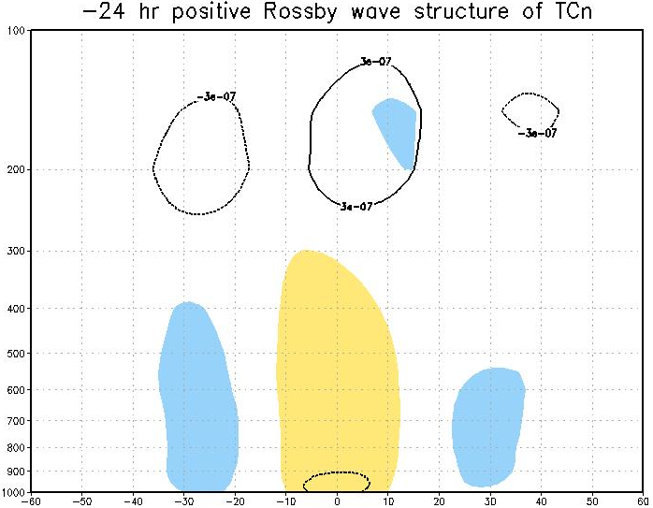
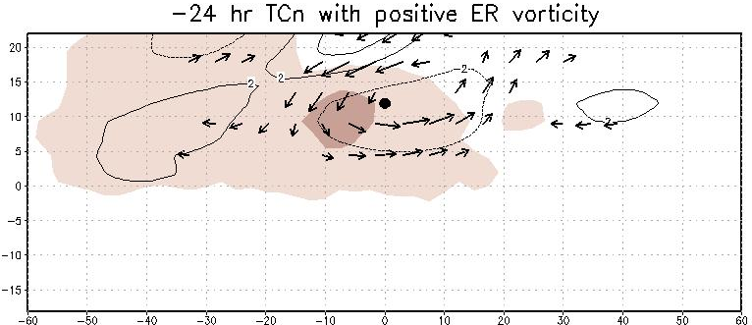
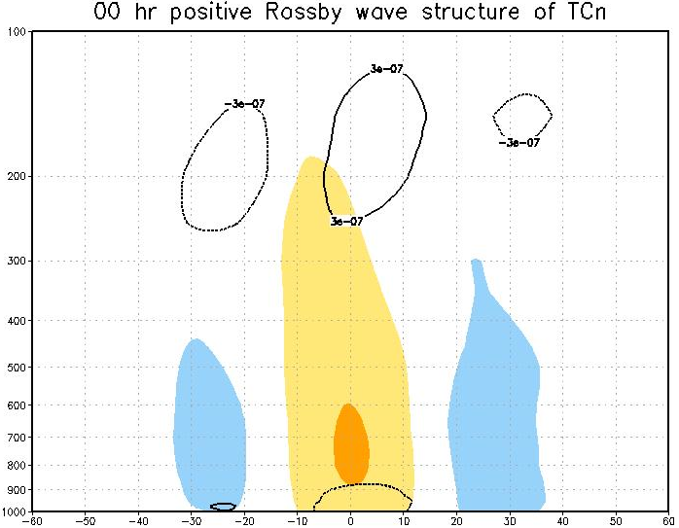
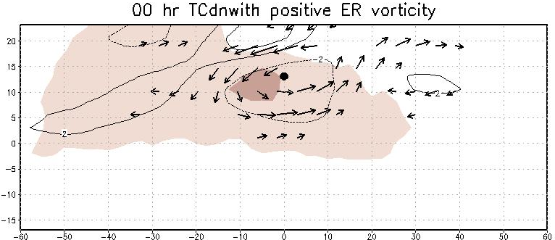
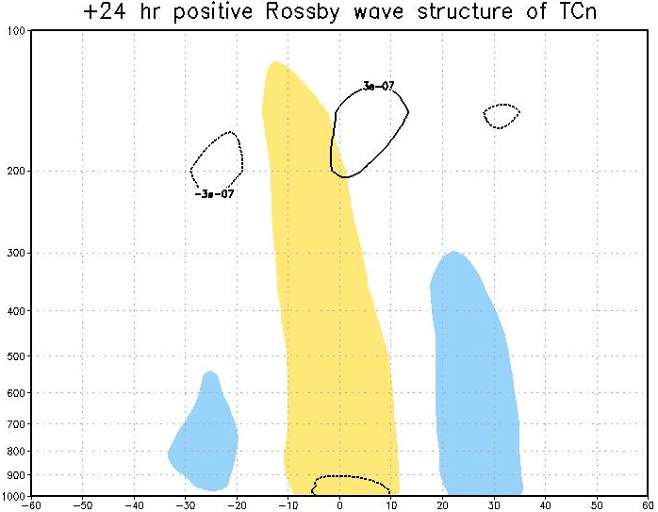
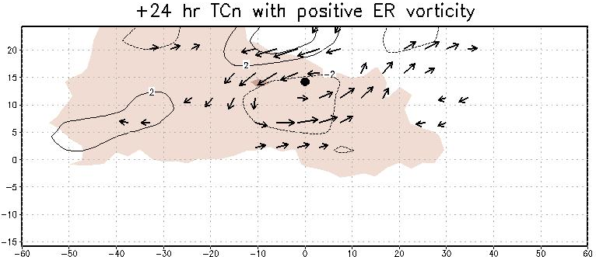
Day -1
Day 0
Day 1

Slide 5
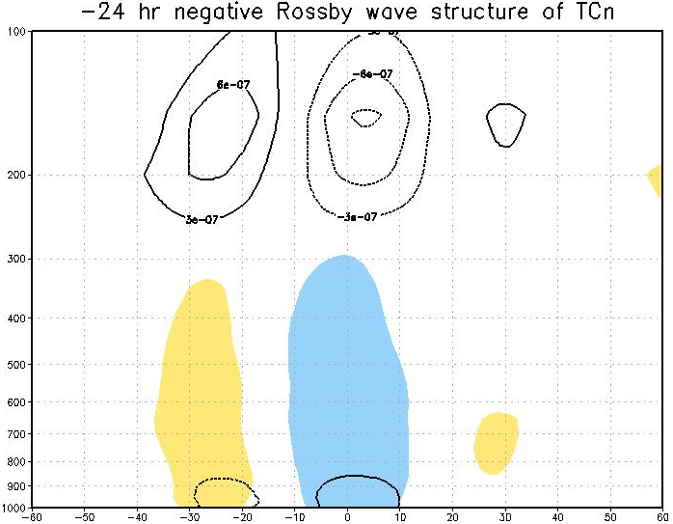
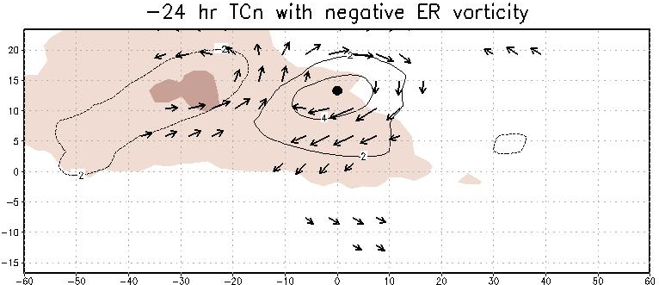
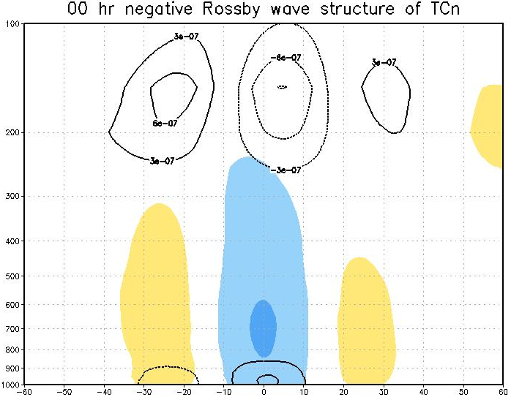
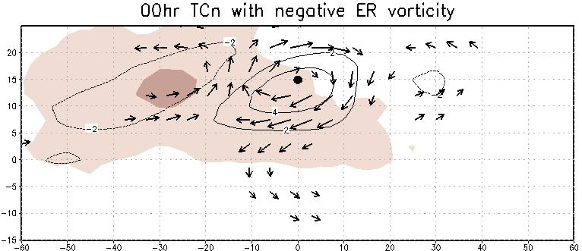
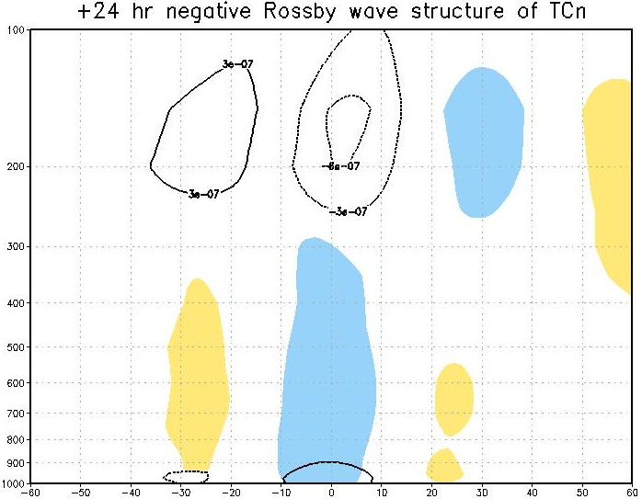
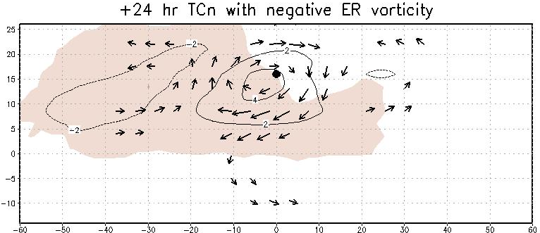
Day -1
Day 0
Day 1

Slide 6
Upper-level processes in tropical cyclogenesis
Cecelski, S. F. and D.-L. Zhang, 2013: Genesis of Hurricane Julia (2010) within an African Easterly wave: low-level vortices and upper-level warming. J. Atmos. Sci., doi:10.1175/JAS-D-13-043.1.
Zhang, D.-L. and H. Chen, 2012: Importance of the upper-level warm core in the rapid intensification of a tropical cyclone. Geophys. Res. Lett., doi:10.1029/2011GL050578.
Zhang, D.-L. and L. Zhu, 2012: Roles of upper-level processes in tropical cyclogenesis. Geophys. Res. Lett., doi:10.1029/2012GL053140.

Slide 7


WRF nested-grid (27/9/3/1 km)
WRF 1km
Shaded: T’
Contour: θ
storm-relative flows
Hydrostatic equation:
$$dlnP=−\frac{g}{RT}dz$$
$$T=\overline{T}\left(z\right)+T′(z,t)$$
The isentropic surfaces descend to their lowest altitudes with the peak warm core
The peak warming is more than 18ºC near Z=14 km
The warming core of stratospheric origin could contribute more than twice as much as the lower-level warming column to pressure changes during the RI.
Curve A: Pmin (p’)
Curve B: p’ above 380-K surface
Curve C: p’ beneath 380-K surface

Slide 8
Upper-level convergence and subsidence in the eye
Cyclonic inflow
Strong divergent outflow
T = 30 h
Z = 17.5 km

Slide 9
Concluding Remarks
The formation of an upper-level warming core, coinciding with the onset of RI, due to the descent of stratospheric air.
The upper divergent outflow layer favors the generation of a warm core by protecting it from ventilation by environmental flows.
Based on a hydrostatic argument, the upper-level warming in the eye is more effective than the lower-level warming in causing surface pressure falls.

Slide 10
Genesis of Typhoon Nari (2001): An “Ideal” Storm
The warming column increases in magnitude and expands in depth with time.
The warming core remains at 200 hPa throughout the
96-h period.
The upper-level warming rate
increases more significantly near 36 h, which coincides with the onset of significant intensification (SI).
The increased upper-level warming rate near 36 h explains well the trigger of Nari’s SI.
Warming at lower temperatures aloft is more effective than the lower-level warming in hydrostatically inducing MSLP falls.
78% of the MSLP changes
4-hPa drop
30-hPa drop
UW: upper-level warming only
dT(z, t) > 0 in the 100–300 hPa layer

Slide 11
6 h prior to, 6 h after and 18 h after the onset of SI
Typical in- up- and outward circulation
The warming core grows in intensity and volume with time during SI, under the protection of a deep-layer divergent circulation in the outer region.

Slide 12
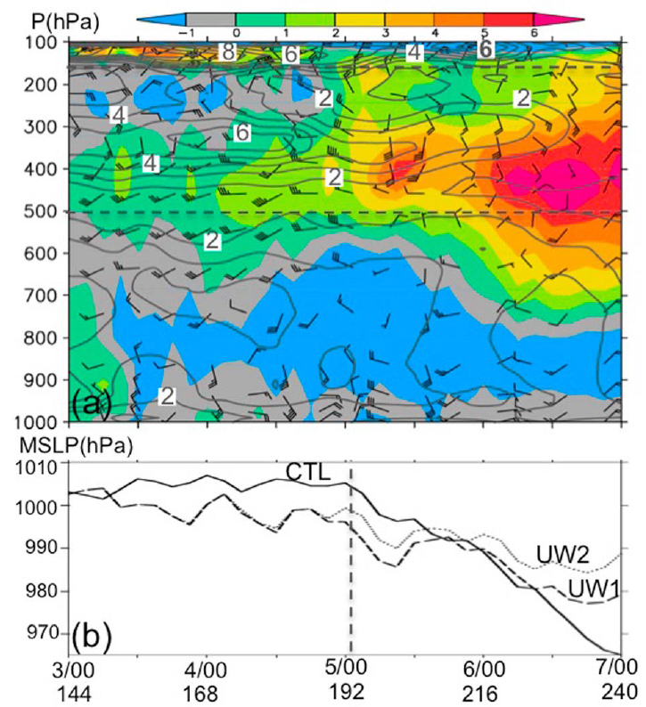
Genesis of Typhoon Chanchau (2006) Under Intense Vertical Wind Shear
The onset of SI is triggered until 192-h.
The upper-level warming is peaked in the 400–450 hPa layer.
Intense VWS with the peak magnitude of greater than 6 x 10⁻¹ s⁻¹ centered at 320 hPa and intense SRFs with the peak magnitude of greater 20–25 m s⁻¹ in the peak warming layer until the onset of SI.
The increased warming depth and rate near 192 h that trigger the SI of Chanchau.
If only the peak warming layer of 300–500 hPa is considered (curve UW2), the storm is weaker than that shown in UW1 (166–500 hPa).

Slide 13
3 h prior to, 9 h after and 36 h after the onset of SI
The intensification of a warm core near 400 hPa within the radius of more than 200 km from 2ºC at 189 h to 6ºC at 201 h, and 7ºC at 228 h.

Slide 14
Concluding Remarks
The upper-level warming accounts for more than 75% of the MSLP changes.
The higher-level warming is more effective than the lower-level one in hydrostatically inducing MSLP falls.
The onset of TCG is triggered when more rapid warming and increased warming depth take place in the upper troposphere where both VWS and SRFs are weak or significantly reduced.
Given warm SSTs and other favorable conditions, the upper-level processes, especially, VWS and SRFs, play critical roles in determining the onset of TCG.
Even with all favorable low-level conditions, TCG may not likely occur if an upper-level warm column could not be established due to the detrimental impact of intense upper-level VWS and ventilation.

Slide 15
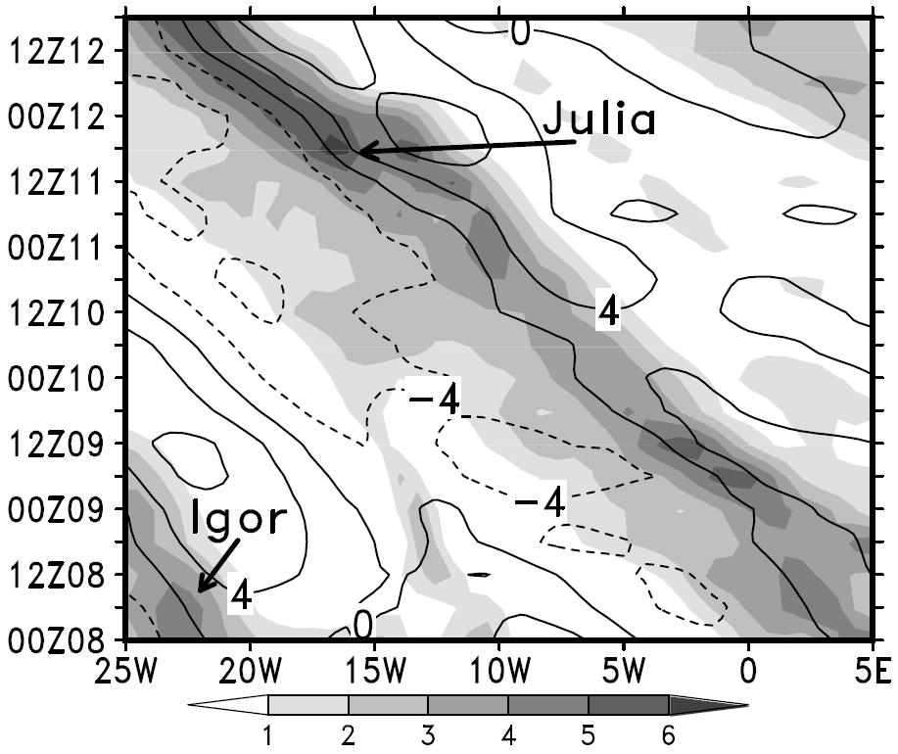
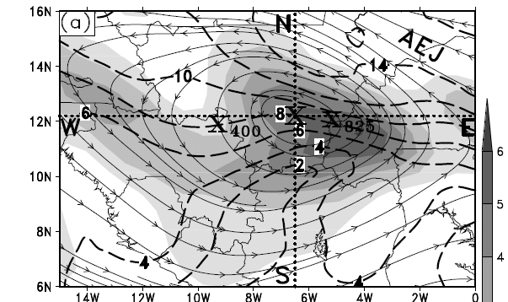
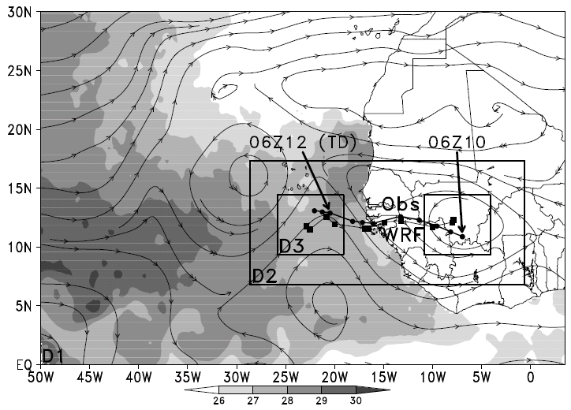
600hPa relative vorticity
zonal wind
co-moving streamlines
9, 3, and 1 km
66 hours simulation
36 vertical levels
model top is 50 hPa

Slide 16
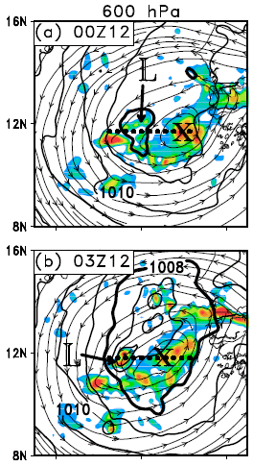
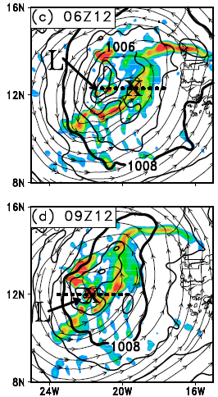
The LLV is intensifying with time and begins to merge with the vertically tilted AEW vortew from the top

Slide 17
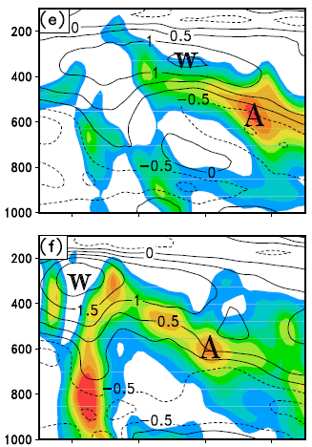
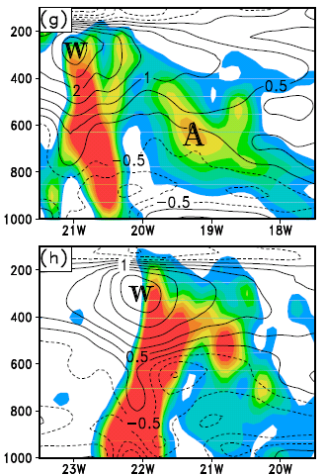
The merging of the LLV and AEW is realized by the bottom-up growth of cyclonic vorticity associated with the LLV and the mid-level cyclonic vorticity of the AEW.

