Slide 1
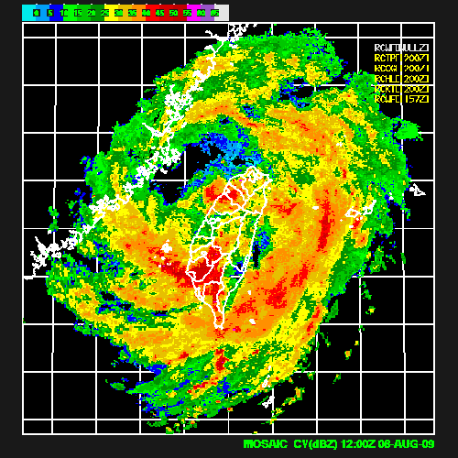
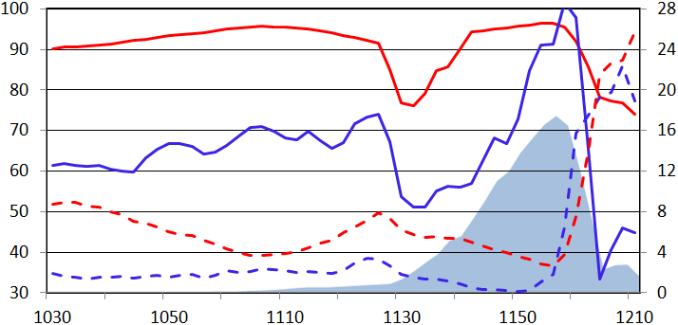
Water Budget and Precipitation Efficiency of Typhoons Morakot (2009)
Ming-Jen Yang¹, Hsiao-Ling Huang¹, and Chung-Hsiung Sui² ¹National Central University, Taiwan ²National Taiwan University, Taiwan
2013 AOGS at Brisbane, Australia
122E
124E
28N
CR
26N
PE
24N
0.9 km
22N
0.6 km
DR
ER
0.3 km
20N
118E
120E
Time (UTC)

Slide 2
Introduction
Morakot’s landfall on Taiwan occurred concurrently with the southwesterly monsoonal flow, very slow movement and the continuous formation of mesoscale convection. (Chien and Kuo 2011; TAO)
The terrain of Taiwan strongly determines the Morridakot rainfall distribution at the time of landfall. (Fang et al. 2011 in WAF; Huang et al. 2011 and Yen et al. 2011 in TAO)
PE (Precipitation Efficiency) was used to predict rainfall from grid-scale vapor convergence in operational model forecasts (Doswell et al. 1996; Auer and Marwitz 1968; Heymsfield and Schotz 1985; Chong and Hauser 1989; Li et al. 2002a; Tao et al. 2004; Sui et al. 2005).
Yang et al. (2011; MWR) investigates the evolution of the water vapor, cloud, and precipitation budgets of Nari (2001) prio to and after landfall on Taiwan.
The water budget study may help us to understand the physical mechanisms producing the heavy rainfall on Taiwan for Morakot, and improve the microphysical parameterization for TCs in the future.

Slide 3
Budget Equations [from Yang et al. (2011;MWR)]
Water vapor budget: q_{v}
Cloud budget: q_{c} = q_{w} + q_{i}
where is the total condensation and deposition;
is the evaporation and sublimation;
is the net horizontal flux convergence;
is the vertical flux convergence; is the divergence term
is the numerical diffusion
is the boundary layer source and vertical (turbulent) diffusion
is the residual term
is the precipitation flux.
CMPE (Cloud Microphysics Precipitation Efficiency; CMPE2, Sui et al. 2007):

Slide 4
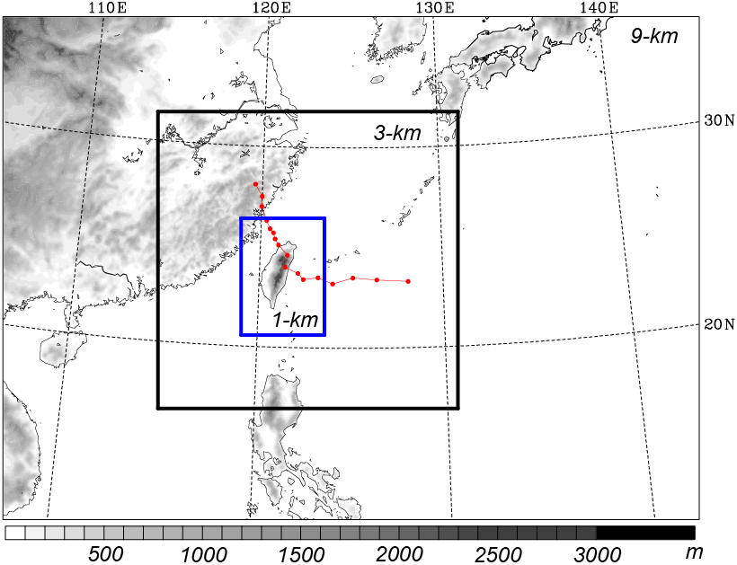
WRF domain and physics for Morakot Simulation
9/3/1 km (416x301 / 541x535/ 451x628)
31 sigma (σ) levels
Two-way feedbacks
No CPS is used!
WRF Single-Moment 6-class scheme (WSM6)
IC/BC: ECMWF 1.125º lat/lon
Initial time: 0000 UTC
6 Aug 2009
Integration length: 96 h

Slide 5
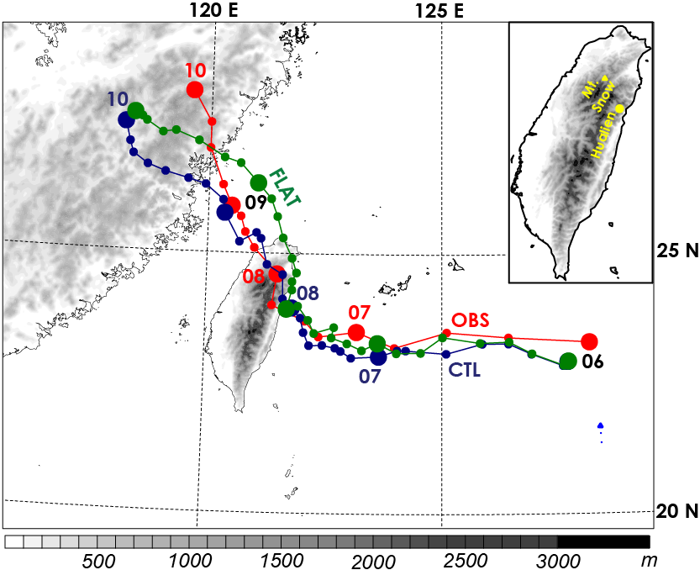
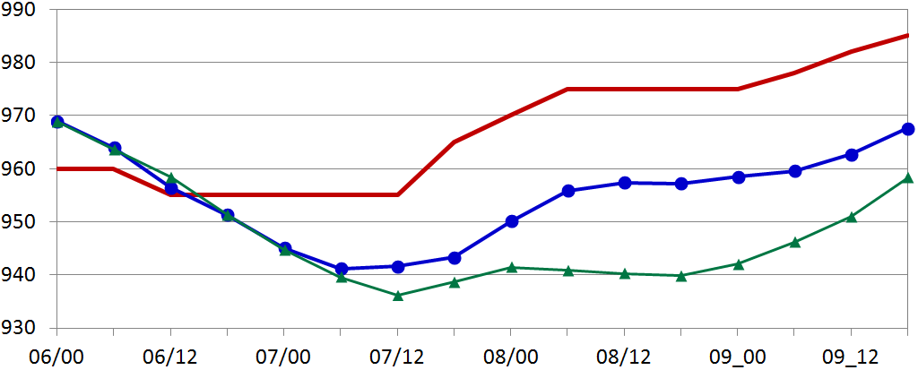
Tracks from the CWB (OBS) and WRF (CTL/FLAT)
OBS
SLP (hPa)
CTL
FLAT
Time (UTC)

Slide 6
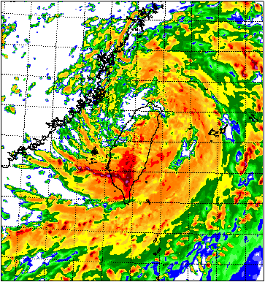
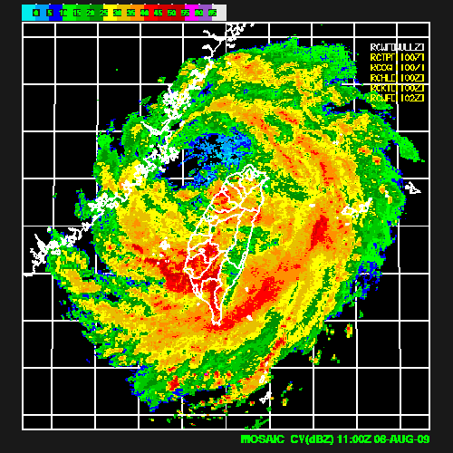
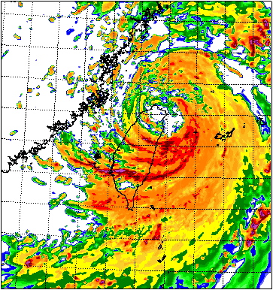
08/08/11 UTC
118E
120E
122E
124E
28N
OBS @ CWB
CTL
26N
122E
124E
28N
24N
26N
22N
24N
20N
22N
28N
20N
26N
118E
120E
24N
22N
FLAT
20N

Slide 7
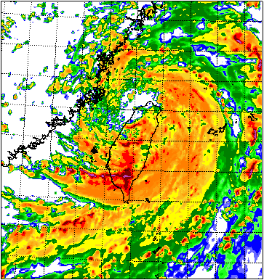
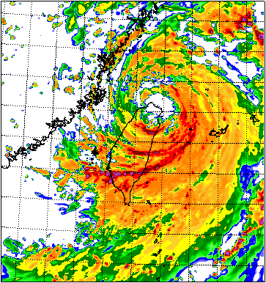
08/08/12 UTC
118E
120E
122E
124E
28N
OBS @ CWB
CTL
26N
122E
124E
28N
24N
26N
22N
24N
20N
22N
28N
20N
26N
118E
120E
24N
22N
FLAT
20N

Slide 8
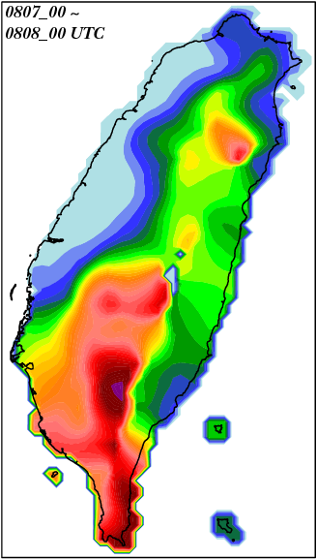
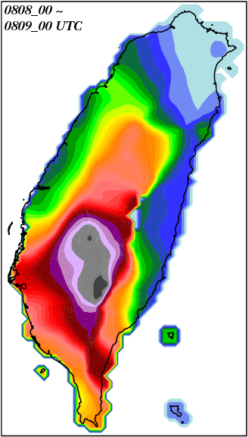
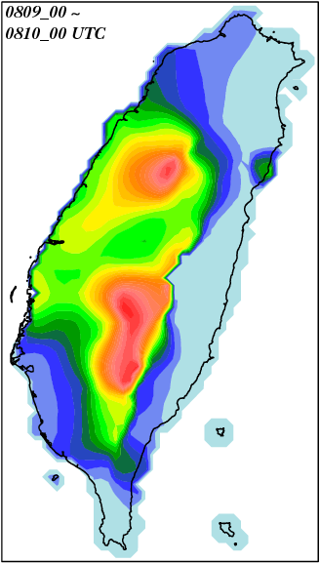
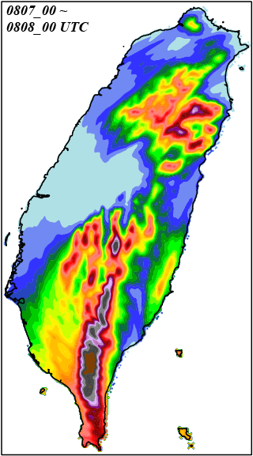
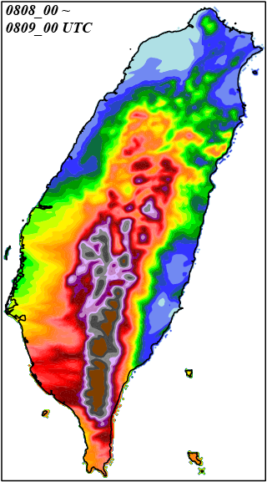
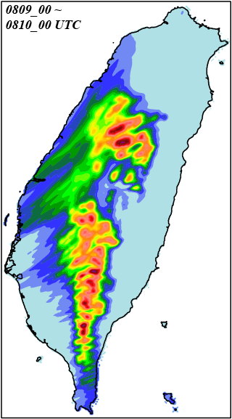
CWB_ OBS
mm
Day1
Day2
Day3
WRF_ CTL

Slide 9
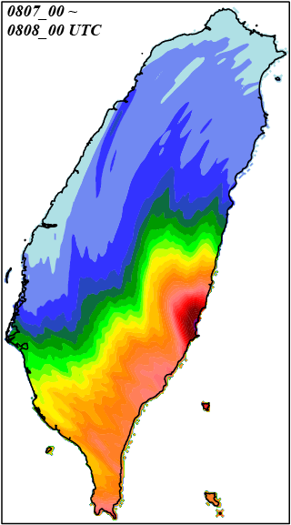
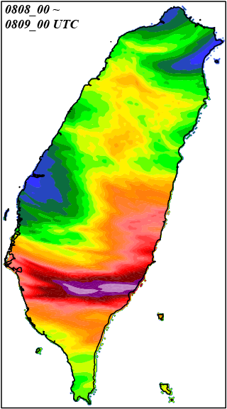
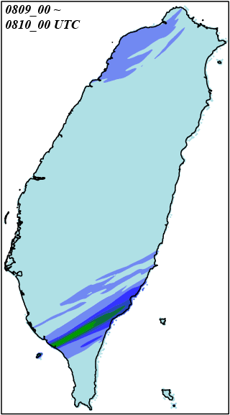
CWB_ OBS
mm
Day1
Day2
Day3
WRF_ FLAT

Slide 10
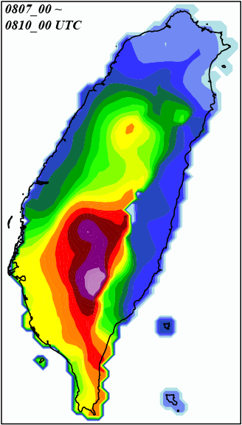
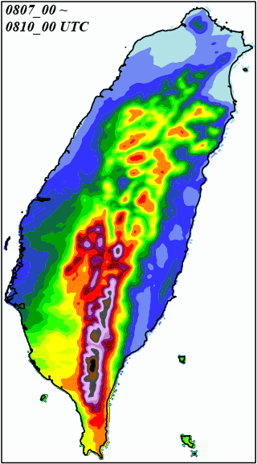
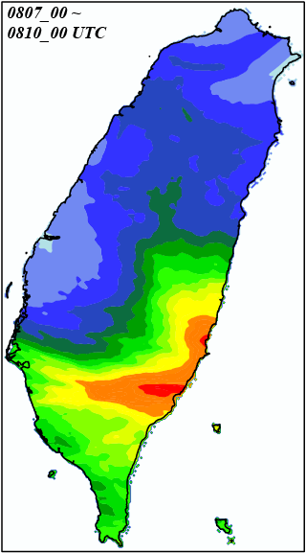
72-h Rainfall (08/07/00 ~ 08/10/00 UTC)
CWB_OBS
WRF_CTL
WRF_FLAT
mm
2323
2683
3392
2477
3847

Slide 11
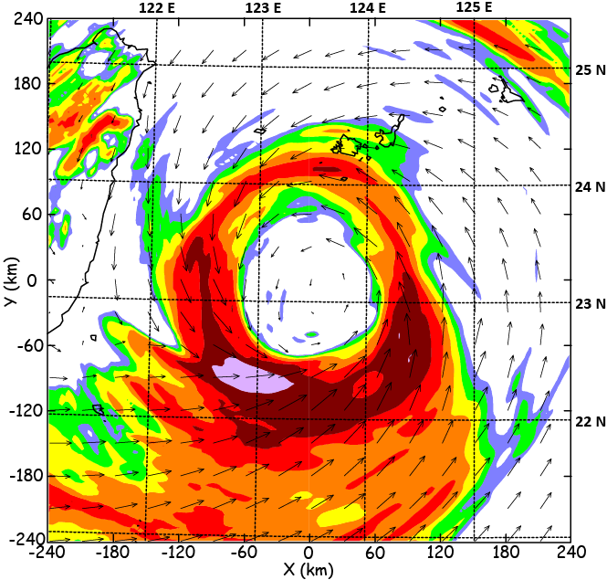
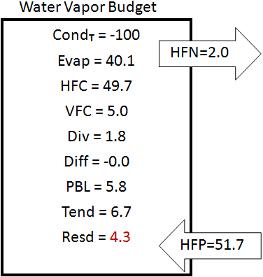
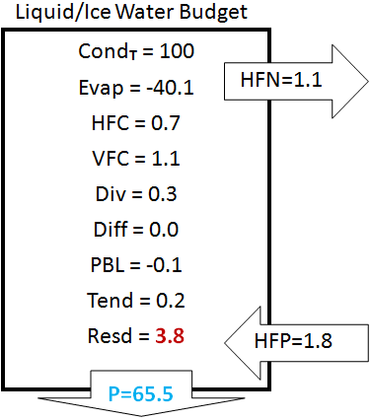
Oceanic Stage (0000 ~ 0100 UTC 7 August 2009)

Slide 12
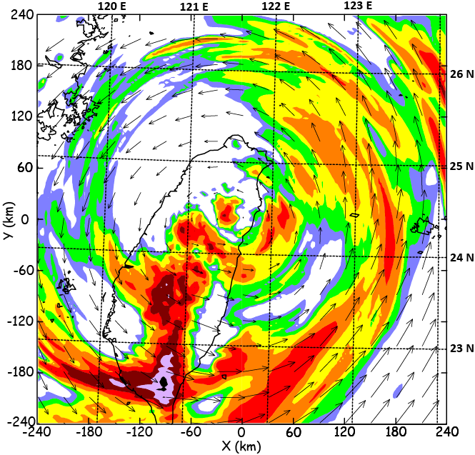
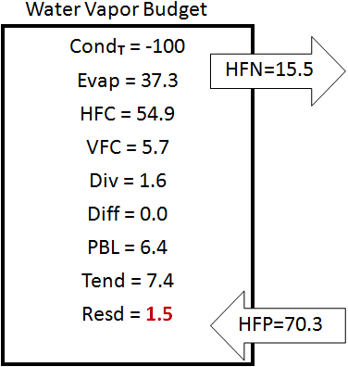
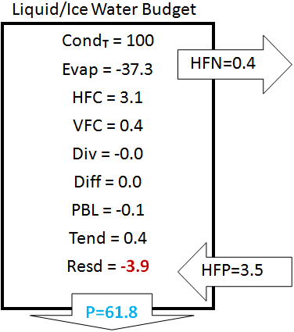
Landfall Stage (00730 ~ 0830 UTC 8 August 2009)

Slide 13
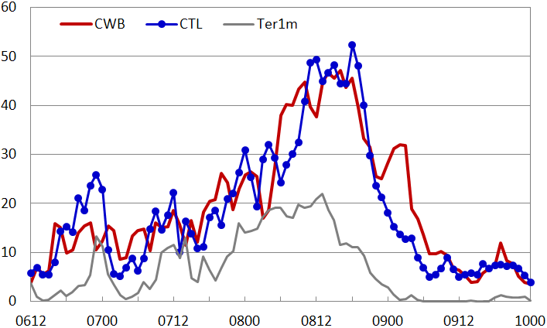
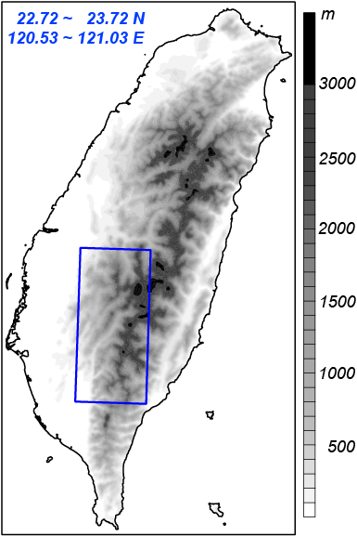
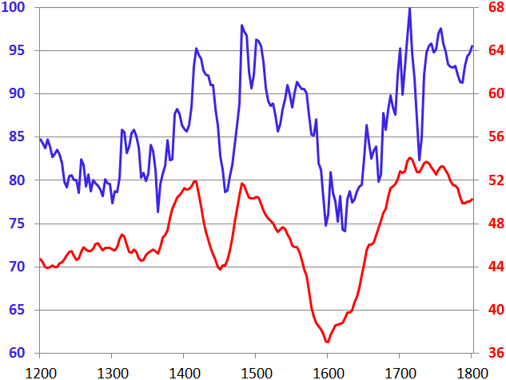
(mm h⁻¹)
FLAT
CTL Run
Efficiency (%)
Rainrate (mm h⁻¹)
Time (UTC)

Slide 14
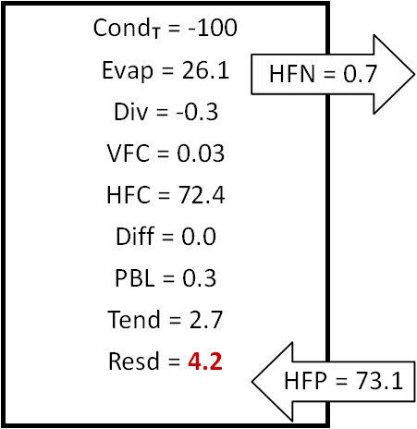
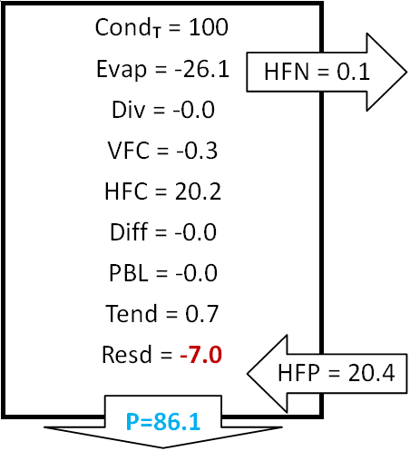
Rainrate (mm h⁻¹)
Efficiency (%)
Efficiency (%)
Water Vapor Budget
Liquid/Ice Water Budget
Time (UTC)

Slide 15
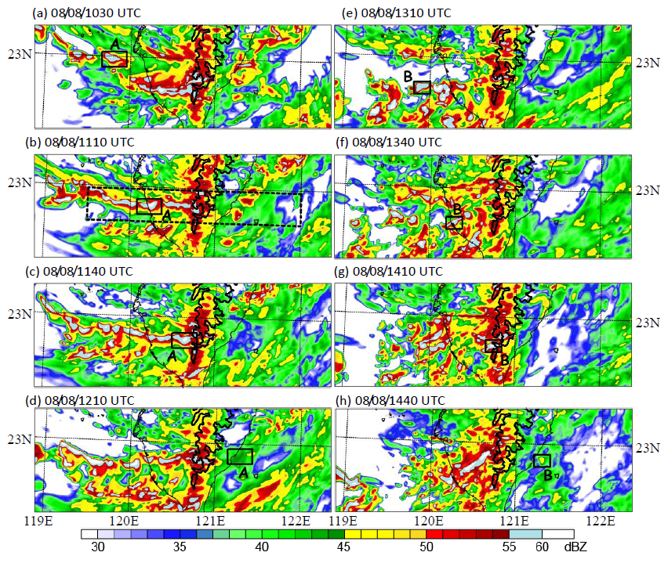

Slide 16
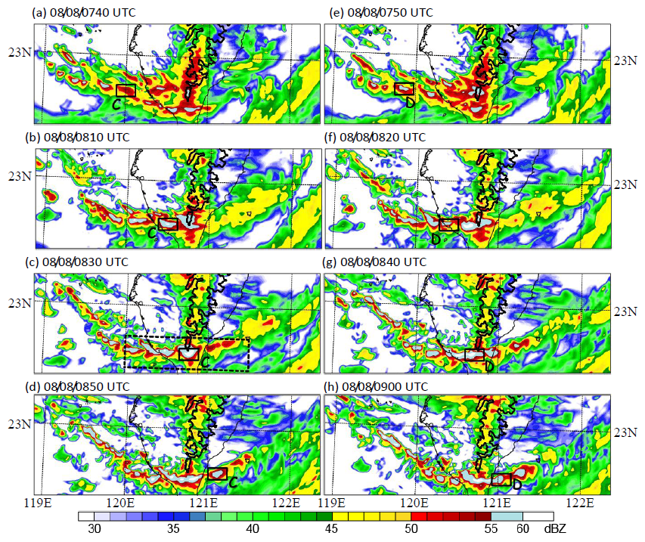

Slide 17
Further devision of microphysical parameters into three components
Condensation Ratio:
Deposition Ratio:
Evaporation Ratio:
where is the total condensation and deposition;
is the cloud water condensation;
is the snow deposition;
is the graupel deposition; is the cloud ice deposition;
is the raindrop evaporation

Slide 18
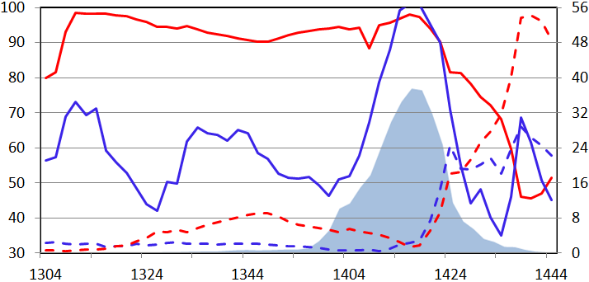
Lagrangian evolution of microphysical parameters
CR
PE
Cell A
Efficiency 1 (%)
0.9 km
0.6 km
Efficiency 2 (%)
DR
ER
0.3 km
Time (UTC)
CR
Cell B
PE
Efficiency 2 (%)
Efficiency 1 (%)
1.2 km
0.9 km
0.6 km
DR
0.3 km
ER
Time (UTC)

Slide 19
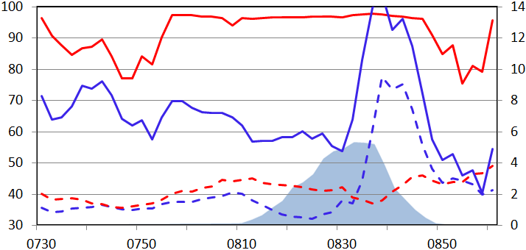
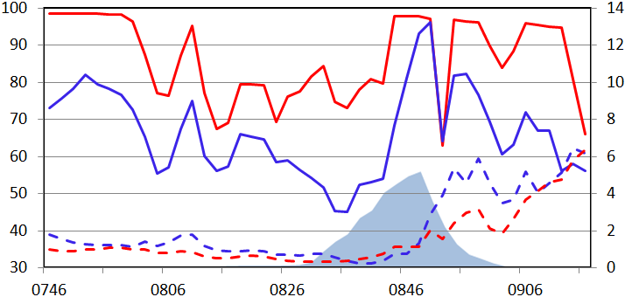
Lagrangian evolution of microphysical parameters
CR
Cell C
PE
Efficiency 1 (%)
Efficiency 2 (%)
DR
0.6 km
ER
0.3 km
Time (UTC)
CR
Cell D
PE
Efficiency 2 (%)
Efficiency 1 (%)
ER
0.6 km
0.3 km
DR
Time (UTC)

Slide 20
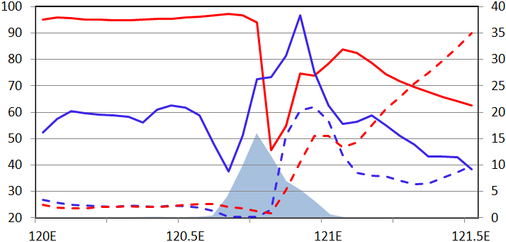
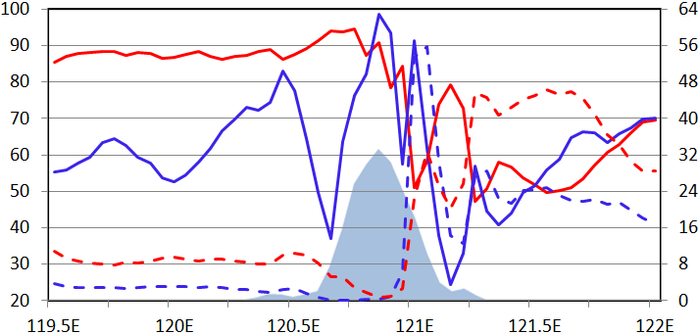
Eulerian evolution of microphysical parameters
In two time-averaged cross sections
CR
Efficiency 1 (%)
PE
Efficiency 2 (%)
Cross Section A
DR
0.8 km
0.4 km
ER
Longitude
CR
DR
Cross Section B
PE
Efficiency 2 (%)
Efficiency 1 (%)
1.2 km
0.8 km
ER
0.4 km
Longitude

Slide 21
Conclusions
The 1-km WRF run reproduced resonably well the Morakot track, the organization, the sizes of eye and eyewall, major convective cells on outer rainbands, and rainfall maxima on southwestern Taiwan.
The surface rainrate (36-54 mm/h) and PE (75-100%) over southwest Taiwan are highly correlated.
The surface rainrate and PE of the no-terrain run are only 50% and 15-20% less than those of full-terrain run.
By following the movement of major convective cells, PEs are 60%-75% over ocean and > 95% above terrain.
The Lagrangian evolution of major cells shows that PE and CR are increased on the windward slope but decreased on the lee side; the reverse trend is found for the DR and ER.
The Lagrangian evolution is also confirmed by the changes of microphysical parameters across the mountains in two time-and-space-averaged cross sections in an Eulerian framework.

