Slide 1
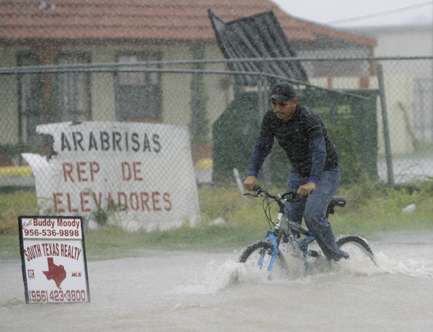
Observed Inner-Core Structural Variability in Hurricane Dolly
Hendricks E. A., B. d. Mcnoldy, and Wayne H. Schubert
Yu-Fen Huang

Slide 2
Introduction
TC intensity change is caused by environmental, oceanic, and internal dynamical factors. (Wang and Wu 2004).
An important internal process is the dynamic instability.
Notes:
its breakdown, and subsequent eddy flux of PV from the eyewall into the eye. This instability is more common in hurricanes because the radial profile of PV typically has a maximum in the eyewall region, where PV is continually produced by diabatic heating.

Slide 3
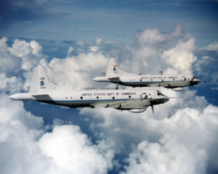
On aircraft reconnaissance missions, airborne radar data have shown that significant variability in the eyewall region. (Marks et al. 1992; Reasor et al. 2000; Roux and Viltard 2004)

Slide 4
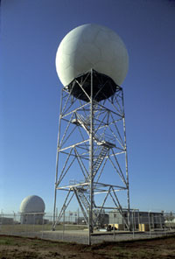
The observations of the inner core of Dolly were taken from the National Weather Service Weather Surveillance Radar-1988 Doppler (WSR-88D) in Brownsville, Texas, prior to landfall.
Notes:
Rarely are land-based Doppler radar able to capture intricate structural details of organized eyewalls, because the hurricane typically becomes disorganized as it approached the coast, and because there is relatively short window of time prior to landfall that the storm is in radar range.

Slide 5
The dynamic eyewall with significant azimuthal variability on short times scales (30 min to 1 h) during a 6-h rapid intensification and deepening period before it made landfall.
Notes:
Rarely are land-based Doppler radar able to capture intricate structural details of organized eyewalls, because the hurricane typically becomes disorganized as it approached the coast, and because there is relatively short window of time prior to landfall that the storm is in radar range.

Slide 6
Synoptic history
Dolly’s origin can be traced to a tropical wave exiting Africa on 11 July 2008.
20 July 2008 formed into a tropical storm, when it was in the western Caribbean Sea.

Slide 7
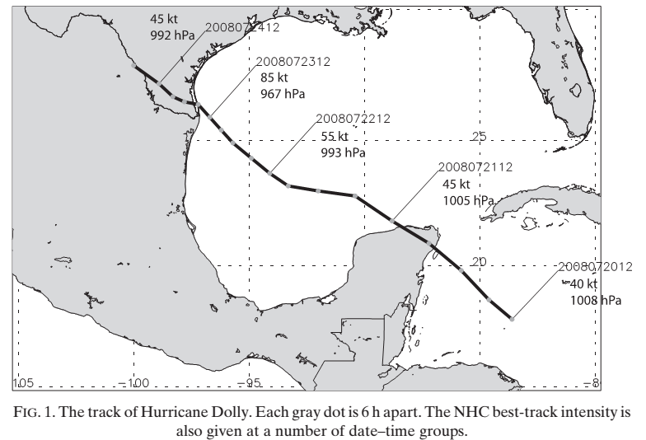
slow down
2008072318
75 kt
Yucatan peninsula

Slide 8
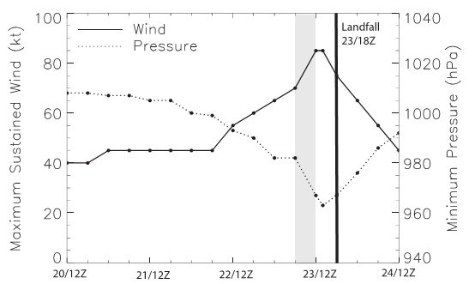
Rapid intensify
significant eyewall asymmetries
The National Hurricane Center (NHC) best-track intensity estimates are shown
Notes:
(These intensity estimates are based in part upon multiple aircraft reconnaissance missions that were conducted in Dolly from both the National Oceanic and Atmospheric Administration and the U.S. Air Force (USAF) Reserve 53rd Weather Reconnaissance Squadron WC-130J aircraft.

Slide 9
Environmental analysis
SHRD: magnitude of the deep-layer 850-200 hPa sheer vector averaged from r=200 to 800 km
RSST: Reynolds analysis sea surface temperature (Reynolds and Smith 1993)
D200: 200hPa divergence averaged from r=0 to 1000 km
RHMD: 700-500hPa relative humidity averaged from r = 200 to 800 km
Notes:
Four critical environmental parameters for tropical cyclone intensity change are the deep-layer vertical wind shear, sea surface temperature(SST), low-to midlevel relative humidity, and upper-level divergence.
RSST: SST data now be improved by using sea ice data to simulate SSTs in ice-cover region.
為什麼要用RSST?

Slide 10
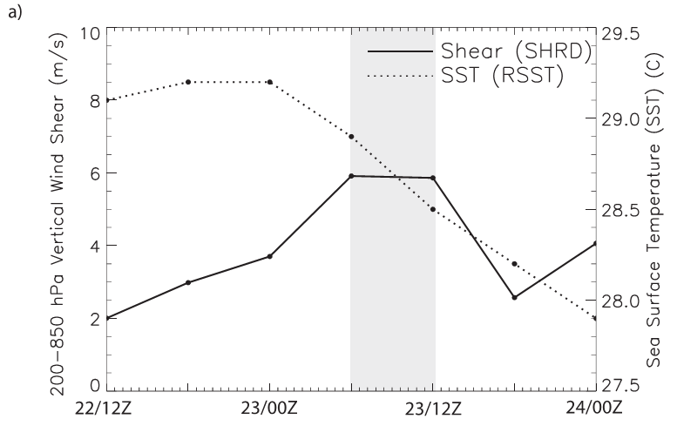

Slide 11
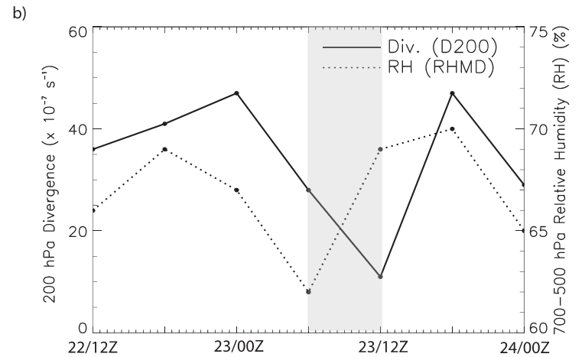
Notes:
The environment was very favorable for intensification between 1200 UTC 22 July and 0000 UTC 23 July.
The environmental became less favorable from 0000 to 1200 UTC 23 July.

Slide 12
When Dolly was rapidly intensifying and deepening, the environmental condition were generally becoming less favorable.
The rapid intensification and deepening event may have been more strongly controlled by the vortex internal dynamics than the environmental condition for this case.
Notes:
with prominent eyewall asymmetries

Slide 13
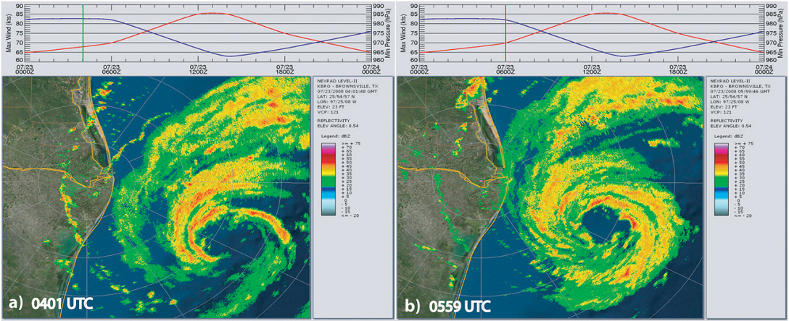
Inner-core analysis

Slide 14
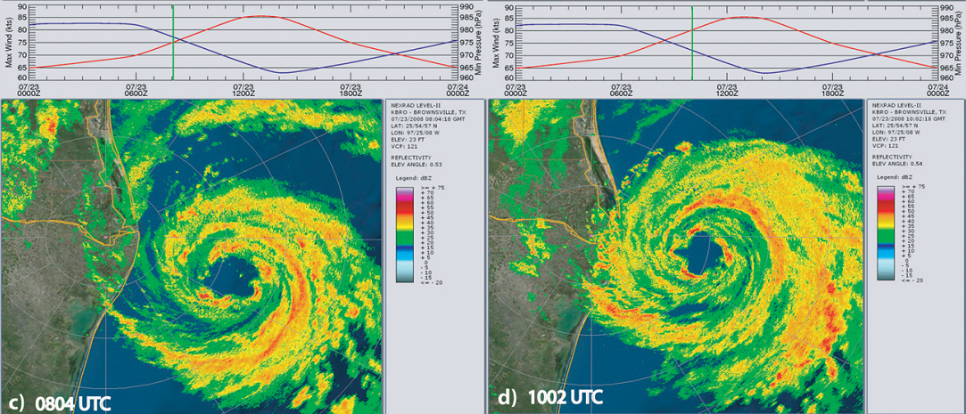
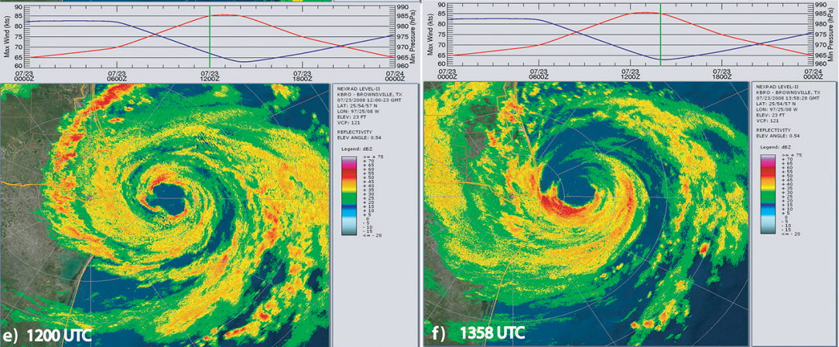
Notes:
National Weather Service Doppler radar located in Brownsville, Texas. (Wind - red; Pressure - Blue)
A time series of best-track intensity.

Slide 15
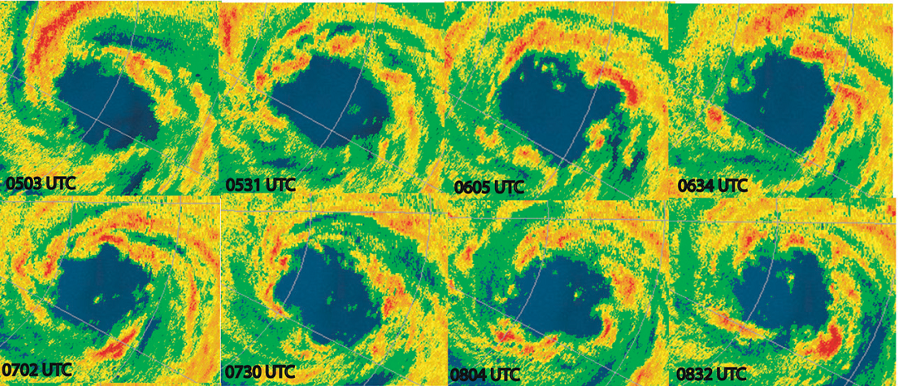
Notes:
The observations showed a dynamic eyewall with significant azimuthal variability on short times scales (30~60 min) during a 6-h rapid intensification and deepening period before it made landfall.
The diameter of the eyewall is approximately 45-50 km. (inferred from the radar data)

Slide 16
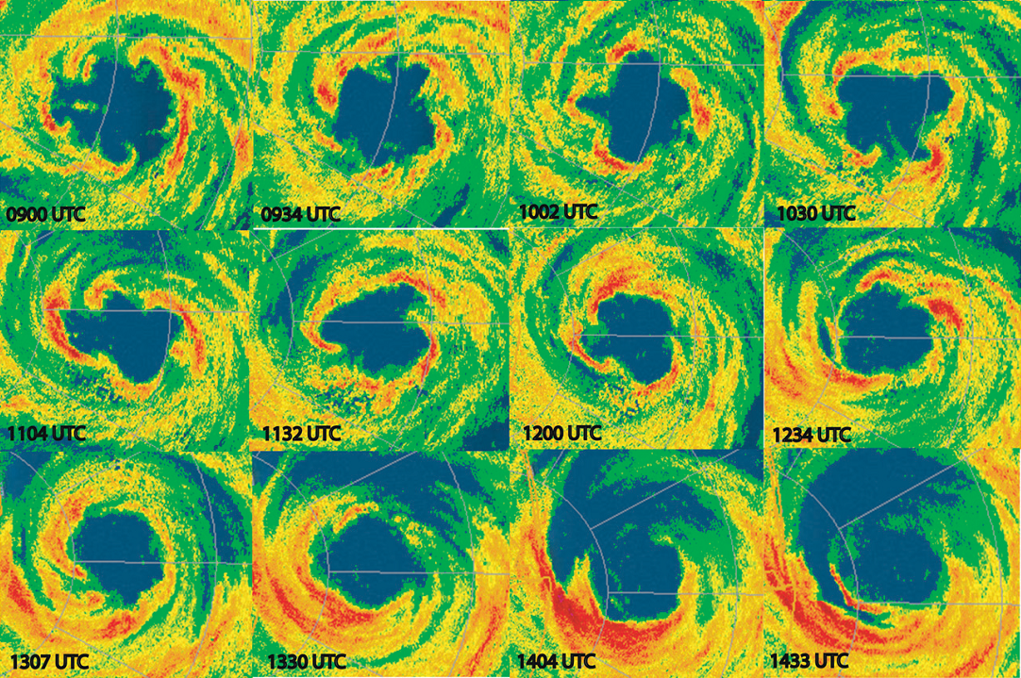
Notes:
The evolution of the eyewall asymmetries from higher to lower azimuthal wavenumbers.
It is not known whether the high-wavenumber asymmetries evolve into lower-wavenumber asymmetries, or whether the high-wavenumber asymmetries grow first, decay, and then are followed by a slower-growing lower-wavenumber asymmetry.

Slide 17
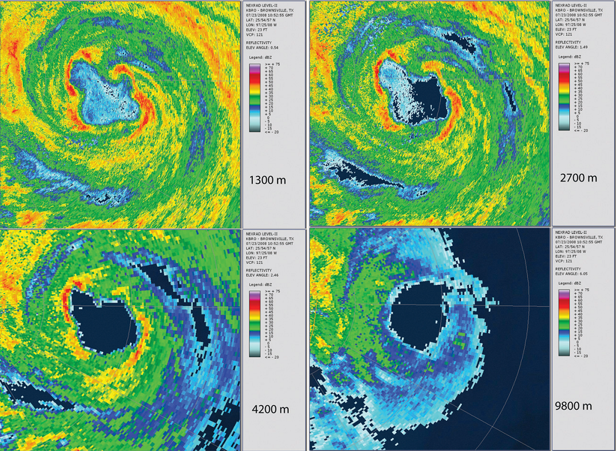
Notes:
Vertical structure of the inner core. (1052 UTC)
高層雷達迴波?

Slide 18
This demonstrates that the asymmetries in the eyewall are primarily confined to lower levels during the instability.
No upshear tilt of the asymmetries in the vertical, which would signify that a baroclinic instability is occurring.

Slide 19
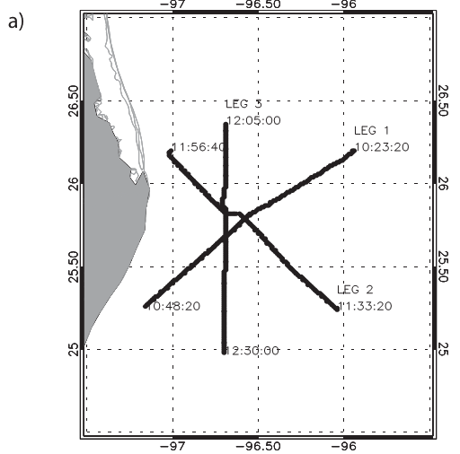
Flight level: 700 hPa
Notes:
In computing the relative vorticity, it was assumed that the winds measured on the flight legs were mostly tangential since the aircraft flew above the boundary layer directly through the vortex center.

Slide 20
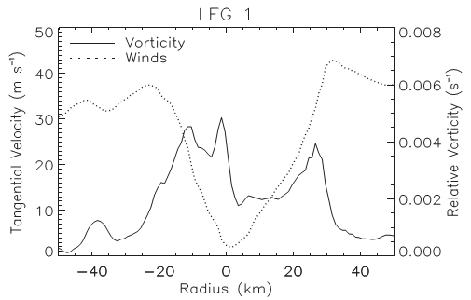
NE
SW
Notes:
The relative vorticity was calculated using centered differencing of the winds on this regular grid.
Eye diameter of Dolly is 50 km.

Slide 21
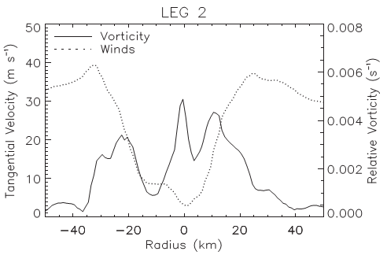
NW
SE

Slide 22
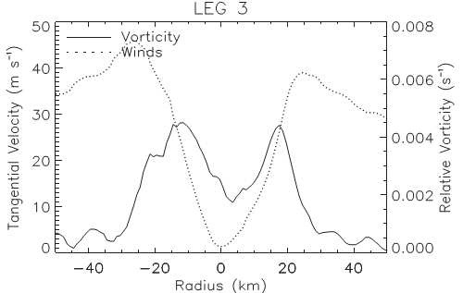
N
S
Notes:
Eye diameter has decreased slightly to 45 km.
Since the Rayleigh necessary condition for barotropic instability was satisfied on some portions of the radial legs. (radial vorticity gradient changes sign)
To confirm that the origin of the Dolly asymmetries was dynamic instability of the eyewall.

Slide 23
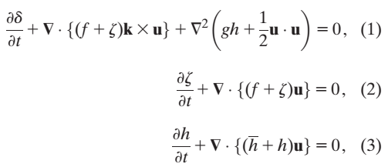
Numerical Simulation
Shallow-water model.
Base on vorticity-divergence
Notes:
H = 6341 m

Slide 24
Double Fourier pseudospectral discretization.
600 km * 600 km → 512 * 512 points.
Dealiasing → 170 Fourier modes
→ resolution is 3.52 km.
The numerical diffusion coefficient was set to 25 m²/s
Time differencing was using a third-order explicit scheme with a time step of 4 s.

Slide 25
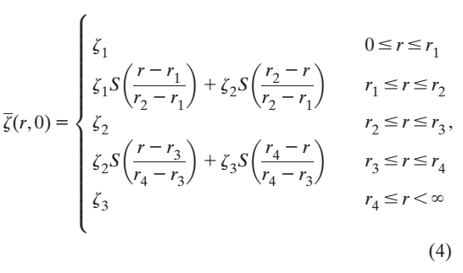
Initial condition
A thin voricity ring was constructed in accordance with the flight-level vorticity of leg 1 from r = 0 to 30 km.
eye
eyewall

Slide 26
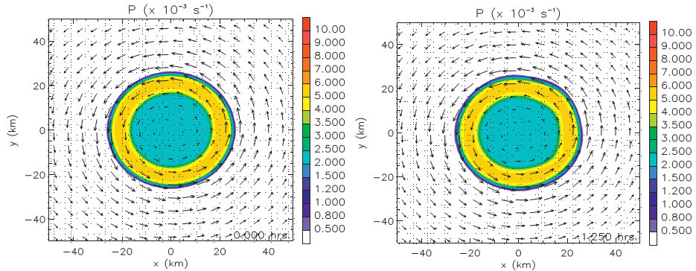
The ring was constructed such that the maximum tangential velocity was set to 40 m/s.
$S\left(s\right)=1−3s^{2}+2s^{3}$
$ξ_{1}=2.0×{10}^{−3} s^{−1}$
$ξ_{2}=5.0×{10}^{−3} s^{−1}$
$r_{1}=15$ km
$r_{2}=1$9 km
$r_{3}=23$ km
$r_{4}=27$ km

Slide 27
$P=\overline{h}(f+ξ)/h$

Slide 28
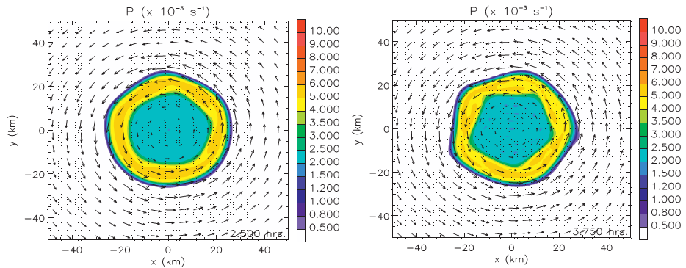

Slide 29
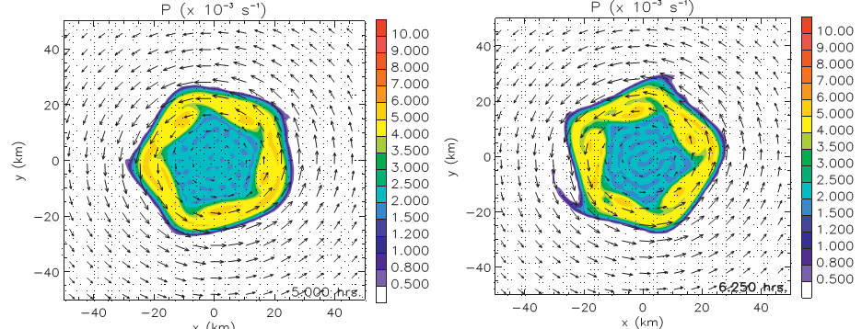

Slide 30
Barotropic instability of a vortex with Dolly’s observed radial vorticity profile can produce the high azimuthal wavenumber asymmetric variability of similar structure and on similar time scales that were observed.

Slide 31
Summery
The most likely cause of the high-wavenumber asymmetries is a convectively modified form of dynamic instability of a thin potential vorticity ring.
The asymmetric mixing of high PV air from the eyewall into the eye
The internal vortex dynamics were dominant contributors to the rapid intensification and deepening.
Notes:
離心力+科氏力+氣壓梯度力=0
The asymmetric mixing of high PV air from the eyewall into the eye increases the centrifugal term in the gradient wind balance equation.
到底這樣的不對稱性是加強還是減弱氣旋各有說詞

Slide 32
Thanks for your listening!

Slide 33
Rankine vortex

Slide 34
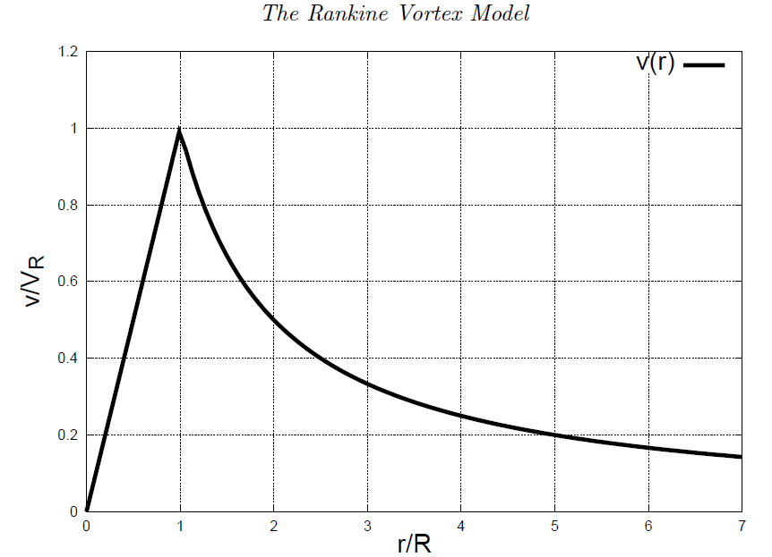

Slide 35
