Slide 1
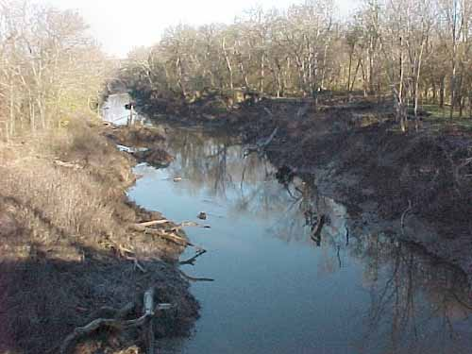
A Method for Evaluating the Accuracy of
Quantitative Precipitation Estimates from a Hydrologic Modeling Perspective
Gourley, Jonathan J., Baxter E. Vieux, 2005: A Method for Evaluating
the Accuracy of Quantitative Precipitation Estimates from a
Hydrologic Modeling Perspective. J. Hydrometeor, 6, 115–133.
Speaker: Yi-Jui ,Su
Advisor:
Professor Ming-Jen,Yang
Date : 2013/05/21

Slide 2
Outline
Introduction
Methodology
Work flow
Results and discussion
Conclusions
References
Ranked probability score (RPS)
Vlfo model
QPE data

Slide 3
introduction
The ensemble approach can provide a setting user-specified ranges and be more objective
∵it’s not a designed to favor a model input
The unique methodology has been developed to evaluate the relative skill of hydrologic simulations using different QPE inputs
Analyze the accuracy of the multisensor to QPE on hydrologic simulation

Slide 4
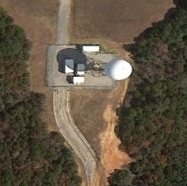
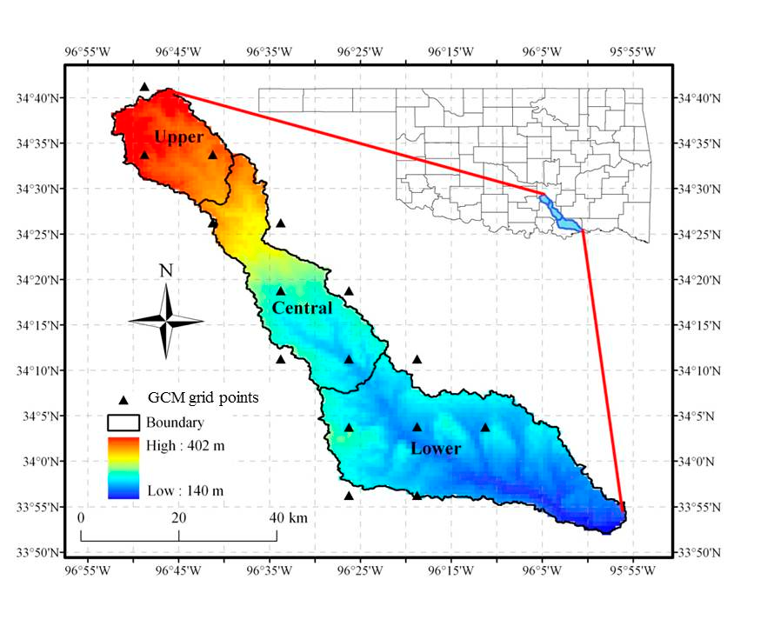
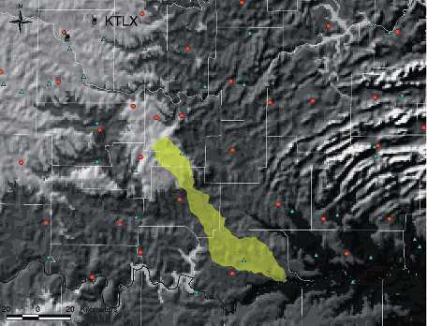
introduction
Background
Blue River basin, Oklahoma
Hourly discharge observations
from USGS
KTLX (WSR-88D)
(site number 07332500)
Notes:
Blue River basin, Oklahoma
是密西西碧和的支流中
Red river 的一小段
KTLX雷達跟上游距離80KM
下游距離200KM
可能因為距離太遠而有迴波上的誤差

Slide 5

Methodology
QPE data
GAG (gauge only)
Oklahoma Meso-network(Mesonet)
1km x 1km common grid using a Barnes scheme (Barnes 1964)
RAD (radar only)
Data from KTLX
Empirical formula : (Woodley et al. 1975)
MS (multisensor)
By QPESUMS (Gourley et al.2001)
Complex from radar, numerical models and infrared satellite data
Gauge-adjustment for RAD and MS
註1
Notes:
Gag
Incorporated on an hourly bias
RAD
在卡是做標
資料來源KFWS NEXRAD
ms
使用National Severe Storms Laboratory are evaluated in this study.
使用QPESUMS來估計結合雷達 模式 衛星 的資料
利用自動尋找melting layer來捨掉受汙染的直
而亮帶會造成估計的高估
目標是分析MS在水文模式中的準確性

Slide 6





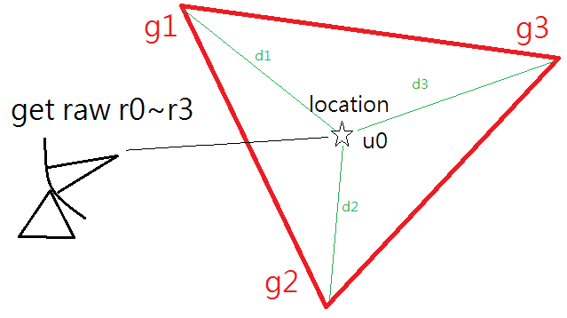

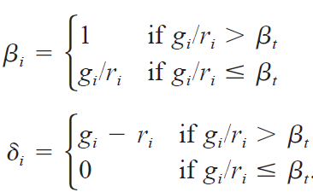

Methodology
Gauge-adjustment
Mean field bias adjustments (-G)
Local bias adjustment (-LG)
(Wilson and Brandes 1979)
(Seo and Breidenbach 2002)
where
( βt is the threshold for multiplicative sample bias )
Notes:
-g 假設調整後的R跟G的差異維0er
an adaptable parameter,
denotes the threshold for the multiplicative sample bias
當雨量筒相對估計值的bias較大時 (g/r>b) 則是將位置點資料加上 (雨量筒跟估計值的差值)
當雨量筒相對估計值得BIAS較小時 ( < ) 則將位置點的資料乘以其bias 以放大

Slide 7
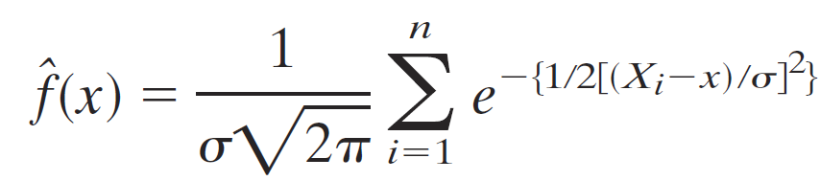

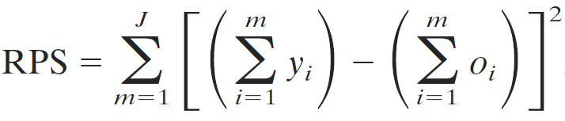

Methodology
Ranked probability score (RPS)
For the ensemble results, we use the Gaussian kernel density estimation to get the probability density function (pdf). (Silverman 1986)
To assess the ensemble skill, we use the ranked probability score (RPS; Wilks 1995)
, where
↙ J is the event number

Slide 8
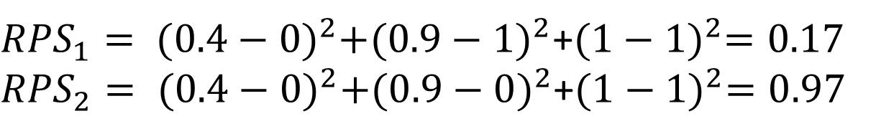
Methodology
Ranked probability score (RPS)
Example:
If the threshold table of the pdfs as
the cumulative distribution function (cdf)
Pdfs table | 0~0.5 mm | 0.6mm ~4 mm | >4mm
Case1 | 0 | 1 | 0
Caer2 | 0 | 0 | 1
Forecast | 0.4 | 0.5 | 0.1
Pdfs table | 0~0.5 mm | 0.6mm ~4 mm | >4mm
Case1 | 0 | 1 | 1
Caer2 | 0 | 0 | 1
Forecast | 0.4 | 0.9 | 1
${RPS}_{1}= {(0.4−0)}^{2}+{(0.9−1)}^{2}$+${(1−1)}^{2}=0.17$
${RPS}_{2}= {(0.4−0)}^{2}+{(0.9−0)}^{2}$+${(1−1)}^{2}=0.97$

Slide 9
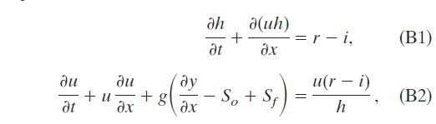



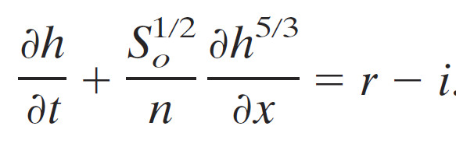

Methodology
Vlfo model (Vieux and Vieux 2002)
By the 1D conservation of mass and momentum equations :
i :Soil infiltration rate
r :Rainfall rate
S0: bed slope
Sf: friction slope
For the kinematic wave, the order of slope >> other forcing:
, and we assume that it’s subcritical
The Mannig’s equation in SI units:
;
As w>>h
↖ R is the hydraulic radius
Substituting all into (B1), we got the governing equation used in the Vlfo model:
Notes:
Subcritical =>neglect the backwater effect

Slide 10
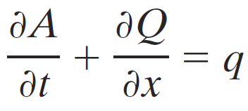


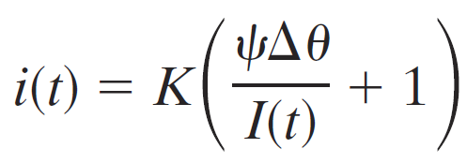

Methodology
Vlfo model (Vieux and Vieux 2002)
Overland flow
Channelized flow
The soil infiltration rate ( i ) use the Green-Ampt equation
To compute the cumulative infiltration (I),
we should know K, ψand θ
, and

Slide 11
Methodology
The variable inputted
n : Manning coefficient
r : rainfall rate
A: Cross-sectional area
Q : channel flow rate
S0: bed slope
K: saturated hydraulic conductivity
ψ: soil suction at wetting front
(as 1/K ,Chow et al.1998)
θ: initial fractional water content

Slide 12

Work flow
Vlfo model
QPE
DEM
GAG
RAD
MS
S0: bed slope
Flow property
STATSGO
Initial soil properties like K,ψand n
Parameter maps(i=0~4)
The scalars for K and n :
θ from 20% to 100% (+20% *i)
-G
-LG
K | 25% | 62.5% | 100% | 137.5% | 175%
n | 25% | 62.5% | 100% | 137.5% | 175%
θ | 20% | 40% | 60% | 80% | 100%
7 rainfall inputs
125 ensemble
Notes:
DEM 數值地形模式
STATSGA 區域土壤地理資料庫

Slide 13




Work flow
The time of maximum discharge
125 ensemble
Time
peak
volume
Compare to the observation
Runoff
coefficient
Bias
Mean absolute error
Root-mean-square error
Mean value
The
maximum peak
The total
discharge volume
Probability distribution function (pdf)
Cumulative distribution function (cdf)
Ranked probability score (RPS)
Notes:
觀測的流量資訊有固有的3~6%的誤差 (sauar and Meyer 1992)
The pdf 提供水文系集模擬結果的分佈資訊 ,而這無法從一般統計分析上得到
CDF involves deriving the region in the phase space where
CDF 代表90%模擬坐落的相位空間
RPS可提供系集分佈和實際發生的契合分數

Slide 14
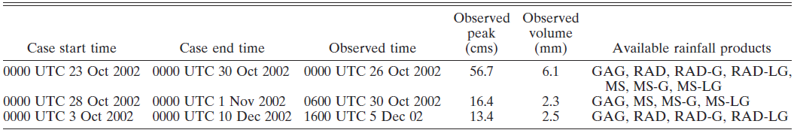
Results & discussion
Three case as follow
We just discuss the first case and its result

Slide 15
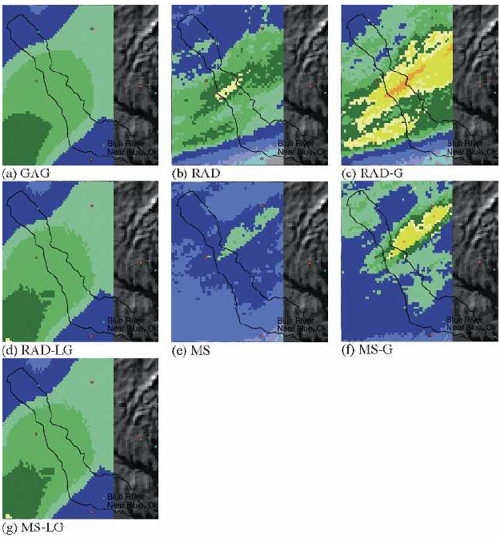
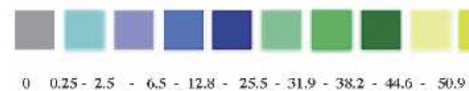
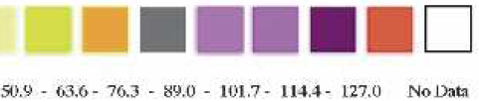
Results & discussion
Case1: 23 Oct 2002
Total precipitation
-G maintain the pattern
-LG smooth the spatial details
The KTLX radar was miscalibration and overestimate. (Gourley et al.2003)

Slide 16
Case 1
MS
MS
RAD
Time
Peak
RAD-G
MS
Volume
Discharge
Notes:
四張分佈圖分別是 最大流量發生時間
最大峰值
總量
跟實際觀測的流線圖，
圖中粗直線式實際觀測的值，可以看到各種資料的pattern都是呈現雙峰分佈，
而這雙峰的分佈就是代入不同參數空間的結果
從做圖中基本上很難看出各個的細部過程 ，只看得出MS的表現和其他的資料最不相同
而且在各個輸出結果上，MS的分佈都是數值最低的，速度最快，
表示MS可能在原本的資料上就有低估降水的情形

Slide 17

Case 1
In the PDF pattern, Bimodal shape caused by the parameter maps set in the Vlfo model.
The members of θ set as 100% have higher peak and volume mode, but lower time density
∵ the nonlinear effect for the soil infiltration rate
↖ The infiltration as ponding
Notes:
在PDF 的圖形中，大部分的分佈都呈現雙峰形狀的分佈，而作者細看這些分佈後，發現這些峰值是因為不同參數空間帶入Vlfo模式的結果
而其中，最敏感的參數就是 初始土壤飽和度θ ，作者發現當θ射為飽和時的成員都會有較大的peak 跟VOLUME值的峰中，
但時間的分佈卻較為分散
這是因為當初始的土壤飽和度θ決定了土壤入滲的非線性作用的影響，
當θ為飽和時，在土壤上方產生的積水可能造成土壤更容易產生地下水回流效應
使得造成高流量的時間很難預報
但是流量的值卻會特別高

Slide 18
Case 1
Time
Peak
overestimate
GAG RAD RAD-G RAD-LG MS MS-G MS-LG
GAG RAD RAD-G RAD-LG MS MS-G MS-LG
Volume
overestimate
GAG RAD RAD-G RAD-LG MS MS-G MS-LG
Notes:
而將各個資料的PDF整理成CDF表示如此圖所示，可以看到在時間上RAD-G是最接近觀測的，
PEAK上則是RAD跟MS-G最接近，RAD-LG跟RAD-G都嚴重高估
VOLUME則是MS最接近,RAD-G和 –LG依樣高估 甚至沒包含到觀測值

Slide 19
Case 1
RAD-G have the best performance in Time
The MS ,MS-G are bad predictions in Time, but good in Peak and Volume
Having more relationship with the gauge data(GAG,RAD-LG,MS-LG) will tend to have better performance in time than in peak and volume
-LG were bad in Peak and Volume
Notes:
從統計圖表中可以看到
首先和前面CDF得圖呼應的是，在前面表現很好的點，都有著比較高的分數
MS MS-G雖然對TIME的模擬很差，但是在PEAK跟VOLUME卻都不錯
因為RAD的反衍資料是高估的，所以會造成RAD的降雨量是較高，進而影響到

Slide 20
Summary and conclusions
Setting the range of parametric uncertainty and the algorithms of objectively evaluating QPE provide more objective estimation.
θ is a important parameter for infiltration, we need the initial data and the spatial variability.
Ranked probability score (RPS) can show the capability for ensemble forecast.

Slide 21
Summary and conclusions
Rain gauge data can’t provide a accurate depiction of the spatial variability of the rainfall field .
Satellite data may play an important role in QPE where ground-based radar cannot obtain a representative, low-level sample.

Slide 22
Summary and conclusions
Mean field bias adjustment(-G) have better result than local bias adjustment (-LG) in the hydrologic simulation.
∵ -LG emphasis on individual rain gauge measurements, and the spatial details in original rainfall field are smoothed.
-G
-LG
在雷達資料的空間分佈下做變化，但會因降雨分布跟雨量筒位置的關係而錯估降雨
保留相較於雨量計資料高估的估計，而低估部分則是雨量計的線性內差
Notes:
當雨量筒相對估計值的bias較大時 (g/r>b) 則是將位置點資料加上 (雨量筒跟估計值的差值)
當雨量筒相對估計值得BIAS較小時 ( < ) 則將位置點的資料乘以其bias 以放大

Slide 23
References
Gourley, Jonathan J., Baxter E. Vieux, 2005: A Method for Evaluating the Accuracy of Quantitative Precipitation Estimates from a Hydrologic Modeling Perspective. J. Hydrometeor, 6, 115–133.
Wilks, D. S., 1995: Statistical Methods in the Atmospheric Sciences: An Introduction. Academic Press, 467 pp.
Seo, D.-J., and J. P. Breidenbach, 2002: Real-time correction of spatially nonuniform bias in radar rainfall data using rain gauge measurements. J. Hydrometeor., 3, 93–111.
Wilson, James W., Edward A. Brandes, 1979: Radar Measurement of Rainfall—A Summary. Bull. Amer. Meteor. Soc., 60, 1048–1058.
Oklahoma Water Survey : http://oklahomawatersurvey.org/?p=387
The KTLX radar : http://weather.gladstonefamily.net/site/KTLX

Slide 24
Thanks for Your Attention

Slide 25
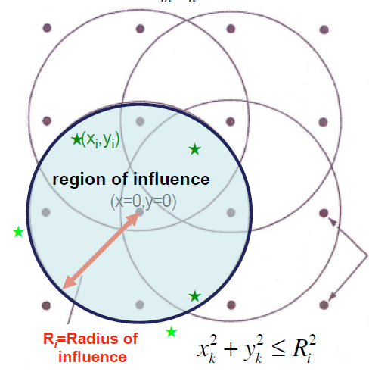



補充
Barnes Objective analysis
Applies a Gaussian Weighting function
the first guess space
The analysis points
,where
Just the function of relative distance
d
Γ =[0,1]
Back
圖片來源 Dr. Shu-Chih Yang, data assimilation class

Slide 26
Case 1
Significances levels of RPS differences
MS is significantly different from others

Slide 27
Results & discussion
Case2: 28 Oct 2002
Notes:
在ms沒資料的區域，lg會給予跟gag相同分佈的資訊

Slide 28
Case2

Slide 29
Case2
Time
Peak
Volume

Slide 30
Case2
Time
Peak
Volume

Slide 31
Results & discussion
Case3: 03 Dec 2002

Slide 32
Case3

Slide 33
Case3
Time
Peak
Volume

Slide 34
Case3
Time
Peak
Volume

