Slide 1
Assessing the Impacts of Different WRF Precipitation Physics in
Hurricane Simulations
NASRIN NASROLLAHI, AMIR AGHAKOUCHAK, JIALUN LI, XIAOGANG GAO,
KUOLIN HSU, AND SOROOSH SOROOSHIAN
Center for Hydrometeorology and Remote Sensing, University of California, Irvine, Irvine, California
(Manuscript received 14 July 2010, in final form 23 February 2012)
指導教授:楊明仁 老師
報告者:鍾宜娟
報告日期:2013/5/14
Nasrollahi, N., A. AghaKouchak, J. Li, X. Gao, K. Hsu, and S. Sorroshian, 2012: Assessing the impacts of different WRF precipitation physics in hurricane simulations. Wea. Forecasting, 27, 1003–1016.

Slide 2
Introduction
Previous studies showed that microphysics and cumulus schemes are the most sensitive model parameterizations among other physics options for weather prediction models.
➔ Gallus (1999) and Wang and Seaman (1997) also confirmed the influence of cumulus schemes in simulations of precipitation patterns.
➔ Jankov et al. (2007) examined various combinations of cumulus convection schemes, microphysical options, and boundary conditions.
Their results showed that no configuration was significantly better at all times.
Furthermore, the variability of predictions was more significant with respect to the choice of the cumulus option. However, to a lesser extent, the choice of microphysical scheme affected the variability of the predictions.
➔ Lowrey and Yang (2008) investigated major precipitation errors that arose from physical and cumulus parameterizations, and concluded that precipitation is actually more sensitive to cumulus schemes than to cloud microphysics options.

Slide 3
Introduction
This study will assess the impact of different WRF parameterization schemes on predicted precipitation, hurricane track, and time of landfall, for Hurricane Rita.
A total of 20 combinations of microphysics and cumulus schemes were used, and the model outputs were validated against ground-based observations.
Notes:
This study investigated the performance of the WRF in forecasting
precipitation, hurricane track, and landfall time using various microphysics and cumulus schemes.

Slide 4
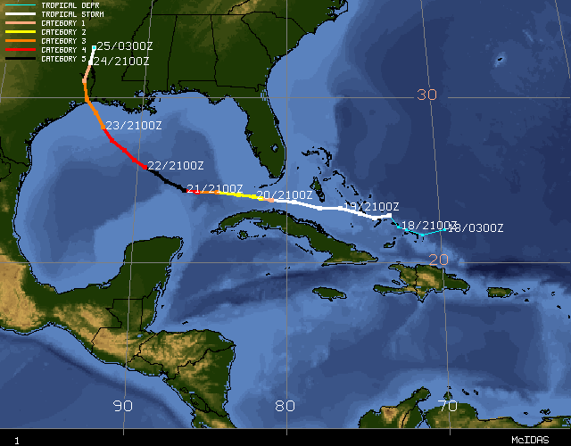
Hurricane Rita
2005/9/18
Hurricane Rita made landfall with windspeeds of 120 mph along the Texas/Louisiana border early on September 24th.
此圖取自http://www.ncdc.noaa.gov/img/climate/research/2005/rita/ritatrack-cimss.gif
Notes:
mph : miles per hour

Slide 5
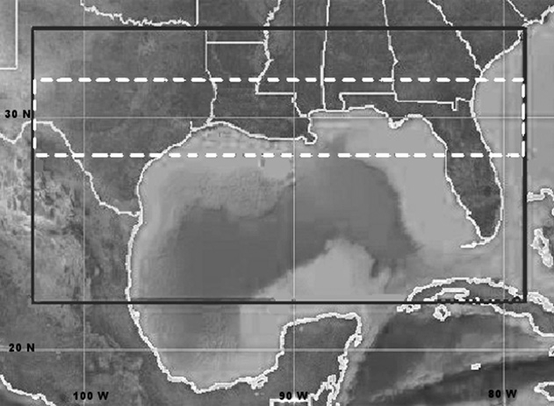
Model configuration
WRF version 2.2 was used to
simulate Hurricane Rita.
Black box : Domain consisting of
575 × 320 grid points, 4-km grid
size, and 28 vertical levels.
Dashed box : The area used for
the model and data comparison .
(area:2300 km×400 km with
575×100 grid cells of 4 km).
The simulation began at 1200 UTC 21 September 2005, and continued until
1200 UTC 25 September 2005.
The reference precipitation measurements are based on the
stage IV precipitation data.
(Multisensor radar-based gauge-adjusted precipitation data available from NCEP.)
The best estimate of the hurricane track obtained from the NHC
(National Hurricane Center).
Notes:
In all simulations, the 6-hourly analyses from the Global Forecast System (GFS), developed by the National
Centers for Environmental Prediction (NCEP), were used as the initial and boundary conditions of the model.
The simulation was performed in ‘predictive’ mode, with observations only updated at boundaries throughout
the simulation (i.e., no observation assimilation).

Slide 6
Model configuration
A total of 20 combinations of microphysics and cumulus schemes were investigated.
Microphysics schemes
Cumulus parameterizations
Purdue Lin (LIN)
Kessler (KES)
Ferrier (FER)
WRF singlemoment three-class microphysics scheme (WSM3)
WRF singlemoment five-class microphysics scheme (WSM5)
Kain–Fritsch (KF)
Betts–Miller–Janjic´ (BMJ)
Grell–Devenyi (GD)
No cumulus parameterization (NCP)

Slide 7
Results and discussion
a. Precipitation
b. Hurricane track
c. Time of landfall

Slide 8
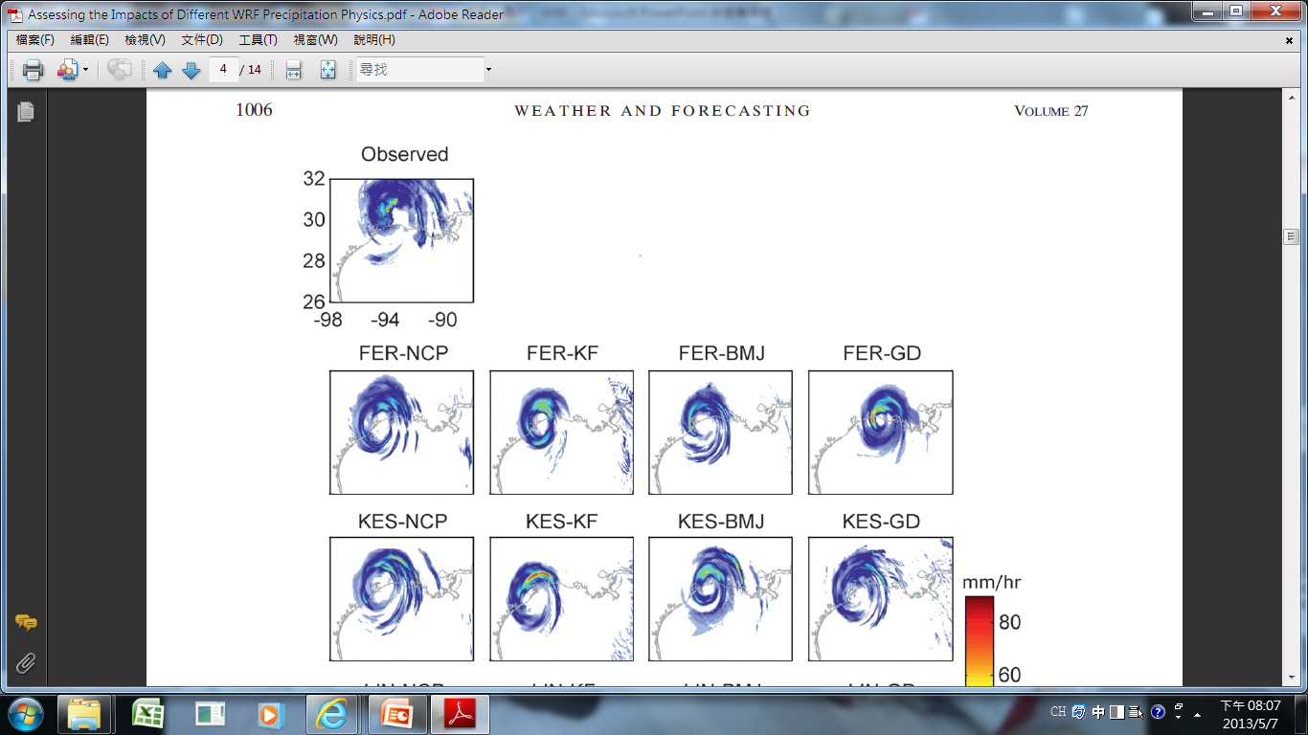
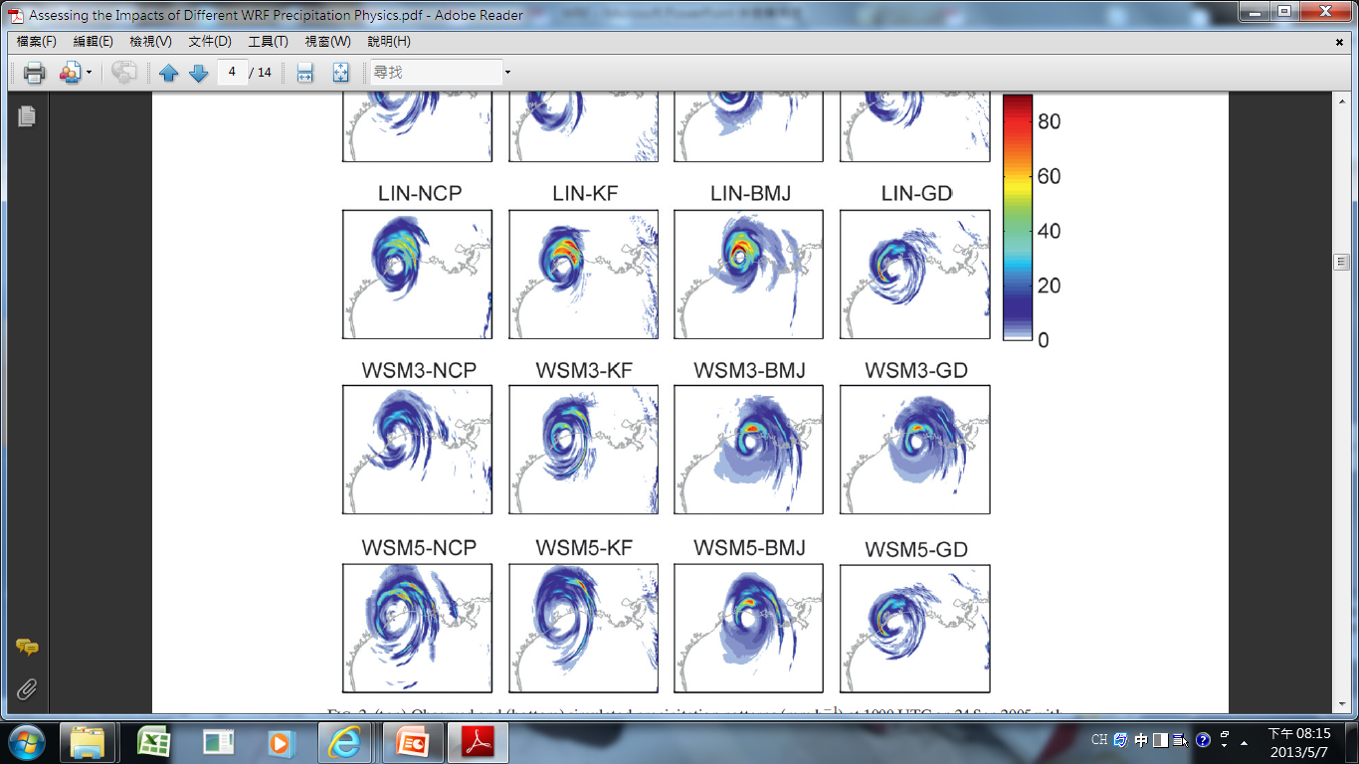
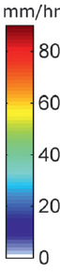
Observed and modeled precipitation patterns at 1000 UTC 24 September 2005.

Slide 9
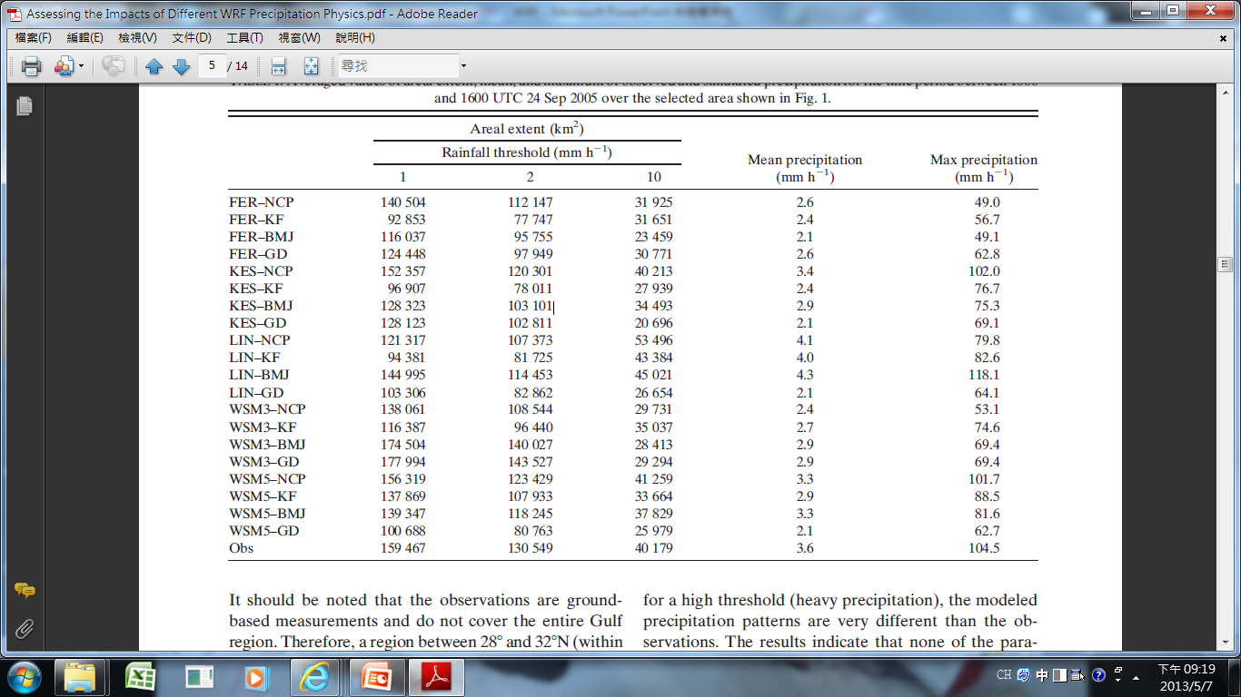
Averaged values of areal extent, mean, and maximum precipitation for the time period between 1000 and 1600 UTC 24 Sep 2005.
Notes:
The areal extent of the storm was calculated as the number of grid pixels (WRF grid point, hereafter pixel)
that exceed a specified rainfall threshold, multiplied by the pixel size.
Table 1 lists the areal extents computed based on three thresholds (1, 2, and 10 mm h21).

Slide 10
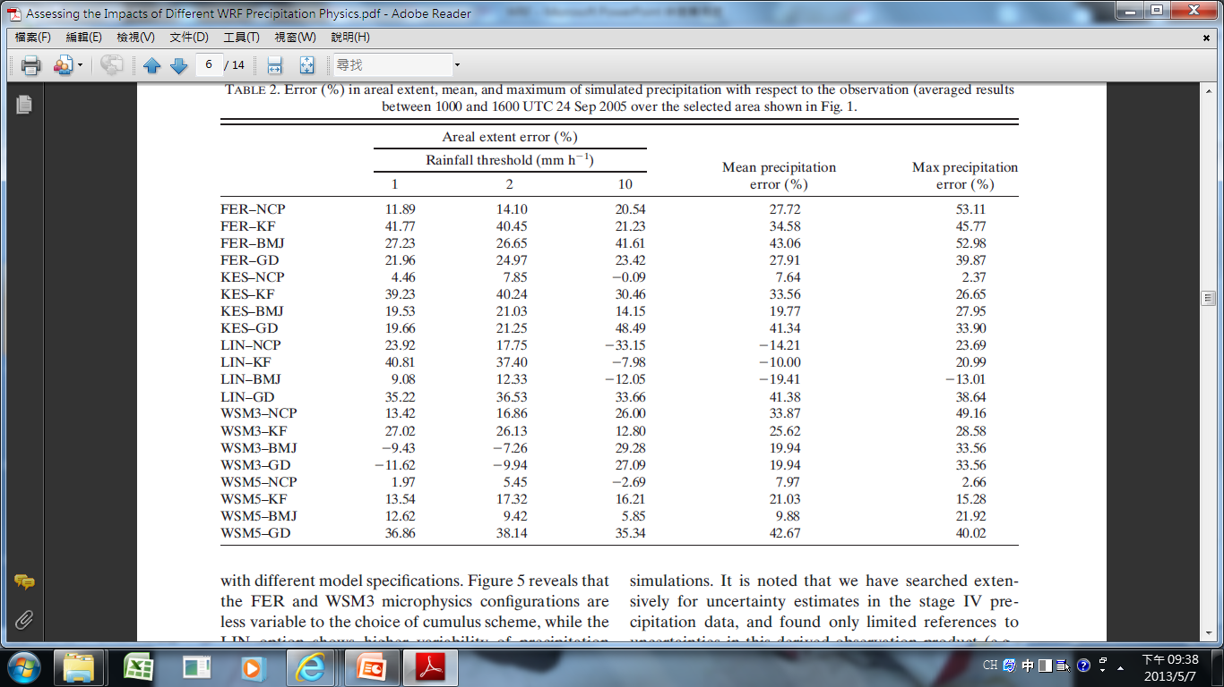
The error (%) of the modeled precipitation with respect to the observations.

Slide 11
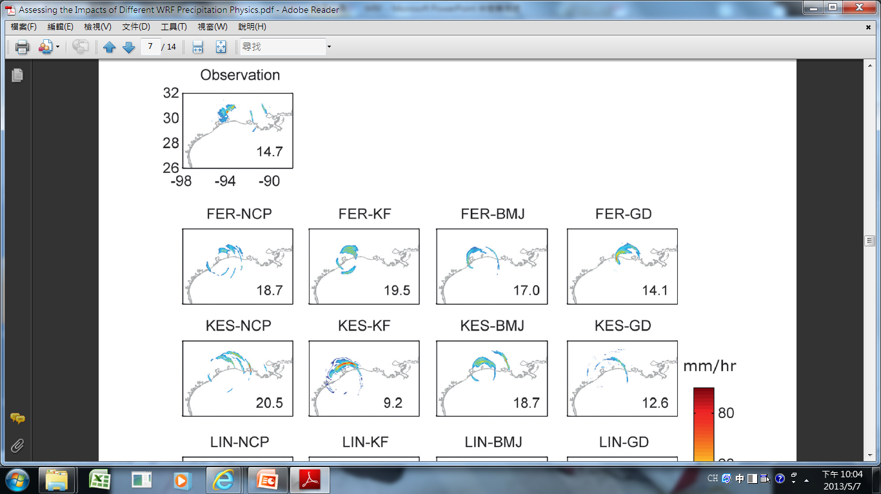
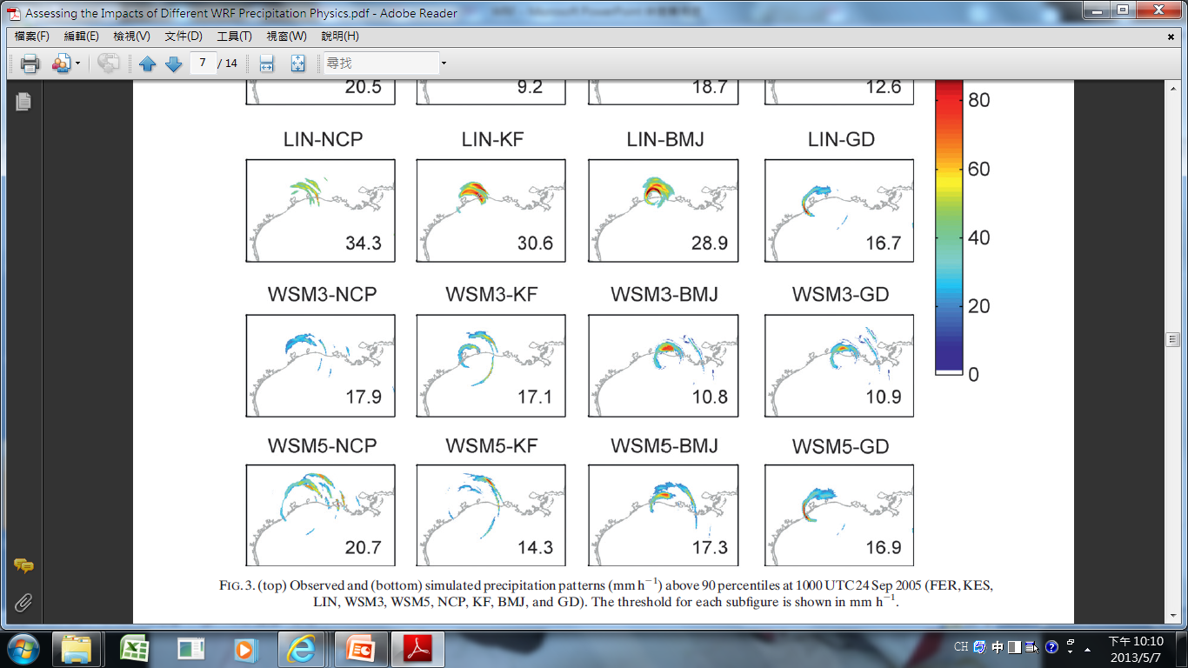
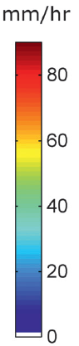
Observed and simulated precipitation patterns above 90 percentiles at 1000 UTC
24 Sep 2005.

Slide 12
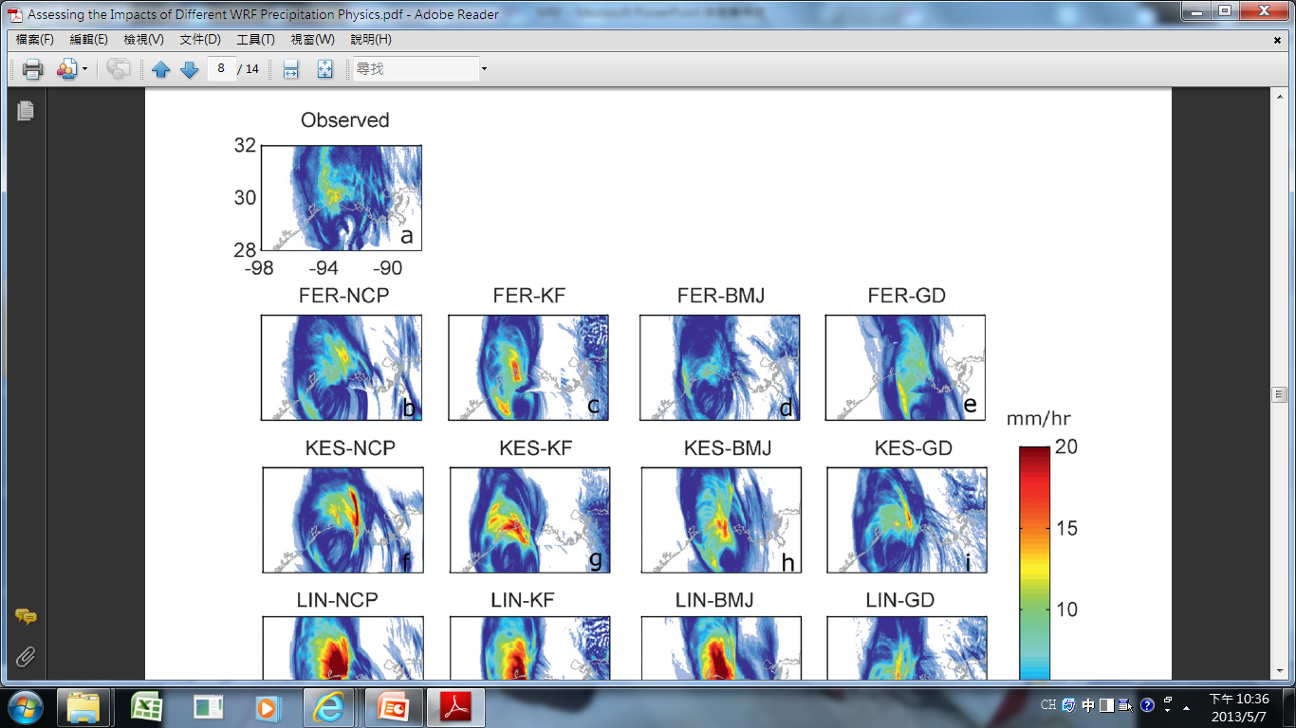
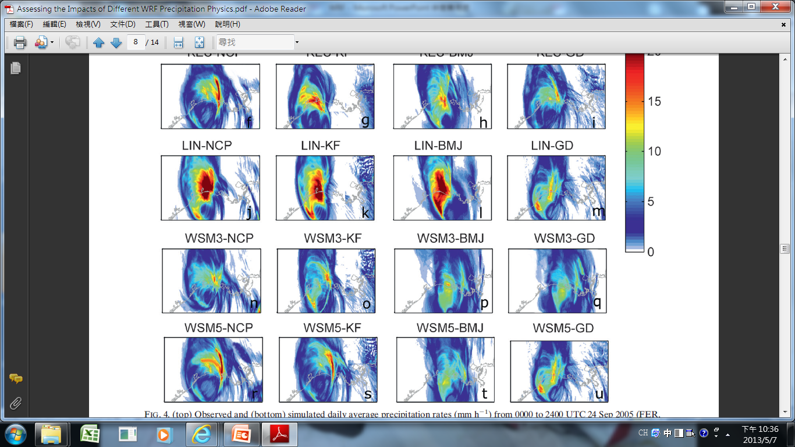
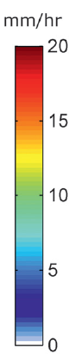
Observed and simulated daily average precipitation rates from 0000 to 2400
UTC 24 Sep 2005.

Slide 13
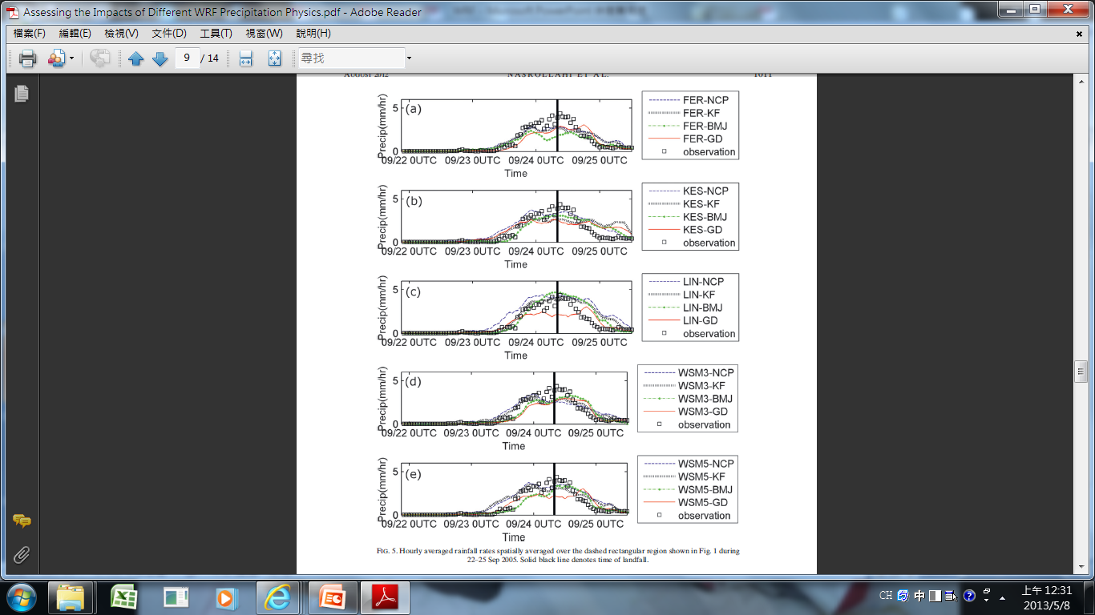
Hourly averaged
rainfall rates
spatially averaged
over the dashed
rectangular.
9/24 0740UTC

Slide 14
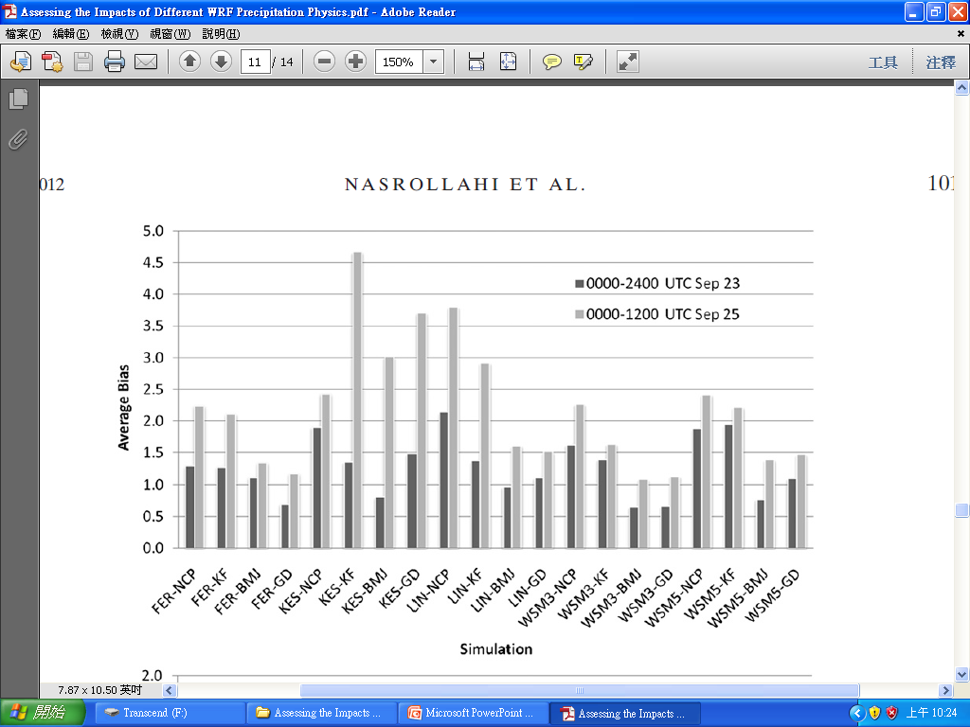
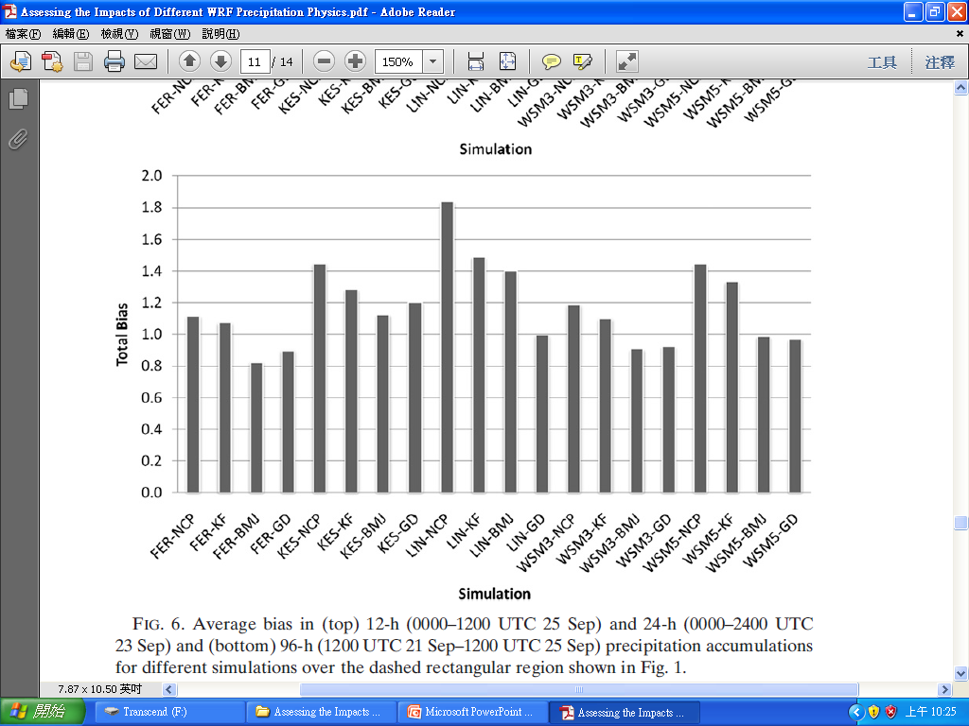
Biases of precipitation accumulations.
Average bias
in 24-h (prior to landfall)
and 12-h(after landfall)
precipitation accumulations.
Total bias
96-h precipitation accumulations
(1200 UTC 21 Sep–1200 UTC 25 Sep)

Slide 15
Results and discussion
a. Precipitation
b. Hurricane track
c. Time of landfall

Slide 16
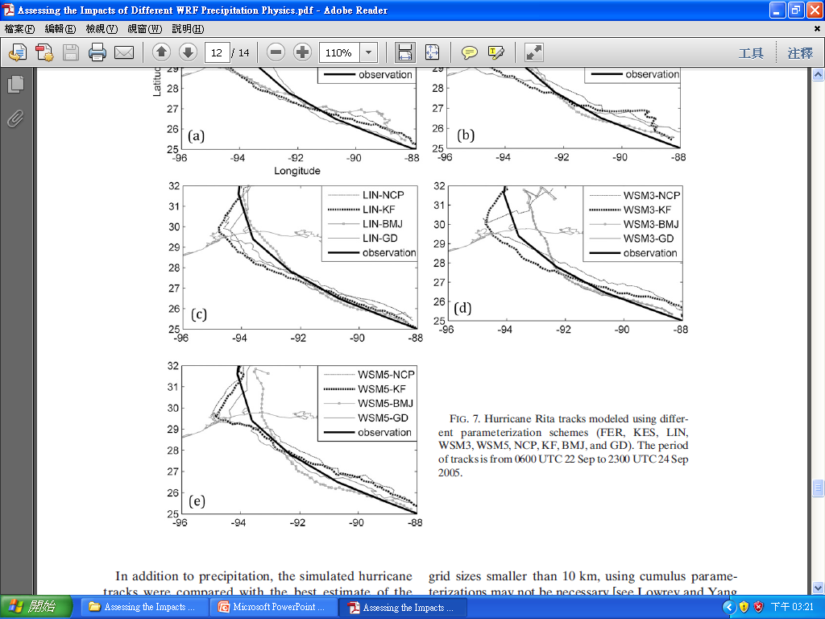
Simulated and observed hurricane tracks.
The period of tracks is from
0600 UTC 22 Sep to 2300 UTC 24 Sep 2005.

Slide 17
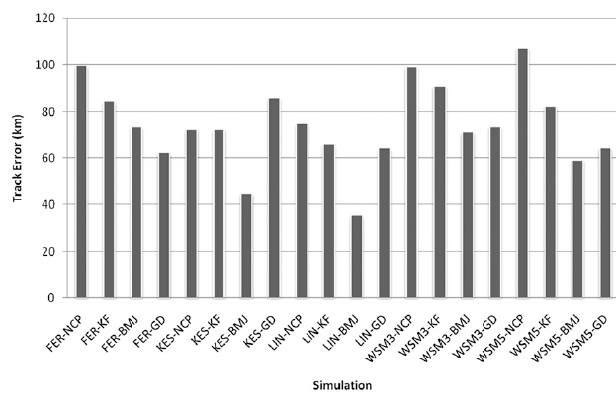
An average of the track error throughout the 4-day model simulation is computed with respect to the observed track.
FER
KES
LIN
WSM3
WSM5

Slide 18
Results and discussion
a. Precipitation
b. Hurricane track
c. Time of landfall

Slide 19
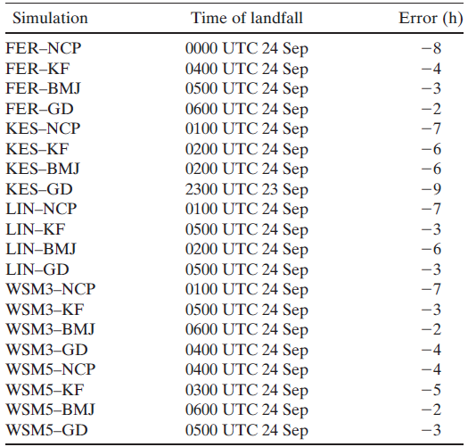
Time of landfall predicted by various parameterization.
The National Hurricane Center (NHC) reported that 0740 UTC 24 September 2005
was the best estimate of the time of landfall.

Slide 20
Summary and conclusions

Slide 21
Summary and conclusions
No single combination can be considered ideal for modeling precipitation amount, areal extent, hurricane track, and the time of landfall.
Precipitation
Precipitation areal extent
➔For lower thresholds(1,2 mm/h) : WSM5 option led to the least amount of error.
For a higher threshold (10 mm /h) : KES scheme led to the least error.
➔The WSM3 and WSM5 physics options were superior to the others.
Total amounts of daily precipitation
➔ The simulation scenarios were found to overestimate precipitation accumulation.
➔ None of the physics and cumulus options provided reliable estimates of heavy
precipitation patterns and locations.
➔The results for the BMJ and GD schemes are better than NCP and KF.
Simulations with no convective scheme(NCP) lead to higher bias.
LIN–GD, WSM5–BMJ, and WSM5–GD resulted in a more reasonable bias.
➔The model’s ability to simulate precipitation is best achieved using WSM5–BMJ.
Notes:
Furthermore, the results revealed that the overestimations were higher over land than over the Gulf region.

Slide 22
Summary and conclusions
Hurricane tracks
➔ The model outputs deviated more from each other as simulation time
increased and the hurricane approached the land.
➔ The LIN and KES microphysics options and the BMJ cumulus scheme (LIN–BMJ
and KES–BMJ) provided the best hurricane track forecasts.
Time of landfall
➔ WSM5–BMJ, WSM3–BMJ, and FER–GD were the best combinations for simulation of the landfall time.
Some studies have suggested that, for grid sizes smaller than 10 km, using cumulus parameterizations may not be necessary. However, the results of this study indicate that the use of cumulus schemes improves the model output.

Slide 23
The End

Slide 24
It should be noted that the results of this study are based on one case study and cannot be generalized for different climate conditions. Future studies using different model configurations for different climate regions are required to validate the results at different climate conditions.
Not using the positive-definite transport scheme for moisture may also contribute to large positive bias in surface precipitation.

Slide 25
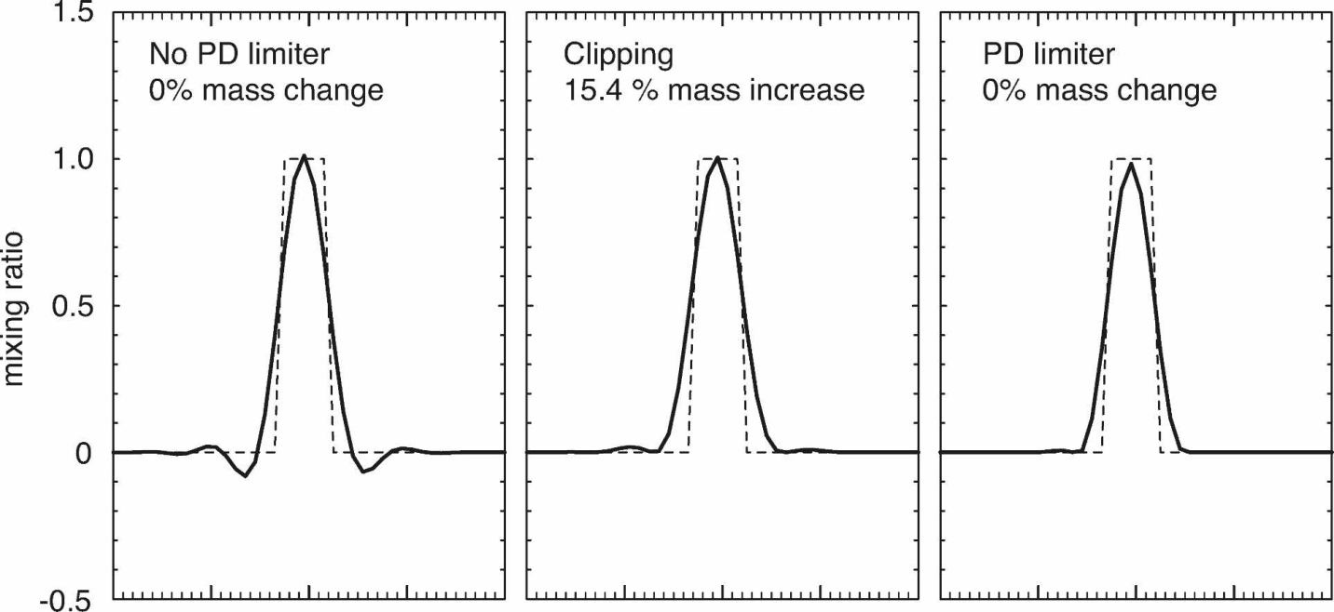
Positive-definite transport scheme
The positive-definite scheme eliminates spurious sources of water arising from the clipping of negative moisture values in the non-positive-definite model formulation.
Clipping refers to setting any negative mixing ratios to zero after the transport step is
complete.
The clipping removes the
negative moisture values but
results in an approximately
15.4% increase in the
integrated tracer mass.
Mass is no longer
conserved when clipping
negative mixing ratios
Notes:
Clipping refers to setting any negative mixing ratios to zero after the transport step is complete.
The clipping removes the negative moisture values but results in an approximately 15.4% increase in the integrated tracer mass.
Mass is no longer conserved when clipping negative mixing ratios—it is increased by the amount of clipped
tracer mass.

Slide 26
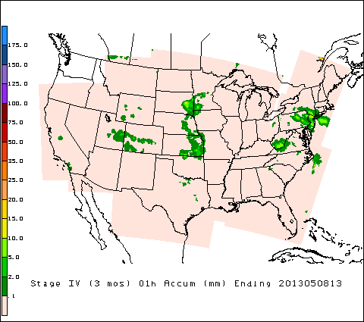
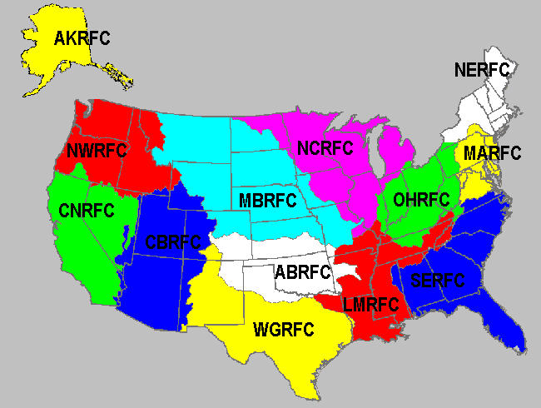
Hourly Precipitation Analysis at NCEP/EMC
Stage IV: Mosaiced from the regional multi-sensor analyses generated
by the RFCs
Mosaiced into a national product at NCEP, from the regional hourly/6-hourly multi-sensor (radar + gauges) precipitation analyses produced by the 12 River Forecast Centers (RFCs) over CONUS. Some manual QC done at the RFCs. Mosaic done at NCEP within an hour of receiving any new hourly/6-hourly data from one or more RFC.
參考資料 : http://www.emc.ncep.noaa.gov/mmb/ylin/pcpanl/stage4/
Notes:
Stage II: NCEP National Multi-sensor Hourly Precipitation Analysis
Generated at NCEP, from hourly radar precipitation estimates and from hourly gauge reports. Generated at ~35 minutes after the top of the hour, and again at T+6h and T+18h. No manual QC.
CONUS -- Continental United States

Slide 27
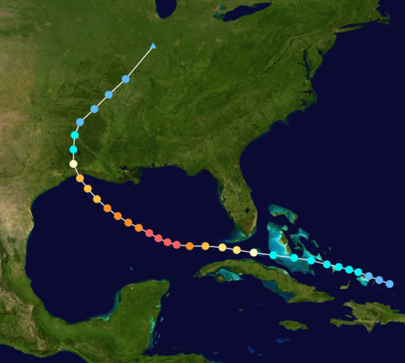
Hurricane Rita
9月24日凌晨3時30分，颶風「麗塔」挾強勁風力在得州薩賓帕斯與路易西安納州卡梅倫之間的海岸地區登陸，對德克薩斯州和路易西安納州形成威脅。
此圖取自http://zh.wikipedia.org/wiki/%E9%A3%93%E9%A3%8E%E4%B8%BD%E5%A1%94

Slide 28
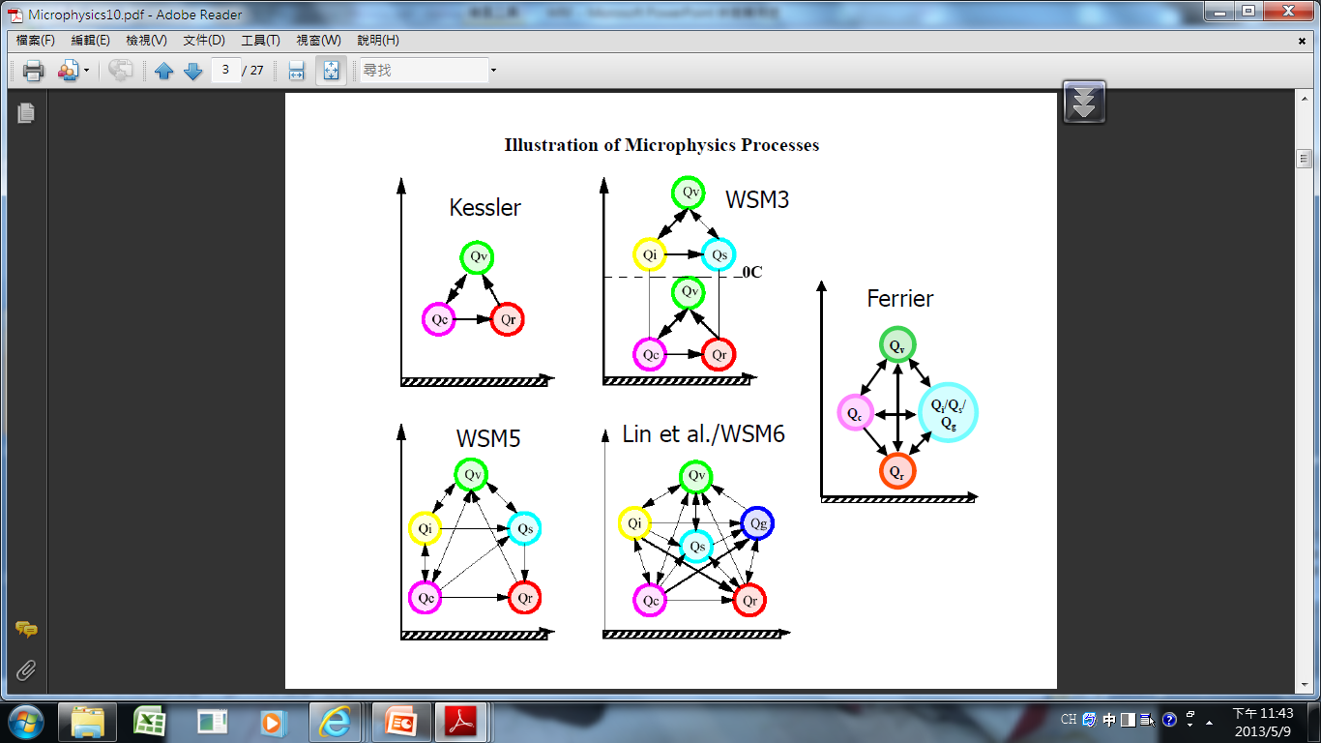
Microphysics Processes
此圖取自 http://www.mmm.ucar.edu/wrf/users/workshops/WS2010/presentations/Lectures/Microphysics10.pdf

Slide 29
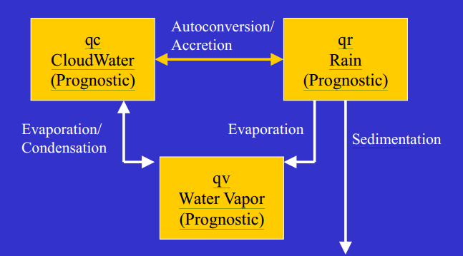
Kessler(KES)
Warm rain and no ice
- Separate liquid into cloud water and rain.
Idealized microphysics
Time-split rainfall
此圖取自http://www.mmm.ucar.edu/wrf/users/workshops/WS2010/presentations/Lectures/morrison_wrf_workshop_2010_v2.pdf

Slide 30
WRF singlemoment three-class microphysics scheme(WSM3)
3-class microphysics with ice
(cloud/ice, snow/rain, vapor)
Ice processes below 0 deg C
Ice sedimentation
Semi-lagrangian fall terms in V3.2
Notes:
Simple ice
Semi-lagrangian fall terms in V3.2

Slide 31
WRF singlemoment five-class microphysics scheme(WSM5)
5-class microphysics with ice
(cloud, ice, snow, rain, vapor)
Supercooled water and snow melt
Ice sedimentation
Semi-lagrangian fall terms in V3.2
Notes:
Mixed phase
Semi-lagrangian fall terms in V3.2

Slide 32
Purdue Lin (LIN)
6-class microphysics including graupel
(cloud, ice, snow, rain, graupel, vapor)
Includes ice sedimentation and time-split fall terms

Slide 33
Ferrier (FER)
Single moment scheme
Designed for efficiency
– Advection only of total condensate and vapor
– Diagnostic cloud water, rain, & ice
(cloud ice, snow/graupel)
Supercooled liquid water & ice melt
Variable density for precipitation ice (snow/graupel/sleet) – “rime factor”
Notes:
Advects total condensate and water vapor
(This unique aspect makes it computationally efficient
Most other schemes advect each species separately)
sleet (frozen raindrops)

Slide 34
cumulus schemes
積雲參數法在積雲產生過程和降水計算皆有所不同。
Betts-Miller-Janjic 積雲參數法於深對流之建立時，將模式之熱力和濕度調整至一準平衡狀態
KF 積雲參數法之對流程度則透過格點上之對流可用位能決定（CAPE）
GD 積雲參數法為一系集積雲參數法，其對流之動力控制則由CAPE、低層垂直風和濕度輻合等決定

Slide 35
Kain–Fritsch (KF)
The KF scheme is a mass flux parameterization. It uses the Lagrangian parcel method (e.g., Simpson and Wiggert 1969; Kreitzberg and Perkey 1976), including vertical momentum dynamics (Donner 1993), to estimate whether instability exists and, if so, what the properties of convective clouds will be.

Slide 36
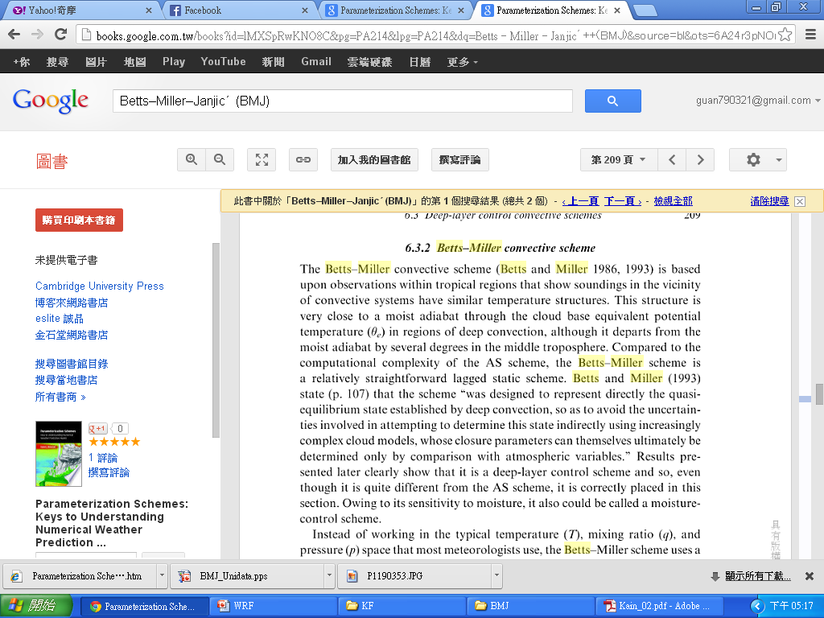
Betts–Miller–Janjic´ (BMJ)
http://books.google.com.tw/books?id=lMXSpRwKNO8C&pg=PA214&lpg=PA214&dq=Betts%E2%80%93Miller%E2%80%93Janjic%C2%B4++(BMJ)&source=bl&ots=6A24r3pNOm&sig=gqE_dBm5bFMGPoN6rjb1_o8Ac8s&hl=zh-TW&sa=X&ei=07CMUbLeAoWbkwXs3YGwDg&ved=0CGIQ6AEwBg#v=onepage&q=Betts%E2%80%93Miller%E2%80%93Janjic%C2%B4%20%20(BMJ)&f=false

Slide 37
Grell–Devenyi (GD)

Slide 38
microphysics option vs cumulus parameterization
The microphysics option provides atmospheric heat and moisture tendencies. It also accounts for the vertical flux of precipitation and the sedimentation process (Skamarock et al. 2007).
The cumulus parameterization is used to vertically redistribute heat and moisture independent of latent heating due to precipitation.

Slide 39
Summary and conclusions
No single combination can be considered ideal for modeling precipitation amount, areal extent, hurricane track, and the time of landfall.
Precipitation
Precipitation areal extent
➔For lower thresholds(1 ,2 mm/h) : WSM5 option led to the least amount of error.
For a higher threshold (10 mm h21) : KES scheme led to the least error.
➔The WSM3 and WSM5 physics options were superior to the others.
Total amounts of daily precipitation
➔ The simulation scenarios were found to overestimate precipitation accumulation.
➔ WSM3–BMJ led to the best approximation of precipitation over land and over
the Gulf region.
➔ The results for the BMJ and GD schemes are better than NCP and KF.
➔ LIN–GD, WSM5–BMJ, and WSM5–GD resulted in a more reasonable bias.
➔ Simulations with no convective scheme(NCP) lead to higher bias.
None of the physics and cumulus options provided reliable estimates of heavy
precipitation patterns and locations.
The model’s ability to simulate precipitation is best achieved using WSM5–BMJ.
Notes:
Furthermore, the results revealed that the overestimations were higher over land than over the Gulf region.

