Slide 1
How Does the Eye Warm? Part I: A Potential Temperature Budget Analysis of an Idealized Tropical Cyclone
Stern, D. P., and F. Zhang, 2013: How does the eye warm? Part I: A
potential temperature budget analysis of an idealized
tropical cyclone. J. Atmos. Sci., 70, 73–90.

Slide 2
OUTLINE
Introduction
Warm-core structure of simulation
a. Model setup and description of simulation
b. Evolution of the warm core
Budget analysis
a. Evolution of temperature change and its relationship to perturbation temperature
b. A potential temperature budget
c. Decomposing advection into horizontal and vertical, mean and eddy
d. Why is RADVE positive in the eye during intensification?
e. Structure of mean vertical velocity in the eye
Discussion and conclusions
Reference

Slide 3
Introduction
A defining characteristic of tropical cyclones is that they are ‘‘warm-core’’ vortices. To a first approximation, tropical cyclones are in thermal wind balance (Willoughby 1990), and so this warm core is associated with the strength of the primary circulation decreasing with height above the top of the boundary layer (where a maximum is generally found; e.g., Franklin et al. 2003).
Given this, surprisingly little is known about the details of the warm. This is primarily for two reasons:
-In situ mid- and upper-tropospheric observations of tropical cyclones are very rare in the last 40 yr.
- A few early case studies from the 1960s and 1970s (La Seur and Hawkins 1963; Hawkins and Rubsam 1968; Hawkins and Imbembo 1976) have dominated many scientists viewpoints regarding the warm core.

Slide 4
Kurihara (1975) performed a temperature budget analysis of an axisymmetric simulation with 20-km horizontal grid spacing and 11 vertical levels. He found that the temperature increase in the ‘‘eyewall’’ was the result of a small positive residual between diabatic heating and adiabatic cooling. Owing to the coarse resolution, the simulation could not resolve an eye.
Zhang et al. (2002, hereafter ZLY02) performed a detailed potential temperature budget analysis of a simulation of Hurricane Andrew (1992), at 6-km grid spacing and with 23 vertical levels. The azimuthal mean θ budget was calculated over a 1-h period (using data every 5 min) during which the simulated Andrew was very intense, yet still intensifying. ZLY02 found a narrow zone of diabatic cooling along the eye/eyewall interface, coinciding with the axis of strongest mean descent. As this net advective warming largely cancelled the diabatic cooling, the actual temperature change over this 1-h period was relatively small.
Notes:
SN12 further showed that in idealized numerical simulations, the warm core was generally maximized in the midtroposphere (4–8 km), in contrast to what is widely believed to be a preferred uppertropospheric (above 10 km) maximum (Halverson et al. 2006; Holland 1997; Knaff et al. 2004; Braun 2002; Emanuel 1986; Wang 2001; Powell et al. 2009).
In this study, we continue to investigate the mean structure and variability of the warm core in numerical simulations, Corresponding author address: Dr. Daniel P. Stern, Department of Meteorology, The Pennsylvania State University, University Park, PA 16802. E-mail: dps19@psu.edu 1 Note that the rapid decrease of tangential winds with height in the (;1 km) layer just above the maximum is not a consequence of the warm-core nature of tropical cyclones. Rather, it is associated
with the height variation of unbalanced flow (Kepert 2001; Stern and Nolan 2011).
JANUARY 2013 S T ERN AND ZHANG 73 DOI: 10.1175/JAS-D-11-0329.1 2013 American Meteorological Society and examine the mechanisms by which this structure is achieved, through analysis of a potential temperature budget.
Kurihara (1975) performed a temperature budget analysis of an axisymmetric simulation with 20-km horizontal grid spacing and 11 vertical levels. He found that the temperature increase in the ‘‘eyewall’’ was the result of a small positive residual between diabatic heating and adiabatic cooling. Owing to the coarse resolution, the simulation could not resolve an eye.
Zhang et al. (2002, hereafter ZLY02) performed a detailed potential temperature budget analysis of
a simulation of Hurricane Andrew (1992), at 6-km grid spacing and with 23 vertical levels. The azimuthal mean u budget was calculated over a 1-h period (using data every 5 min) during which the simulated Andrew was very intense, yet still intensifying. ZLY02 found a narrow zone of diabatic cooling along the eye/eyewall interface, coinciding with the axis of strongest mean descent. As this net advective warming largely cancelled the diabatic cooling, the actual temperature change over this 1-h period was relatively small and did not resemble the distribution of any one budget term.

Slide 5
SN12 (Stern and Nolan ,2012) showed that in idealized numerical simulations, the warm core was generally maximized in the midtroposphere (4–8 km), in contrast to what is widely believed to be a preferred uppertropospheric (above 10 km) maximum (Halverson et al. 2006; Holland 1997; Knaff et al. 2004; Braun 2002; Emanuel 1986; Wang 2001; Powell et al. 2009).
In this study, we use potential temperature budgets to attempt to understand what leads to such a structure, and why it is different from what conventional wisdom suggests (i.e., an upper-level maximum). We continue to investigate the mean structure and variability of the warm core in numerical simulations, and examine the mechanisms by which this structure is achieved, through analysis of a potential temperature budget.

Slide 6
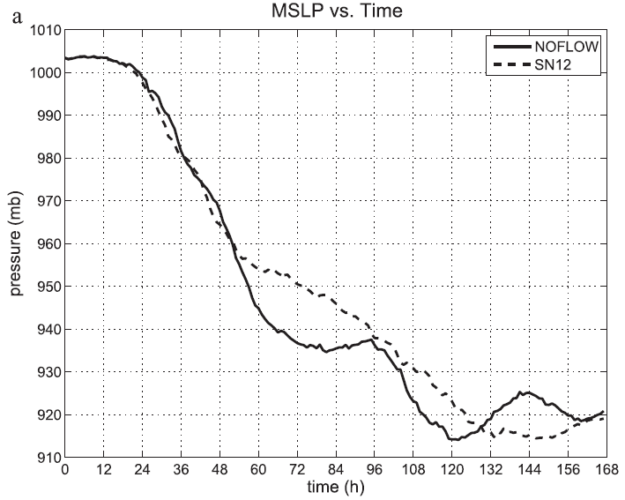
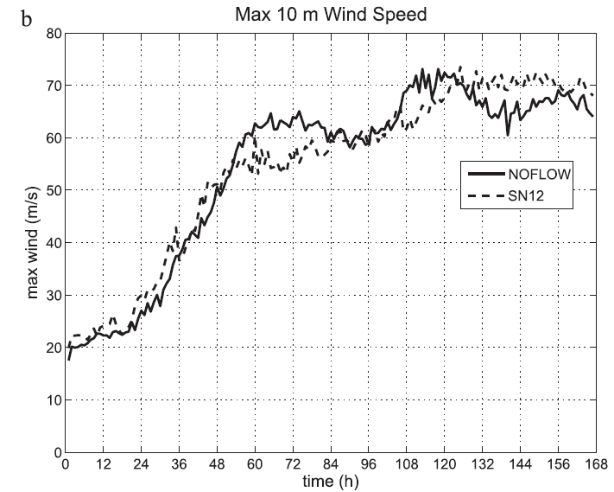
Warm-core structure of simulation
a. Model setup and description of simulation
WRF 3.1.1
Vertical : 40 levels
Triply-nested grid : 18, 6, 2 km
Idealized hurricane
Quiescent environment (NOFLOW) <--> (SN12 set: +5 m/s )
SST=28°C
Initial vortex profile and environment sounding (moist-tropical sounding of Dunion 2011)
Parameterization :
PBL – YSU
Microphysics – WRF singlemoment six-class microphysics(WSM6)
< 10m/s
Rapidly Deepening
for another 12h-18h
weakening
Notes:
In mathematics, a doubly periodic function is a function defined at all points on the complex plane and having two "periods", which are complex numbers u and v that are linearly independent as vectors over the field of real numbers. That u and v are periods of a function ƒmeans that
for all values of the complex number z.
The doubly periodic function is thus a two-dimensional extension of the simpler singly periodic function, which repeats itself in a single dimension. Familiar examples of functions with a single period on the real number line include the trigonometric functions like cosine and sine. In the complex plane the exponential function e^{z} is a singly periodic function, with period 2πi.
Only constant functions can be doubly periodic and analytic everywhere. Why? Our functions take on over and over the values they take on over the unit square. If a function is analytic over the (closed) unit square then it’s bounded over that square, and since it’s doubly periodic, it’s bounded everywhere. By Liouville’s theorem, the only bounded analytic functions are constants

Slide 7
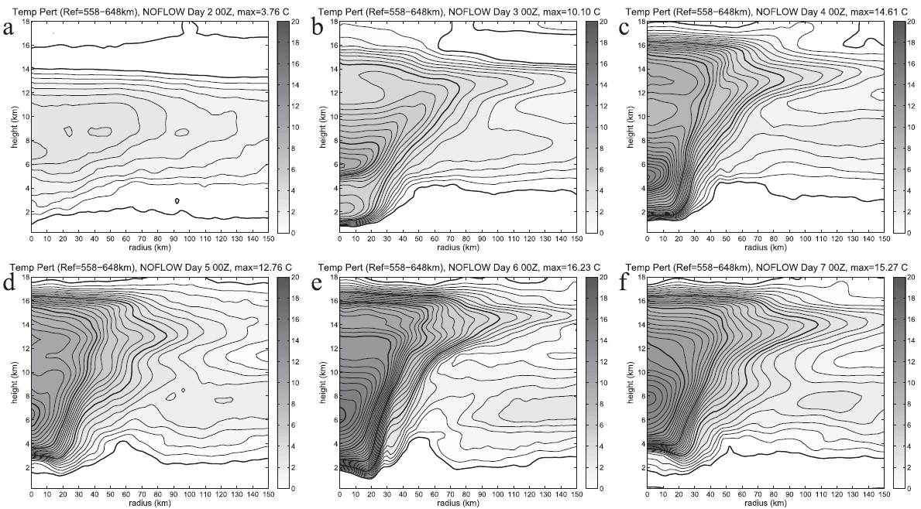
b. Evolution of the warm core (T’)
WARM -RING (Schubert et al. 2007)
INERTIAL INSTABILITY
Midlevel T’ maximum : 4~8 km
Day 1 : 5.5 km
Day 2 00Z
Day 3 00Z
Day 4 00Z
12-14km
7 km
2km
6 km
5 km
12-14km
6.5 km
6.5 km
8 km
Day 5 00Z
Day 6 00Z
Day 7 00Z
The environment is the mean temperature averaged in the 550-650 km annulus.
The contour interval is 0.5°C, and the 0°C, 4°C, 8°C, 12°C, and 16°C contours are thickened.
.
Notes:
A striking feature revealed by Figure 3 is that the warmest temperatures in the eye at
middle and lower levels occur in a ring at the outer edge of the eye. The gure also suggests a transition from a lowertropospheric warm-ring structure to an upper-tropospheric warm-core structure.
(schubert et al. 2007)
慣性不穩定：氣團被橫向轉移，原有速度使氣團不再返回原有位置。在低緯度，科氏力弱，比較易出現慣性不穩定

Slide 8
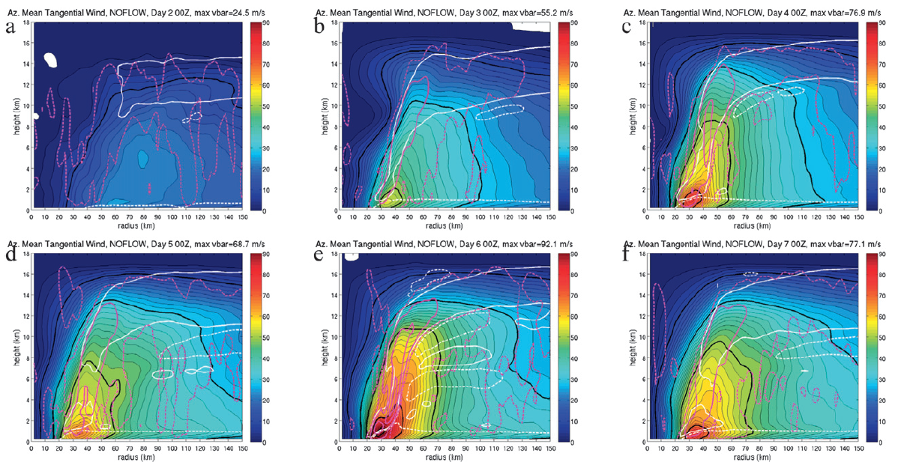
Azimuthal mean tangential wind (Vt)
Day 2 00Z
Day 3 00Z
Day 4 00Z
Day 5 00Z
Day 6 00Z
Day 7 00Z
Contours are thickened every 20 m/s, starting from 10 m/s.
Radial velocity is contoured in white at +2 (solid) and -2 (dashed) m/s.
Dashed magenta - Vertical velocity at +0.1 Solid magenta - at +1, +3, and +5 m/s

Slide 9
Budget analysis
a. Evolution of temperature change and its relationship to perturbation
temperature
b. A potential temperature budget
c. Decomposing advection into horizontal and vertical, mean and eddy
d. Why is RADVE positive in the eye during intensification?
e. Structure of mean vertical velocity in the eye

Slide 10
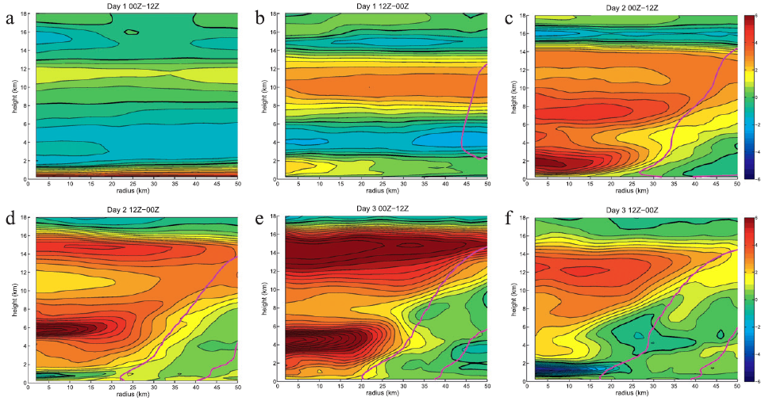
a. Evolution of temperature change and its relationship to perturbation temperature.
Since the structure of changes in Δθ and T’ is qualitatively the same , we can safely use a θ budget to understand the evolution of the warm core as defined by T’
12-hr mean azi. Δθ
Day 2: T’
Day 3: T’
RI (36hr)
Day 1
Day 2
7 km
2 km
Day 3
14.75 km
14.75 km
14 km
5.75 km
5.75 km
?
cooling
Contours are every 0.5 ° C from -10 to +10 ° C (color bar from -6 to +6° C), with the zero contour thickened.
magenta contoured -The 12-h-mean +0.10 m/s azimuthal mean vertical velocity .

Slide 11
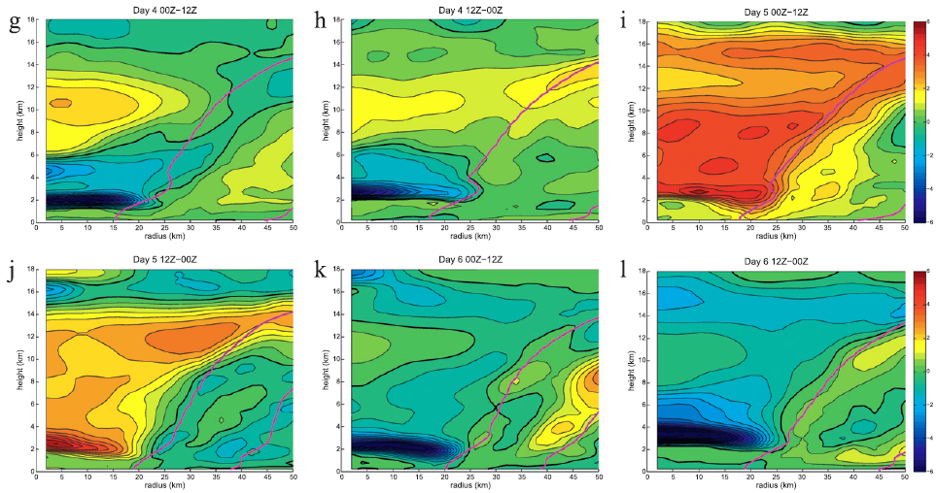
12-hr mean θ
12-hr mean azi. Δθ
Day 4
Day 5
2 km
cooling
cooling
Day 6
2nd weakening
2 km
Contours are every 0.5 ° C from -10 to +10 ° C (color bar from -6 to +6° C), with the zero contour thickened.
magenta contoured -The 12-h-mean +0.10 m/s azimuthal mean vertical velocity .

Slide 12
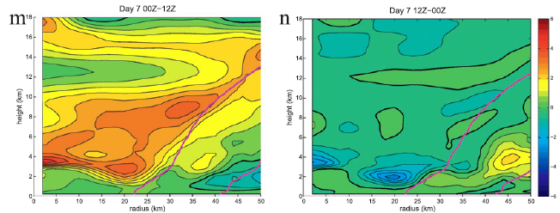
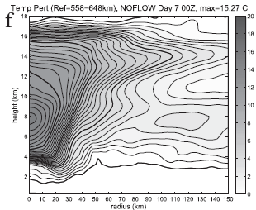
12-hr mean azi. Δθ
Day 7
Day 7: T’
near-zero ∆θ
Contours are every 0.5 ° C from -10 to +10 ° C (color bar from -6 to +6° C), with the zero contour thickened.
magenta contoured -The 12-h-mean +0.10 m/s azimuthal mean vertical velocity .

Slide 13
b. A potential temperature budget
By calculating a budget of azimuthal mean θ, based on the following equation:
the actual change in potential temperature over ∆t (K/12hr)
the tendency from subgrid-scale
horizontal diffusion.
the tendency from diabatic heating
the tendency
from the total advection
(horizontal + vertical)
the tendency from the boundary layer
parameterization scheme
Period =12 h
Notes:
We now investigate the mechanisms by which the changes in T and u described in the previous subsection occur.
PBL is the tendency from the boundary layer parameterization scheme, which in addition to tendencies within the boundary layer itself, yields tendencies from subgrid-scale vertical diffusion throughout the free atmosphere.
HDIF- We use standard second-order horizontal diffusion on model coordinate surfaces (‘‘diff_opt51’’ in WRF). The eddy viscosity is the standard first-order Smagorinsky scheme, based on the deformation and a mixing length (which is proportional to gridspacing; ‘‘km_opt54’’ in WRF).
Middle-atmosphere models commonly employ a sponge layer in the upper portion of their domain. It is shown that the relaxational nature of the sponge allows it to couple to the dynamics at lower levels in an artificial manner. In particular, the long-term zonally symmetric response to an imposed extratropical local force or diabatic heating is shown to induce a drag force in the sponge that modifies the response expected from the “downward control” arguments of Haynes et al. [1991]. In the case of an imposed local force the sponge acts to divert a fraction of the mean meridional mass flux upward, which for realistic parameter values is approximately equal to exp(−Δz/H), where Δz is the distance between the forcing region and the sponge layer and H is the density scale height. This sponge-induced upper cell causes temperature changes that, just below the sponge layer, are of comparable magnitude to those just below the forcing region. In the case of an imposed local diabatic heating, the sponge induces a meridional circulation extending through the entire depth of the atmosphere. This circulation causes temperature changes that, just below the sponge layer, are of opposite sign and comparable in magnitude to those at the heating region. In both cases, the sponge-induced temperature changes are essentially independent of the height of the imposed force or diabatic heating, provided the latter is located outside the sponge, but decrease exponentially as one moves down from the sponge. Thus the effect of the sponge can be made arbitrarily small at a given altitude by placing the sponge sufficiently high; e.g., its effect on temperatures two scale heights below is roughly at the 10% level, provided the imposed force or diabatic heating is located outside the sponge. When, however, an imposed force is applied within the sponge layer (a highly plausible situation for parameterized mesospheric gravity-wave drag), its effect is almost entirely nullified by the sponge-layer feedback and its expected impact on temperatures below largely fails to materialize. Simulations using a middle-atmosphere general circulation model are described, which demonstrate that this sponge-layer feedback can be a significant effect in parameter regimes of physical interest. Zonally symmetric (two dimensional) middle-atmosphere models commonly employ a Rayleigh drag throughout the model domain. It is shown that the long-term zonally symmetric response to an imposed extratropical local force or diabatic heating, in this case, is noticeably modified from that expected from downward control, even for a very weak drag coefficient.

Slide 14
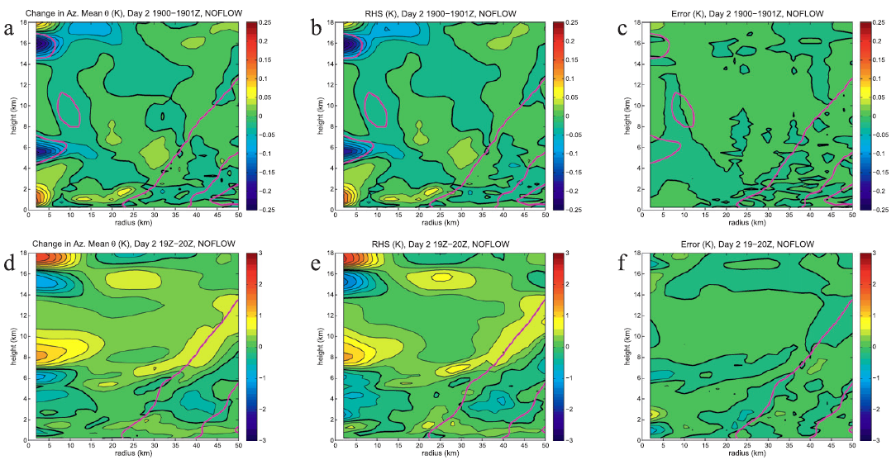
∆t = 1min
RHS
ERROR
∆t = 1 hr
not representative (ZLY02)
The contour intervals are 0.025 and 0.1 K for the top and bottom rows, respectively.
magenta contoured - +0.10 m/s azimuthal mean vertical velocity.

Slide 15
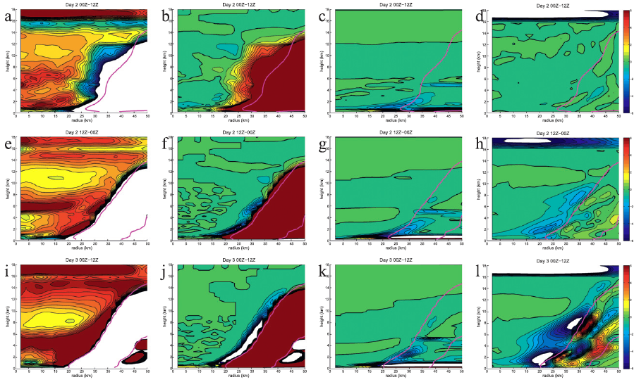
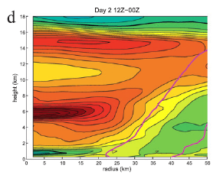
RI Period
( 6min data)
Day 2
-0.5K/12hr at 3 km.
Day2 mean ∆θ
Day 3
All of these features are quite similar to those seen in Du (Fig. 4d), and so total advection of potential temperature can largely explain the distribution of warming throughoutmost of the eye during this period.
Each field is contoured from +6.0 to -6.0 K (per 12 h), every 0.5 (per 12 h).
The zero contour is thickened.
Magenta solid- azimuthal mean vertical velocity = 0.1 m/s.
+6K/12hr at 6km high within 20km.
Warming in the nascent eye is largely due to
advection.
HDIF can be of the same magnitude as HEAT and TADV is somewhat in contrast to ZLY02.

Slide 16
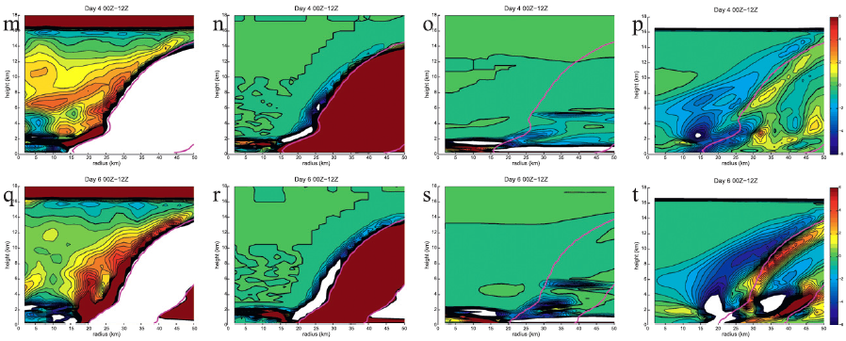
Period of near-steady-state intensity
( 6min data)
Day 4
Weakening Period
( 6min data)
( Same as last period.)
Day 6
Horizontal diffusion plays an important role in the maintenance of temperature
within the eye, once the storm is sufficiently intense.
Each field is contoured from +6.0 to -6.0 K (per 12 h), every 0.5 (per 12 h).
The zero contour is thickened.
Magenta solid- azimuthal mean vertical velocity = 0.1 m/s.

Slide 17
c. Decomposing advection into horizontal and vertical, mean and eddy
Azimuthal mean radial advection
Azimuthal mean vertical advection
Azimuthal mean θ from the eddy advections can be written
in terms of the divergences of eddy fluxes (flux form)

Slide 18
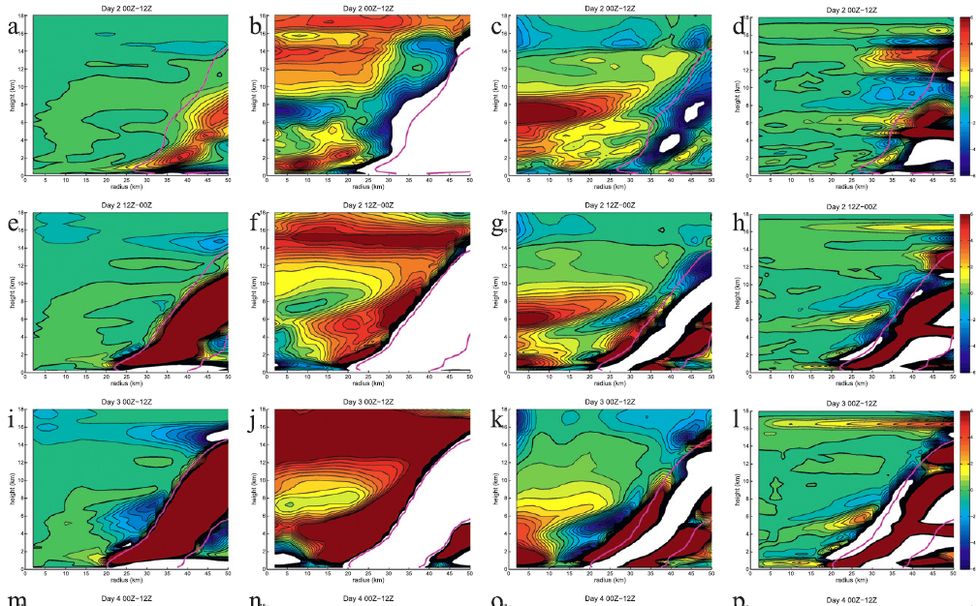
RI Period
( 6min data)
Day 2
6-8 km
(Cooling)
(Warming)
Day 3
Each field is contoured from +6.0 to -6.0 K (per 12 h), every 0.5 (per 12 h).
The zero contour is thickened.
Magenta solid- azimuthal mean vertical velocity = 0.1 m/s.

Slide 19
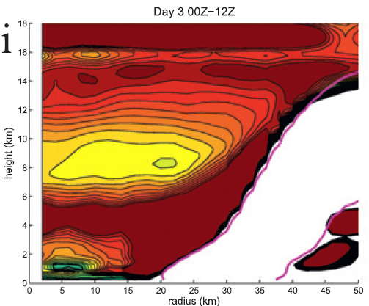
RI Period
( 6min data)
Day 3
Day 3 TADV
Day3 mean ∆θ
Note that the midlevel TADV maximum during intensification is not always due to RADVE: during the 12-h period of greatest warming (0000–1200 UTC day 3), VADVM is maximized at the height of greatest ∆θ, while RADVE is relatively small there. During this period, it is also evident that the local minimum in TADV near 8 km is a result of VADVM being minimized near this height.
Each field is contoured from +6.0 to -6.0 K (per 12 h), every 0.5 (per 12 h).
The zero contour is thickened.
Magenta solid- azimuthal mean vertical velocity = 0.1 m/s.

Slide 20
d. Why is RADVE positive in the eye during intensification?
1.RADVE can be quite substantial well inside the eye, and that this term appears to be responsible for most of the midlevel warming during the first 24 h of RI. This is contrary to our expectation (and to results from previous studies) that mean vertical advection would always be the dominant mechanism of warming.
2.The asymmetries can lead to a warming tendency at all, given that the mean radial gradient of θ is negative.

Slide 21
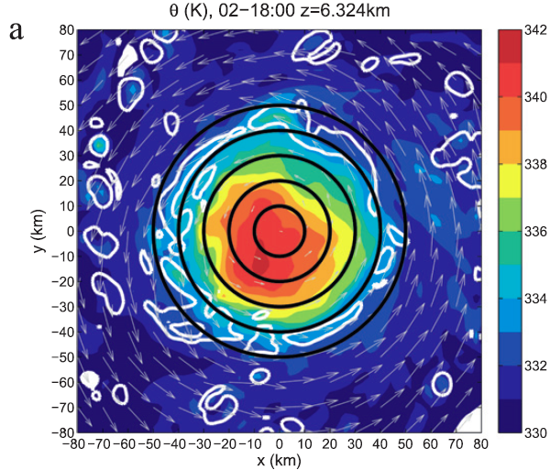
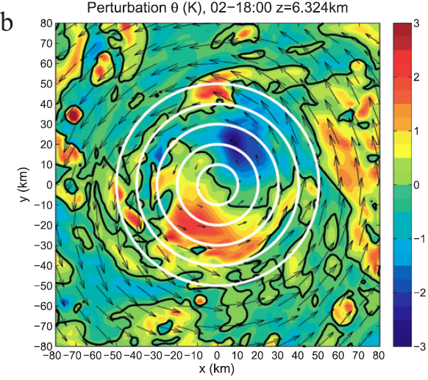
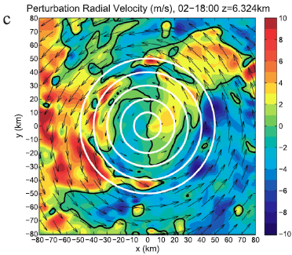
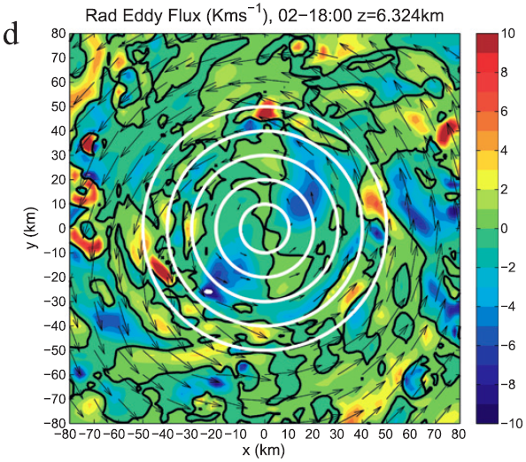
0200-1800 UTC day 2
NNE
SSW
Nolan et al. (2001) “wobble”
Caused by wavenumber-1 instability
(23th level ,near where both ∆θ and RADVE are maximized)
.Range rings are drawn every 10 km.
Notes:
The most plausible source of this asymmetry is the excitement of a wavenumber-1 instability. Nolan et al. (2001) showed that the wavenumber-1 instability, which exists for any vortex where the angular velocity is maximized away from the center, represents a displacement of the low-vorticity core of a vortex within the larger-scale circulation. This is responsible for the often-observed trochoidal oscillation (‘‘wobble’’) of the pressure minimum, and is an important mechanism for mixing between the eye and the eyewall.

Slide 22
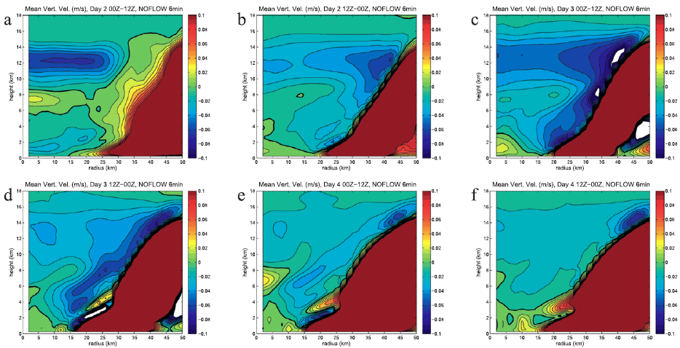
e. Structure of mean vertical velocity in the eye
During RI, weak descent.(5-6cm/s)
Day 3
Day 2
Day 4
After RI, weaker descent.(1-3cm/s)
Azimuthal mean vertical velocity, averaged over consecutive 12-h periods from 6-min data.
Contouring is from -0.1 to +0.1 m/s, every 0.01 m/s. The zero contour is thickened.

Slide 23
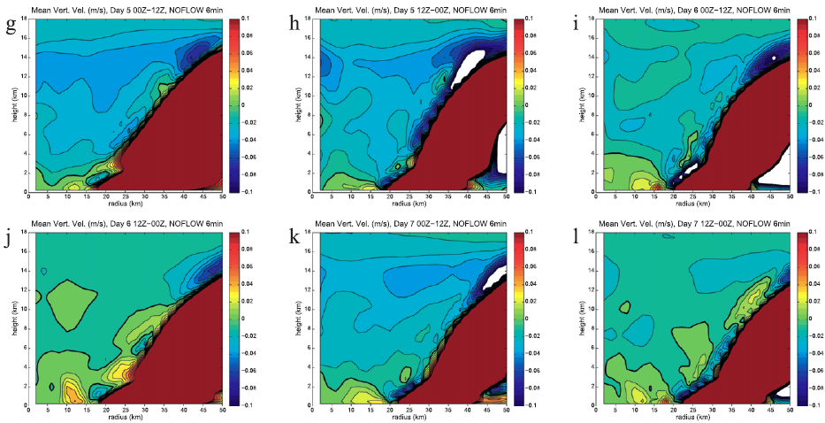
Day 5
Day 6
Day 7
Azimuthal mean vertical velocity, averaged over consecutive 12-h periods from 6-min data.
Contouring is from -0.1 to +0.1 m/s, every 0.01 m/s. The zero contour is thickened.

Slide 24
Discussion and conclusions
In this study, we investigated the structure of the warm core in tropical cyclones, through a detailed potential temperature budget analysis of a simulation
conducted in a quiescent environment.
The maximum perturbation temperature consistently was found at midlevels (4–8-km height), at all times. Here, we showed that this is because the very large warming that occurs during the initial rapid intensification is maximized at
midlevels.

Slide 25
Day 2
During RI
During RI
Day 3
At the beginning of RI, when the storm is still weak, the greatest warming comes not from mean subsidence (as there is actually ascent in this region over a 12–18-h period), but rather from the divergence of the radial eddy flux of θ (RADVE), which is maximized at midlevels.
We showed that the eddy fluxes are likely a consequence of a wavenumber-1 instability (Nolan et al. 2001).
Day 2
During the latter part of RI, RADVE becomes less important, and the mean vertical advection (VADVM) is responsible for warming the eye. Mean descent tends to be maximized
in the upper troposphere (12–13 km), whereas VADVM is maximized in the midtroposphere (4–6 km). This is because the static stability is very small from 8- to 13-km heights (not shown), and so it is difficult for descent to lead to large warming.
Day 3
Day 3

Slide 26
Contract to the Doppler radar studies of Guimond et al. (2010) and Heymsfield et al. (2001) ,our results are not consistent with this hypothesis, as much of the warming in our simulation is a result of weak mean subsidence, and the large downdrafts along the interface do not yield substantial warming.
The spatial pattern of HDIF is often quite similar to that of VADVM, thereby preventing net warming from being maximized away from the center.

Slide 27
The importance of horizontal diffusion on the temperature structure of the eye is a new finding, as far as we are aware. It is consistent however, with the recent study of Bryan and Rotunno (2009), which showed that the maximum intensity in axisymmetric simulations is very sensitive to the strength of the horizontal diffusion. (Parameterization)
We conclude this study by discussing what we still do
not know:
1) the true mean height of the maximum perturbation
temperature and the degree to which this height varies in real tropical cyclones.
2) the vertical structure of vertical velocity in our idealized
simulations is representative of real tropical cyclones.
Notes:
Given that horizontal diffusion is a parameterization of the effects of unresolved turbulence, the true importance of such turbulence on the structure of the warm core, and the realism of our simulation in this respect, remains highly uncertain.

Slide 28
Reference
Schubert, W. H.,C. M. Rozoff, J. L. Vigh, B. D. McNoldy, and J. P. Kossin,2007: On the distribution of subsidence in the hurricane eye.Quart. J. Roy. Meteor. Soc., 133, 595–605.
http://onlinelibrary.wiley.com/doi/10.1029/96JD01994/abstract
http://en.wikipedia.org/wiki/Thermal_wind
http://www.sjsu.edu/faculty/watkins/thermal.htm
http://www.geog.ucsb.edu/~joel/g110_w08/lecture_notes/cooling_processes/cooling_processes.html
http://baike.baidu.com/view/956932.htm
Nolan, D. S., M. T. Montgomery, and L. D. Grasso, 2001: The wavenumber-1 instability and trochoidal motion of hurricanelike vortices. J. Atmos. Sci., 58, 3243–3270

Slide 29
Thanks for your attention!!

Slide 31
Potential Temperature
$$θ=T{(\frac{P_{0}}{P})}^{R/C_{p}}$$
1) Temperature a parcel of air would reach if moved to sea level and warmed adiabatically.
2) Useful for comparing temperatures of air parcels at different elevations (pressures).
Notes:
非绝热加热（diabatic heating）
系统和外界之间的热量交换过程。如把大气作为整体来考虑，非绝热加热过程主要包括：
①辐射。大气的最根本能源是太阳辐射。但它只有一小部分直接为大气所吸收；一部分被地表面吸收，使地面增温；其余则被地球和大气反射回宇宙空间（见大气环流的能量平衡和转换）。此外，大气还吸收地面的长波辐射，同时大气本身也放射长波辐射。通过辐射过程，大气可以获得或丧失能量。
②感热输送。通过传导、湍流和对流等过程，将地面的热量输送给大气。
③潜热释放。空气中水汽的凝结或凝华过程和水滴的冻结过程，都将有大量的潜热释放，这是对流层大气获得热能的重要方式之一。除上述非绝热加热之外，还有在高层大气中的化学和光化学效应释放能量（见大气化学、平流层和中层大气物理学、大气臭氧层）。非绝热加热过程对中期和长期天气过程以及气候的形成和变化，都有重要的作用。
绝热加热（adiabatic heating）
Adiabatic processes are reversible
Adiabatic processes in atmosphere mainly related to vertical motion
Vertical motion subjects air parcels to changes in pressure
1)Rising air parcels expand due to reduced pressure and cool
2)Sinking air parcels contract due to increased pressure and warm

Slide 32
Thermal wind
$$\frac{∂V_{g}}{∂z}=\left(\frac{g}{f}\right)\hat{k}× ∇_{H} (lnT)$$

Slide 33
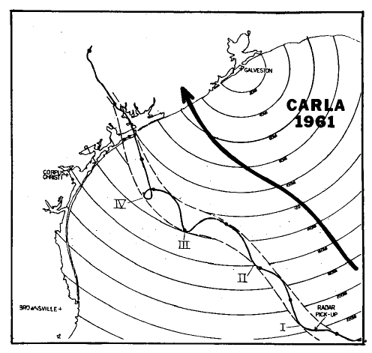
Nolan et al. (2001) “wobble”

Slide 34
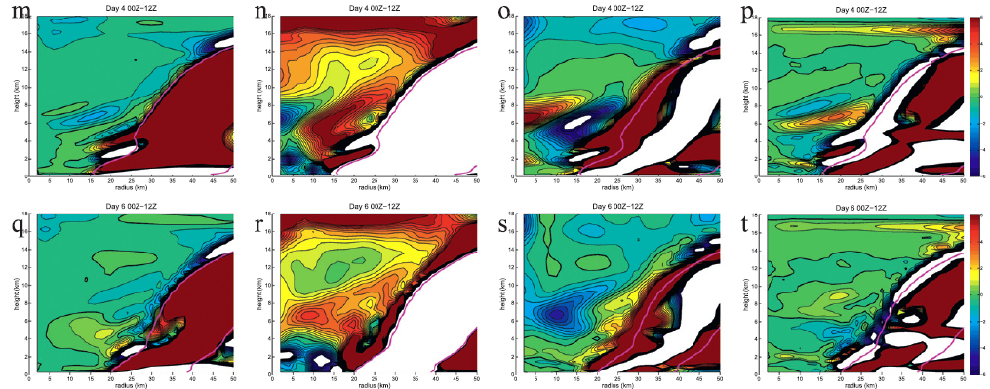
Period of near-steady-state intensity
( 6min data)
Day 4
Weakening Period
( 6min data)
Day 6
Each field is contoured from +6.0 to -6.0 K (per 12 h), every 0.5 (per 12 h).
The zero contour is thickened.
Magenta solid- azimuthal mean vertical velocity = 0.1 m/s.

