Slide 1
Configuration and evaluation of the WRF model for the study of Hawaiian regional climate
Reporter : Lin Ching
Zhang, C., Y. Wang, A. Lauer, and K. Hamilton, 2012: Configuration and evaluation of the WRF model for the study of Hawaiian regional climate. Mon. Wea. Rev., 140, 3259–3277.

Slide 2
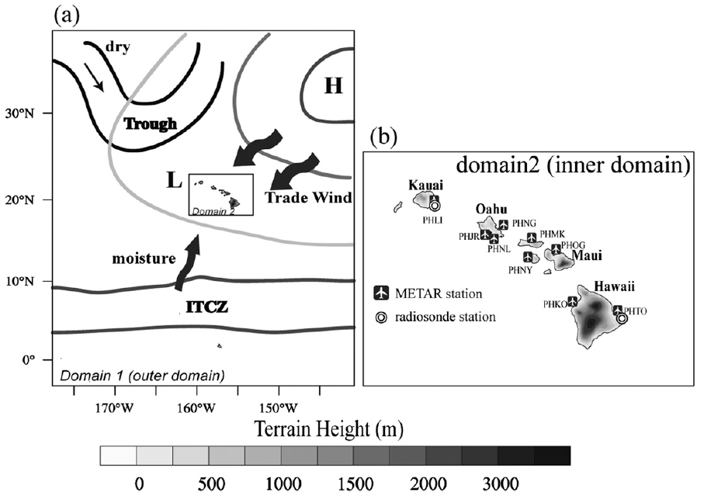
Introduction
Two seasons in Hawaiian Islands (HIs):
Summer – May to October
Winter – October to April
Despite large-scale mean descent, rainfall is frequent and abundant due to the strong interaction between orography and prevailing trade winds (Schroeder 1993)
The trade wind–induced rainfall along the windward sides of the mountains is the most significant contributor to the statewide rainfall (Lyons 1982).

Slide 3
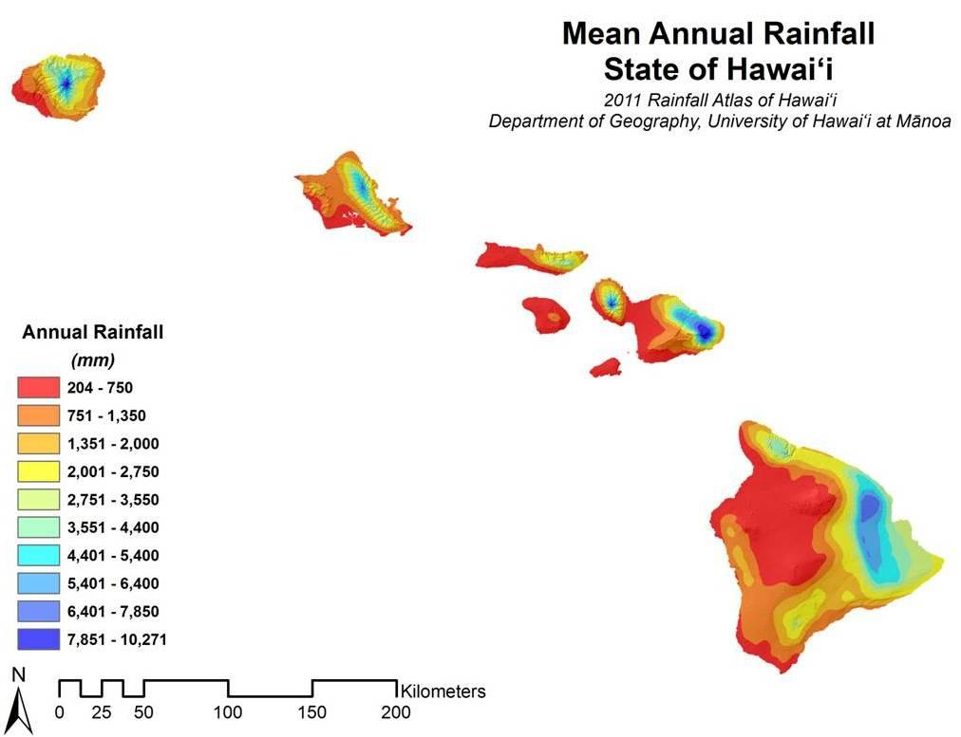
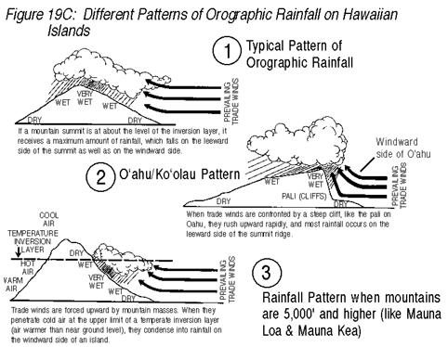
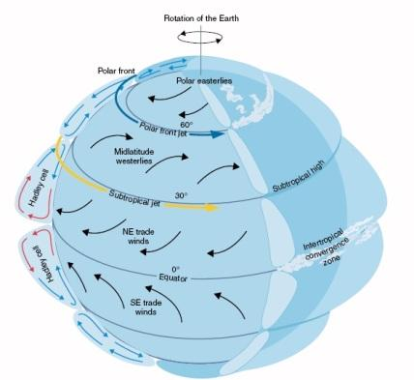
Prof. Millen, University of Hawaii
Satellite Applications for Geoscience Education, Space Science and Engineering Center, University of Wisconsin-Madison

Slide 4
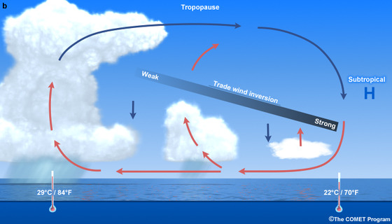
Introduction
On average about 82% of all days in the Hawaii region are trade wind inversion (TWI) days (Cao et al. 2007)
Trade Wind Inversion (TWI)
The trade wind inversion height and trade wind strength have a close relation to precipitation over the Hawaiian Islands.
To resolve the microclimates in the Hawaiian Islands range from humid and tropical windward flanks to dry leeward areas, a high-resolution numerical model is necessary.
The representation of model physical processes have to be changed.
UCAR/COMET
RCM simulations for HIs:
Zhang et al. (2005) used the high resolution Mesoscale Spectral Model with 1.5-km grid size to do short-term integrations.
=> coupled a land surface model (LSM) get further improvements
Jimenez et al. (2010) performed a 14-yr simulation over complex topography in Spain with 2-km horizontal resolution and showed that the WRF model with high resolution can be used for dynamical downscaling in a region with complex terrain.
( 2-day run with 1-day spinup => daily mean surface wind )

Slide 5
Model configuration
15 km
3 km
186
320
276
260
WRF-ARW v3.3
12-month continuous simulation: Oct. 2005 – Nov. 2006
Two domain with one-way nesting: 15, 3 km
31 vertical layers with top at 10 hPa
Buffer zone: 15 points

Slide 6
Model configuration
Microphysics scheme: WSM 6-class scheme
replaced the autoconversion and accretion rates to the parameterizations from Khairoutdinov and Kogan (2000)
Cloud droplet number concentration : 300 cm⁻³ => 55 cm⁻³
more representative for the clean maritime conditions typically found in the Hawaiian region
Shortwave and longwave radiation schemes: CAM3
PBL scheme: Mellor–Yamada–Janjic PBL scheme
Land surface processes: Noah LSM
Cumulus parameterization only for outer domain: modified Tiedtke scheme

Slide 7
Model configuration
IC & BC: Modern-Era Retrospective Analysis for Research and Applications (MERRA) reanalysis (NASA)
Data resolution: 0.5º x 0.6667º (lat x lon) and 31 levels (1000 to 10 hPa)
Time interval: 6 hour
Soil temperature and moisture: ECMWF Re-Analysis Interim data (ERA-Interim)
SST: daily 0.25º x 0.25º global analysis (NOAA)
diurnal SST variation is calculated based on the surface energy budget (Zeng and Beljaars 2005)
Simulation period: 0000 UTC 1 Oct. 2005 to 0000 UTC 1 Nov. 2006
First month is for model spinup.
Discussion: 1 Nov. 2005 to 31 Oct. 2006
Two seasons:
winter: 1 Nov. 2005 to 30 Apr. 2006
summer: 1 May 2006 to 31 Oct. 2006
Two land surface data for inner domain, outer domain is only identical with the new land surface data

Slide 8
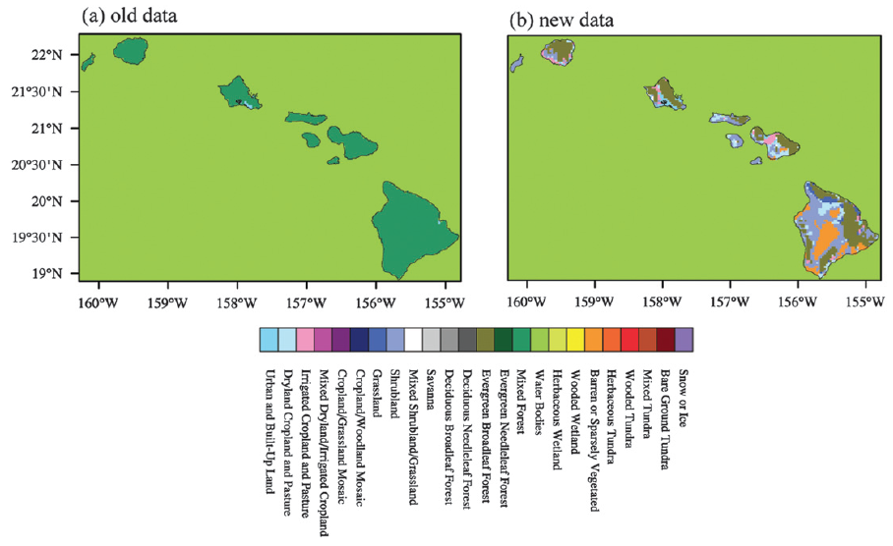
Land surface dataset (for LSM)
Land cover/use:
1-s NLCD (the 2001 National Land Cover Database; Homer et al. 2004) to match the USGS (U.S. Geological Survey) 24 categories
only urban & mixed forest
24 categories

Slide 9
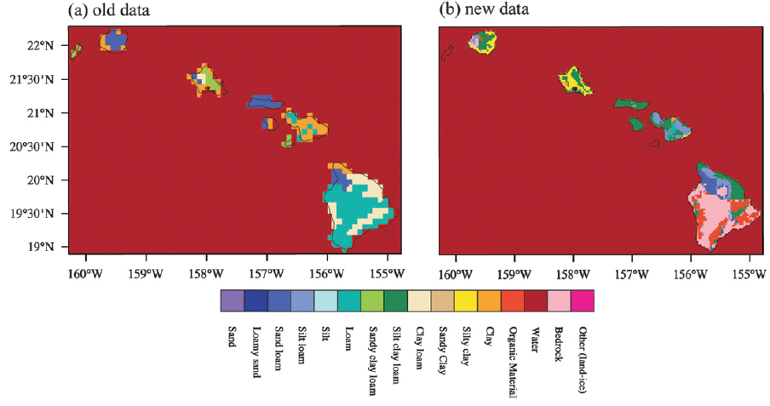
Land surface dataset (for LSM)
Soil type:
The official WRF:
30-s soil data from STATSGO (State Soil Geographic datasets)
+ 5-min soil data from FAO (United Nation Food and Agriculture Organization)
= 16-category global soil data
New soil data:
STATSGO → STATSGO2 (renamed as the U.S. General Soil Map)

Slide 10
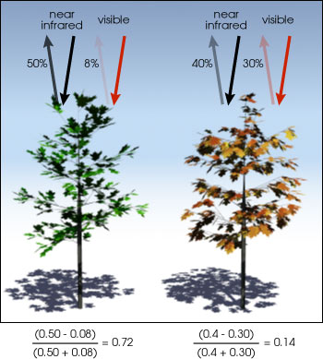
Land surface dataset (for LSM)
GVF: Green Vegetation Fraction
NDVI₀: bare soil
NDVI₁: dense vegetation
$$GVF=\frac{NDVI−{NDVI}_{0}}{{NDVI}_{1}−{NDVI}_{0}}$$
NDVI: Normalized Difference Vegetation Index
NIR: near-infrared light
VIS: visible light
The pigment in plant leaves, chlorophyll, strongly absorbs visible light (from 0.4 to 0.7 µm) for use in photosynthesis.
The cell structure of the leaves strongly reflects near-infrared light (from 0.7 to 1.1 µm).
NDVI ~ 1 → highest possible density of green leaves
NDVI = 0 → no green leaves
$$NDVI=\frac{NIR−VIS}{NIR+VIS}$$
NDVI₀ = 0.04
NDVI₁ = max. NDVI in Hawaiian Islands
NASA

Slide 11
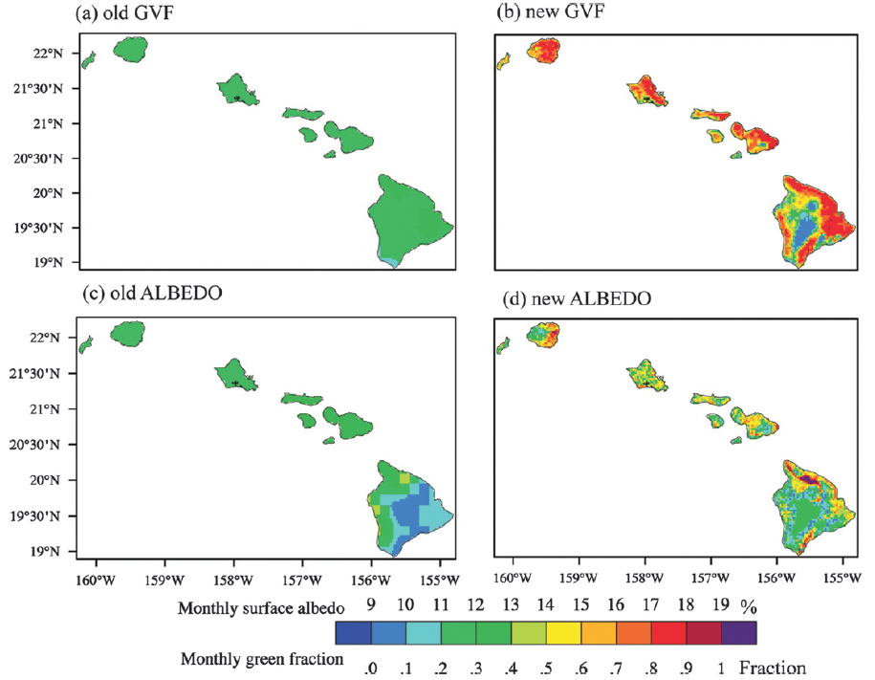
Land surface dataset (for LSM)
NOAA AVHRR NDVI data
MODIS NDVI dataset
NOAA AVHRR
MODIS albedo data
MODIS : 0.05º 5-yr-averaged (2000-04) dataset

Slide 12
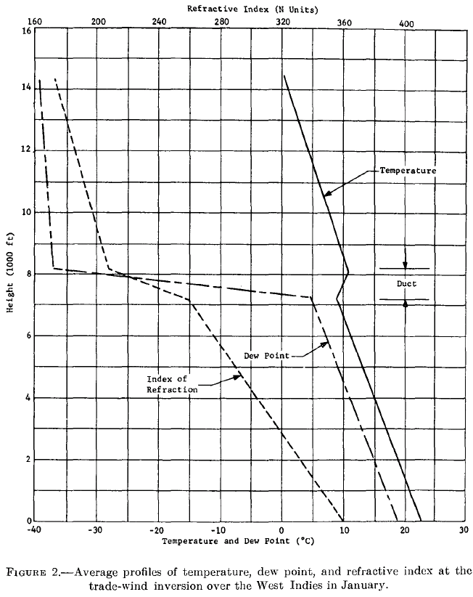
Data for evaluation
Lihue
Seasonal surface winds: QuikSCAT (Quick Scatterometer
measurements, NASA) → 25-km, monthly mean
Monthly mean Cloud: 1º x 1º MODIS cloud data
Trade wind inversion (TWI) height: calculated based on two
daily soundings at 1200UTC, Lihue and Hilo
refractivity N:
1. vertical profile to 10-m intervals
2. linear regression (Az + B) for N(z), to
find out the min. slope A with 300 m
sliding window
3. inversion base height at the max.
lapse of A
slope │A│ > 60 km⁻¹
TWI height 1.0 ~ 4.0 km
Hilo
3.6 km
1.2 km
(Baynton, 1965)

Slide 13
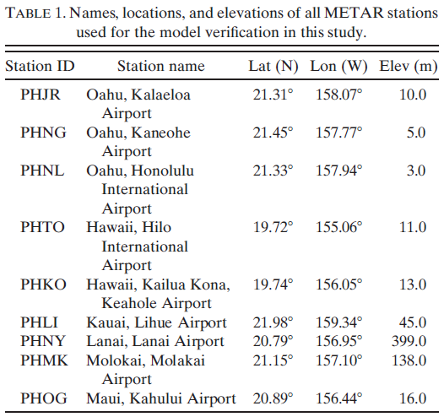
Data for evaluation
Precipitation:
monthly rainfall data of 190 stations from NCDC (National Climatic Data Center)
daily rainfall data of 30 stations from USGS, averaged to monthly
15-min rainfall data of 65 rain gauges from Hydronet system, converted to hourly and monthly
Daily mean surface variables: 9 airports (METAR)

Slide 14
Analysis methods
m: simulated quantity
o: observed quantity
Spatial correlation coefficient:
Temporal correlation coefficient

Slide 15
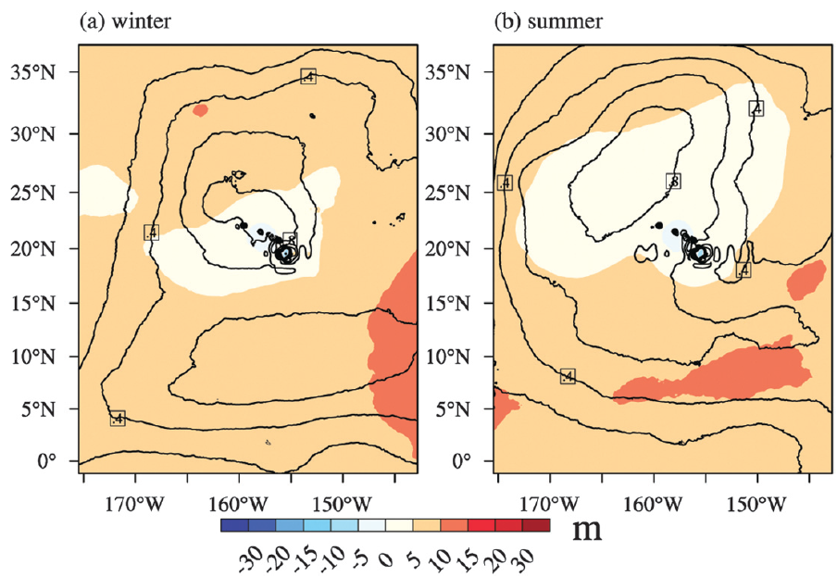
Large-scale circulation
Winter- and summer- averaged large-scale circulation
Biases (HRCM – MERRA) of H500 (shaded) and SLP (contour)
Bias of H500 < 5 m around the HIs
Bias of SLP < 1 hPa

Slide 16
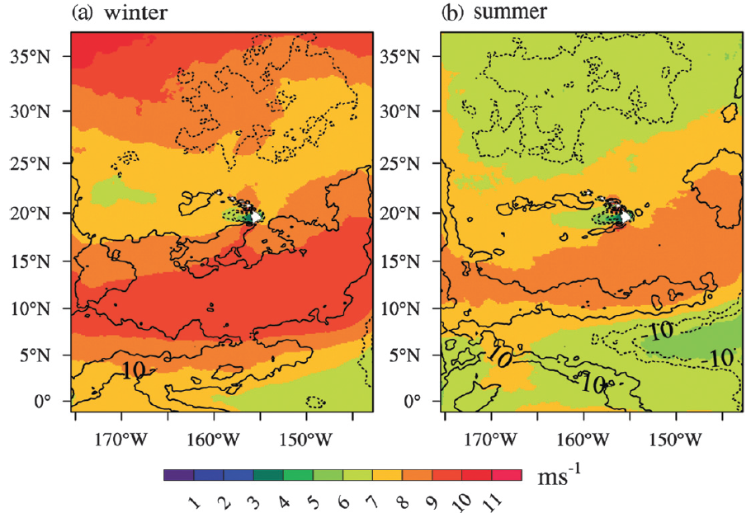
Large-scale circulation
Seasonal averaged 10-m wind speed (shaded) and its bias radio (contour, HRCM – QuikSCAT)
Bias radio < 5% and actual bias < 0.5 m s⁻¹ around the HIs
Neg. bias north of the HIs and pos. bias south of the HIs < 15 %

Slide 17
Total cloud fractions
MODIS vs.HRCM
winter
ITCZ
ITCZ
SC = 0.74
10 – 20 % less than observation

Slide 18
Total cloud fractions
MODIS vs.HRCM
summer
ITCZ
ITCZ
SC = 0.74
about 10 % higher north of 15N but underestimate ITCZ

Slide 19
Total cloud fractions
MODIS vs.HRCM
summer
MODIS cannot resolve the trade cumuli well due to its coarse resolution

Slide 20
Vertical structure
Lihue
Hilo
Lihue | TWI days | Mean TWI Height (km)
Obs | 283 | 2.001
D1 | 262 | 2.411
D2 | 283 | 2.176
Hilo | TWI days | Mean TWI Height (km)
Obs | 291 | 2.197
D1 | 303 | 2.499
D2 | 327 | 2.205

Slide 21
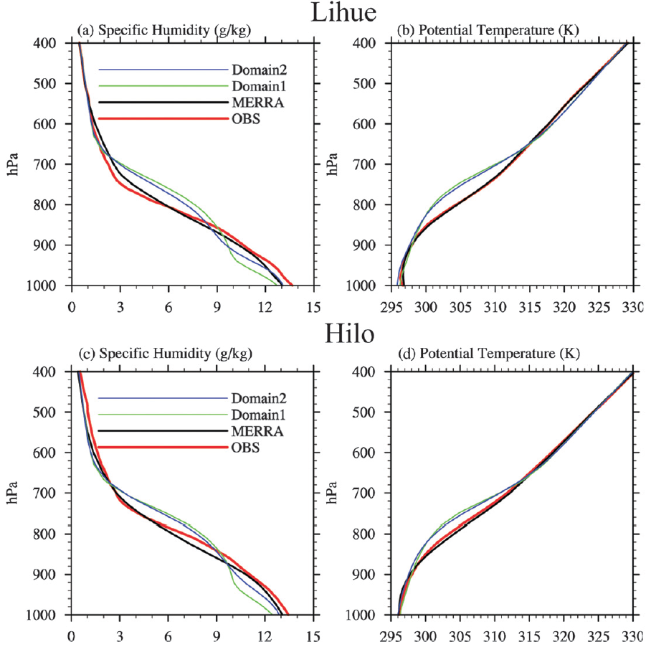
Composited vertical profiles on TWI days
0.5º x 0.5º area mean

Slide 22
Composited vertical profiles on TWI days
0.5º x 0.5º area mean
small wet bias
small dry bias
dry bias of
0 ~ 1 g kg⁻¹

Slide 23
Composited vertical profiles on TWI days
0.5º x 0.5º area mean
wet bias
cold bias of 0 ~ 3 K
D1: bias ~ 2 g kg⁻¹
D2: bias < 1.2 g kg⁻¹
Simulation at Hilo is similar to at Lihue
small dry bias

Slide 24
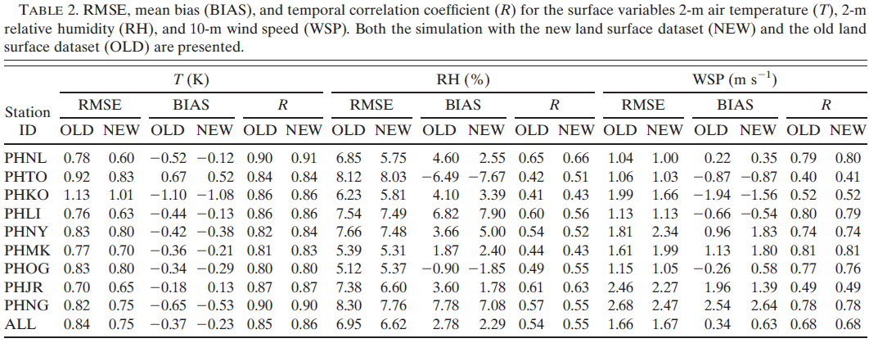
Daily mean bias of surface variables
HRCM surface hourly output METAR observational stations
Averaged to daily mean surface variables:
2-m air temperature2
2-m relative humidity
10-m winds
RMSE, mean bias (BIAS), temporal correlation coefficient (R)
Bilinear interpolation
0.70
↨
1.13
-1.10
↨
0.67
0.80
↨
0.90
< 8.3
< 7.78
0.41
↨
0.65
1.0
↨
2.7
-1.94
↨
2.54
0.40
↨
0.81

Slide 25
Daily mean bias of surface variables
Simulation with the new land surface dataset shows an overall improvement.
Model has difficulty in reproducing wind speed.
RMSE, mean bias (BIAS), temporal correlation coefficient (R)

Slide 26
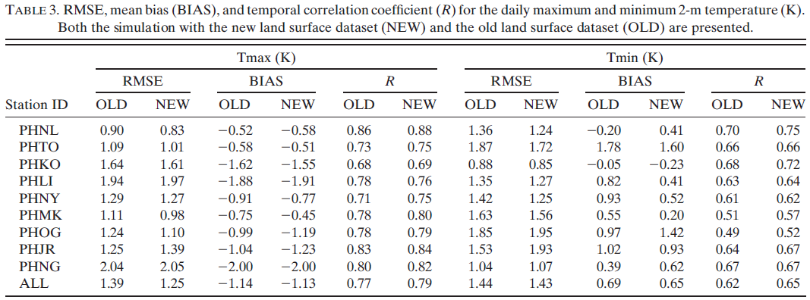
Surface daily max. (Tmax) and min. (Tmin) 2-m temperatures
Slightly improved by the new land surface dataset, but not improved at all stations
HRCM simulationsn have smaller diurnal surface temperature amplitudes
→ 1 K lower Tmax and 0.7 K higher Tmin
RMSE, mean bias (BIAS), temporal correlation coefficient (R)
Cold bias
Warm bias

Slide 27
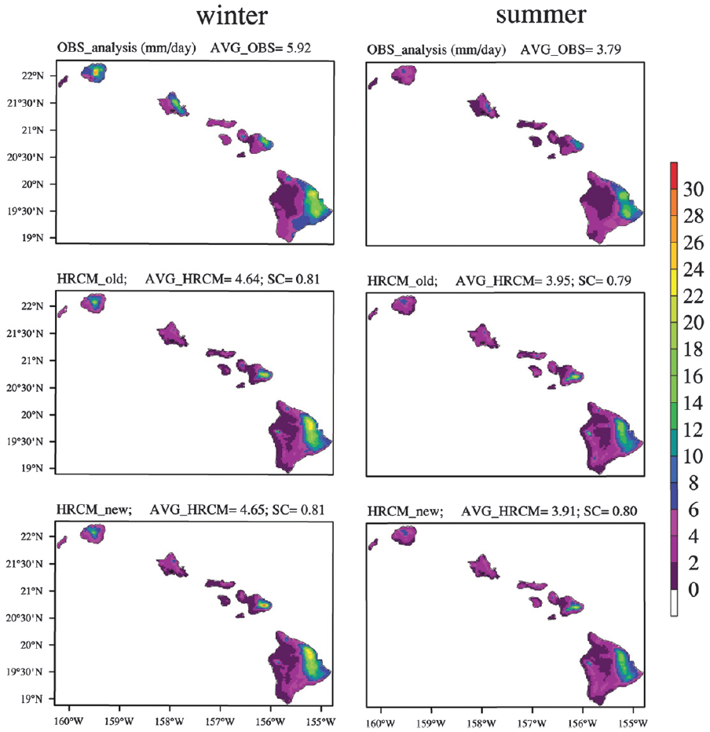
Spatial distribution of precipitation
OBS
Gridded precipitation dataset by using Cressman objective analysis
Well reproduced on the windward sides of Hawaii and Maui.
Underestimate over Oahu due to failed simulated storm in March 2006
No significant improvement between new and old land surface dataset
Kauai
Oahu
Maui
Hawaii
OLD
NEW

Slide 28
Diurnal rainfall variations
Hawaiian standard time
TWI days: TWI exist both Kauai and Hawaii
→ 251 TWI days
Rainfall intensity peak (RIP):
the hour with max. observed hourly rainfall averaged over all TWI days.
Kauai: late night to early morning
Oahu: afternoon
Maui: midnight to early morning (north)
early afternoon (other parts)
Hawaii: late afternoon to early night
Rainfall frequency peak (RFP):
the hour when rainfall occurs most frequently
consistent with RIP, except Oahu
→ RIP in afternoon, RFP in early morning
model
fail
model
fail

Slide 29
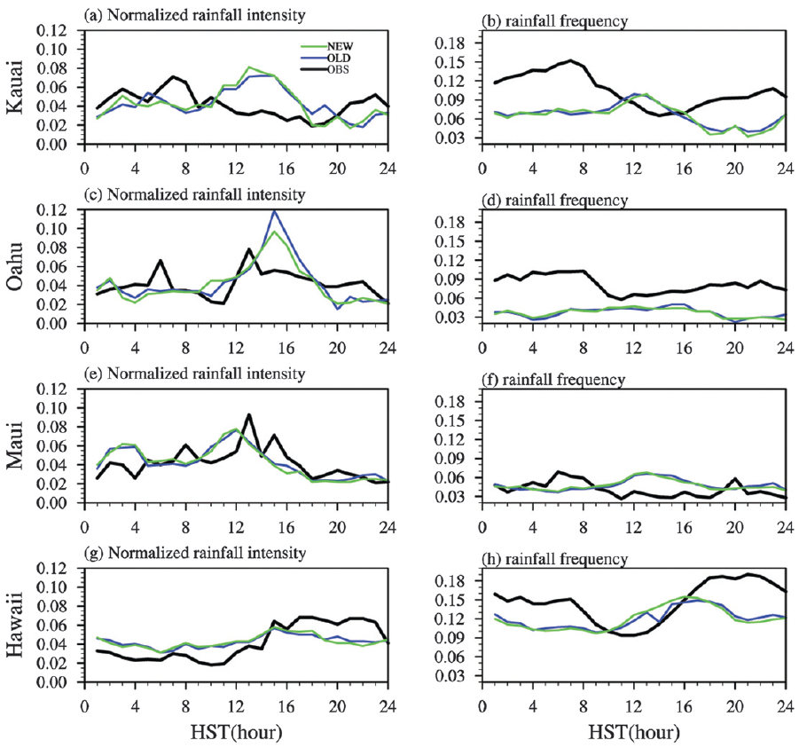
Diurnal rainfall variations
Underestimate in night
Underestimate in night
Underestimate in night

Slide 30
Synoptic variability of precipitation
Pentad mean island-scale precipitation data
correlation coefficients between
R1: OBS and HRCM_OLD
R2: OBS and HRCM_NEW
R3: HRCM_OLD and HRCM_NEW
HRCM captures most of the rainfall events reasonably well except for some events in March.
Using new land surface datasets slightly improved the simulation
fail
fail

Slide 31
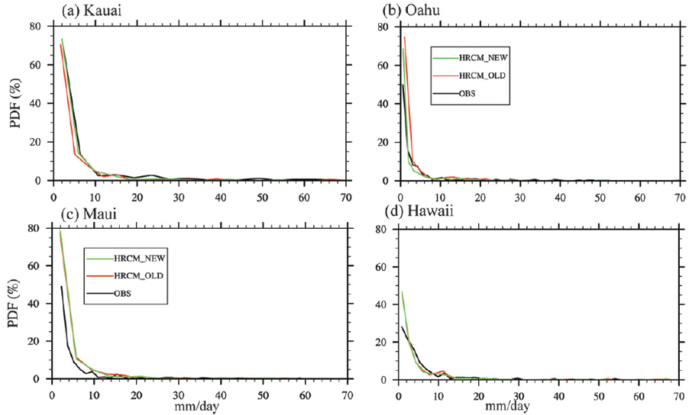
Probability density functions (PDFs)
underestimate
overestimate
overestimate
overestimate
underestimate
HRCM tends to simulate slightly more light rain except for the island of Kauai.

Slide 32
Summary and conclusions
HRCM: 1-yr continuous WRF simulation forced by observed lateral boundary conditions.
New land surface dataset based on various data sources
→ overall improved simulations of surface variables in most of Hawaiian region.
Precipitation is a particular challenging quantity for dynamical downscaling of climate and climate change in the Hawaii region.
HRCM performance:
Well | Fail
Seasonal mean large-scale circulation | Surface wind speed
Surface air temperature | Spatial distribution of precipitation
Surface relative humidity | Rainfall frequencies at night (underestimate)
Total precipitation over windward side | Light rainfall frequency (overestimate)
Total cloud fraction
Precipitation diurnal cycle

Slide 34
Refractivity N (Smith and Weintraub, 1953)
$$N=77.6\frac{P}{T}+3.73×{10}^{5}\frac{P_{w}}{T^{2}}$$
refractivity N:
1. vertical profile to 10-m intervals
2. linear regression (Az + B) for N(z), to
find out the min. slope A with 300 m
sliding window
3. inversion base height at the max.
lapse of A
slope │A│ > 100 km⁻¹
TWI height 1.0 ~ 4.0 km

