Slide 1
Sensitivities of a Squall Line over Central Europe in a Convective-Scale Ensemble
K. E. HANLEY, D. J. KIRSHBAUM N., M. ROBERTS and G. LEONCINI
Mon. Wea. Rev., 141, 112–133
2013/04/23

Slide 2
Introduction (I)
Even when the convection is driven mainly be synoptic-scale features, mesoscale and local-scale processes can still influence the exact location(s) and timing of initiation.
Although such grid spacing are able to explicitly represent large convective clouds, they fail to fully resolve important turbulent features at smaller scales that regulate cloud development and precipitation production (Bryan et al. 2003).
Convection-permitting models yield qualitatively more realistic precipitation fields and are quantitatively more skillful than lower-resolution simulations with parameterized convection.

Slide 3
Introduction (II)
The uncertainties in the large-scale meteorological conditions which can lead to errors in the moist instability and the vertical motions.
How subtle errors inherited through ICs and LBCs transfer down to the small scale. (Argence et al. 2008; Reinecke and Durran 2009; Hanley et al. 2011)
The role of large-scale uncertainties on the quantitative precipitation forecast (QPF) skill of a convective-scale ensemble.

Slide 4
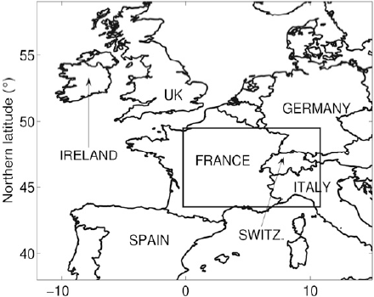
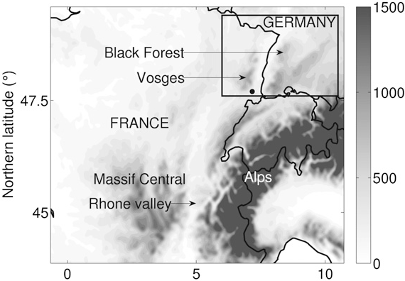
Convective and Orographically Induced Precipitation Study (COPS; Wulfmeyer et al. 2008) Schwitalla et al. (2008) 13 cases during summer 2005 of MM5 ➔ Precipitation is over-/under-estimated at windward/lee side Convection initiation occurred several hrs too early Peak rain rates were underestimated Model errors of high-resolution (1-km) were strongly reduced than 7-km grid
COPS
Rhine valley
high frequency of summertime convection initiation through slope and valley wind systems (Barthlott et al. 2006), but low skill of operational convection forecasts
radiosonde station
SWITZ. (瑞士)
中央高原

Slide 5
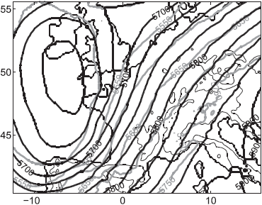
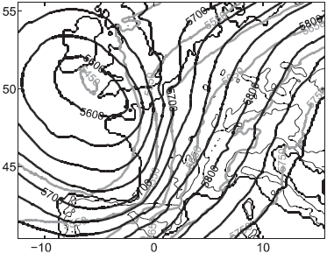
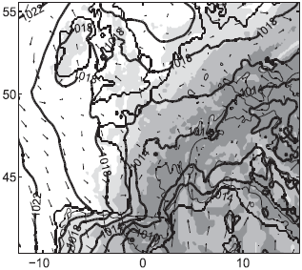
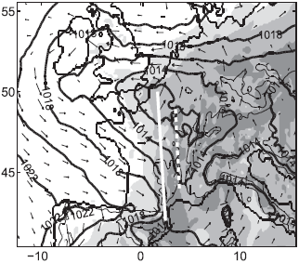
a. Operational analyses and observations
Intensive Observing Period 9c (IOP9c) 2007/07/20
1000-500-hPa thickness 500 hPa height
07/19 1800 UTC
07/20 0600 UTC
surface cold front midlevel front

Slide 6
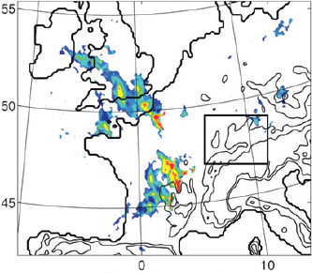
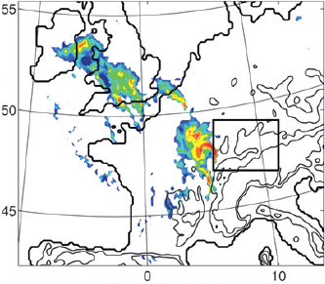
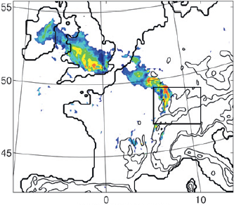
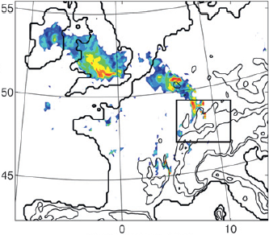
Rain rate (mm h⁻¹) from the Met Office’s Nimrod system
07/20 0300 UTC
07/20 0700 UTC
primary
07/20 1000 UTC
07/20 1100 UTC
secondary

Slide 7
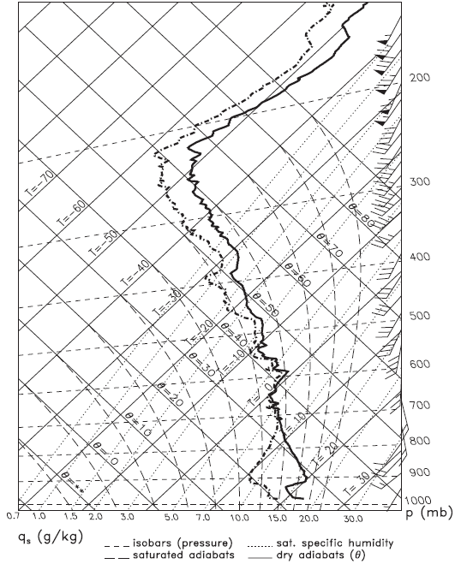
07/20 0800 UTC
COPS
radiosonde station
a high-resolution COPS sounding from Burnhaupt le Bas at the southern end of the Rhine valley
strong nocturnal inversion

Slide 8
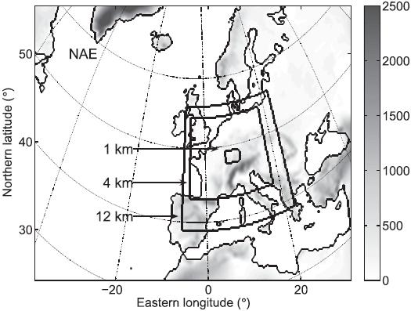
b. Model description and ensemble setup
Met Office Unified Model (MetUM) V7.3
12/4/1 km (150x150x38 / 370x300x70 / 300x190x70)
38 terrain followed levels
One-way nested
LBC: NAE 0.22º (300 x 180 x 38 )
IC: 24 members (23 have perturbed ICs and model physics)
Initial time: 1800 UTC,
19 July 2007
Integration length: 3+24 h
Ensembles: MOGREPS
North Atlantic European (NAE) Met Office Global and Regional Ensemble Prediction System (MOGREPS; Bowler et al. 2008)

Slide 9
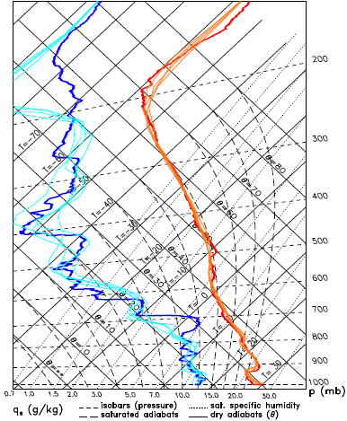
2007/07/14 1100 UTC Achern (48.64N, 8.07E, 140 m amsl)
from Hanley (2011)

Slide 10
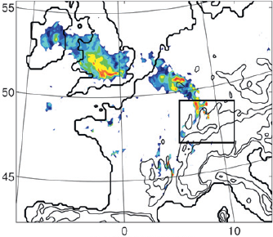
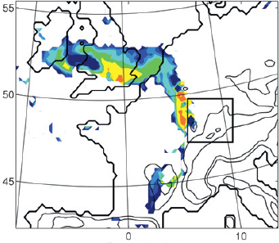
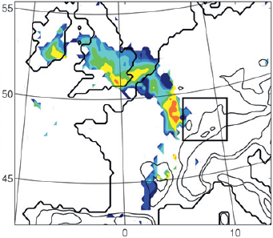
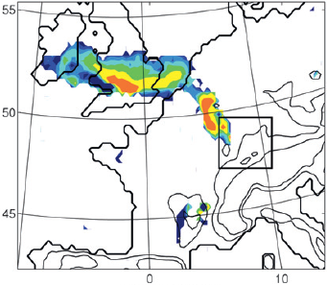
07/20 1100 UTC
Met Office’s Nimrod (5km)
NAE-Control (4km)
Pert06 (4km)
Pert20 (4km)

Slide 11
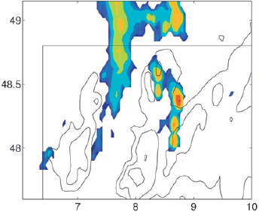
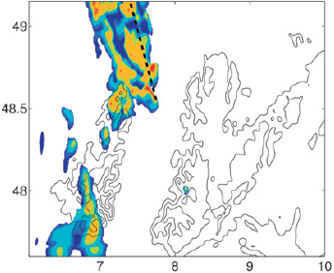
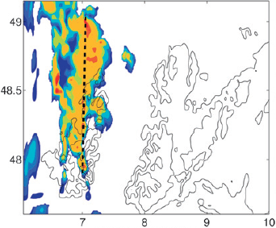
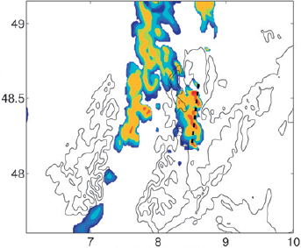
07/20 1100 UTC
DWD radar composite (2.8km)
NAE-Control (1km)
Pert06 (1km)
Pert20 (1km)
Deutscher Wetterdienst (DWD)

Slide 12
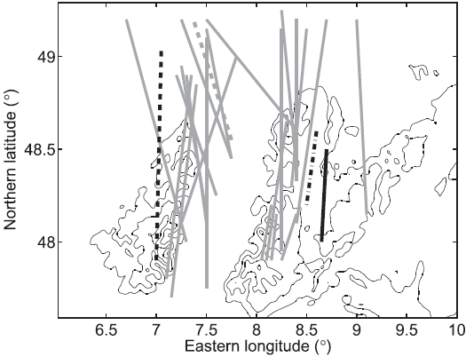
07/20 1100 UTC of 1-km ensemble
Control
Pert06
Pert20
OBS
Trails the observations by 50-200 km

Slide 13
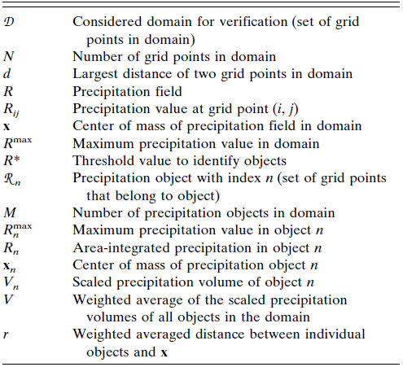
a. The SAL (structure, amplitude, and location) method
Wernli et al. (2008)

Slide 14
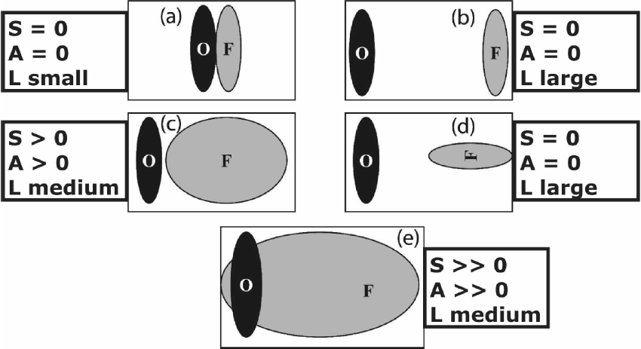

Slide 15
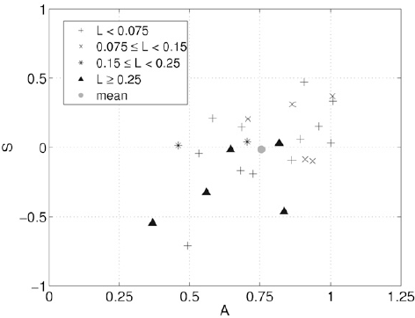
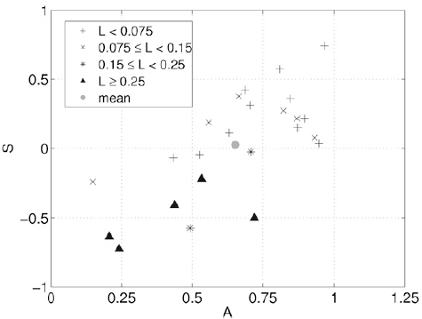
b. Accumulated rainfall
4-km ensemble
07/20 0800—1400 UTC
1-km ensemble
The cumulative rainfall over the domain is larger when the precipitation is more widespread.

Slide 16
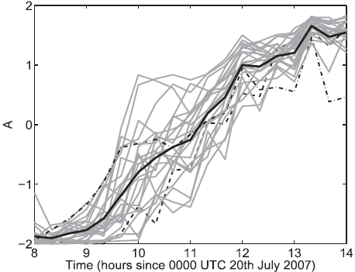
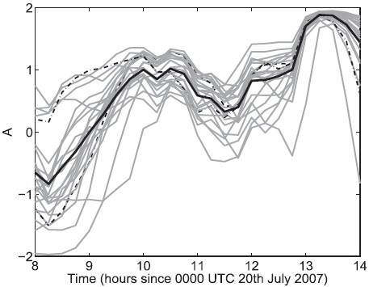
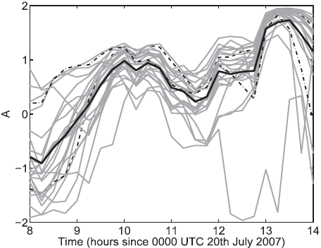
c. Instantaneous rainfall
24-km NAE ensemble
4-km ensemble
1-km ensemble
DWD radar composite (2.8km)
mean
Pert06
Pert20

Slide 17
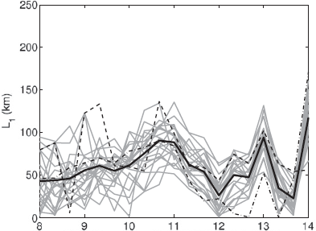
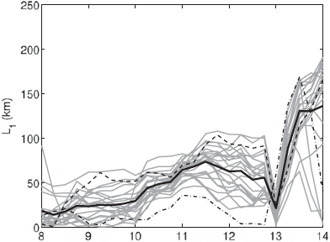
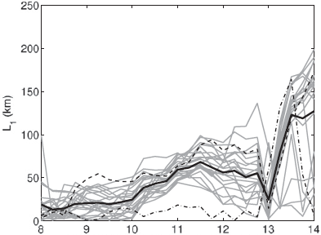
24-km NAE ensemble
4-km ensemble
mean
1-km ensemble
Pert06
Pert20
The convection over the COPS region was apparently
linked to positional errors as the squall line entered the COPS domain through its lateral boundaries.

Slide 18
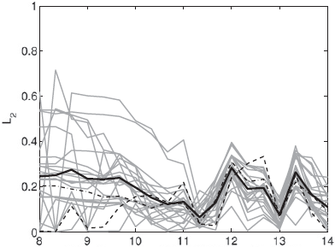
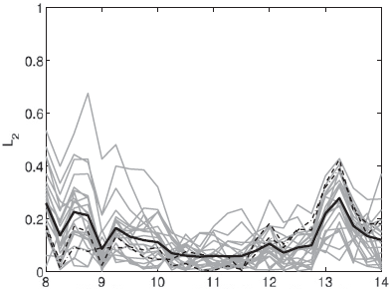
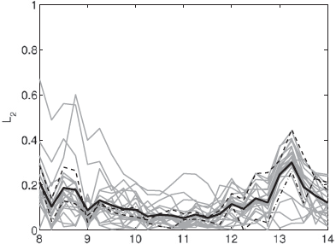
24-km NAE ensemble
4-km ensemble
mean
1-km ensemble
Pert06
Pert20

Slide 19
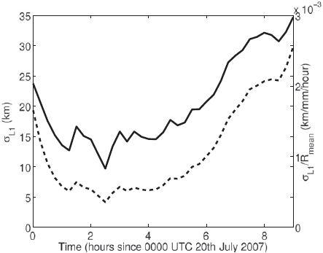
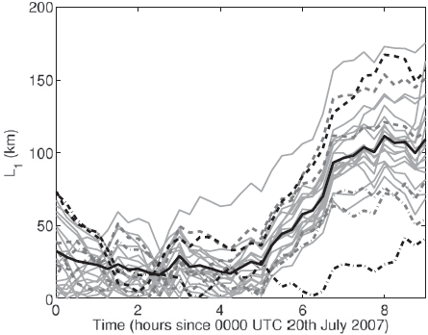
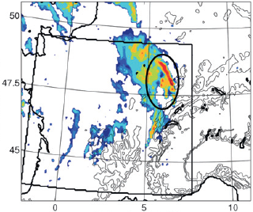
standard deviation of the SAL L₁ component computed in (solid line) standard deviation of the SAL L₁ component computed in normalized by the mean instantaneous rain rate (dashed line)
mean
Pert06
Pert20

Slide 20
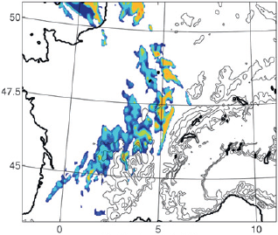
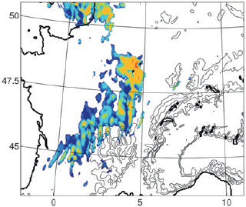
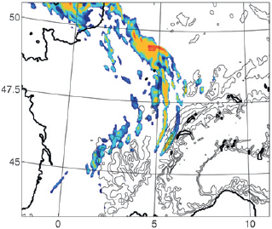
07/20 0730 UTC
Met Office’s Nimrod (5km)
NAE control (4km)
NAE-Pert06 (4km)
NAE-Pert20 (4km)
The primary squall-line initiation over France was critical for accurately simulating the 2nd squall line over the Black Forest.

Slide 21
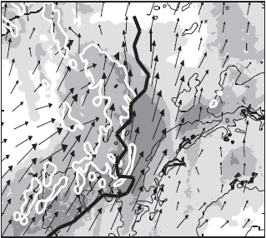
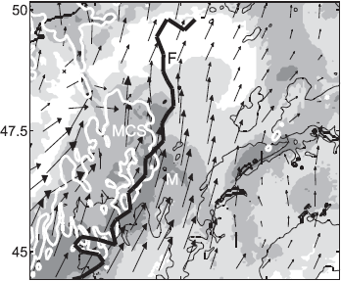
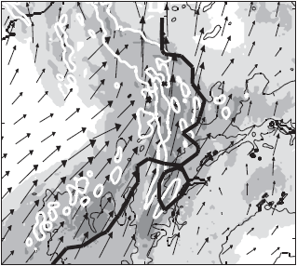
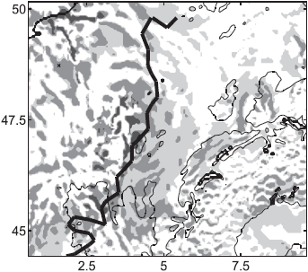
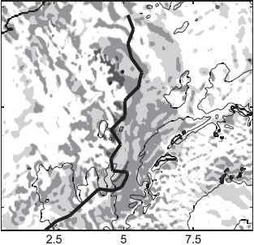
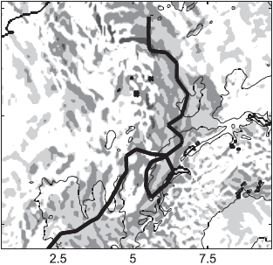
Mechanisms and large-scale sensitivities a. Squall-line initiation
Pert20 simulation @ 700 hPa on 4-km
q (g/kg)
0400 UTC
0600 UTC
0730 UTC
w (m/s)

Slide 22
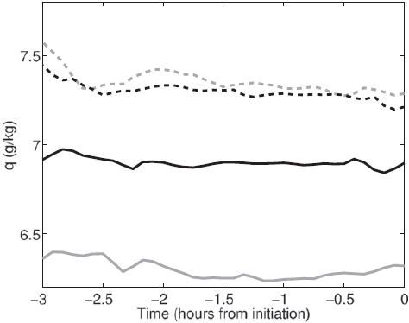
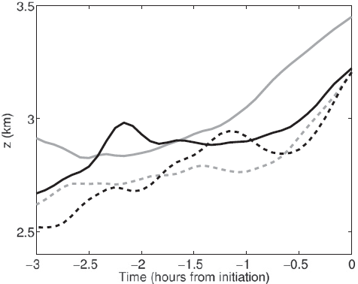
cloud base near the center of developing squall line
nearly adiabatic lifting: constant q as z increase
Pert06
Pert03
Pert20
Pert10
Pert10
Pert03
Pert06
Pert20
verified well: Pert10 & Pert20 verified poorly: Pert03 & Pert06

Slide 23
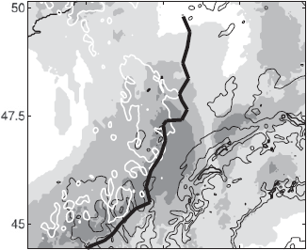
b. Composites
07/20 0600 UTC @ 700 hPa on 4-km
composite A: verify well (Perts 04, 10, 20) composite B: verify poorly (Perts 02, 03, 06)
q (g/kg)
composite A (Perts 04, 10, 20)
composite B (Perts 02, 03, 06)
diff of composite A & B
w (m/s)

Slide 24
07/20 0600 UTC @ p_{msl}
composite A (Perts 04, 10, 20)
composite B (Perts 02, 03, 06)
Ter (km)
diff of composite A – Met
diff of composite B – Met
P_diff (mb)

Slide 25
07/20 0600 UTC
the midlevel front develops faster (strong geostrophic forcing) the MCS and midlevel front propagate faster to the east (stronger westerly advection over France) the moisture anomaly propagates more quickly northward (stronger southerly advection in the warm sector)

Slide 26
07/19 2100 UTC
07/20 0600 UTC
07/20 0600 UTC
UK
UK
UK
A
PVU
B
A (increased upper-level forcing & low-level cyclogenesis) increased RT(2100-0600 UTC) over UK and northern France is 24% higher than B. the prefrontal convection developed earlier and farther to the east in A.
PVU
A-B

Slide 27
A-B
A
B

Slide 28
c. Ensemble sensitivity analysis
p_{msl} @ 07/20 0600 UTC
w @ 07/20 0600 UTC
U₇₀₀ @ 07/20 0600 UTC
SAL L₁ @ 07/20 0900 UTC

Slide 29
Summary and conclusions (I)
IOP9c (2007/07/20) of the COPS field campaign “primary” squall line developed ahead of a decaying MCS propagated over the COPS region dissipated as it descended into the Rhine valley “secondary” squall line regenerated over Black Forest (low-level cold pool collided)
Ensembles captured the primary and secondary squall line: 1-2 h delay & led to a 50-150 km positional error over the COPS a phase error in the onset of intense precipitation
A few members of the 4- and 1-km are improved to predict the squall line timing and position, most members are still suffered from the positional and timing errors
This event was largely driven by synoptic-scale processes, the focus was placed on the sensitivity of the squall-line representation to uncertainties in broader meso- and synoptic-scale features.
A stronger initial PV gradient , a stronger jet streak ➔ rise to stronger ageostrophic ascent . The stronger geostrophic flow and faster cyclogenesis ➔ the development and propagation of both the midlevel frontal circulation and the midlevel moisture anomaly.
COPS

Slide 30
Summary and conclusions (II)
Events are broadly predictable at the synoptic scale may be significantly more uncertain at the convective scale.
Larger-scale uncertainty: forecast error at lead times of 6-12 h and depends on the synoptic regime (Vie’ et al. (2011) and Gebh rdt et al. (2011)).
Convective-scale uncertainties: small-scale features and model-physics parameterizations large-scale uncertainties

