Slide 1
Determining Key Model Parameters of Rapidly Intensifying Hurricane Guillermo(1997) Using the Ensemble Kalman Filter
Chen Deng-Shun
16 Apr, 2013, NCU
Godinez, Humberto C., Jon M. Reisner, Alexandre O. Fierro, Stephen R. Guimond, Jim Kao, 2012: Determining Key Model Parameters of Rapidly Intensifying Hurricane Guillermo (1997) Using the Ensemble Kalman Filter. J. Atmos. Sci., 69, 3147–3171.

Slide 2
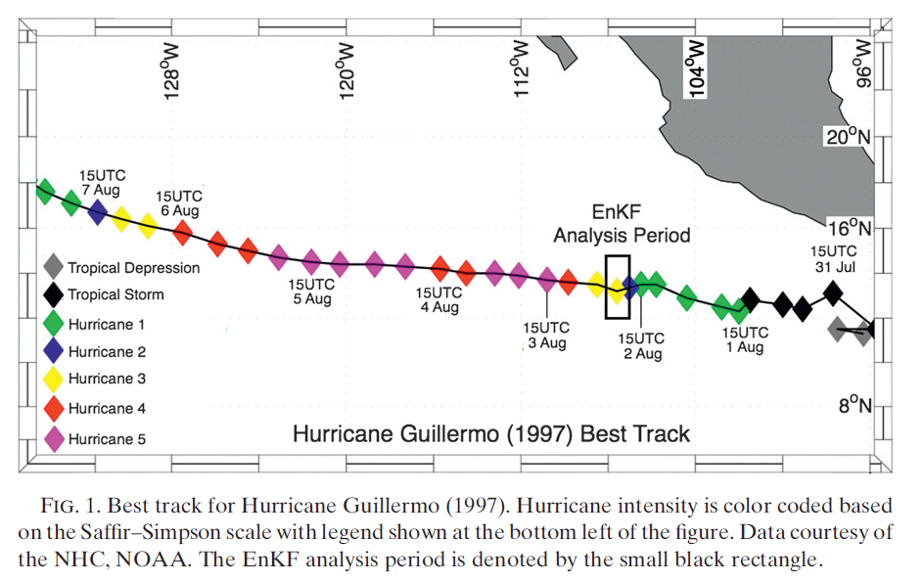
Hurricane Guillermo(1997)

Slide 3
Parameter Estimation Model
Predictive Model
Navier-Stokes equation set
Bulk microphysical model
Four parameters used within in model
Discrete model
Parameter Estimation Model
Parameter estimation with EnKF
Temporal average

Slide 4
Navier-Stokes Equation Set
momentum equation
energy equation
TKE model
Reisner and Jeffery (2009)
Notes:
Loa alamos National Laboratory High Gradient large-eddy smooth cloud model

Slide 5
Bulk Microphysical Model

Slide 6
Parameters of interest
Wind shear
Diffusion coefficient for surface momentum
Surface vertical transport of water vapor
Turbulence length scale(from the surface to the free atmosphere)
Notes:
The simulated vortex is sensitive to small change in wind shear.
Surface flux
Vertical transport of water vapor
Turbulent transport of water vapor

Slide 7
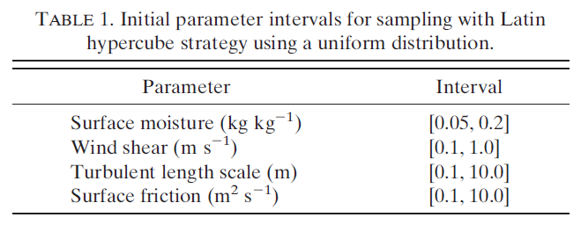
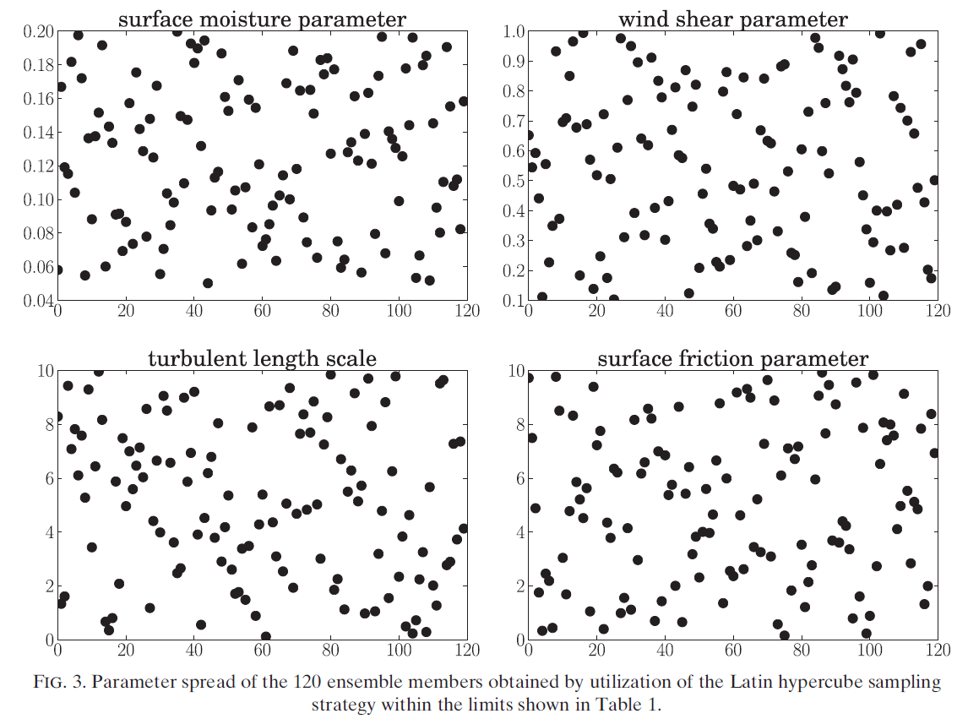
Latin Hypercube Sampling :
LHS ensures that the ensemble of random numbers is representative of the real variability.

Slide 8
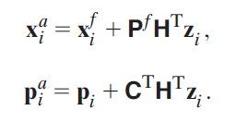
Parameter Estimation with EnKF
EnKF analysis equation
Perturbed observation
Model forecast covariance matrix
Cross-correlation matrix
Parameter correlation matrix

Slide 9
Considerations for parameter estimation with EnKF
Time Average and Member Average
Though EnKF as a tool to estimate the model parameters using the variable data.
The model parameters can affect the dynamics structure, but they do not evolve though model.
The object of this paper is to estimate a constant parameter value for the given dataset.

Slide 10
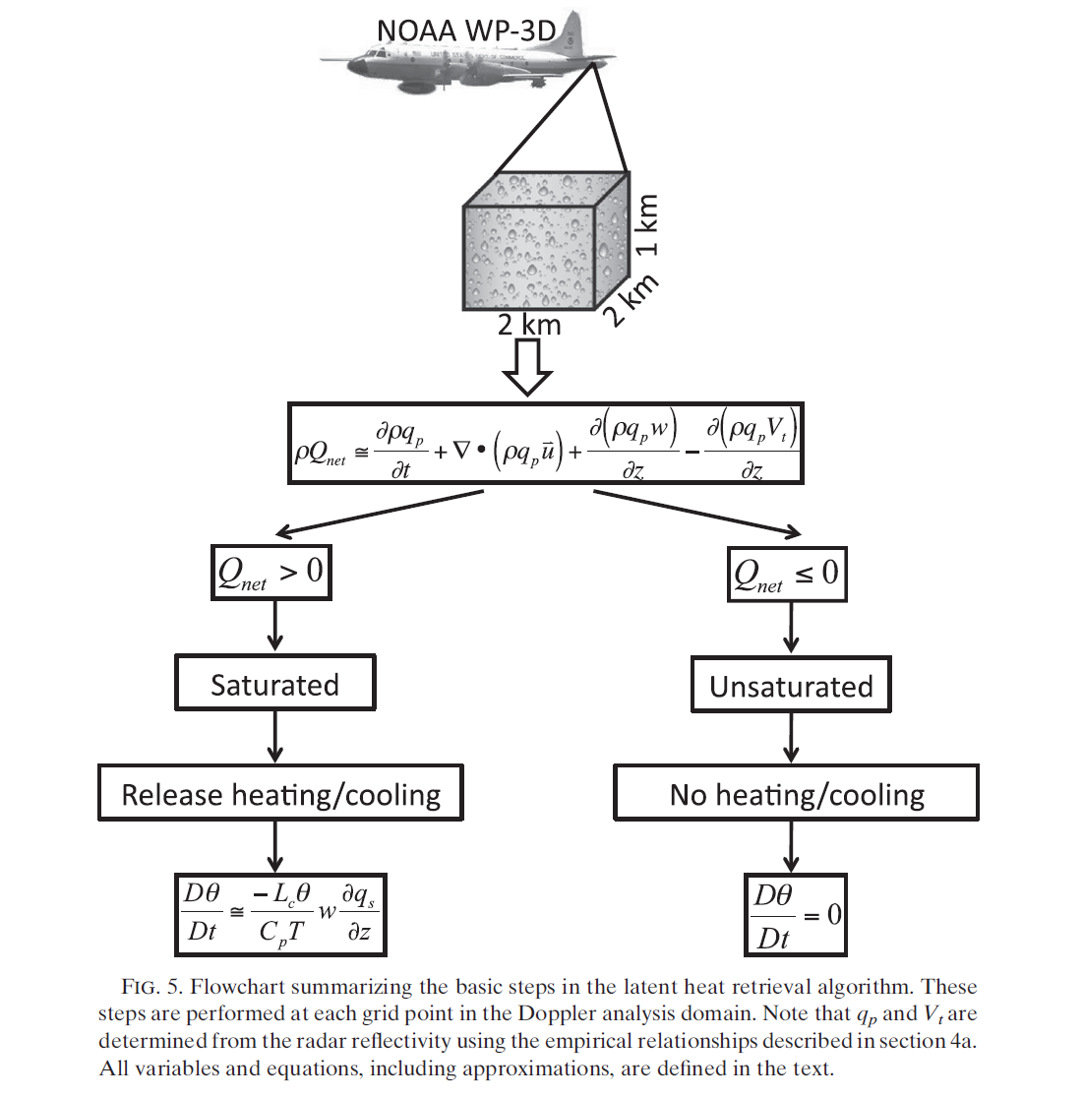
Parameter Estimation Model Setup
Derived Doppler Data Fields
Notes:
1. Precipitation continuity equation (determine the saturation state)
2. Determine the magnitude of heat release using the first law of thermodynamics and the vertical velocity

Slide 11
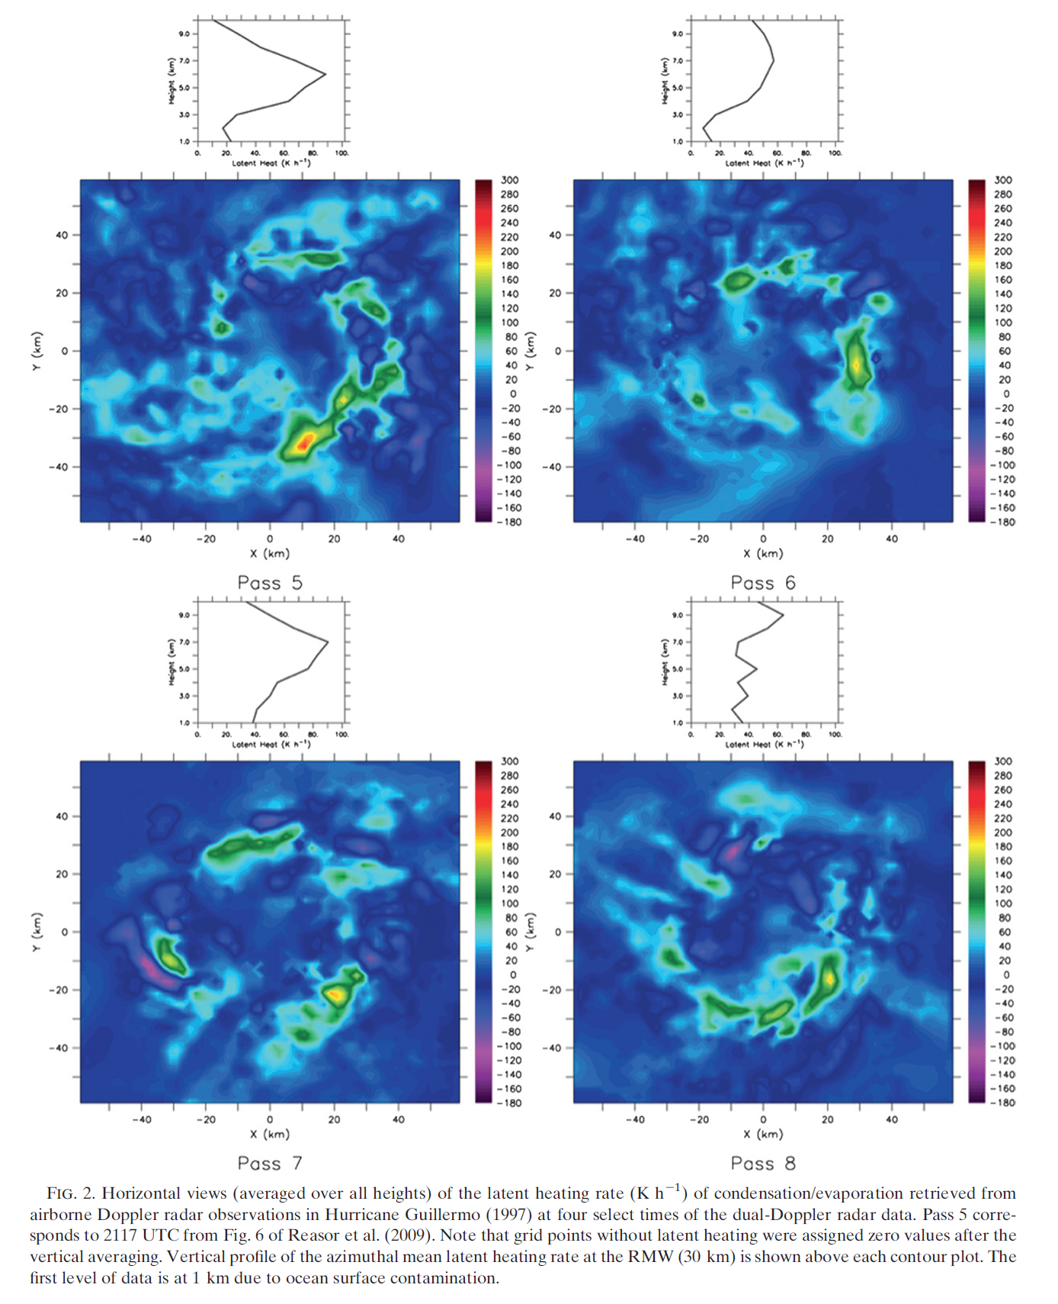
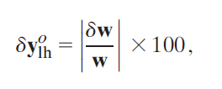
Observation error in the retrieved latent heating
δw = 1.56 m/s Reasor et al. (2009)

Slide 12
Parameter Estimation Model Setup
EnKF and observation selection
(k x n) (n x 1) (1x l)
Sorting from smallest to largest

Slide 13
Results
Leading to large variations in the simulated intensity and structure.
Large amounts of derived data required to reasonably estimate.
The newly estimated parameters lead to an overall reduction in the model forecast error.

Slide 14
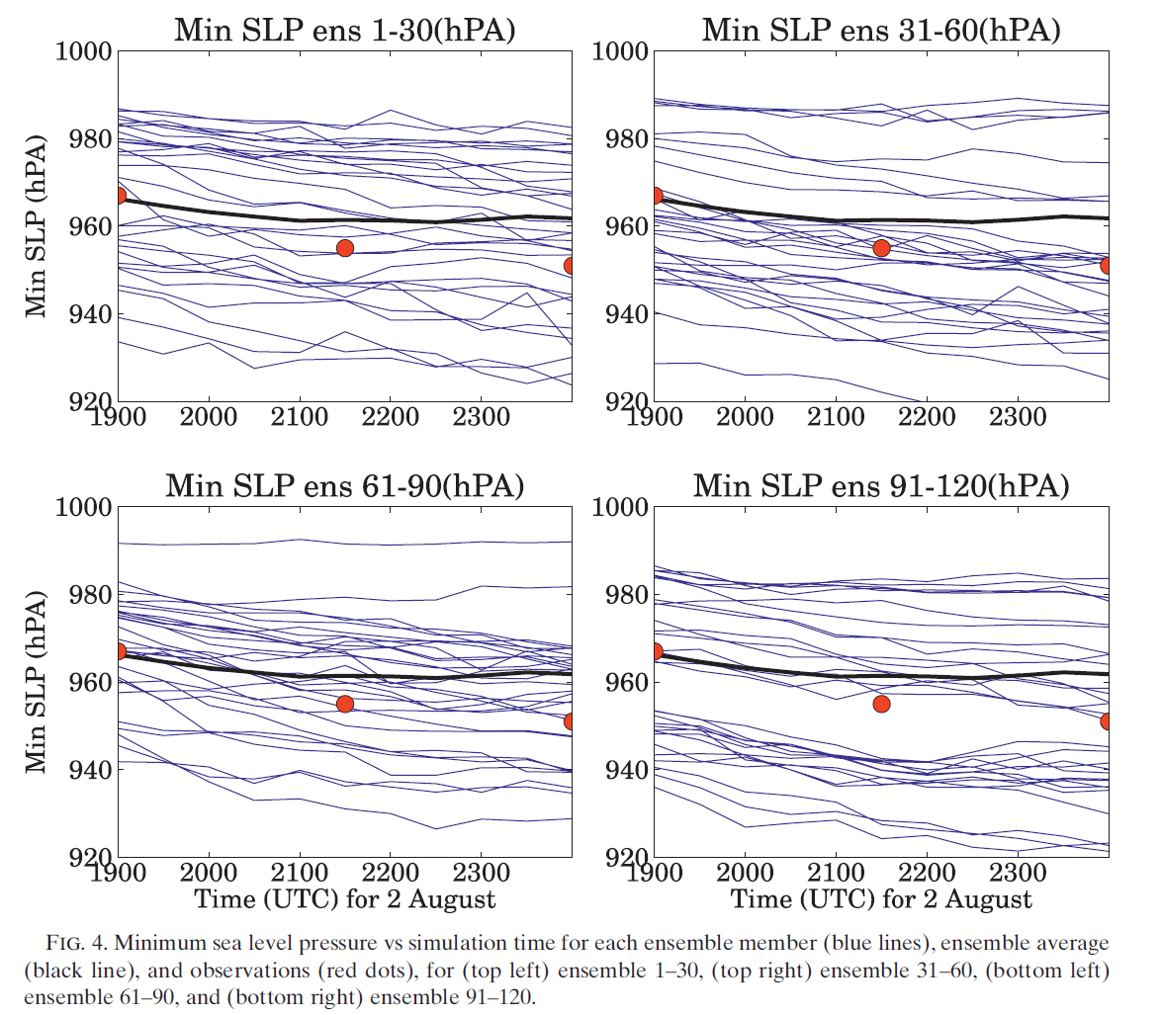
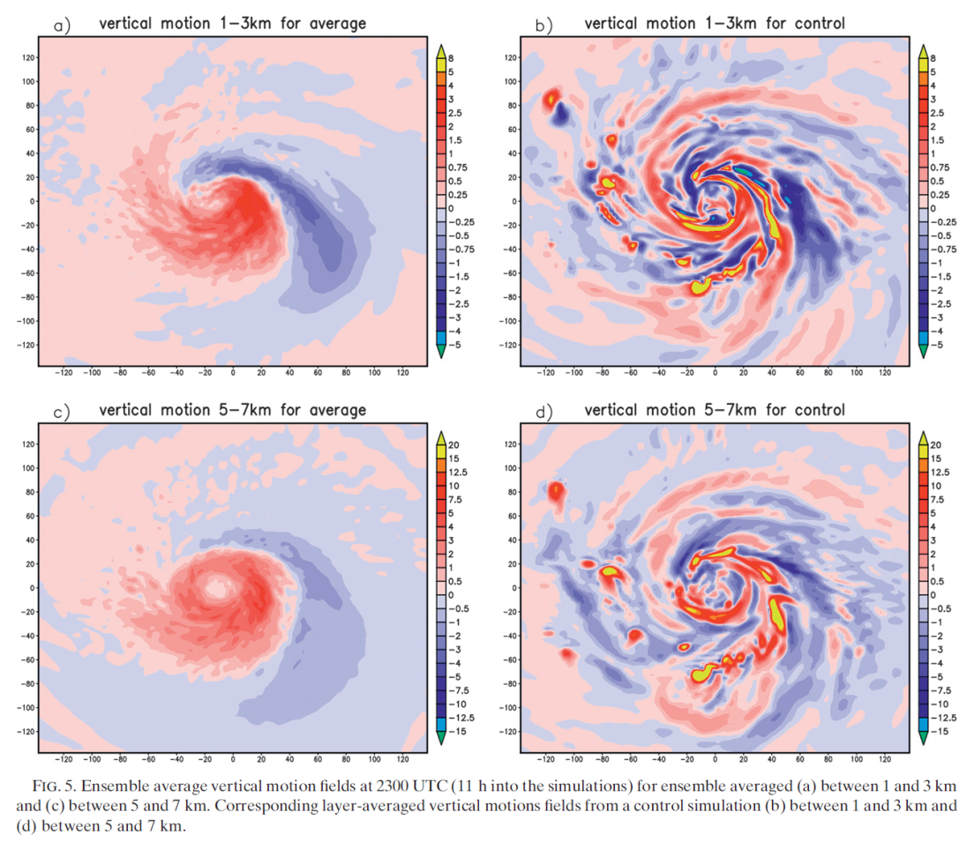
Results
vertical motion
Ensemble average
Control
Min. SLP

Slide 15
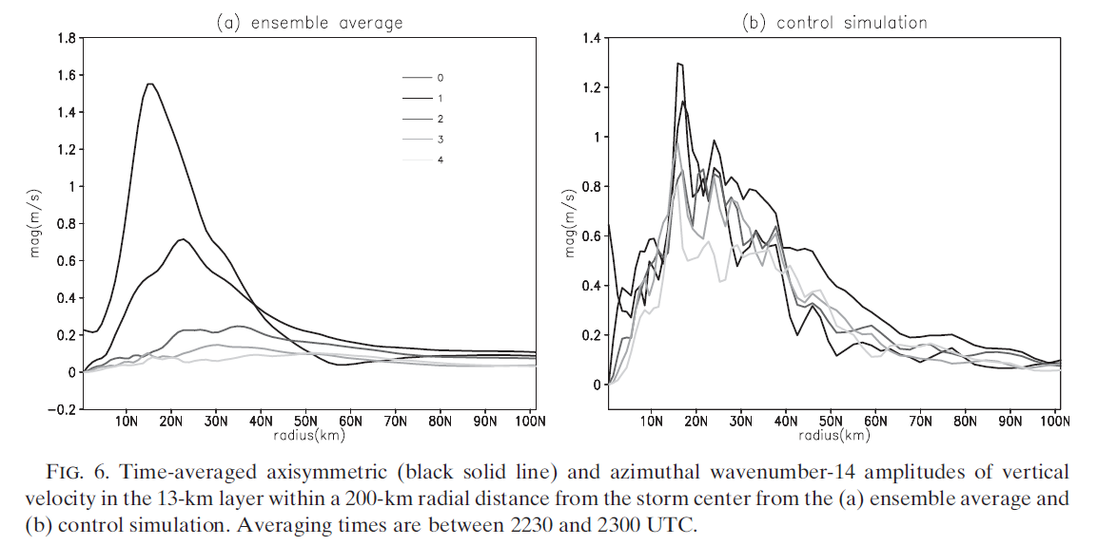
vertical velocity
Reasor et al. (2009)

Slide 16
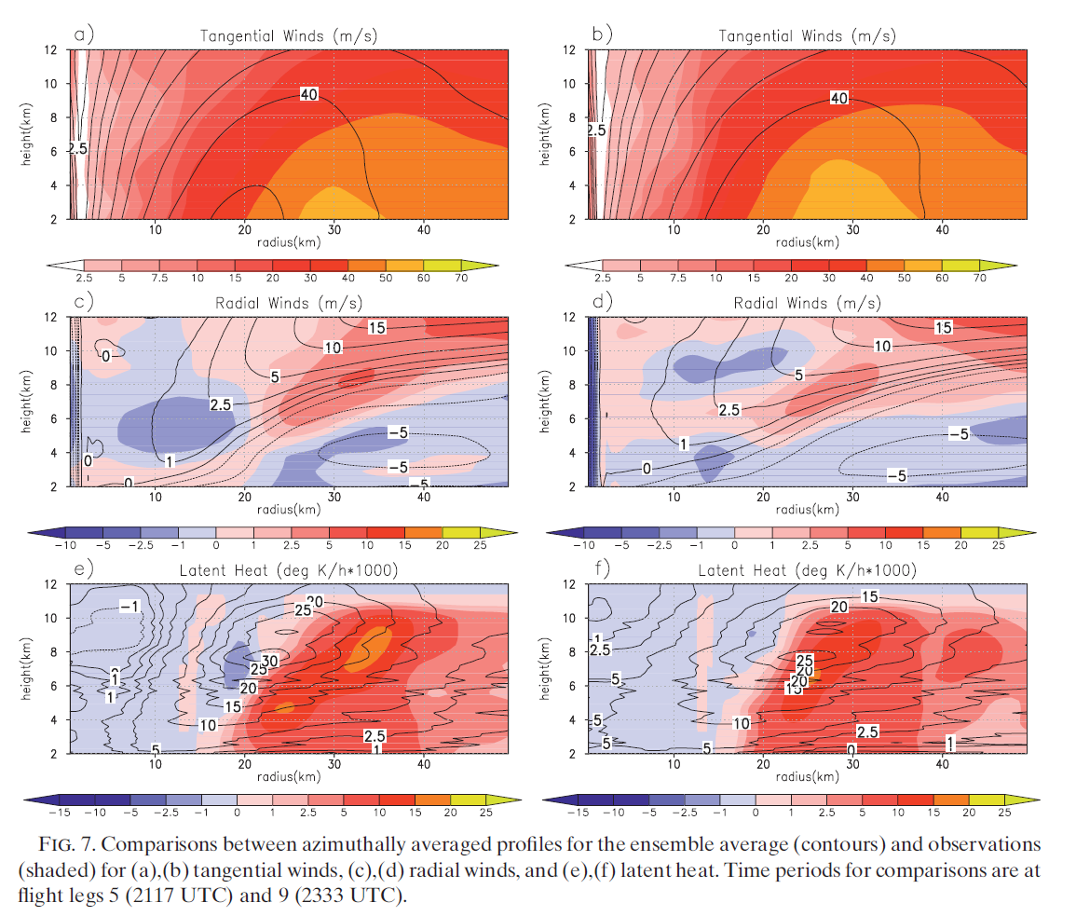
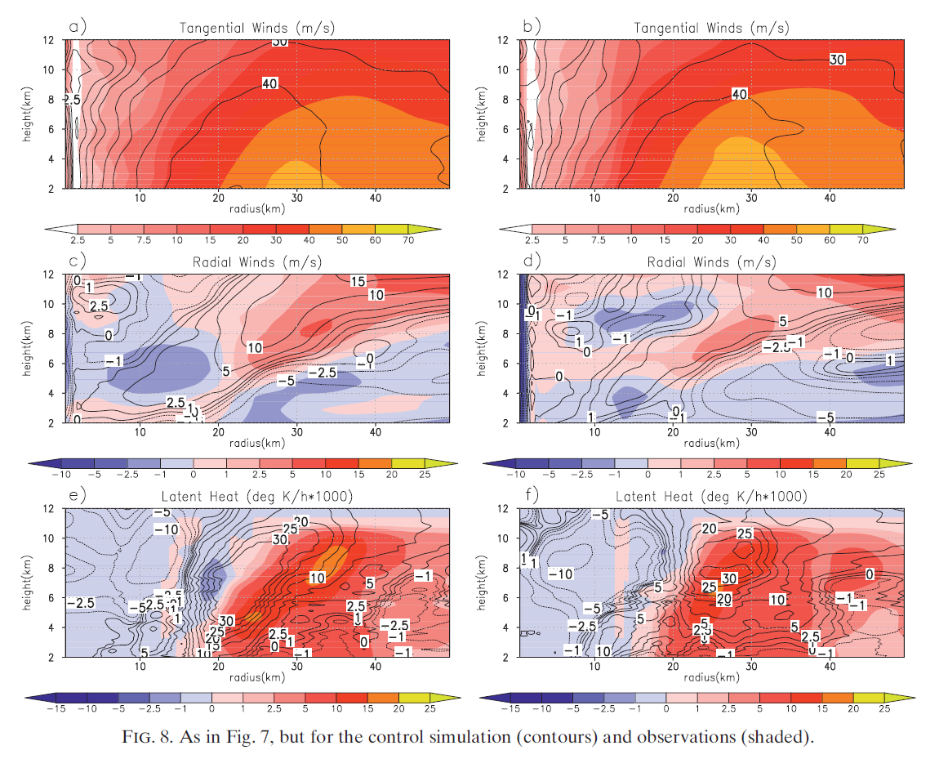
Ensemble average
Control
legs 5
legs 9
legs 5
legs 9
Larger values of latent heat are required to compensate for the impact of spurious evaporation (Reisner and Jeffery 2009)

Slide 17
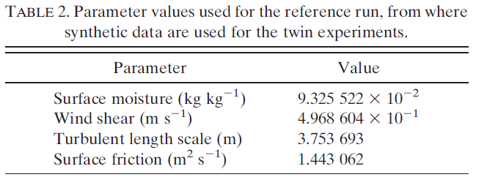
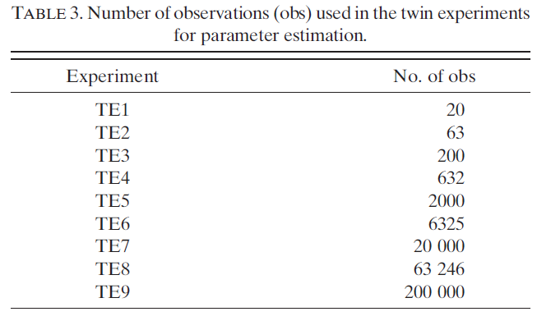
Tong and Xue (2008) : A smaller number of data leads to a slower convergence rate in some experiments, and a number larger than 50 results in overadjustment to some parameters
How many observations should be assimilated ?
Reference run
experiments
ensemble mean + white noise

Slide 18
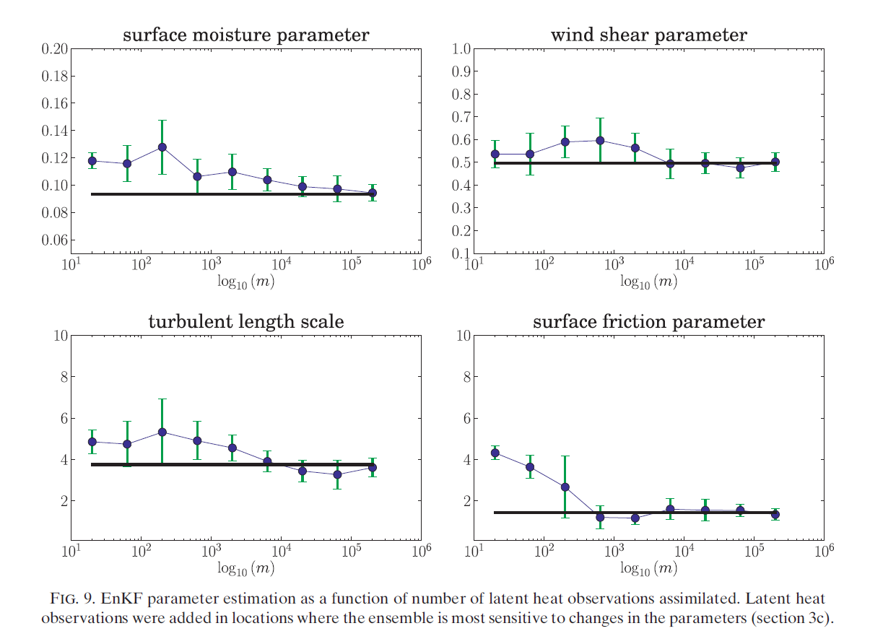
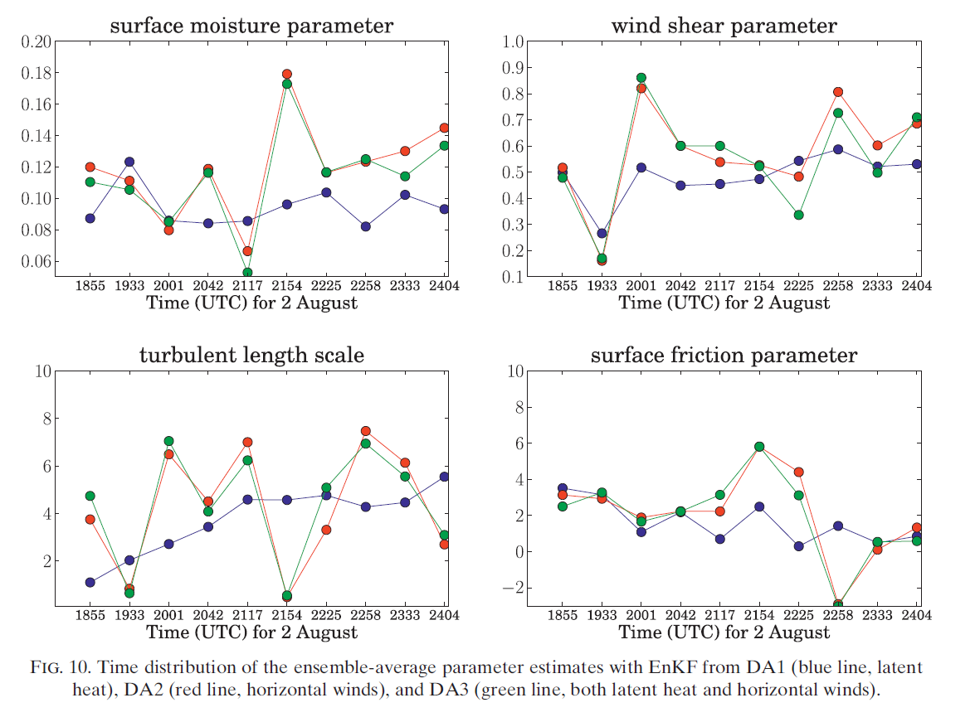
Blue : latent heat (DA1)
Red : horizontal wind (DA2)
Green : latent heat + horizontal wind (DA3)
Reference run parameter
TE1
TE9
It is only when approximately 200 000 observations are used that all 4 parameters converge to the correct values.
Sensitivity test
Consistent with Yussouf and Stensrud (2012)

Slide 19
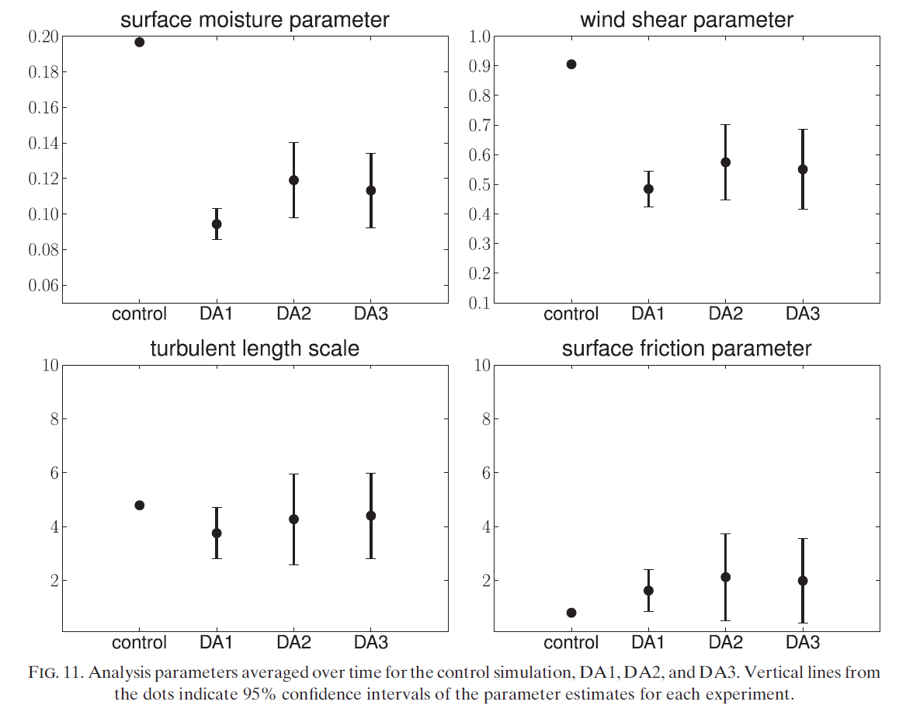

Slide 20
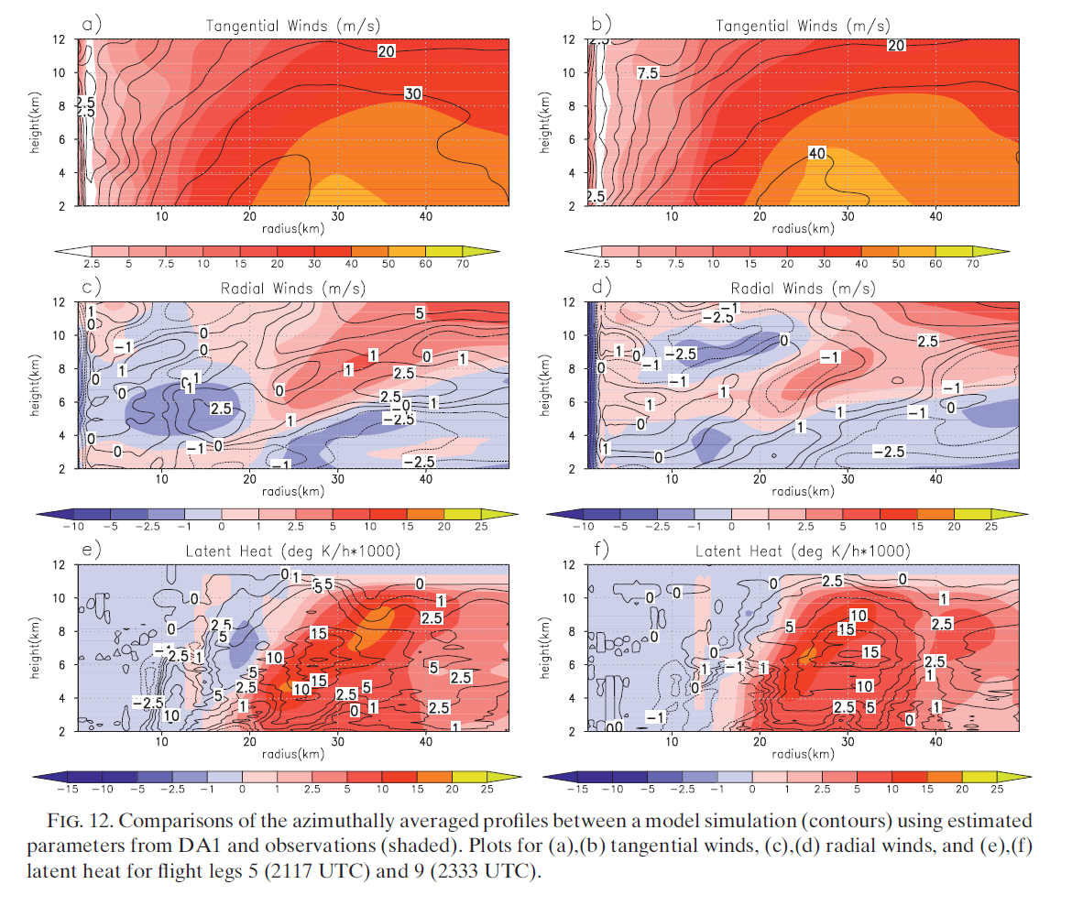
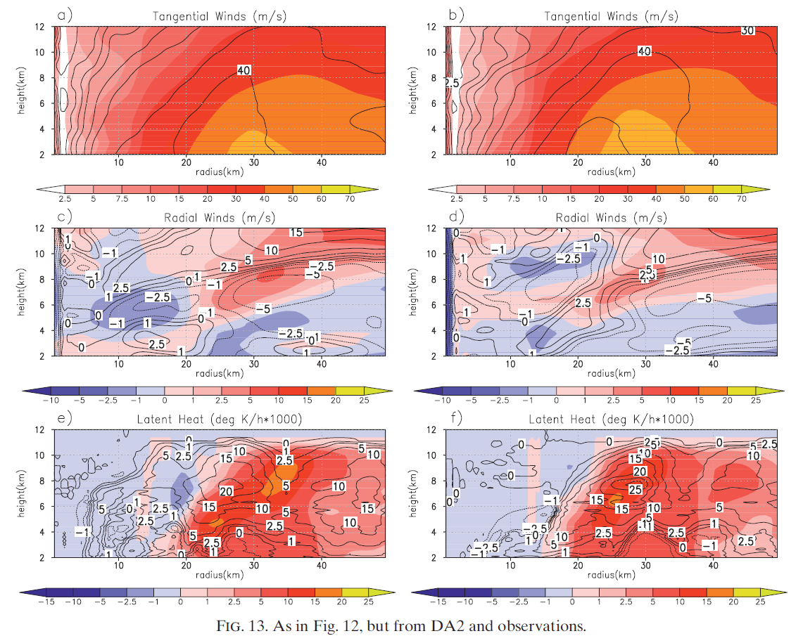
DA1
DA2
legs 5
legs 9
legs 5
legs 9

Slide 21
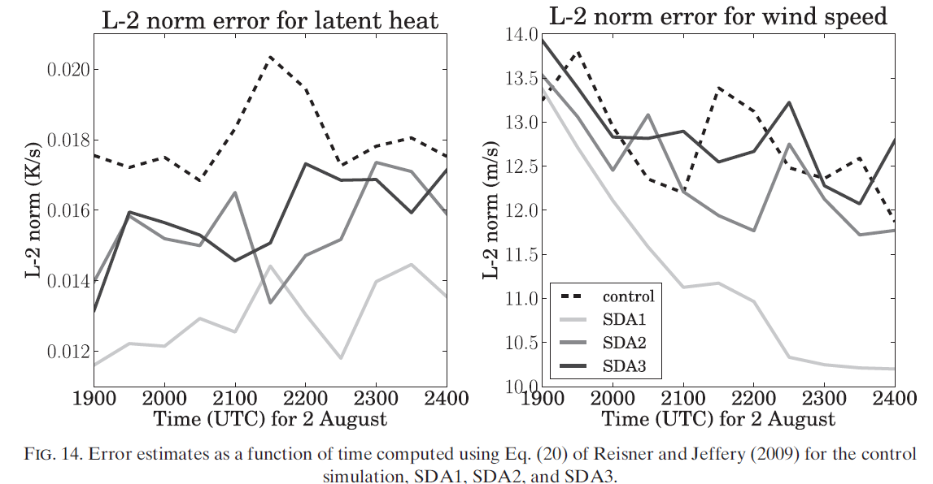
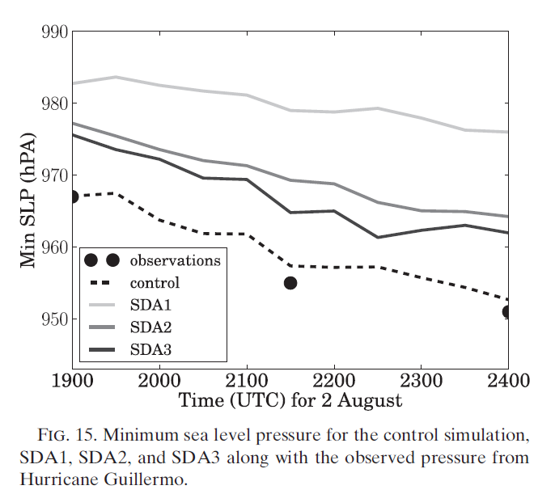

Slide 22
Summary and Conclusions
The estimates obtained using derived latent heat fields produced lower model forecast errors in structure.
The results with latent heat produced a hurricane the has a reasonable intensity.
Numerical errors in the model, such as numerical diffusion and spurious evaporation.
The parameters associated with the primary component of hurricane intensification, condensation of water vapor into cloud water, should also be included in the current parameter estimation procedure.

Slide 23
Summary and Conclusions
The influence that a small number of parameters has upon the evolution and formation of a simulated hurricane.
Improving both hurricane structure and intensity, by estimating parameter using latent heat observations, will be further explored in future research.

Slide 24
Thanks for your sweet attention !!
Question ?
“The fear of the LORD is the beginning of wisdom .”

Slide 25
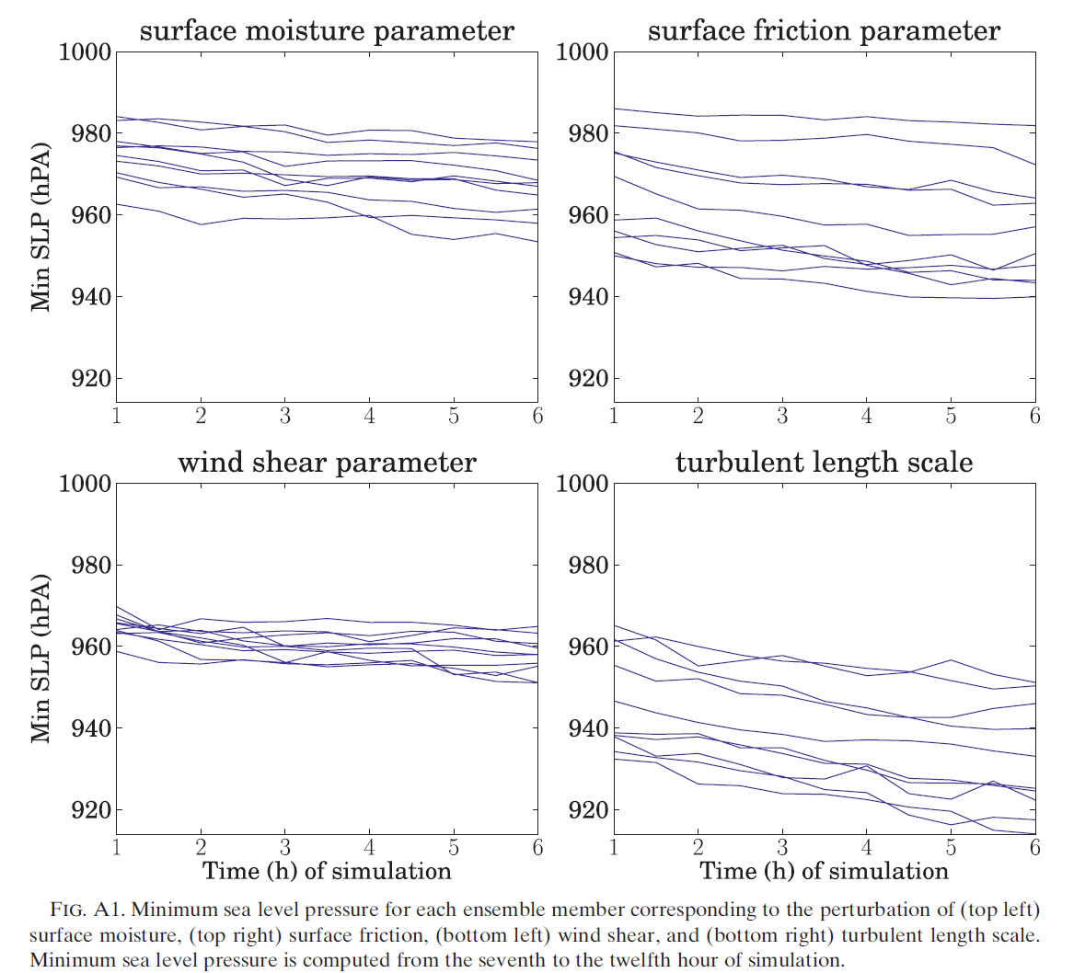
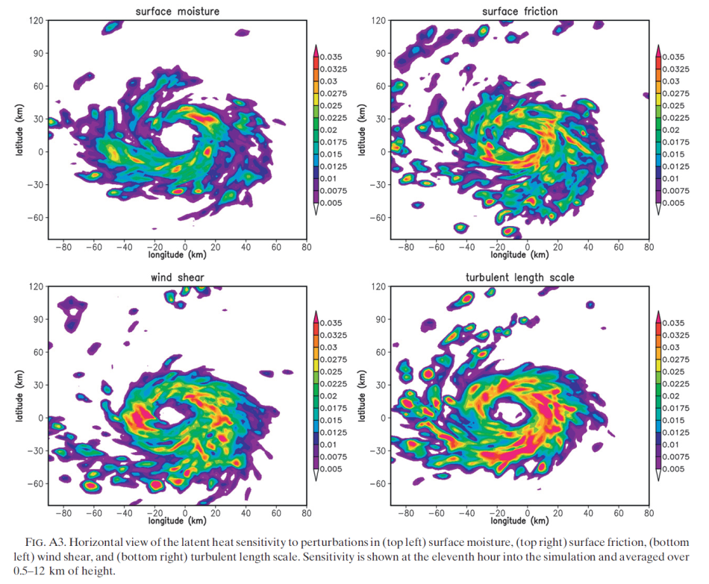
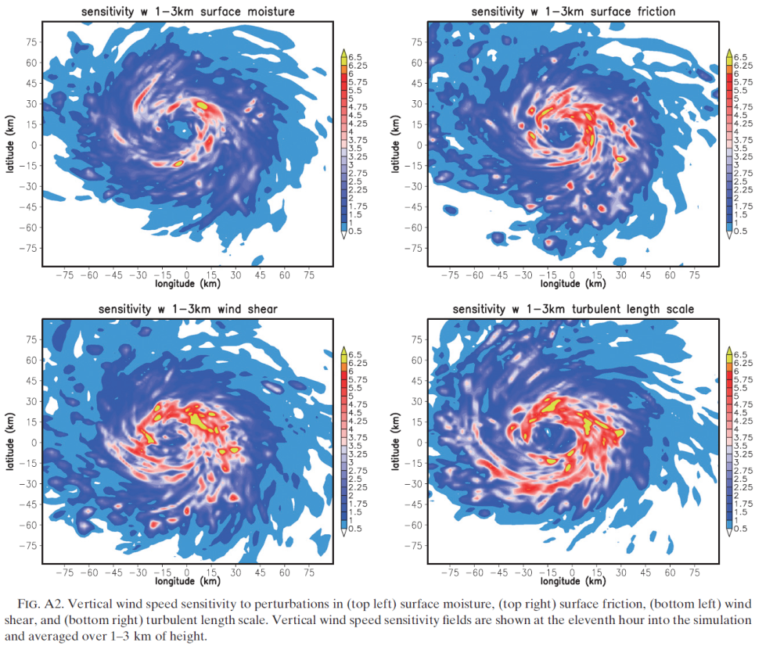
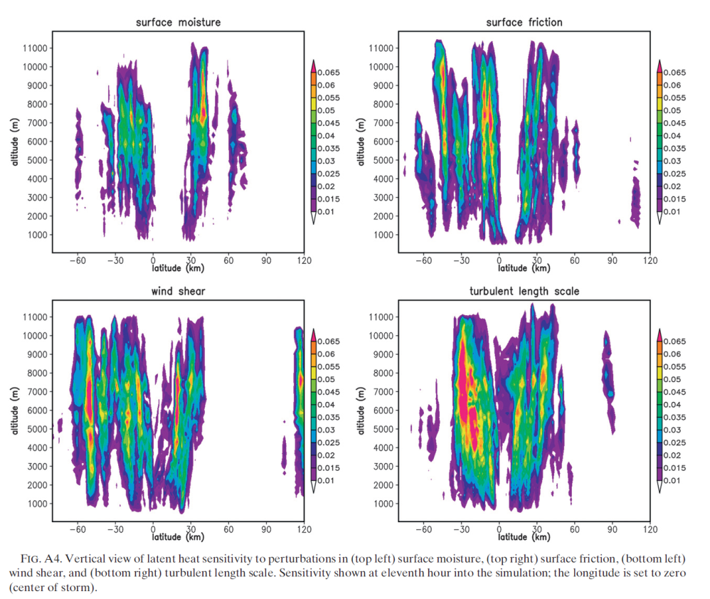
back

Slide 26
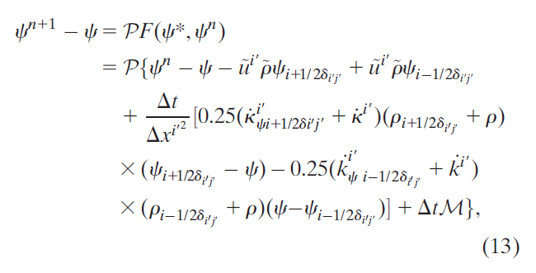
Discrete model

