Slide 1
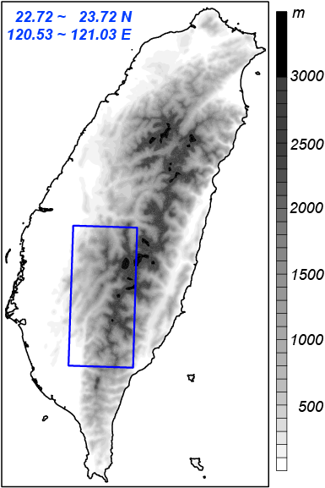
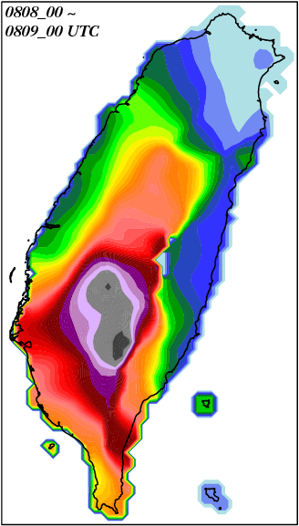

Water Budget and Precipitation Efficiency of Typhoon Morakot (2009)
Hsiao-Ling Huang¹, Ming-Jen Yang¹, and Chung-Hsiung Sui²
¹National Central University, Taiwan
²National Taiwan University, Taiwan
Submitted to Journal of the Atmospheric Sciences
mm

Slide 2
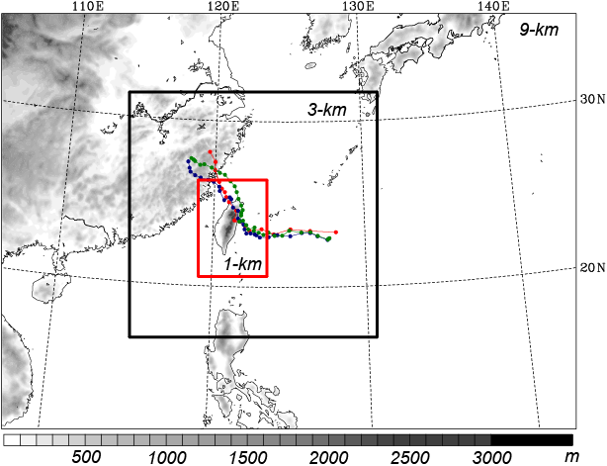
WRF domain and physics for Morakot Simulation
  9/3/1 km (416x301 / 541x535/ 451x628)
  31 sigma (σ) levels
  Two-way feedbacks
  No CPS is used!
  WRF Single-Moment
  6-class scheme (WSM6)
  IC/BC: EC 1.125º
  lat/lon
  Initial time: 0000 UTC,
  6 Aug 2009
  Integration length:
  96 h

Slide 3
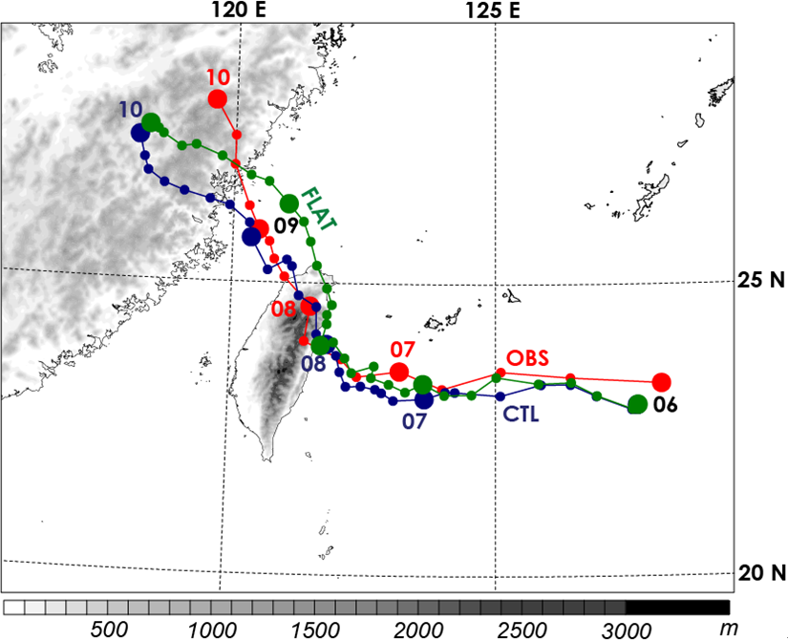

Slide 4
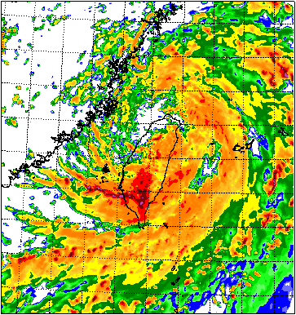
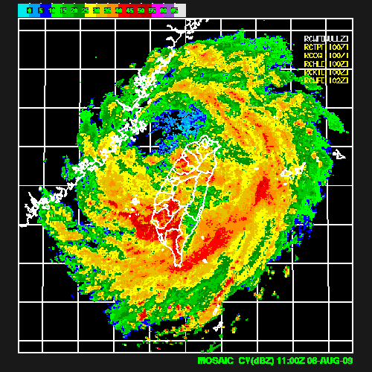
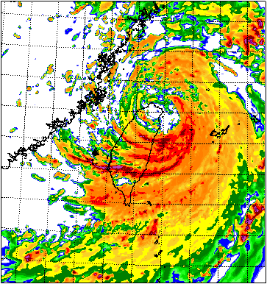
08/08/11 UTC
118E
120E
122E
124E
28N
CWB_OBS
CTL
26N
122E
124E
28N
24N
26N
22N
24N
20N
22N
28N
20N
26N
118E
120E
24N
22N
FLAT
20N

Slide 5
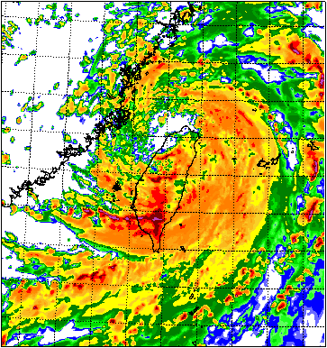
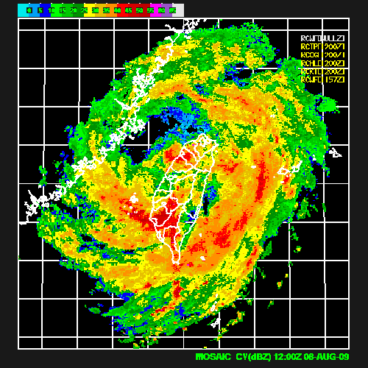
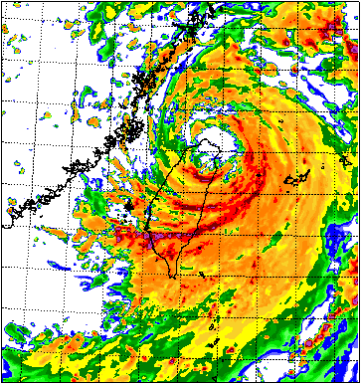
08/08/12 UTC
118E
120E
122E
124E
28N
CWB_OBS
CTL
26N
122E
124E
28N
24N
26N
22N
24N
20N
22N
28N
20N
26N
118E
120E
24N
22N
FLAT
20N

Slide 6
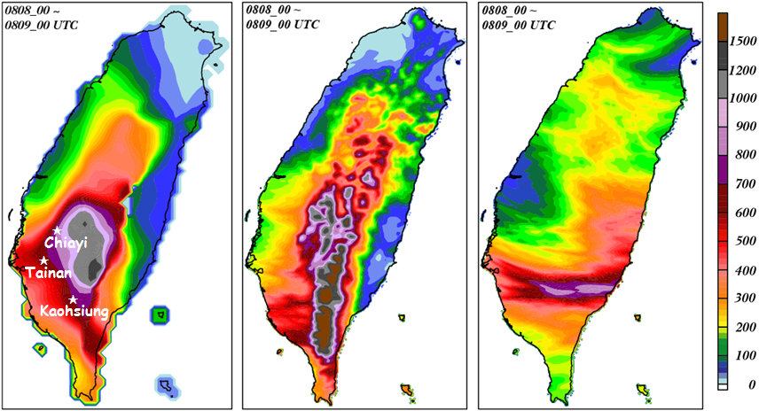
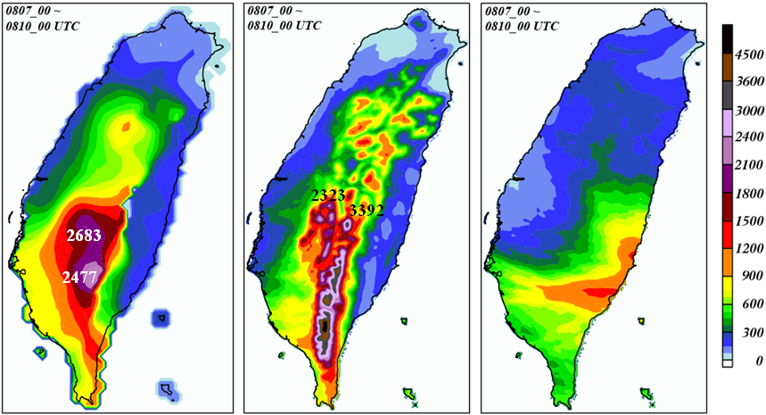
24-h rainfall
(08/08/00 ~ 08/09/00 UTC)
OBS
CTL
FLAT
72-h rainfall
(08/07/00 ~ 08/10/00 UTC)

Slide 7
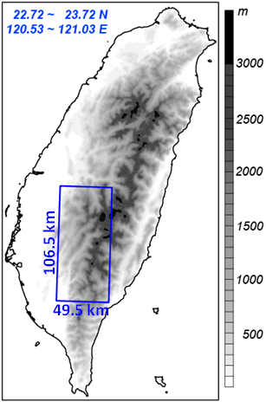
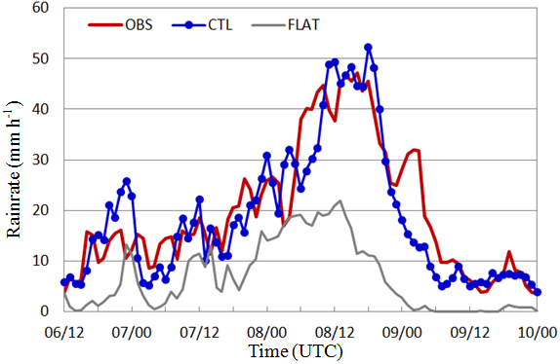

Slide 8

Budget Equtions [from Yang et al. (2011;MWR)]
Water vapor budget: q_{v}
Cloud budget: q_{c} = q_{w} + q_{i}
where is the total condensation and deposition;
is the total evaporation and sublimation;
is the net horizontal flux convergence;
is the vertical flux convergence;
is the divergence term
is the numerical diffusion
is the boundary layer source and vertical (turbulent) diffusion
is the residual term
is the precipitation flux.
PE [defined as Cloud Microphysics Precipitation Efficiency (Sui et al. 2005, 2007)]:

Slide 9
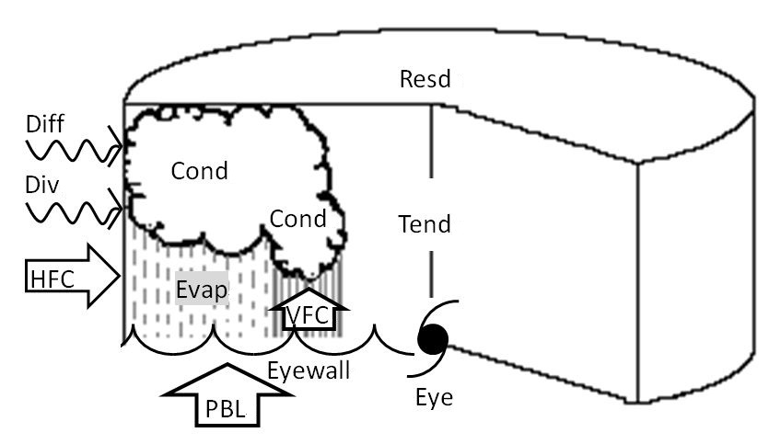
Budget Equtions [from Yang et al. (2011;MWR)]
Water vapor budget: q_{v}
Cloud budget: q_{c} = q_{w} + q_{i}
PE [defined as Cloud Microphysics Precipitation Efficiency (Sui et al. 2005, 2007)]:

Slide 10

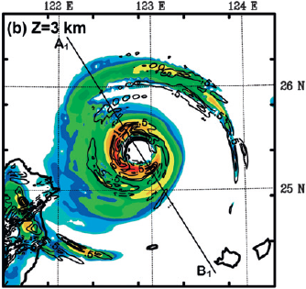
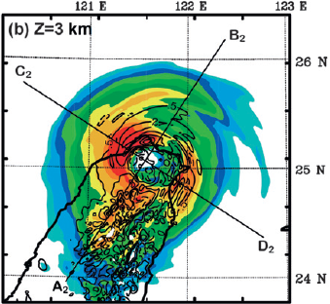

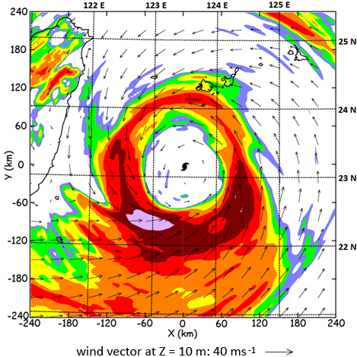
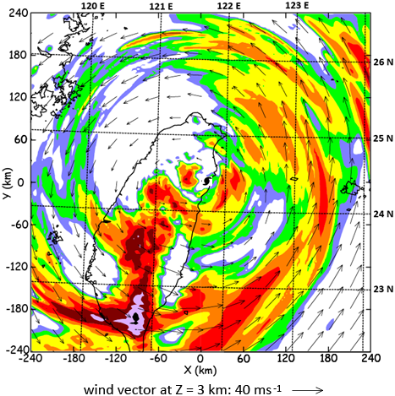
dBZ
7.41*10¹¹ kg h⁻¹
9.06*10¹¹ kg h⁻¹
48
Nari
(2001)
44
40
Yang et al.
(2011)
36
32
28
24
20
over ocean
landfall
mm h⁻¹
Morakot
(2009)
128
64
32
16
8
4
2
1
2.28*10¹² kg h⁻¹
1.63*10¹² kg h⁻¹

Slide 11
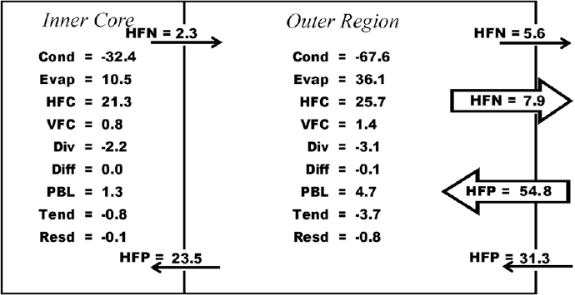
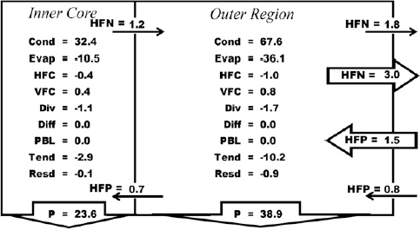
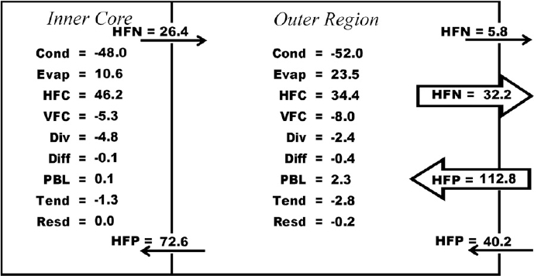
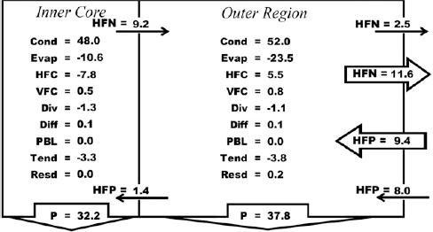
over
ocean
Nari
(2001)
Resd = -1.0
Resd = -0.9
62.5
Water Vapor Budget
Liquid/Ice Water Budget
Yang et al.
(2011)
landfall
Resd = 0.2
Resd = -0.2
70.0

Slide 12
dBZ
7.41*10¹¹ kg h⁻¹
9.06*10¹¹ kg h⁻¹
48
Nari
(2001)
44
40
Yang et al.
(2011)
36
32
28
24
20
over ovean
landfall
mm h⁻¹
Morakot
(2009)
128
64
32
16
8
4
2
1
2.28*10¹² kg h⁻¹
1.63*10¹² kg h⁻¹

Slide 13
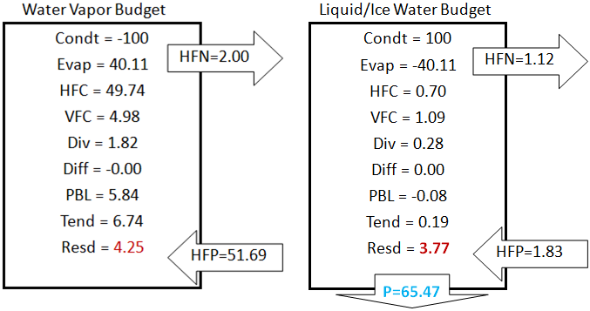
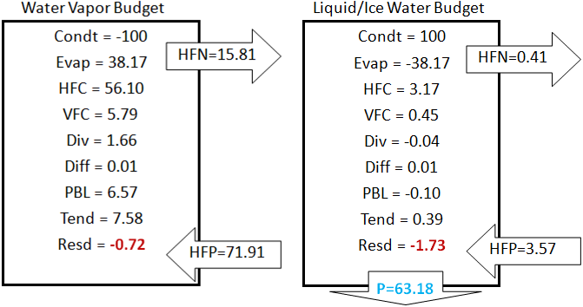
over
ocean
Morakot
(2009)
landfall

Slide 14
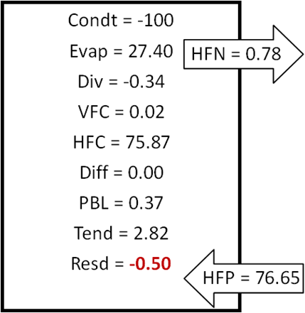
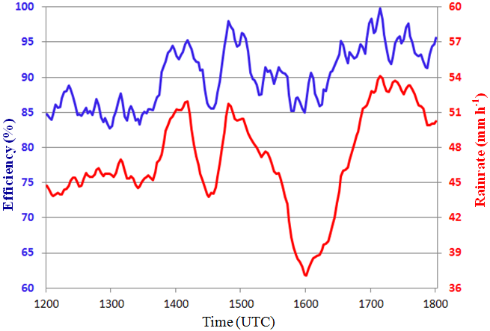
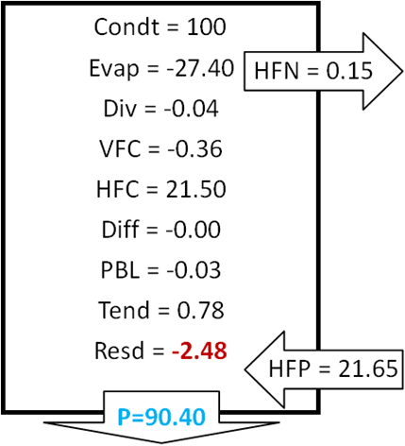
Water Vapor Budget
Liquid/Ice Water Budget

Slide 15
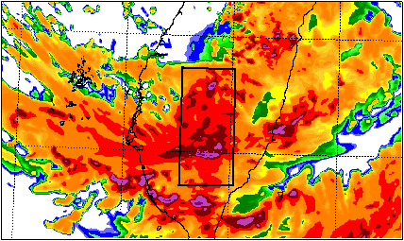
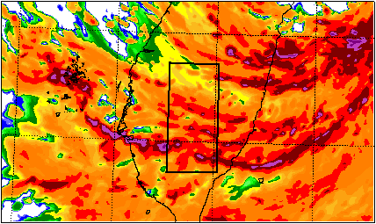
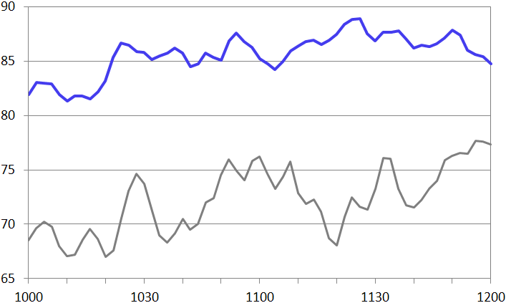
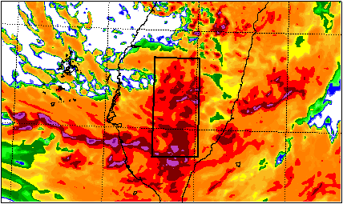
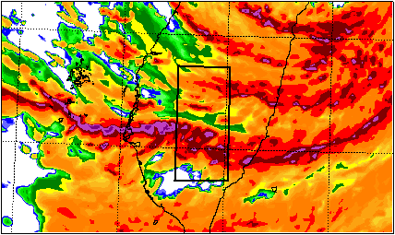
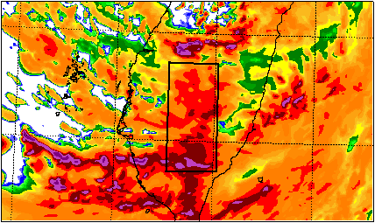
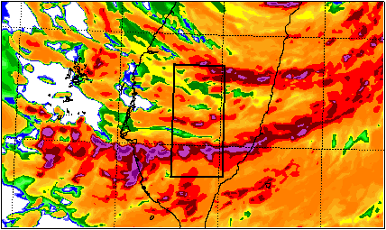
CTL
FLAT
24N
24N
08/08/10 Z
23N
23N
PE (%)
CTL
24N
24N
15~20 %
08/08/11Z
FLAT
119E
23N
23N
24N
Time (UTC)
24N
08/08/12 Z
23N
23N
120E
121E
122E
120E
121E
122E

Slide 16



Lagrangian framework discussion
where CR is the condensation ratio;
DR is the deposition ratio;
CR + DR = 1
ER is the evaporation ratio;
Cond_{C} is the cloud water condensation;
Dep_{S} is the snow deposition;
Dep_{G} is the graupel deposition;
Dep_{I} is the cloud ice deposition;
Evap_{R} is the raindrop evaporation.

Slide 17
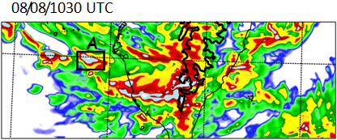
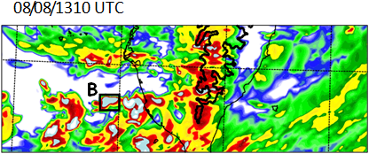
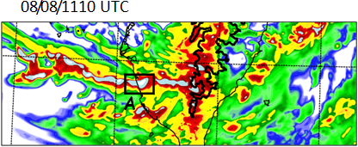
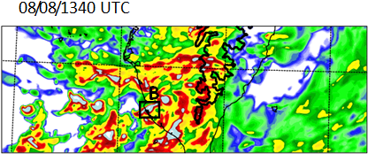
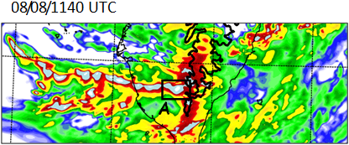
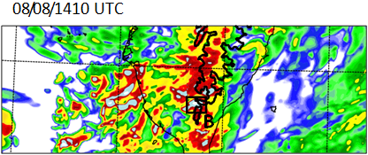
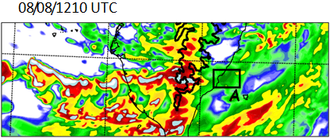
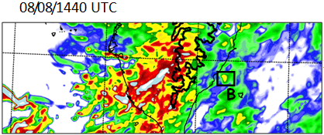
Cell A
Cell B

Slide 18
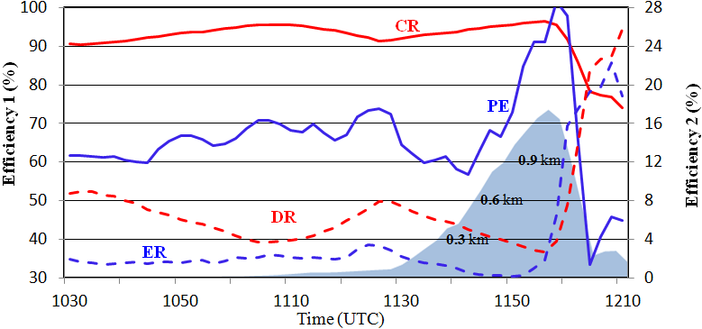
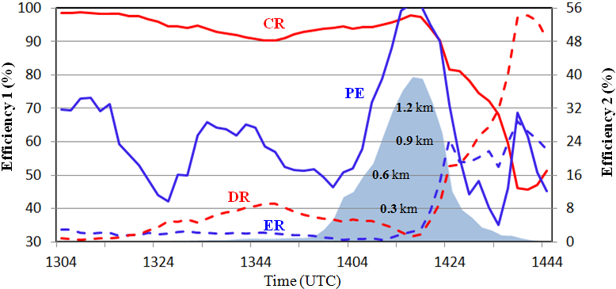
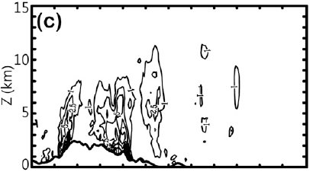

Cell A
Cell B
evaporation

Slide 19
Summary
The cloud-resolving simulations (with horizontal grid size of 1-2 km) of Typhoons Nari (2001) and Morakot (2009) capture the storm track, intensity, and precipitation features reasonably well. The highly-asymmetric outer rainbands of Morakot combined with the southwesterly monsoonal flow to produce near world-record heavy landfall on Taiwan (>2800 mm in 4 days).
The simulated rain rate and PE of the FLAT storm are 50% and 15-20 % less than those of the CTL storm over Taiwan during Morakot’s landfall period. Because of a bigger storm radius (240 km for Morakot vs. 150 km for Nari), Morakot has a storm-total condensation three times larger than Nari.
Owing to the highly asymmetric circulation embedded in a large-scale intra-seasonal oscillation, Morakot has stronger horizontal convergence of water vapor, producing more percentage of rainfall out of total condensation, than Nari.

Slide 20
Summary
The PE > 95 % over the Taiwan mountain during Morakot landfall and postlandfall periods, causing many landslides and burying the village of Shiaolin (lose of 500 people).
Convective cells within rainbands propagated eastward, with PEs increasing from 45~70 % over ocean to >95 % over mountain.
The high PEs (>95%) at the mountain : CR increased and ER decreased through the CMR orographic lifting.
The low PEs (<50%) on the lee side: ER strong increased and CR decreased.
The secondary increase of PEs on the lee side: is mainly produced by DR (more snowflakes and graupel particles) being transported to upper atmospheric by vertically-upward propagating gravity waves above the rugged terrain.

