Slide 1
Ensemble prediction of rainfall during the 2000–2002Mei-Yu seasons: Evaluation over the Taiwan area
Yang, M.-J., B. J.-D. Jou, S.-C. Wang, J.-S. Hong, P.-L. Lin, J.-H.
Teng, and H.-C. Lin (2004), Ensemble prediction of
rainfall during the 2000–2002 Mei-Yu seasons: Evaluation
over the Taiwan area, J. Geophys. Res., 109, D18203,
doi:10.1029/2003JD004368.

Slide 2
Outline
Keywords
Equitable threat score(ETS)
Bias score(BS)
Introduction
Data and model description
Ensemble methods
Ensemble results
Conclusions
References

Slide 3
Keywords
 |  | Observed
 |  | T | F
Forecast | T | a | b
 | F | c | d
Dichotomous forecasts:
Provide a clear “yes” or “no” answer
Equitable threat score(ETS):在計算除了模式與觀測皆無降水且不是隨機猜中的情況下，模式正確預測降水的機率
,where
Bias score(BS):模式預測降水次數與觀測降水次數之比
猜true的次數
$$ETS=\frac{a−a_{r}}{a+b+c−a_{r}}$$
$$a_{r}=\frac{(a+b)(a+c)}{total}$$
真正true機率
($ETS∈[\frac{−1}{3},1]$ , 0 indicates no skill, and 1 means the perfect score)
$$BS=\frac{a+b}{a+c}$$
($\frac{forcast True}{observed True})$
($BS∈[0,∞]$ , and 1 means the perfect score)

Slide 4
Introduction
This study follows Yang et al. [2000] and Yang and Tung [2003] in a double-nested MM5, to evaluate the real-time 6 members ensemble forecasts of precipitation over Taiwan during the Mei-Yu season (May and June) in 2000, 2001, and 2002.
Purpose:
Ability of 15-km MM5 to simulate precipitation
MM5 precipitation verification change as a function of precipitation threshold and forecast duration
Influence of using different combinations of cumulus and microphysics schemes
Spatial distribution of ETS and BS and respect to Taiwan’s topography
Compare ensemble to a single high-resolution forecast

Slide 5
Keywords
Equitable threat score(ETS)
Bias score(BS)
Introduction
Data and model description
Ensemble methods
Ensemble results
Conclusions
References

Slide 6
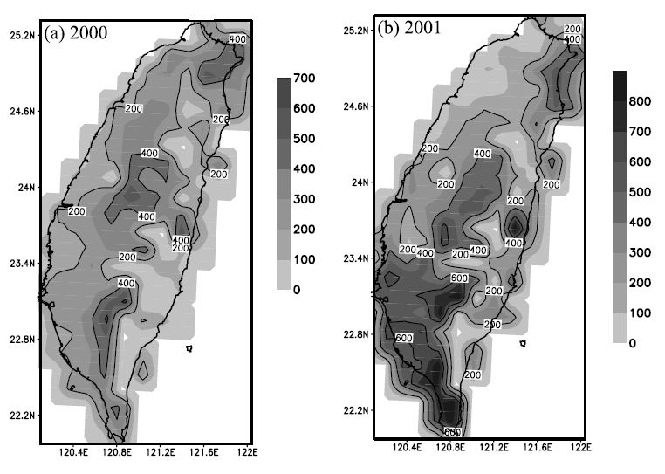
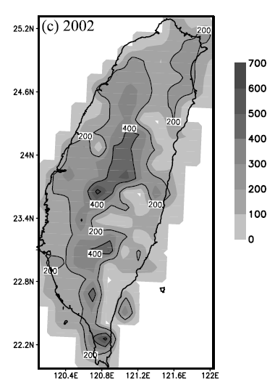
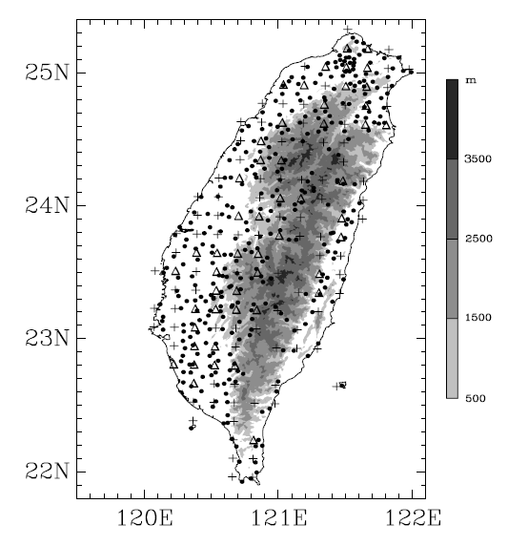
Data sets
Three Mei-Yu cases：2000,2001,2002(00UTC 23May to 00UTC 21 June)
Rainfall data used 343 Automatic Rainfall and Meteorological Telemetry System (ARMTS) stations
15*15km, neglect the grid less than 3 station
140→51 grid used

Slide 7
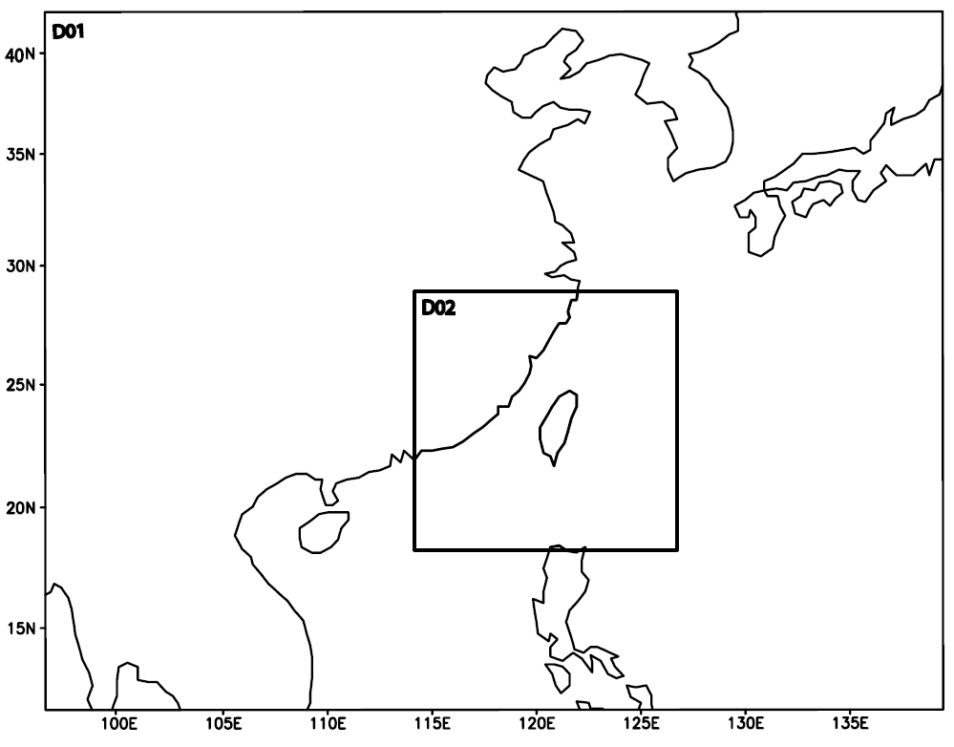
Model sets
MM5 ensemble, with two grid size (45,15km),
domain size(81*71,79*79), and 23 σ levels
I.C. by CWBGFS first guess field [Lion et al. 1997]
B.C. by CWBGFS forecast field through the MM5 “regrid” package
MM5 forecast 36 hours, produced twice a day (00 & 12)
→ 58 forecast event in a season

Slide 8
Parameterizations
MRF model PBL scheme [Hong & Pan,1996]
Radiation scheme with interaction between clear sky and clouds [Dahia,1989]
Four cumulus and three microphysics schemes used (table)
Kain-Fritsch + 3 microphysics → “microphysics ensemble”
4 cumulus + Resiner 1 → “cumulus ensemble”

Slide 9
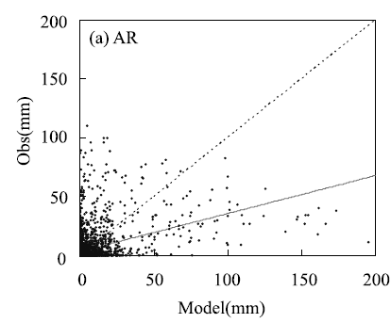
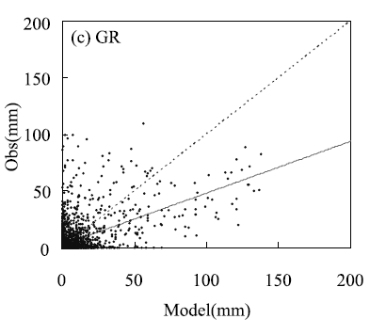
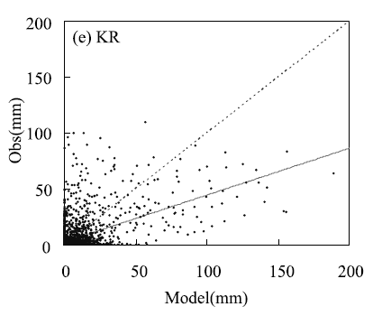
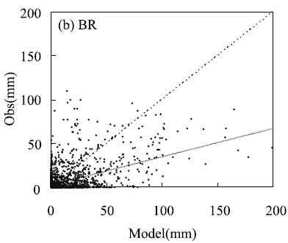
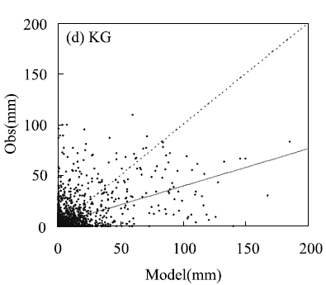
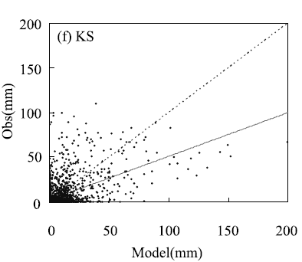
90% over the corner < 25mm
Outlier points = poor forecast
→15-km overestimated the 12-hr forecast
Notes:
2000These outlier points represent poor rainfall
forecasts on these grid points, resulting from bad timing of a
Mei-Yu front, improper precipitation parameterization over
these areas, and not enough resolution to resolve the complex
interaction of environmental airflows with local topography.

Slide 10
RMSE table
In parenthesis, the RMSE of statistically significant at the 95% confidence level
With increase of forecast duration, the predictive skill tends to decrease [Chien et al.2002]

Slide 11
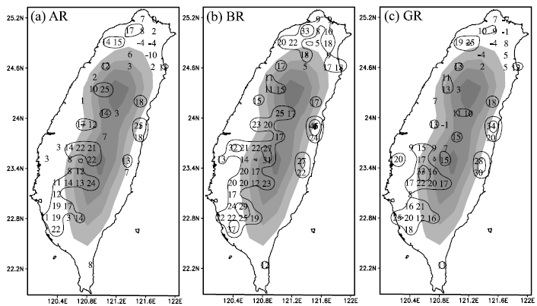
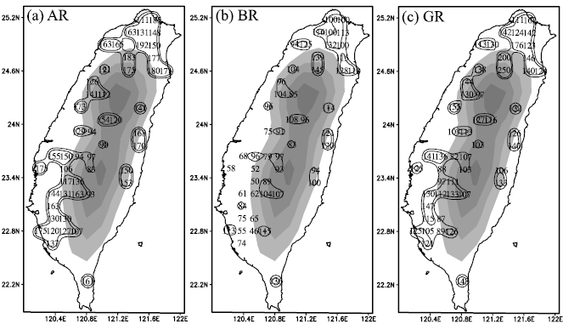
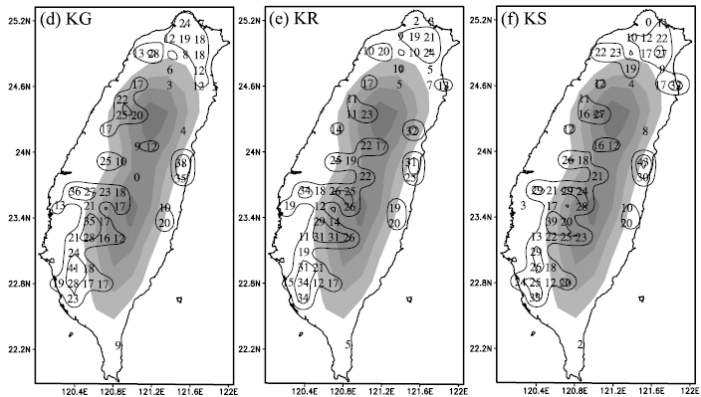
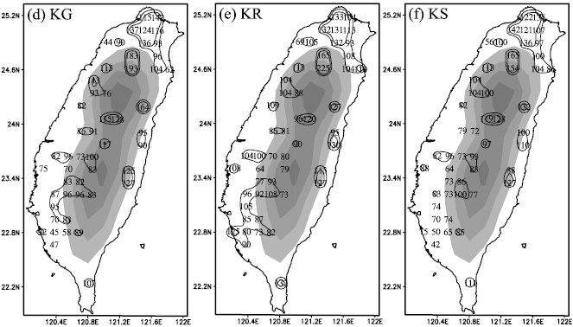
ETS
BS
NE
NW
C
SW
SW
Most member’s high skill(ETS>0.2) over the five area
→ The maxima rainfall region for 2000
→ Different precipitation physics used, same regions occurred rainfall
Notes:
2000

Slide 12
Compared with rainfall threshold

Slide 13
Keywords
Equitable threat score(ETS)
Bias score(BS)
Introduction
Data and model description
Ensemble methods
Ensemble results
Conclusions
References

Slide 14
Ensemble methods
AVG ：same weighting (1/6) for all 6 member
CPS ：same weighting (1/4) for the four cumulus ensemble member
MPH：same weighting (1/3) for the three microphysics ensemble member
MLR ：Multiple linear regression

Slide 15
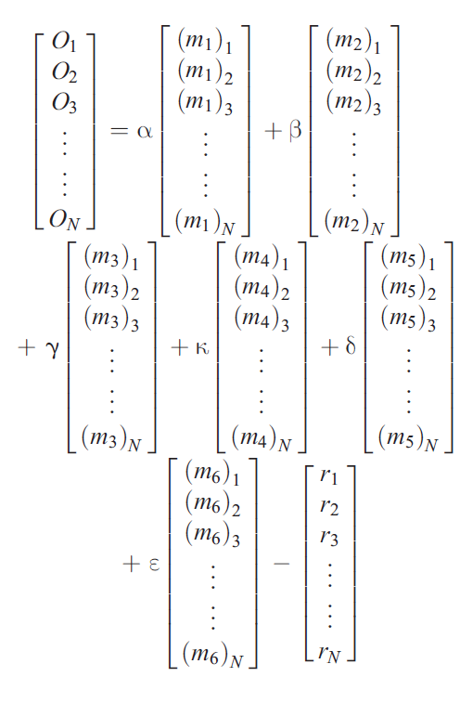
Multiple linear regression (MLR)
$m_{1}\sim m_{6}：ensemble member$
O： observed rainfall
r ：the forecast difference
N：total sample size
(58 forecast events in a Mei-Yu season)
(α,β,γ,κ,δ,ε)：weighting coefficients
for ensemble members
(varies with space)

Slide 16
Multiple linear regression (MLR)
向量形式
移項
平方
微分

Slide 17
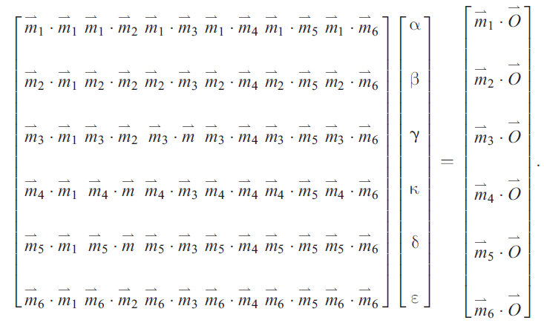
Multiple linear regression (MLR)
A B C
B(= $A^{−1}$C) is the weighting coefficient of each member

Slide 18
Horizontal distribution of weighting coefficient
MLR apply more weight with higher rainfall predictive skill (ETS&BS)
→Provide better precipitation prediction than a simple average forecast
Notes:
2000

Slide 19
Keywords
Equitable threat score(ETS)
Bias score(BS)
Introduction
Data and model description
Ensemble methods
Ensemble results
Conclusions
References

Slide 20
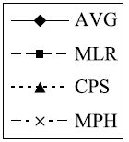
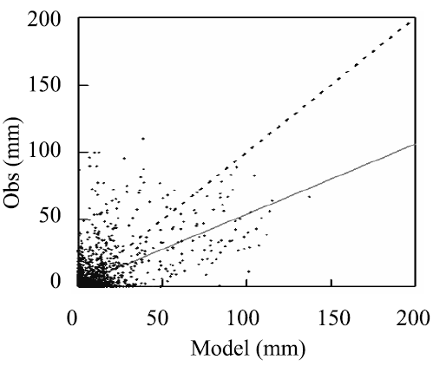
Ensemble results
MLR improve the prediction
(correlation coefficient = 0.59)
MLR had best ETS except for 15-35mm rainfall
6 member > 3 member
Notes:
2000

Slide 21
Compare to high-resolution rainfall
5-km grid point (4 nest domain：135,45,15,5)
Compare the case during 2001
31σ levels
Kain-Fritsch cumulus and Goddard microphysics scheme

Slide 22
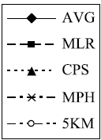
From the results：
MLR outperformed
Others better in moderate thresholds (2.5-15mm)
5-km better in heavy rainfall thresholds (25-50)
Poor performance for 5-km ∵feedbacks from the outer domain through boundary forcing [Warner & Hsu,2000]
High resolution still has valuable information for heavy rainfall
CPU time for 5-km ＝ four/three 15-km ensemble
→four/three 15-km ensemble had better skill
for light to moderate thresholds
Notes:
2001

Slide 23
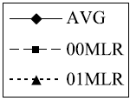
Using previous-year weighting coefficients
Varying weighting coefficients is done in a hindcast
→Using the previous Mei-Yu season or previous week during same season data
Current-year (01MLR) had best ETS and BS skill
Previous-year (00MLR) had similar ETS trend, but less skill

Slide 24
Conclusions
Comparing the RMSE, no one outperformed.
But for ETS, all had better performance over NE, central, and SW mountain area and the NW and SW coastal plane.
The regions more accumulated rainfall in Mei-Yu season.
The MLR ensemble rainfall with 15-km had the best ETS and BS skill compared to AVG, CPS, MPH, and even the high-resolution with 5-km.
The CPU time for single 5-km similar to four/three average ensemble with 15-km, and 15-km had better ETS and BS skill for light to medium rainfalls.
It might be more effective to perform several low-resolution ensemble runs than one high-resolution.

Slide 25
Conclusions
MLR ensemble using the weight coefficients determined from previous Mei-Yu season, still had similar ETS trend to current-year, but less skill
Rainfall during Taiwan’s Mei-Yu season may have certain climatological characteristics associated with topography and prevailing wind.
MLR method could capture this climatological attribute.
Use the previous Mei-Yu season or previous week during same season to got MLR weighting coefficients

Slide 26
References
Yang, M.-J., B. J.-D. Jou, S.-C. Wang, J.-S. Hong, P.-L. Lin, J.-H. Teng, and H.-C. Lin (2004), Ensemble prediction of rainfall during the 2000–2002 Mei-Yu seasons: Evaluation over the Taiwan area, J. Geophys. Res., 109, D18203, doi:10.1029/2003JD004368.
洪景山、林得恩、劉素屏、周仲島、簡芳菁、林沛練、張文錦、繆璿如、陳致穎、雷銘中，2006：WRF 模式之敏感度測試 第二部份：定量降水預報校驗,大氣科學，34, 261-275。
http://www.cawcr.gov.au/projects/EPSverif/scores/scores.html
http://www.met.reading.ac.uk/clouds/publications/ets_is_not_equitable.pdf

Slide 27
Thanks for your attention

