Slide 1
Momentum budget of a squall line with trailing stratiform precipitation: Calculations with a high-resolution numerical model
Yang, M.-J., and R. A. Houze, Jr., 1996:
Momentum budget of a squall line with
trailing stratiform precipitation: Calculations with a
high-resolution numerical model. J. Atmos. Sci., 53,
3629–3652.

Slide 2
Outline
Keyword
Introduction
Model description
Simulation results
Evolution of momentum generation and advective processes
Area-average momentum budgets
Impact of momentum flux on mean flow
Large-scale momentum budget
Conclusions
Reference

Slide 3
Keyword
Squall line

Slide 4
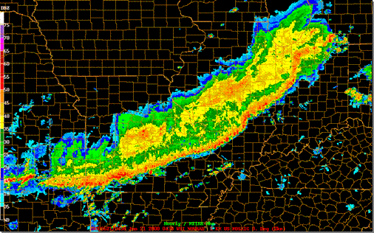
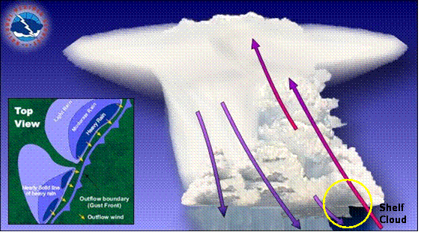
Squall line
propagation
Gust front
2000km
Shelf
Cloud
Cold pool
Pictures originated from http://www.crh.noaa.gov/sgf/?n=spotter_squall_lines
20-50 km
Notes:
Squall lines are associated with sharp wind shear, including sudden, marked shifts in wind direction and speed.
The storms first develop where there is the best combination of moisture, instability and lift. The storms will continue to evolve and new cells will develop (commonly toward the south and east). The squall line will sustain itself by producing its own lift due to outflow boundaries. As long as instability and moisture remain present out ahead of the squall line, the squall line will continue to propagate.

Slide 5
Introduction
By MM4 simulation of the 10-11 June 1985 squall line in the Preliminary Regional Experiment for Storm-scale Operational Research Meteorology(PRE-STORM). (Cunning,1986.; Gao et al.,1990) They investigated the meso-β-scale momentum budget and its effects on large-scale mean flow, and found that cross-line momentum generation was the strongest contribution to the momentum budget.
Convectively generated downdrafts were as important as updrafts in vertically transporting horizontal momentum within both the convective and stratiform regions.
Gallus and Johnson(1992) used rawinsonde data to diagnose the momentum fluxes and tendencies in the same squall line case as above. They found a strong midlevel mesolow, which contributed to RTF tendency in the vicinity of a FTR tendency elsewhere through most of the storm.
Notes:
However, the rawinsonde data they used did not fully resolve the CV region.

Slide 6
Introduction
The convective and stratiform precipitation regions are distinct both kinematically (Houze 1982,1989) and microphysically (Houze 1989,1993; Braun and Houze 1994a,b, 1995a,b), and the large-scale flow responds fundamentally differently to the vertical heating profiles in these two regions(Mapes 1993; Mapes and Houze 1995).
The radar echo structure in the convective and stratiform precipitation regions is also distinct, as a result of the different kinematics and microphysics, and techniques are available to separate the convective and stratiform precipitation regions based in their different reflectivity structure (Churchill and Houze 1984; Steiner et al. 1995).
Notes:
However, the rawinsonde data they used did not fully resolve the CV region.

Slide 7
Until now, the separate roles of the convective and stratiform precipitation regions have not been investigated in terms of how they may influence the large-scale horizontal momentum field.
Objective of this study: to investigate the momentum budget of a 2D squall line with leading-line/trailing-stratiform structure and thereby gain insight into contributions of the convective and stratiform precipitation regions to the momentum transports over a large-scale region containing the storm.

Slide 8
Model description
2-D version of the Klemp and Wilhelmson(1978) compressible nonhydrostatic cloud model, as modified by Wilhelmson and chen(1982).
Microphysical bulk parameterization is described by Lin et al.(1983), with improvements suggested by Potter(1991).
Ice-phase microphysics is included.
Integrated for 15h. (Because of the constant favorable condition, the storm did not actually died before 15h. )
The basic-state environment is assumed constant in time and horizontally homogeneous.
Coriolis force, surface drag, and radiation effects are neglected.
Outout time interval : 2min.

Slide 9
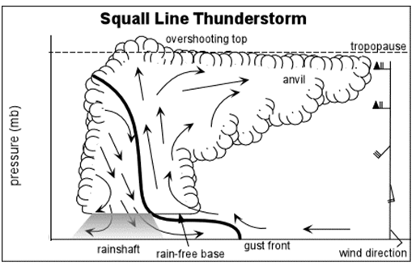
Grids settings:
Open boundary with phase speed c*=30 m/s
To keep the storm in the fine grid region, the model’s domain translated with the storm.
z (vertical)
x(cross-line)
y(along-line)
model top : 21.7km
No variation, no velocity component.
Δz=550m
... …. … … … …
x(cross-line)
455 grids, 4814 km
x(cross-line)
Stretched mesh
70 grids , 2250km
1.075:1
62grids
Fine grid region
315 grids
Δx=1 km
y(along-line)
Δz=140m
Picture originated from,’ Atmospheric Science_University of illinois at
urbana-champaign website ‘
Picture originated from ’NOAA radar observation. ’

Slide 10
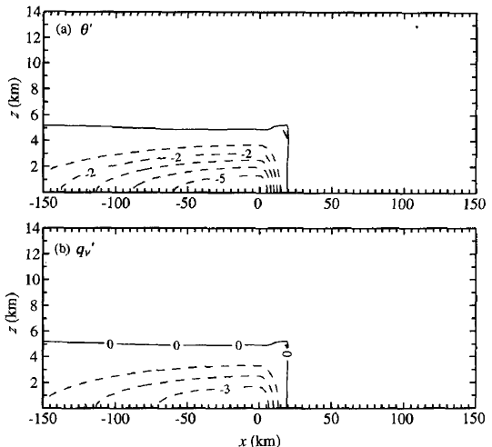
Initialization
Environment- based on the 2331 UTC 10 June 1985 sounding data at Enid, Oklahoma.(4h before the squall line passed the station.)
Convection- triggered by a 5-km deep, 170-km wide cold pool with a -6-K potential temperature and a -4 g/kg water vapor.
Picture originated from,’ Yang, M.-J., and R. A. Houze, Jr., 1995: Sensitivity of squall-line rear inflow to ice microphysics and environmental humidity.‘ Fig.5

Slide 11
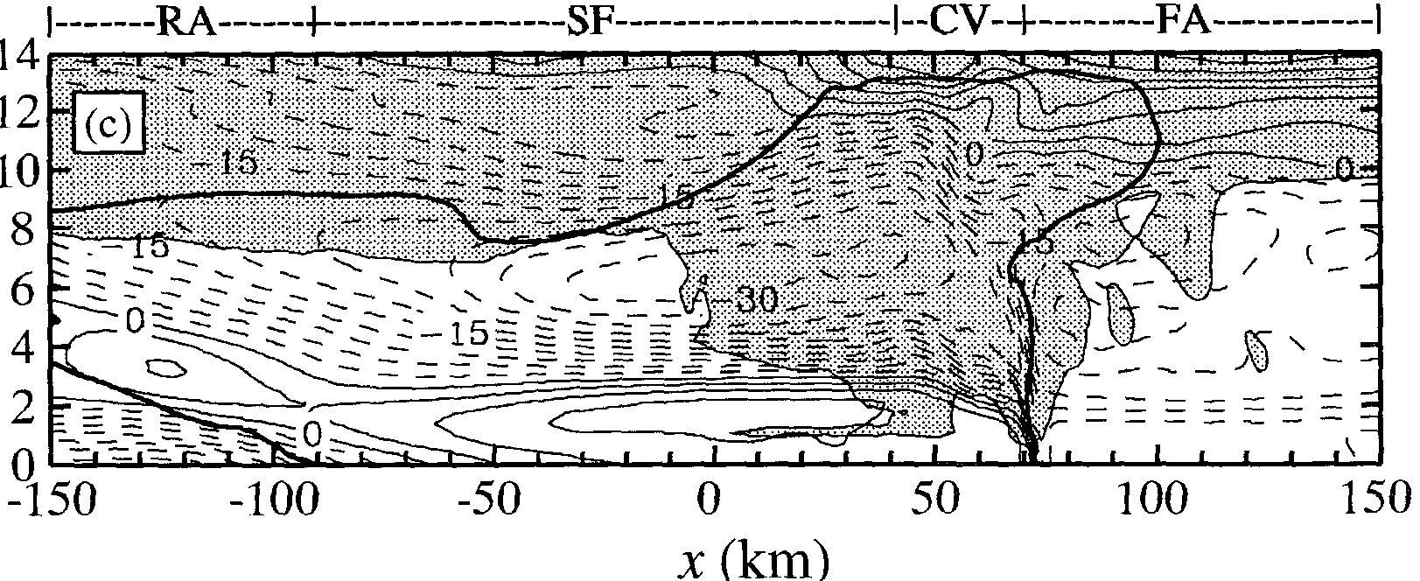
Three time periods :
t=7.5-8.5h (initial stage)
t=10-11h (mature stage)
t=12.5-13.5h (slowing-decaying stage)
Four subregions :
CV (Convective Precipitation)
SF (Stratiform Precipitation)
RA (Rear Anvil)
FA (Forward Anvil)
Convective precipitation region-
surface rainfall rate ≥ 15 mm/h.
or the gradient of rainfall rate > 5 mm/h/km.
Stratiform precipitation region-
not satisfying these criteria.
Fine grid region
315km

Slide 12
Simulation results

Slide 13
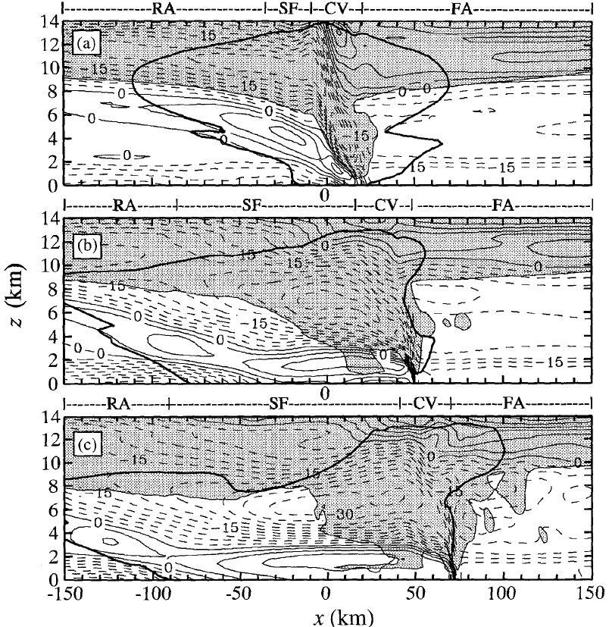
Kinematic Fields
U-c(storm-relative horizontal wind)
Shaded cloudy region-time-averaged
nonprecipitating hydrometeor(cloud
water and cloud ice) mixing ratio
≥ 0.1g/kg
Solid line- RTF flow
Dashed line- FTR flow
Heavy outline-storm precipitation
boundary (time-averaged modeled
radar reflectivity 15-dBZ contour)

Slide 14
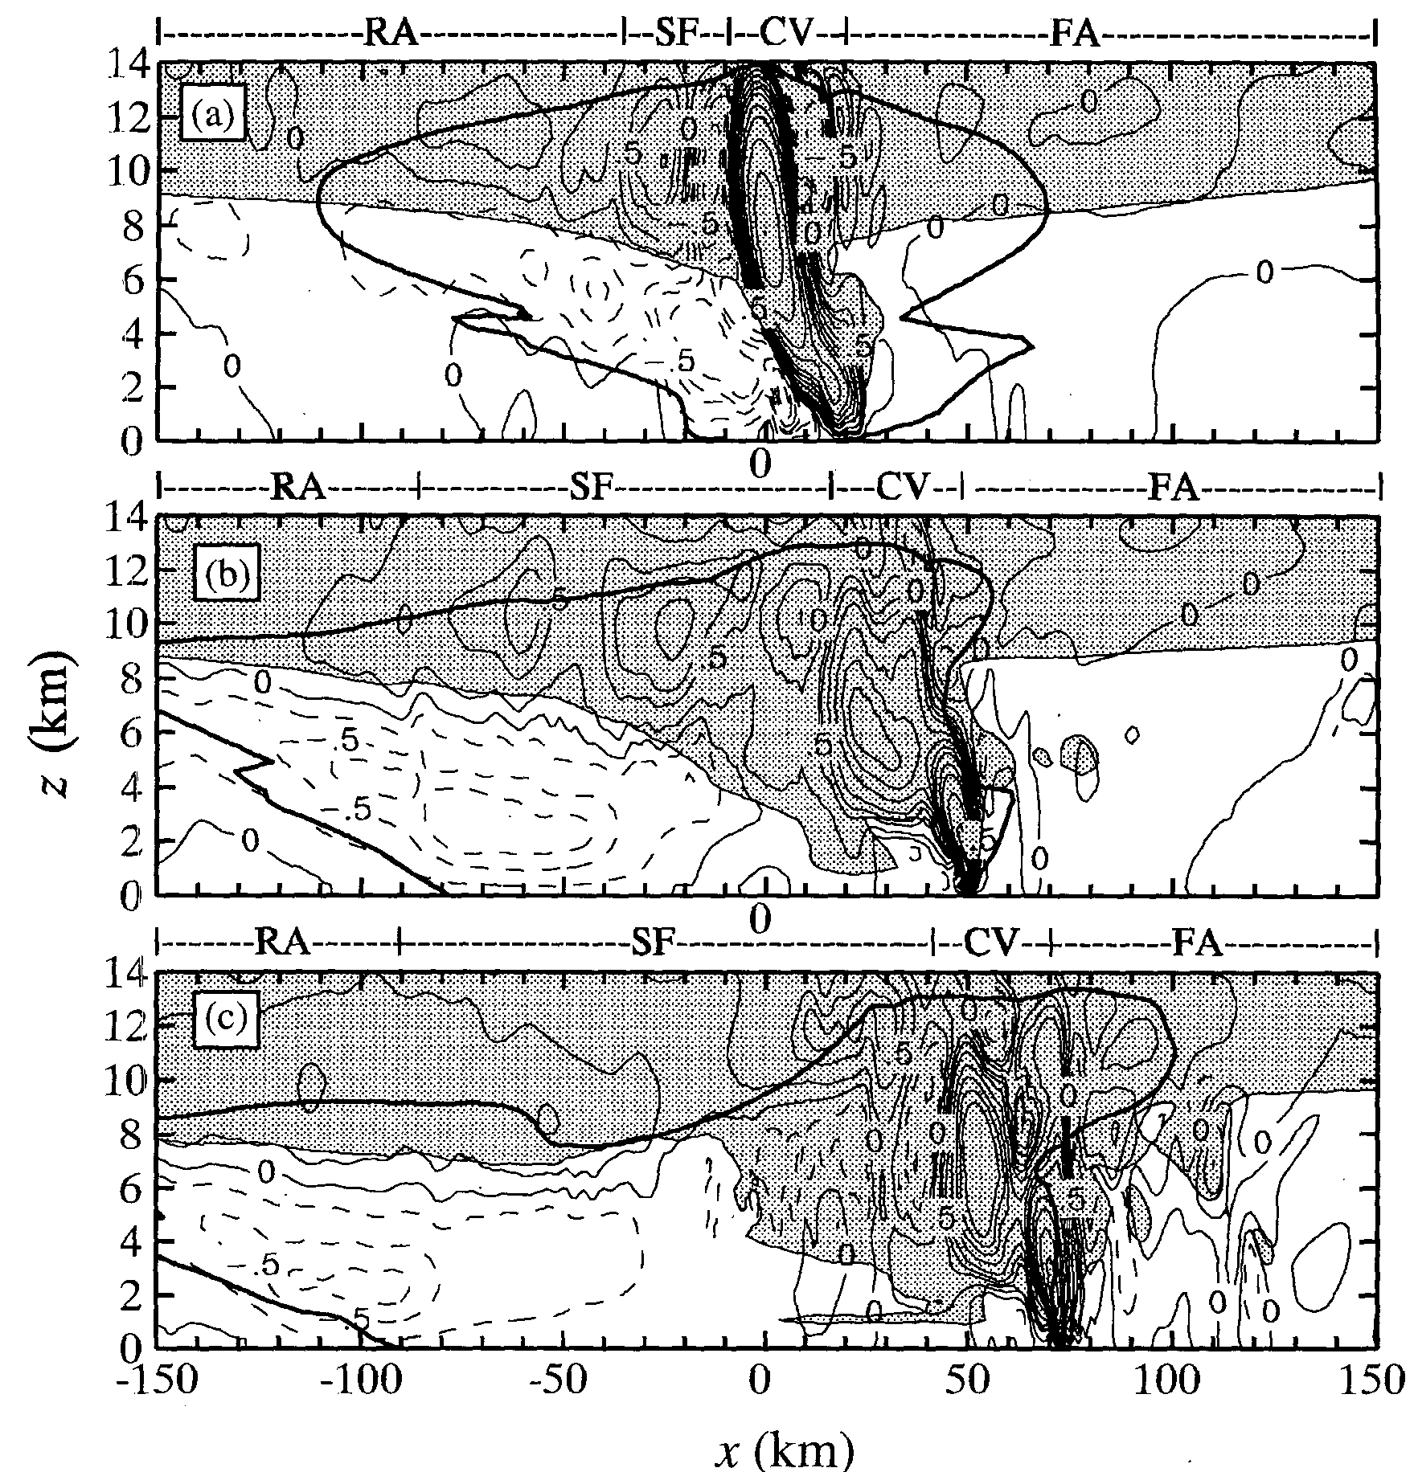
Kinematic Fields
ω (vertical celocity)
Solid line- positive
Dashed line- negative
Notes:
(b) 2 updrafts caused by…
mesoscale updraft and downdraft

Slide 15
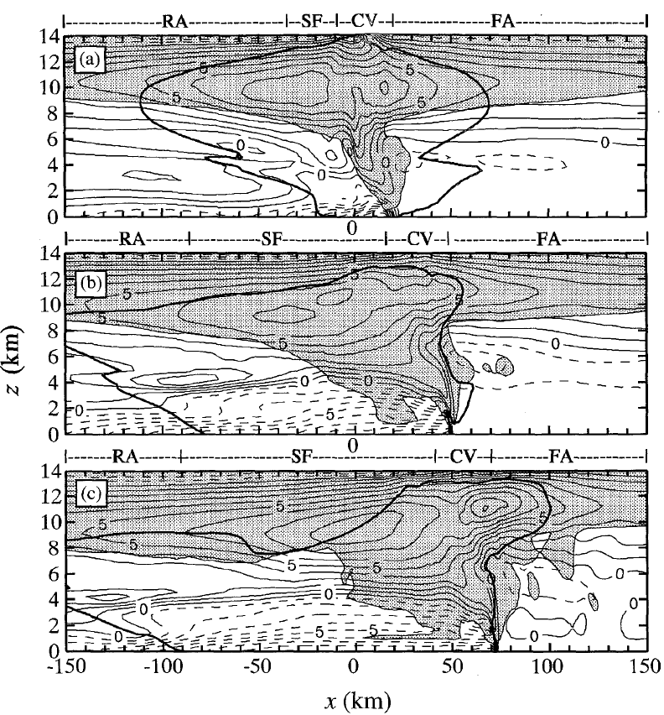
Thermal Fields
θ' (potential temperature perturbation)
Solid line- positive
Dashed line- negative
Notes:
(c) Cold pool decaying because…

Slide 16
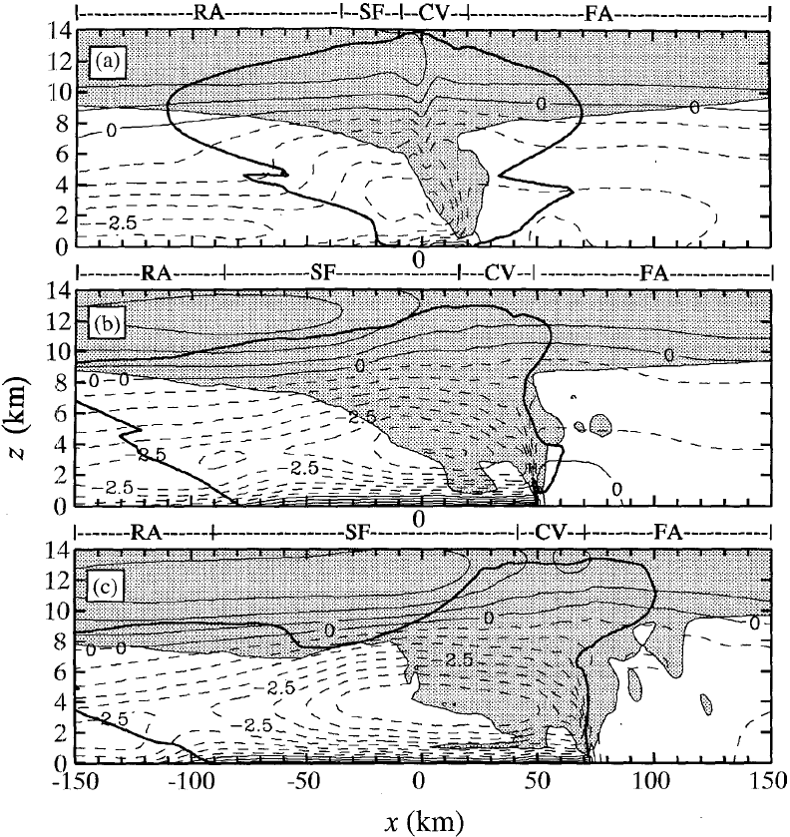
Pressure Fields
p’ (pressure perturbation)
Solid line- positive
Dashed line- negative
L
H
L
L
H
L
L
H

Slide 17
Subregional contributions to the large-scale mean horizontal and vertical velocity fields
I physical quantity
[I] average I over A
<I> average I over subregions
300-km-wide
large scale area
Fractions of A covered by subregions

Slide 18
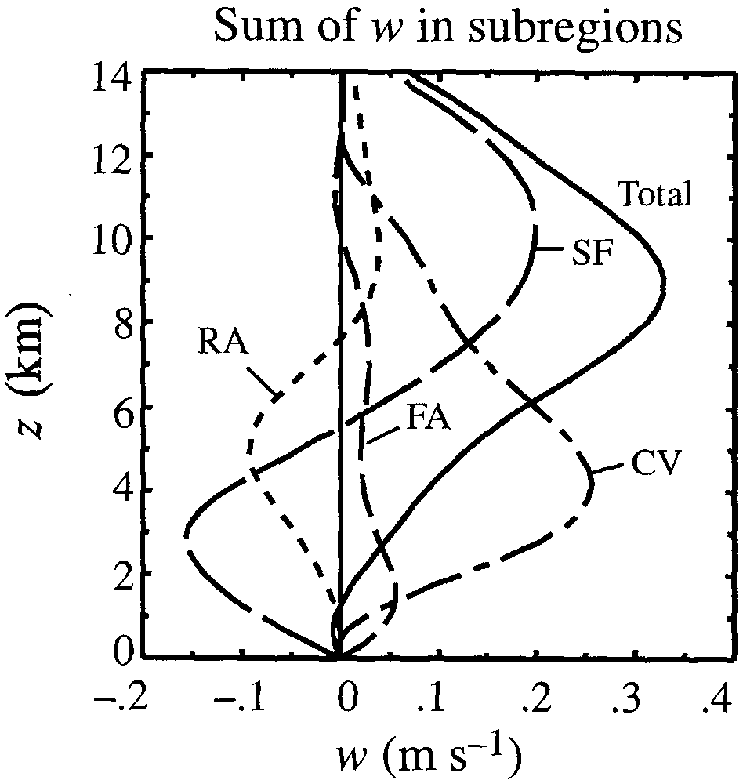
Mature period:
I = ω
Total curve(A) shows a mean updraft.
Maximum at higher level than CV:
Caused by the effect of the
mesoscale updraft/downdraft in the
SF.
7.5km
5.5km
All positive.
Maximum: 4km
1.5km
PBL top
Favorable for the convective cells’
development ahead the gust front.

Slide 19
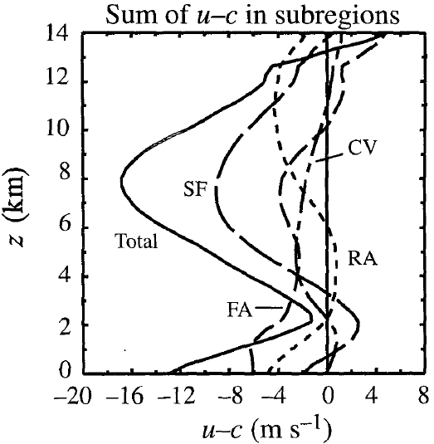
Mature period:
I = u-c
The large-scale horizontal wind is
Mainly determined by SF.
→Which shows string FTR flow at
midlevels and RTF flow at low levels.

Slide 20
Evolution of momentum generation and advective processes

Slide 21
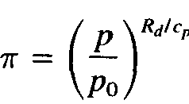
The horizontal momentum equation in a coordinate system
moving with the squall line (neglect Coriolis force):
nondimensional pressure perturbation
specific heat at constant p
local tendency in the
moving coordinate system
(TEN)
basic-state virtual potential temperature
(PGF)
(HAD)
(TRB)
subgrid-scale
turbulent mixing
(VAD)
ground-relative horizontal wind
propagation speed
storm-relative horizontal wind
‘

Slide 22
Rewrite in time-averaged form:
(TEN)
(PGF)
(HAD)
(TRB)
(VAD)
ADV=HAD+VAD
Generally small
Where
Three time periods :
t=7.5-8.5h (initial stage)
t=10-11h (mature stage)
t=12.5-13.5h (slowing-decaying stage)

Slide 23
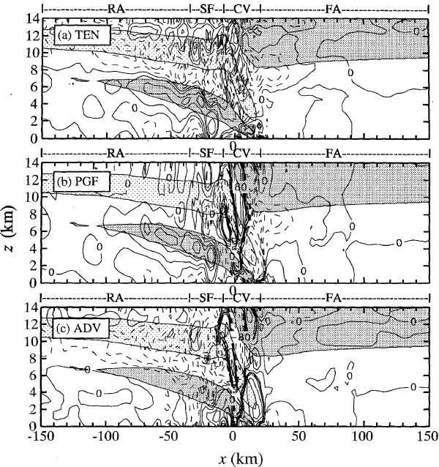
t=7.5-8.5h (initial stage)
Solid line- RTF flow
Heavily shaded-RTF >3 m/s
Dashed line- FTR flow
Lightly shaded- FTR < -18 m/s
Consistent with the 2 RTF wind
maximum.
The descending RTF flow is in
part a dynamical response to the
latent cooling process.
(Yang and Houze, 1995b)
Consistent with the 2 FTR wind
maximum.

Slide 24
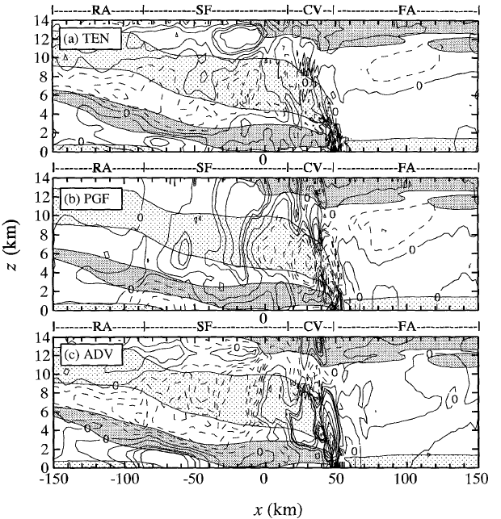
t=10-11h (mature stage)
Solid line- RTF flow
Heavily shaded-RTF >3 m/s
Dashed line- FTR flow
Lightly shaded- FTR < -18 m/s
All features intensified/extended.
RTF flow penetration.
Resulting in weakening the
diverging upper level flow.
(Consistent with U-c plot.)
L drove the ascending FTR flow and
transported hydrometeors
rearward to form the stratiform
precipitation region.
L
L
In CV, ADV(RTF) worked opposite
to PGF(FTR).
HAD extended and tilted the
FTR flow.
RTF flow penetration.

Slide 25
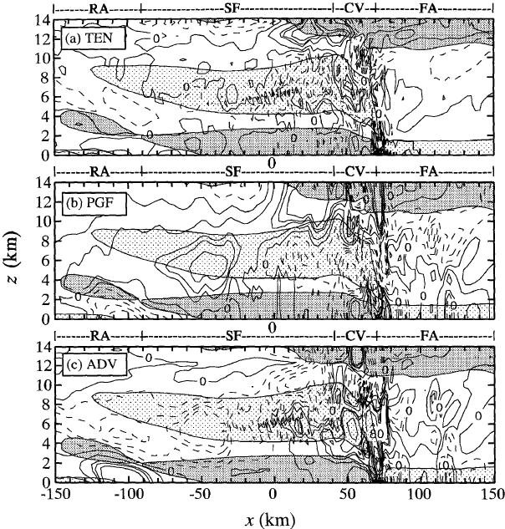
t=12.5-13.5h (slowing-decaying stage)
Solid line- RTF flow
Heavily shaded-RTF >3 m/s
Dashed line- FTR flow
Lightly shaded- FTR < -18 m/s
All features exhibited a more
weakly organized but similar to
mature stage.
L
L

Slide 26
Area-average momentum budgets

Slide 27
Target: To inquire the role of the cloud system in terms of the deviations from the mean flow.
Horizontal averaged in large-scale area A (L=300km)
means average over a subregion i of A.
Horizontal averaged form of momentum equation:
(TEN)
(PGF)
(HAD)
(VAD)
(TRB)
ADV=HAD+VAD
Generally small
Since the terms are qualitatively similar during three stages,
→ Only mature stage (t=10-11h) is discussed.

Slide 28
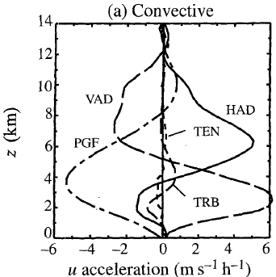
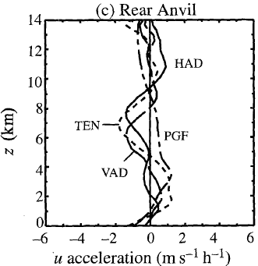
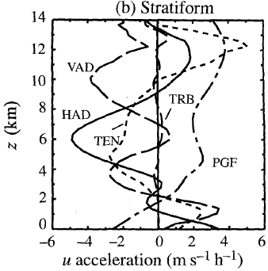
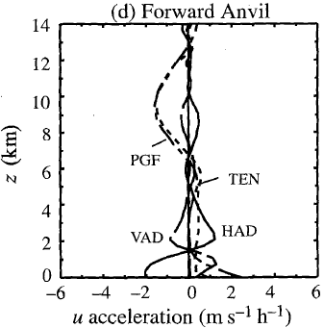
t=10-11h (mature stage)
Positive-RTF flow
Negative-FTR flow
TRB is very small.
VAD and HAD is roughly out
of phase.
In rear region, all terms are
relatively small.
TEN dominates.
Calculation of the correct
momentum tendency in SF is
essential to computing the overall
effect of the storm on large-scale
momentum field.
TEN is a small residual of other
forcing terms.
5 km
4 km
TEN is RTF at lower level, which is
similar to SF.
→ Intensify the RTF flow.
2 km

Slide 29
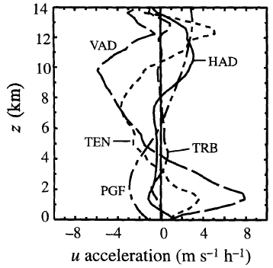
t=10-11h (mature stage), the sum of all subregions.
Positive-RTF flow
Negative-FTR flow
TEN is similar to SF.
Once the system is mature,
SF dominates the net momentum
tendency of large-scale region A.
3 km

Slide 30
Impact of momentum flux on mean flow

Slide 31
Define means and perturbations of a velocity component V (V=u or w) as
Time-averaged + Deviation
and
Space-averaged + Deviation
Following Priestly(1949) for the decomposite of large-scale heat fluxes in general circulaions,
we decomposite the total vertical flux of storm-relative horizontal momentum
into three physically distinct parts.
(Note that
and
are neglected.)
basic-state density
transport by standing eddies.
(steady-state meso-scale circulation)
the momentum transport
by steady mean flow.
(Mean flow in A)
transport by transient eddies.
(temporally fluctuating
convective-scale flow)

Slide 32
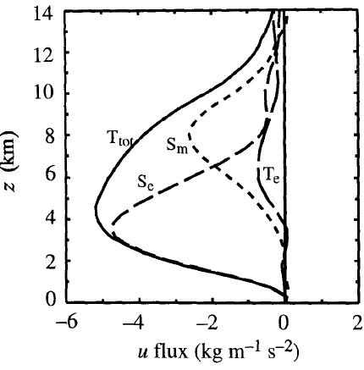
t=10-11h (mature stage)
=
+
+
Positive-RTF flow
Negative-FTR flow
All fluxes contribute to FTR flow.
Above 6.5km, dominates.
Below 6.5km, dominates.

Slide 33
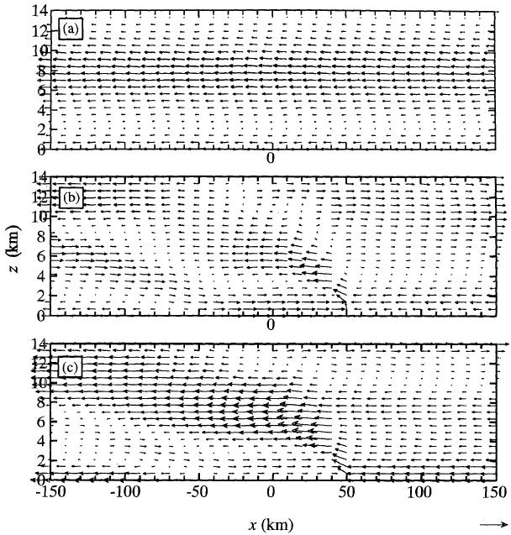
t=10-11h (mature stage)
FTR (> 6.5km)
FTR (< 6.5km)
FTR

Slide 34
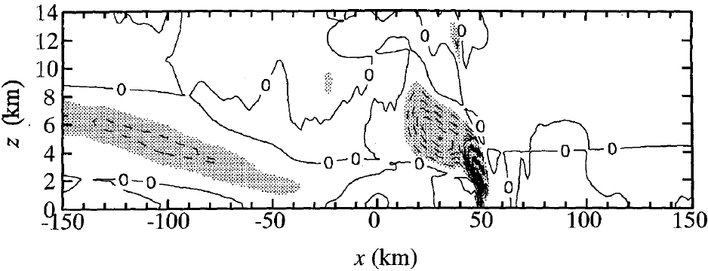
t=10-11h (mature stage) , subregion area-averaged
6.5 km
6.5 km
Positive-RTF flow
Negative-FTR flow
Shaded-velocity product < -5 (m/s)^2

Slide 35
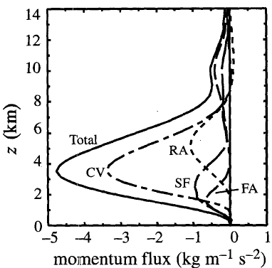
t=10-11h (mature stage) , subregions’ contribution
CV contributes to 65-75% Total.

Slide 36
Large-scale momentum budget

Slide 37
Rewrite time-averaged form in flux form,
And combine with anelastic mass continuity equation :
(v is horizontal wind.)
Applying area-averaged operator :
We have

Slide 38
Time- and space- averaged momentum equation :
(TEN)
Horizontal PGF
(PGF)
Horizontal mean-flow
flux convergence
(HMF)
Vertical eddy-flux convergence by
standing eddies (VEF)
Vertical mean-flow
flux convergence
(VMF)
Generally small
Vertical convergence effect =VMF+VEF

Slide 39
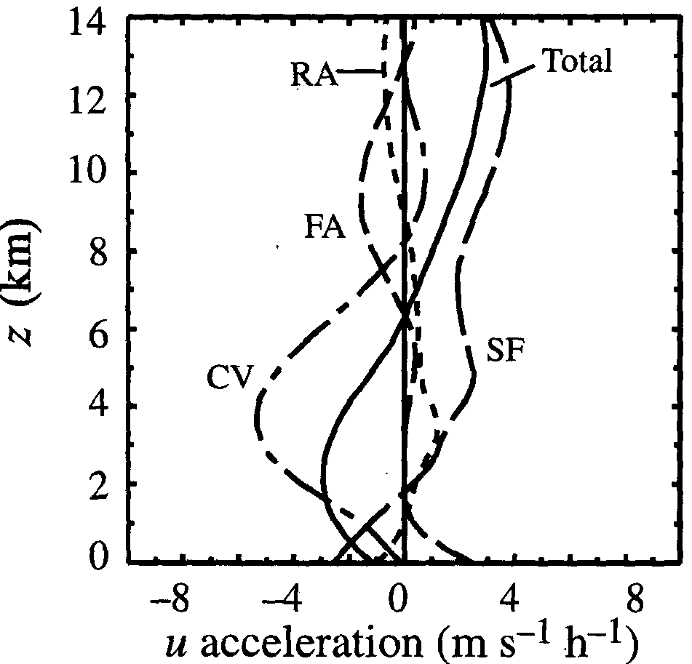
t=10-11h (mature stage), large-scale time- and subregion- averaged but except for PGF.
Positive-RTF flow
Negative-FTR flow
In CV, PGF is determined.
In SF, PGF in lower level is smaller.
8 km
In both rears, PGF is weaker.
6.5 km
In lower level, CV FTR dominant;
In upper level, SF RTF dominant.
2 km

Slide 40
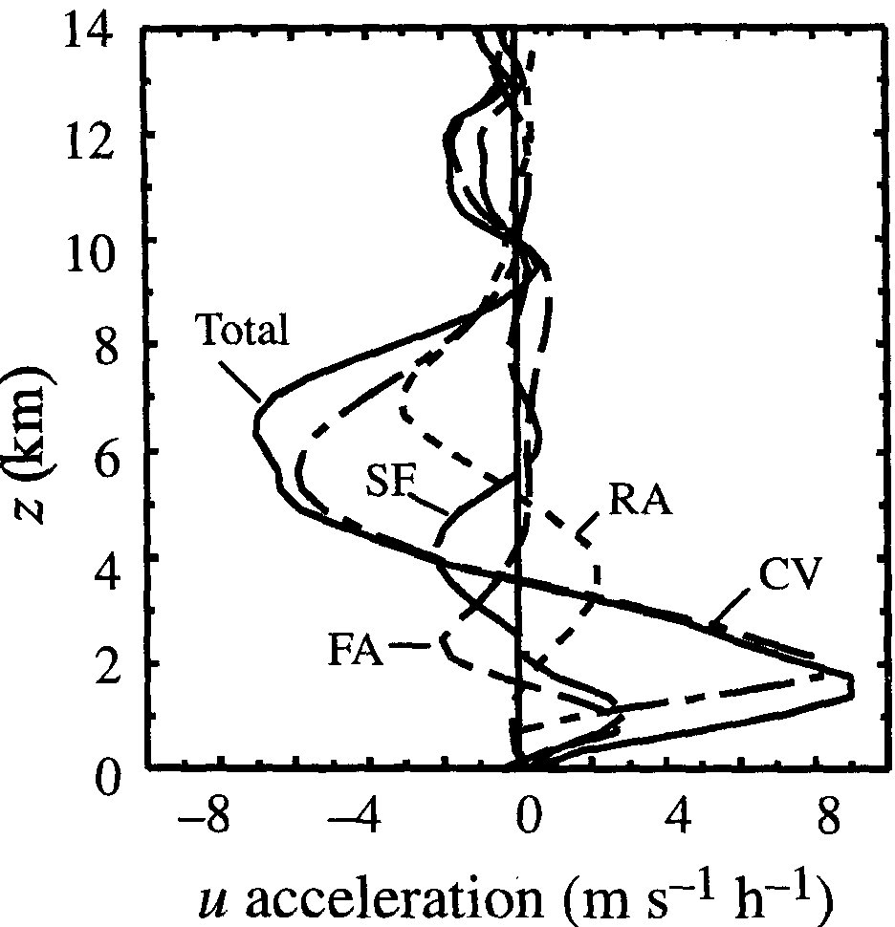
t=10-11h (mature stage), large-scale time- and subregion- averaged but except for VEF.
Positive-RTF flow
Negative-FTR flow
In SF, RTF/FTR in lower/mid level
is both smaller than in CV.
5 km
In CV, VEF pattern.
3.5 km
In RA, VEF associated with
descending rear inflow made the
pattern.
1.8 km
In FA, VEF produced momentum
change in lower level.

Slide 41
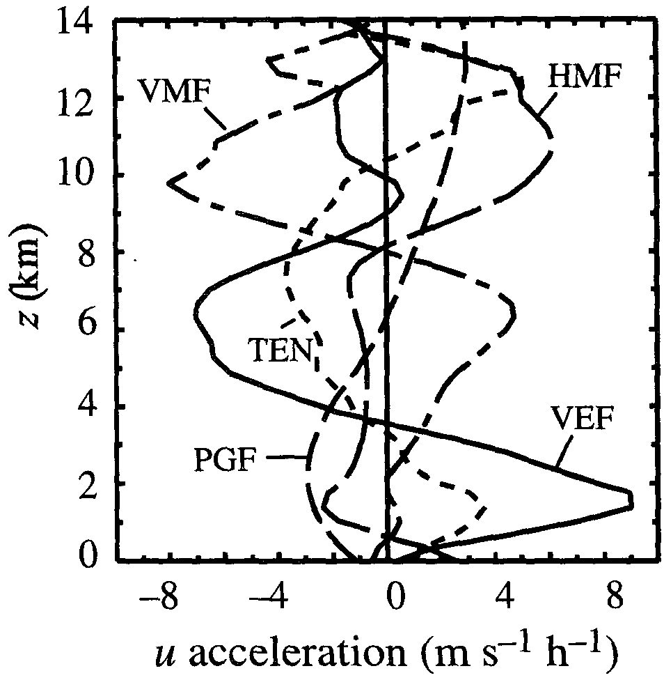
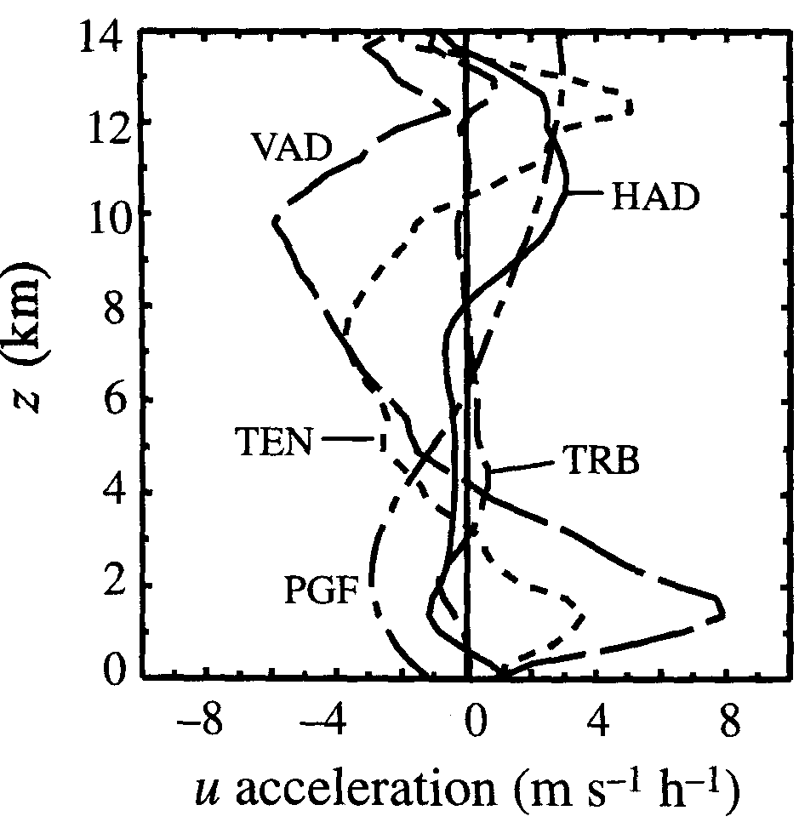
t=10-11h (mature stage), large-scale time- and space- averaged.
Positive-RTF flow
Negative-FTR flow
VEF and VMF contributed TEN.
HMF is similar to HAD.
mid/low level,
VEF contributed TEN;
higher level,
HMF and PGF contributed TEN.
HMF+PGF
8 km
Area average:
the sum of all subregions.
VEF
VEF

Slide 42
Conclusions

Slide 43
x
=
+
+
Positive-RTF flow
Negative-FTR flow
All fluxes contribute to FTR flow.
Above 6.5km, dominates.
Below 6.5km, dominates.

Slide 44
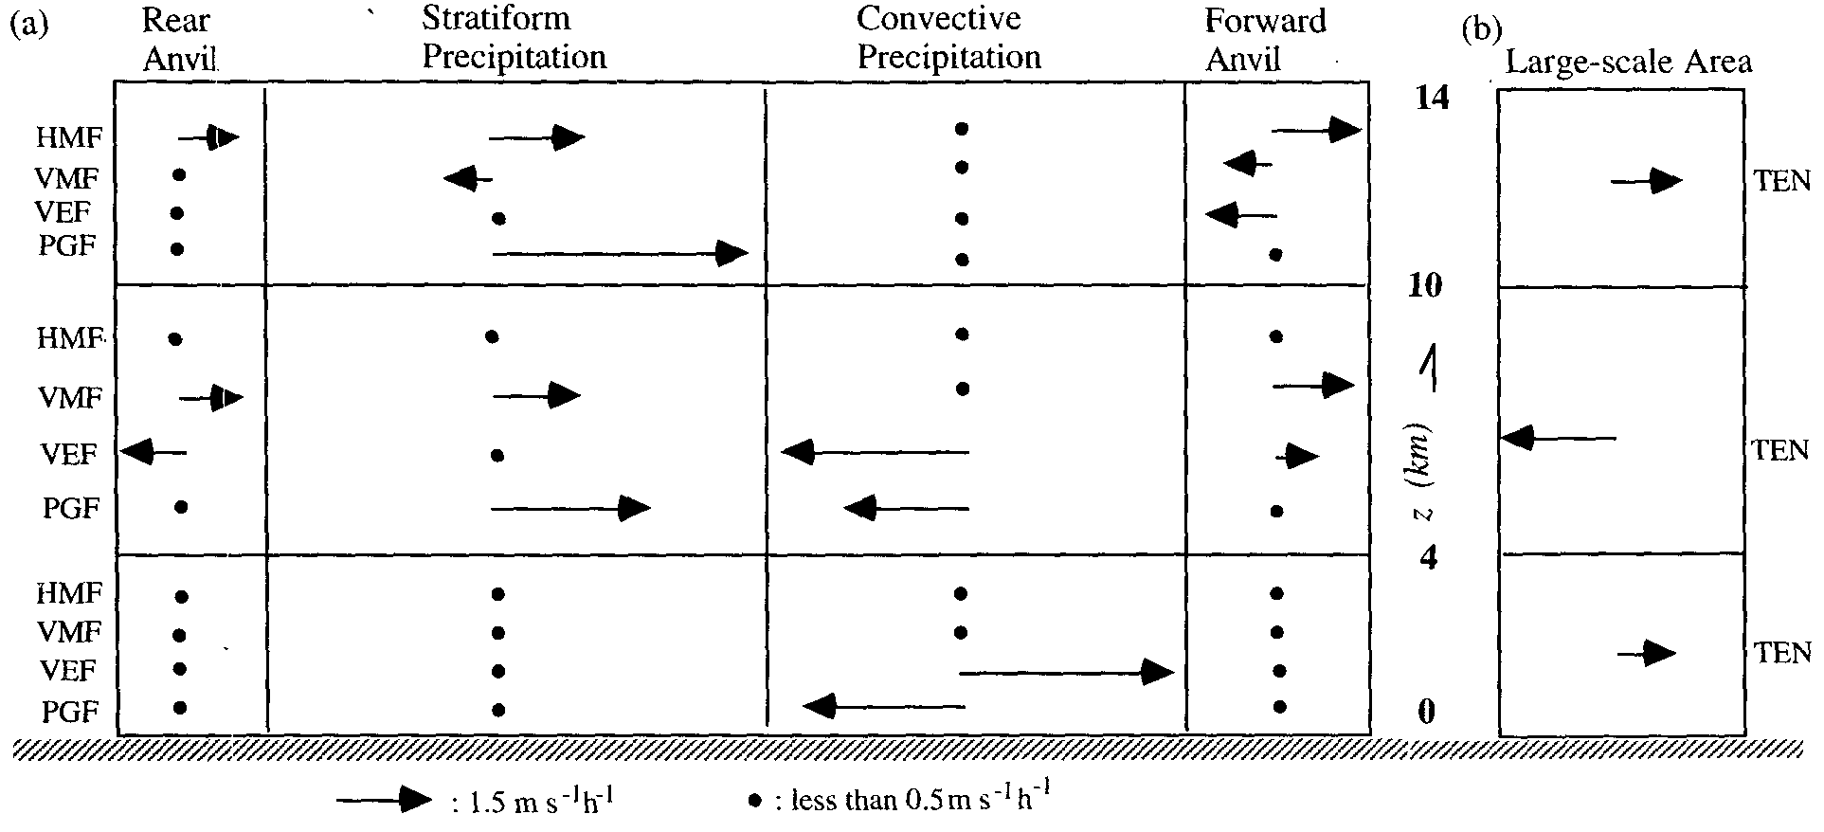
(TEN)
(PGF)
(HMF)
(VMF)
(VEF)
H
(meso-high)
L
(meso-ϒ-low)
Small resudual terms
Notes:
TEN is a delicate imbalance of strong terms of opposite sign.

Slide 45
Caveat : Coriolis force is not included.
Different CV and SF structure may change the vertical profile of terms.

Slide 46
Reference
http://ww2010.atmos.uiuc.edu/(Gl)/guides/mtr/svr/modl/line/squall.rxml
Atmospheric Science_University of illinois at urbana-champaign
http://www.crh.noaa.gov/sgf/?n=spotter_squall_lines
Yang, M.-J., and R. A. Houze, Jr., 1995: Sensitivity of squall-line rear inflow to ice microphysics and environmental humidity. Mon. Wea. Rev., 123, 3175–3193.
http://www.theweatherprediction.com/habyhints/150/
http://encyclopedia2.thefreedictionary.com/squall+line
http://en.wikipedia.org/wiki/Squall_line
Office of the Federal Coordinator for Meteorology (2008). ”Chapter 2 : Definition”
Yang, M.-J., and R. A. Houze, Jr., 1995: Multicell squall line structure as a manifestation of vertically trapped gravity waves. Mon. Wea. Rev., 123, 641–661.
http://blog.sciencenet.cn/u/sanshiphy
http://www.weatherquestions.com/What_is_a_gust_front.htm
Cunning J., B., Cunning, John B., 1986: The Oklahoma-Kansas. Preliminary Regional Experiment for STORM-Central. Bull. Amer. Meteor. Soc., 67, 1478–1486.

Slide 47
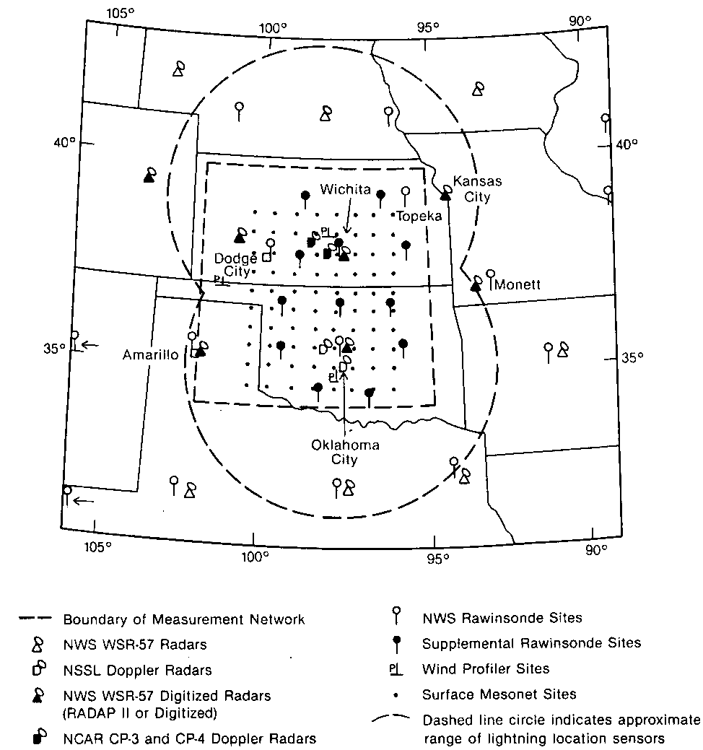
Picture originated from ‘Cunning J., B., Cunning,
John B., 1986: The Oklahoma-Kansas.
Preliminary Regional Experiment for
STORM-Central. Bull. Amer. Meteor. Soc., 67,
1478–1486.’

Slide 48
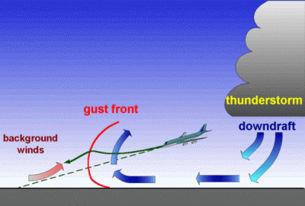
Picture originated from ‘http://www.weatherquestions.com/What_is_a_gust_front.htm’
A gust front is the leading edge of cool air rushing down and out from a thunderstorm. There are two main reasons why the air flows out of some thunderstoms so rapidly. The primary reason is the presence of relatively dry (low humidity) air in the lower atmosphere. This dry air causes some of the rain falling through it to evaporate, which cools the air. Since cool air sinks (just as warm air rises), this causes a down-rush of air that spreads out at the ground. The edge of this rapidly spreading cool pool of air is the gust front. The second reason is that the falling precipitation produces a drag on the air, forcing it downward. If the wind following the gust front is intense and damaging, the windstorm is known as a downburst.

Slide 49
For unsaturated air, ,
Consider the pressure,

Slide 50
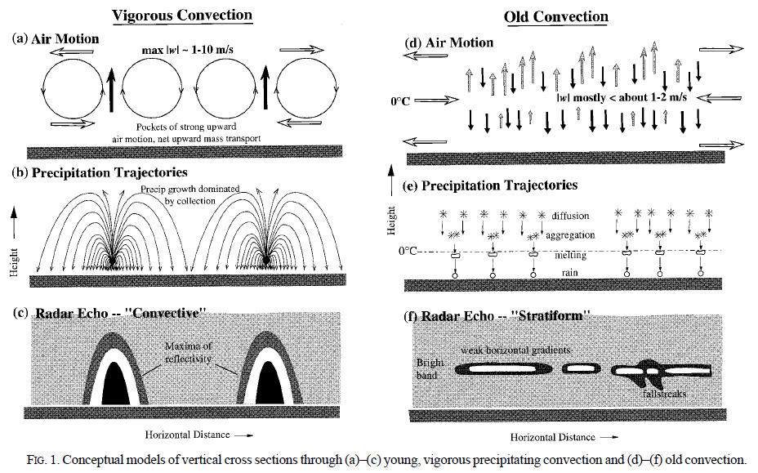
Picture originated from ‘Stratiform precipitation in regions of convection: a meteorology
paradox?’ Robert A. Houze Jr., University of Washington, Seatle, Washington

