Slide 1
Sensitivity of Squall-Line Rear Inflow to Ice Microphysics and Environmental Humidity
Yang, M.-J., and R.A. Houze, Jr

Slide 2
Hydrometeor types
Ice-phase microphysics
RTF
Environmental humidity
No. 1 microphysics processes

Slide 3
CNTL
Full model physics for 15 h.
Turn off the hail generation processes after 6 h (Fovell and Ogura, 1988), because there were very few hailstones in the mature or decaying stage of the 10-11 June squall line.

Slide 4
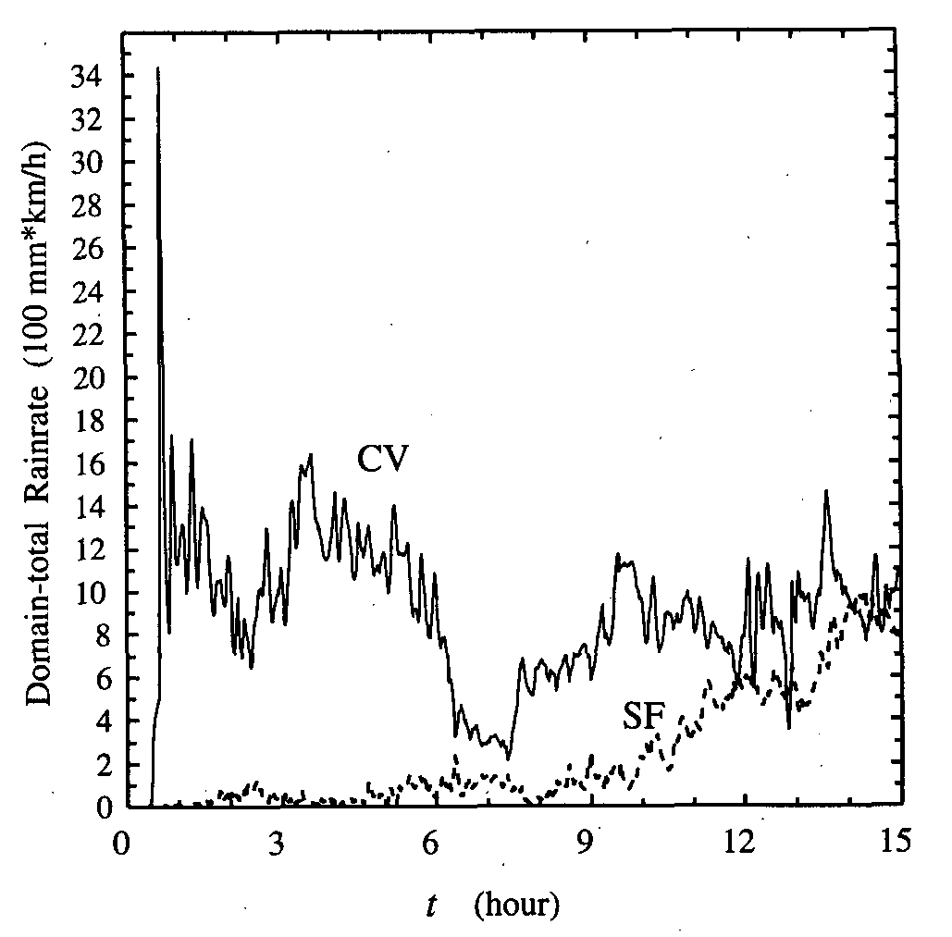
CNTL – Overview
Hail off
Notes:
After t = 8h, the simulated squall line reaches a quasi-steady state.
Convective region: rainfall rate > 15mm/h, or gradient of rainfall rate > 5mm/h. (Churchill and Houze, 1984)

Slide 5
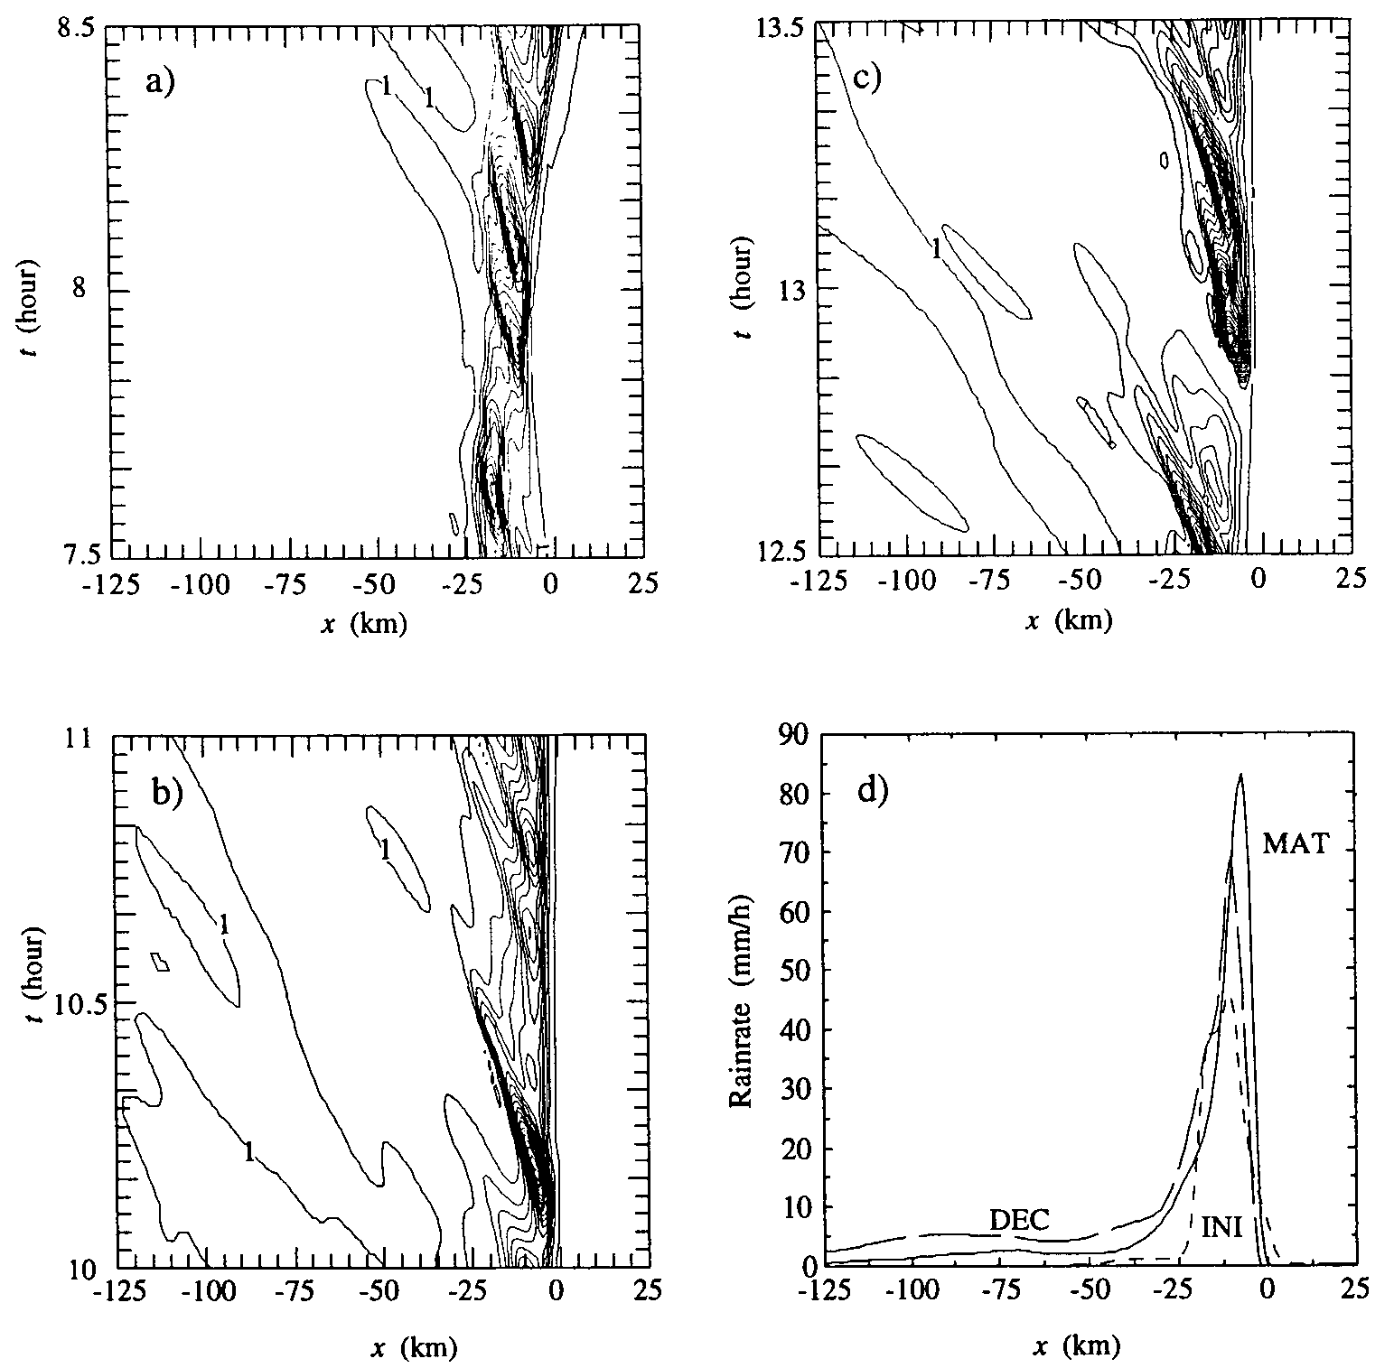
decaying
initial
mature
Notes:
Fig. a-c show the surface rainfall rate over three 1-h periods.
Stratiform region had just begun to develop and was very narrow.
Convective region reached its maximum intensity, and stratiform region became broader
Convective rainfall became less intense, and the trailing stratiform precipitation region broadened further.
1-h-averaged rainfall rates over these three periods.

Slide 6
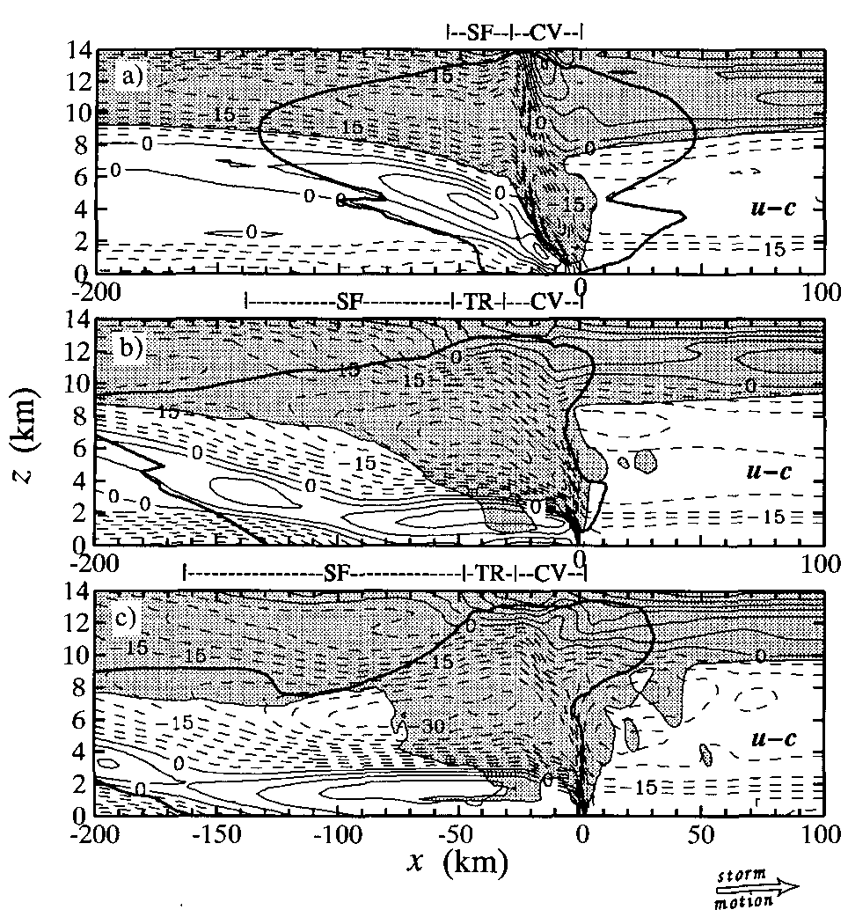
Kinematic Structure
initial
Shaded:
Cloud region
(no rain, mixing ratial > 0.1 g/kg)
Highlighted:
Storm Precipitation boundary
(radar reflectivity of 15 dBZ)
Line:
storm-relative horizontal wind field
(dash line: FTR; solid line: RTF)
RTF
FTR
mature
decaying
Notes:
Strong inflow in the boundary layer.
Weaker and drier inflow at midlevels
Strong outflow at upper levels.
RTF plays a crucial role in supplying potentially cold and dry midlevel air from the environment to aid in the production of the convective and mesoscale downdrafts.
FTR and RTF intro.
FTR: stronger, broader, and more horizontally oriented (stronger than OBS)
RTF: more organized with a double-core structure. (one is behind the convective region, the other was near melting level at back edge. It developed later than the first RTF maximum as previous stury( Small and Houze 1987; Rutledge et al. 1988) (weaker than OBS, might be a result of neglecting the background baroclinicity, Zhang and Gao 1989)
c) Both FTR and RTF were mostly horizontally oriented.

Slide 7
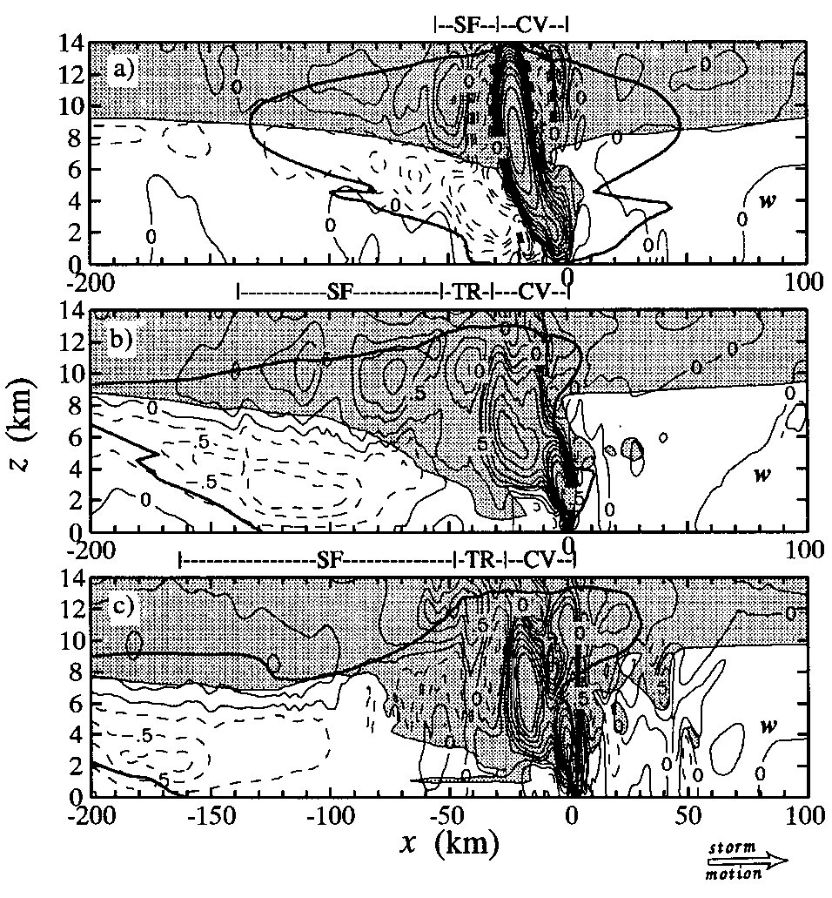
Shaded:
Cloud region
(no rain, mixing ratial > 0.1 g/kg)
Highlighted:
Storm Precipitation boundary
(radar reflectivity of 15 dBZ)
Line:
Vertical velocity
(dash line: ↓; solid line: ↑)
Notes:
a) At the leading edge, dynamically induced upper-level downdrafts surrounded the intense upper-level updraft as a result of mass compensation (Houze 1993)
b) Midlevel updraft was microphysically forced by the latent warming of condensation. 一樣有往水平發展的跡象
c) Both are weaker
The maximum of the RTF at the back edge of the stratiform precipitation was collocated with the strongest mesoscale downdraft.
The FTR-RTF interface still had an orientation similar to the updraft-downdraft interface, indicating their relation.

Slide 8
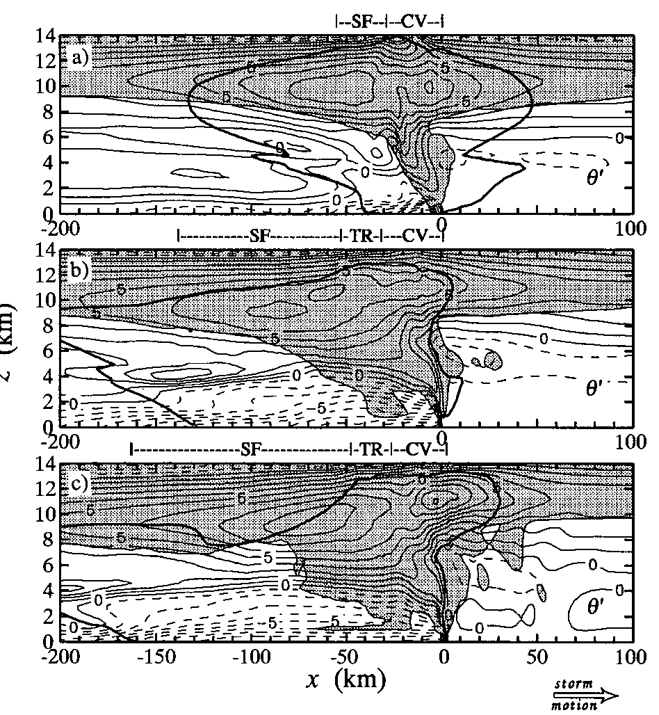
Thermal and Pressure Structure
Shaded:
Cloud region
(no rain, mixing ratial > 0.1 g/kg)
Highlighted:
Storm Precipitation boundary
(radar reflectivity of 15 dBZ)
Line:
Potential temperature perturbation
(dash line: - ; solid line: +)
warm
cool
Notes:
*Cloud region: warm (latent heating); A midlevel warm core was located in the stratiform region; A low-level precipitation-induced cold pool was produced by latent cooling of evaporation and melting
*Cold pool became stronger and wider; there was a local region of relatively fdry and warm air, probably produced by adiabbatic warming of mesoscale downdrafts.
*The midlevel warm plume broadened; the cold pool also widened, but its strength was slightly weaker because of weaker convective activity.

Slide 9
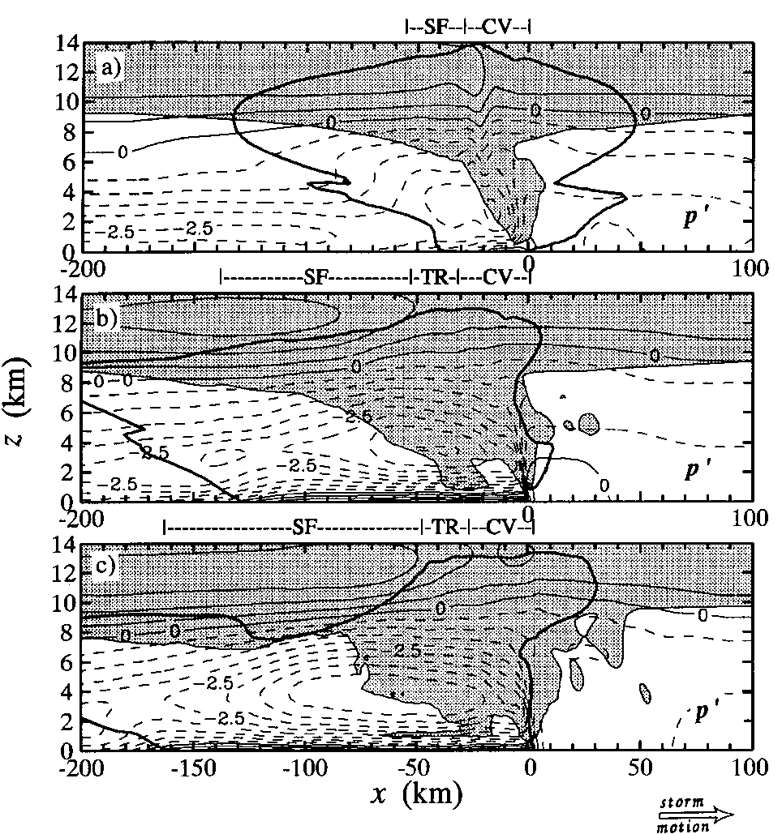
Shaded:
Cloud region
(no rain, mixing ratial > 0.1 g/kg)
Highlighted:
Storm Precipitation boundary
(radar reflectivity of 15 dBZ)
Line:
Pressure perturbation field
(dash line: - ; solid line: +)
Notes:
There was a hydrostatically generated meso-gama-scale low.(LeMone 1983; Fovel and Ogura 1988; Braun and Houze 1994) At the surface, the gust front high pressure was mainly dynamically generated. (Fovel and Ogura 1988; Houze 1993; Szeto and Cho 1994)
The meso-gama-scale low pressure intensitfied as a result of increased cooling by evaporation and melting within the cold pool head. In the stratiform region the storm-induced pressure perturbation field was characterized by a broadscale pressure max. near storm top and a pressure minimum at midlevels.
*The mesolow in the stratiform region was collocated with the maximum of RTF flow at the back edge of the stratiform precipitation region. The horizontal pressure gradient force associated with the mesolow drew midlevel air into the storm from the rear to induce the rear inflow.
c) The meso-gama-scale low pressure in the convective region remained strong, while gust front high pressure weakened.

Slide 10
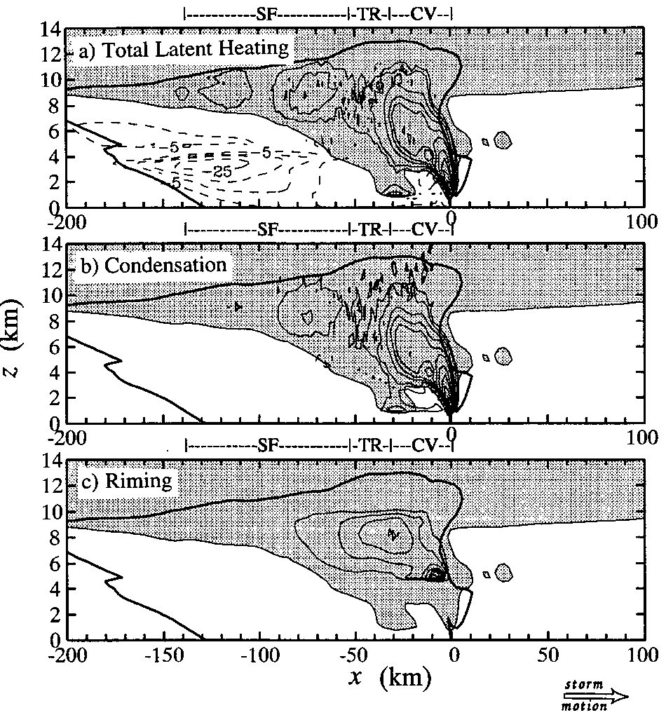
heating
cooling
Heating:
Condensation of cloud water
Riming warming
Deposition (occurred throughout most of the stratiform cloud region)
Notes:
Riming warming associated with accretion of cloud and rain droplets by snow particles

Slide 11
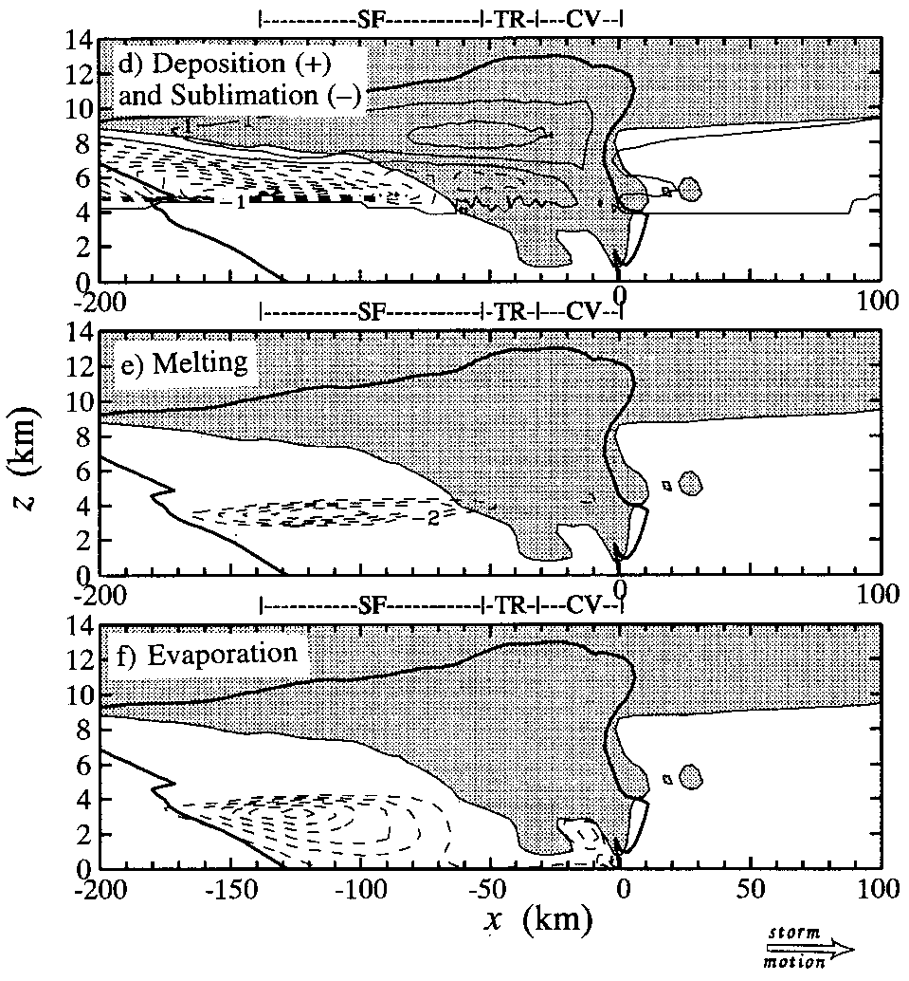
Cooling:
Sublimational (sublimational cooling of snow particles first drives the RTF to descend and penetrate through the storm [hypothesis of Rutledge et al. 1988])
Melting (bright band)
Evaporation

Slide 12
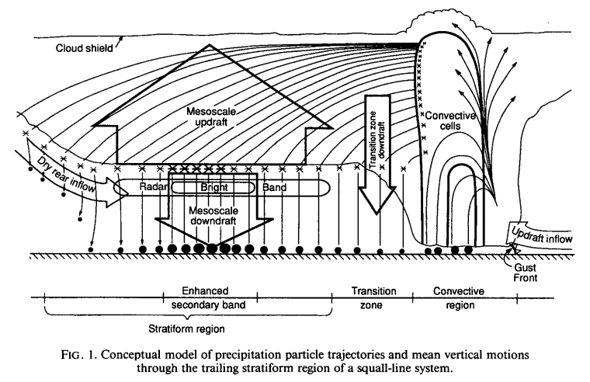
(Biggerstaff, M. I., and R. A. Houze Jr., 1993)

Slide 13
Hydrometeor types
Ice-phase microphysics
RTF
Environmental humidity
No. 1 microphysics processes

Slide 14
Sensitivity Tests
Run | Run time | Restart time | Comments
CNTL | 15 h |  | Full physics; turn off hail generation after 6 h
HAIL | 13 h |  | Full physics; leave hail generation after 6 h
NICE | 14 h |  | No ice-phase microphysics
NEVP | 12 h | CNTL at 3 h | No evaporative cooling
NMLT | 12 h | CNTL at 3 h | No melting cooling
NSUB | 12 h | CNTL at 3 h | No sublimational cooling
DRYM | 12 h |  | Drier midlevel environment

Slide 15
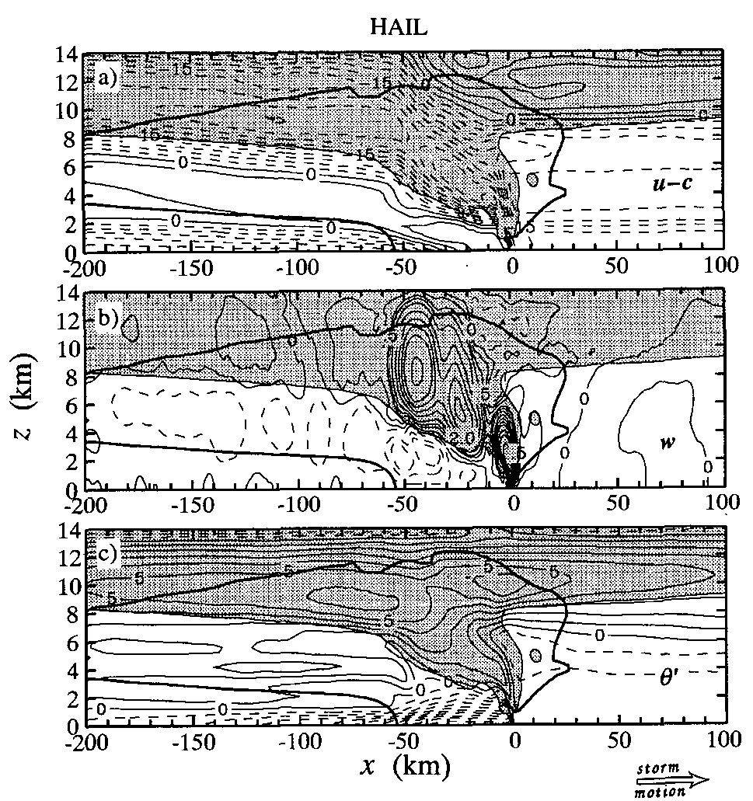
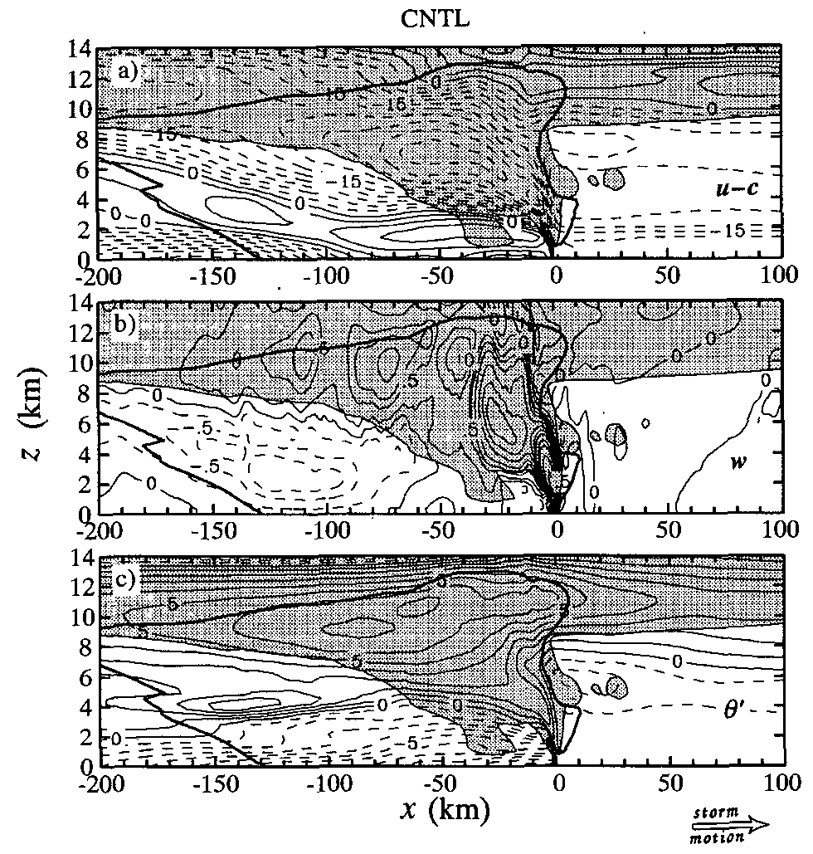
RTF flow is slightly weaker and more vertically oriented
Narrower precipitation region
Multicellular structure
Narrower cold pool
Notes:
Hydrometeors fall out quickly, before they can be transported very far behind the convective line by FTR flows; therefore, the surface precipitation region is much narrower during the mature stage.
Hydrometeors fall out quickly
Even in the last stage
Heavier hydrometeors fall out too quickly to be transported far away. The cooling by evaporation and melting associated with hail particles thus occurs closer to the convective region and leads to a narrower cold pool.
*RTF flow shows only one maximum in the convective region, because the horizontal pressure gradient associated with the midlevel mesolow in the stratiform region is too weak to generate an RTF wind maximum as a result of weaker buoyancy gradient at the rear of the system ©
**The realistic structure of the simulated descending rear inflow is sensitive to the assumed hydrometeor types, which affect the kinematic structure of the storm through their fallout pattern and the subsequent effects of diabatic processes on the thermal and pressure field

Slide 16
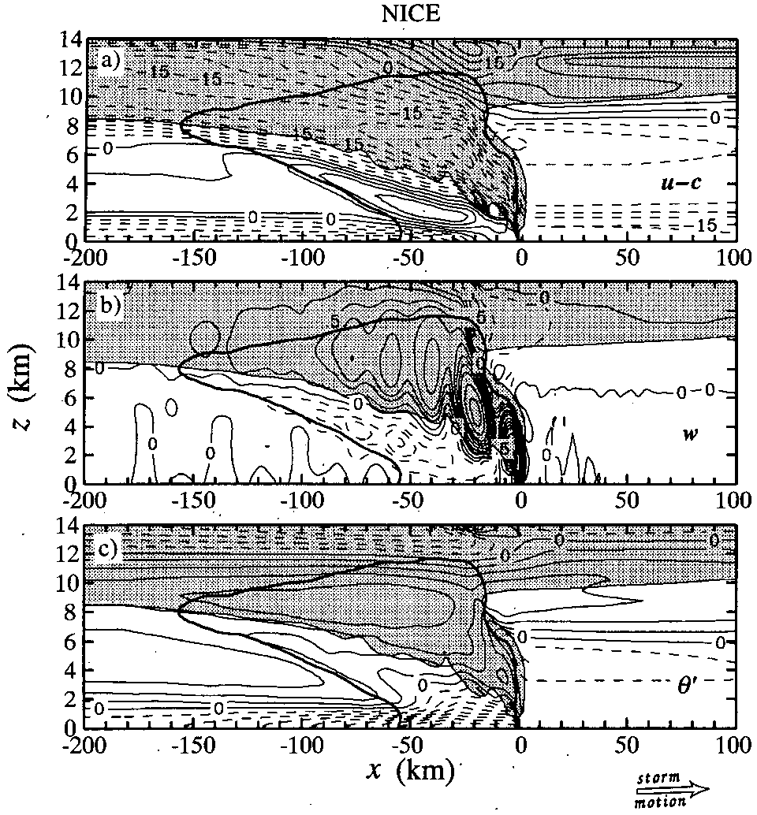
Only capture the precipitation structure within the convective region
The mesoscale up/downdraft is narrower and weaker
The midlevel warm plume is weaker
Notes:
The simulated storm propagates more slowly during the mature stage, but it has a more distinct multicellular behavior.
After t=4h, the NICE storm reaches a “quasi-equilibrium” state in which convective cells are periodically generated at leading edge with a period of 14-15min.
No realistic stratiform precipitation region.
Qualitative: NICE只抓住對流區的降雨結構
Quantitative: NICE的上升速度和溫度暖羽區都較弱 (cold pool 差不多)
* Ice microphysics have both a qualitative and quantitative impact on storm structure.
RTF flow is slightly weaker and more vertically oriented
** ice-phase microphysics are essential to the realistic structure of the descending RTF flow.

Slide 17
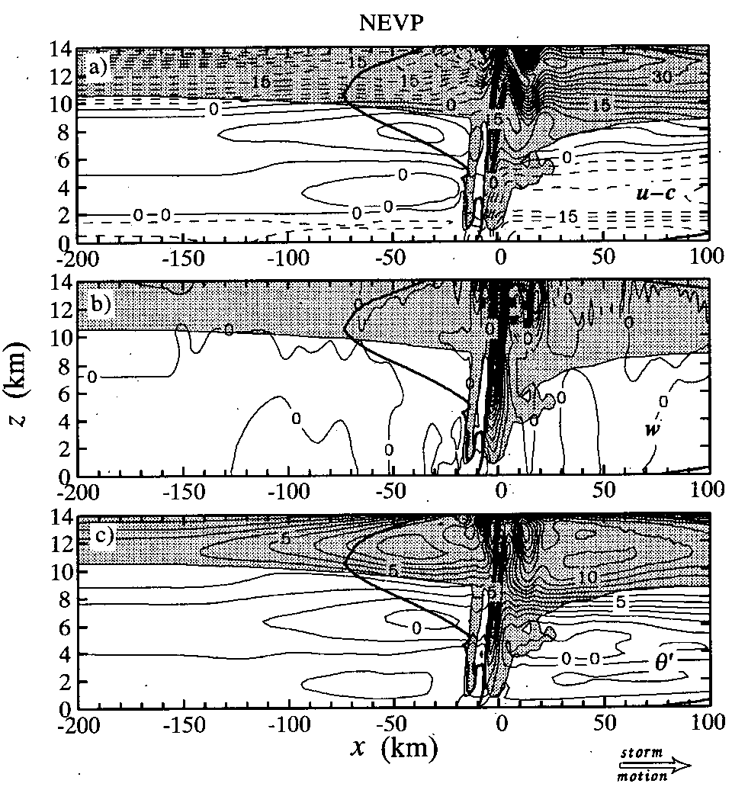
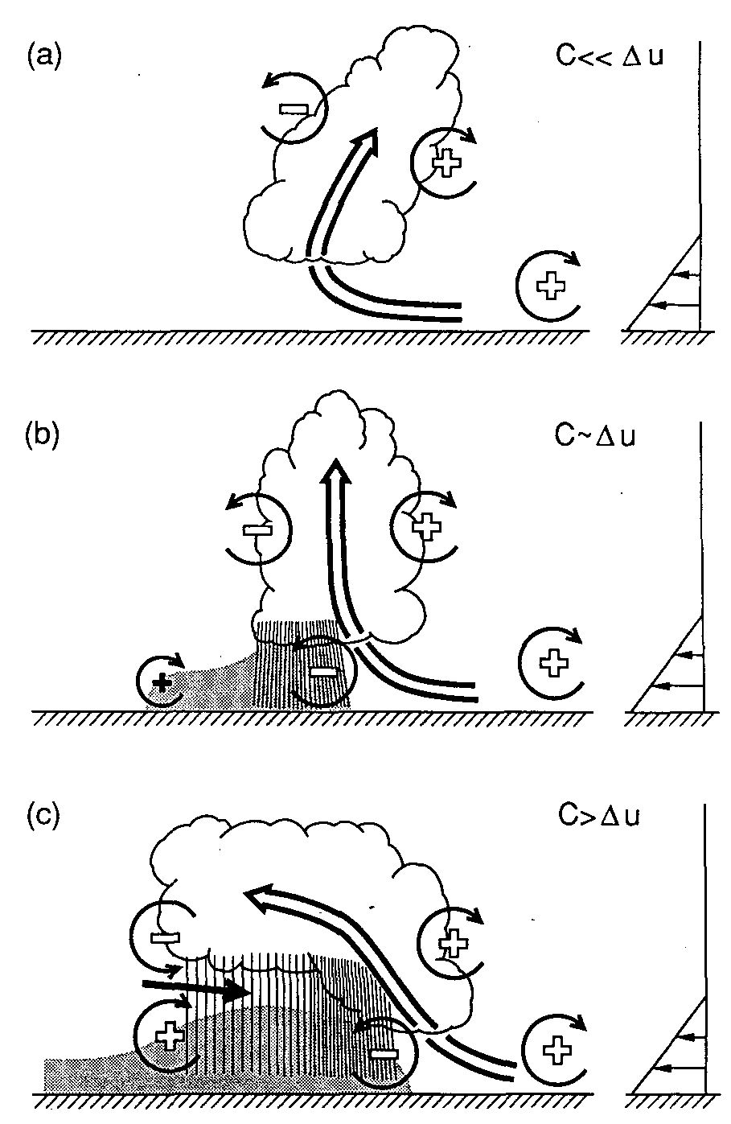
The storm never develops an upshear tilt
No mesoscale ascent or decent.
No subcloud cool pool
No stratiform precipitation behind the convective region
(Weisman 1992)
Notes:
The NEVP storm moves very slower than the CNTL storm.
The vorticity generation by the cold pool is required to overcome the vorticity associated with the environmental low-level wind shear in order for the storm to become tilted upshear.
The RTF flow is elevated and entirely a consequence of strong midlevel winds in the large-scale environment overtaking and entering the storm.
* The descending rear inflow develops in response to dynamical and microphysical feedbacks in the trailing stratiform region.

Slide 18
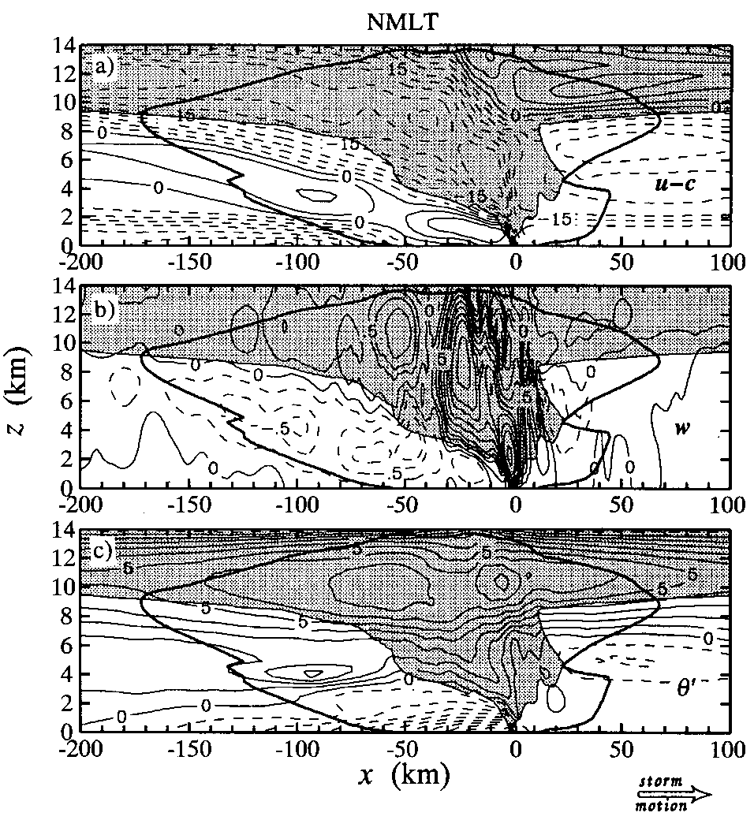
Weaker and more vertically oriented FTR flow
The double-core structure of FTR is well preserved
The narrower mesoscale ascent zone
Notes:
The NMLT storm generally propagates slower than the CNTL storm; however, the speed difference becomes smaller once the system becomes well developed.
The double-core structure of the RTF flow is well preserved in the NMLT run; however, its strength is less than in the CNTL run.. This result demonstrates that cooling by melting is not the cause of the rear inflow.
The mid- to upper-level updrafts are stronger, but the low-level updrafts are weaker.
雖然melting cooling不是最主要造成沉降的原因，但卻仍有顯著增強downdraft的情形 (because warming at the back edge of the NMLT storm is 33% narrower.

Slide 19
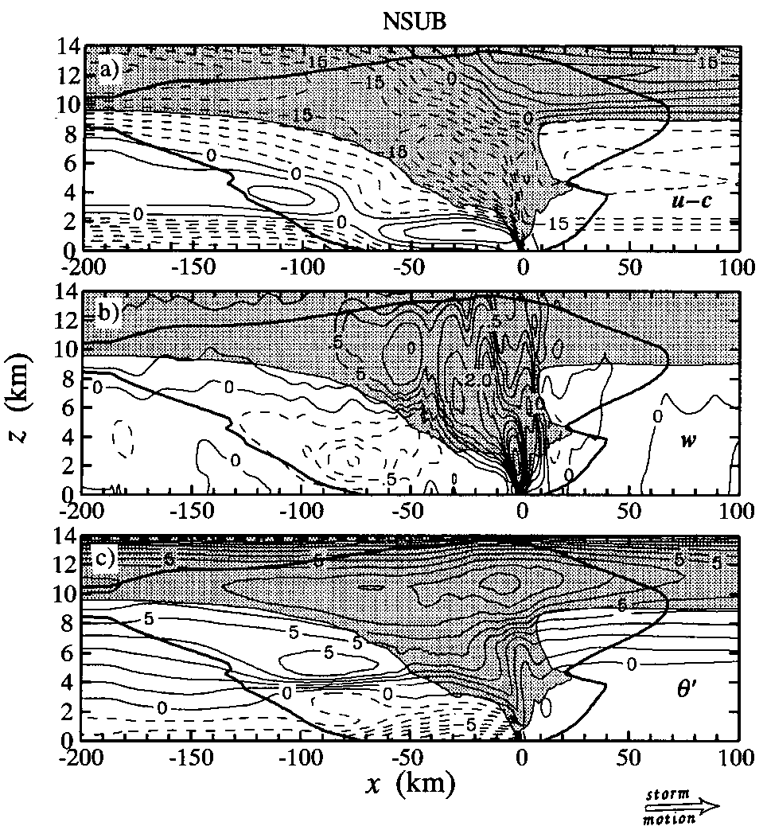
Weaker FTR flow
Narrower mesoscale updrafts/downdrafts in the stratiform region.
Downdraft is below the melting level.
Notes:
Slower than CNTL storm.
The latent cooling by evaporation and melting are the most important microphysical processes determining the structure and strength of rear inflow in the cloud-model simulations.
The sublimational cooling at the base of the trailing anvil cloud is key to the initiation of downward air motion above the melting level.

Slide 20
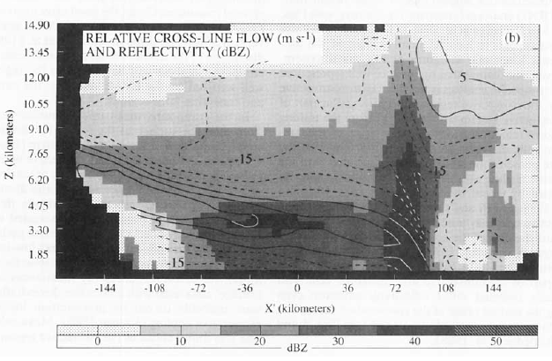
(Biggerstaff and Houze 1993)
Notes:
觀測也是從melting level上方1km 開始有下沉氣流

Slide 21
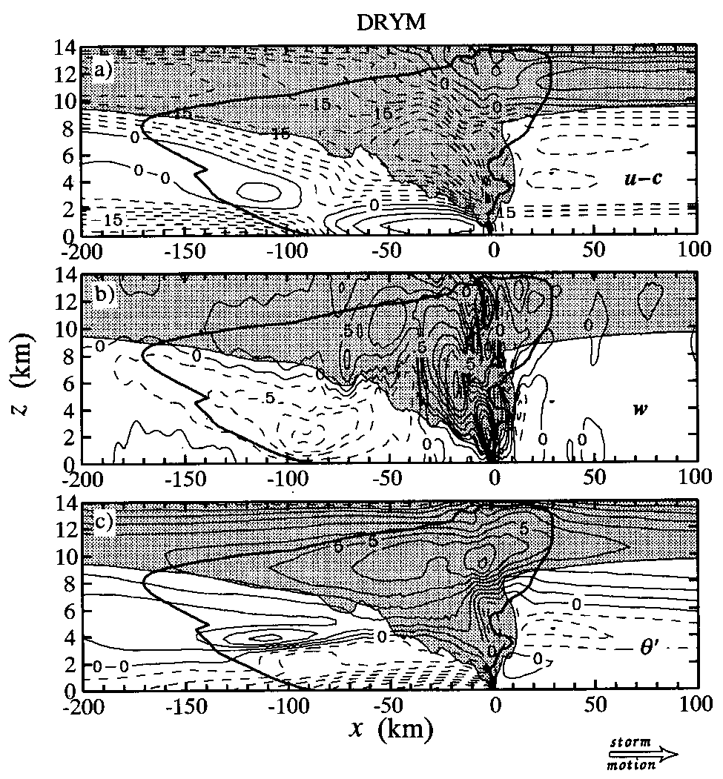
More upright and weaker ascending FTR flow; Weaker RTF flow
Stratiform region is narrower and weaker
Low-level updrafts are weaker but midlevel downdrafts are stronger.
Notes:
Half moisture (z=2.5~6 km or p=800~450mb)
We expected the reduced midlevel environmental moisture to enhance the sublimational and evaporative cooling at the back edge of the system and thus to increase the local buoyancy gradients and the rear inflow strength. However, the horizontal buoyancy gradients of DRYM storm in the stratiform region are weaker than those of the CNTL storm. >> because the more upright system orientation.
The drier environment air entrained into the leading convective region enhances evaporative cooling at midlevels, which counteracts the vorticity tendency produced by the cold pool and tilts the convection into a more upright orientation.
A result of an enhanced evaporative cooling associated with lower midlevel environmental humidity.

Slide 22
Role of mesolows in the formation of descending RTF flow
Notes:
Smull and Houze (1987) suggested that the midlevel mesolow in the stratiform region might associated with the mesolow in the convective region to establish a broad RTF current across the storm. They further suggested that the RTF flow in some cases could be generated by “ the physical processes internal to the mesoscale convective system” without the aid of ambient flow entering the system.
The model is nonhydrostatic, the convection is explicitly resolved, and the environment is horizontally uniform, so that there are no large-scale baroclinic processes active in the simulation

Slide 23
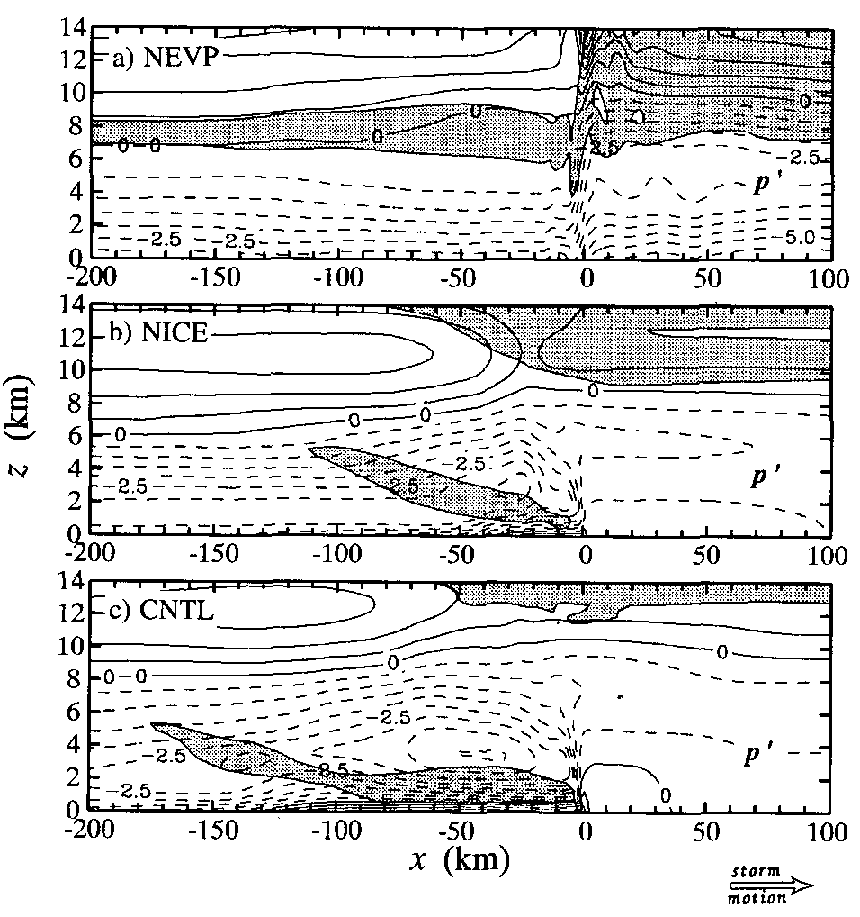
NEVP: no mesolows, no descending rear inflow.
NICE: only one mesolows, only one RTF wind maximum
CNTL: two mesolows
Notes:
The rear inflow results from environmental winds entering and overtaking the storm
* This structure is consistent with Smull and Houze’s suggestion that the resulting horizontal pressure-gradient force associated with the stratiform region mesolow draws midlevel air into the storm from the rear to induce the rear inflow.

Slide 24
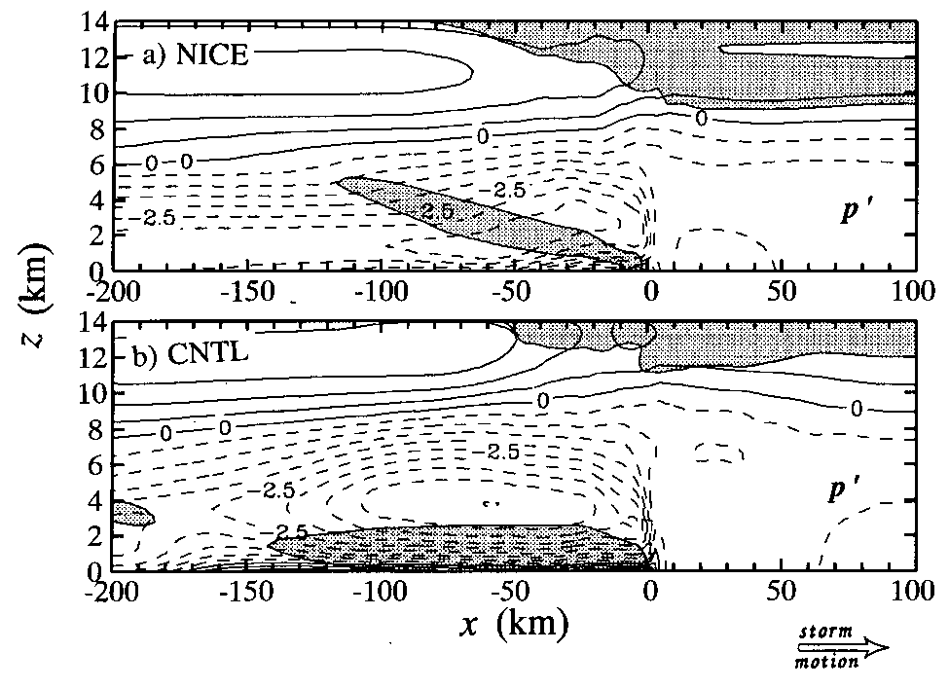
The RTF flow during the late stage of the NICE storm has the same width, intensity, and slope as in the mature stage.
CNTL: RTF is broader and stronger, and the two RTF are more distinct from each other
Notes:
Since large-scale baroclinic processes are inoperative and the decending rear inflow in this model is caused entirely by the storm-induced circulation, this study confirms the conclusion of Smaull and Houze and Lafore and Moncrieff that the rear inflow can be generated by physical processes internal to the MCS.
Also supports the argument that two separate midlevel mesolows are involved in the development of the RTF flow and that the two mesolows may act constructively to establish a continuous RTF flow channel across the storm.

Slide 25
Conclusions
Run | Storm Speed | Storm orientation | RTF flow structure
CNTL | 12.2 m/s | upshear tilt | Two maximum in the storm (8 m/s)
HAIL | 11 m/s | upshear tilt | One maximum in convective region
NICE | 8 m/s | upshear tilt | One maximum in convective region
NEVP | 5 m/s | upright to downshear tilt | A highly elevated RTF flow
NMLT | 12 m/s | less upshear tilt | Two maximum in the storm (6 m/s)
NSUB | 10.8 m/s | less upshear tilt | Two maximum in the storm (7 m/s)
DRYM | 12.2 m/s | more upright | Two maximum in the storm (3 m/s)

Slide 26
Hydrometeor types
The HAIL test shows that the descending rear inflow is sensitive to the hydrometeor types.
Ice-phase microphysics
The NICE test shows that ice microphysics are crucial to the proper exitence of the descending rear inflow and mesoscale updraft/downdraft.
Environmental humidity
Drier environmental air enhances the evaporative cooling at midlevels at leading edge and counteracts the upshear tilt induced by the cold-pool circulation.
No. 1 microphysics processes
Evaporative cooling is the most important latent cooling process determining the descending RTF flow.
Notes:
The structure and strength of the RTF flow is sensitive to precipitation hydrometeor types, ice-phase microphysics, and the latent cooling of evaporation, melting and sublimation.

Slide 27
HAPPY NEW YEAR!

Slide 28
Model Setting
Klemp and Wilhelmson (1978) compressible nonhydrostatic cloud model, as modified by Wilhelmson Chen(1982)
2D version, x and z coordinate
Basic-state environment: constant in time and horizontally homogeneous. Large-scale motion, Coriolis force, surface drag, and radiation effects are neglected.

Slide 29
62 grid points in the vertical, grid size is 140m to 550m, and the model top is at 21.7 km.
455 grid points in horizontal, and 315 points make up a regular fine mesh with 1-km resolution (1.075:1). Total horizontal domain size is 4814 km (about 10 km/grid). Open boundary condition (KW), with C* = 30 m/s
! The model domain moves with the storm.

Slide 30
Cloud microphysics: Lin et al.(1983) with five types of water condensate (cloud water, cloud ice, rainwater, snow, and hail.
Initail conditions: The smoothed initial temperature and dewpoint for the simulation are from the 2331UTC 10 June 1985 sounding of Enid, Oklahoma. Extra moisture was added to the sounding in low levels in order to favor the development of convection.

Slide 31
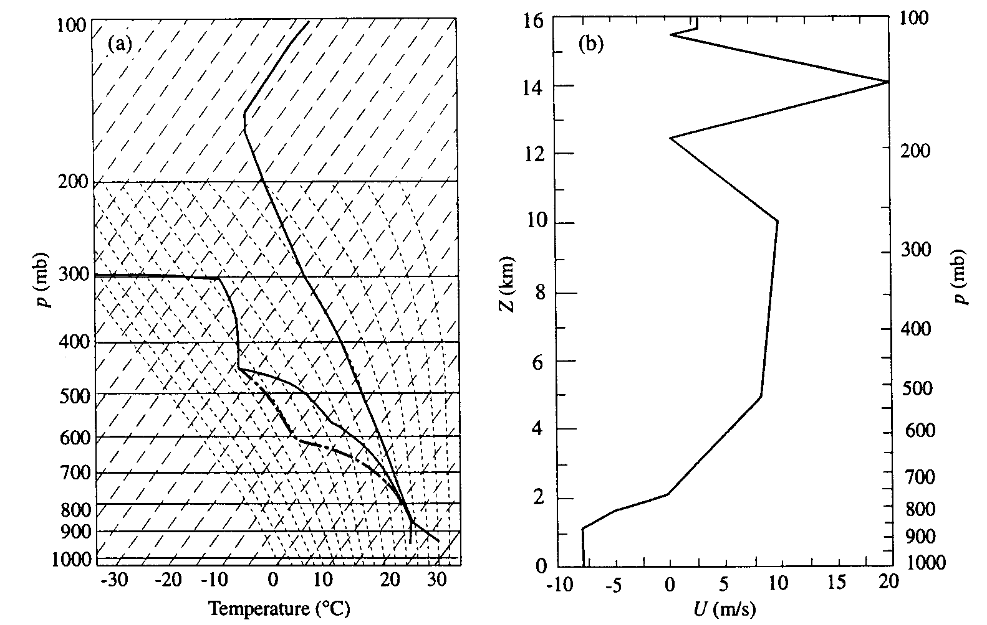

Slide 32
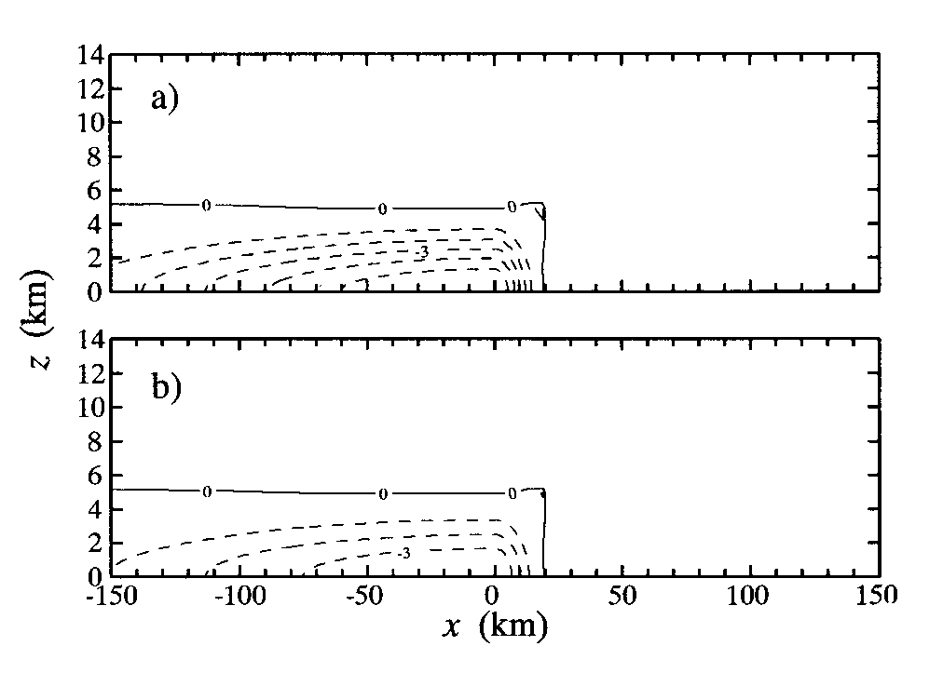

Slide 33
Lin et al. (1983)
Hail particle diameter > 5 mm, a density between 0.8 and 0.9 g/cm^3, and a terminal velocity between 10 and 40 m/s or more.
The cloud droplets and ice crystals are assumed to be monodispersed and to have no appreciable fall speeds compared to air vertical velocity.
The precipitating particles (rainwater, snow ,and hail) are assumed to have exponential size distribution. The density of water is used for snow’s slope parameter of its size distribution function. (Potter ,1991) No density correction factor is applied to the fall speed of snow. (Braun and Houze, 1994)

Slide 34
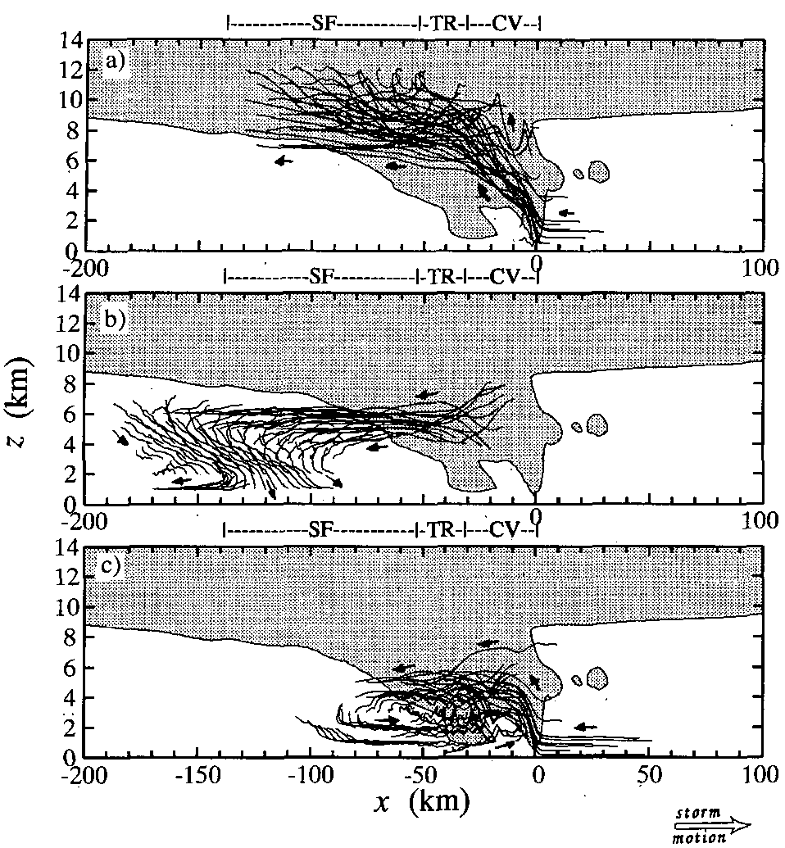
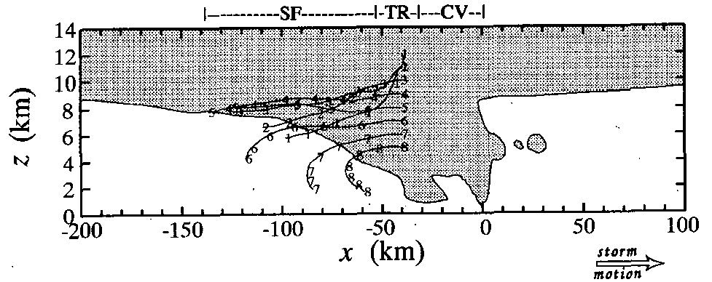
Notes:
Most of the air within mesoscale updrafts originally comes from the high-θ_{e} boundary layer ahead of the system.
About half of the air within mesoscale downdraft is from the leading-edge convective region, and the other half is from the poststorm midlevel lowθ_{e} layers.
Precipitation particles falling into the transition zone are from the low levels of the convective region.

