Slide 1
Improved Analyses and Forecasts of Hurricane Ernesto’s Genesis Using Radio Occultation Data in an Ensemble Filter Assimilation System
REFERENCE :
Liu., H., J. Anderson, and Y.-H. Kuo, 2012: Improved analyses and forecasts of Hurricane Ernesto’s genesis using radio occultation data in an ensemble filter assimilation system. Mon. Wea. Rev., 140, 151–166.
陳登舜
2012.11.30
ATM NCU
Group Meeting

Slide 2
Contents
Introduction
Hurricane Ernesto and RO observation(GPS RO)
The assimilation system(EAKF)
Assimilating only RO refractivity
Impact of RO data on analyses and forecasts of the storm’s genesis
Summary and discussion

Slide 3
Introduction
Tropical cyclone factors
Warm water temperatures of at least 26.5 degrees down to a depth of at least 50 m
Rapid cooling with height in the atmosphere, which allows the release of the heat of condensation that powers a tropical cyclone.
High humidity, especially in the lower-to-mid troposphere
Small vertical wind shear
A distance greater than five degrees of latitude away from the equator
Preexisting system of disturbed weather
Require good measurements of temperature and water vapor in the troposphere.
GPS RO provide high-vertical-resolution refractivity that are a function of water vapor and temperature.

Slide 4
Introduction(con’t)
It need a good multivariate, flow-dependent estimate of the forecast error covariance to correct forecast errors in water vapor, temperature and wind
Ensemble data assimilation techniques can provide one way to address multivariate and flow-dependent forecast error covariance
A few preliminary studies with assimilation of RO refractivity in ensemble assimilation system have demonstrated benefits for forecasts of Hurricane Ernesto (2006) and Typhoon Shanshan (2006; Liu et al. 2007; Anthes et al. 2008)
Notes:
The environment of tropical storms are often moist convective and latent heat release
Forecast error may be strongly flow dependent and forecast errors of wind and temperature may be strongly correlated with water vapor

Slide 5
Hurricane Ernesto and RO observation(GPS RO)

Slide 6
Hurricane Ernesto genesis
1007 hPa, 30 kt
TD
00Z, 25, August
1004 hPa, 35 kt
TS
997 hPa
Category 1
21Z, 25, August
TS
12Z, 26, August
Hurricane
12Z, 27, August

Slide 7
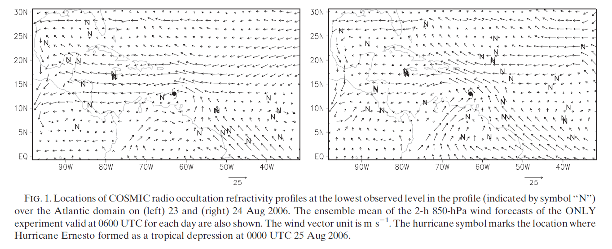
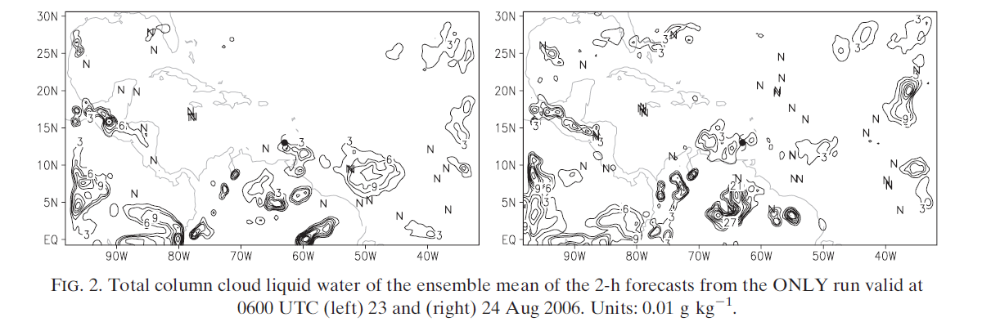
Hurricane Ernesto
06Z, 23
06Z, 24
Wind
850 hPa
qc

Slide 8
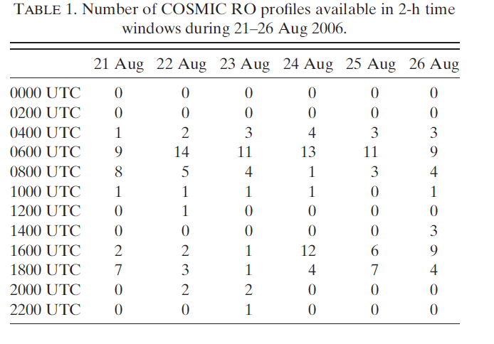
RO observations

Slide 9
Assimilating only RO refractivity

Slide 10
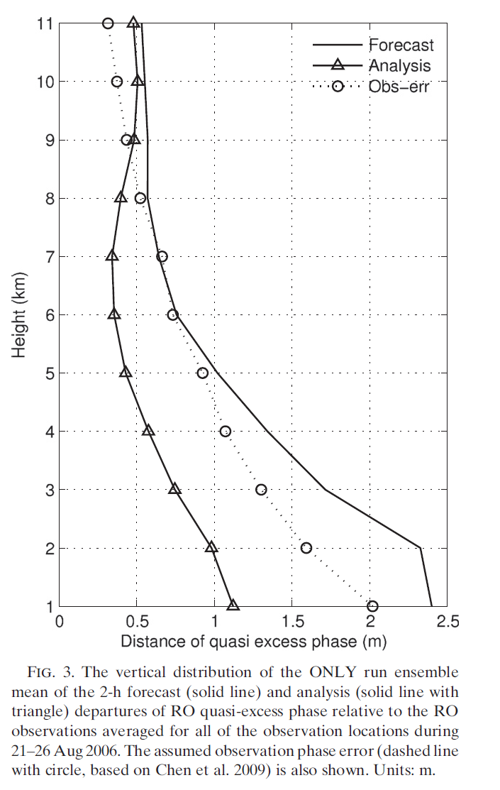
The forecast and assimilation system
Model - WRF
36km horizontal resolution grid
35 vertical levels, top to 20 hPa
Kain-Fritsch cumulus scheme
WRF single-moment five class
YSU boundary layer scheme
Noah land surface model
Assimilating system - EAKF
WRF (ARW) DART EAKF
Ensemble Adjustment Kalman Filter
U, V, T, Qv, Qc, Qr, Qi, Qs, sfp, gph, mass
$$y−H(x^{b})$$
$$y−H(x^{a})$$
R

Slide 11
Experiments
EXP. | NODA | ONLY | ONLY 6-km
Description of Assimilating | No observation to be assimilated | Assimilate only RO profiles | Assimilate only RO profiles but above 6 km

Slide 12
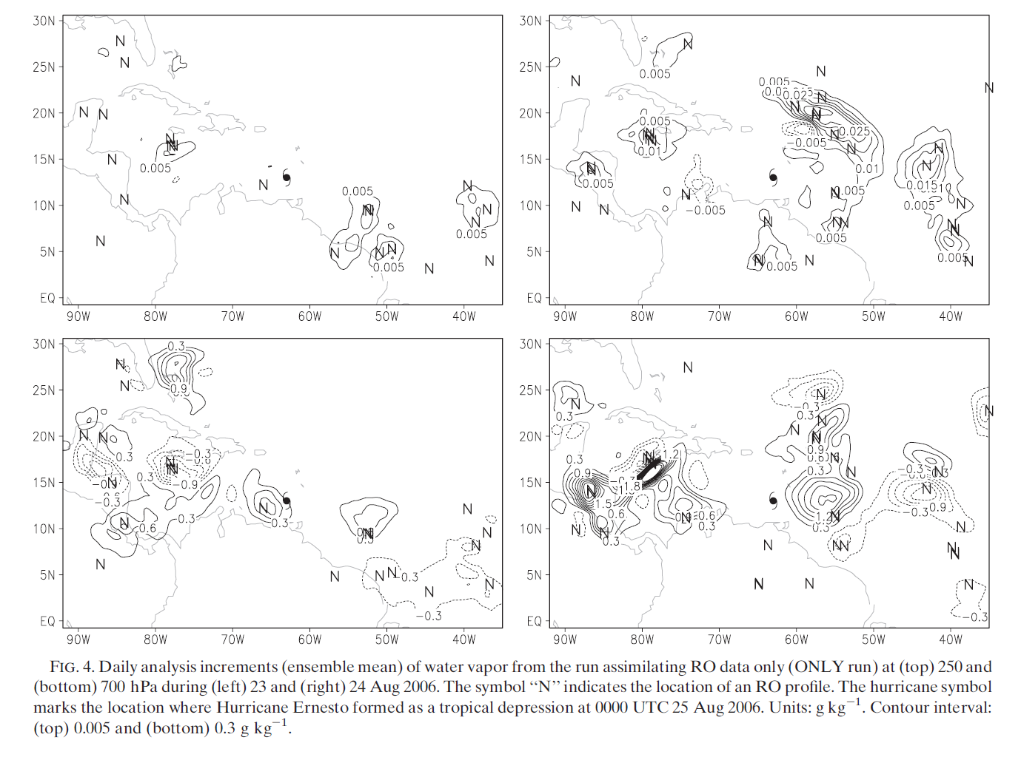
Assimilating only RO refractivity
23
24
0.015
250 hPa
0.03
0.9
700 hPa
0.6
1.8
Analysis increment (A-B) of water vapor

Slide 13
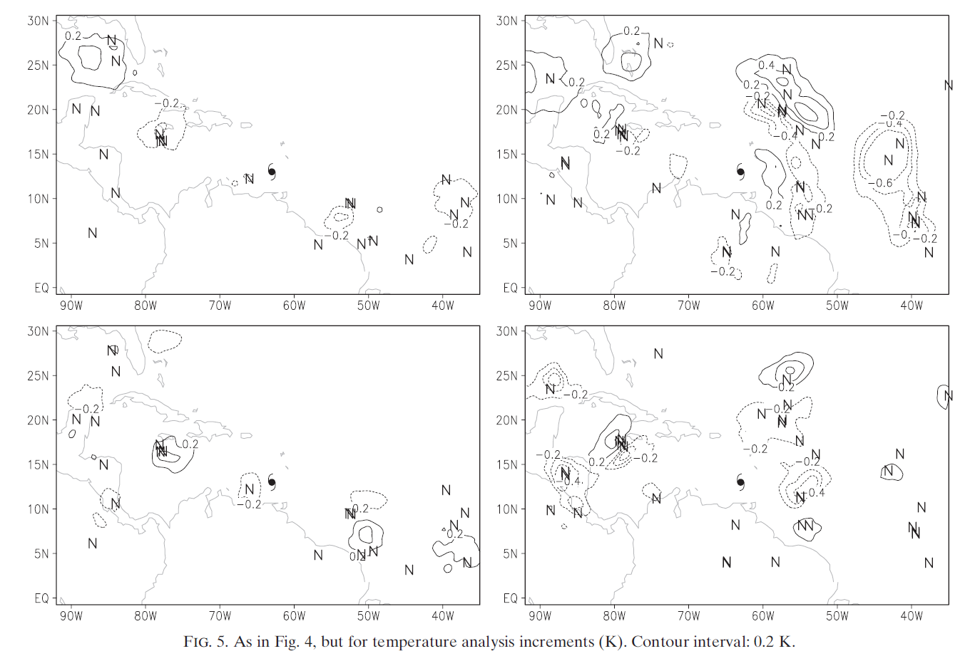
Assimilating only RO refractivity
23
24
250 hPa
-0.4
-0.6
-0.2
-0.6
700 hPa
Analysis increment (A-B) of temperature

Slide 14
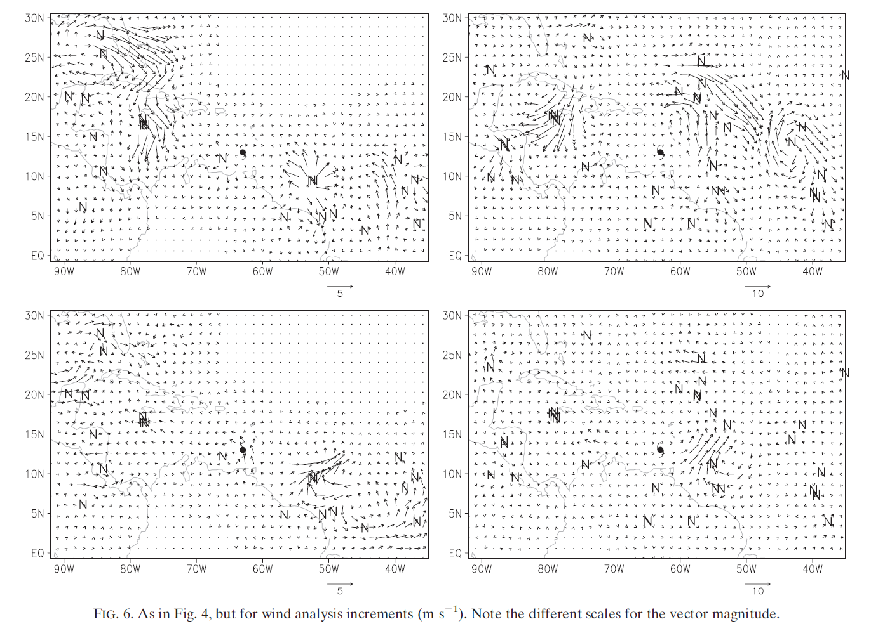
Assimilating only RO refractivity
23
24
5 m/s
250 hPa
10 m/s
700 hPa
5 m/s
10 m/s
Analysis increment (A-B) of wind

Slide 15
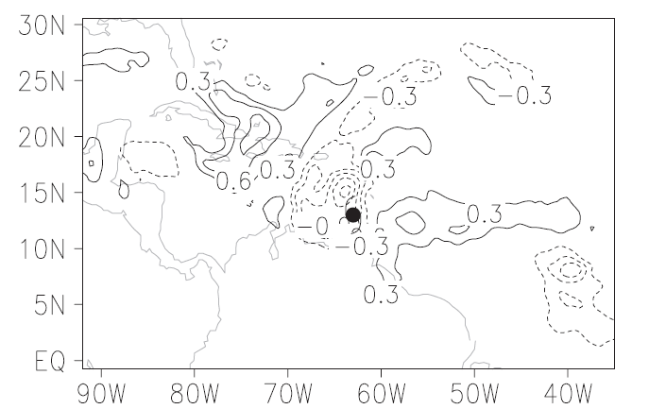
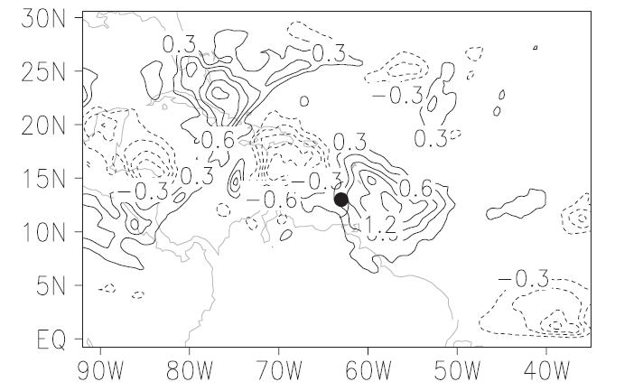
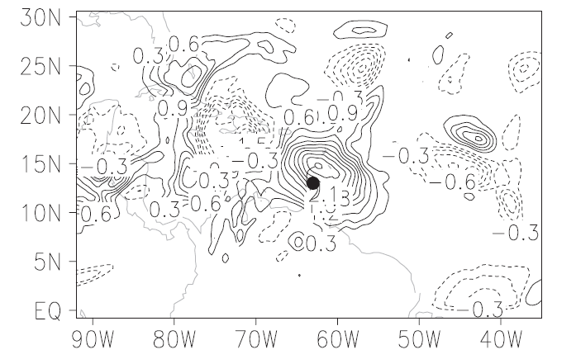
Assimilating only RO refractivity
Qv (ONLY – NODA) @ 700 hPa
23 06Z
24 00Z
1500km, 3 g/kg
25 00Z

Slide 16
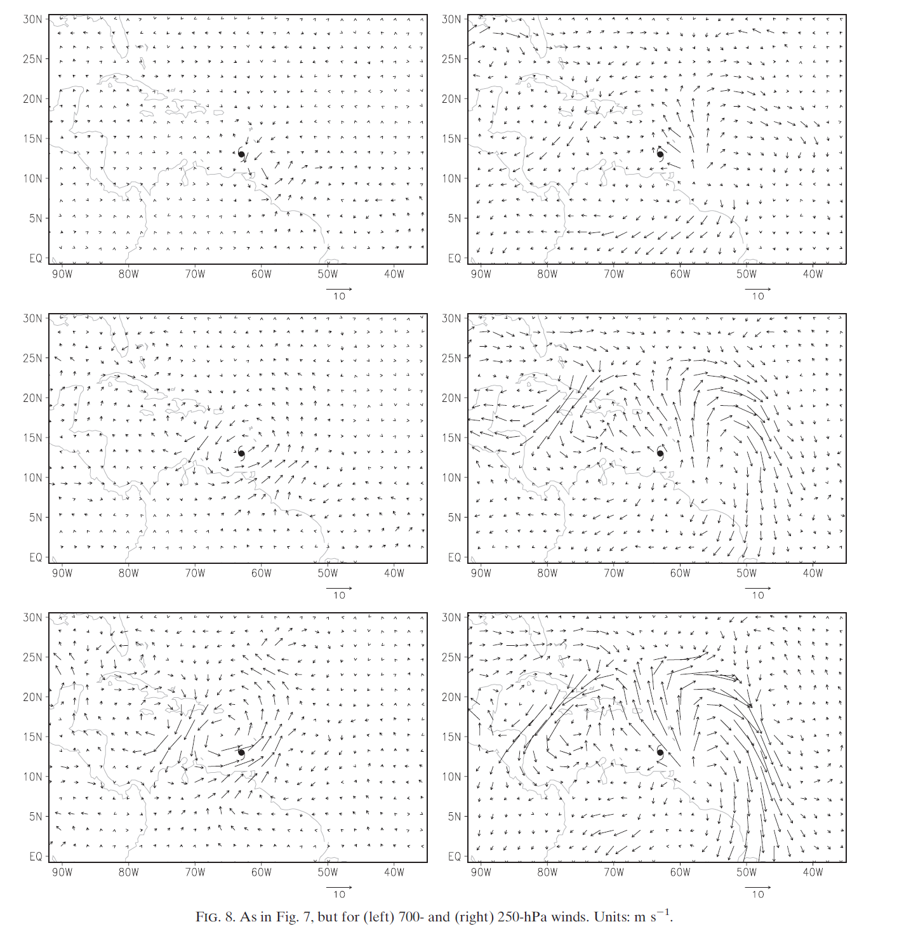
Assimilating only RO refractivity
Wind(ONLY – NODA) @ 700 hPa
23 06Z
“These wind adjustment favor the development of the storm.”
24 00Z
5 m/s
10 m/s
25 00Z
700 hPa
250 hPa

Slide 17
Brief conclusion
The RO refractivity is more strongly related to water vapor in lower troposphere of the topics.
Larger wind increments are consistent with those for temperature and water vapor and make the analyses more balance.
There were no RO profiles near the time 25 00Z, so, all impacts from the RO data comes from observation at previous analysis times.

Slide 18
Hypothesis
The RO refractivity data in the lower troposphere has mostly water vapor information and can be strongly related to the winds of both upper and lower troposphere, especially in moist convectively active environment.
When RO data in the lower troposphere is ignored, the impact from the assimilation of RO data can be significantly reduced.

Slide 19
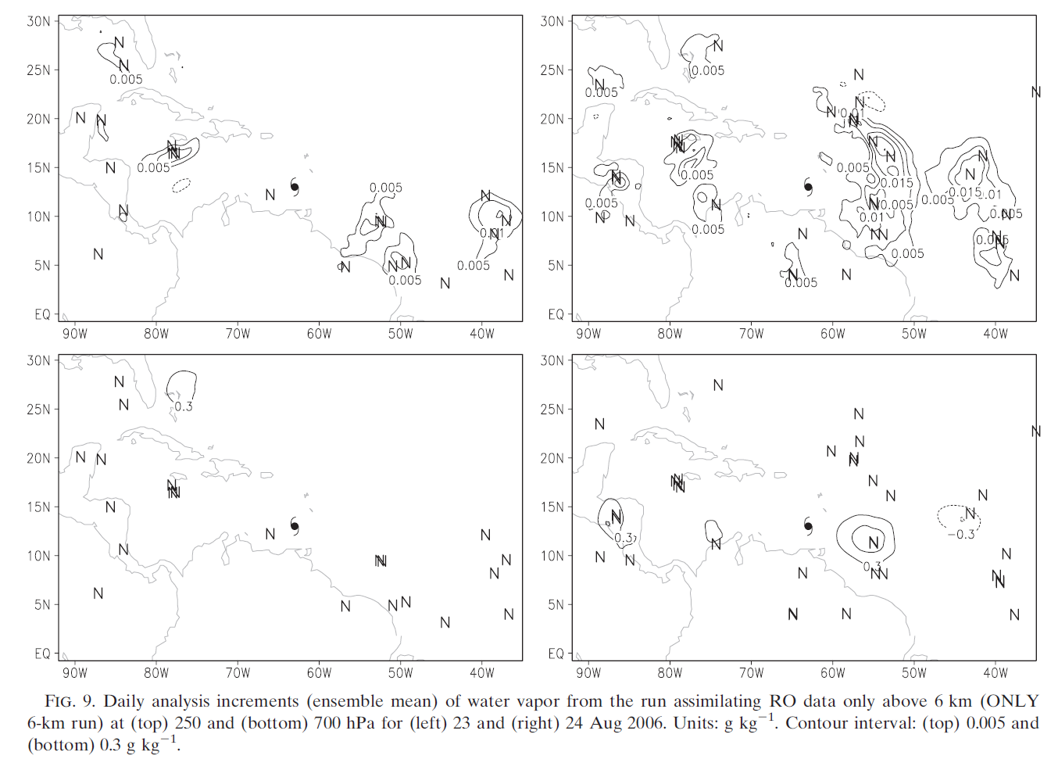
OLNY 6-km Run V.S. ONLY Run
ONLY 6-km
ONLY
23
24
23
24
250 hPa
700 hPa
Analysis increment of water vapor

Slide 20
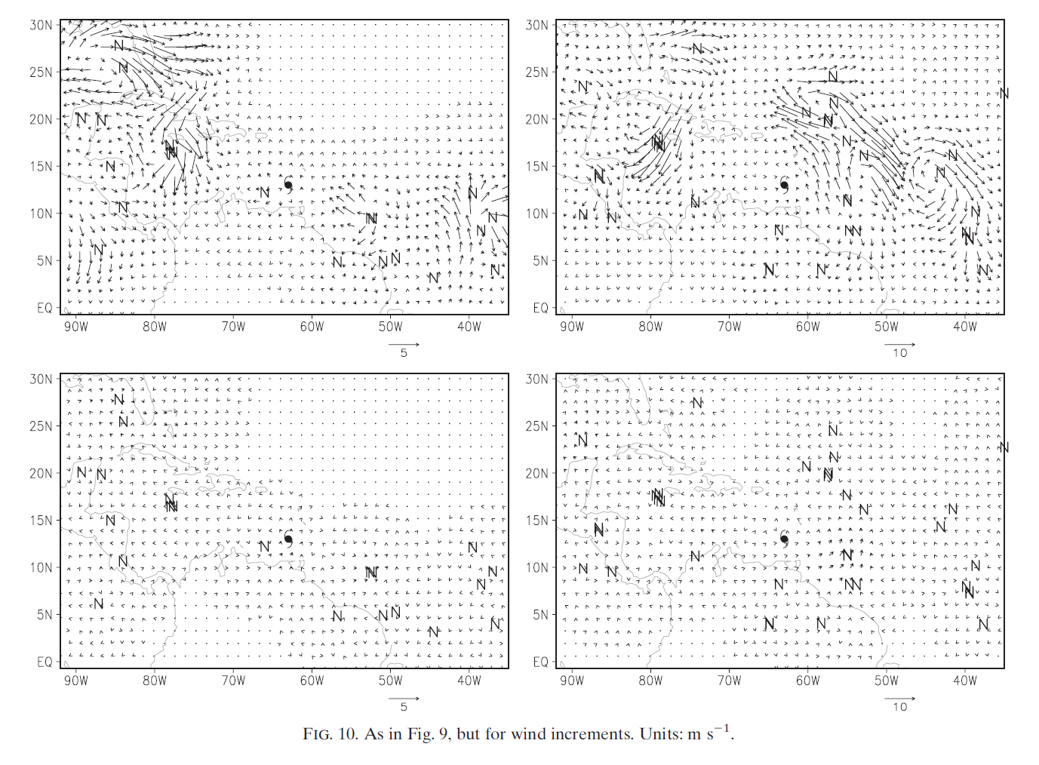
OLNY 6-km Run V.S. ONLY Run
ONLY 6-km
ONLY
23
24
23
24
No divergence
250 hPa
700 hPa
Analysis increment of wind

Slide 21
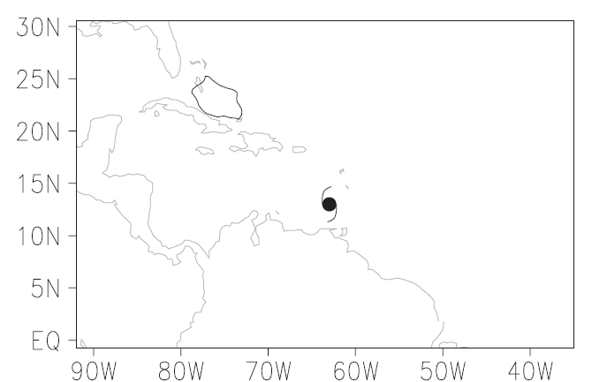
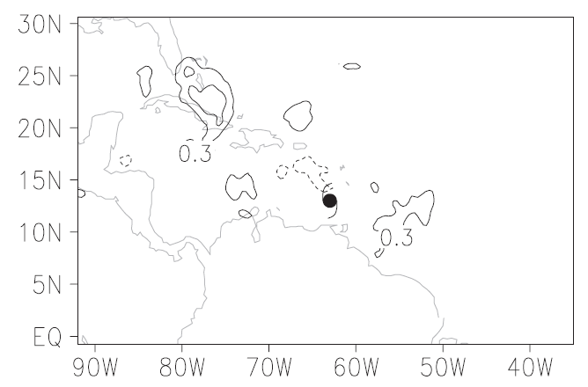
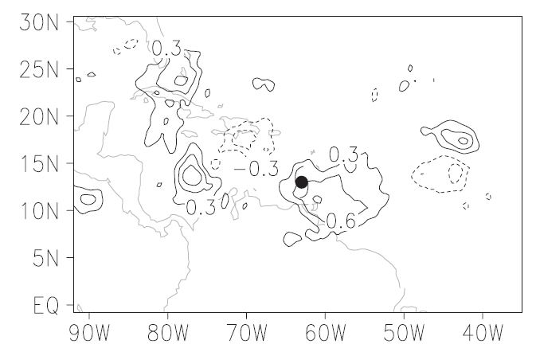
OLNY 6-km Run V.S. ONLY Run
Qv, 700 hPa
0.9 g/kg
23 06Z
24 00Z
25 00Z
3.0 g/kg
Qv (EXP – NODA) @ 700 hPa

Slide 22
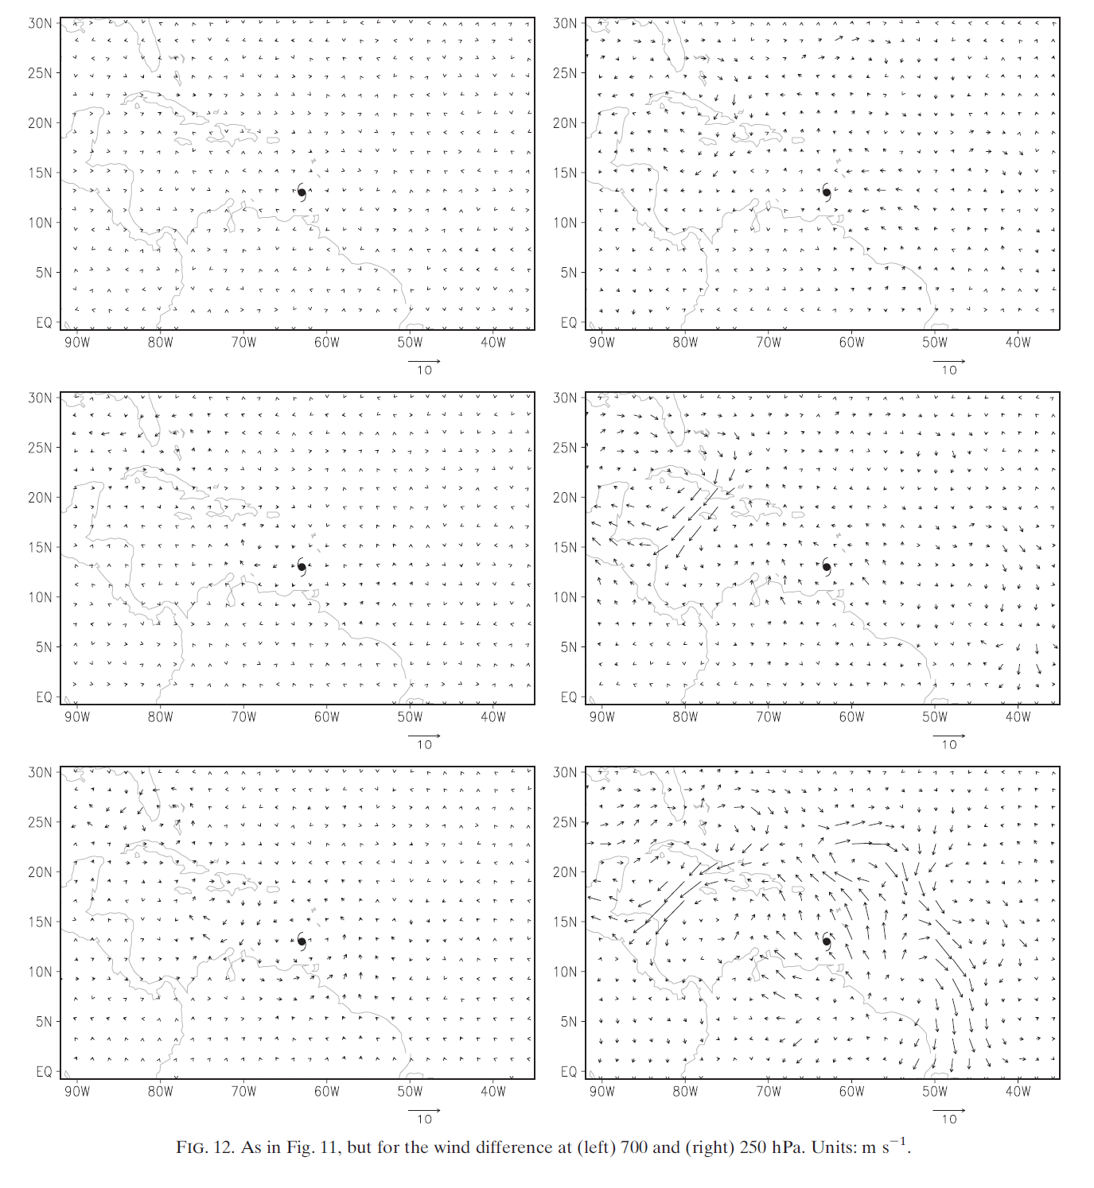
OLNY 6-km Run V.S. ONLY Run
ONLY 6-km
ONLY
Wind, (ONLY 6-km – NODA) @ 700 hPa
23 06Z
24 00Z
25 00Z
700 hPa
250 hPa
700 hPa
250 hPa
Wind(EXP– NODA) @ 700 hPa
Notes:
Large scale divergence flow is much reduced at 250 hPa
Cyclone circulation completely disappears at 700 hPa

Slide 23
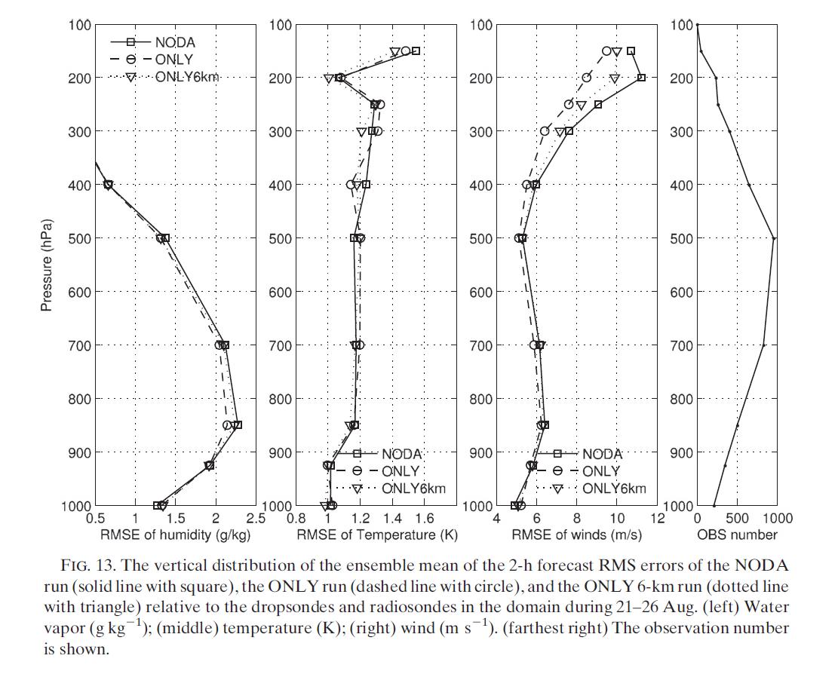
RMSE

Slide 24
Brief conclusion
RO refractivity below 6-km contributes strongly to the water vapor and wind adjustments in the lower troposphere as well as divergence adjustments in the upper troposphere in the convectively active area.
The more moisture in the lower troposphere provides more fuel to the convection and so enhances convergent(divergent) circulation in the lower(upper) troposphere.
The multivariate forecast error covariance estimated from the ensemble forecast is realistic and captures the key features of the moist convective environment.

Slide 25
Impact of RO data on analyses and forecasts of the storm’s genesis

Slide 26
Experiments
EXP. | CTRL | RO | RO 6-km
Description of Assimilating | Radiosonde : T, Wind, Qv Aircraft : Wind, T Satellite cloud drift winds Surface station : P “No” satellite infrared and microwave sounders, radiance, and images | Adds RO profiles | Adds RO profiles only above 6 km

Slide 27
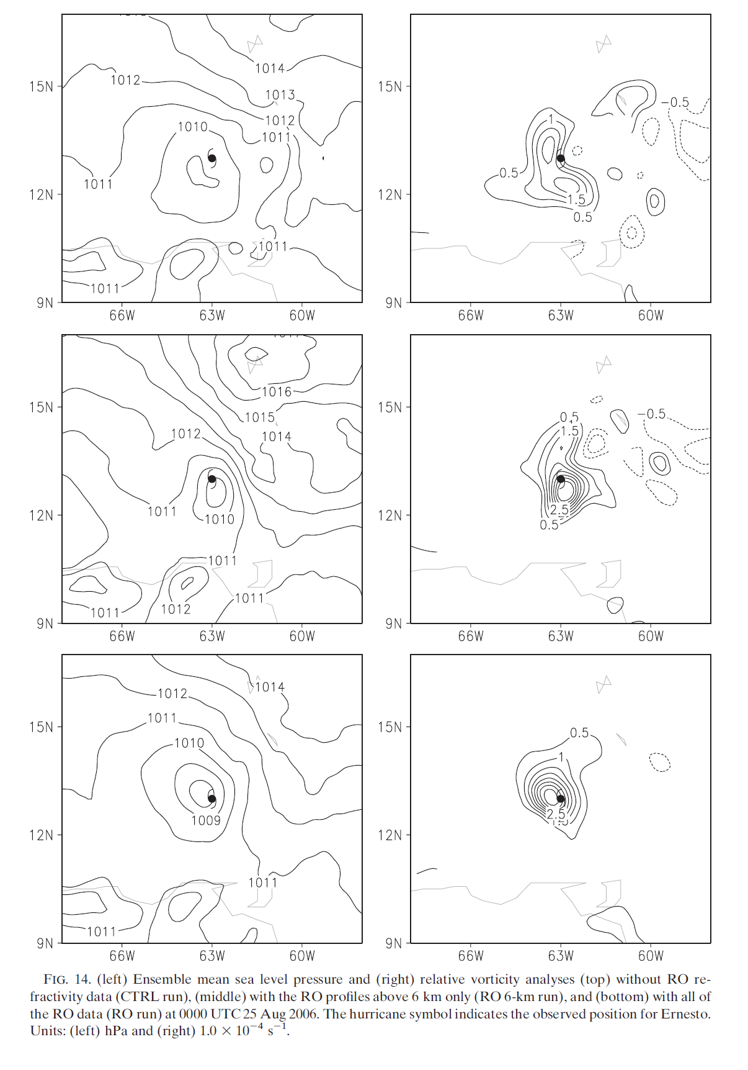
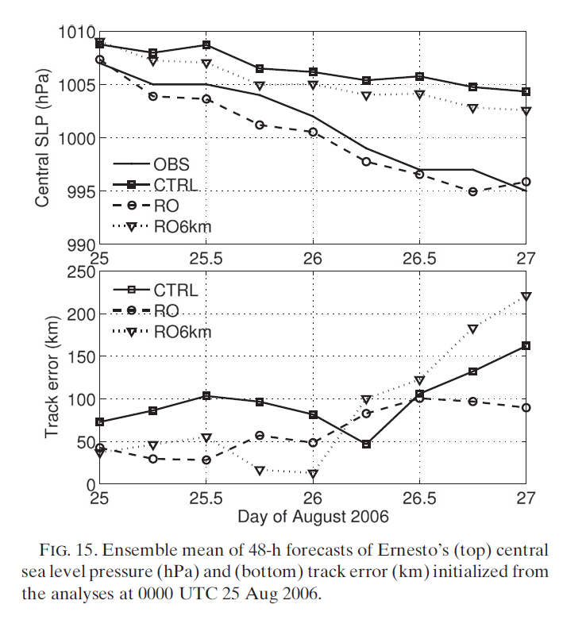
Results
SLP
Relative Vorticity
1010 hPa
CTRL
RO 6-km
1009 hPa
1008 hPa
RO
OBS:1007 hPa

Slide 28
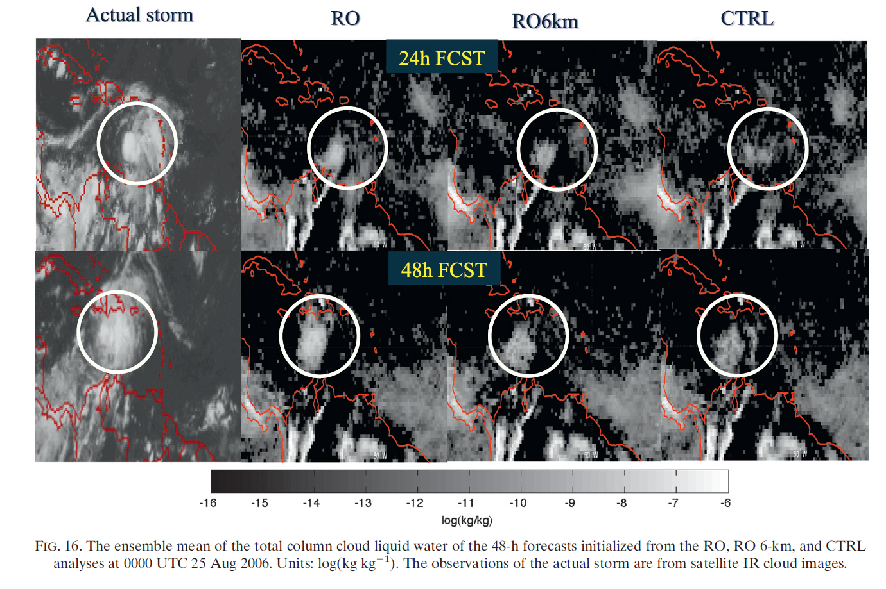
Compare Observation

Slide 29
Summary and Conclusion
The water vapor and wind analysis adjustments are propagated by model forecasts into the storm’s genesis area.
The more moisture in the lower troposphere provides more fuel to the convection and so enhances convergent(divergent) circulation in the lower(upper) troposphere.
The root-mean-square error of water vapor and wind forecasts compared to dropsonde and raidosonde observations are reduced consistently.

Slide 30
Summary and Conclusion(con’t)
The major impact of RO data disappears when only assimilated the RO profile above 6-km, which suggesting the importance of assimilating RO data in the lower troposphere.
Ro refractivity data has potential to improve analyses and forecasts of tropical cyclones using ensemble assimilation system.

Slide 31
Reference
https://proxy.subversion.ucar.edu/DAReS/DART/trunk/tutorial/section9/tut_section9.pdf

Slide 32
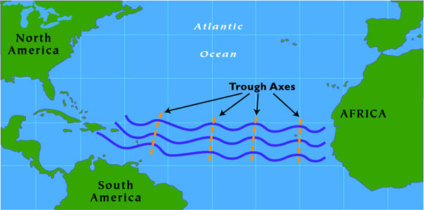
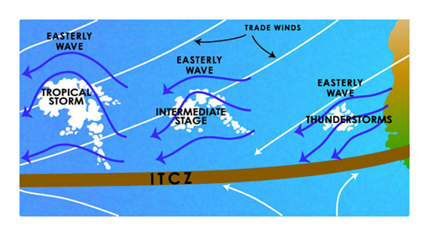
Easterly waves

Slide 33
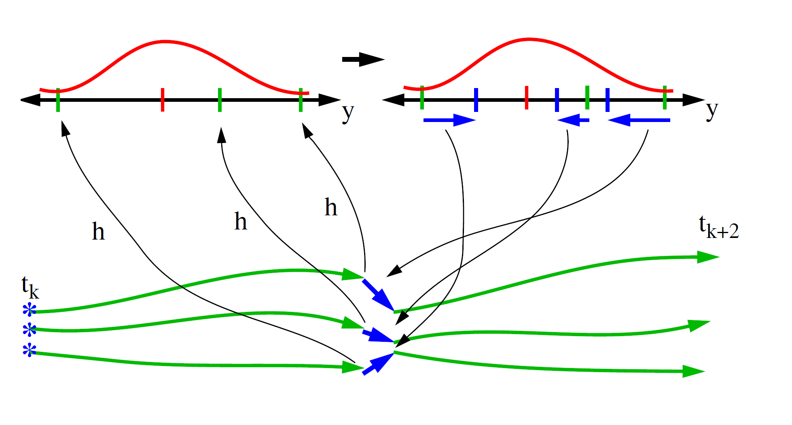
Ensemble Filter

Slide 34
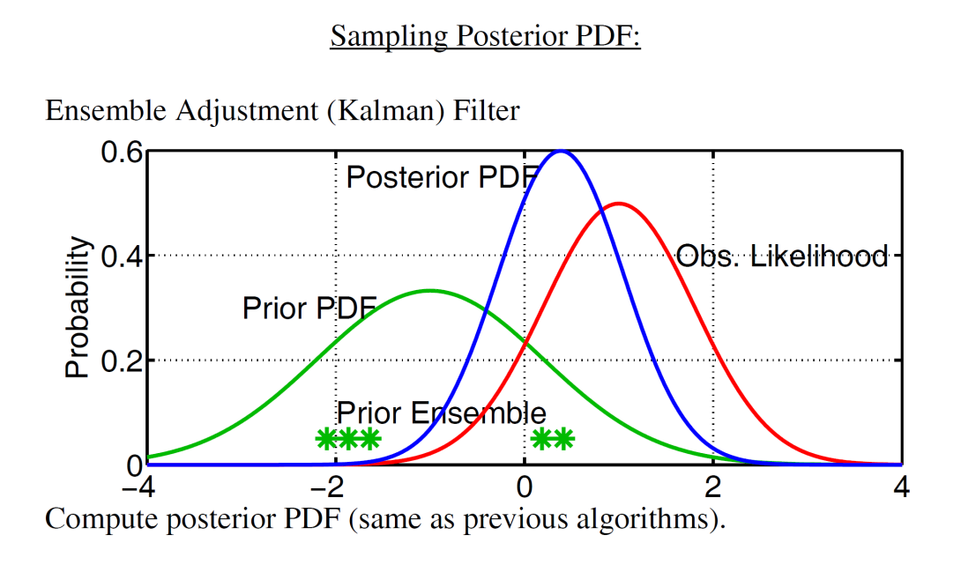
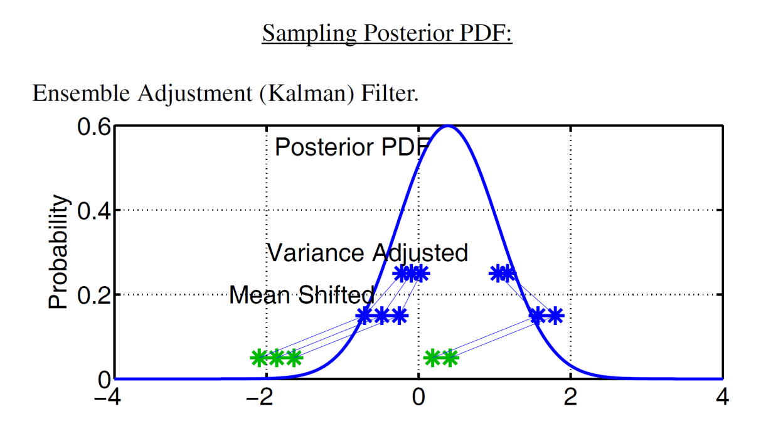
EAKF

Slide 35
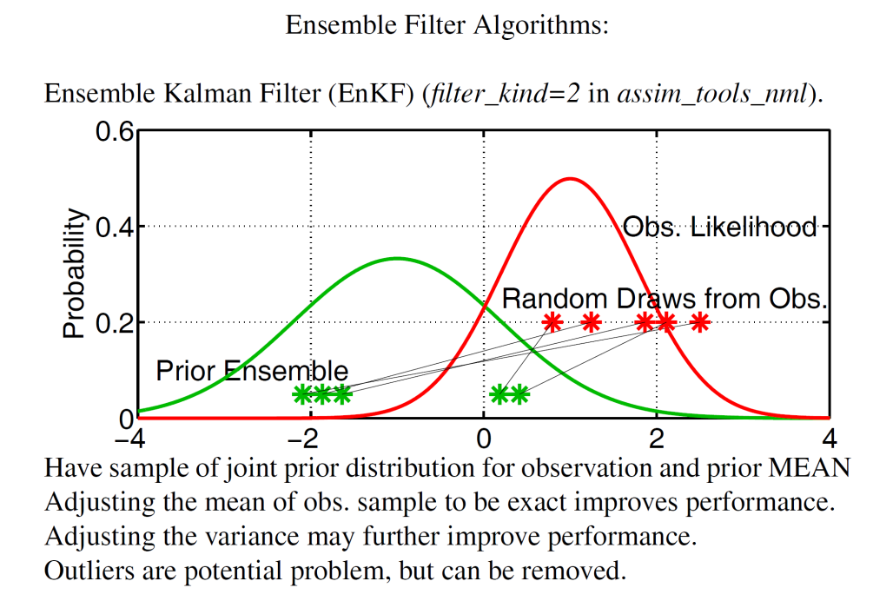
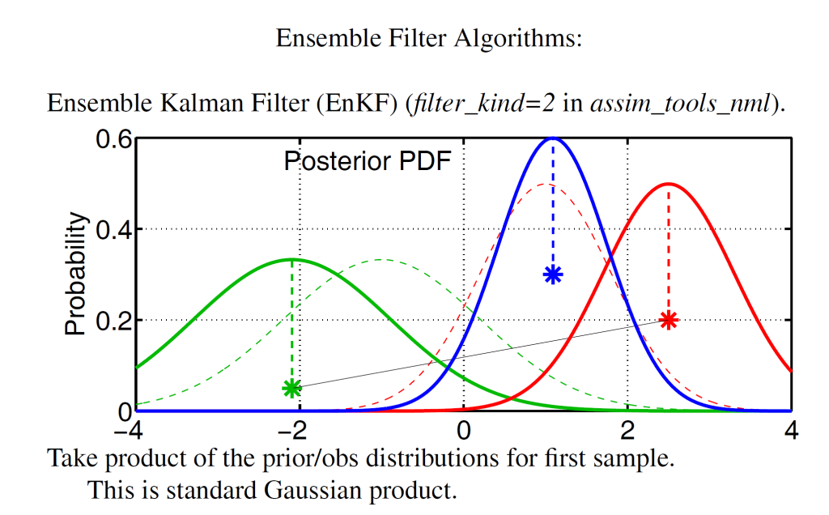
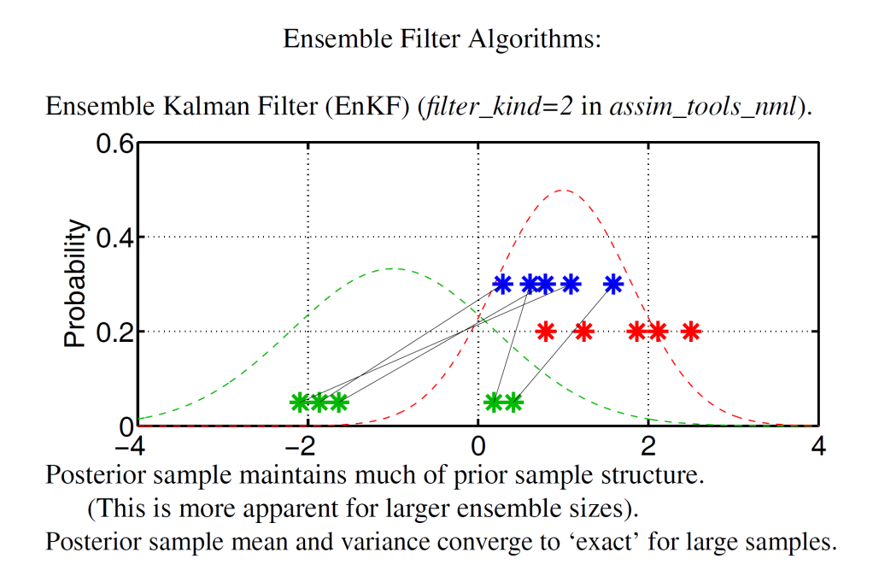

Slide 37
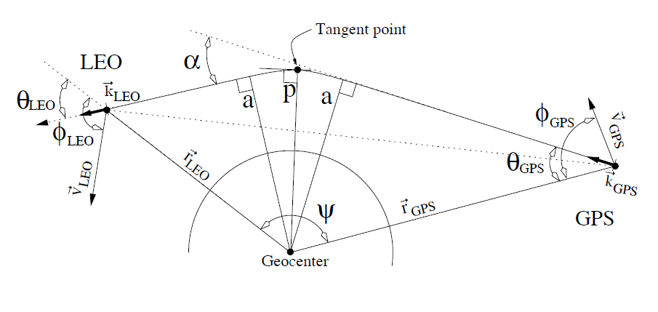
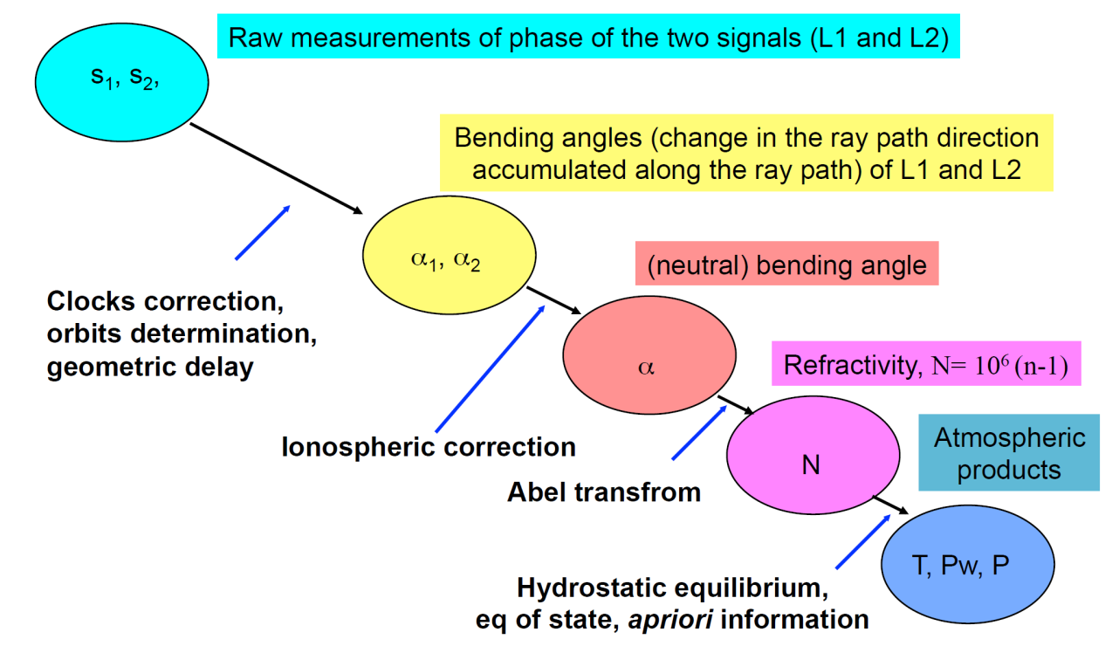
GPS RO

