Slide 1
Water Budget of Typhoon Nari (2001)
報告人 : 鍾宜娟
指導教授 : 楊明仁老師
Yang, M.-J.*, S. A. Braun, and D.-S. Chen, 2011: Water budget of Typhoon Nari (2001). Mon. Wea. Rev., 139, 3809-3828, doi: 10.1175/MWR-D-10-05090.1. (SCI)

Slide 2
Outline
Introduction
Key word
Model description
Method
Result
a. Water vapor budget
b. Condensed water budget
c. Vertically integrated sources and sinks
d. Volume-integrated budgets
e. Precipitation efficiencies
Conclusion

Slide 3
introduction
Although there have been many observational and modeling studies of tropical cyclones (TCs), the understanding of TCs’ budgets of vapor and condensate and the changes of budgets after TCs’ landfall is still quite limited.
Analyse the MM5 output from YZH(2008) with high spatial and temporal resolutions(2-kmhorizontal grid size and 2-min output interval).
Object 1:To investigate the evolution of the water vapor, cloud,
and precipitation budgets during Nari’s landfall on Taiwan.
Object 2: To understand what portions of the heavy rainfall from Nari
were produced in situ, and what portions of rainfall
were produced by moisture transported from the
surrounding oceanic environment.
Object3: To examine whether the precipitation efficiency is indeed
increased after Nari’s landfall

Slide 4
Outline
Introduction
Key word
Model description
Method
Result
a. Water vapor budget
b. Condensed water budget
c. Vertically integrated sources and sinks
d. Volume-integrated budgets
e. Precipitation efficiencies
Conclusion

Slide 5
Key words
HFC / VFC
HFC (horizontal flux convergence):
VFC (vertical flux convergence):
Warm rain process / cold rain process
Samll Drops
Large Drops
Vapor
Rain
Ice crystal
Snow/
Graupel

Slide 6
Outline
Introduction
Key word
Model description
Method
Result
a. Water vapor budget
b. Condensed water budget
c. Vertically integrated sources and sinks
d. Volume-integrated budgets
e. Precipitation efficiencies
Conclusion

Slide 7
Model description
A nonhydrostatic version of the PSU–
NCAR MM5 model. (version 3.5)
Quadruply nested grid (54, 18, 6, and 2
km)domains.
0000UTC 16 September 2001 ~
0000UTC 19 September 2001
high-resolution model output from a cloud-resolving simulation
＊2-km horizontal grid size
＊(x, y, σ) : 271 ×301 × 32 grid points
＊Covering area : 540 km × 600 km
＊IC and BC : Output of the 6-km grid
＊3-ice microphysics scheme
Notes:
Nari 登陸時間~9/16 1300UTC(台灣時間約晚上九點)
The 2-km grid is run separately for 84 h with initial and boundary conditions provided from the outputs of 6-km grid
(obtained by running the triply nested domains separately (54, 18, and 6 km).)
----mainly to increase computational efficiency
32 σ levels in the vertical.
(model top:50hPa ; Higher resolution in PBL)
54,18,6-km grids -- integrated in a two-way
interactive mode for 84 h.
2-km grid -- run separately for 84 h.
The simple liquid–ice microphysics scheme used
herein is referred to as 3-ICE. (In GSR2004 this scheme
was referred to as ‘‘Li.’’) 3-ICE was chosen primarily
because of its similarity to the LFO83-like schemes that
are currently used in storm-scale forecast models such
as ARPS, WRF, and RAMS. The purpose of using a
simple microphysics scheme is to demonstrate some of
its limitations and motivate the use of more sophisticated
schemes.
http://journals.ametsoc.org/doi/pdf/10.1175/MWR2810.1

Slide 8
Model description
Ocean stage: 13–14 h
(0100–0200 UTC 16 September 2001)
landfall stage: 23.5–24.5 h
(1130–1230 UTC 16 September 2001)

Slide 9
Simulated structures (Ocean stage)
Vr=-26m/s
Ocean stage: 13–14 h
Quasi-axisymmetric structure
Color shading
--time-averaged (13–14 h)
simulated radar reflectivity.
Contour in (a) and (d)
--storm-relative radial
velocities
Vr=14m/s
Contours in (b) and (c)
--vertical velocities

Slide 10
Simulated structures (Ocean stage)
The A1B1 cross section
Color shading in(a),(c)
--time-averaged (13–14 h)
simulated radar reflectivity.
Thick contour in (a),(b)
-- vertical velocity
Blue shading in(b)
--cloud water mixing ratio
Thin contours in (b)
--cloud ice mixing ratio
Contours in (c)
--storm-relative radial
velocity.

Slide 11
Simulated structures (Ocean stage)
R=20km
Z=13km
R=60km
ql>0.01 g/ kg
Z=10km

Slide 12
Simulated structures (Land stage)
Land stage: 23.5~24.5h
Asymmetry structure
-- Taiwan’s steep terrain

Slide 13
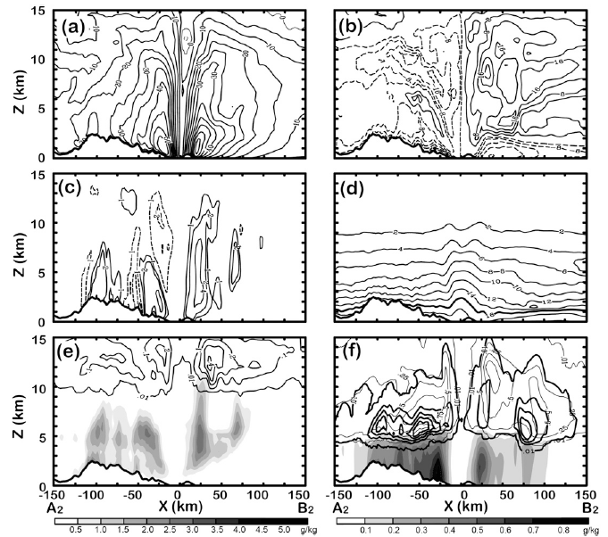
Simulated structures (Land stage)
Vt=55m/s
Vt=60m/s
The A2B2 cross section
qv>16g/kg

Slide 14
Simulated structures (Land stage)
Vt=57m/s
Vt=49m/s
The C2D2 cross section
qv>19g/kg

Slide 15
Outline
Introduction
Key word
Model description
Method
Result
a. Water vapor budget
b. Condensed water budget
c. Vertically integrated sources and sinks
d. Volume-integrated budgets
e. Precipitation efficiencies
Conclusion

Slide 16
Budget formulation
Cylindrical coordinates (r, λ, z)
TC center:
over ocean: the center of minimum sea level pressure.
over land: the primary vortex circulation center at 4-km altitude.
Definitions of averages:
temporal and azimuthal mean:
time-averaged and vertically integrated
time-averaged, volumetrically integrated amount:

Slide 17
Budget formulation
＊Governing equations for
Water vapor (qv):
Cloud (qc):
Precipitation (qp):
qv : water vapor mixing ratio
qc: cloud mixing ratio
qp: precipitation mixing ratio
V’: horizontal air motion
W: vertical air motion
VT: hydrometeor terminal velocities
Notes:
(qc=ql+qi)
(qp =qr + qs + qg)
Numerical diffusion is a difficulty with computer simulations of continua (such as fluids) wherein the simulated medium exhibits a higher diffusivity than the true medium. This phenomenon can be particularly egregious when the system should not be diffusive at all, for example an ideal fluid acquiring some spurious viscosity in a numerical model.
http://en.wikipedia.org/wiki/Numerical_diffusion

Slide 18
Outline
Introduction
Key word
Model description
Method
Result
a. Water vapor budget
b. Condensed water budget
c. Vertically integrated sources and sinks
d. Volume-integrated budgets
e. Precipitation efficiencies
Conclusion

Slide 19
a. Water vapor budget (over ocean)
Condensation/deposition
HFC
Evaporation/sublimation
VFC
net microphysical sink term
total vapor flux convergence

Slide 20
a. Water vapor budget (over ocean)
Boundary layer source/
vertical diffusion term
Divergence term

Slide 21
a. Water vapor budget (after landfall)
Condensation
HFC
Evaporation
VFC
Net condensation
total vapor flux convergence

Slide 22
a. Water vapor budget (after landfall)
Boundary layer source
/vertical diffusion term
Divergence term

Slide 23
Outline
Introduction
Key word
Model description
Method
Result
a. Water vapor budget
b. Condensed water budget
c. Vertically integrated sources and sinks
d. Volume-integrated budgets
e. Precipitation efficiencies
Conclusion

Slide 24
b. Condensed water budget (ocean)
Sources and sinks of rain, graupel, and snow.
source
sink
Rain
Graupel
Snow

Slide 25
b. Condensed water budget (ocean)
Net condensation
Precipitation
fallout term
HFC
Precipitation +
total flux convergence
VFC
Boundary layer source
/vertical diffusion term

Slide 26
b. Condensed water budget(after landfall)
Net microphysical source
HFC
Precipitation fallout term
VFC
Precipitation + HFC+VFC

Slide 27
Outline
Introduction
Key word
Model description
Method
Result
a. Water vapor budget
b. Condensed water budget
c. Vertically integrated sources and sinks
d. Volume-integrated budgets
e. Precipitation efficiencies
Conclusion

Slide 28
c. Vertically integrated sources and sinks
Over ocean
Landfall stage
condensation
evaporation
Precipitation
fallout

Slide 29
c. Vertically integrated sources and sinks
Over ocean
Landfall stage
Total rain source
Warm rain source
Cold rain source

Slide 30
Outline
Introduction
Key word
Model description
Method
Result
a. Water vapor budget
b. Condensed water budget
c. Vertically integrated sources and sinks
d. Volume-integrated budgets
e. Precipitation efficiencies
Conclusion

Slide 31
d. Volume-integrated budgets
The inner core (R=0~R=50 km)
the outer rainband region (R=50~R=150 km)
All values are normalized by the storm-total condensation.
87.8％
HFC=46.9
5.5 ％
15 ％

Slide 32
d. Volume-integrated budgets
Storm-total condensation is increased approximately 22%. (within a 150-km radius)

Slide 33
d. Volume-integrated budgets
21.9
37.4

Slide 34
Outline
Introduction
Key word
Model description
Method
Result
a. Water vapor budget
b. Condensed water budget
c. Vertically integrated sources and sinks
d. Volume-integrated budgets
e. Precipitation efficiencies
Conclusion

Slide 35
e. Precipitation efficiencies
The cloud microphysics precipitation efficiency (CMPE)
--Define the efficiency from a “microphysical perspective”.
(Total precipitation)
(Total condensation)
The large-scale precipitation efficiency (LSPE)
--Define the efficiency from a “large-scale vapor budget perspective.”
(Total precipitation)
(Total vapor transport into a large-scale area)

Slide 36
e. Precipitation efficiencies
73％
67％

Slide 37
Outline
Introduction
Key word
Model description
Method
Result
a. Water vapor budget
b. Condensed water budget
c. Vertically integrated sources and sinks
d. Volume-integrated budgets
e. Precipitation efficiencies
Conclusion

Slide 38
Conclusions
＊ For the vapor budget
While Nari is over the ocean
Evaporation from the ocean surface is 11% of the inward horizontal vapor transport within a 150-km radius.
The net horizontal vapor convergence into the storm is 88% of the net
condensation.
After landfall
The net horizontal vapor convergence into the storm within 150 km is increased to 122% of the net condensation.
＊ For the condensed water budget
While Nari is over the ocean
Precipitation particles are falling out as quickly as they are produced.
Warm rain processes dominate in the eyewall region, while the cold
rain processes are comparable outside of the eyewall.
After landfall
Taiwan’s steep terrain enhances Nari’s secondary circulation significantly
and produces stronger horizontal vapor import at low levels, resulting in a
22% increase in storm-total condensation.
Notes:
2.After landfall, Taiwan’s steep terrain enhances Nari’s secondary circulation significantly
and produces stronger horizontal vapor import at low levels, resulting in a 22% increase in storm-total
condensation.
3. Precipitation efficiency, defined from either the large-scale or microphysics perspective, is
increased 10%–20% over the outer-rainband region after landfall, in agreement with the enhanced surface
rainfall over the complex terrain.
1. Introduction
Malkus and Riehl (1960) indicated that the ratio of the
moisture source from the ocean to the net horizontal
import of moisture into a tropical cyclone (TC) was less
than 10%. Despite the small percentage, the ocean moisture
source plays an important role in the generation and
maintenance of

Slide 39
Conclusions
＊ Precipitation efficiency
Precipitation efficiency, defined from either the large-scale or
microphysics perspective, is increased 10%–20% over the outer-
rainband region after landfall, in agreement with the enhanced
surface rainfall over the complex terrain.

Slide 40
END

Slide 42
主要的結論
1.For the vapor budget, while Nari is over the ocean, evaporation from the ocean surface is 11% of the inward horizontal vapor transport within 150 km of the storm center, and the net horizontal vapor convergence into the storm is 88% of the net condensation. The ocean source of water vapor in the inner core is a small portion (5.5%) of horizontal vapor import, consistentwith previous studies.
2.After landfall, Taiwan’s steep terrain enhances Nari’s secondary circulation significantlyand produces stronger horizontal vapor import at low levels, resulting in a 22% increase in storm-total condensation.
3. Precipitation efficiency, defined from either the large-scale or microphysics perspective, is increased 10%–20% over the outer-rainband region after landfall, in agreement with the enhanced surface rainfall over the complex terrain.

Slide 43
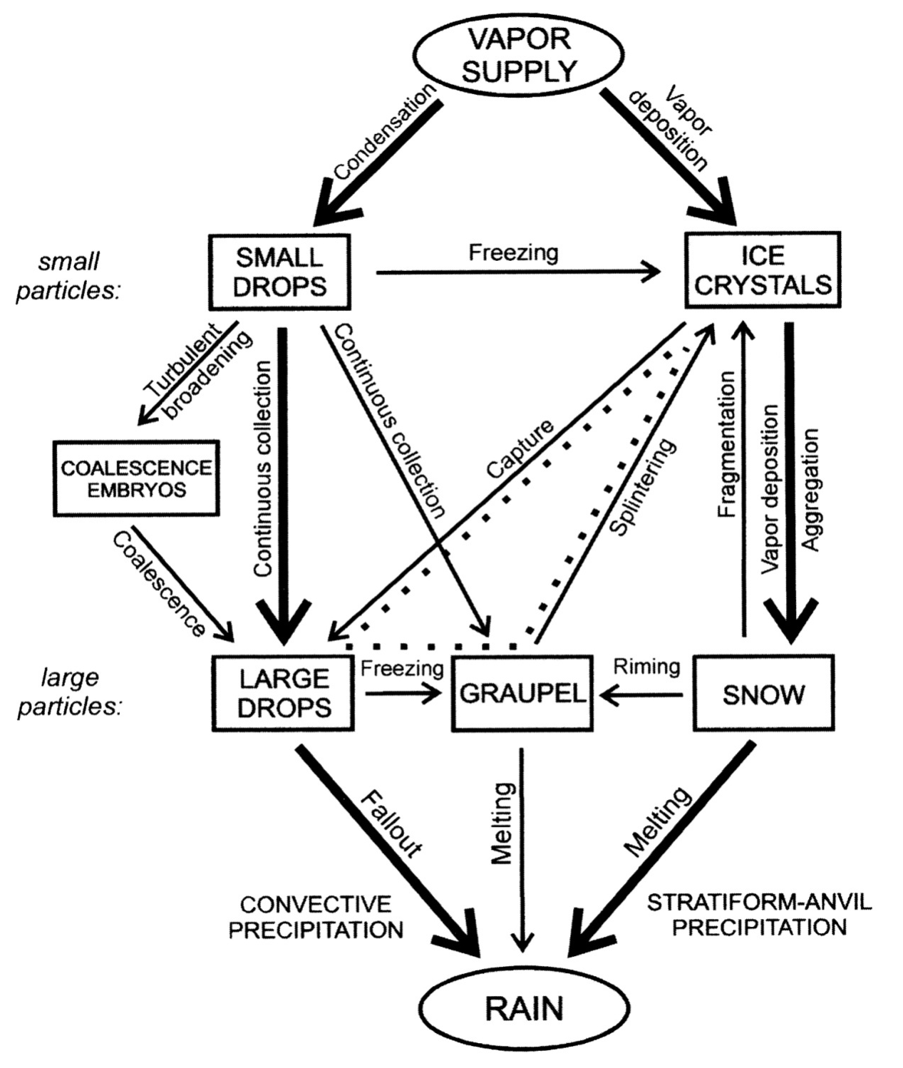
暖雲降雨過程
(warm-rain process)
冷雲降雨過程
(cold-rain process)
此示意圖取自Rutledge and Hobbs (1984)

