Slide 1
Momentum budget evolution of Typhoon Nari (2001) during the landfall process
Yang, M.-J., T.-C. Chen Wang, Y. Zhang, and C.-Y. Weng, 2011:
Momentum budget evolution of Typhoon Nari (2001)
during the landfall process. Terr., Atmos., and Oceanic
Sci., 22, 595–612, doi: 10.3319/TAO.2011.05.31.01(TM)

Slide 2
Outline
Keywords
Introduction
Methodology
Axisymmetric AAM and Radial momentum Budgets over ocean
Asymmetric AAM and Radial momentum Budgets over land
Conclusions

Slide 3
Keywords
Supergradient wind
Momentum budget

Slide 4
Supergradient wind
GWB model(Gradient-wind balance)
Coriolis force
Vg
centrifugal force
Pressure gradient
force
L
V>Vg
Notes:
http://ww2010.atmos.uiuc.edu/(Gh)/guides/mtr/fw/grad.rxml
Gradient Wind: A steady horizontal air motion along curved parallel isobars or contours in an unchanging pressure or contour field, assuming there is no friction and no divergence or convergence. A wind of greater speed than the gradient wind required by the existing pressure gradient and centrifugal force.
( http://encyclopedia2.thefreedictionary.com/supergradient+wind )
( http://www.superglossary.com/Definition/Weather/Gradient_Wind.html )
Gradient Wind. A wind induced in a certain direction by flow of air balancing the pressure gradient caused by the earth's rotation and centrifugal force
( http://en.mimi.hu/aviation/gradient_wind.html )
(其他在 “file：meeting paper reference” 裡面)

Slide 5
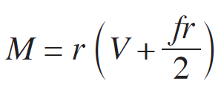
Momentum budget
Momentum = m * V
angular momentum = r * m * V
Absolute angular momentum (AAM,M)
Caused by earth rotation
Relate to earth
Equations will be discussed later.
The law of conservation of angular momentum states that when no external torque acts on an object or a closed system of objects, no change of angular momentum can occur.
Notes:
在絕對座標內
角動量，就如動量一般，是一個可用來表徵物體運動特徵的物理量。

Slide 6
Introduction
GWB assumption for the tangential wind has been widely used in theoretical studies for TCs.(Shapiro and Willoughby 1982; Emanuel 1986)
GWB model is a good approximation to the azimuthally-averaged tangential winds in the inner-core region for flows above the MBL and below the upper outflow layer.(La Seur and Hawkins 1963; Willoughby 1990, 1991)
Systematic GW unbalance flows in the eyewall, especially near the radius of maximum wind(RMW).(Gray and Shea 1973)
Utilizing AAM and radial momentum budget, Zhang indicated that both conclusions are correct for the levels of observations they analyzed.(Zhang et al. 2001)
These studies are only for marine TCs , and it remains unknown whether the GWB model is still applicable when a TC makes landfall, such as CMR in Taiwan.

Slide 7
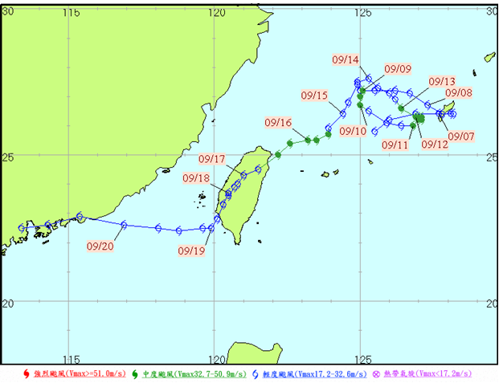
Case : Typhoon Nari(2001)
- Struck Taiwan on UTC 16 Sep.
- More than 1400mm/3days
92 death tolls.
(Sui et al. 2002)
Picture originated from CWB
Notes:
9/16: marine to land.

Slide 8
Objectives of the study
Investigate the evolution of tangential and radial flows of Nari during its landfall in Taiwan.(From more axisymmetric structure over ocean to asymmetric features over mountains. )
Understand the extent that GWB is still valid for a TC made landfall.
Gain insight and examine the physical mechanism responsible of the sloping midlevel radial flow over terrain.

Slide 9
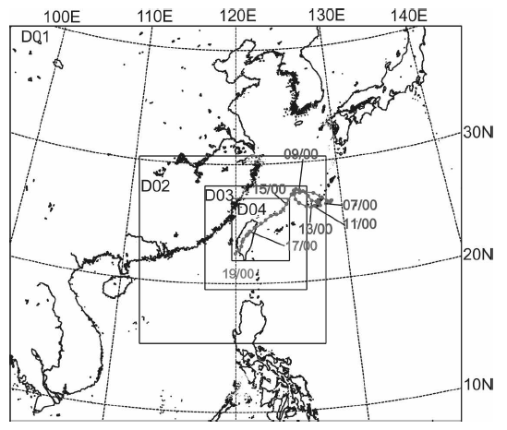
Methodology
PSU-NCAR MM5 model ver.3.5
Horizontal ：54 ,18, 6, 2km (quadruply nested-grid )
Vertical：32 σ levels (top= 50 hPa )
Time period : 1200 UTC 16 Sep. ~ 0000 UTC 19 Sep. (84 h)
SST is constant
I.C. and B.C. : ECMWF/TOGA (1.125°*1.125° horizontal resolution)
TC initialization : Davis and Low-Nam (2001)
Parameterization :
cumulus (Grell 1993)(54, 18 km)
microphysics( Reisner et al. 1998) with graupel included
PBL (MRF model)(Hong and Pan 1996)
atmospheric radiation(Dudhia1989)
Output interval : 2-min and 2-km
PSU-NCAR MM5 model ver.3.5
Notes:
governing eq. based on PSU-NCAR MM5 model (Dudhia 1993; Grell et al. 1995)
This study is high temporal and spatial resolution.

Slide 10
Methodology
Governing equation for radial and tangential wind
Radial Pressure
Gradient Force(PGFR; Up)
Centrifugal Force(UE)
Coriolis Force(Uc) Including The Effect of Vertical Motion
PBL Effects And Turbulent
Mixing(UTB)
(Residues)
Local tendency
Horizontal advection
Vertical advection
λ – azimuthal angle.
r – radius from TC center, pointing outward.
z – vertical height.
U – radial wind in cylindrical coordinate.
V – tangential wind in cylindrical coordinate.
W – vertical wind in cylindrical coordinate.
Tangential Pressure
Gradient Force(PGFR; Vp)
Centrifugal Force(VE)
Coriolis Force(Vc) including the effect of vertical motion
PBL Effects And Turbulence
Mixing(VTB)
(Residues)
Ω – angular velocity on the earth.
Ф – latitude.
U’ – storm relative radial wind.
V’ – storm relative tangential wind.

Slide 11
Lagrangian derivative of AAM equation
Caused by earth rotation
β – df/dФ
Vm – projections of U and V onto longitudinal axes.
Relate to earth’s rotation
Pressure Torque
Longitudinally-Oriented
Coriolis Torque By
The Vertical Motion
Beta Torque
Torque Due To The
PBL Effects And
Turbulent Mixing

Slide 12
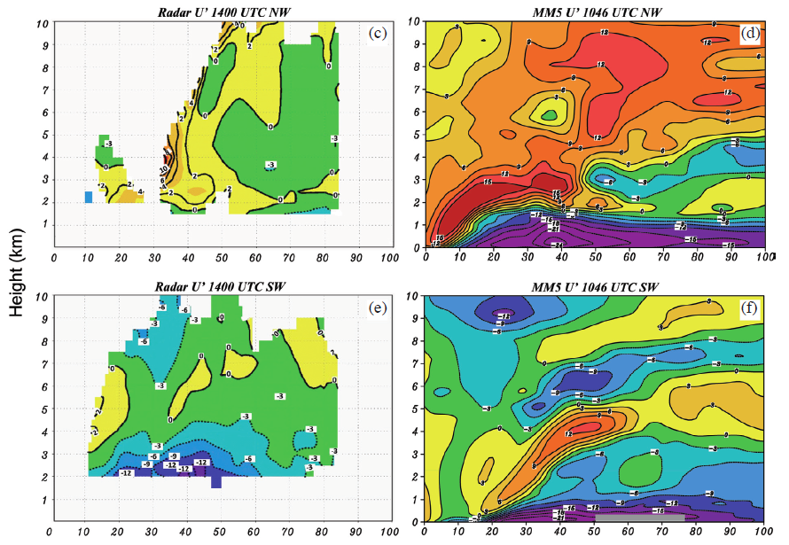
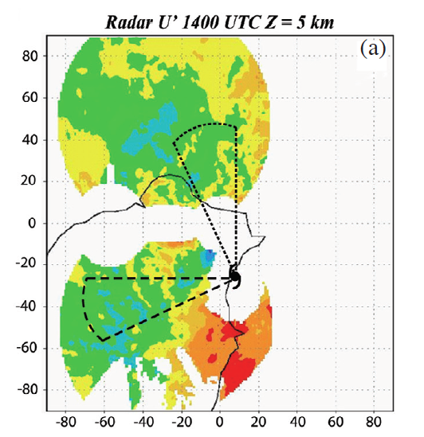
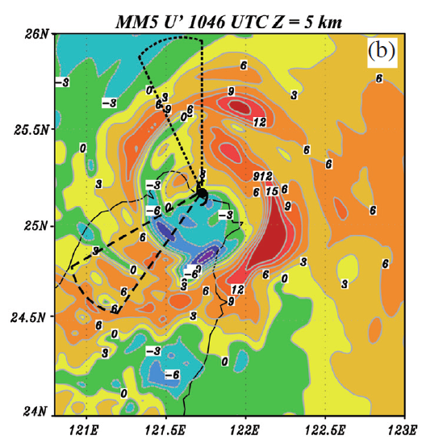
NW
NW
SW
SW
SW
For the different terrain imposed on
the simulated storm due to the landfall
position error.
Notes:
Time lag

Slide 13
Axisymmetric AAM and Radial momentum Budgets over ocean

Slide 14
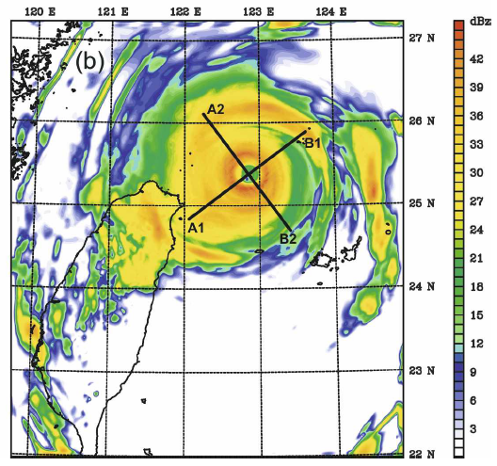
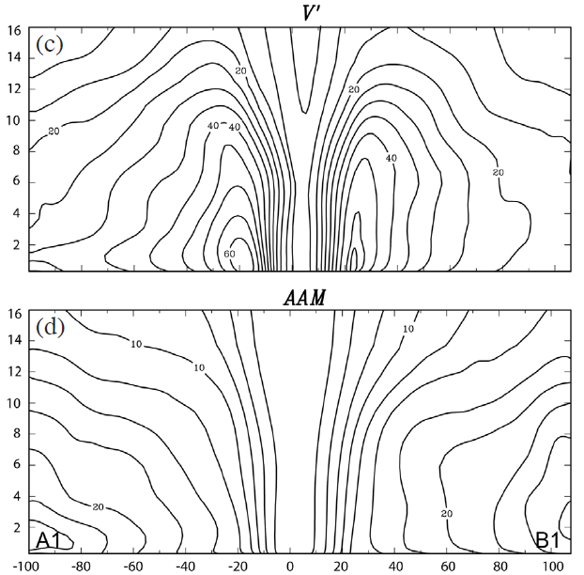
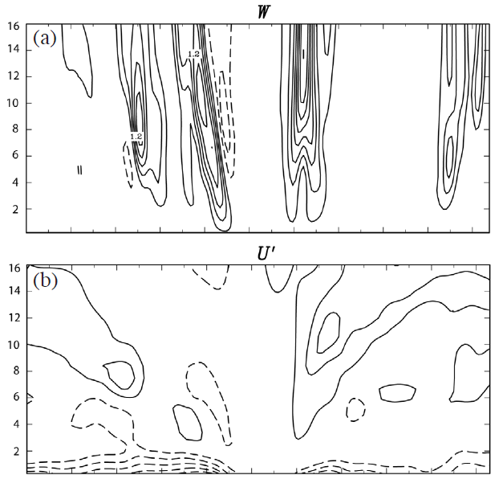
Oceanic Nari:0100-0200 UTC 16 Sep. 2001 (t=13-14h)
B1
A1
Less degree of asymmetry.
Solid: positive
(upward, outflow)
Dashed: negative
(downward, inflow)
NE: stronger and more upright.
SW: low level inflow stronger
and deeper.
A1
B1
Notes:
小時時間平均，A1B1剖面。
TC still at its developing stage. And some degree of asymmetry induced by storm’s internal dynamical process can be seen.

Slide 15
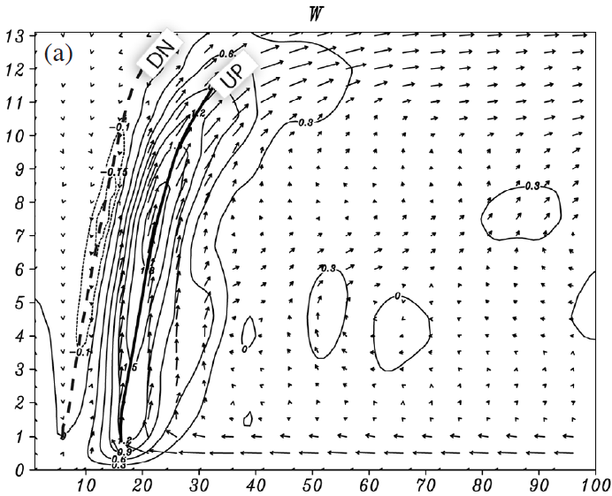
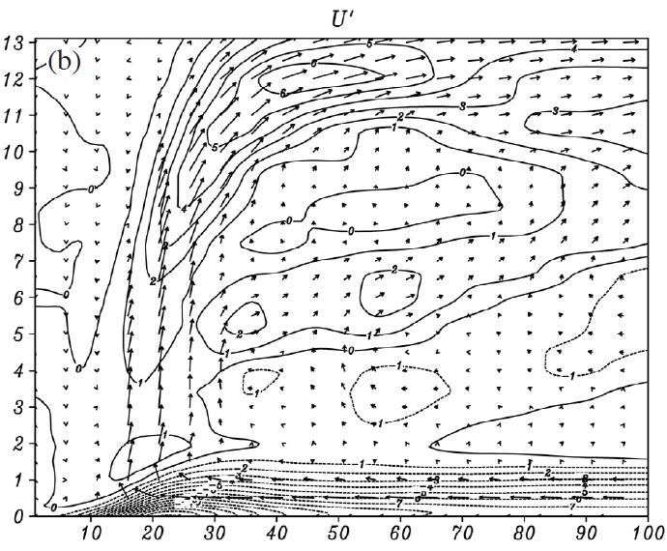
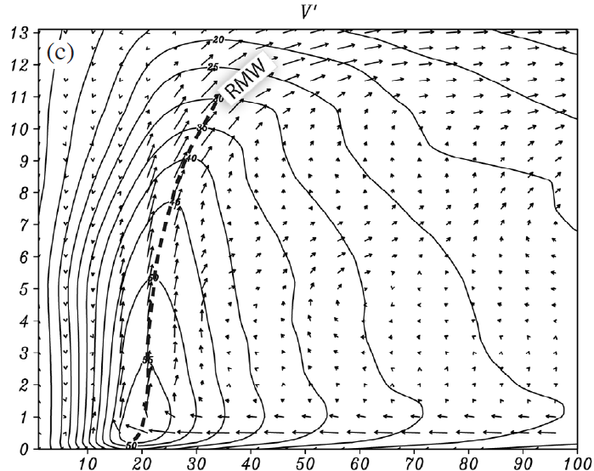
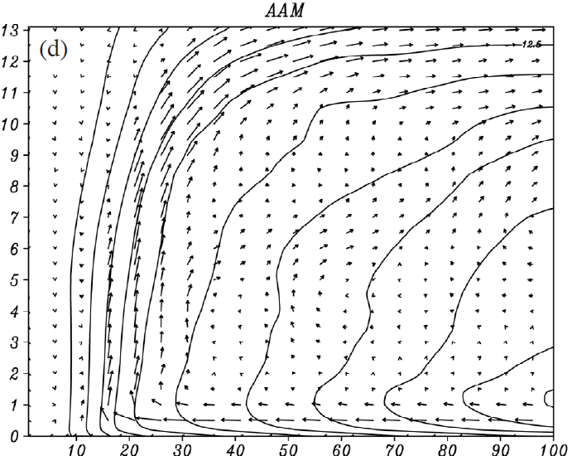
Oceanic Nari:0100-0200 UTC 16 Sep. 2001 (t=13-14h)
outflow
DN
wall :12km
eye
UP
inflow
wall
UP
RMW
Radial advection
MBL top: V’ max=57 m/s
MBL friction
Notes:
方位角、小時時間平均 kinetic and AAM field of Nari.
(c) Friction cause vertical (tangential??) wind shear? How? Where?

Slide 16
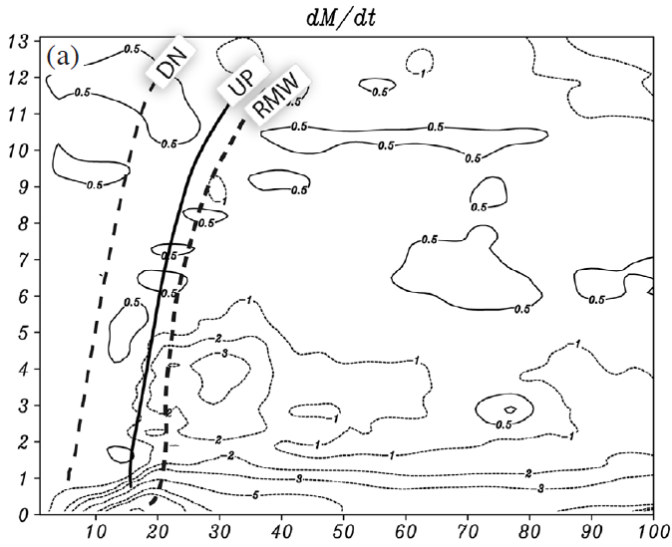
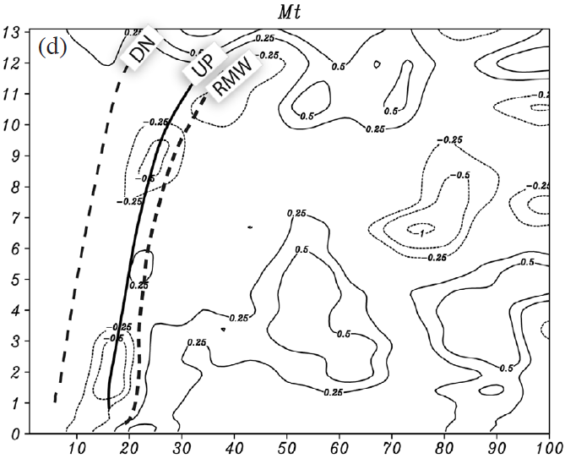
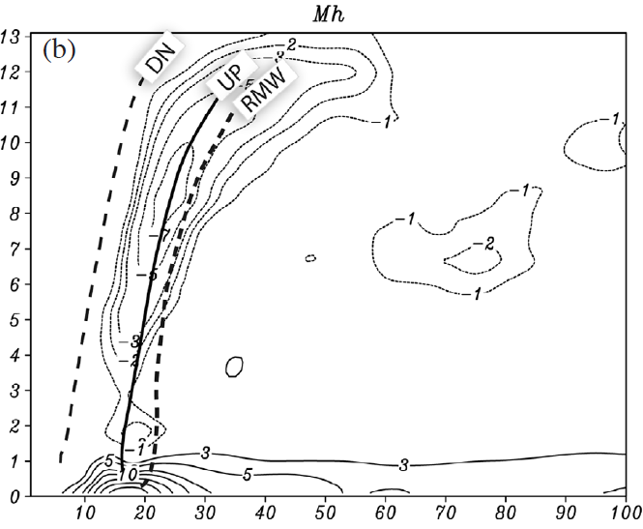
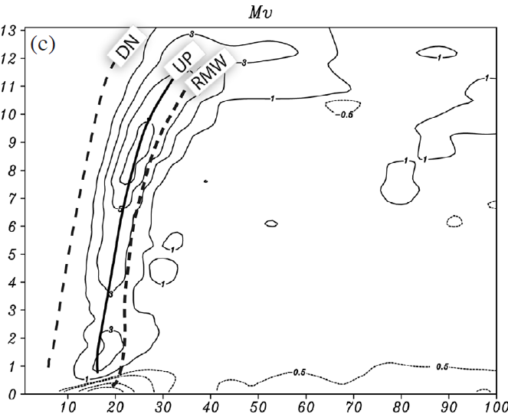
Oceanic Nari:0100-0200 UTC 16 Sep. 2001 (t=13-14h)
Solid: positive
(upward, inflow)
Dashed: negative
(downward, outflow)
AAM
Slightly
conserved
UP
Solid: positive (source)
Dashed: negative (sink)
Outward AAM
Upward AAM
Indicate a slow spindown of tangential wind inside the eye.
Inward AAM
AAM
Sink
Notes:
方位角、小時時間平均 AMM budget.
水平、垂直異號。

Slide 17
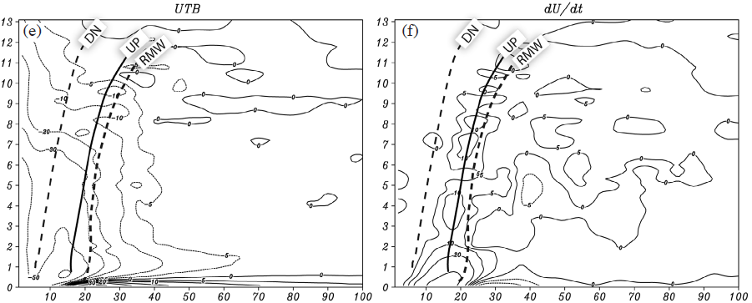
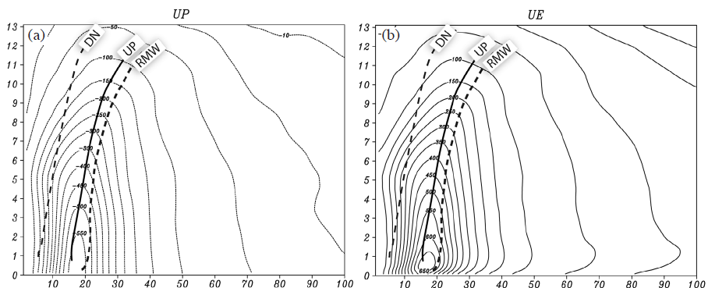
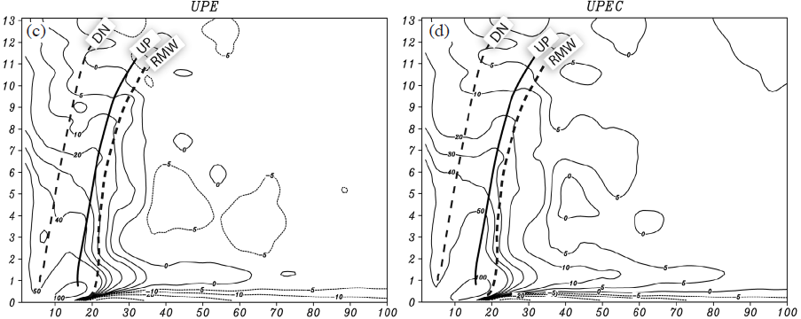
Oceanic Nari:0100-0200 UTC 16 Sep. 2001 (t=13-14h)
Outward
Up max
UP
SuperCyclostrophic
UE>Up
Supergradient-wind
UE>Up
Same structure as Up , opposite sign.
Same as gradient-wind imbalance
SubCyclostrophic
UE<Up
Subgradient-wind
UE<Up
Inward
Cyclostrophic imbalance
= Up+UE
Gradient –wind imbalance
= Up+UE +Uc
Solid: positive
Dashed: negative
Solid: positive (outward)
Dashed: negative (inward)
Notes:
方位角 、 小時時間平均
Radial momentum budget terms and the extent of different balanced-wind approximation since its on the sea.
Proof Zhang?

Slide 18
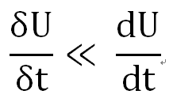
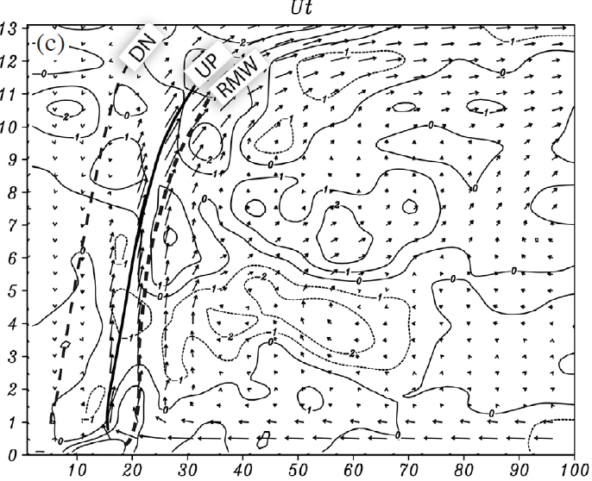
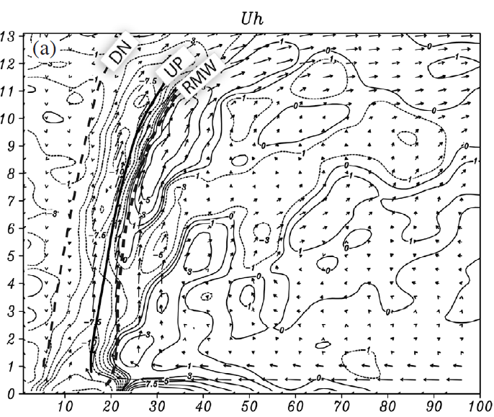
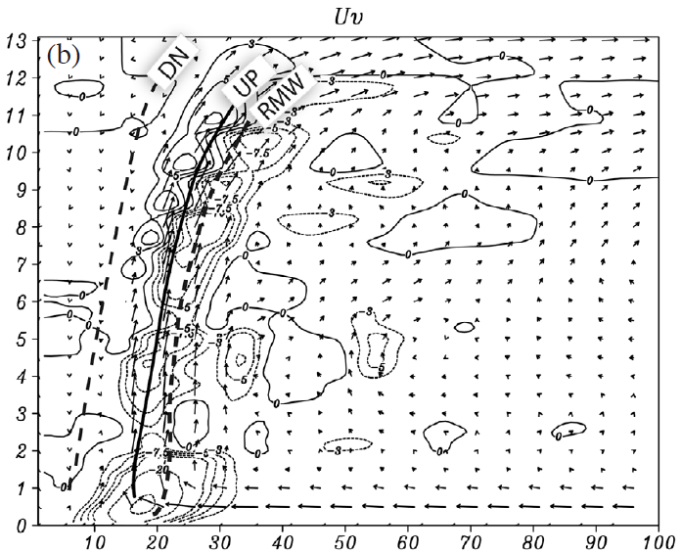
Oceanic Nari:0100-0200 UTC 16 Sep. 2001 (t=13-14h)
Solid: positive (outward)
Dashed: negative (inward)
Upper level:
outflow
In the wall : increase radial inflow
Below the up axis : slightly decrease radial outflow;
Above then increase.
Out of wall : decrease inflow
Strengthen upper level outflow
Low level from eye to wall :
further reduce the central pressure
Solid: positive (outward, upward )
Dashed: negative (inward, downward )
Notes:
方向角、小時時間平均。
Tendency << Lagrangian → Suggested that the oceanic Nari ‘s radial flow evolved very slowly during its intensifying stage.

Slide 19
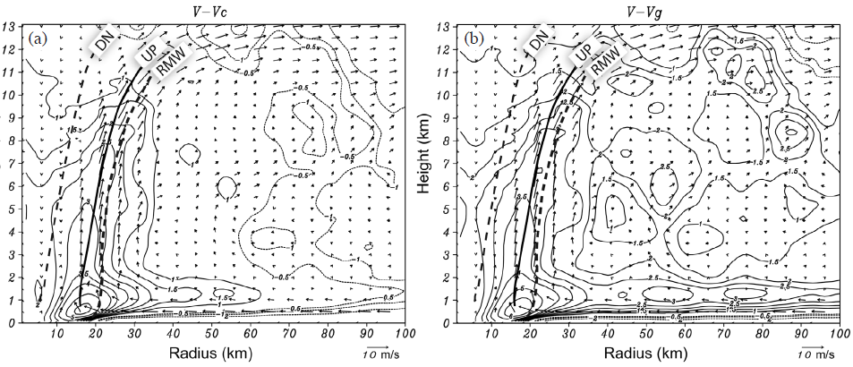
Oceanic Nari:0100-0200 UTC 16 Sep. 2001 (t=13-14h)
Supercyclostrophic wind
= 6 m/s
Supergradient wind
> 6 m/s
Subcyclostrophic wind
Subgradient wind
Acyclostrophic wind
= V-Vc
Agradient wind
= V -Vg
Notes:
方向角、小時時間平均。
非氣旋流、非梯度風。

Slide 20
Asymmetric AAM and Radial momentum Budgets over land

Slide 21
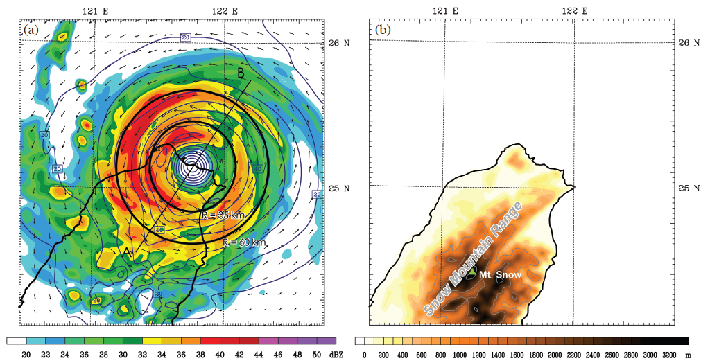
Landfall Nari:1000-1100 UTC 16 Sep. 2001 (t=22-23h)
B
30km
A
60km
Snow Mountain Range
Z=3 km
Contour – V’
Shaded – midlevel (σ =0.4~0.8) radar reflectivity (t=22.5 h)
Vector – horizontal wind (t=22.5h)

Slide 22
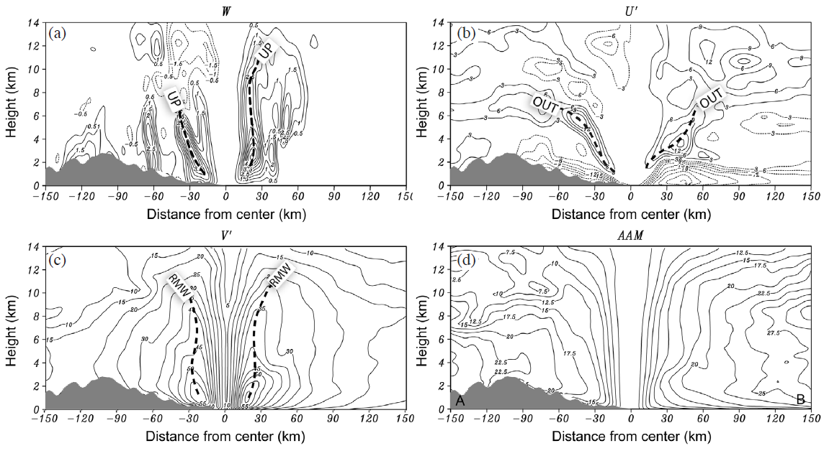
Landfall Nari:1000-1100 UTC 16 Sep. 2001 (t=22-23h)
Buckling height
Notes:
AB剖面 小時平均
Buckling height reduce the vertical gradient above the lower level , which occurs at a higher altitude in the outer region(r>40) over land than over the ocean. Indicating the rapid spindown of V due to the enhanced sfc.

Slide 23
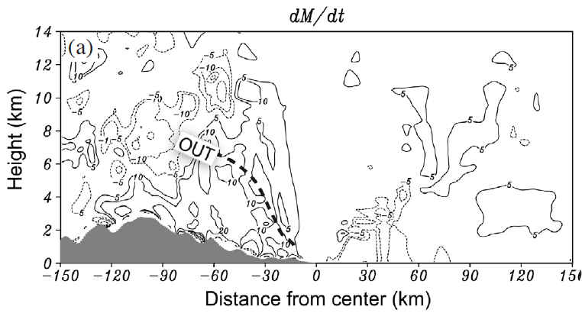
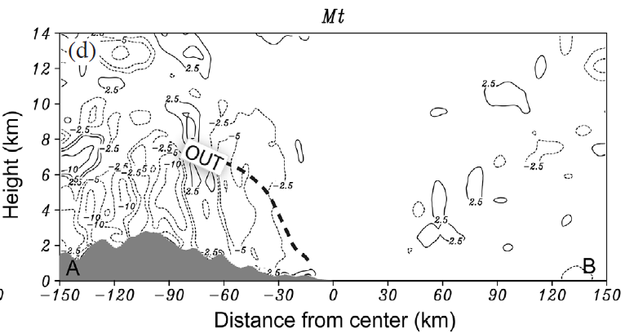
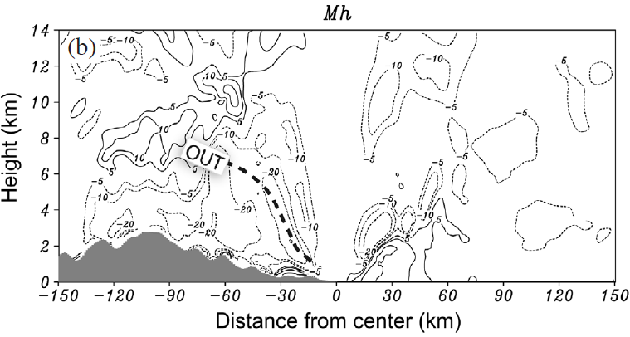
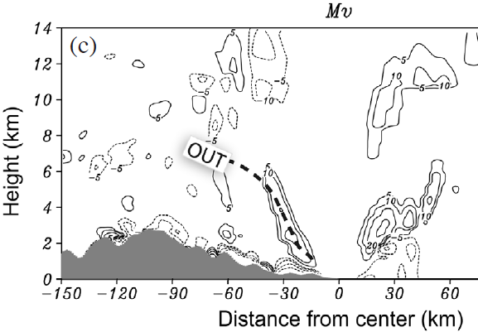
Landfall Nari:1000-1100 UTC 16 Sep. 2001 (t=22-23h)
(
) * M
Land: mostly negative.
Ocean: very small.
Notes:
AB剖面，小時時間平均。

Slide 24
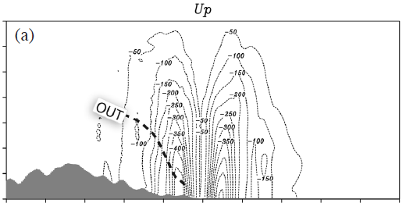
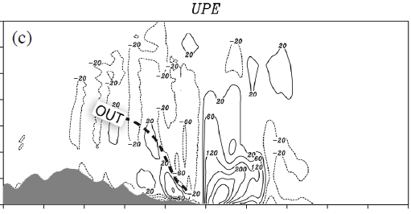
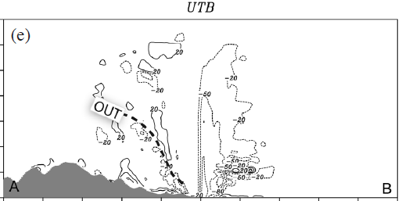
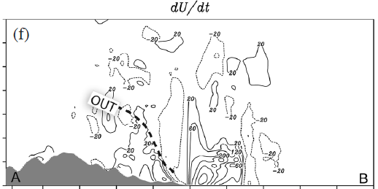
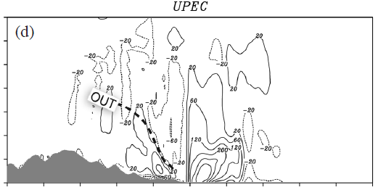
Landfall Nari:1000-1100 UTC 16 Sep. 2001 (t=22-23h)
Negative: inward.
Peak value decreased:
-500 m/s*h (ocean) → -450 m/s*h (land)
Supergradient wind
(UE>UP)
(stronger at off shore )
> 500 m/s
Solid: positive (outward)
Dashed: negative (inward)
> 800 m/s
Notes:
AB剖面。
UPEC(GW unbalance) is similar to UPE(cyclostrophic unbalance).
UTB –(< 0) by turbulence mixing in the eye (< 30 km)
dU/dt – low level slightlr outward (> 0 ); up level outward flow is decreased by UTB.

Slide 25
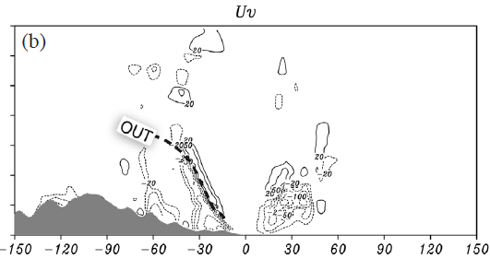
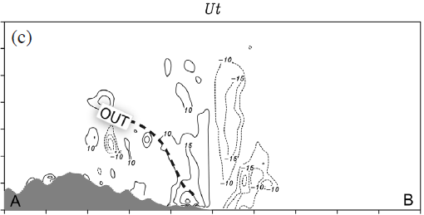
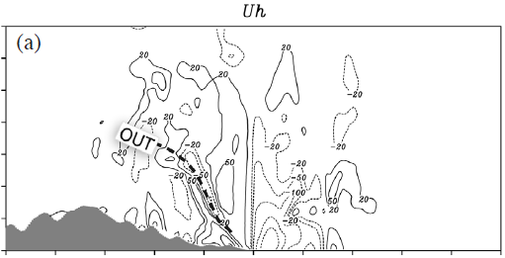
Landfall Nari:1000-1100 UTC 16 Sep. 2001 (t=22-23h)
Supergradient wind
Notes:
AB剖面。

Slide 26
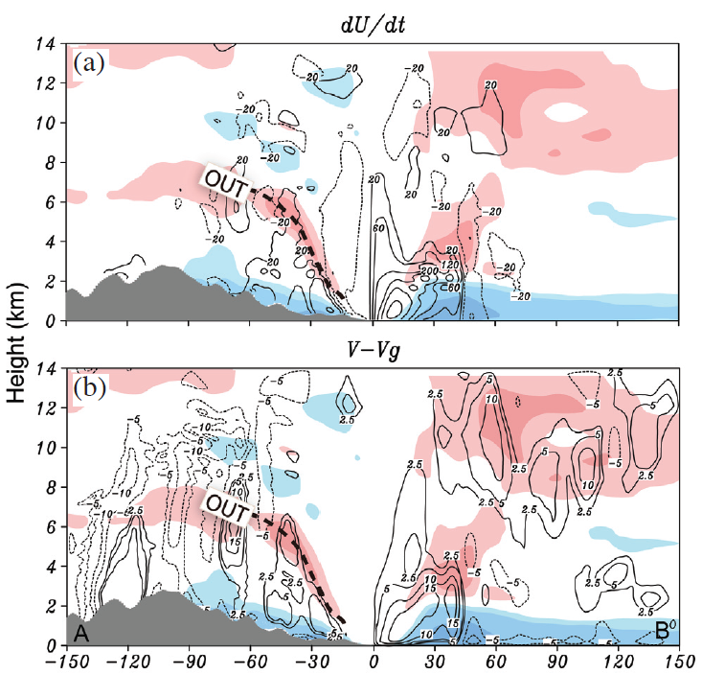
Landfall Nari:1000-1100 UTC 16 Sep. 2001 (t=22-23h)
Over ocean:
R < 40 km in eye
dU/dt >0 reduce the inward.
Over land:
Accompanied by the vertical
transport (outward).
Contour – dU/dt , V-Vg
solid(positive)
dashed(negative)
Shaded – U’
10 m/s
5 m/s
Over ocean:
In the eye
Strong supergradient wind
Upper outflow level
Weak supergradient wind
Over land:
Sub- and super- oscillation
15 m/s
Notes:
AB剖面。

Slide 27
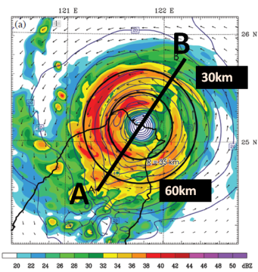
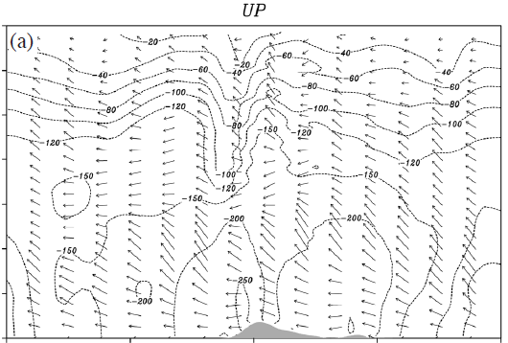
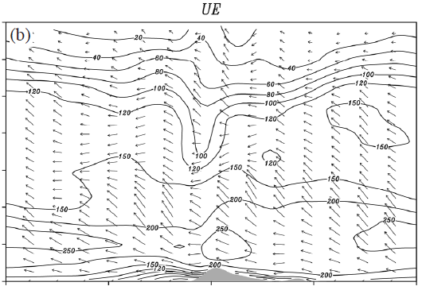
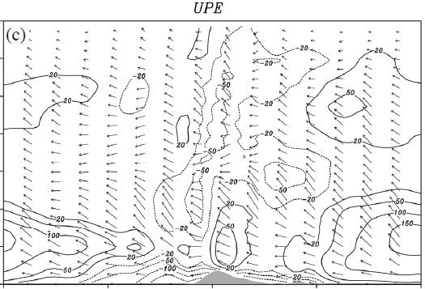
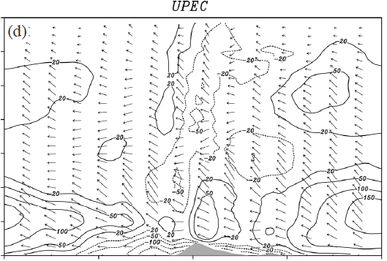
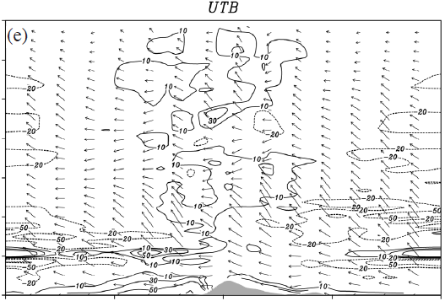
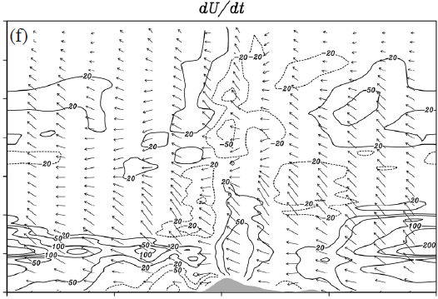
Landfall Nari:1000-1100 UTC 16 Sep. 2001 (t=22-23h), R=35km (large GW imbalance near eye.)
UTB works over the land than over the ocean (north).
Supercyclostrphic wind
(Since in th eye)
Similar to GW imbalance, but with fluctuation (turbulent mixing).
Supergradient wind
Notes:
R=35 km
UPEC is similar to UPE (since C acceleration is small.)

Slide 28
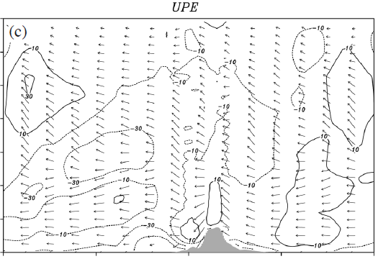
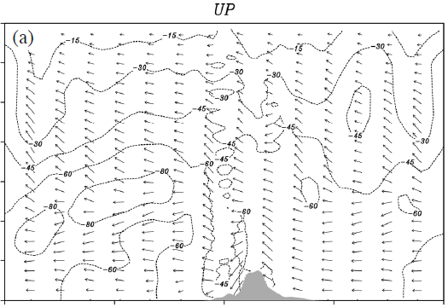
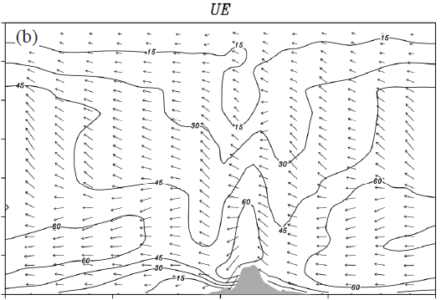
Landfall Nari:1000-1100 UTC 16 Sep. 2001 (t=22-23h), R=60 km (outer principal rainband.)
UTB works beneath PBL and over the terrain
→ retard radial inflow.
Similar to GW imbalance, but with fluctuation (turbulent mixing).
Only over the terrain and the rainband (NW) :
UE overcompensates UP (supergradient wind)
Notes:
R=60 km

Slide 29
Landfall Nari:1000-1100 UTC 16 Sep. 2001 (t=22-23h)
Contour – agradient wind
solid(positive), dashed(negative)
Shaded – U’
9 m/s
21 m/s
R=35 km
N Semicircle/
near the wall and mid-low level:
Strong supergradient winds (by terrain).
SE quadrant-
(lee side of Snow Mountain Range):
Subgradient winds at low level and lee
Side.
-24 m/s
6 m/s
R=60 km
North Semicircle:
Strong supergradient winds near the
wall and low level.
Southeastern quadrant
(lee side of Snow Mountain Range):
Strong subgradient winds lee Side.
-24 m/s

Slide 30
Conclusions

Slide 31
 | Oceanic Nari | Landfall Nari
AAM Budget | Conserved: outside the eye, above MBL. Sink: Eye, MBL.
Tangential wind Budget
Radial wind Budget | Supergradient wind (UE(V)>UP): the bottom of the eye to the upper outflow layer inside the eyewall.(Gray and Shea 1973) Subgradient wind (UE(V)<UP): Below the MBL outside the wall. | Low level inflow stronger and thicker. Outflow maximum over the terrain.
 |  | 35 km | Supergradient wind (UE(V)>UP): over the terrain. Subgradient wind (UE(V)<UP): Leeside the terrain.
 |  | 60 km | The same.
GWB’s validation | Below the outflow region and over MBL. (La Seur and Hawkins 1963; Willoughby 1990, 1991) | Invalid.
Leads to more quickly-evolved vortex flows and 2nd circulations above terrain.

Slide 32
Reference
CWB
氣象名詞查詢表 http://photino.cwb.gov.tw/rdcweb/lib/h/g_000853.htm
http://www.phy.ncu.edu.tw/notes/angular/purpose.htm
wikipedia :http://en.wikipedia.org/wiki/Angular_momentum
http://encyclopedia2.thefreedictionary.com/supergradient+wind
http://www.superglossary.com/Definition/Weather/Gradient_Wind.html
http://en.mimi.hu/aviation/gradient_wind.html

Slide 33
THANKS FOR YOUR ATTENTION.

Slide 37
Cyclostrophic Flow
Vc
centrifugal force
Pressure gradient
force
L

Slide 38
Domain | D1 | D2 | D3 | D4
Dimensions (x,y) | 81*71 | 100*100 | 166*166 | 271*301
Grid size (km) | 54 | 18 | 6 | 2
Area coverage(Km^2) | 4320*3780 | 1782*1782 | 990*990 | 540*660
Time step(s) | 90 | 30 | 10 | 3.3
Integration hours | 0-84 | 0-84 | 0-84 | 0-84

