Slide 1
A modeling study of Typhoon Nari (2001) at landfall. Part II: Structural changes and terrain-induced asymmetries.
Yang, M.-J., D.-L. Zhang, X.-D. Tang, and Y. Zhang,
J. Geophys. Res.
Notes:
納莉颱風在登陸前後的結構改變與地形所造成的不對稱性

Slide 2
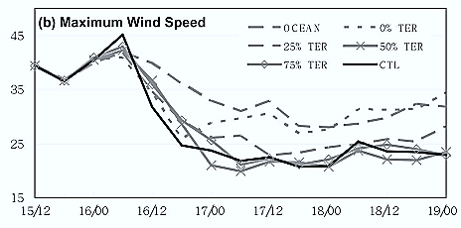
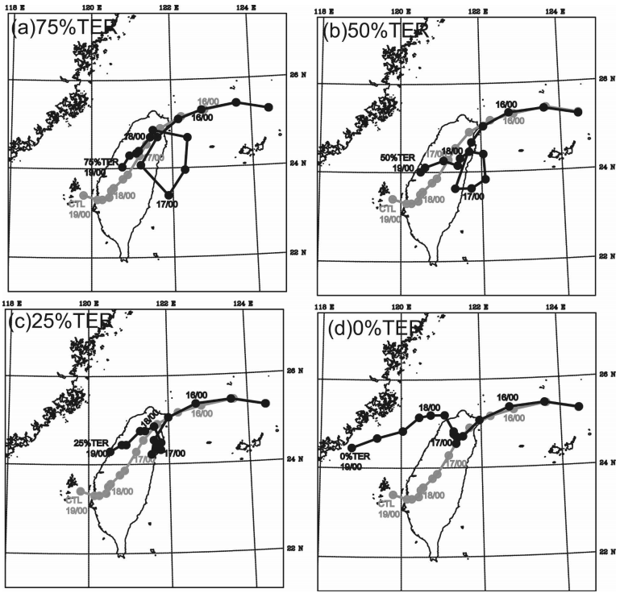
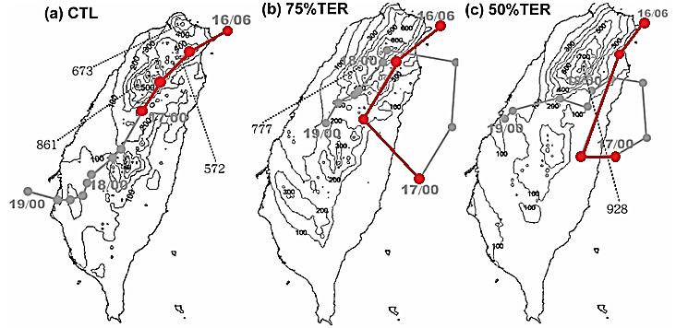
Part I
The effects of Taiwan topography on the track, intensity, and surface precipitation during the landfall of Nari.
Notes:
路徑：降低地形會在颱風登陸後造成非線性的路徑
強度：降低地形會使颱風在登陸後強度減弱
地面降水：較高的地形會造成較多的區域性降水，是受地形抬升影響
Not the corresponding 3-D structural changes.

Slide 3
Domain | D1 | D2 | D3 | D4
Duration | 9/15/2001 1200UTC ~ 9/19/2001 0000UTC
Dimensions (x,y) | 81*71 | 100*100 | 166*166 | 271*301
Grid size (km) | 54 | 18 | 6 | 2
Area coverage (km*km) | 4320*3780 | 1780*1782 | 990*990 | 540*600
Levels | 32 sigma (σ) levels
Time step (s) | 90 | 30 | 10 | 3.3
Integration hours | 0-84

Slide 4
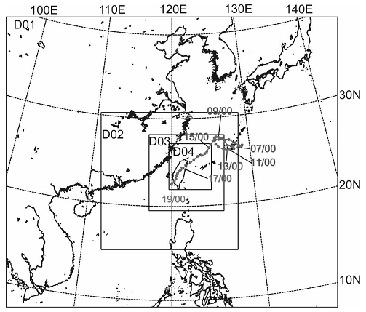
2km grid
Cylindrical coordinates
(r, θ, z)
B.C.: outputs of 6km grid
Notes:
Part II 是以D4的模擬呈現

Slide 5
14h
24h
30h
Ocean Stage
Partial Landfall Stage
Full Landfall Stage
Use minimum surface central pressure to determine the cyclone center.
Use vortex circulation center to determine the cyclone center.

Slide 6
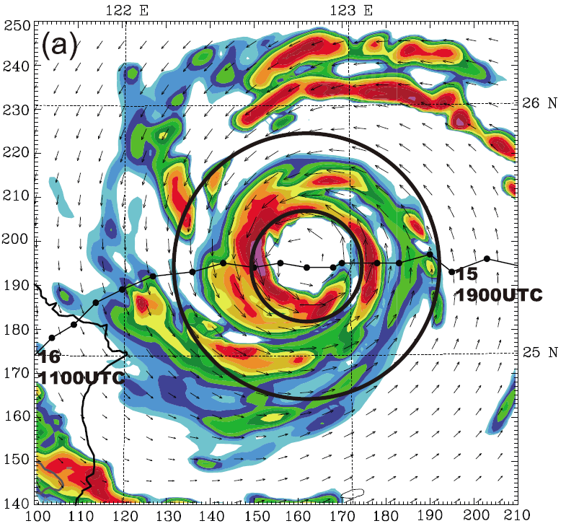
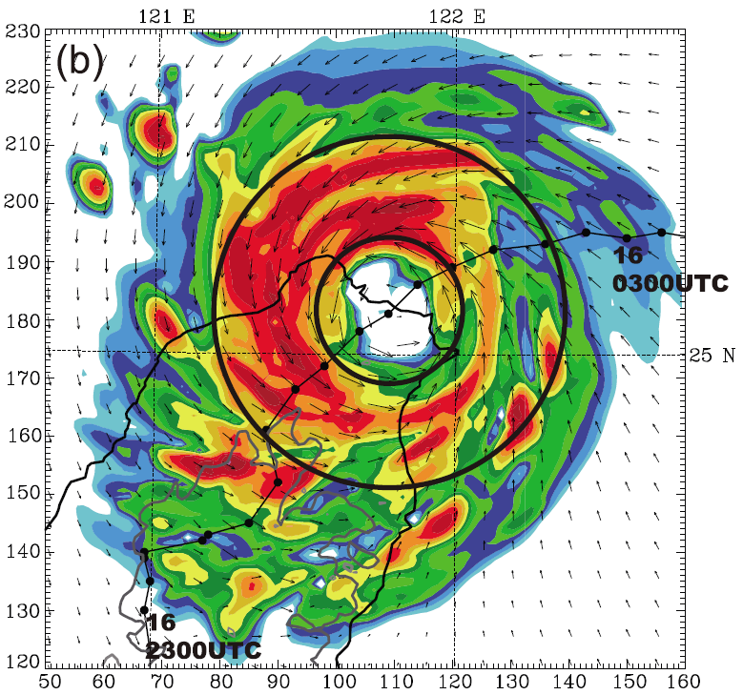
Topographic Effects on Landfall Structure
Notes:
Mean radar (中層 sigma=0.4~0.8), horizontal wind vector (底層 sigma=0.7~1)
眼縮小，雨量上升
登入後西北岸的降水增強（因為moist tangential flow被地形抬升，且造成颱風東南部較少降雨）

Slide 7
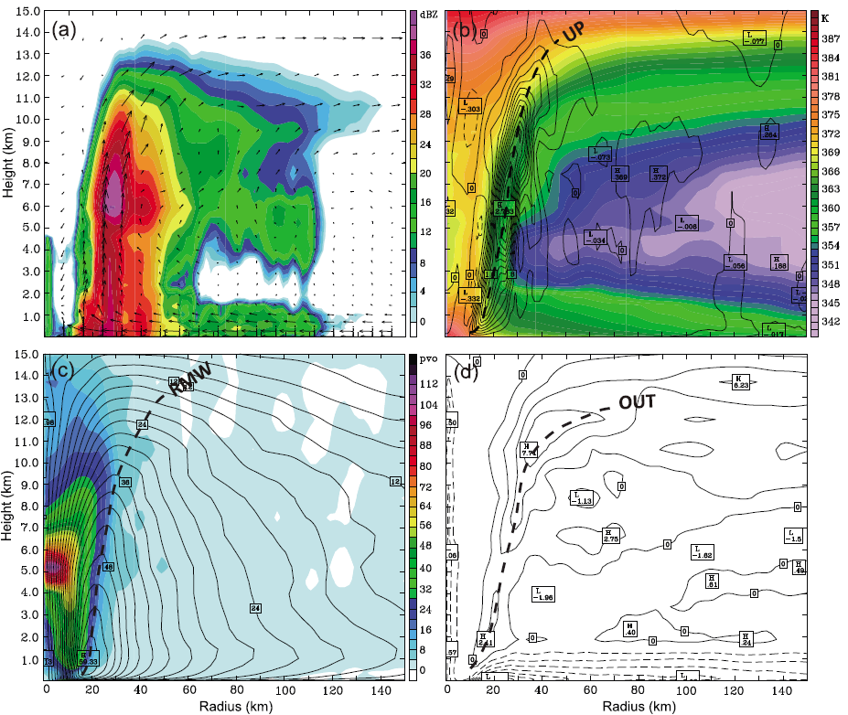
Notes:
CTL STRUCTURE (8h prior landfall)
Radar reflectivity : 強而直的上升氣流加強眼牆的雷達回波 (在許多研究都有類似的情形)
Vertical velocity & Equivalent potential temperature: 眼牆6km處有最大值3m/s，外側有較寬廣但較弱的上升氣流，眼的boundary layer有高相當位溫，外側區域4km處則最低
Tangential velocity & potential vorticity 最大風速在眼牆接近地面的地方，在眼內5km處有最大PV
Radial wind: 在低層1km處有強inflow, 7km處有maximum outflow

Slide 8
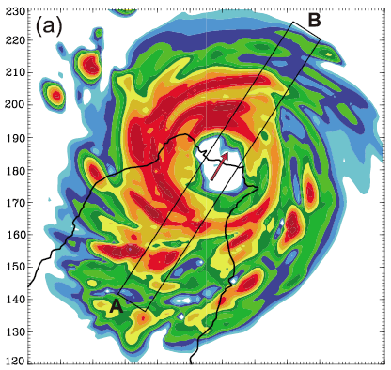
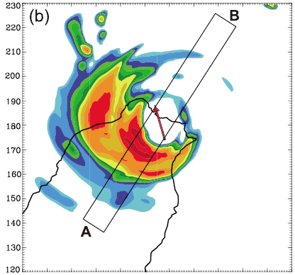
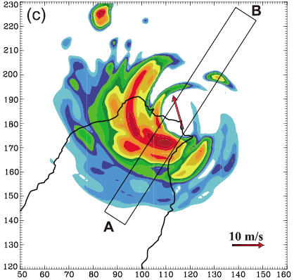
Full terrain
No terrain
Ocean
22h
21h
20h
Notes:
Midlevel mean (sigma=0.4~0.8) radar reflectivity, (a) full terrain(22h) (b) no terrain(21h) (c) ocean(20h)
Arrow: environmental shear vector between 200~850hPa within 200 km from the typhoon center
地形阻擋和地表摩擦會降低颱風的移速
Full terrain 的颱風眼最小，在眼牆會有強對流(以下會有cross section的圖)，且雨區最為寬廣（因強烈的水氣幅合以及地形激發的對流之氣旋式平流所造成之降雨）

Slide 9
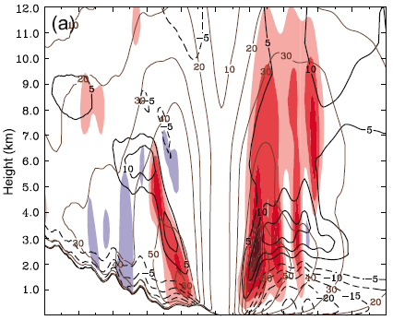
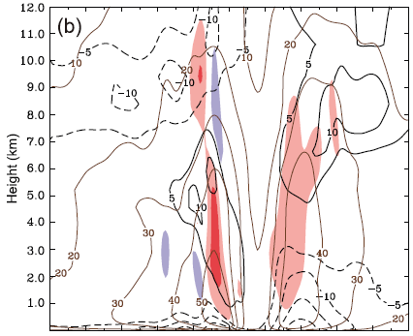
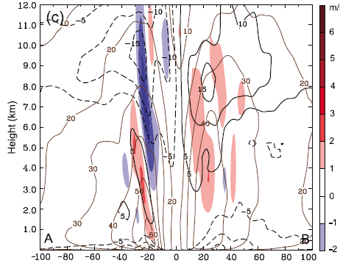
Full terrain
No terrain
Ocean
22h
21h
20h
Notes:
Vertical cross section (brown contour: tangential flow, black contour: radial flow, color: vertical velocity)
由上升速度明顯看出地形會加強對流(radial wind)
海面低層有強入流，使海面上的眼牆能發展較深較強。
有地形的部分眼牆傾斜，而眼牆的tilt與outflow的傾斜有關。Outflow將inner core的水氣往外帶使雨區增大
登陸時tangential wind減弱 (但沒有比去地形還弱，說明地形可能會增強tangential wind，而減弱的原因或許是因為摩擦力)

Slide 10
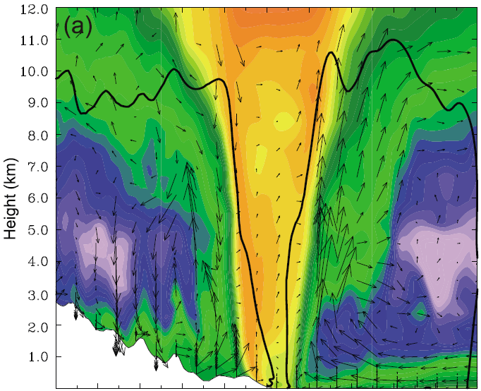
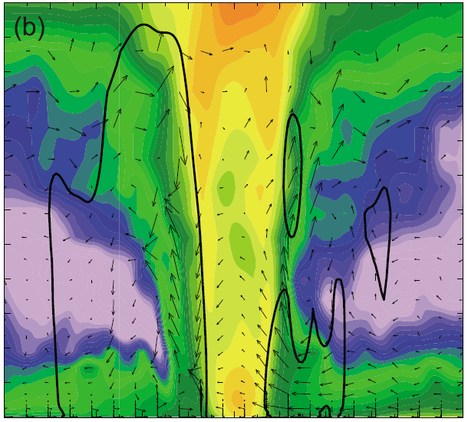
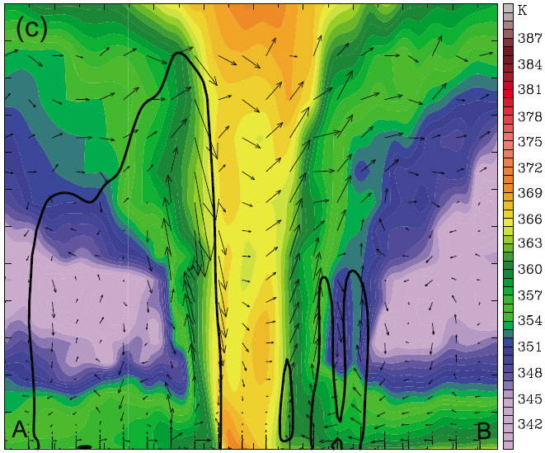
Full terrain
No terrain
Ocean
22h
21h
20h
Notes:
Vertical cross section (color: equivalent potential temperature, Bold outline: 20dBZ radar)
右側海面上的深對流使次環流較明確，而左側地形上方則因為上升下沉氣流傾斜，因此次環流也向外傾斜
根據No-terrain和ocean的敏感度測試結果，除了海水能夠提供水氣，因此ocean模擬出的相當位溫比no-terrain還高，但其他結構都較為相似，其二者的次環流結構也較為類似
而20dBZ的等值線也使我們再次確認地形會使降雨區擴大
左側的下沉氣流把中層的低相當位溫往下帶

Slide 11
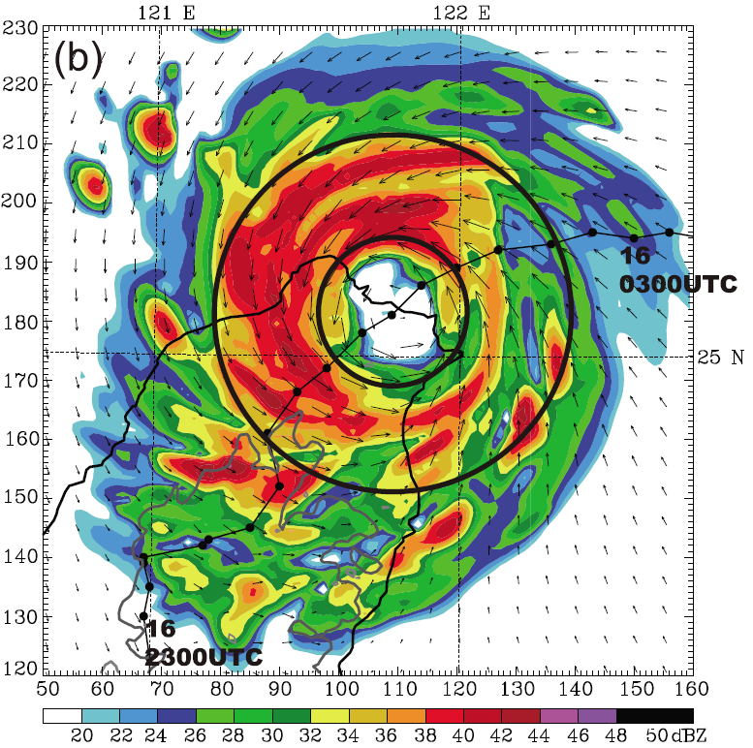

Slide 12
Notes:
方位角-高度圖 (a)(c) color: radial wind, vector: in-plane flow; (b)(d) color: radar reflectivity, contour: vertical velocity (22h)
25km(eye wall): 迎風面有較深的inflow且有上升氣流(較深的inflow會使降雨增強)，背風面的inflow則較淺且會產生下沉氣流
60km(outer rainband): 東邊海面上有較強的inflow(向陸地輻合)，並且在高層有明顯outflow，次環流結構明顯；雷達迴波的對流胞也非常明顯。(Vertical motion還有山嶽波的特徵)

Slide 13
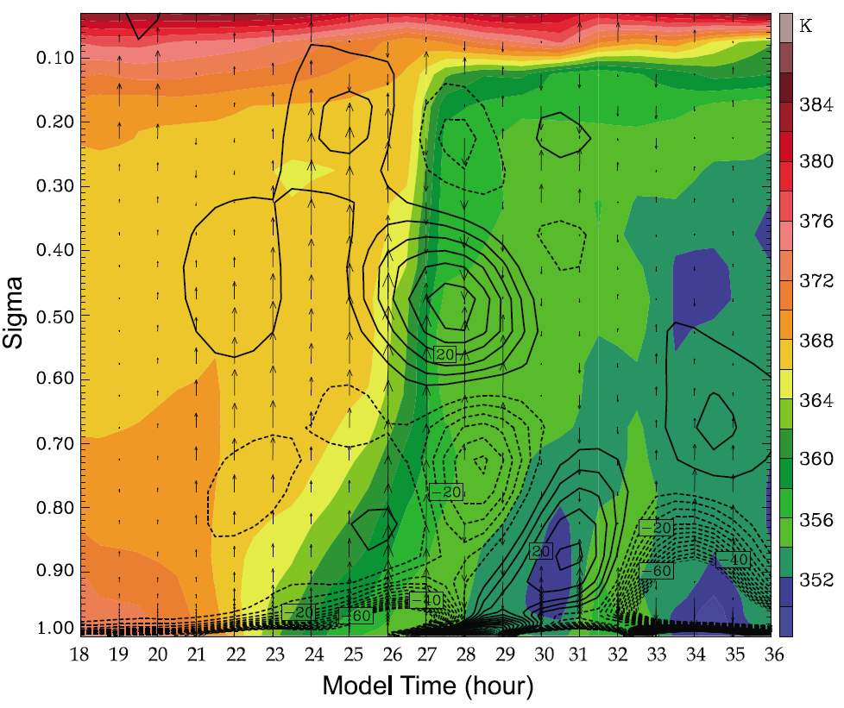
Landfall
Notes:
Vertical motion, horizontal divergence, 和相當位溫的時序圖 (以颱風眼為中心附近12km*12km的區域)
登陸前氣塊較少有垂直運動
登陸前2小時(20h~22h)垂直運動開始增強；
登陸後，底層的上升運動變強（因為地表的摩擦加上地形抬升伴隨的低層輻合）
登陸後水氣通量減少，使低層呈現低相當位溫
登陸後(28h~30h)) 下沉氣流與輻散可能是因為地形所影響的，颱風中心剛好在雪山山脈高處

Slide 14
Vortex Contraction after Landfall
Previous observational and modeling studies have documented contraction of the eye wall as a phenomenon of TC growth over the ocean [Willoughby et al., 1982; Willoughby and Black, 1996; Liu et al., 1999]

Slide 15
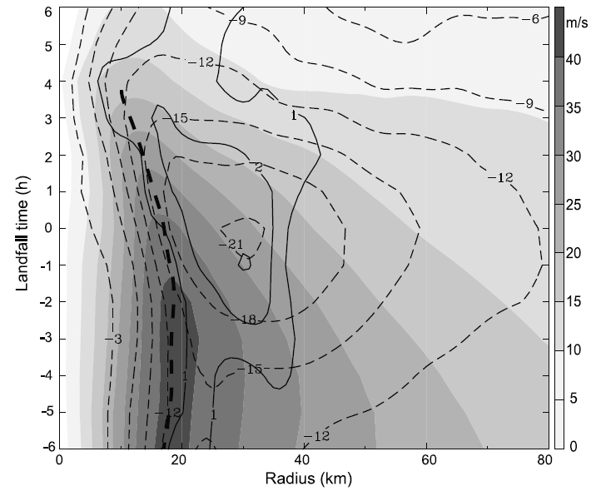
Notes:
方位角平均 Holmolor 空間時序圖（solid line: vertical velocity near 700hpa, shade: storm-relative tangential, dash: radial wind speed, 長粗線: 地表附近最大風速半徑）
地表的RMW(最大風速半徑)在登陸前2小時開始縮小，登陸後縮小更迅速（Nari的緩慢移動與地形抬升的潛熱釋放所造成）
登陸後4h，颱風開始變弱，(中層垂直速度和radial wind極大值皆開始向外延伸)

Slide 16
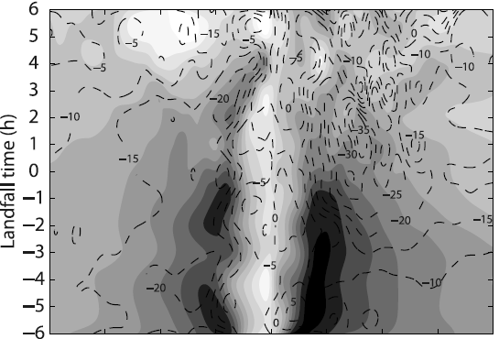
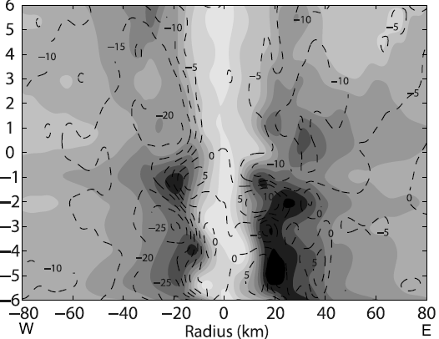
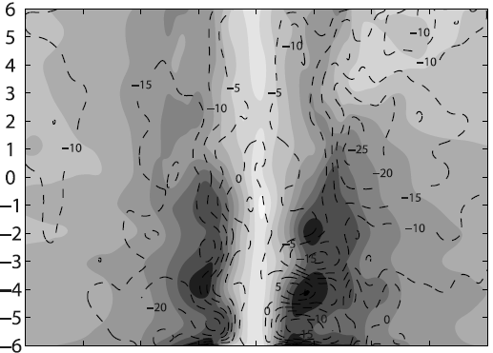
Full terrain
50% terrain
No terrain
Notes:
Time-radius cross section(shaded: near-surface storm-relative tangential wind, contour: radial wind) (full terrain, 50% terrain, no terrain) 在登陸後，西邊眼牆內縮較東邊眼牆快，但東側(ocean)地表逕向風大於西側(Mt.)逕向風(次環流不對稱)
當地形降低了50%，眼牆內縮較不明顯，但東側地表的徑向風仍然大於西側徑向風(次環流不對稱)
在地形全部去掉以後，幾乎沒有眼牆內縮的現象並且也沒有surface tangential wind 和逕向風不對稱的現象
因此我們可以說，這樣眼牆內縮和次環流不對稱的情況是由台灣地形激發的，而非颱風本身內部動力所造成

Slide 17
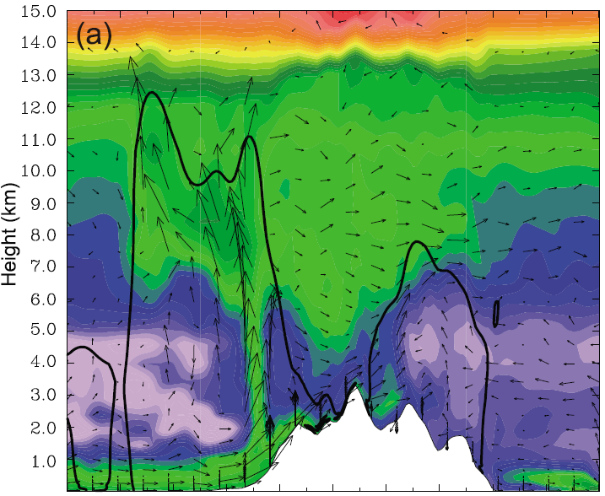
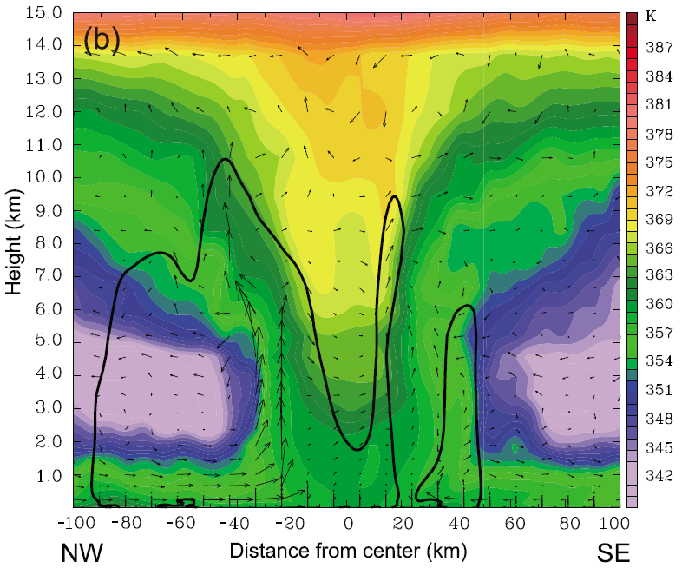
Eye Wall Breakdown after Landfall
t=30h
Notes:
Vertical cross section of across-track(color: equivalent potential temperature, vector: storm-relative in-plane flow, bold line: 20dBZ) (t=30)
登陸後，颱風西北側的次環流仍然可見，底層入流與上升氣流將較高的相當位溫往上層帶(因為Ekman pumping的關係)，與去地形實驗相似
而東南側底層的高相當位溫因為東南側的垂直運動較西北側背風面要弱，因此無法向上傳輸。(且當低相當位溫inflow在MBL上層輻合又遇到眼牆較濕的空氣，產生了下沉氣流。)
東南側的低相當位溫隨著地形升高而抬升，將其地面相當位溫降低，使眼牆breakdown (更清楚如下圖)
相反的，在去地形的模擬中就沒有這種情形，且颱風結構仍然分明

Slide 18
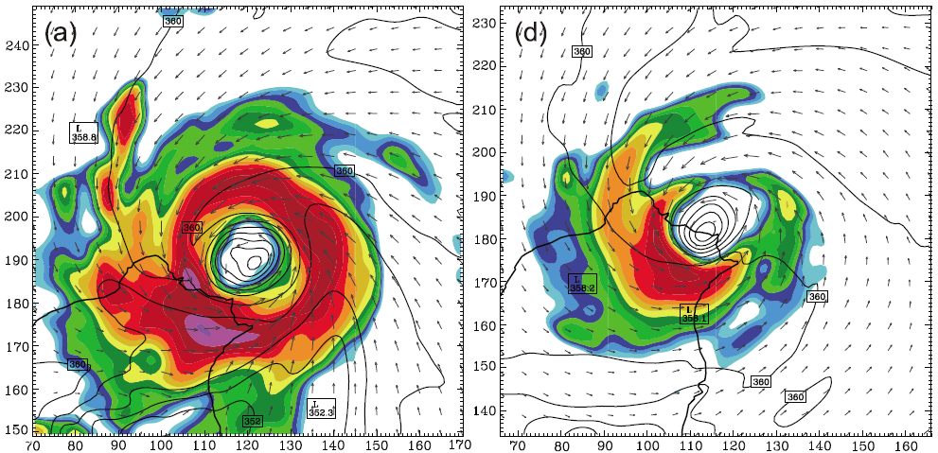
t=20h
Higher-$θ_{e}$
Lower-$θ_{e}$
Notes:
Color: radar reflectivity, contour: equivalent potential temperature, vector: surface flow (sigma=0.996)
t= 20h, highest θ_{e} in eye, and large θ_{e} gradient in the eye wall.
去地形的颱風被higherθ_{e} 環繞，且眼牆的地方的gradient較小

Slide 19
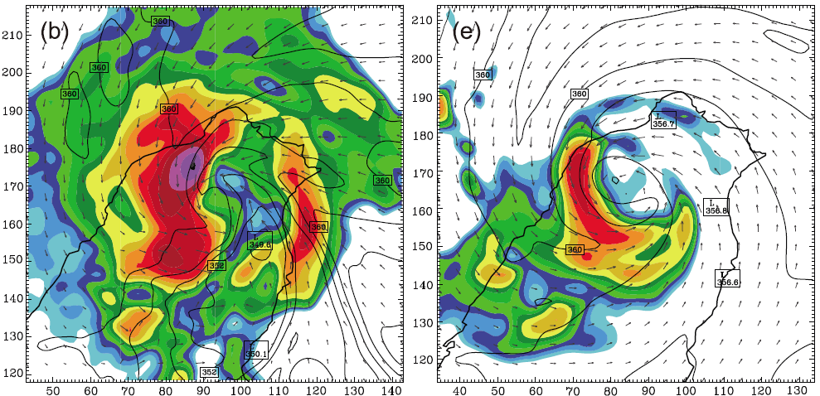
t=25h
Higher-$θ_{e}$
Lower-$θ_{e}$
Notes:
T=25, converge into the eye.
lowerθ_{e} 穿越眼牆進到颱風眼中，higherθ_{e} in eye wall 被breakdown ，且颱風結構被破壞
去地形的部分除了颱風眼的higherθ_{e}消失了，其他則幾乎沒有上述情況。去地形的西側眼牆雷達迴波較弱、降雨較少是因為在MBL的地方有higherθ_{e} ，而此現象是因為缺發地形抬升

Slide 20
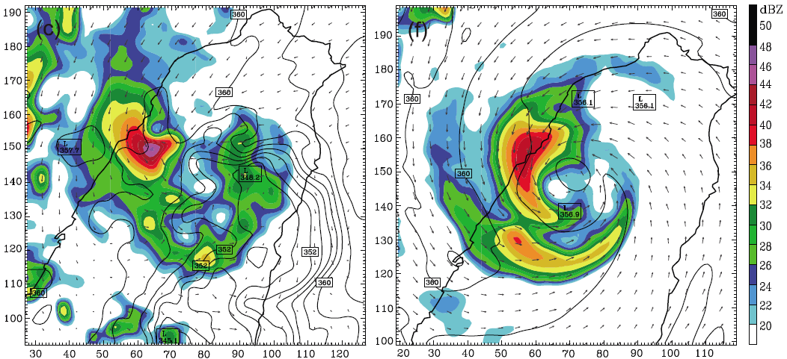
t=30h
Higher-$θ_{e}$
Lower-$θ_{e}$
Notes:
T=30, higherθ_{e} 持續從海面上提供給西邊氣旋，使其仍有深對流與降水
而東邊則因為lowerθ_{e} 使颱風眼牆消散並且有偶陣雨
去地形的西側眼牆雷達迴波較弱、降雨較少是因為在MBL的地方有higherθ_{e} ，而此現象是因為缺乏地形抬升

Slide 21
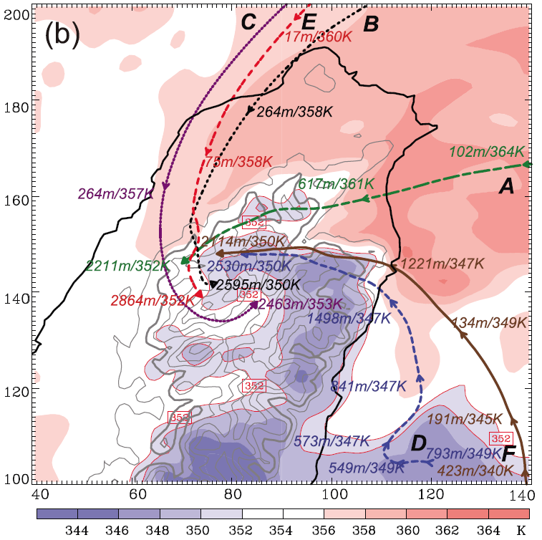

Slide 22
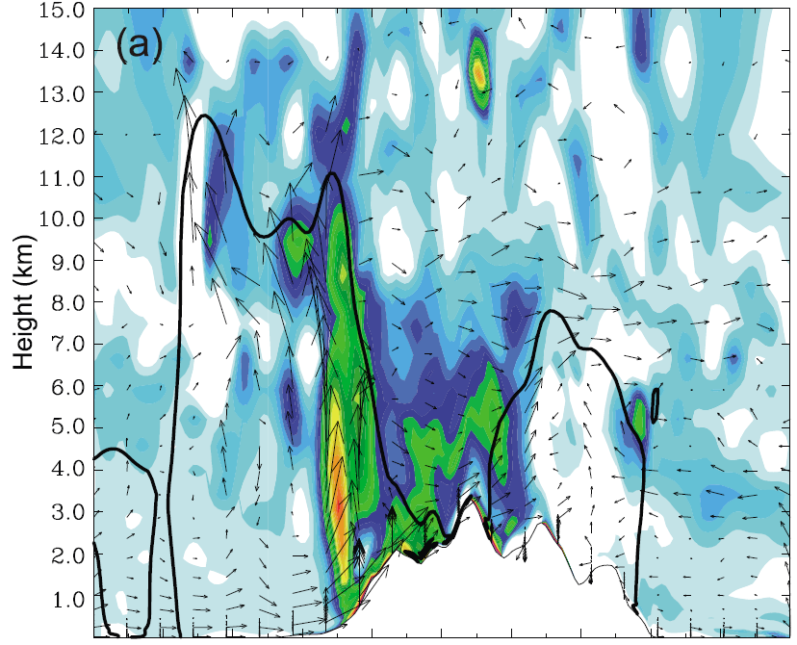
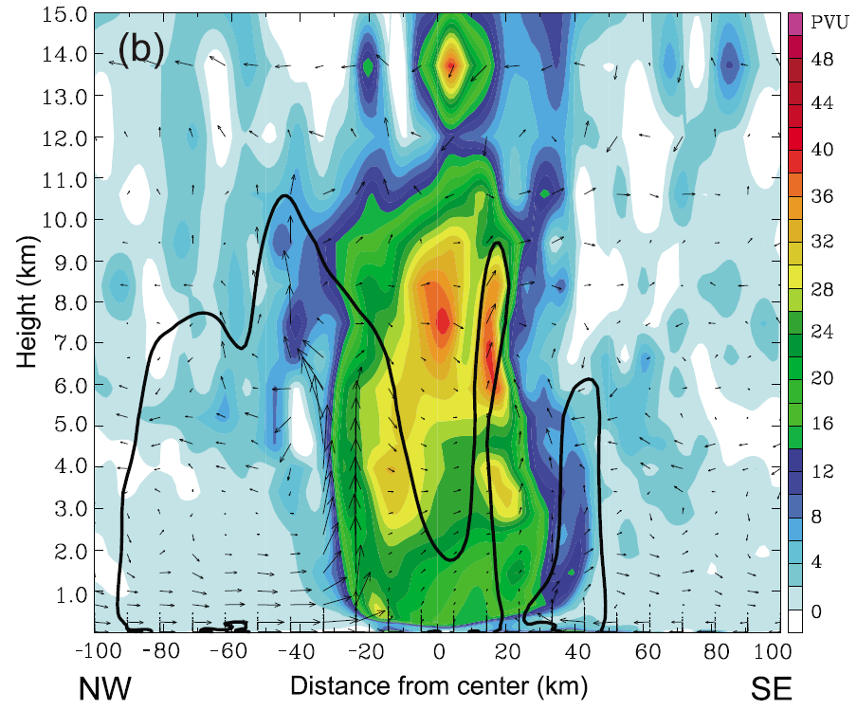
t=30h
Notes:
PV 的不對稱與breakdown; Vertical cross section of across-track(color: potential vorticity, vector: storm-relative in-plane flow, bold line: 20dBZ) (t=30)
跟相當位溫一樣，PV的部分也是被風側的眼牆breakdown，去地形的PV結構則與颱風在海上相像
根據這幾張圖，我們可以知道眼牆的breakdown和氣旋結構不對稱是因為的地形效應所造成

Slide 23
Conclusions
After landfall, the tangential flow is weakened but the low-level radial wind is strengthened , due to the terrain blocking and surface friction.
At the time of landfall, Nari shows stronger primary and secondary circulations in the presence of the CMR topography because of the enhanced latent heat release.
Notes:
登陸後，因為地形阻礙和地表摩擦，tangengial wind ↓ ，radial wind↑
隨著地形抬升和潛熱釋放，使NARI在登陸後呈現較強的主環流與次環流

Slide 24
RMW and midlevel eye wall updraft contract after landfall. When latent heating rates decrease, the inner core vortex size begins to increase and the storm weakens slowly.
The interaction of Nari’s vortex circulation with the elevated lower-$θ_{e}$ air, combined with the CMR topographical lifting, accounts for most of the asymmetrical structures after landfall.
Notes:
登陸後，眼牆會向內縮。而當潛熱釋放趨緩時，颱風眼又開始慢慢變大且變弱
地形抬升伴隨著低相當位溫的闖入，是造成登陸後不對稱結構以及結構破壞的關鍵之一

Slide 25
Thank you for your listening!

Slide 26
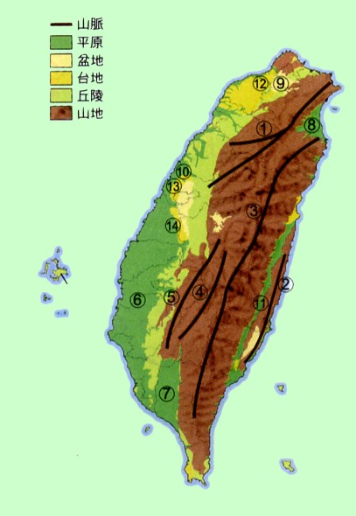
http://www.tlsh.tp.edu.tw/~t127/topographytaiwan/images/0101.jpg

Slide 27
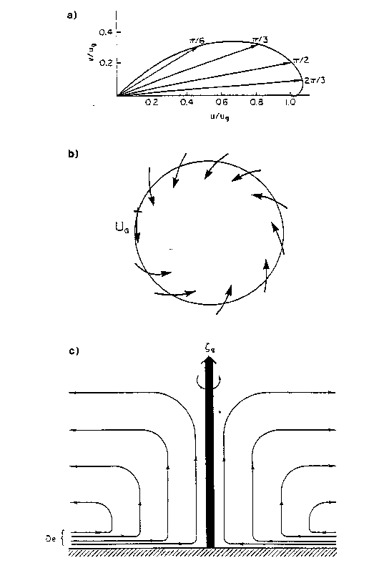
Notes:
Figure 5 . (a) Hodograph of Ekman spiral; the vectors indicate the increase of wind speed and its veering with height, (b) Illustration of the ageostrophic wind in the PBL of a cyclone, and (c) vertical velocity in cyclone due to Ekman pumping (Holton, 1979).
Ekman boundary layers, Ekman pumping/suction, and spin-up/spin-down
Ekman pumping works on the principle of frictional geostrophic motion. If the fluid is at solid body rotation and the rotation rate is then increased, the bulk of the fluid (except near the walls) is now in relative motion to the new rotation rate of the inertial reference frame. A frictional, viscous layer is created along the floor (Ekman layer) and the walls (Stewartson layer) of the tank. At this point, the geostrophic balance between Coriolis force and pressure gradient force is destroyed, and the Coriolis force dominates, forcing mass transport to the right of the surface stress, or outward along the floor of the tank and upward along the walls. A secondary circulation is then induced.

Slide 28
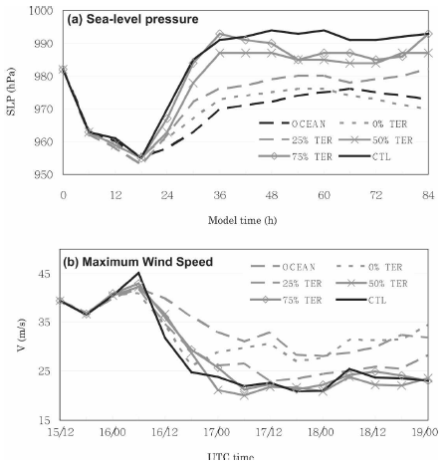
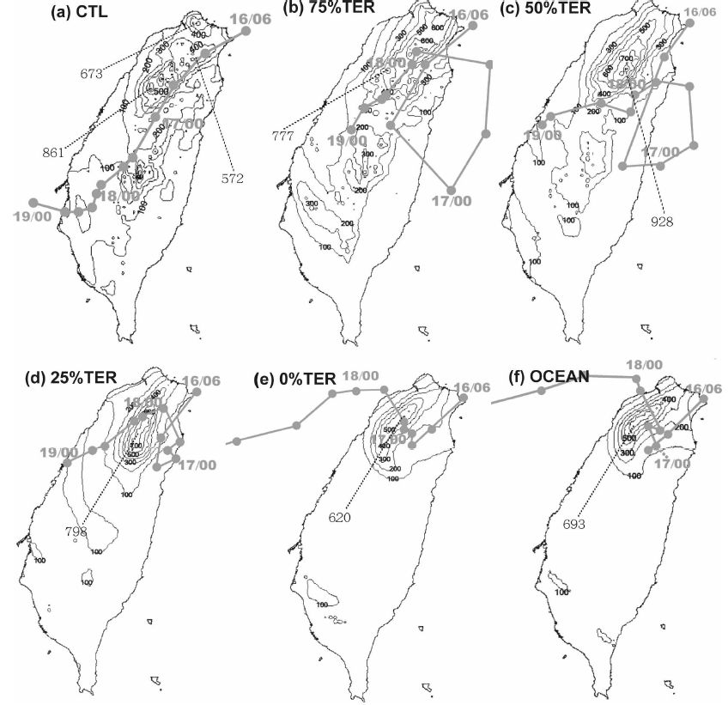
(Fig. 20 in Part I)
Notes:
當地形被去掉以後以上特徵皆不存在
有地形會有較多區域性降水，並且在登陸時增強更多

