Slide 1
Sensitivity of Tropical Cyclone Intensity to Ventilation in an Axisymmetric Model
Brian Tang, and Kerry Emanuel J. Atmos. Sci., 69, 2394–2413.

Slide 2
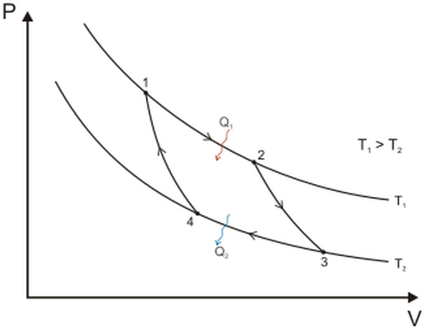
熵(entropy)
熱力過程通常可以區分為三類：自然過程、非自然過程、以及可逆過程
自然過程通常為不可逆且趨向平衡之過程
Carnot Cycle

Slide 3
Introduction
Environmental vertical wind shear excites two types of vortex Rossby waves: the quasi-mode and sheared vortex Rossby waves.
A vertical sheared TC reach outward 40-50 km from the center, and the perturbation induced by the tilt of the outer vortex reach outward 150~200 km. (Riemer et al. 2010)
This study will focus on effect of entropy mixing on TCs. Ventilation is the flux of low-entropy environmental air into the TC’s inner core (Simpson and Richl 1958).
Eddy entropy fluxes into the inner core are important, the low-entropy air frustrates the TC heat engine and constrains the intensity.
The ventilation pathway: upper-level: vertical wind shear (Frank and Ritchie 2001, Kwon and Frank 2008) midlevel: a reduction of eyewall θe (Cram et al. 2007) low-level: low-entropy environmental air; downdrafts (Riemer et al. 2010, Riemer and Montgomery 2011)

Slide 4
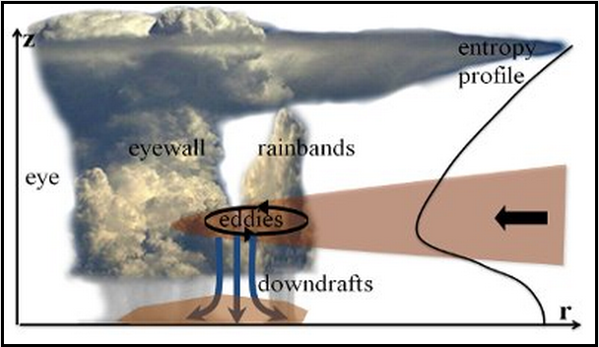
http://www.atmos.albany.edu/facstaff/tang/research.html
Ventilation of Tropical Cyclones Ventilation – defined as the entrainment of cooler, drier air at midlevels of the troposphere into a tropical cyclone - acts as anti-fuel, causing the storm to weaken. Ventilation in both theoretical and modeling frameworks, the diagnostic will be used to evaluate mesoscale hurricane models and projections of tropical cyclone activity with climate change.

Slide 5
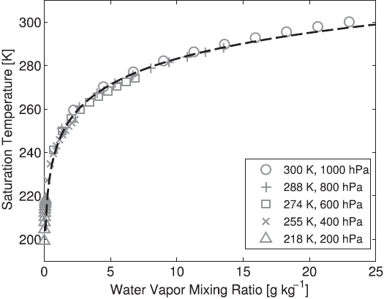
General description
RH between 10~100 %
T_{L}: saturation temperature is the empirical formula from Bolton (1980)

Slide 6
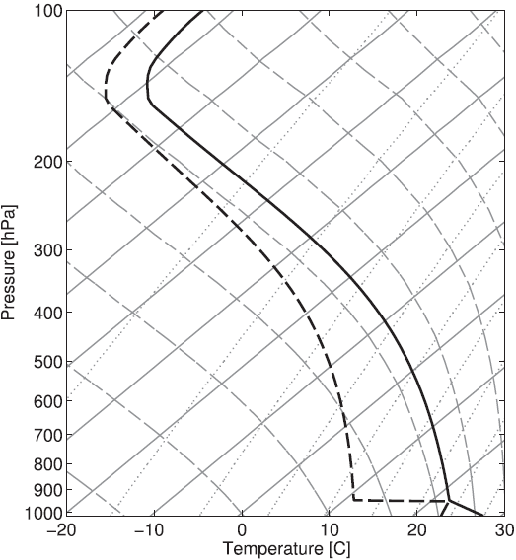
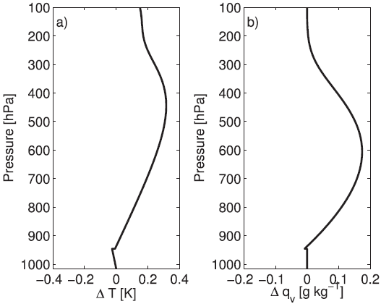
Pini: 1015 mb Tini: SST=28℃ RHini: 75 % Coriolis parameter: 5×10⁵s⁻¹ Vt max: 20 ms⁻¹ (R=100 km)

Slide 7
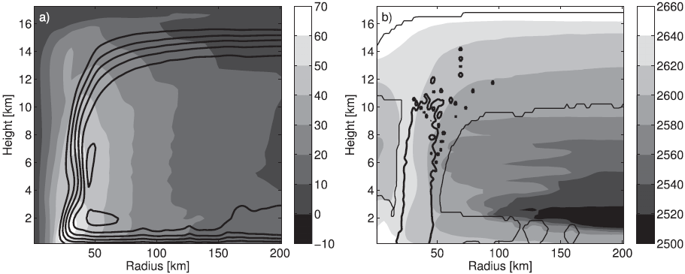
7 days after initialization
Tangential wind (ms⁻¹)
Pseudoadiabatic (J kg⁻¹ K⁻¹)
L

Slide 8
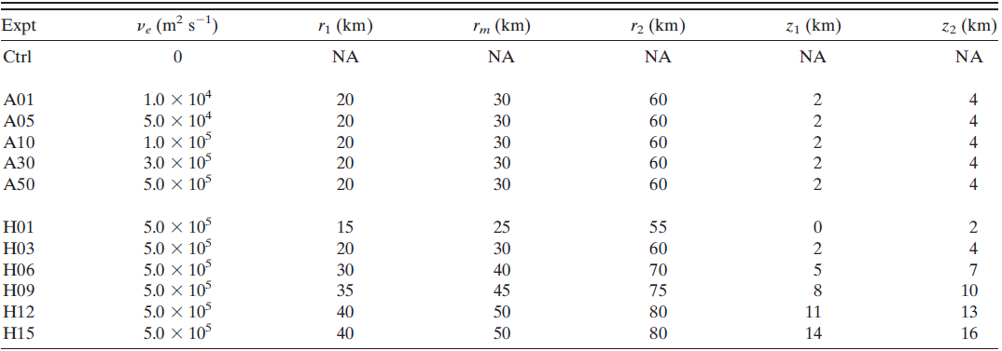
Fixed ventilation experiments
Ventilation region is introduced by adding a term to the turbulent entropy flux parameterization to reflect a fixed area of enhanced entropy mixing between the eyewall and near-environment

Slide 9
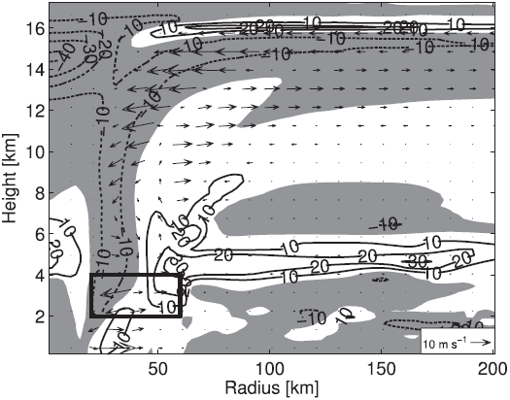
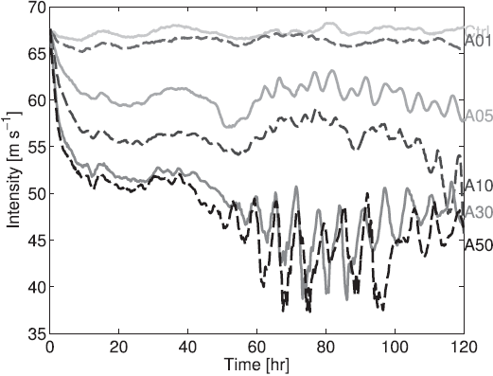
a. Ventilation amplitude
A corresponding decrease in TC intensity to increasing ventilation amplitude
A50-CTL in 24-48h averaged
W
quasi-steady

Slide 10
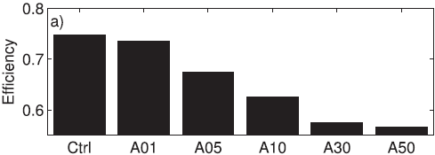
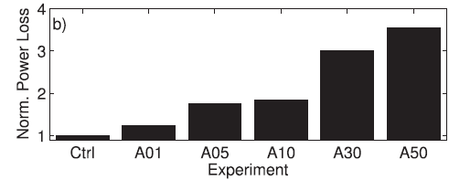
Innermost 60 km lowermost 17 km averaged over 24-48 h
: the surface entropy flux : the reference temperature : the dissipation rate
Innermost 60 km the lowest 2 km averaged over 24-48 h
The ventilation increases, the power loss increases

Slide 11
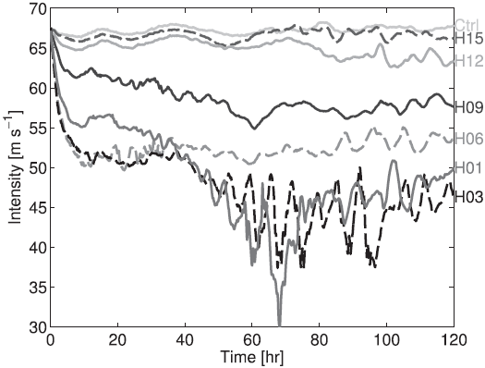
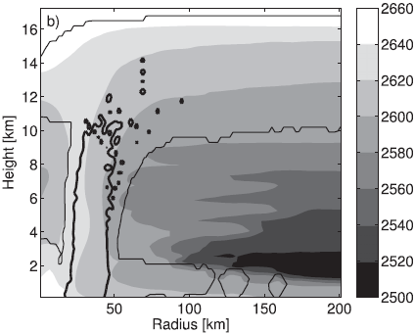
b. Ventilation height
mean flux
L

Slide 12
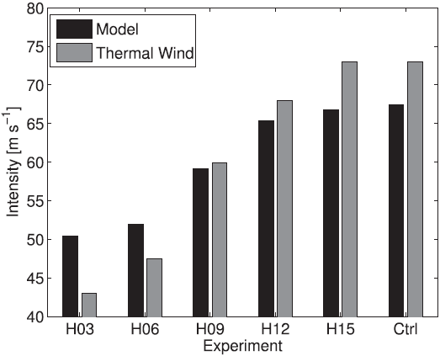
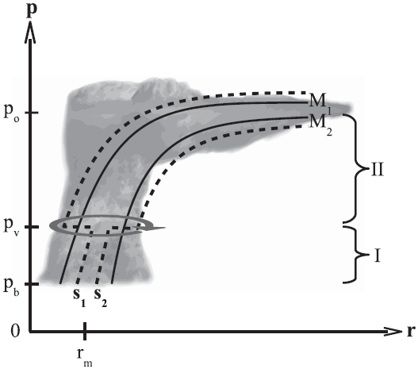
max. tangential wind @ h=1km
: the azimuthal vorticity : the vertical velocity : the radius of maximum wind

Slide 13
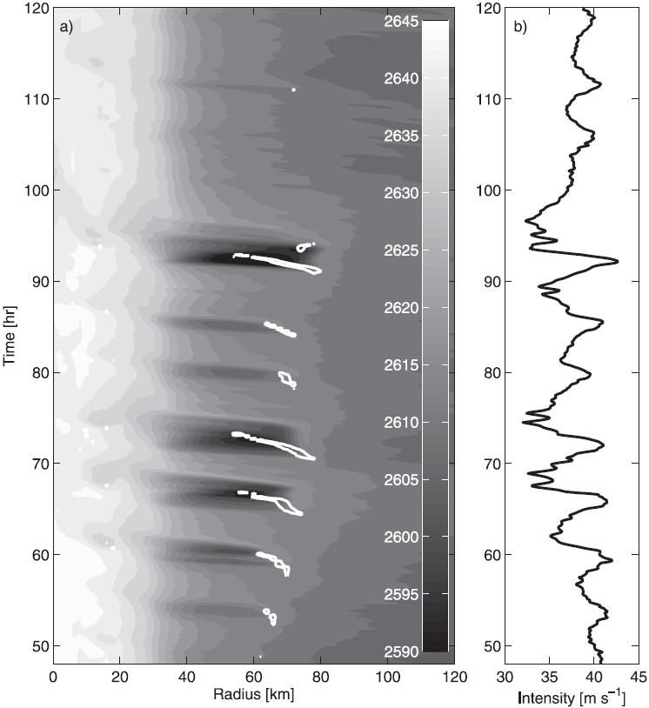
c. Oscillatory intensity regime

Slide 14
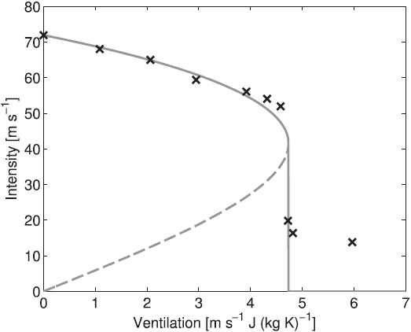
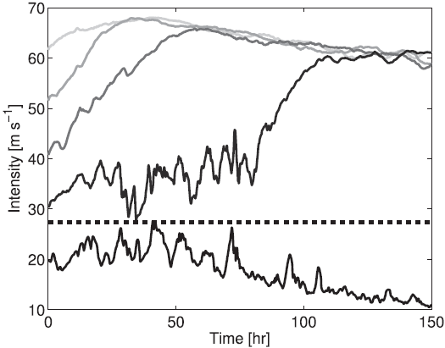
Results
stable unstable
entropy: 4 ms⁻¹ J kg⁻¹ K⁻¹ minimum intensity: 27 ms⁻¹
final 12-h averaged Vt
The experiments of the ventilation threshold are very disorganized with no well-defined radius of maximum wind and no coherent secondary circulation.

Slide 15
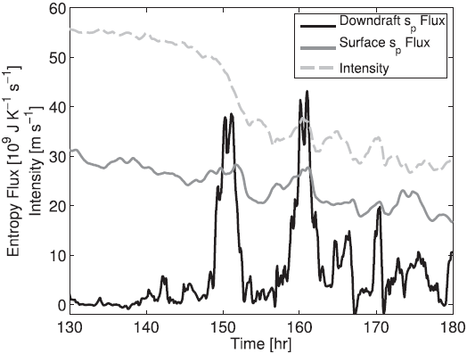
Between R=20 ~ 60 km
downdraft entropy flux at H of 1.5 km surface entropy under 5 ms⁻¹ J kg⁻¹ K⁻¹

Slide 16
Summary
Ventilation (Ax) fixed area at midlevels across the eyewall with varying strength. Strong ➔ cooling of the upper-level warm core & quickly weakens the TC; lower mechanical efficiency, downdrafts lowers the mean intensity further.
Ventilation height (Hx): the weakening decreases as the ventilation height increase associated with thermal wind relationship, less effective at inducing weakening.
ventilation at midlevels ➔ a reduction in maximum intensity downdraft modification of the boundary layer ➔ reducing the hurricane heat and weakening the storm ventilation at upper-level ➔ no effective weakening mechanism
Significantly weaken the storm: mixing of low-entropy environmental air or formation of downdrafts

Slide 17
How eddy entropy mixing actually occurs is not well understood.
★ the ventilation does not reflect the possibility of nonlocal mixing
★ large uncertainty of the effective eddy viscosities (the influence of vertical wind shear)
★ depend strongly on the radial gradient of potential vorticity
★microphysics is quite simplified influence downdraft (evap. and melt of ice)

