Slide 1
A Modeling Study on the Development of a Bowing Structure and Associated Rear Inflow within a Squall Line over South China
Meng, Z., F. Zhang, P. Markoswki, D. Wu, and K. Zhao, 2012: A modeling study on the development of a
bowing structure and associated rear inflow within a squall line over south China. J. Atmos. Sci., 69, 1182–1207.

Slide 2
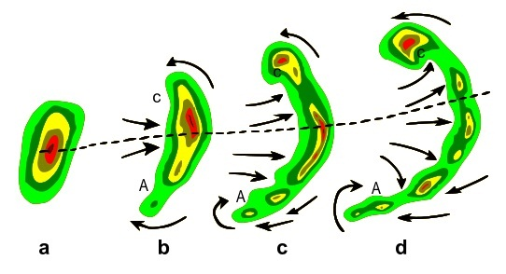
Bookend vortex：
Line end vortices develop on either side of the system, and the vortices help enhance the mid-level rear inflow.
Cyclonic on the northern end of the system and anticyclonic on the southern end, for an environment of westerly vertical wind shear
The Coriolis force acts to intensify the cyclonic vortex and weaken the anticyclonic vortex.

Slide 3
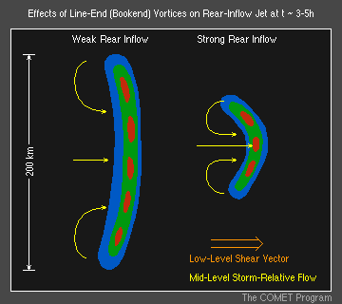
Introduction
This study examines the formation and evolution of the bowing process for a squall line that occurred in spring 2007 in South China.

Slide 4
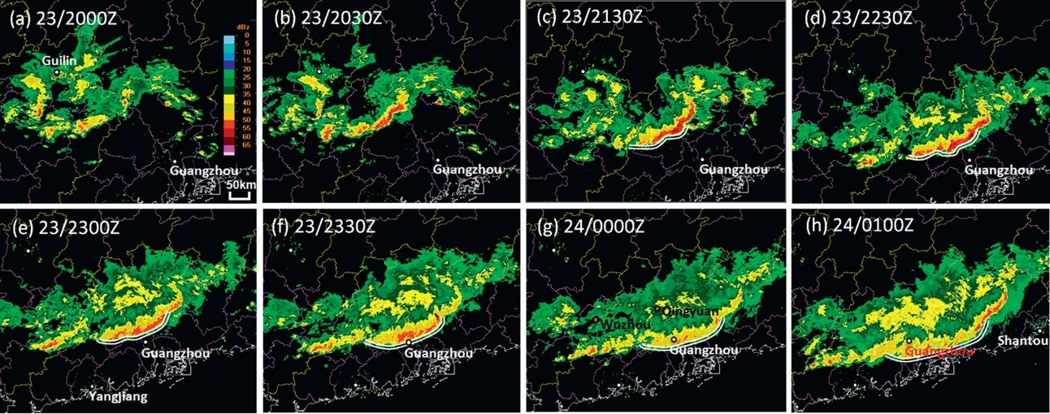
Observation
shaded : dBZ

Slide 5
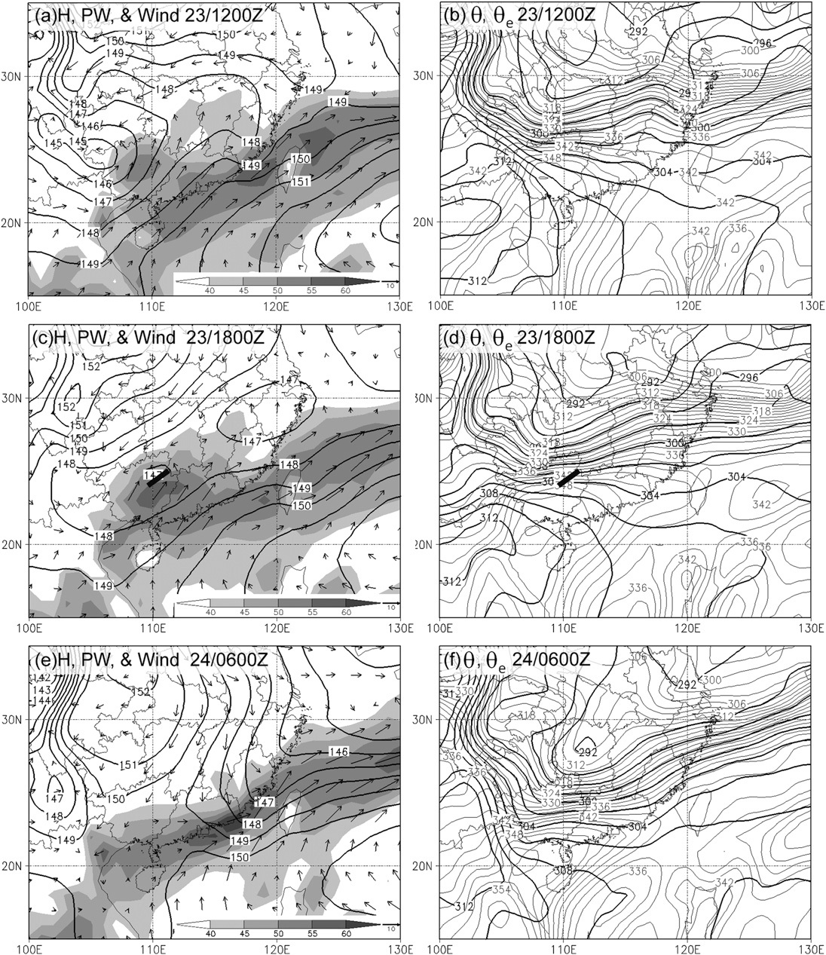
Environmental features of the squall line
contour :
geopotential height (m)
thick contours : θ (K)
shaded :
precipitation (kgm⁻²)
thin contours : θe (K)
(kgm⁻²)
(kgm⁻²)
(kgm⁻²)
(wind at 850 hPa)

Slide 6
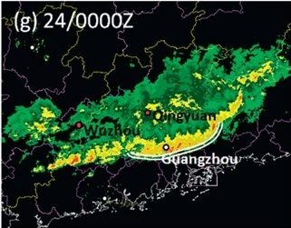
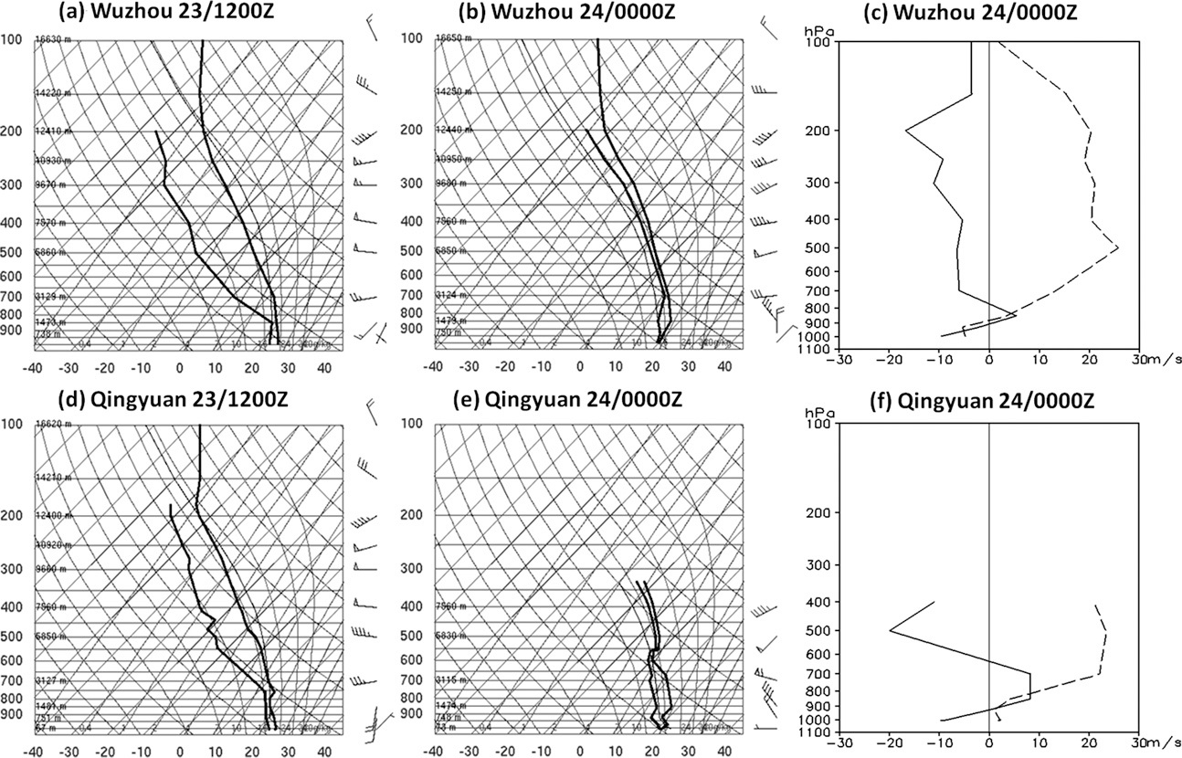
Radiosondes (Wuxhou, Qingyuan)
Qingyuan
Wuzhou
CAPE : 1067 Jkg⁻¹
Wind shear : 15 ms⁻¹
solid : normal
dash : parallel
CAPE : 747 Jkg⁻¹
Wind shear : 30 ms⁻¹

Slide 7
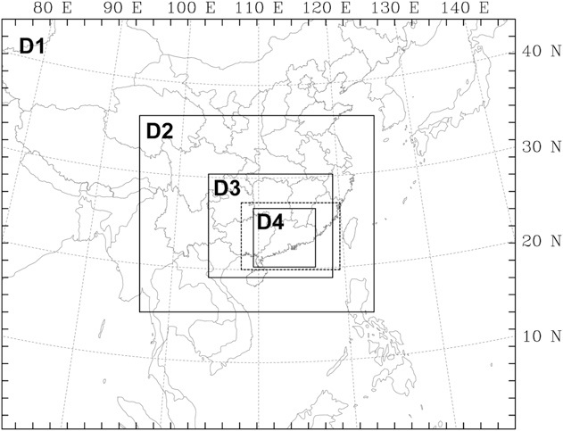
Numerical model and configurations
WRF V3.2
Starting at 1200 UTC 23 April 2007.
Initial and boundary conditions provided by 6-hourly FNL NCEP analysis of 1。x1 。
 | Do.1 | Do.2 | Do.3 | Do.4
Grid points | 150*120 | 205*172 | 316*205 | 481*451
Horizontal intervals | 40.5 km | 13.5 km | 4.5 km | 1.5 km
Vertical layers | 35 layers
Microphysics | WSM6
Planetary boundary processes | Yonsei State University
Cumulus parameterization | Grell-Devenyi |  | No

Slide 8
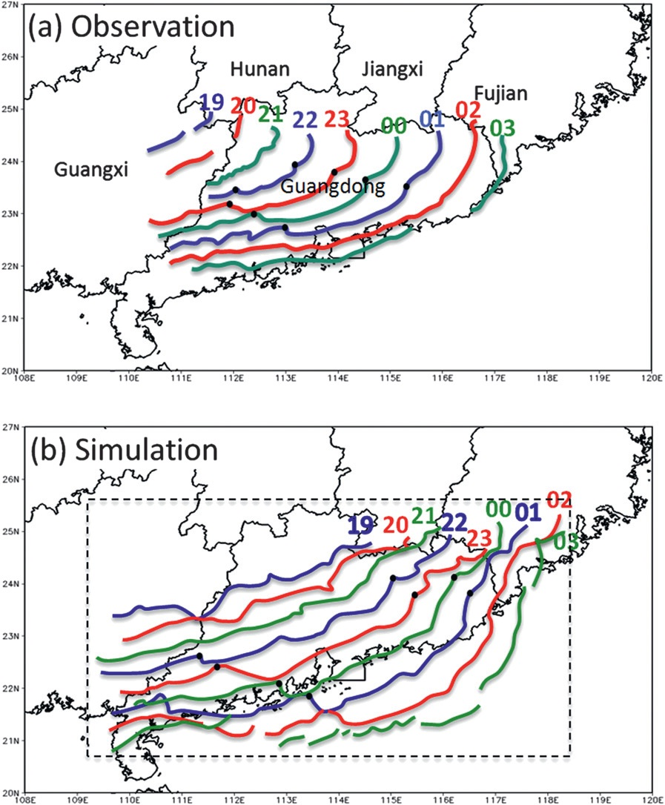
Result from the numerical simulation
c ≈ 17 ms⁻¹
c ≈ 16 ms⁻¹
Notes:
於4.5km網格中討暴風尺度而不用1.5km，且1.5km較多雜訊。

Slide 9
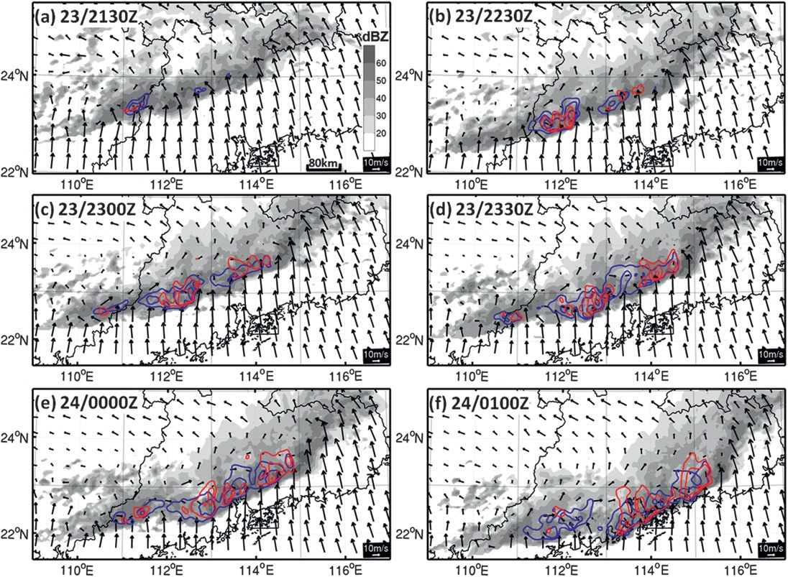
Radar reflectivity and rear inflow
shaded : dBZ
blue : 1.5 km RI
(> 4 ms⁻¹)
red : 2.5 km RI
(> 4 ms⁻¹)
line-relative wind vector at 1.5 km height

Slide 10
The formation mechanism of the large bowing structure

Slide 11
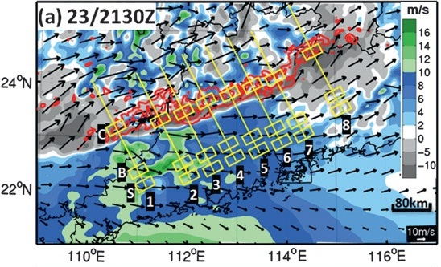
Speed of cold pool
B | Buoyancy
Θ’_{v} | Virtual potential temperature perturbations
Θ_{v} | Environmental Virtual potential temperature
q_{c} | Mixing ratio of condensate
Θ’_{v} = Θ_{c} - Θ_{v}
Θ’_{v}(H) $≤$ -1 K
Notes:
虛位溫

Slide 12
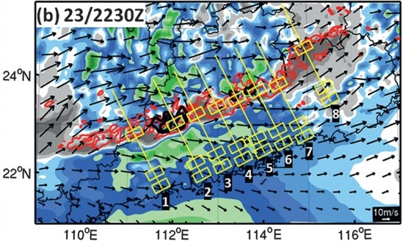
south
north

Slide 13
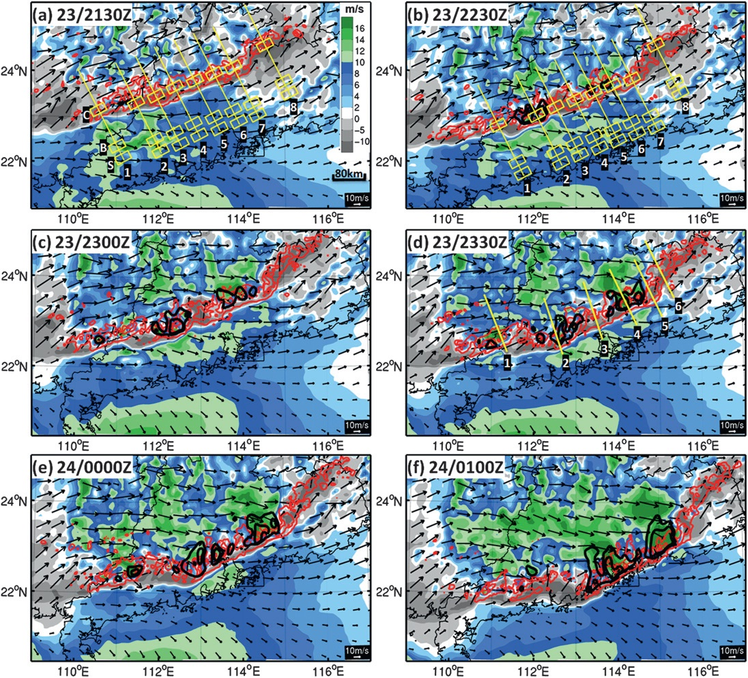
Environmental vertical shear
shaded : vertical wind shear
(0.25~3 km)
red : 50 & 60 dBZ
black : 4 & 8 ms⁻¹ RI
(2.5 km)

Slide 14
Formation mechanism of rear inflow
environmental flow
pressure gradient
bookend vortices

Slide 15
Environmental flow
shaded : dBZ
blue : 1.5 km RI
red : 2.5 km RI
line-relative wind vector at 1.5 km height

Slide 16
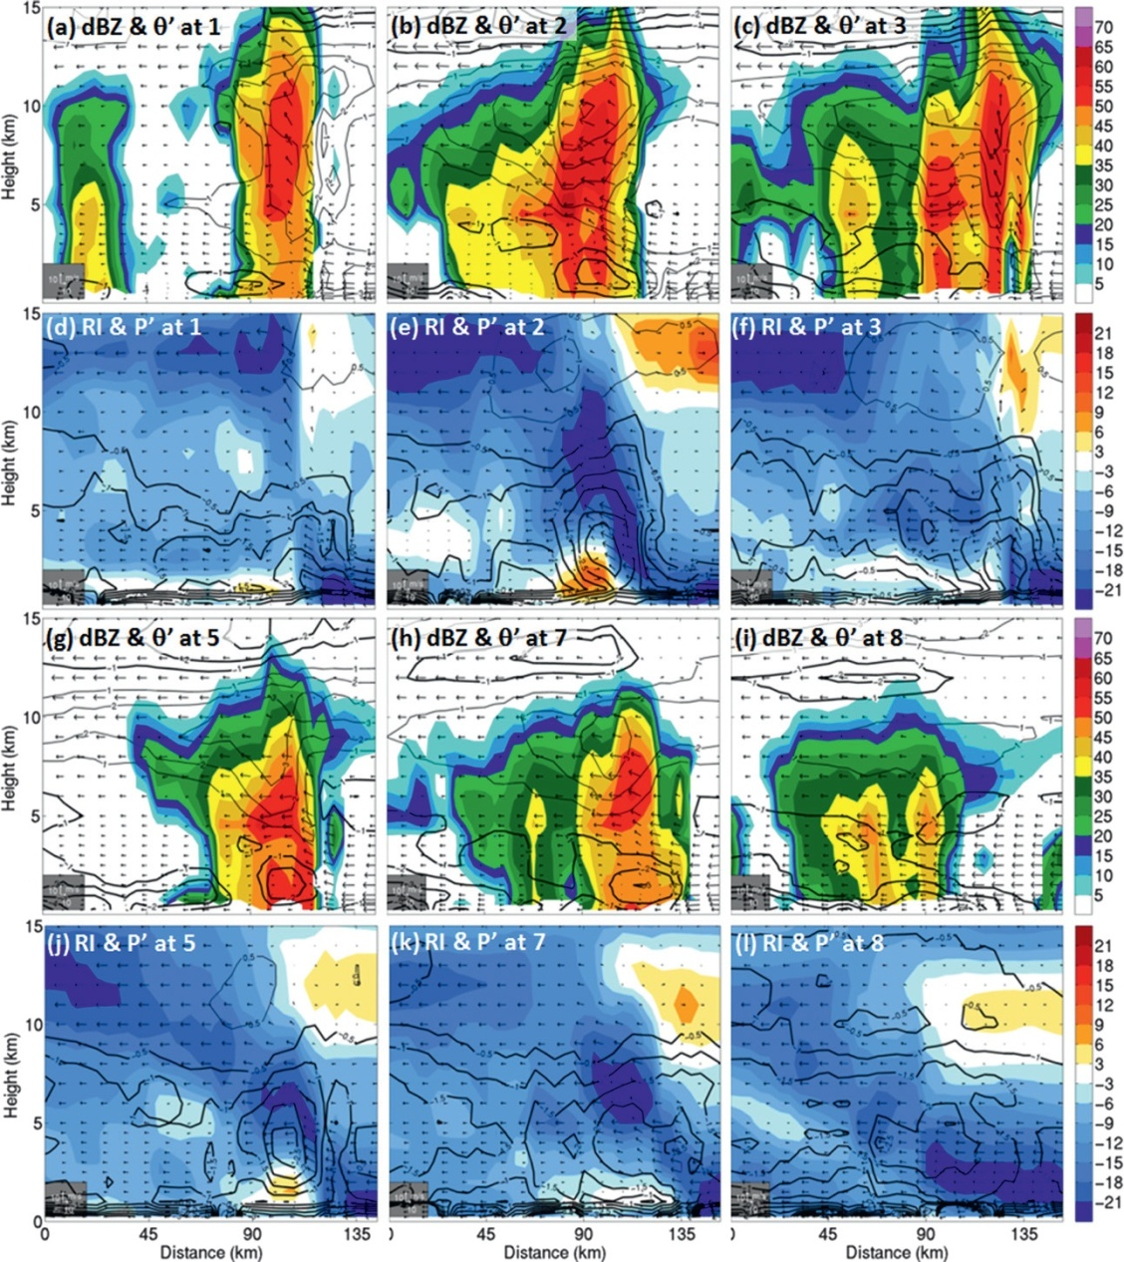
Pressure gradient
23/2130 Z
contours : θ，
shaded : dBZ
(dBZ)
shaded : RI
contours : p，
(ms⁻¹)
(dBZ)
(ms⁻¹)
Notes:
氣壓擾動是減去圖2中虛線方塊內的平均氣壓

Slide 17
23/2230 Z
23/2330 Z
(ms⁻¹)
(ms⁻¹)
shaded : wind speed
contours : p，

Slide 18
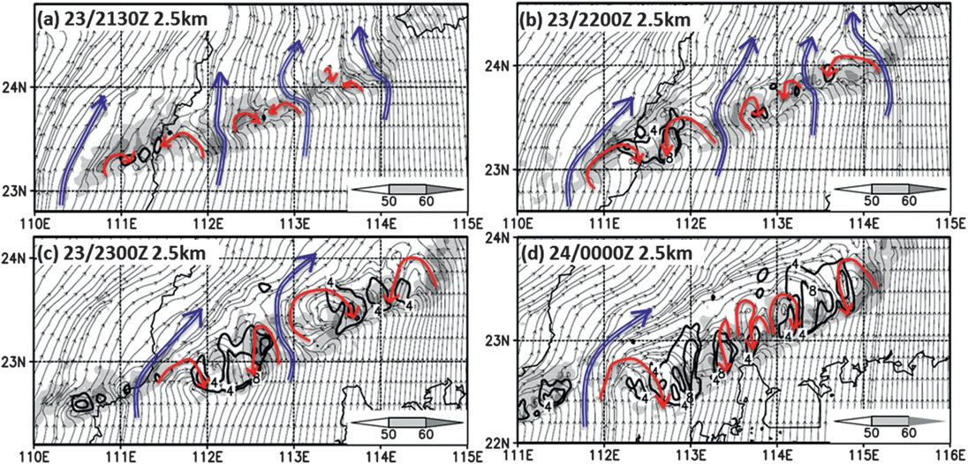
bookend vortices
(dBZ)
(dBZ)
(dBZ)
(dBZ)
vector : line-relative streamline
contour : rear inflow

Slide 19
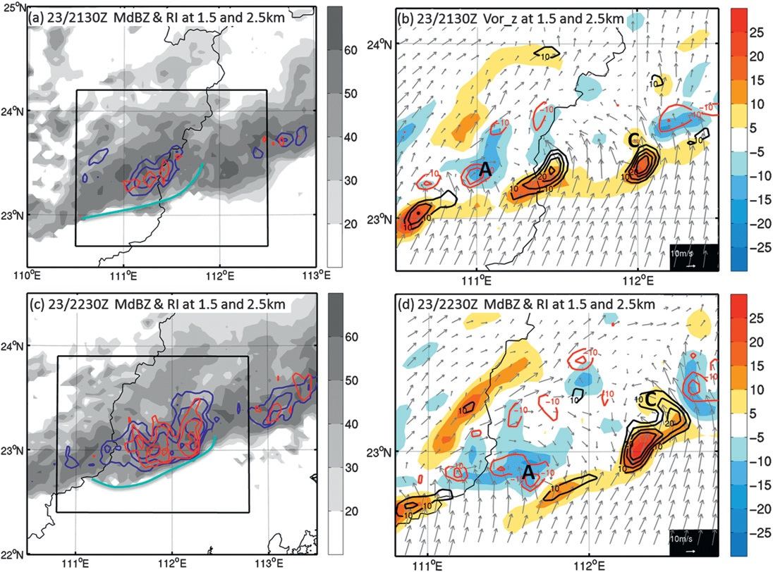
southern bow segment
shaded : dBZ
red contour:
RI at 2.5 km
blue contour:
RI at 1.5 km
shaded :
1.5 km
vertical vorticity
contours :
2.5 km
vertical vorticity
(dBZ)
(s⁻¹)
(dBZ)
(s⁻¹)
line-relative wind vector at 2.5 km height

Slide 20
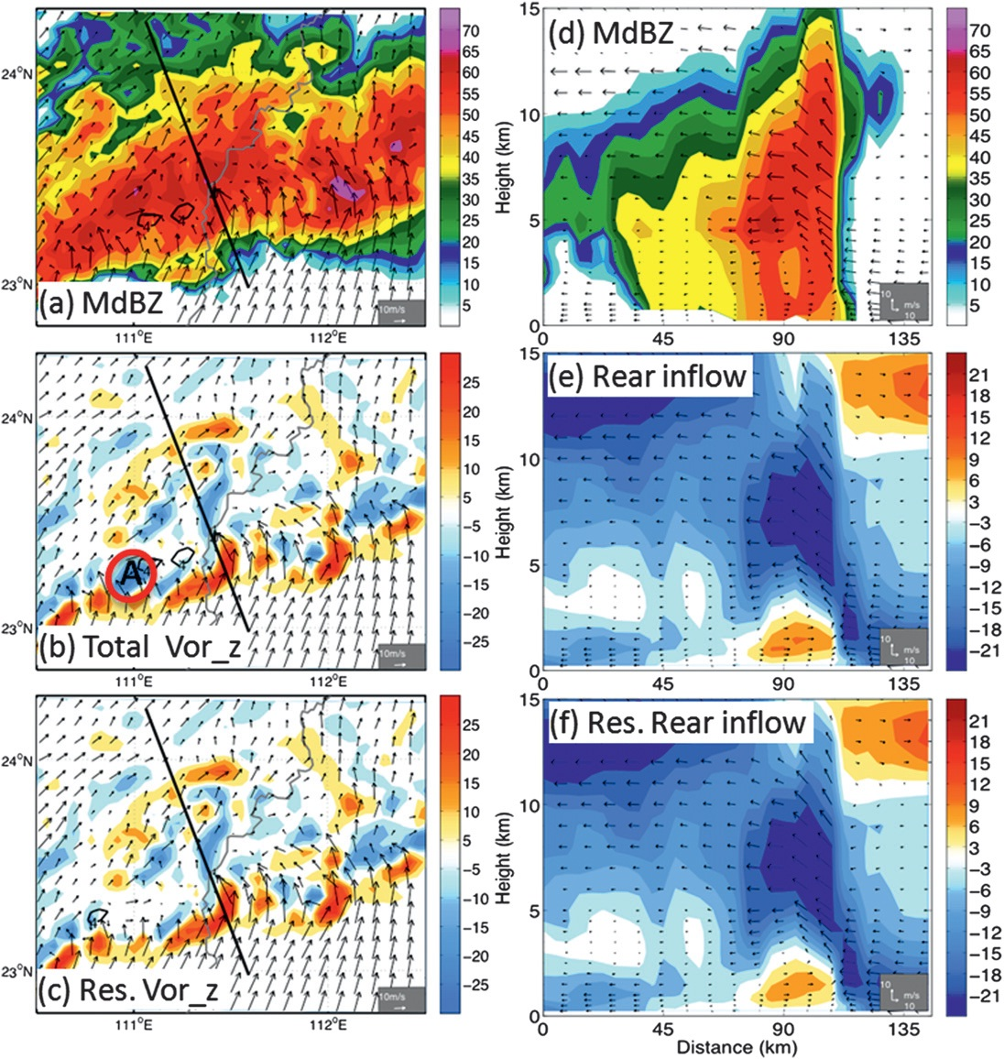
23/2130 z
shaded : dBZ
black contours : RI
(dBZ)
(dBZ)
shaded :
wind speed(ms⁻¹)
shaded :
2.5 km
vertical vorticity
black contours : RI
(s⁻¹)
(ms⁻¹)
(s⁻¹)
(ms⁻¹)
line-relative wind vector at 2.5 km height

Slide 21
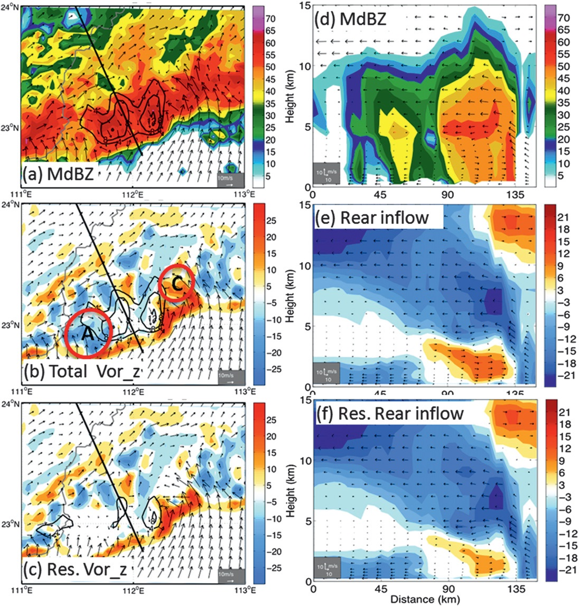
23/2230 z
shaded : dBZ
black contours : RI
(dBZ)
(dBZ)
shaded :
wind speed(ms⁻¹)
shaded :
2.5 km
vertical vorticity
black contours : RI
(s⁻¹)
(ms⁻¹)
(s⁻¹)
(ms⁻¹)

Slide 22
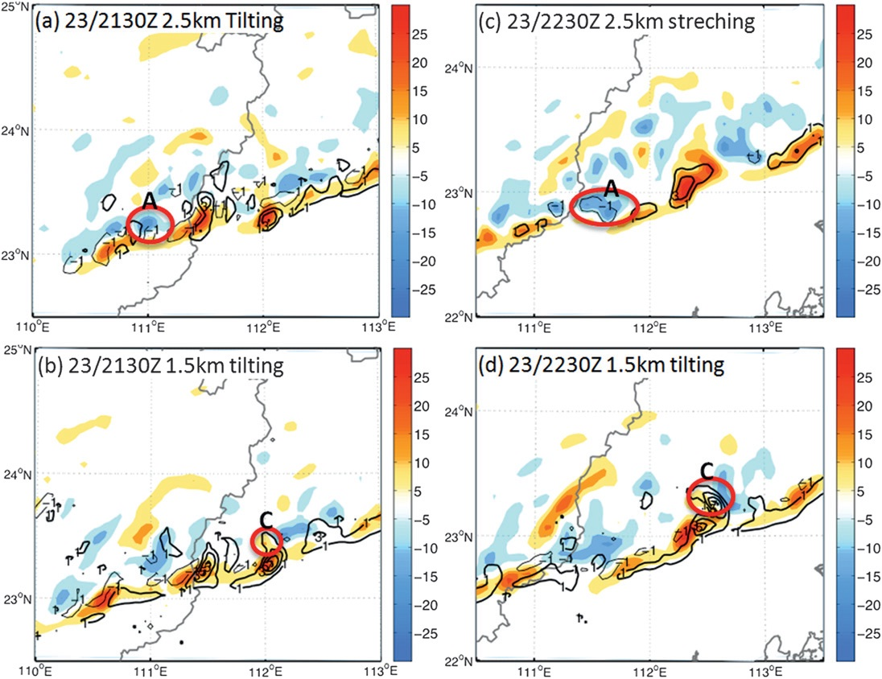
Vorticity budget analysis
contours : stretching terms ($2×{10}^{−8}$ $s^{−2}$)
(s⁻¹)
(s⁻¹)
(s⁻¹)
(s⁻¹)
shaded : vertical vorticity
contours : tilting terms ($2×{10}^{−8}s^{−2}$)

Slide 23
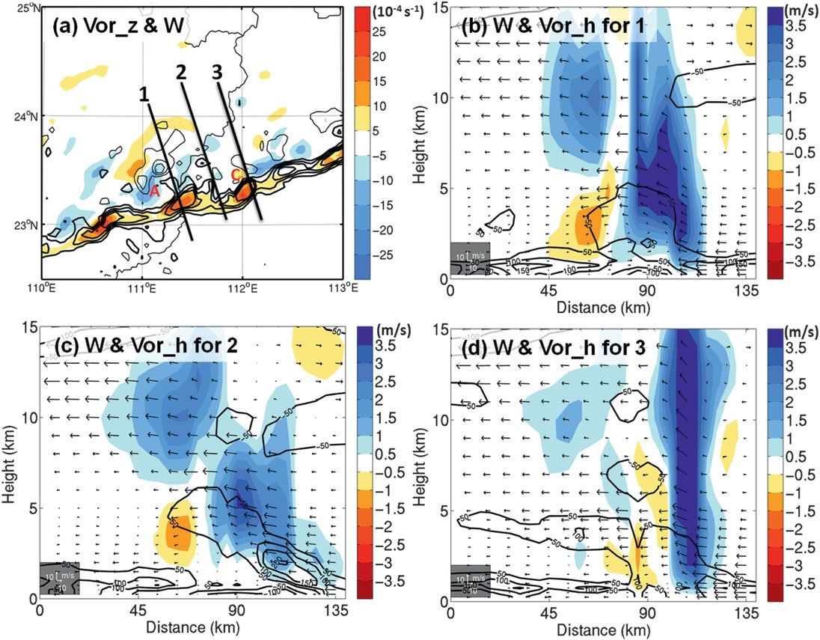
23/2130 z
shaded :
1.5 km
vertical vorticity
contours :
verticial velocity
shaded :
vertical velocity
contours :
horizontal vorticity

Slide 24
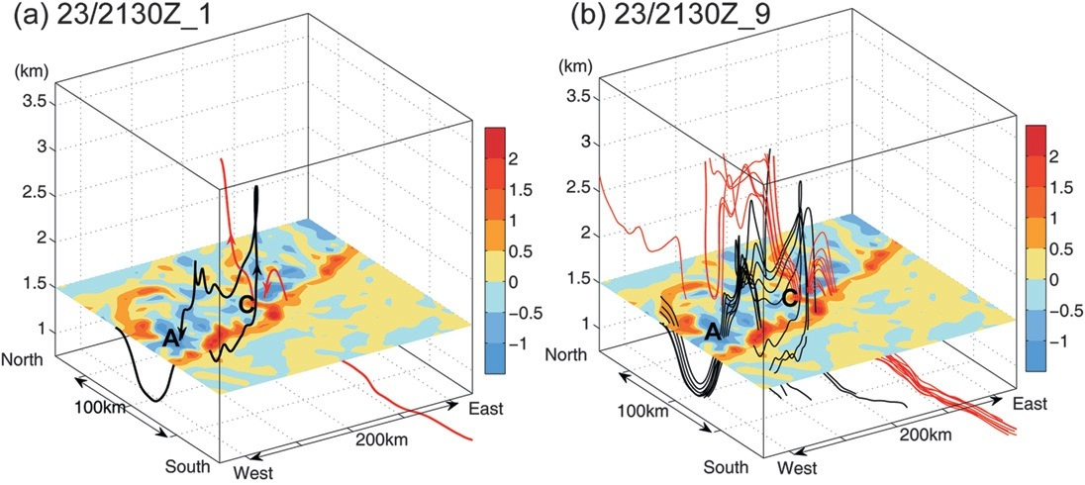
Vortex line (southern bow segment)
(s⁻¹)
(s⁻¹)
shaded :
1.5 km vertical vorticity

Slide 25
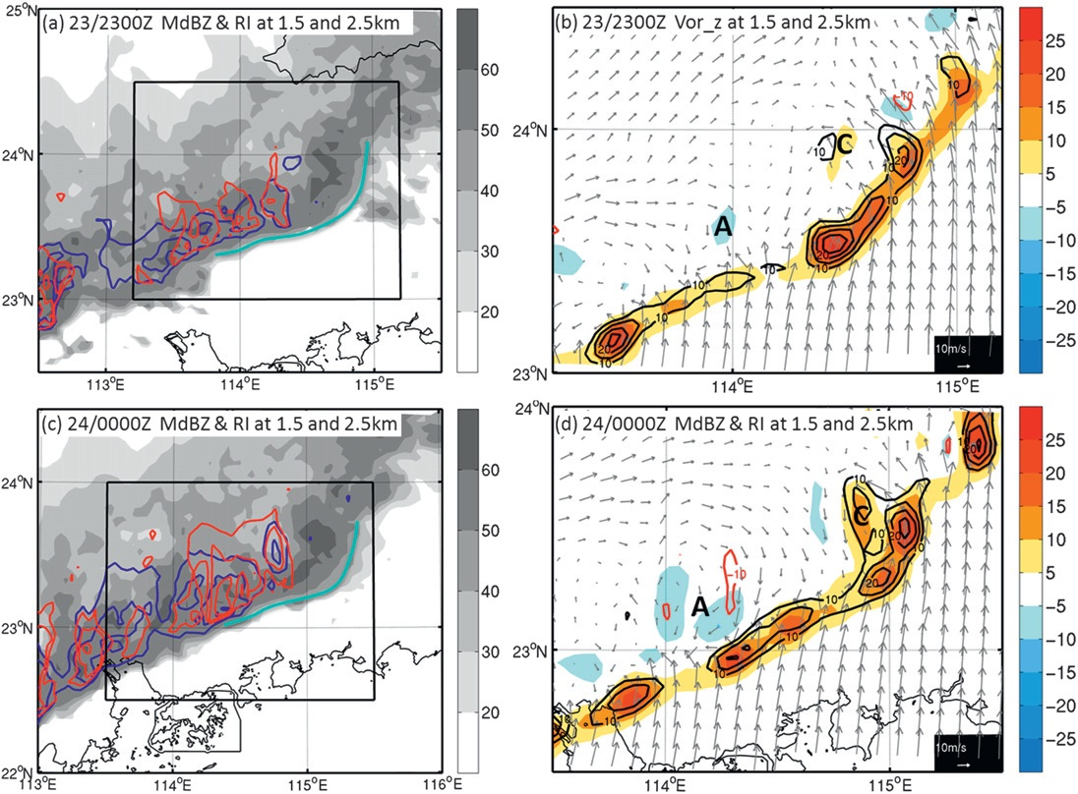
northern bow segment
shaded : dBZ
red contour:
RI at 2.5 km
blue contour:
RI at 1.5 km
shaded :
1.5 km
vertical vorticity
contours :
2.5 km
vertical vorticity
(dBZ)
(s⁻¹)
(dBZ)
(s⁻¹)
line-relative wind vector at 2.5 km height

Slide 26
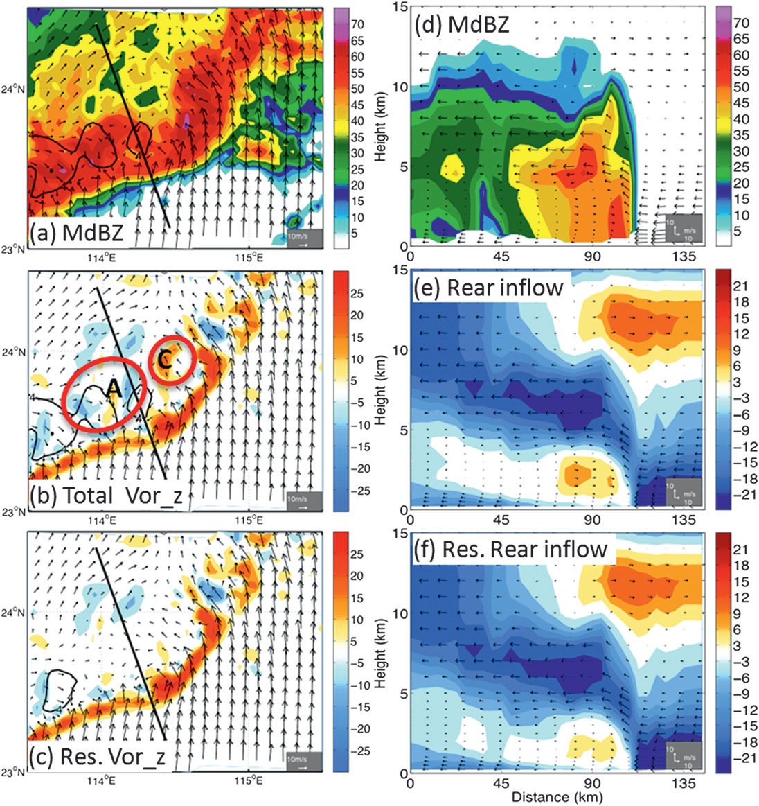
23/2300z
shaded : dBZ
black contours : RI
(dBZ)
(dBZ)
shaded :
wind speed (ms⁻¹)
shaded :
2.5 km
vertical vorticity
black contours : RI
(s⁻¹)
(ms⁻¹)
(s⁻¹)
(ms⁻¹)

Slide 27
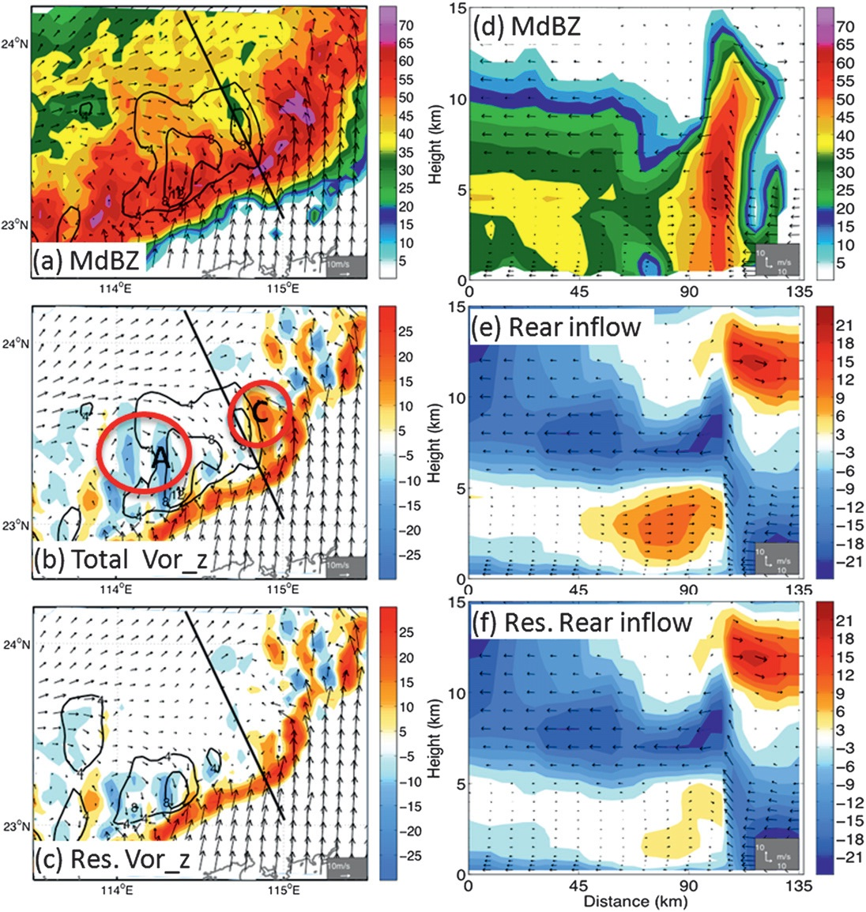
23/2400z
shaded : dBZ
black contours : RI
(dBZ)
(dBZ)
shaded :
2.5 km
vertical vorticity
black contours : RI
shaded :
wind speed(ms⁻¹)
(s⁻¹)
(ms⁻¹)
(s⁻¹)
(ms⁻¹)

Slide 28
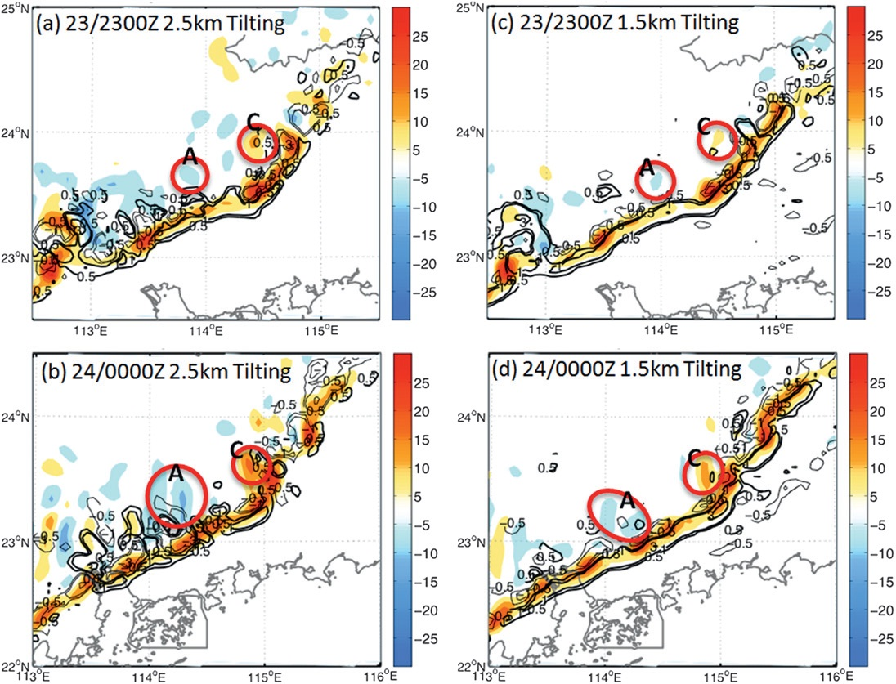
Vorticity budget analysis
(s⁻¹)
(s⁻¹)
(s⁻¹)
(s⁻¹)
shaded : vertical vorticity
contours : tilting terms ($2×{10}^{−8}s^{−2}$)

Slide 29
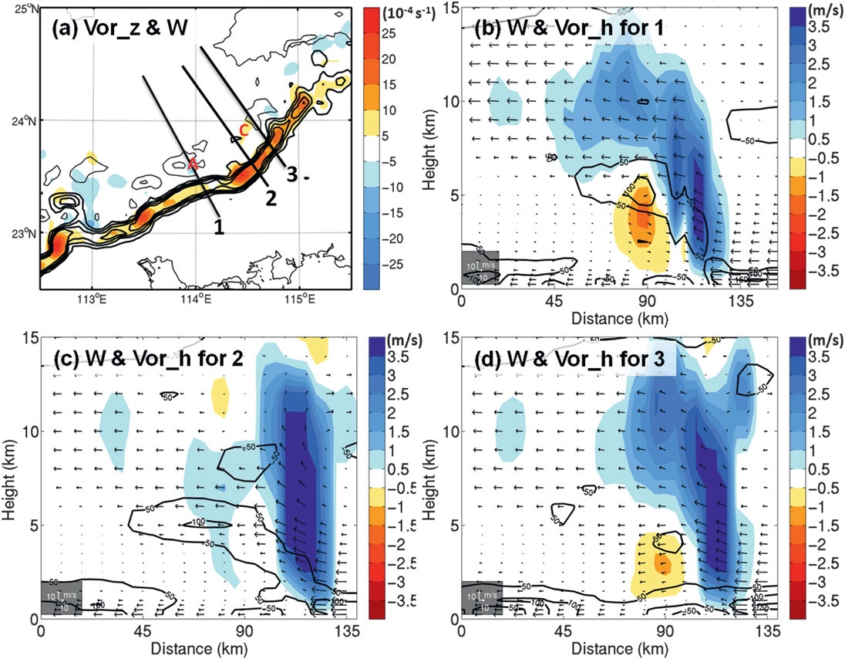
shaded :
1.5km
vertical vorticity
contours :
verticial velocity
shaded :
vertical velocity
contours :
horizontal vorticity

Slide 30
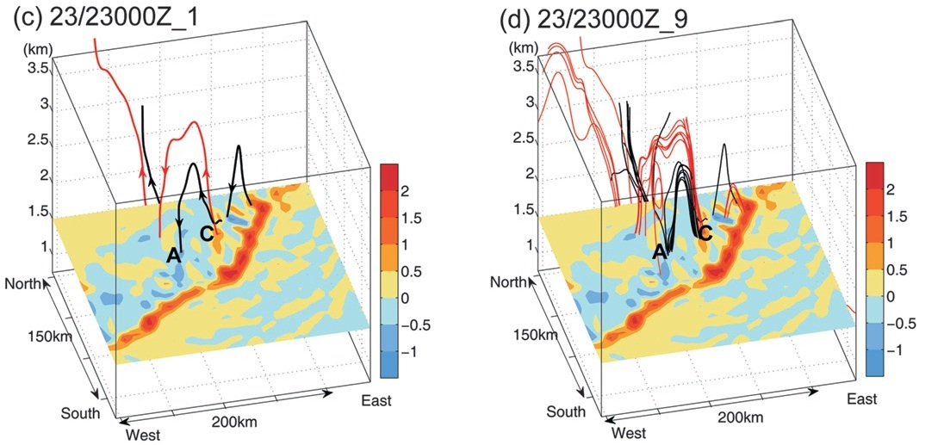
Vortex line (northern bow segment)
(s⁻¹)
(s⁻¹)
shaded :
1.5 km vertical vorticity

Slide 31
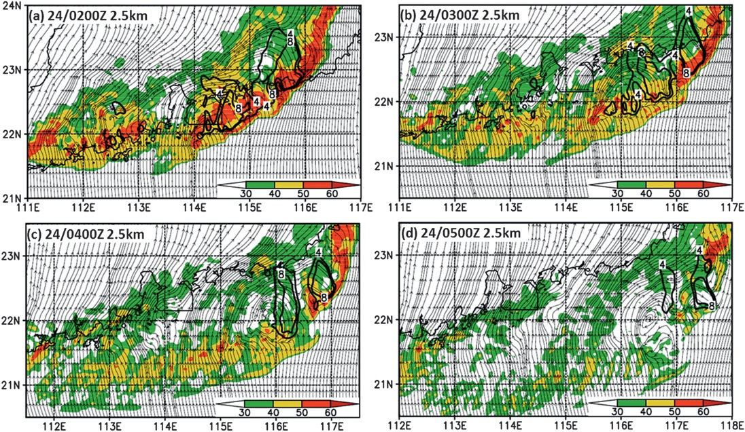
The collapse of the big bowing structure
(dBZ)
(dBZ)
(dBZ)
(dBZ)
shaded : dBZ
stream line : 2.5 km
black contour : RI

Slide 32
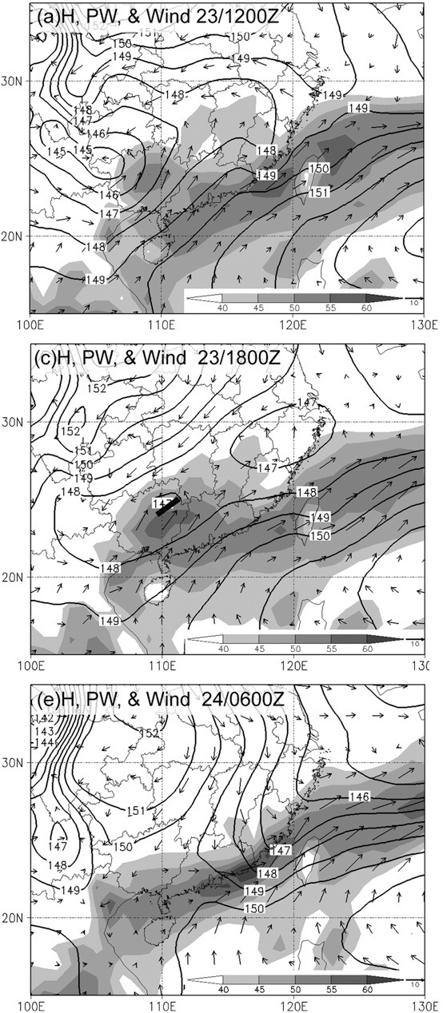
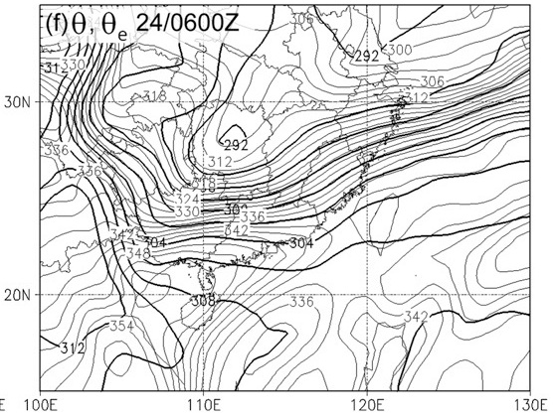
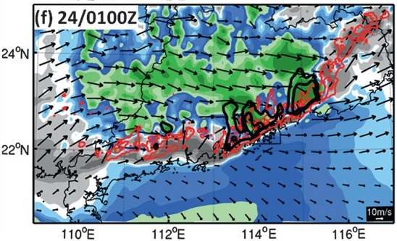
thick contours : θ (K)
thin contours : θe (K)
(wind at 850 hPa)
contour :
geopotential height (m)
shaded : wind shear

Slide 33
Conclusion
The formation of the bowing structure is found to be closely associated with the rear inflow.
Midtropospheric rear inflow is forced by bookend vortices, environmental flow and horizontal pressure gradient are not primarily responsible for the formation of the rear inflow.
Bookend vortices form mainly through tilting of horizontal vorticity：
southern part：Vortices are formed through the upward tilting of lower-
level baroclinic horizontal vorticity.
northern part：vortices are formed through the downward tilting of
upper-level baroclinic horizontal vorticity.

Slide 34
THE END

Slide 35
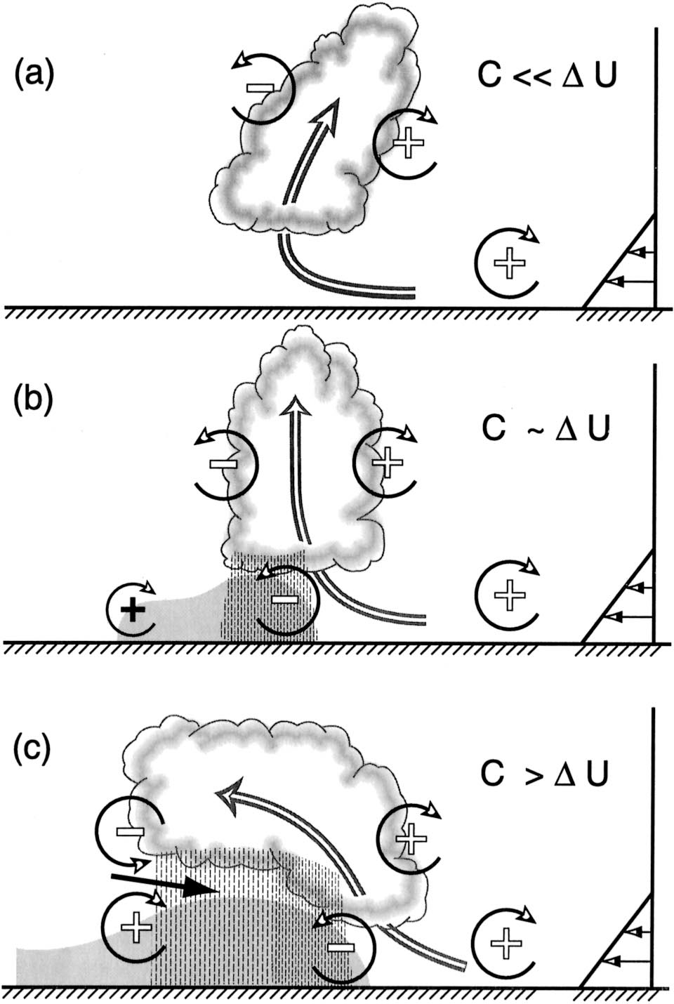
冷池與環境風切的平衡
Notes:
C為系統移動速度，因為颮線主要由冷池推動，所以移動速度可視為冷池的強度。
U為環境風切
A圖顯示當環境風切大於冷池的強度時，風切所造成的正的窩度較大，故會使得對流向下游傾斜
B圖當冷池的強度與環境風切相等時，兩者造成的渦度平衡，產生筆直的強烈上升氣流。
C圖當颮線後期，冷池強度增強且大於環境風切時，冷池產生的負渦度，會使得對流向上游傾斜。

Slide 36
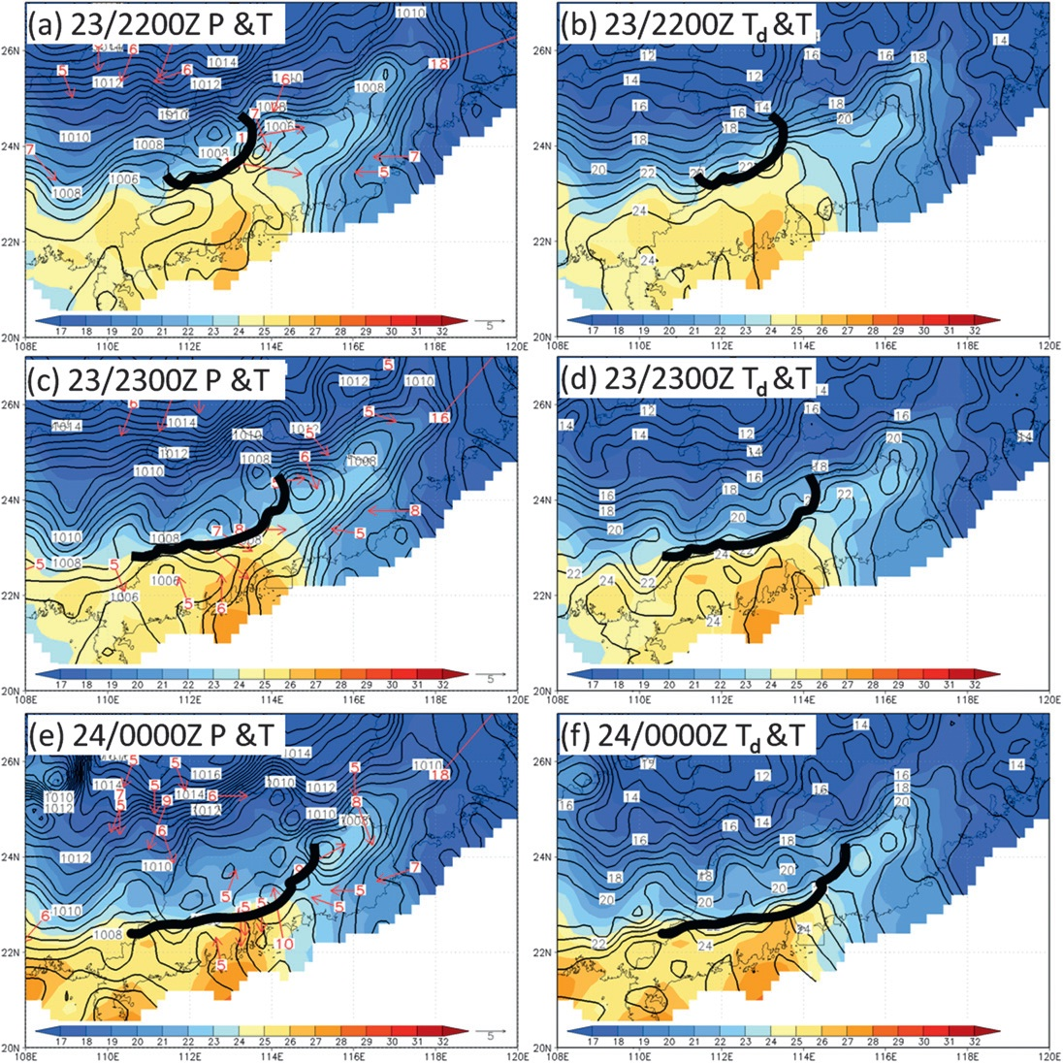
Notes:
(a)在2200出現中尺度低壓在颮線後方
(c)在2300中尺度高壓中心逐漸增強。
(bdf)露點溫度與溫度梯度分布類似，在峰後為乾冷，鋒前暖濕空氣。

Slide 37
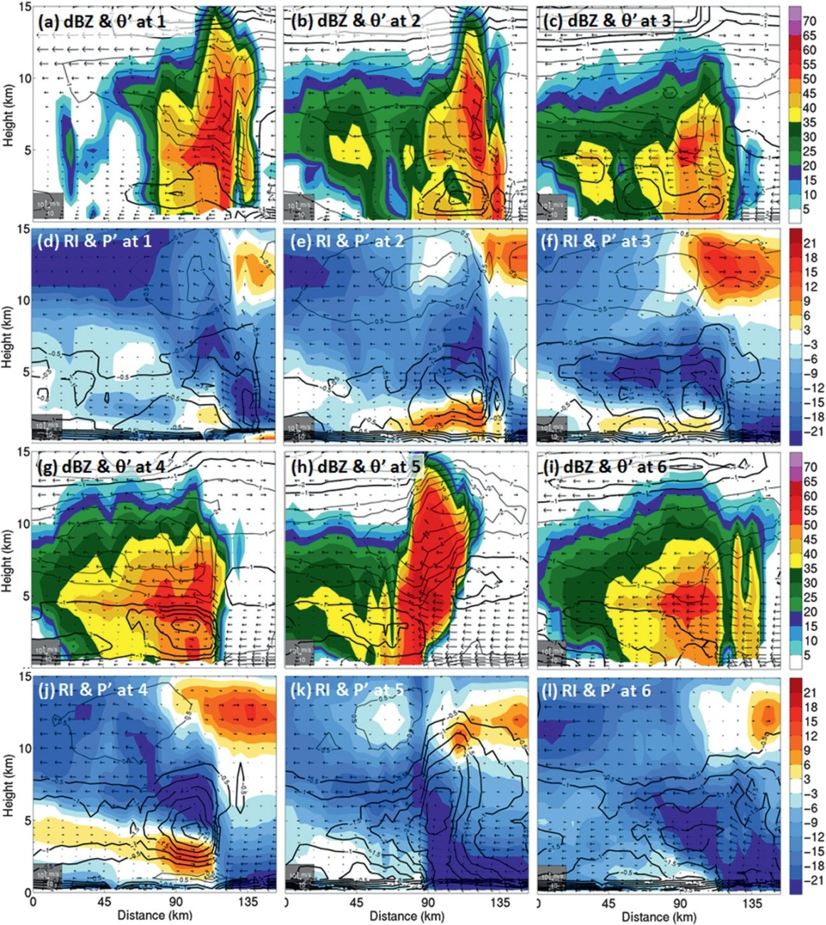
2330 UTC

Slide 38
