Slide 1
Thermodynamic Aspects of Tropical Cyclone Formation
Wang, Z., 2012: Thermodynamic aspects of tropical cyclone formation. J. Atmos. Sci., 69, 2433–2451.
reporter : Lin Ching
Based on
Dunkerton, T. J., M. T. Montgomery, and Z. Wang, 2009: Tropical cyclogenesis in a tropical wave critical layer: Easterly waves. Atmos. Chem. Phys., 9, 5587–5646.
Wang, Z., T. J. Dunkerton, and M. T. Montgomery, 2010a: Genesis of Pre-Hurricane Felix (2007). Part I: The role of the easterly wave critical layer. J. Atmos. Sci., 67, 1711–1729.
Wang, Z., T. J. Dunkerton, and M. T. Montgomery, 2010b: Genesis of Pre-Hurricane Felix (2007). Part II: Warm core formation, precipitation evolution, and predictability. J. Atmos. Sci., 67, 1730–1744.

Slide 2
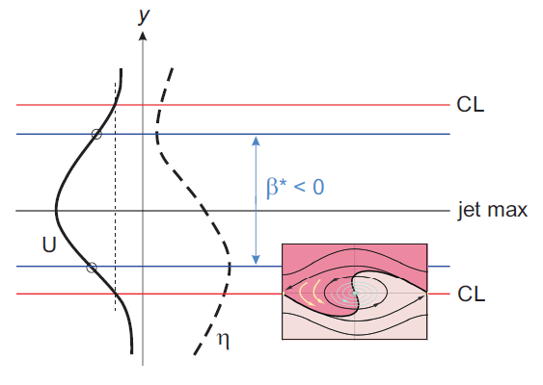
Marsupial Paradigm: Hypotheses
Dunkerton et al. 2009
The marsupial paradigm indicates that the critical layer of a tropical easterly wave is important to tropical storm formation because
Hypothesis 1:
  Wave breaking of the cyclonic vorticity near the critical surface provides a favorable environment for vorticity aggregation and TC formation;
Hypothesis 2:
  The wave critical layer is a region of closed circulation, where air is repeatedly moistened by convection and protected from dry air intrusion;
Hypothesis 3:
  The parent wave is maintained and possibly enhanced by MCV within the wave critical layer.

Slide 3
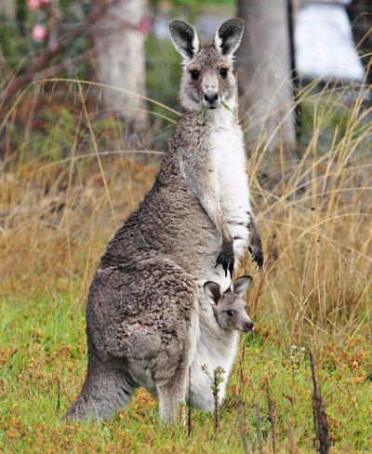
Marsupial Paradigm: Hypotheses
Dunkerton et al. 2009
The marsupial paradigm indicates that the critical layer of a tropical easterly wave is important to tropical storm formation because
Hypothesis 1:
  Wave breaking of the cyclonic vorticity near the critical surface provides a favorable environment for vorticity aggregation and TC formation;
Hypothesis 2:
  The wave critical layer is a region of closed circulation, where air is repeatedly moistened by convection and protected from dry air intrusion;
Hypothesis 3:
  The parent wave is maintained and possibly enhanced by MCV within the wave critical layer.
Marsupials are mammals in which the female typically has a pouch (called the marsupium, from which the name 'Marsupial' derives) in which it rears its young through early infancy.
The hypothetical pathway for genesis via tropical waves may be regarded as a marsupial theory of tropical cyclogenesis in which the “juvenile” proto-vortex is carried along by the “mother” wave until it is ready to be “let go” as an independent tropical disturbance.

Slide 4
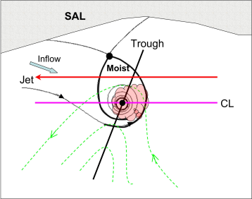
Over the Atlantic and the eastern Pacific, tropical easterly waves play an important role in tropical cyclogenesis, and nearly 85% of the intense (or major) hurricanes originate from tropical easterly waves (e.g., Landsea 1993).
Formation of a tropical storm within a wave pouch
dashed : streamlines in ground-based frame of reference (inverted-V pattern)
solid : streamlines in frame of reference moving at same speed with wave (wave pouch)
gray shading : deep convection is sustained within the pouch
V
Wave pouch protect mesoscale vortices inside from hostile environment (dry air from Saharan air layer)
inverted-V pattern
Wang et al. 2010a
The intersection of the critical latitude and the trough axis pinpoints the pouch center as the preferred location for tropical cyclogenesis.

Slide 5
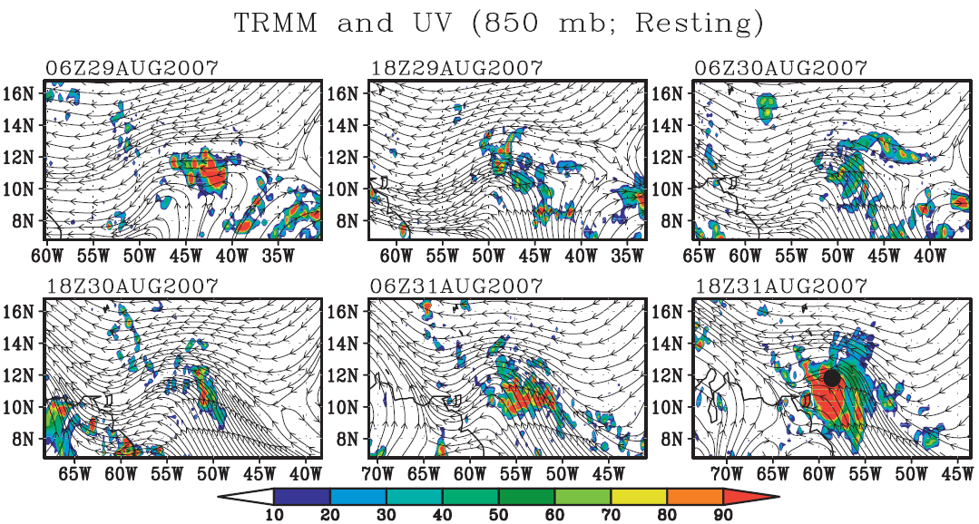
Felix: TRMM and 850 hPa streamlines
(Resting; Day -2.5~Day 0)
Wang et al. 2010a
No closed circulation!
Why this location?

Slide 6
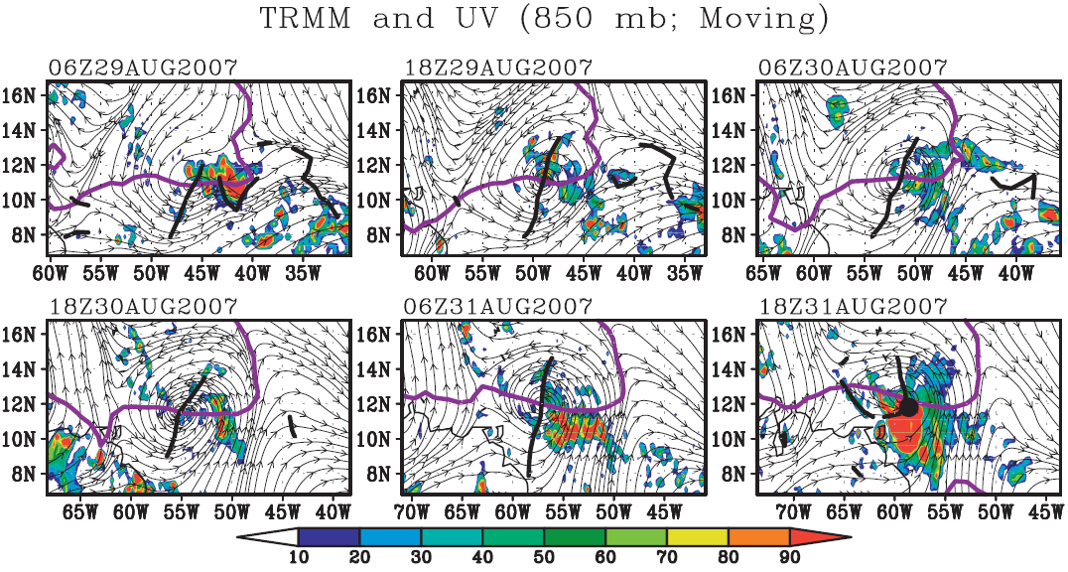

Felix: TRMM and Translated 850 hPa Streamlines
Lagrangian Flow
Wang et al. 2010a
wave relative flow
Center of the pouch!
C_{p} : wave propagation speed

Slide 7
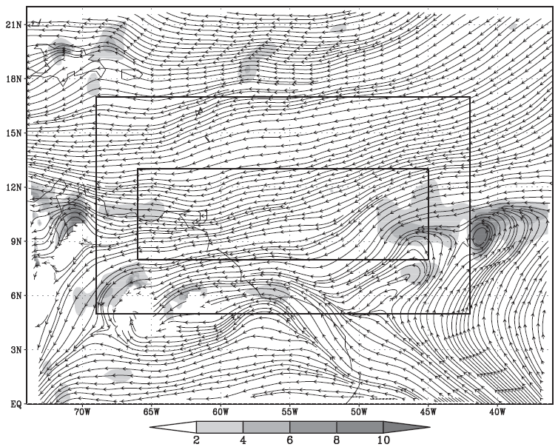
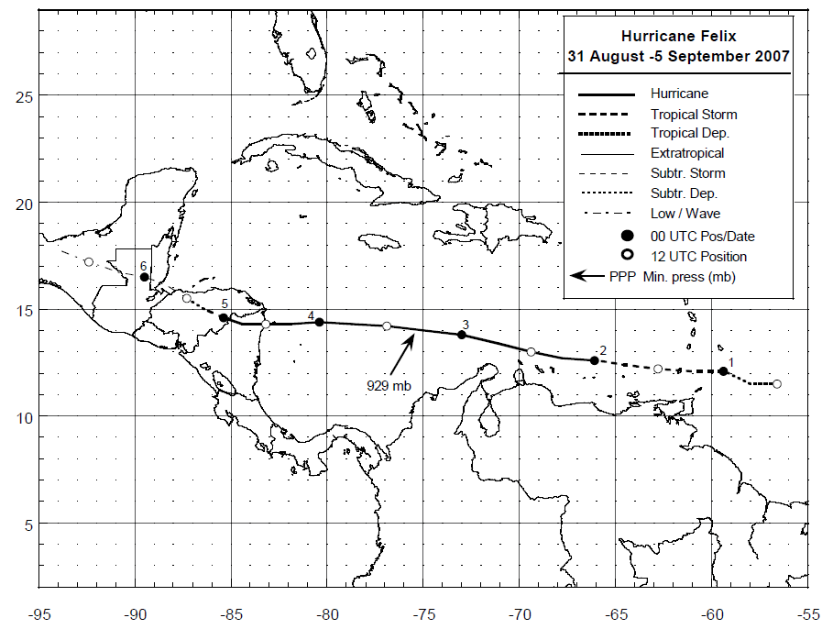
Model Configuration
three inner model grids
WRF model
4-domain: 81, 27, 9, 3 km
27 vertical levels
initial time is 00Z 29 Aug, 2007
69-h run with the end at NHC-declared genesis time (21Z 31 Aug, 2007)
input data: ECMWF 6-hrly, T106 analyses (1.125 x 1.125)
Domain 1, 2: new Kain-Fritsch scheme
Domain 3, 4: no cumulus scheme
WRF single-moment, 6-class microphysics (WSM6)
Yonsei University (YSU) pbl scheme
Wang et al. 2010a

Slide 8
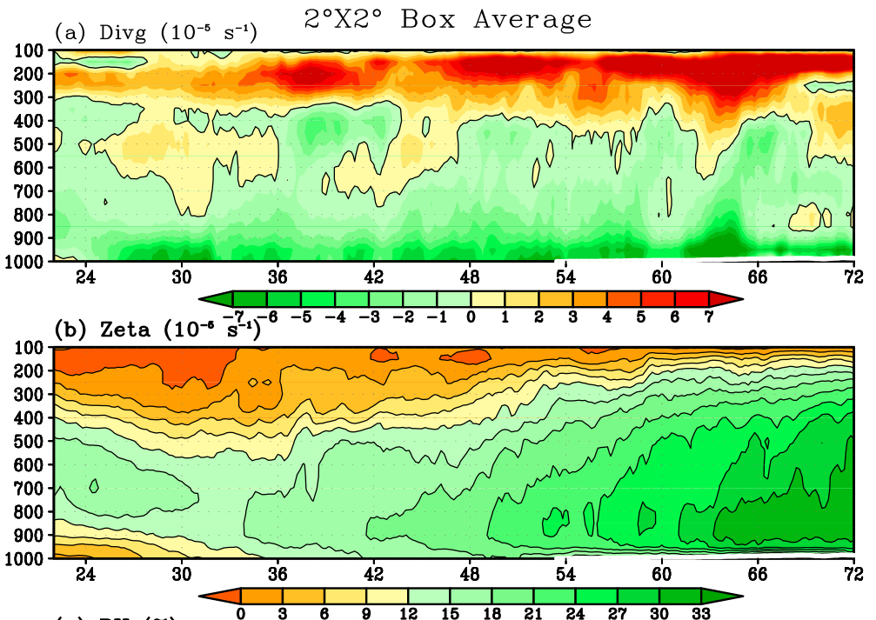
Time-height Cross Section: Divg and Zeta
P (mb)
Time (hour)
Wang et al. 2010a
Bottom-up development: Low-level convergence plays the key role in spinning up the cyclonic circulation near the surface.

Slide 9
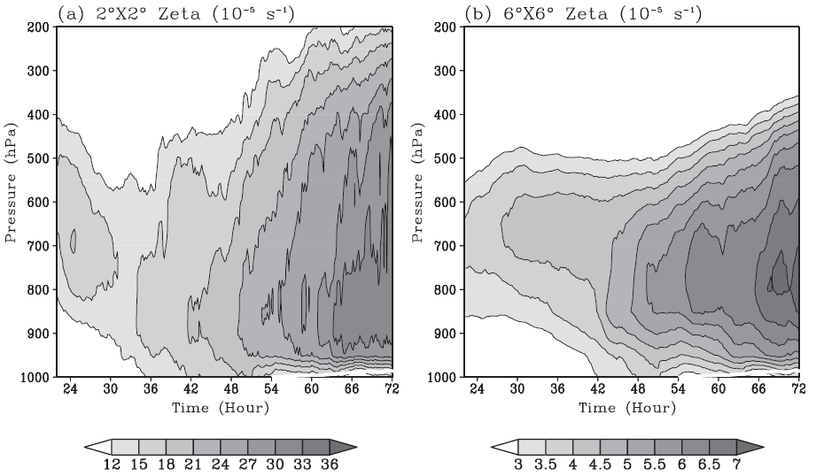
Time-height Cross Section of relative vorticity
meso—β– scale
meso—α– scale
vorticity increase near the surface is mainly
due to the low-level convergence, consistent with the bottom-up development theory
why the vorticity evolution is different at different spatial scales?

Slide 10
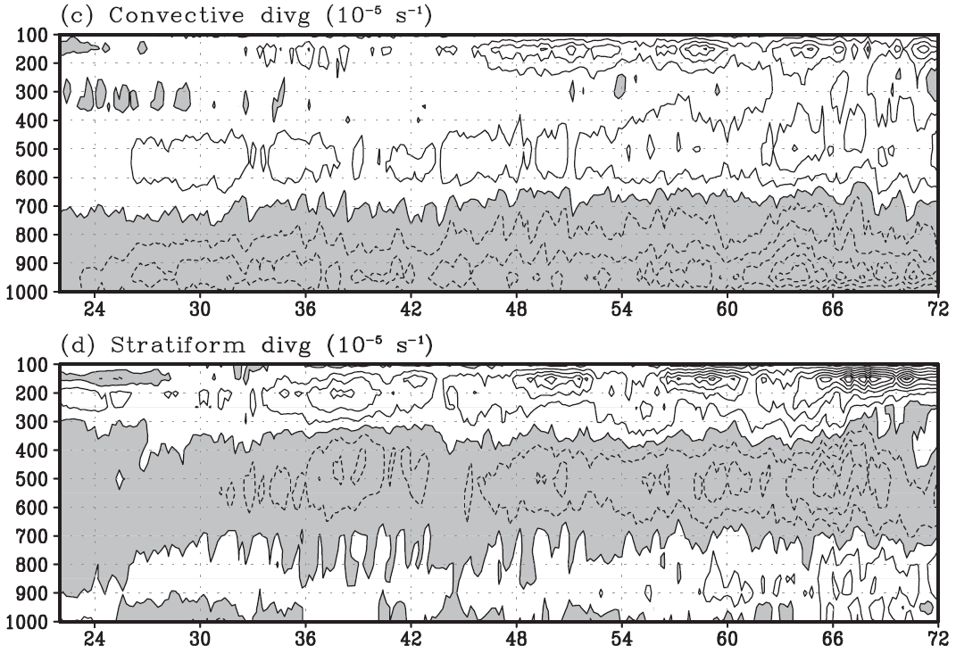
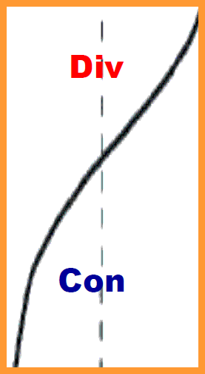
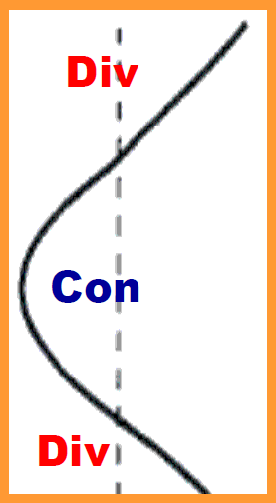
Stratiform vs. Convective
Divergence Profiles
2º box following the wave pouch
Convective
Stratiform
Pressure (mb)
Wang et al. 2010b
Time (hour)
Stratiform process: favors the development of a mid-level vortex.
Convective process: favors the spin-up of the low-level circulation.

Slide 11
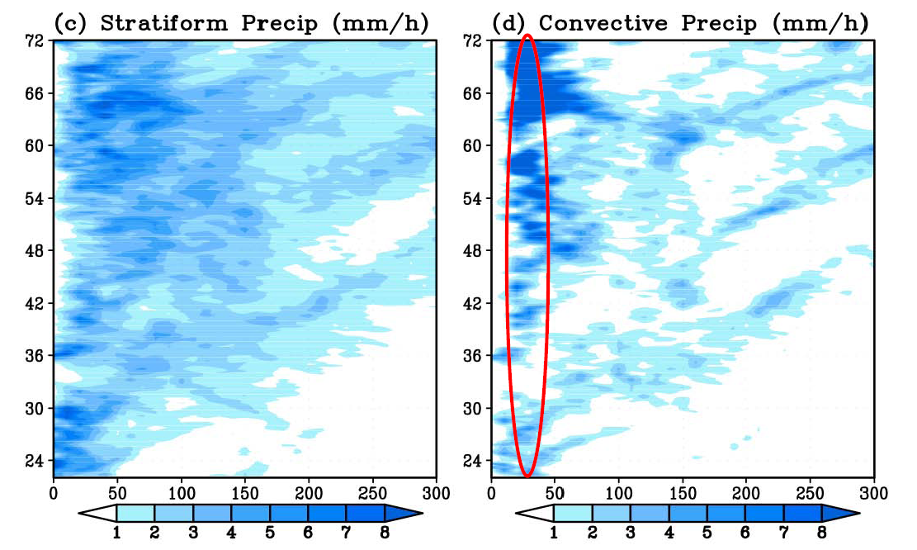
Time-Radius Plots of Stratiform vs. Deep Convective Precipitation
Time (hour)
Wang et al. 2010b
Radius (km)

Slide 12

vorticity equation in isobaric coordinates
(1)
local tendency of the absolute vorticity in the wave’s comoving frame of reference
convergence of advective vorticity flux
(horizontal advection of the absolute vorticity and the stretching effect)
convergence of the nonadvective vorticity flux
(sum of the vertical advection of the vertical vorticity and the tilting effect)
residual term, including diffusion and subgrid processes.
η is the absolute vorticity,
V’ is the wave-relative horizontal flow,
p is pressure,
v is the vertical velocity in isobaric coordinates,
k is the vertical unit vector

Slide 13
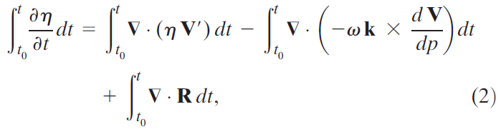
integrated vorticity equation
The vorticity budget terms are usually very noisy (Wang et al. 2010a).
To get a smooth evolution pattern, we integrated Eq. (1) with time:
lhs term represents the net change of absolute vorticity during the time interval t - t0,
rhs terms represent the accumulative effects of different processes during the same time period

Slide 14
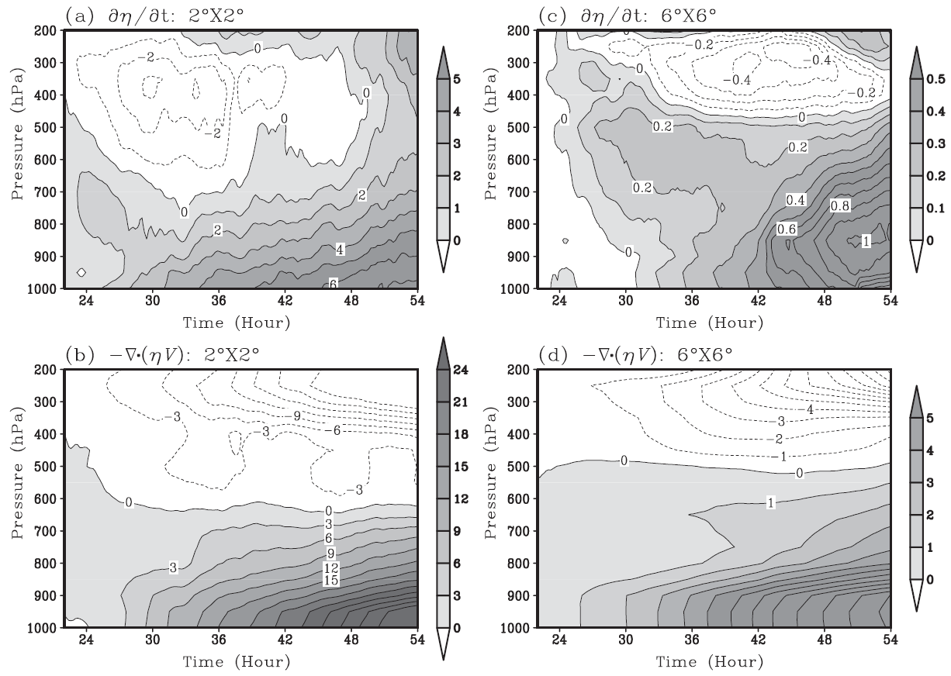
net vorticity tendency
convergence of the advective vorticity flux
meso-β
persistent spinup
meso-α
10⁻⁵ s⁻¹

Slide 15

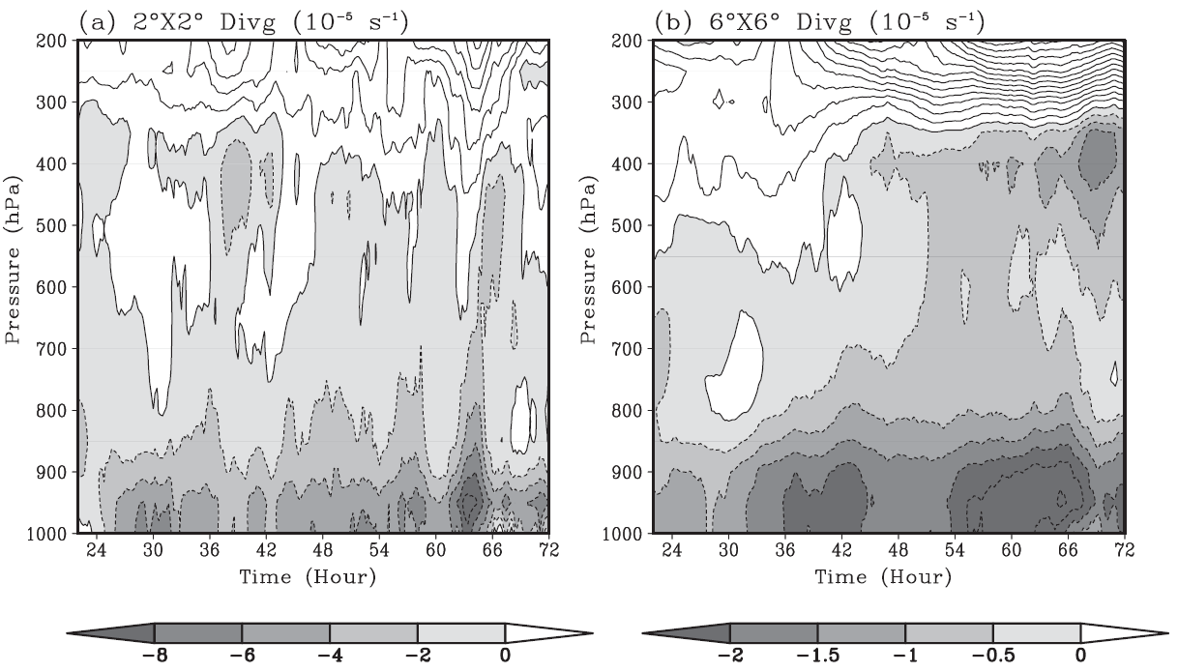
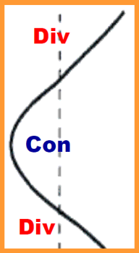
meso-β
meso-α
Convective
Stratiform
stronger low-level convergence near the pouch center is associated with the spatial distribution of convective and stratiform precipitation

Slide 16
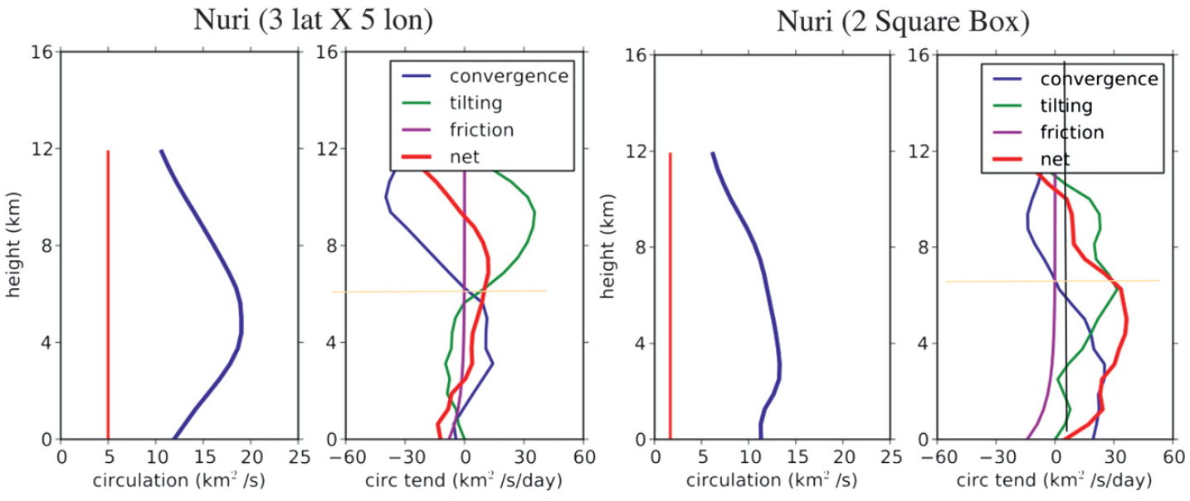
circulation budget analysis
Raymond and Lopez Carrillo (2011)
meso-α
meso-β
midlevel maximum with the maximum positive convergence tendency between 4 and 5.5 km
-- stratiform precipitation-dominant profile
convergence term contributes to positive tendency below the 6.5-km.
The positive tendency is particularly strong below 3 km
-- deep convection-dominant profile

Slide 17
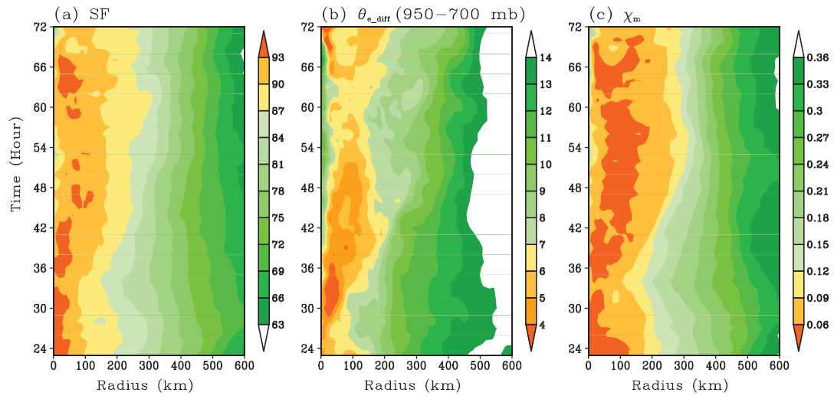
saturation fraction (SF): ratio of total precipitable water to saturated precipitable water from the surface to 300 hPa
θ_{e_diff} : a measure of potential instability
χ_{m} : ratio of the midlevel saturation deficit to the surface disequilibrium

Slide 18
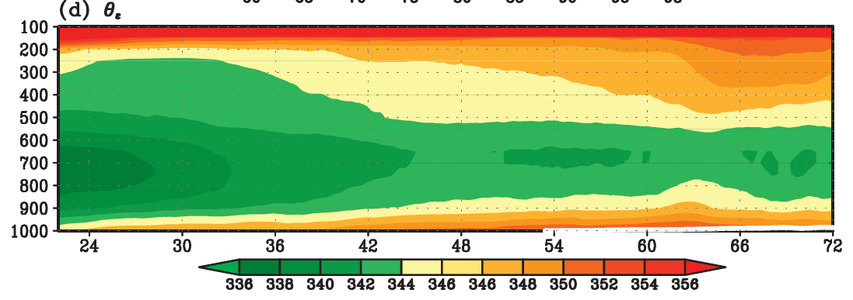
θ_{e_diff} : a measure of potential instability
The small θ_{e_diff} near the pouch center likely results from persistent convection, which moistens the middle troposphere, elevates the midlevel θ_{e}, and reduces the downdraft convective available potential energy (DCAPE) (Tory andMontgomery 2008; Tory and Frank 2010).
Wang et al. 2010a
=> favorable environment for further convection

Slide 19


χ_{m} : introduced by Emanuel (1995) for the ‘‘Coupled Hurricane Intensity Prediction System’’ (CHIPS) model.
-> ratio of the midlevel saturation deficit to the surface disequilibrium
s_{m} : moist entropies of middle troposphere
s_{b} : moist entropies of boundary layer
s₀* : saturation entropy of sea surface
moist entropy :
Small values of χ_{m} are due either to small midlevel saturation deficit or to induced surface disequilibrium (and thus stronger surface latent and sensible heat fluxes).

Slide 20
meso-β scale region near the pouch center
  high saturation fraction
  small θ_{e} difference between surface and mid-level
  small values of χ_{m}
=> thermodynamically favorable for deep convection and tropical cyclone development.

Slide 21
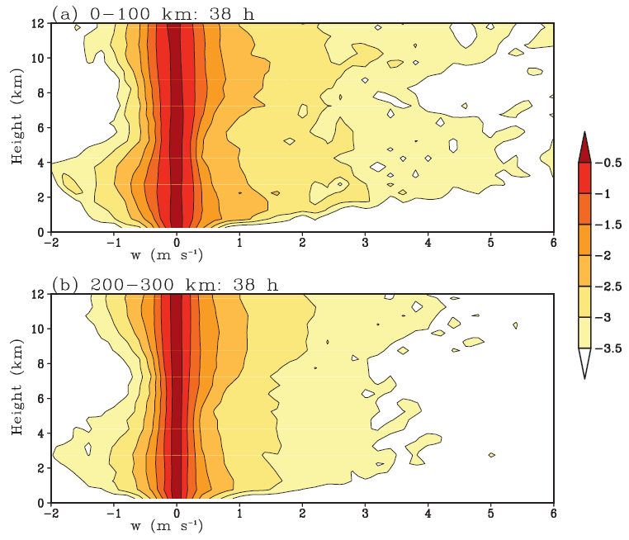
Contoured Frequency by Altitude Diagrams (CFAD) of Vertical Velocity

Slide 22
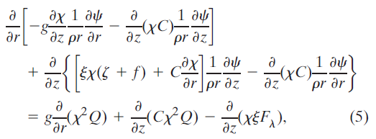
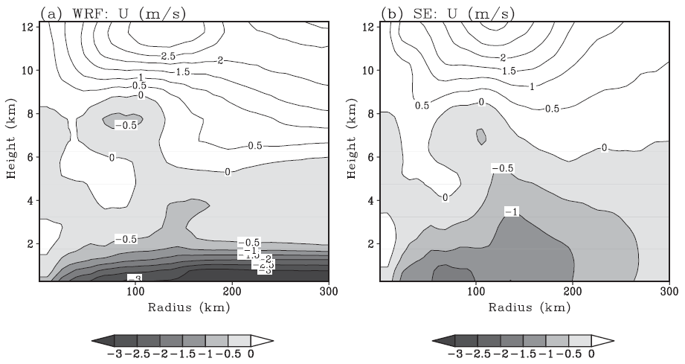
To examine the transverse circulation associated with the wave pouch before the formation of a tropical depression by using Sawyer–Eliassen equation (Bui et al., 2009)
Sawyer–Eliassen (SE) equation
On account of the discrepancies, the SE equation will be used only to understand the qualitative roles of the convective heating and stratiform heating in spinning up the TC protovortex at the pregenesis stage, and we mainly focus on the inner pouch region.

Slide 23
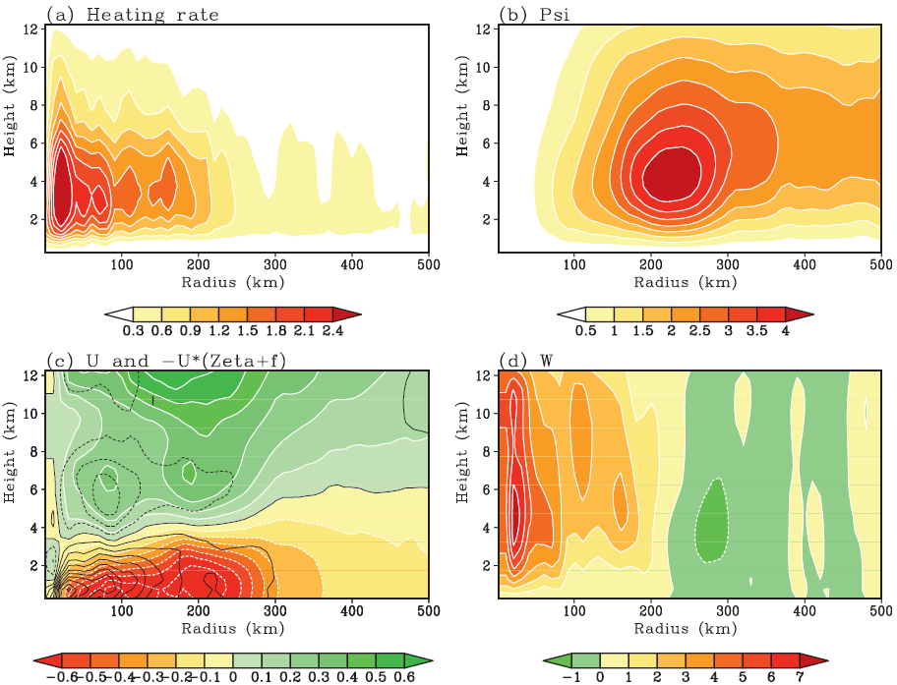

Convective heating
from WRF
SE streamfunction
momentum tendency

Slide 24
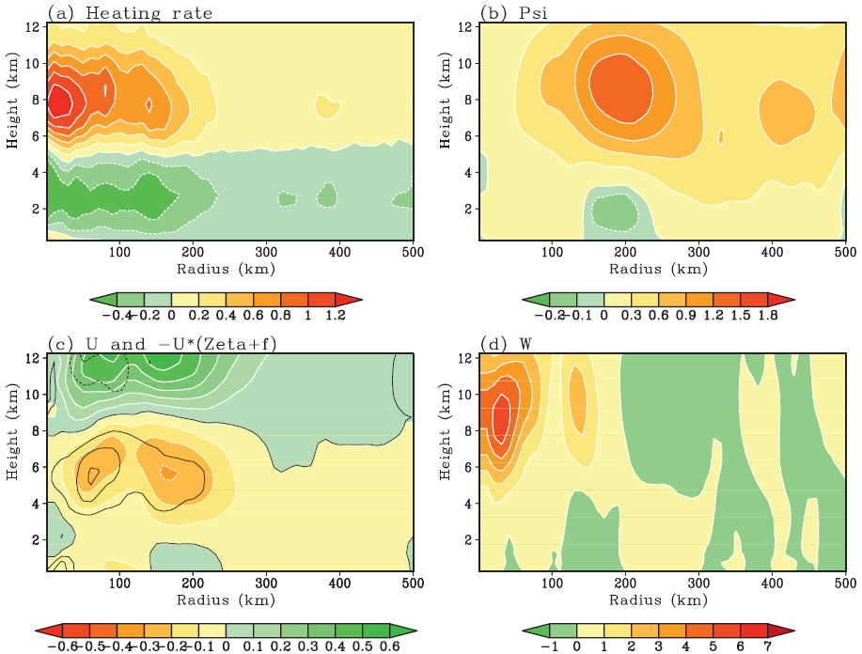
stratiform heating
condensational heating
evaporative cooling
surface
heat
fluxes

Slide 25
PREDICT Field Experiments in 2010
  PREDICT: Pre-Depression Investigation of Cloud-systems in the Tropics experiment sponsored by the National Science Foundation (NSF )
NSF–NCAR Gulfstream V (GV) aircrafts
Over the west Atlantic from 15 August to 30 September 2010.
Dropsonde data used from the PREDICT field experiment (Montgomery et al. 2012)
Dynamical forecast method (marsupial paradigm) was used to predict the track of possible genesis locations, and flight patterns were designed based on the tracks.
Developing system :
pre-Karl and pre-Matthew
Nondeveloping system :
ex-Gaston

Slide 26
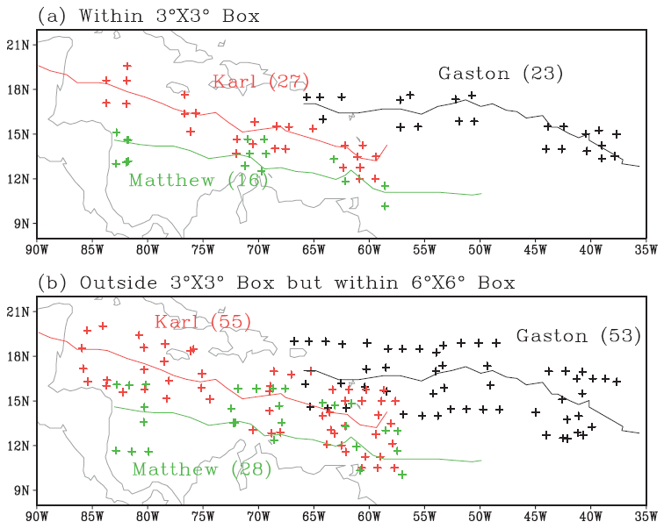
PREDICT GV Dropsondes
inner pouch region
outer pouch region

Slide 27
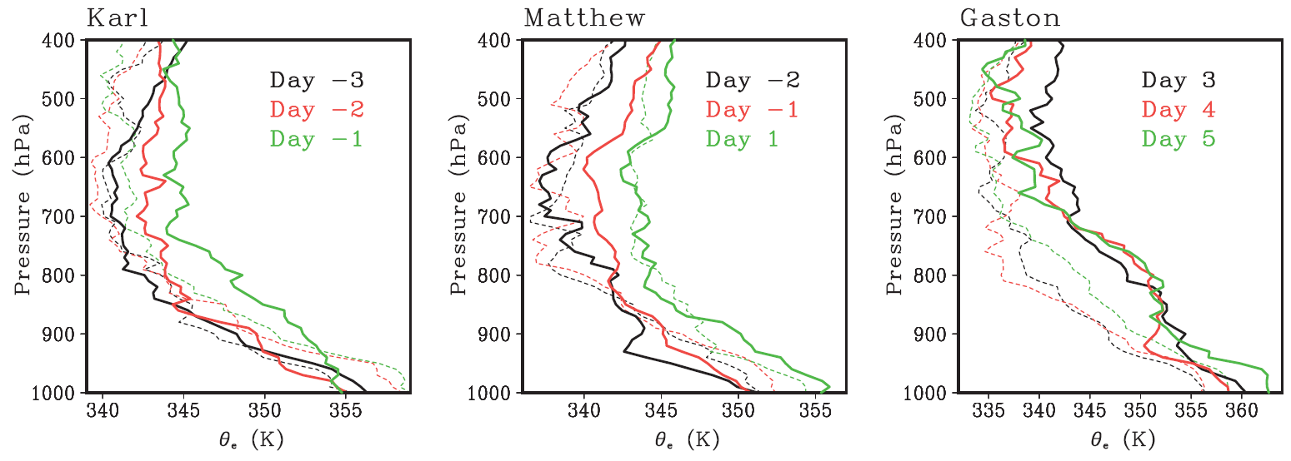
θ_{e}
Dash:
outer pouch
Solid:
inner pouch
developing wave :
by the increase of the midlevel θ_{e} and decrease of θ_{e}_diff prior to genesis near the pouch center
midlevel θ_{e} is warmer at the inner pouch region than at the outer pouch region
thermodynamic conditions near the pouch center may be different from the pouch average,
thermodynamic conditions near the pouch center are critical for tropical cyclone development.

Slide 28
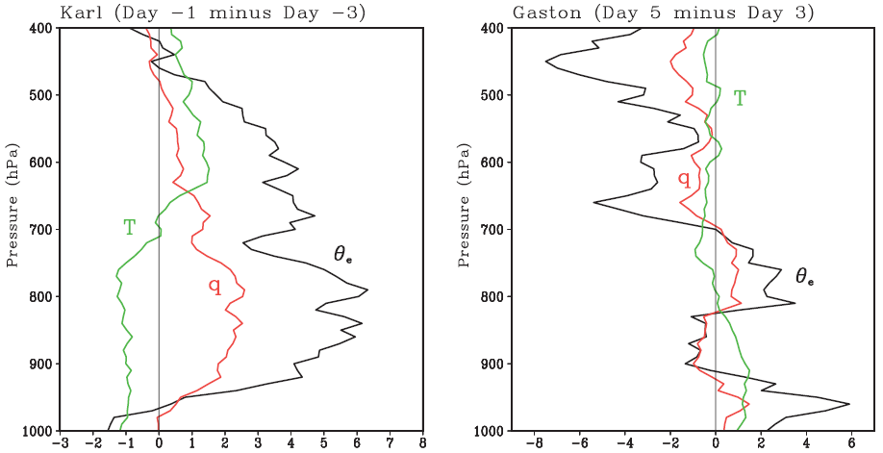
inner pouch
the increase of equivalent potential temperature is due to the increase of specific humidity or midlevel moistening.
midlevel drying is likely the cause for the nondevelopment of Gaston.

Slide 29
Conclusions
The center of the wave pouch is characterized by high saturation fraction, small θ_{e} difference between the surface and the middle troposphere, and a short incubation time scale
The thermodynamic conditions near the pouch center are particularly favorable for moist deep convection. The strong radial gradient of the convective heating can effectively drive the secondary circulation and spin up a surface vortex.
PREDICT dropsondes showed that the mid-level θ_{e} near the pouch center becomes 3-5 K warmer than that at the outer pouch region one to two days prior to genesis – an indicator of genesis?
The thermodynamic conditions near the pouch center are thus critically important for TC formation but may be masked out if a spatial average is taken over the pouch scale.

Slide 31
Tropical cyclogenesis
two-stage (Karyampudi and Pierce 2002):
preconditioning of the synoptic andmeso-a environment
construction and organization of a tropical-cyclone-scale vortex at the meso-b scale
two groups of ideas regarding this stage:
‘‘top-down’’ development wherein a vortex in the midtroposphere [which presumably forms within the stratiform region of a mesoscale convective system (MCS)] somehow engenders a surface circulation by ‘‘building downward’’ from the midtroposphere
‘‘bottom-up’’ development in which the spinup of the system-scale vortex occurs at low altitudes (below ;3 km) in association with the generation and aggregation of primarily cyclonic potential vorticity (PV) anomalies through condensation heating in relatively downdraft-free convection

Slide 32
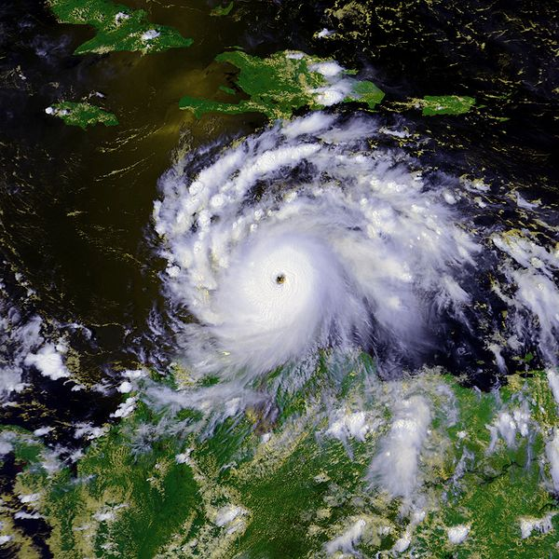
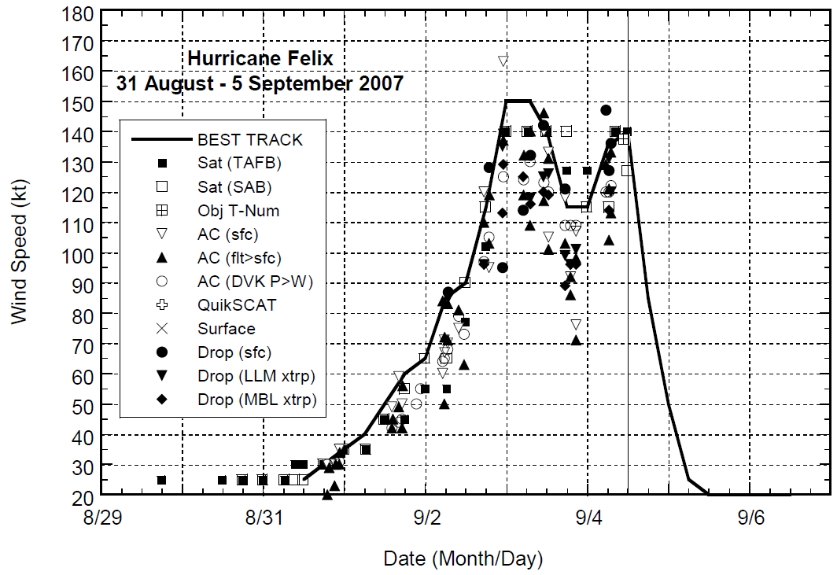
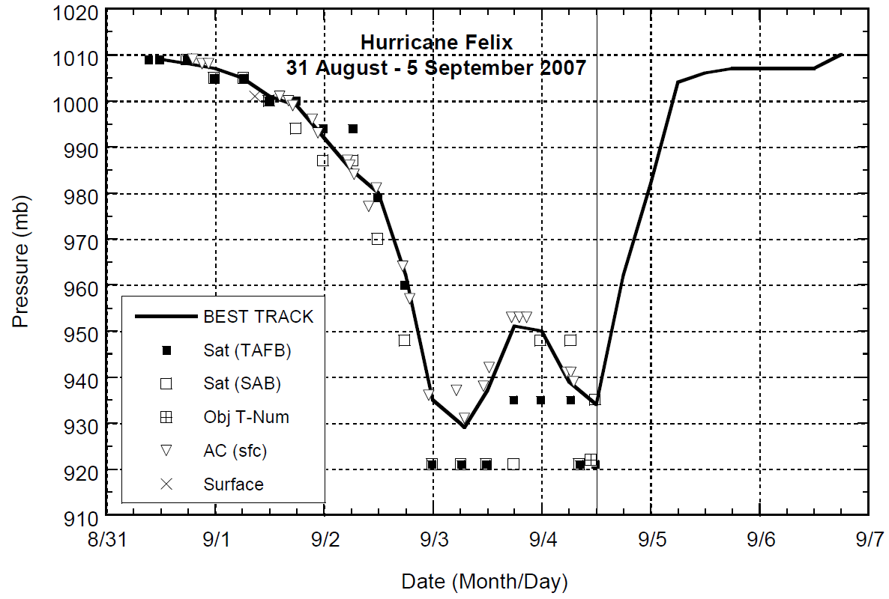
Hurricane Felix
31 August -5 September 2007
929 mb

Slide 33
Consideration of horizontal scales exposes the
challenging nature of the problem
Planetary scale: 10000-40000 km
  Madden-Julian Oscillation
  Kelvin waves
  Rossby & Rossby-gravity waves
Synoptic scale: 2000-8000 km
  Easterly waves
  Hydrodynamic instability of the ITCZ
  Extratropical intrusions
Meso-α: 200-2000 km
  Inertia-gravity waves
  Tropical wave critical layer
  Isolated regions of recirculation
Meso-β : 20-200 km
  Tropical cyclones, hurricanes & typhoons
  Gravity waves
  Mesoscale convective systems
Meso-γ : 2-20 km
  Vortical hot towers
  Deep convective clouds
  Squall lines
2
1: Forward enstrophy cascade
1
2: Inverse energy cascade

Slide 34
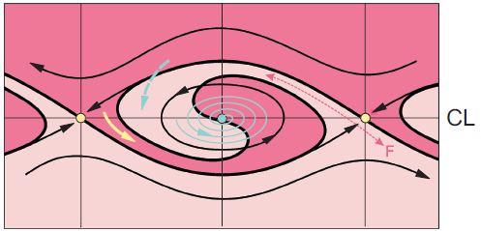
Critical Layer
Critical surface/latitude (linear): where Cp=U or the wave intrinsic frequency = 0
Wave critical layer (nonlinear)
  A layer with finite width due to the nonlinear interaction of the wave with its own critical surface
  A region of approximate closed circulation, where air parcels are trapped and the flow is isolated from its surrounding
y
Trough
x

Slide 35

Dunkerton et al. 2009
Adapted from Andrews et al., 1987
critical latitude
Kelvin- Helmholtz Instability
Kelvin cat’s eye
cat’s eye provides
a region of cyclonic vorticity and weak deformation by the resolved flow,
containment of moisture entrained by the developing gyre and/or lofted by deep convection therein,
confinement of mesoscale vortex aggregation,
a predominantly convective type of heating profile,
maintenance or enhancement of the parent wave until the vortex becomes a self-sustaining entity and emerges from the wave as a tropical depression.

Slide 36
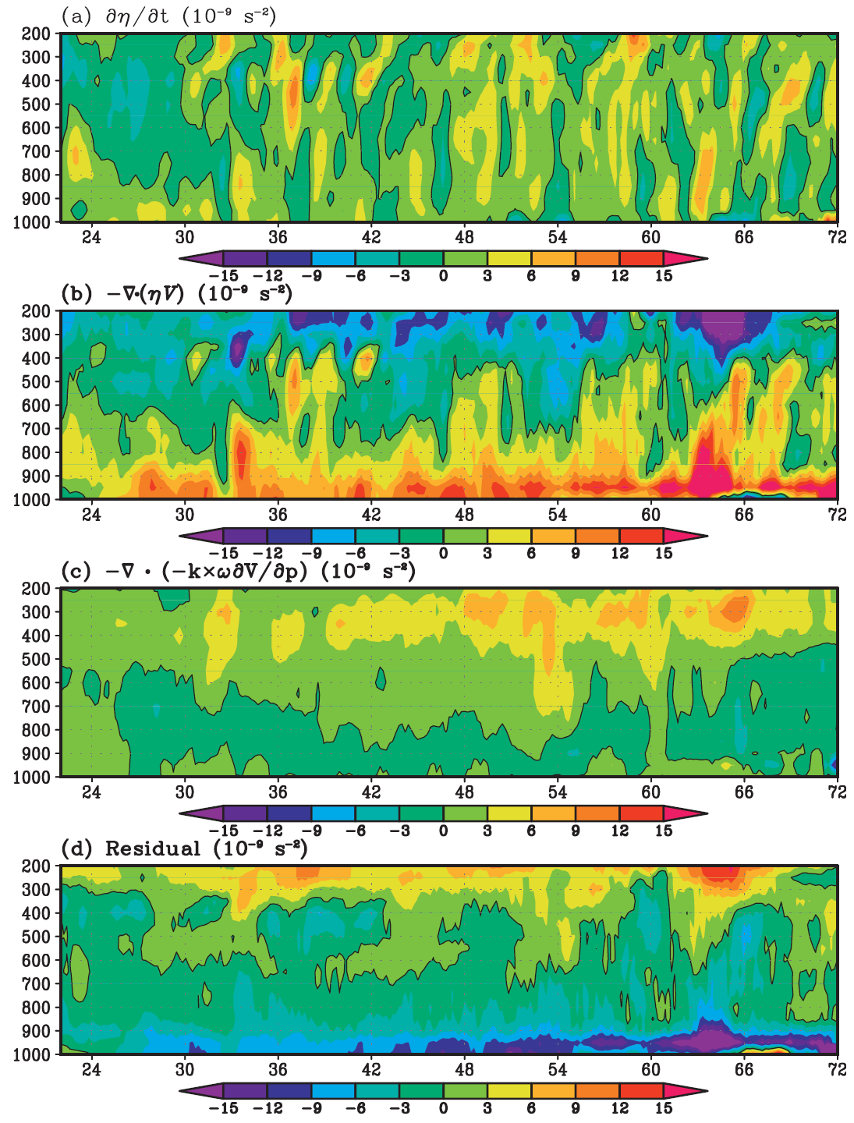

Slide 37
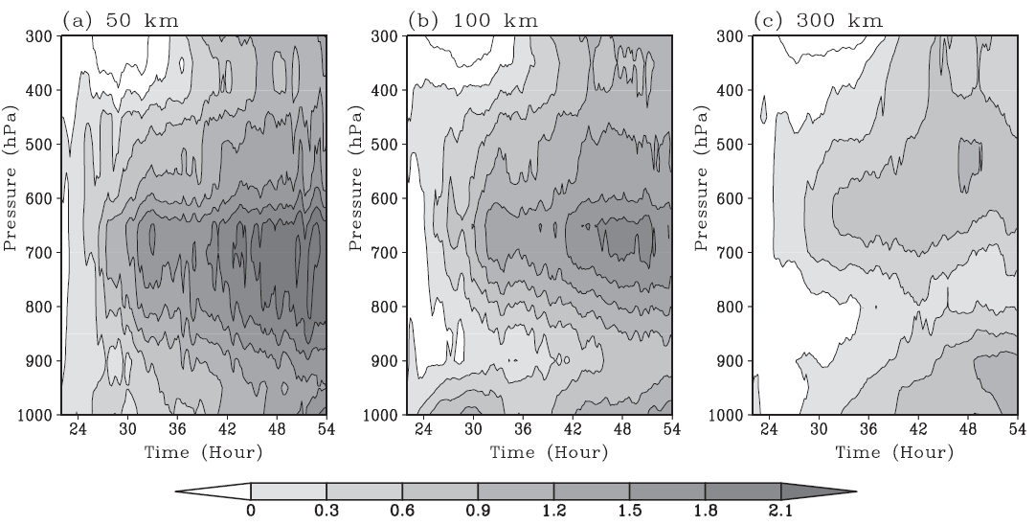
change of virtual temperature from t = 22 h
W
W

