Slide 1
Sensitivity of idealized squall-line simulations to the level of complexity used in two-moment bulk microphysics schemes.
Speaker: Huan Chen
Professor: Ming-Jen Yang
Van Weverberg, K., A. M. Vogelmann, H. Morrison, and J.
Milbrandt, 2012: Sensitivity of idealized squall-line
simulations to the level of complexity used in two-
moment bulk microphysics schemes. Mon. Wea. Rev.,
140, 1883–1907.

Slide 2
Introduction
This paper investigates the level of complexity that is
needed within bulk microphysics schemes to represent the
essential features associated with deep convection. To do so,
the sensitivity of surface precipitation is evaluated in two-
dimensional idealized squall-line simulations with respect to
the level of complexity in the bulk microphysics schemes of
H. Morrison et al. and of J. A. Milbrandt and M. K. Yau.
Factors examined include the number of predicted moments
for each of the precipitating hydrometeors, the number and
nature of ice categories, and the conversion term
formulations.

Slide 3
Some models tend to have more complexity by predicting not only the mixing ratio but also the number concentration of the hydrometeors (‘‘two-moment schemes’’; e.g., Ferrier 1994; Morrison et al. 2009, hereafter MTT; Seifert and Beheng 2001) and the radar reflectivity (‘‘three-moment schemes’’; e.g., Milbrandt and Yau 2005b, hereafter MY).

Slide 4
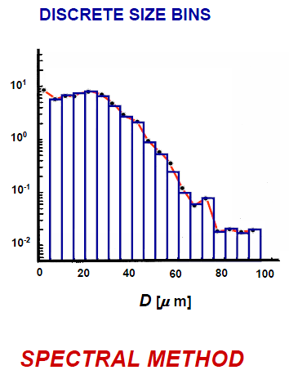
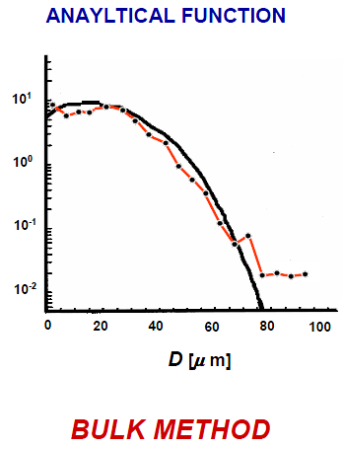
Keyword
two-moment bulk microphysics scheme
A Multi-Moment Bulk Microphysics Scheme
and the Explicit Simulation of Hail
(Milbrandt and Yau
2004)

Slide 5
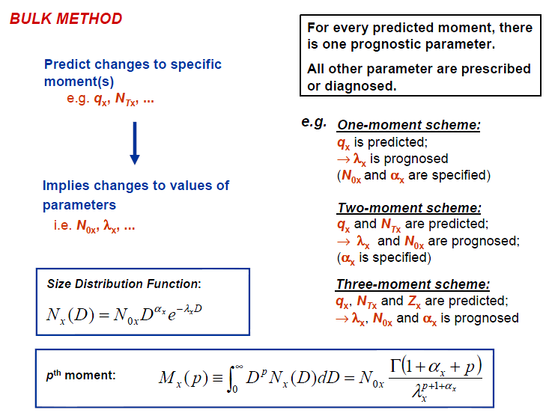
A Multi-Moment Bulk Microphysics Scheme
and the Explicit Simulation of Hail
(Milbrandt and Yau
2004)

Slide 6
Model description
ARW-WRF version 3.2
2D idealized squall-line case
Domain: 600 km x 20 km, vertical cross with a horizontal grid spacing of 1 km, and vertical grid spacing of 250 m
radiation and boundary layer processes: turn off
1.5-order turbulent kinetic energy (TKE) scheme
Simulation time : 5h

Slide 7




the size distributions of all precipitating hydrometeors in both schemes are represented by inverse exponential functions of the form
:intercept parameter
:slop parameter
:particle diameter
:number concentration

Slide 8
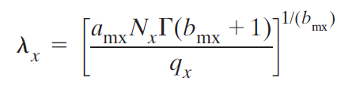





:number concentration(kg^-1)
:mixing ratio
and are the parameters of the mass-diameter power-law relation
Mass and number-concentration-weighted bulk fall
velocities for all hydrometeor species are calculated
based on empirical power-law velocity–diameter relationships

Slide 9
Experiment design
Experiment 1: Number of predicted moments
Experiment 2: Nature and number of predicted ice categories
Experiment 3: Conversion process formulations

Slide 10
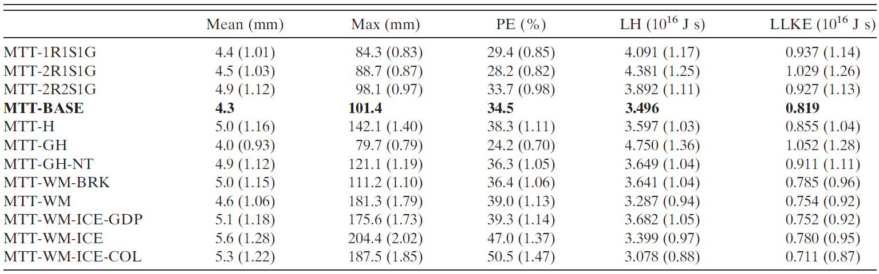
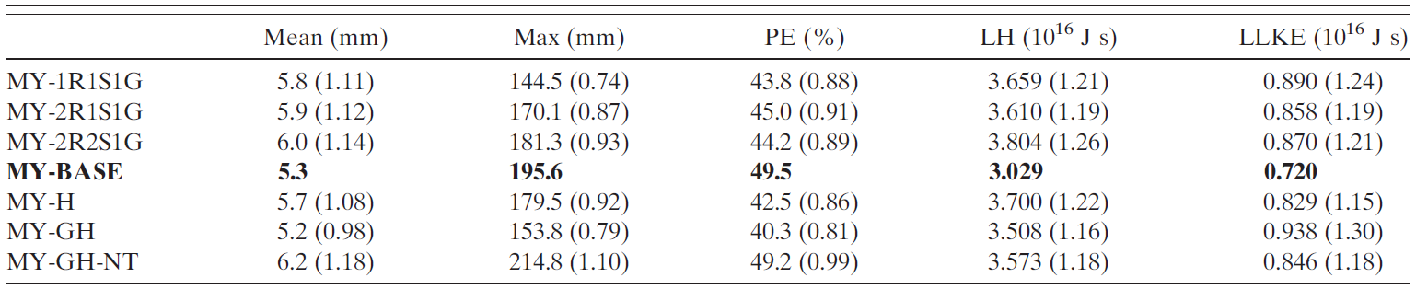

Results
Sui et al. (2007)

Slide 11
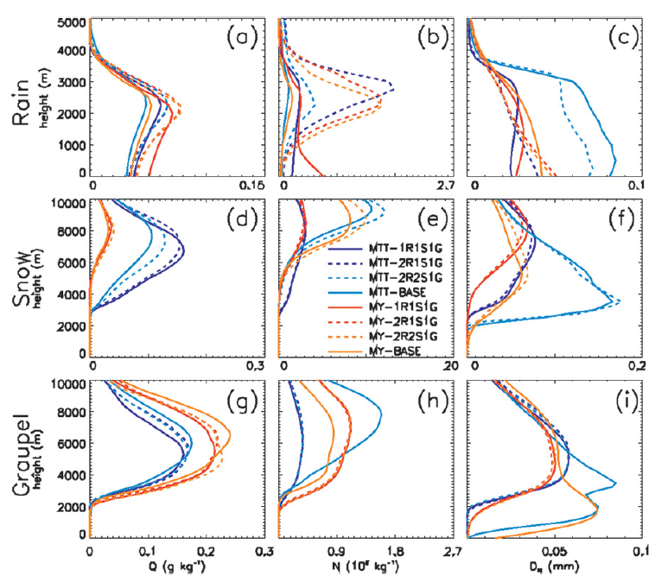
1. Number of predicted moments
domain- and time-averaged vertical profiles
Left to right:
Mixing ratio,
Number concentration,
Number-weighted mean particle diameter
Notes:
3adg:Q略為改變
3b:2R比1R多很多
3c:MTT-BASE最大

Slide 12
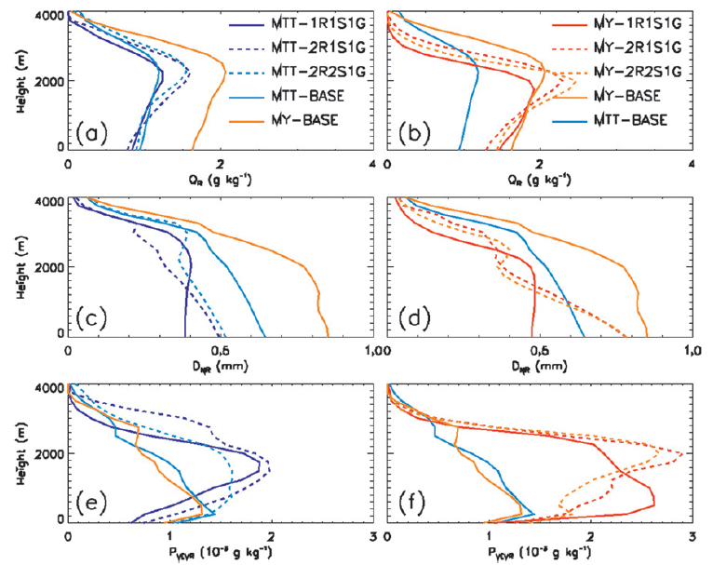
time-averaged vertical profiles
Mixing ratio
Number-weighted mean drop diameter
Rain evaporation
Notes:
4a:MTT-2R2S1G較BASE高
4b:MY-2R2S1G較BASE高
4cd:降水大的區域，雨滴長較大，落速較快
4e:MTT-2R1S1G較MTT-1R1S1G大(rain evaporation)

Slide 13
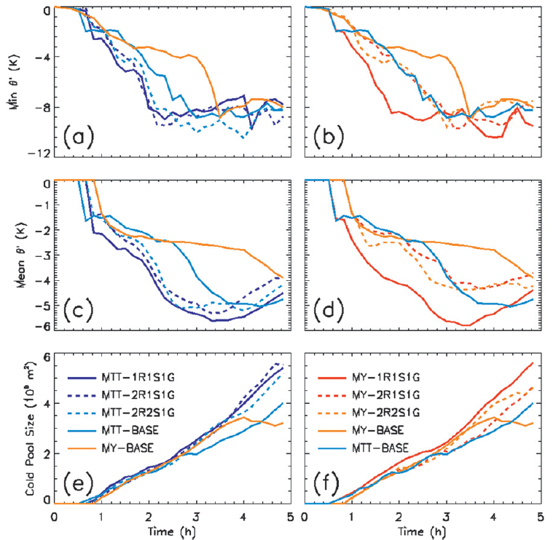
Time evolution of cold-pool characteristics
Notes:
6ac:發展較BASE好
6bd:發展較BASE好
6ef:後期size發展得比BASE大

Slide 14
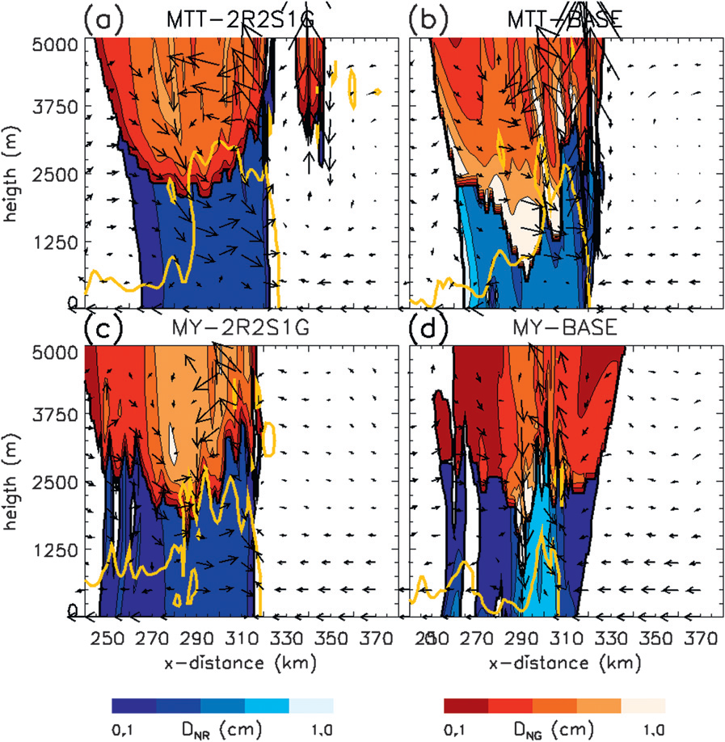
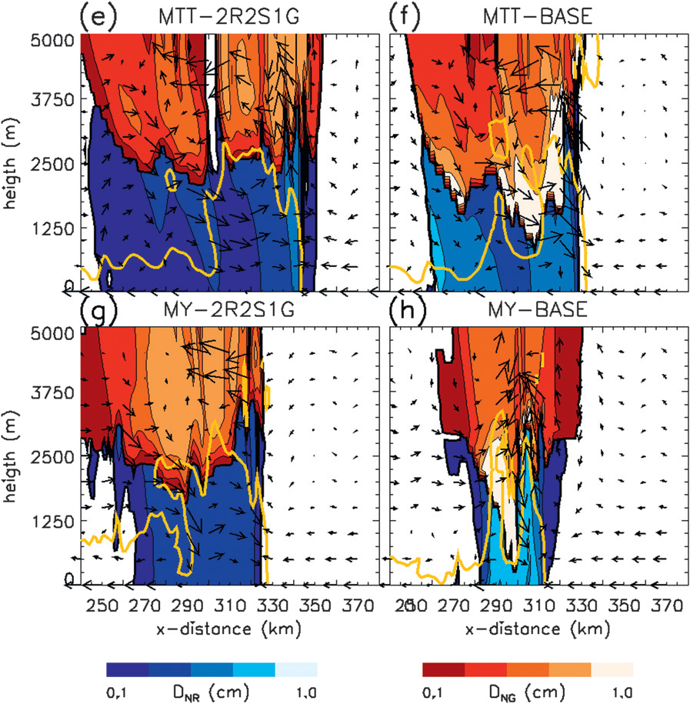
Vertical cross section through the squall line(3h20min~3h50min)
Notes:
8cg:沒有明顯的new cell產生，但強的外流增強suqall line的傳遞，導致邊界層大量降水
8ae:雨滴較小，有大的evaporation，造成gust front有強冷outflow
8bf:outflow減弱，地面降水少
紅色shaded:graupel，藍色shaded:rain(number-weighted mean particle size)
黃線:cold-pool boundary
3h20min~3h50min

Slide 15
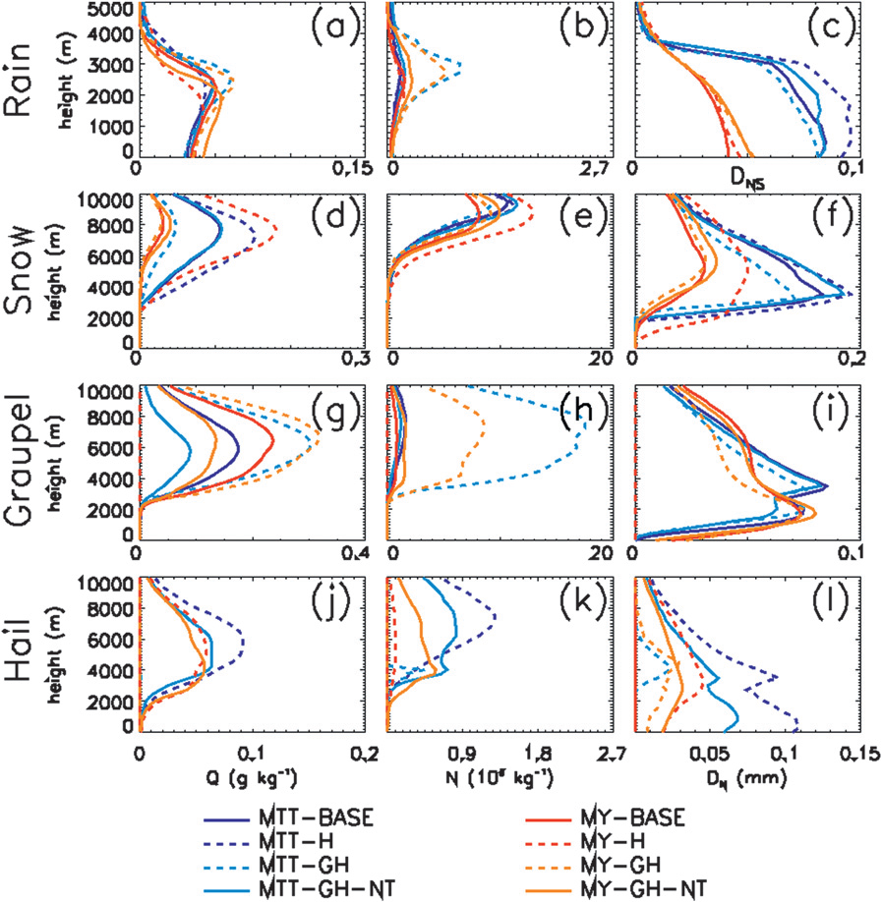
2. Nature and number of predicted ice categories
domain- and time-averaged vertical profiles
Left to right:
Mixing ratio,
Number concentration,
Number-weighted mean particle diameter
Notes:
10d:MTT-H和MY-H的Q有些微增加
10gj:hail和graupel的Q大小幾乎相等，是由於他們較像hail-only(-H)的實驗
10h:MTT-GH和MY-GH十分顯著，但GH-NT並沒有增加graupel的N

Slide 16
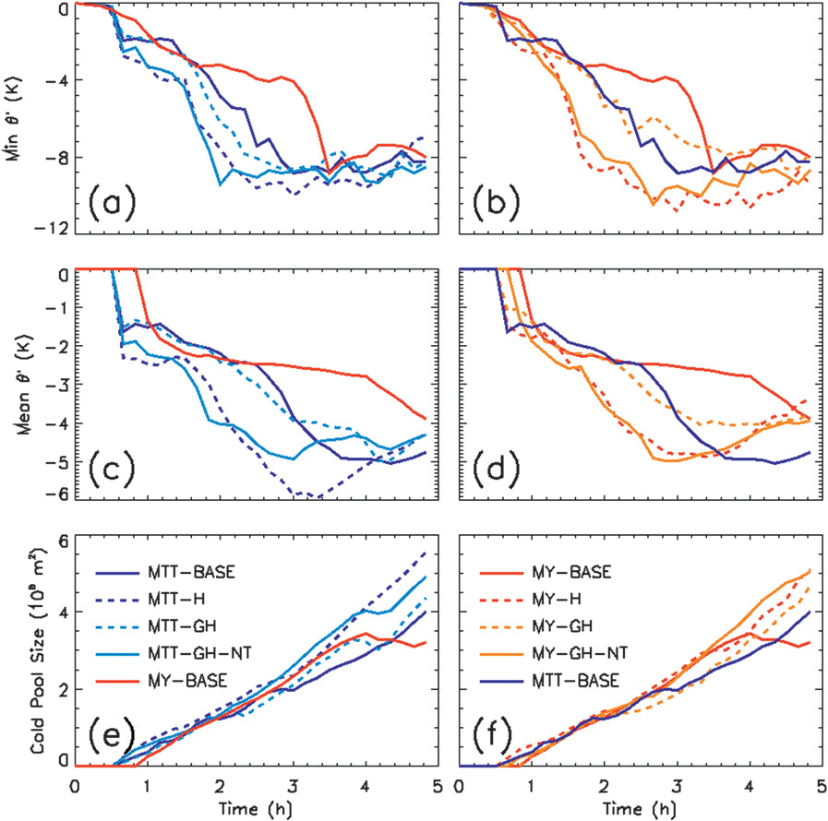
Time evolution of cold-pool characteristics
Notes:
MTT-H&MY-H強度較強，是由於體積較大的hail融化，使地表溫度降低

Slide 17
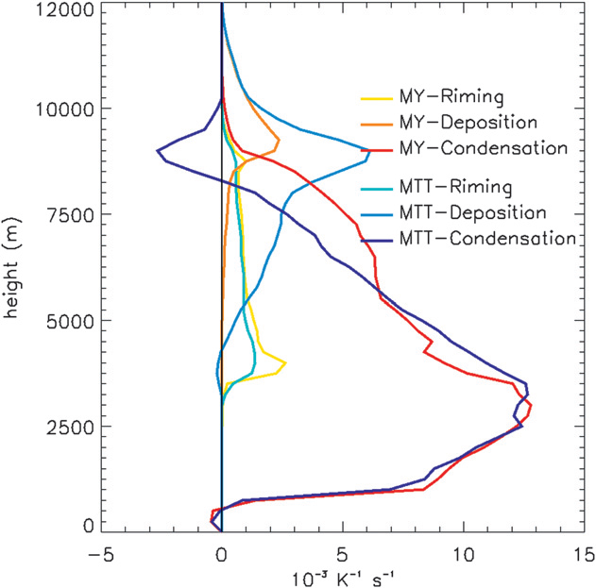
vertical profiles of domain- and time-average latent heat released within updrafts
MY tends to favor riming
MTT tends to favor depositional growth
MTT:depositional 30% riming 7%
MY:depositional 7% riming 9%
Notes:
MY tends to favor riming
MTT tends to favor depositional growth
*deposition的LH release遠大於riming
MTT:depositional 30% riming 7%
MY:depositional 7% riming 9%

Slide 18



3. Conversion process formulations
NRAGR:rain-self-collection
EC:collection efficiency
Thr(threshold diameter):
MY:600μm
MTT:300μm
:number-weighted mean drop diameter

Slide 19
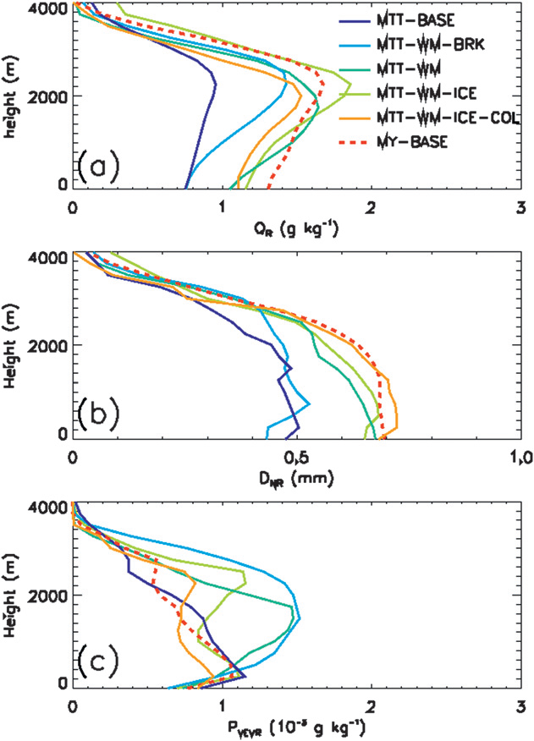
Mixing ratio
time-averaged vertical profiles
Number-weighted mean drop diameter
Rain evaporation
Notes:
15a:MTT-WM-BRK，上層大(相較BASE) WM>WM-BRK(因為較大雨滴)
15c:MTT-WMBRK較大(相較BASE) WM和WM-BRK類似

Slide 20
Conclusion
1. Although the MTT scheme behaves as a deposition-dominated scheme (more snow) with low precipitation efficiency, MY is dominated by riming process (more graupel) with high precipitation efficiency. The lower precipitation efficiency in the MTT scheme is associated mainly with graupel deposition–sublimation, which is not parameterized in the MY scheme.
2. The absence of graupel sublimation in the MY scheme—and hence the higher precipitation efficiency— was the main factor responsible for the differences in domain-average surface precipitation between the MTT and the MY schemes.

Slide 21
3. Domain-maximum precipitation differences, however, were almost entirely due to the different treatments of collisional drop breakup between the schemes.

Slide 22
Reference
Bryan, G. H., and H. Morrison, 2012: Sensitivity of a simulated
squall line to horizontal resolution and parameterization of
microphysics. Mon. Wea. Rev., 140, 202–225.
Milbrandt, J. A., and M. K. Yau, 2005a: A multimoment bulk
microphysics parameterization. Part I: Analysis of the role of
the spectral shape parameter. J. Atmos. Sci., 62, 3051–3064.
Dawson, D. T., M. Xue, J. A. Milbrandt, and M. K. Yau, 2010:
Comparison of evaporation and cold pool development
between single-moment and multimoment bulk
microphysics schemes in idealized simulations of tornadic
thunderstorms. Mon. Wea. Rev., 138, 1152–1171.

Slide 23
The End

Slide 24
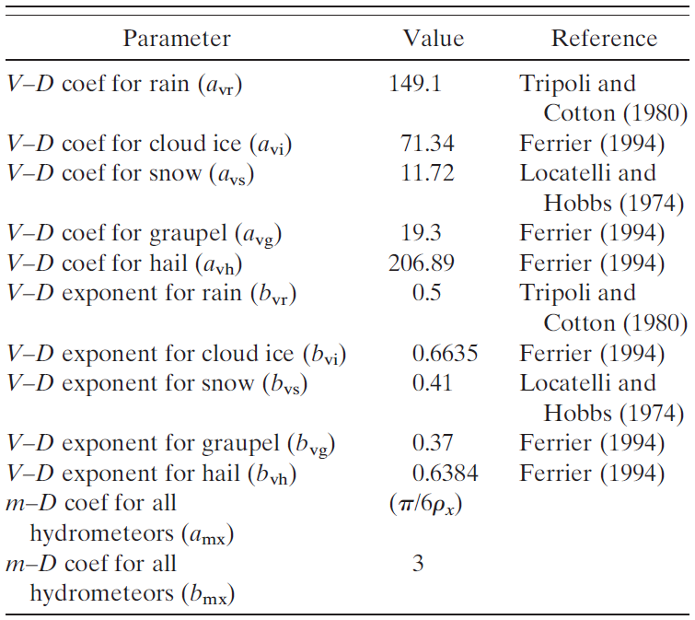
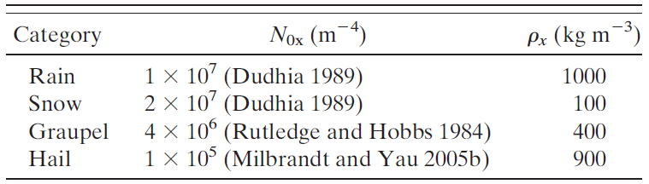
Notes:
Table1&2

Slide 25
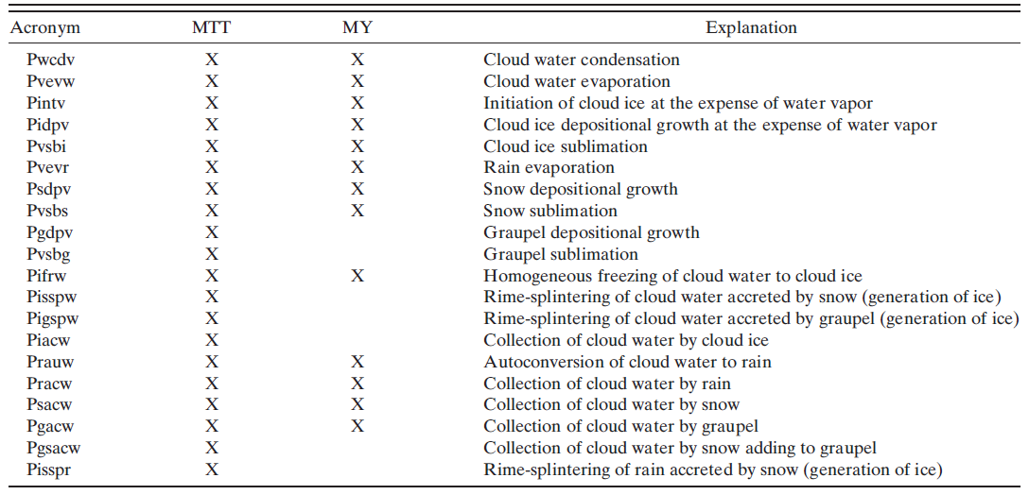
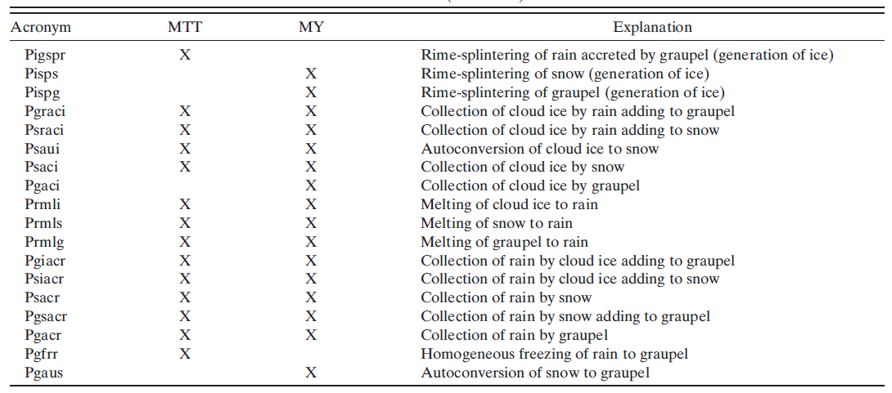
Notes:
TableA1

