Slide 1
Bulk Convergence of Cloud-Resolving Simulations of Moist Convection over Complex terrain
WOLFGANG LANGHANS, JUERG SCHMIDLI, and CHRISTOPH SCHAR J. Atmos. Sci., 69, 2207–2228.

Slide 2
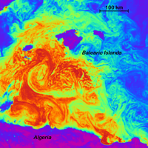
Large eddy simulation (LES)
大渦模擬Large eddy simulation
大渦模擬Large eddy simulation（LES）是一種計算法用來解決湍流流體計算偏微分方程式。這個計算法在1960年代末期廣為流行，最早由Joseph Smagorinsky用這套方程式來模擬大氣氣流，所以在當時主要被使用在氣象計算和預測。在80年代和90年代被廣泛使用於工程領域。
大漩渦是透過較小的漩渦數學模式計算所推導出來的。因此，較小規模的渦旋會用網格尺度（sub-grid scale; SGS）來模擬出來；最常用的SGS模式為Smagorinsky 模式，經由在方程式中添加“渦粘度”(eddy viscosity)係數，以分解出適當的湍流尺度。

Slide 3
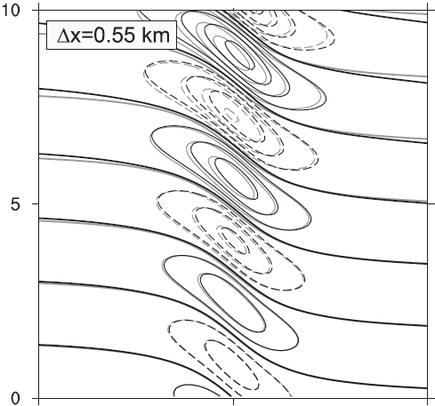
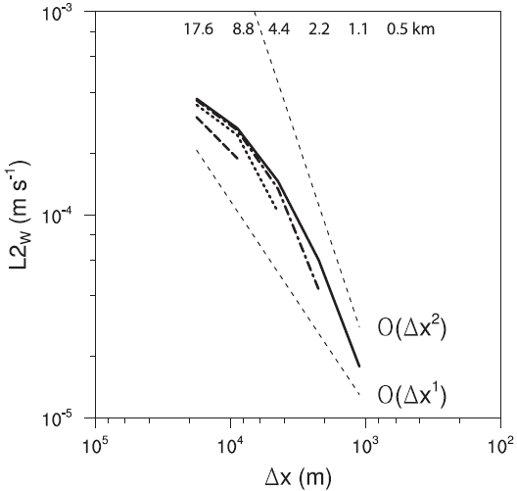
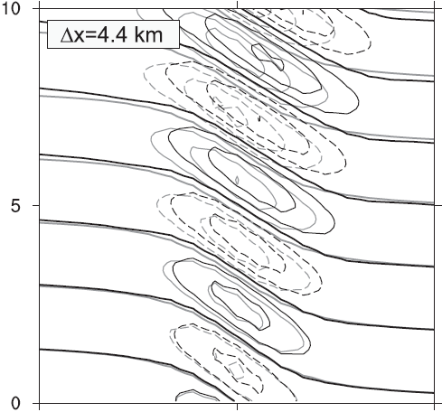
Bell-shaped mountain H: 10-km half-wide mountain V: 1-m high mountain L2: RMSE

Slide 4
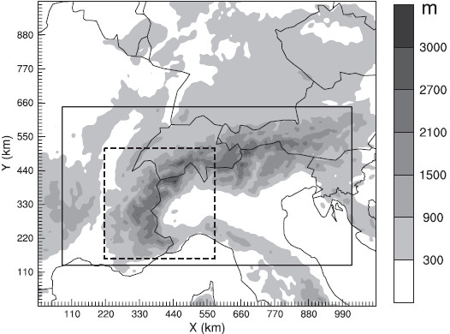
General description
Horizontal: 1100 × 990 km²
Vertical levels: 46 terrain-following
Model top: 20 hPa
Simulation time: 2006/07/11/0000 ~ 07/20/0600 UTC
970 km
352 km
515 km
352 km
Nonhydrosatic COSMO (Consortium for Small-Scale Modeling model)

Slide 5
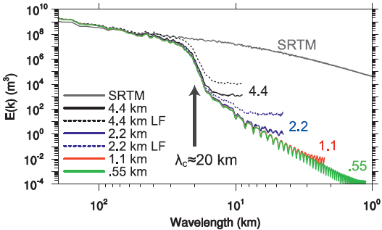
Topography
LF: low-passed filtered topography (5th order low-pass filter to the 4.4-km topography and interpolating to higher resolution)

Slide 6
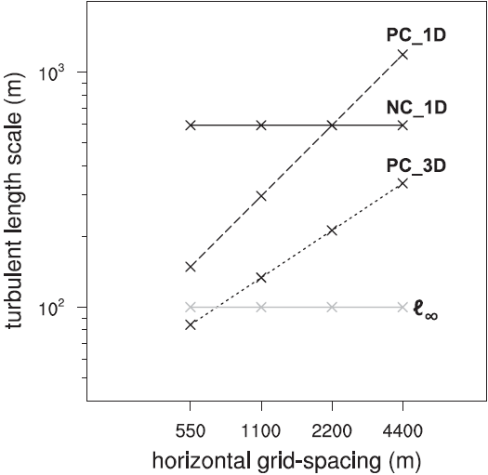
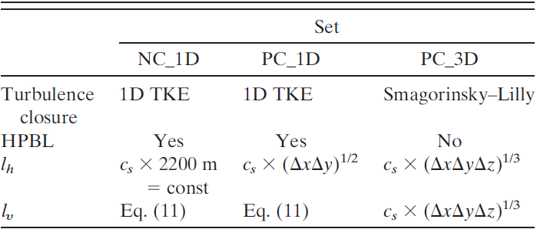
Turbulent diffusion
: vertical diffusion in NC_1D & PC_1D (100 m)

Slide 7
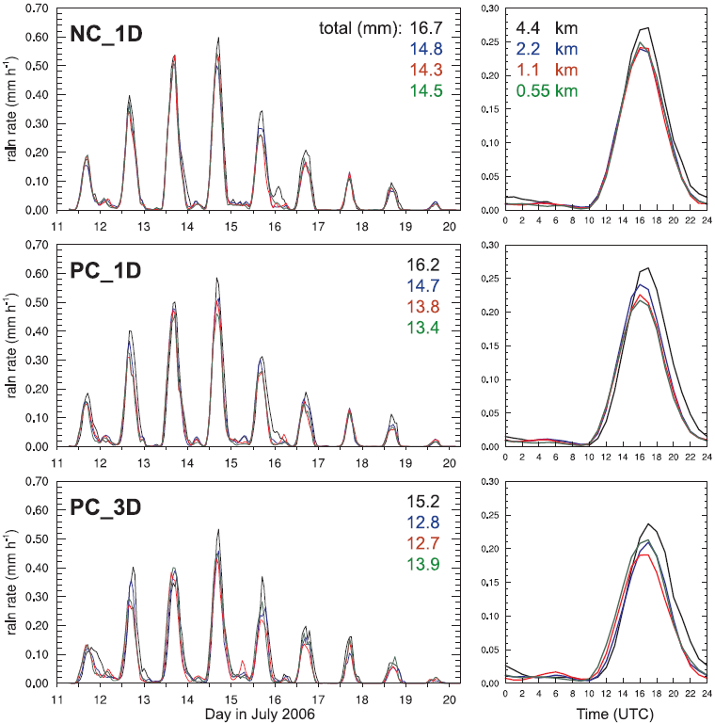
Results Basic simulation characteristics

Slide 8
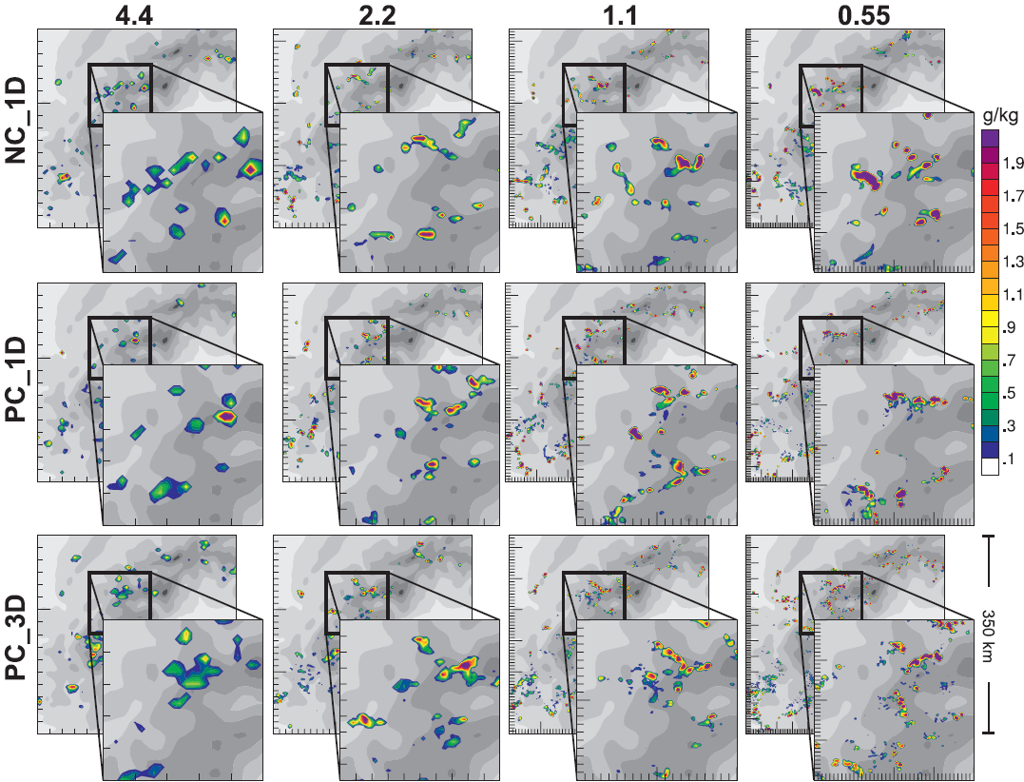
2006/07/14/1400 UTC @ z=6km
352 km
352 km

Slide 9
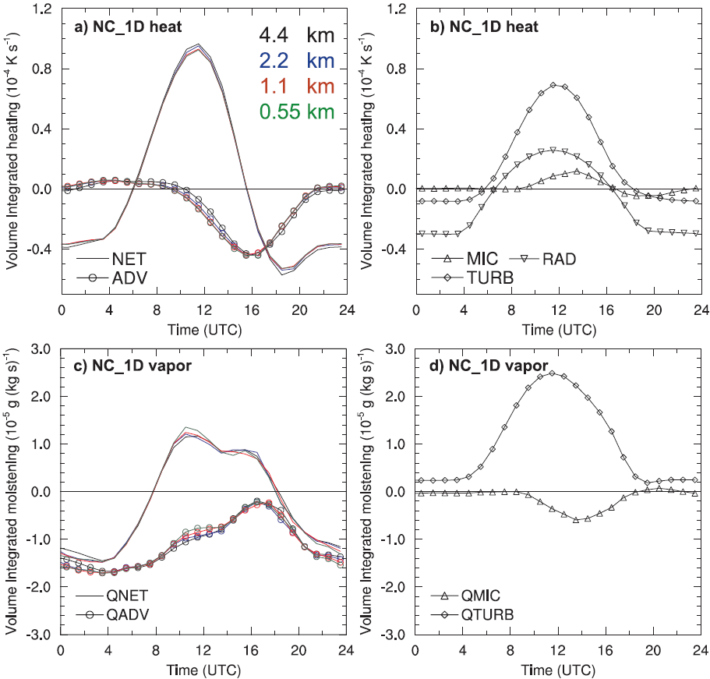
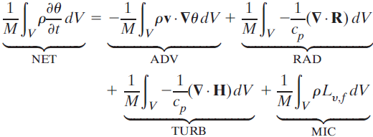
Results Numerical convergence (NC_1D)
4.4 km
ADV: advection RAD: radiative TURB: sensible heat flux convergence MIC: latent heating
4.4 km

Slide 10
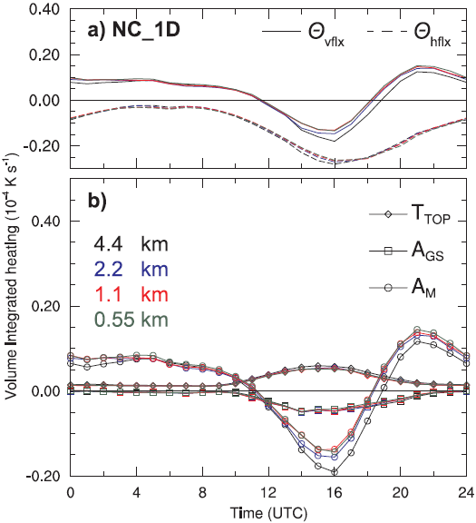
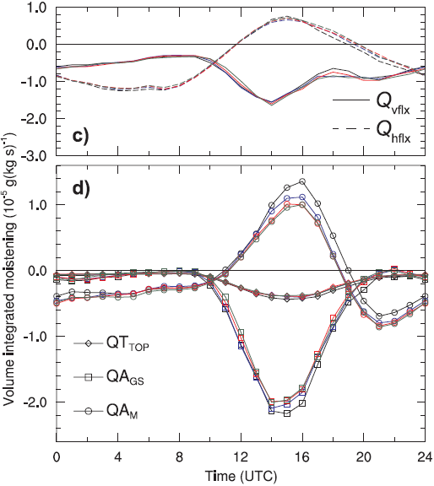
QA_{M}
A_{M}
A_{M}: mean flux A_{GS}: turbulent flux T_{TOP}: unresolved turbulent flux through top of the volume
vflx= A_{M}+A_{GS}+T_{TOP}

Slide 11
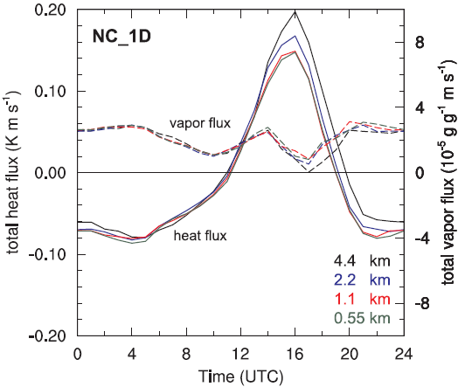
DCFs (Deep Convective Fluxs) @ z=6km

Slide 12
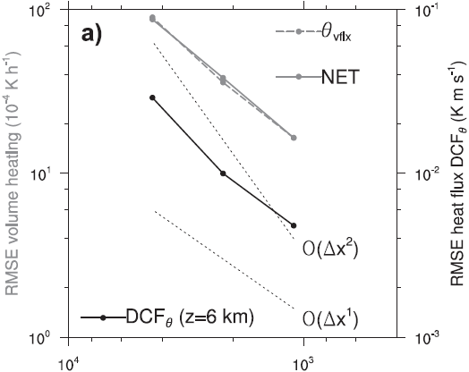
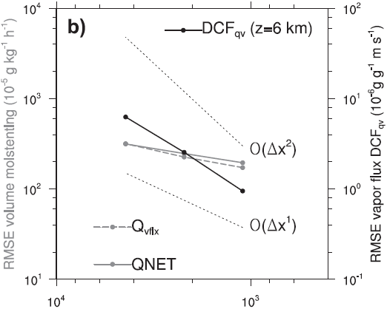
Bell-shaped mountain H: 10-km half-wide mountain V: 1-m high mountain L2: RMSE

Slide 13
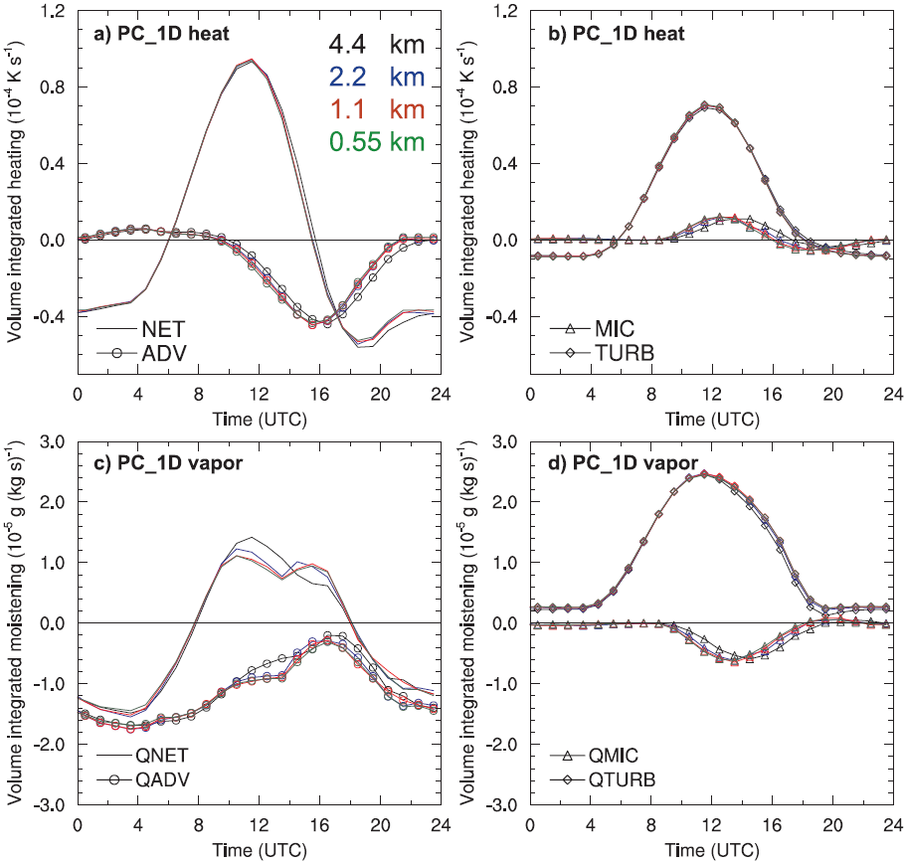
Results Physical convergence (PC_1D)

Slide 14
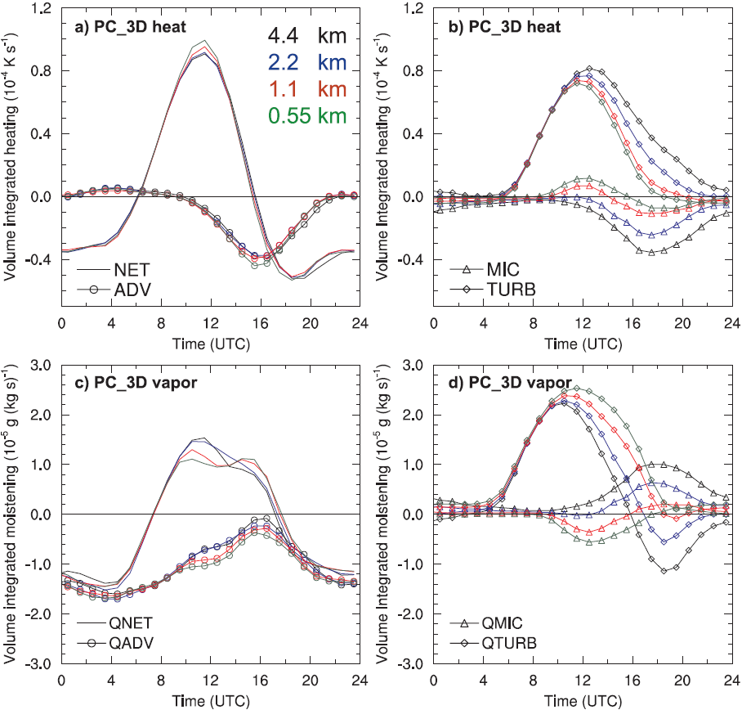
Physical convergence (PC_3D)

Slide 15
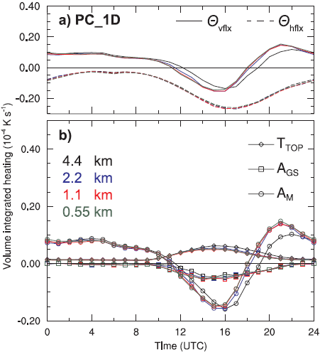
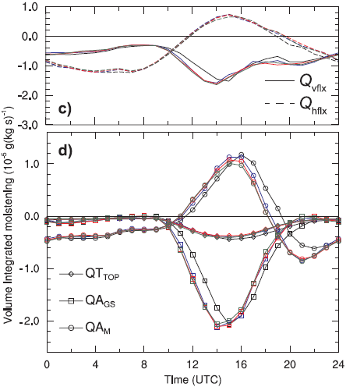
QA_{M}
A_{M}
A_{M}: mean flux A_{GS}: turbulent flux T_{TOP}: unresolved turbulent flux through top of the volume
vflx= A_{M}+A_{GS}+T_{TOP}

Slide 16
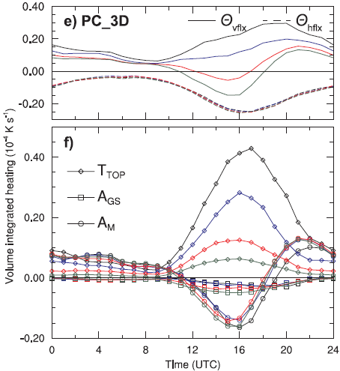
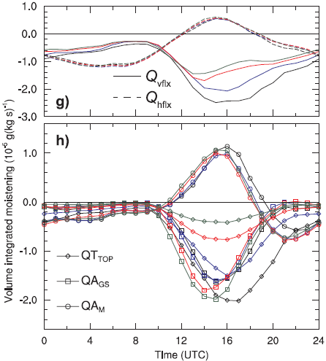
QA_{M}
A_{M}
A_{M}: mean flux A_{GS}: turbulent flux T_{TOP}: unresolved turbulent flux through top of the volume
vflx= A_{M}+A_{GS}+T_{TOP}

Slide 17
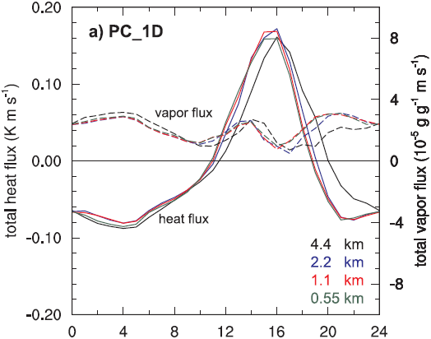
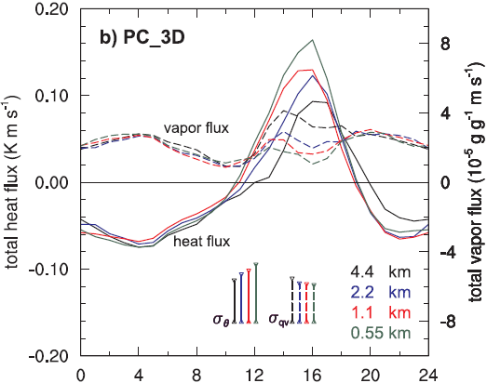
DCFs (Deep Convective Fluxs) @ z=6km

Slide 18
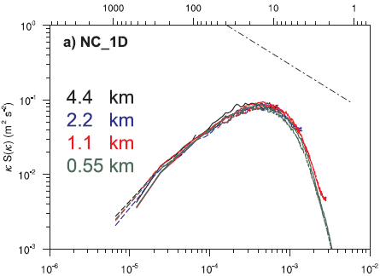
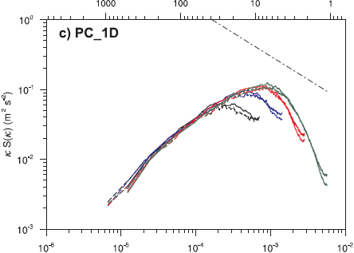
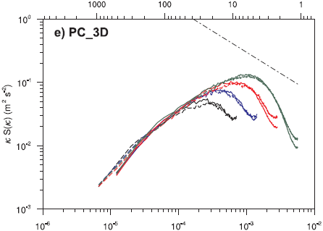
@ z=6 km averaged at 1600 UTC

Slide 19
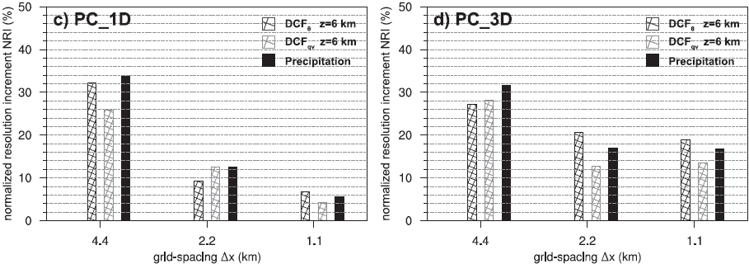

Slide 20
Summary
NC1D using a fixed turbulent length scale, all bulk properties converge systematically toward the 0.55-km solution.
PC is found to decrease systematically with smaller grid spacings, a less obvious physical convergence behavior was found for the PC3D. PC3D closure is explained by an increased latent heat release that balances the decreased turbulent heat entrainment with higher resolution.
Surface precipitation decreases continuously with higher resolution for PC1D. PC3D closure did not involve an increased resolution sensitivity of the net heating/moistening and of surface precipitation.
The consideration of one single synoptic episode domainted by thermally driven orographic convection.

