Slide 1
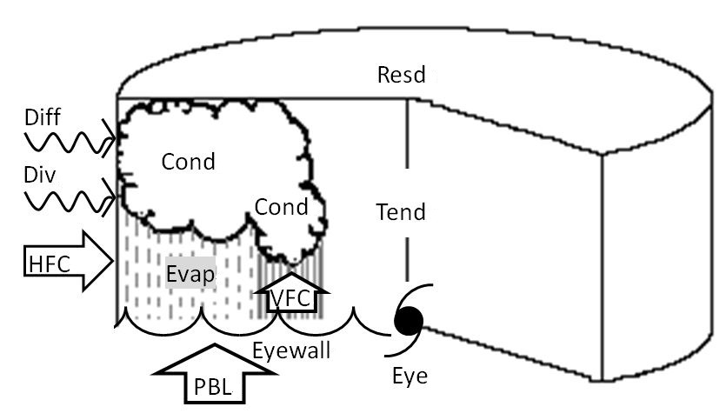
Water Budget and Precipitation Efficiency of Typhoons
Ming-Jen Yang 楊明仁
National Central University

Slide 2
Introduction
Water vapor budgets of TCs have been studied for more than six decades (Malkus and Riehl, 1960 ; Riehl and Malkus, 1961; Hawkins and Rubasm, 1968; Hawkins and Imbembo, 1976; Gamache et al. 1993).
On the other hand, there are only a few studies of the hydrometeor budgets of TCs, probably due to the difficulty of insitu microphysics observations within TCs (Marks 1985; Marks and Houze 1987; Gamache et al.1993).
Outputs from high-resolution model simulations of TCs can be used to analyze the water vapor and condensate budgets of TCs and to improve the understanding of TC microphysical processes (Kurihara, 1975; Zhang et al. 2002; Braun 2006; Yang et al. 2011).
Precipitation efficiency of convective systems can be investigated from both observational soundings and simulation results (Sui et al. 2005, 2007).
Yang (2012; the Encylopedia of Natural Hazards) reviews the studies of water vapor and condensate budgets of TCs, using the simulation results of Typhoons Nari (2001) and Morakot (2009).

Slide 3

Budget Equations [Definition]
Water vapor budget: q_{v}
Condensate budget: q_{c} = q_{w} + q_{i}
where is the condensation and deposition;
is the evaporation and sublimation;
is the net horizontal flux convergence;
is the vertical flux convergence;
is the divergence term
is the numerical diffusion
is the boundary layer source and vertical (turbulent) diffusion
is the residual term
is the precipitation flux.
CMPE (Cloud Microphysics Precipitation Efficiency):

Slide 4
Budget Equations [from Yang et al. (2011;MWR)]
Water vapor budget: q_{v}
Condensate budget: q_{c} = q_{w} + q_{i}
Sui et al. (2005, 2007; JAS)

Slide 5
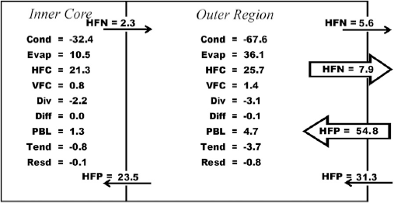
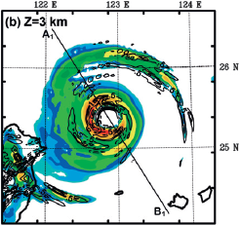
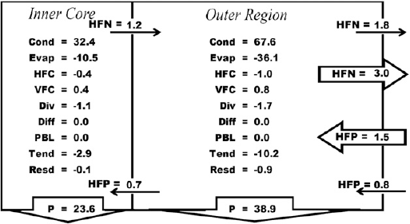
Water Vapor Budget
Typhoon Nari
@ Ocean
Liquid/Ice Water Budget

Slide 6
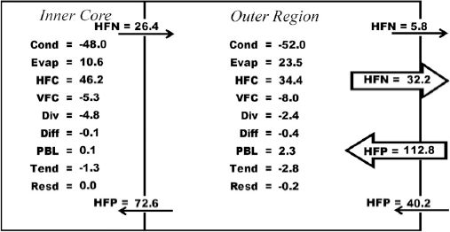
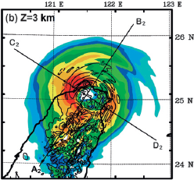
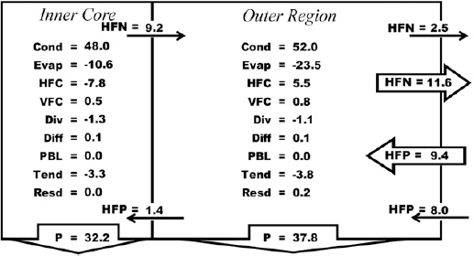
Water Vapor Budget
Typhoon Nari
@ Landfall
Liquid/Ice Water Budget

Slide 7
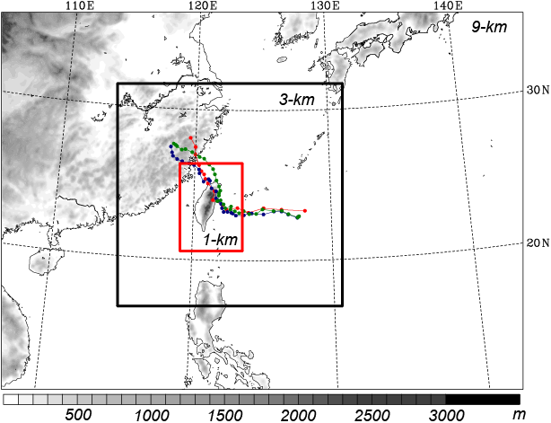
WRF domain and physics for Morakot Simulation
  9/3/1 km (416x301 / 541x535/ 451x628)
  31 sigma (σ) levels
  Two-way feedbacks
  No CPS is used!
  WRF Single-Moment
  6-class scheme (WSM6)
  IC/BC: EC 1.125º
  lat/lon
  Initial time: 0000 UTC,
  6 Aug 2009
  Integration length:
  96 h

Slide 8
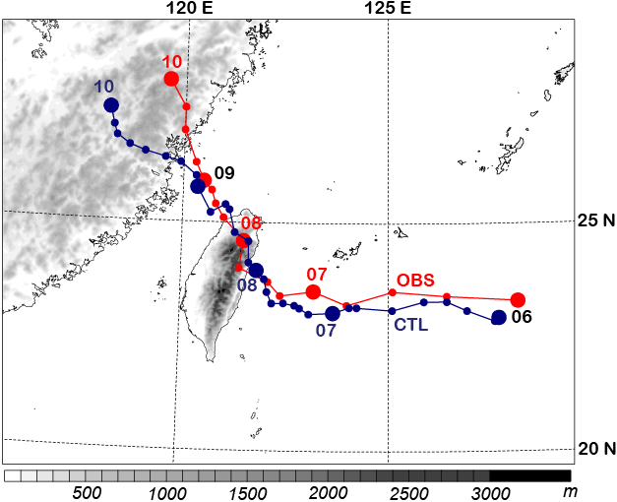
Tracks from the CWB and WRF

Slide 9
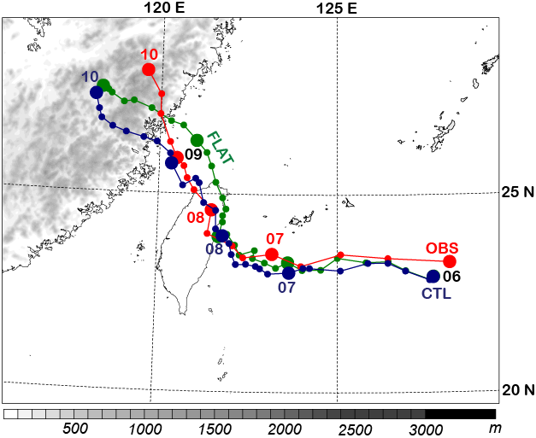
Tracks from the CWB and WRF

Slide 10
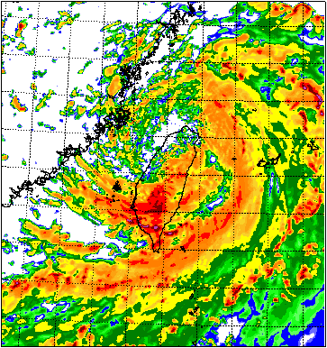
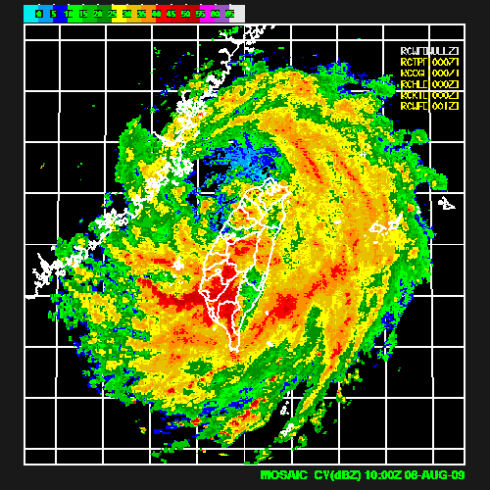
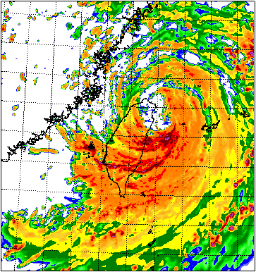
08/08/10 UTC
118E
120E
122E
124E
28N
OBS @ CWB
CTL
26N
122E
124E
28N
24N
26N
22N
24N
20N
22N
28N
20N
26N
118E
120E
24N
22N
FLAT
20N

Slide 11
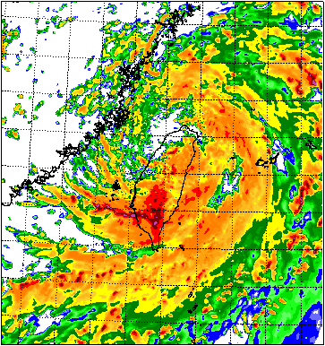
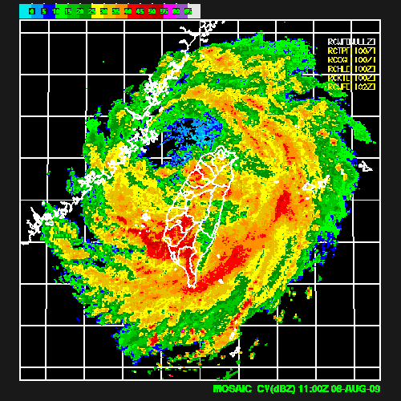
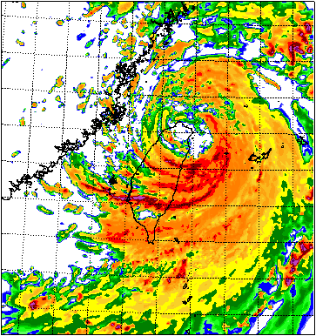
08/08/11 UTC
118E
120E
122E
124E
28N
OBS @ CWB
CTL
26N
122E
124E
28N
24N
26N
22N
24N
20N
22N
28N
20N
26N
118E
120E
24N
22N
FLAT
20N

Slide 12
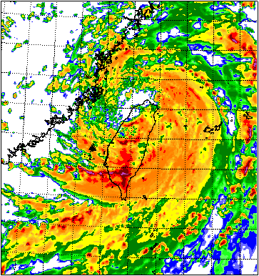
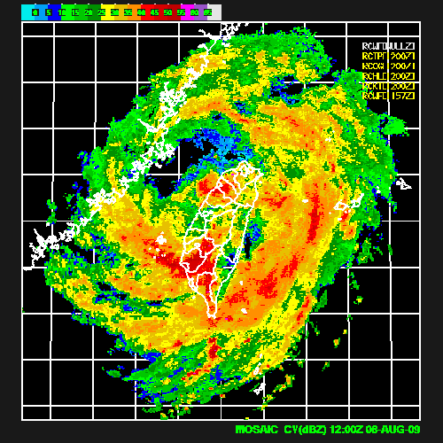
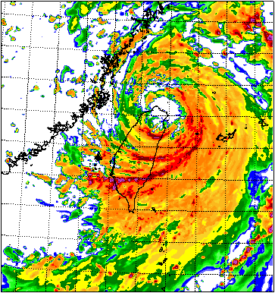
08/08/12 UTC
118E
120E
122E
124E
28N
OBS @ CWB
CTL
26N
122E
124E
28N
24N
26N
22N
24N
20N
22N
28N
20N
26N
118E
120E
24N
22N
FLAT
20N

Slide 13
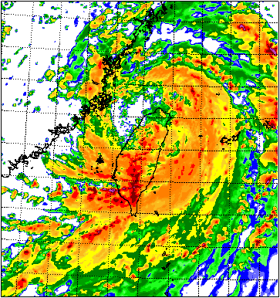
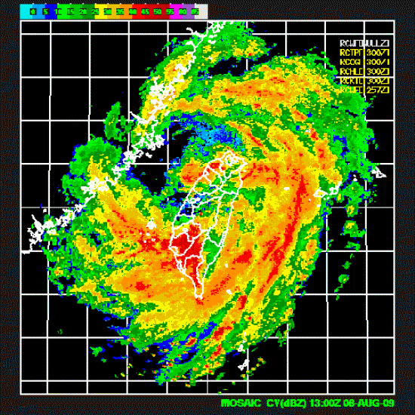
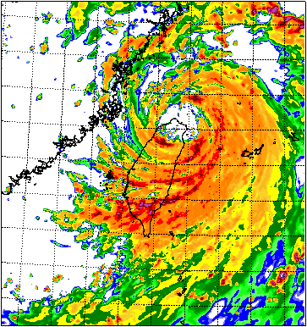
08/08/13 UTC
118E
120E
122E
124E
28N
OBS @ CWB
CTL
26N
122E
124E
28N
24N
26N
22N
24N
20N
22N
28N
20N
26N
118E
120E
24N
22N
FLAT
20N

Slide 14
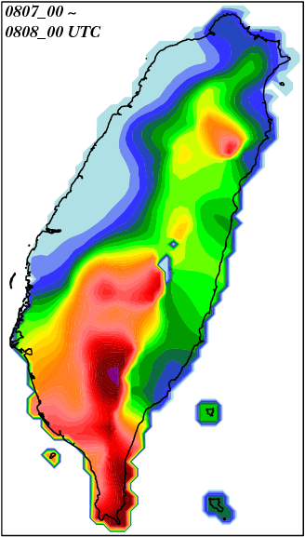
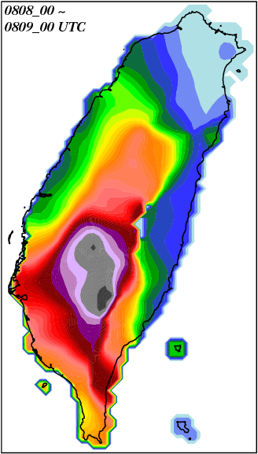
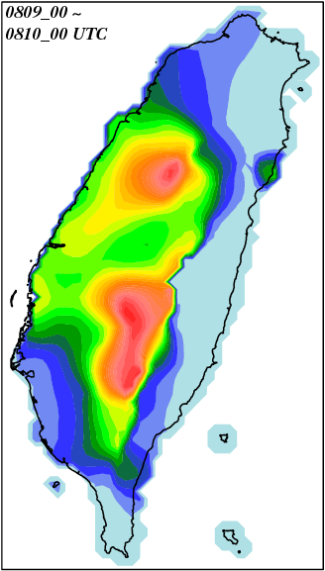

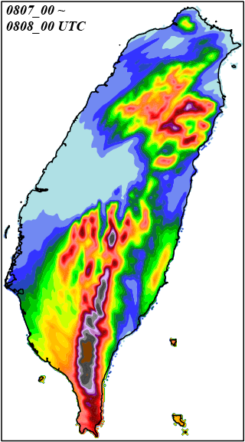
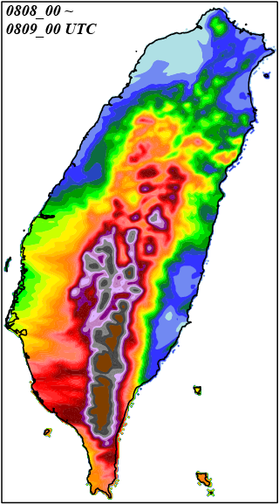
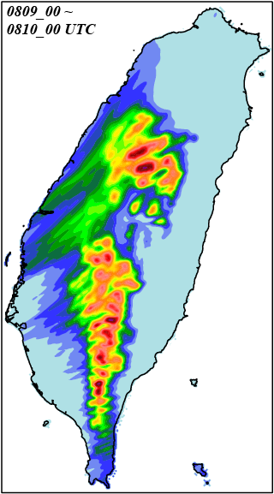
CWB_
OBS
mm
Day1
Day2
Day3
WRF_
CTL

Slide 15
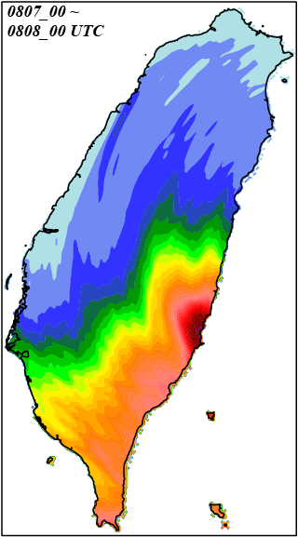
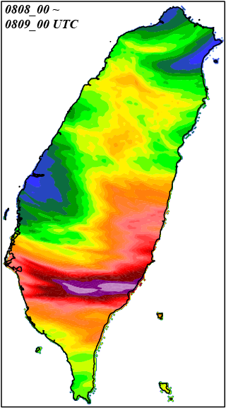
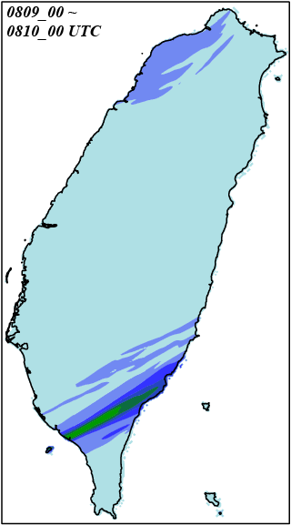
CWB_
OBS
mm
Day1
Day2
Day3
WRF_
FLAT

Slide 16

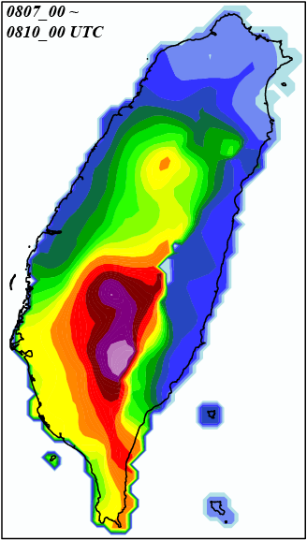
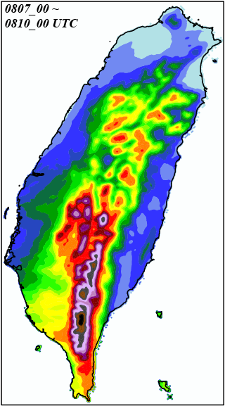
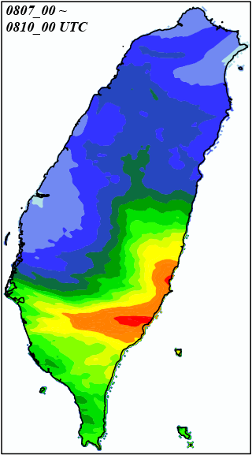
72-h Rainfall (08/07/00 ~ 08/10/00 UTC)
CWB_OBS
WRF_CTL
WRF_FLAT
mm
2323
2683
3392
2477
3847

Slide 17
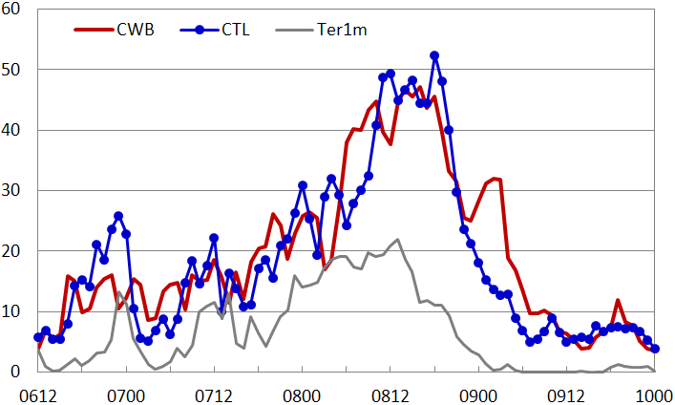
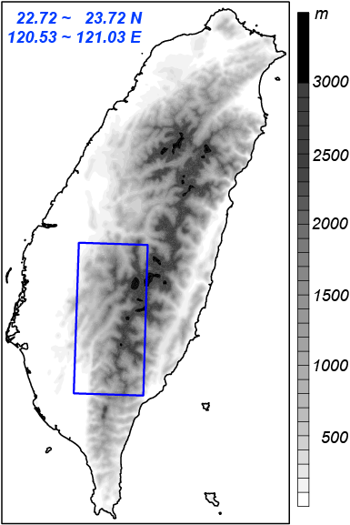
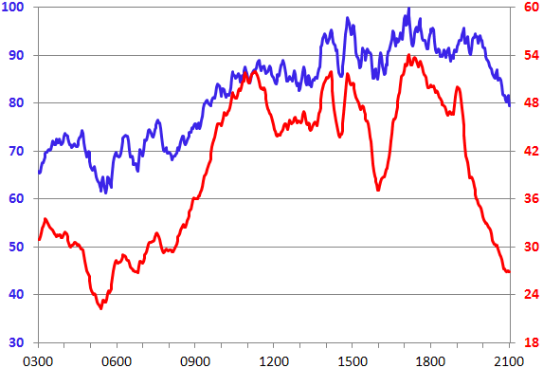
(mm h⁻¹)
FLAT
CTL Run
Efficiency (%)
Rainrate (mm h⁻¹)

Slide 18
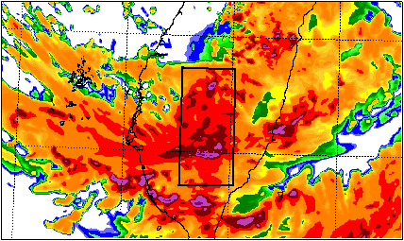
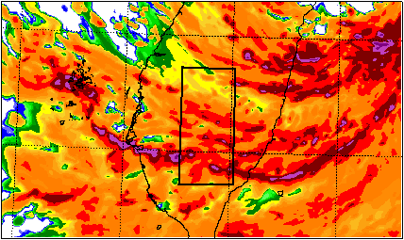
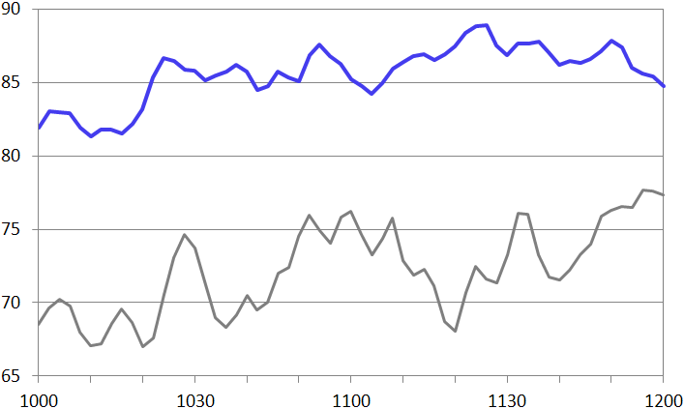
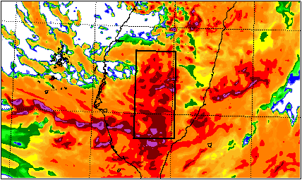
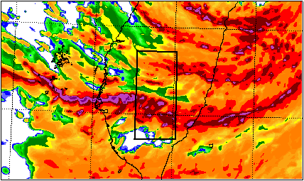
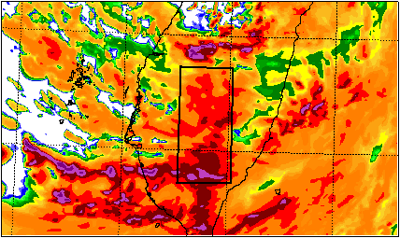
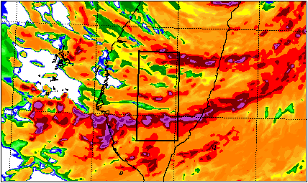
CTL
FLAT
24N
24N
08/08/10 Z
23N
23N
PE (%)
CTL
24N
24N
08/08/11Z
FLAT
119E
23N
23N
24N
Time (UTC)
24N
08/08/12 Z
23N
23N
120E
121E
122E
120E
121E
122E

Slide 19
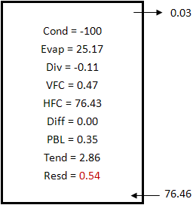
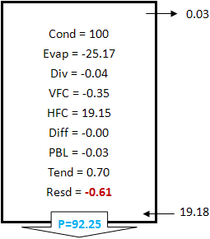
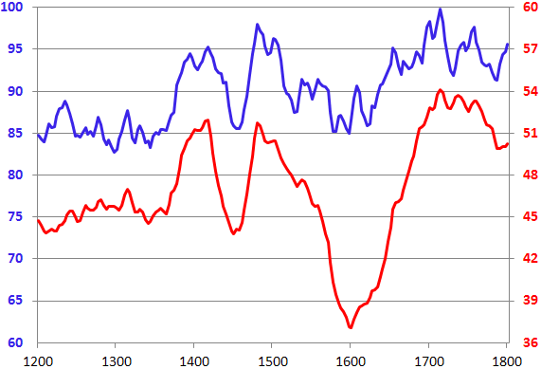
Water Vapor Budget
CTL PE
CTL rain rate
Efficiency (%)
Rainrate (mm h⁻¹)
Time (UTC)
Liquid/Ice Water Budget
CTL PE
●
●
●
●
●
Efficiency (%)
●
Rainrate (mm h⁻¹)
●
CTL rain rate
● OBS
rain rate
Time (UTC)

Slide 20
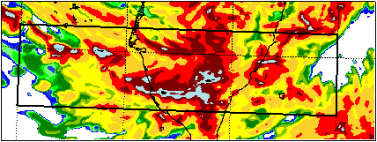
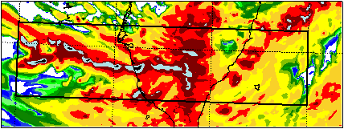
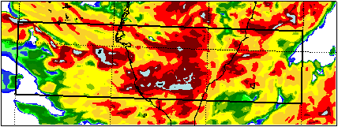





23 N
1030 UTC
1110 UTC
23 N
1040 UTC
1120 UTC
23 N
1050 UTC
1130 UTC
23 N
1100 UTC
1140 UTC
119 E
120 E
121 E
122 E
119 E
120 E
121 E
122 E

Slide 21





23 N
23 N
1150 UTC
1212 UTC
23 N
23 N
1200 UTC
1220 UTC
119 E
120 E
121 E
122 E
119 E
120 E
121 E
122 E
Efficiency (%)
Mean Height (km)
Typhoon Rainband Regime
Mountain Rainfall Regime
Time (UTC)

Slide 22
Summary
Because of a bigger storm radius (240 km for Morakot vs. 150 km for Nari), Morakot has a storm-total condensation three times larger than Nari.
Owing to the highly asymmetric circulation embedded in a large-scale intra-seasonal oscillation, Morakot has stronger horizontal convergence of water vapor, producing more percentage of rainfall out of total condensation, than Nari.
For vapor budget, major balance exits between the total vapor flux convergence and the net vapor loss by net condensation and deposition.
For condensate budget, total flux convergence of water condensate and precipitation fallout are mainly compensated by the net source of condensed water.

Slide 23
Summary
The cloud-resolving simulations (with horizontal grid size of 1-2 km) of Typhoons Nari (2001) and Morakot (2009) capture the storm track, intensity, and precipitation features reasonably well.
The highly-asymmetric outer rainbands of Morakot combined with the southwesterly monsoonal flow to produce near world-record heavy landfall on Taiwan (>2800 mm in 4 days).
The PE > 95 % over the Taiwan mountain during Morakot landfall and postlandfall periods, causing many landslides and burying the village of Shiaolin (lose of 500 people).
Convective cells within rainbands propagated eastward, with PE increasing from 60~75 % over ocean to >95 % over mountain.

Slide 24



Thank you!

