Slide 1
Monsoonal Influence on Typhoon Morakot (2009). Part I: Observational Analysis
reporter: Lin Ching
Wu, L., J. Liang, and C.-C. Wu, 2011: Monsoonal Inﬂuence on Typhoon Morakot (2009). Part I: Observational Analysis. J. Atmos. Sci., 68, 2208-2221.

Slide 2
Introduction
Lots of numerical studies support that the topographic effect of the island can deflect TC tracks, modify the TC structure, and enhance TC rainfall. (e.g., Yeh and Elsberry 1993a,b; Wu and Kuo 1999; Wu 2001; Wu et al. 2002; Chiao and Lin 2003; Chen and Yau 2003; Lin et al. 2005; Chien et al. 2008; Lee et al. 2008; Jian andWu 2008; Yang et al. 2008; Wu et al. 2009)
However, compared to the topographic effect, relatively few studies have been conducted on the interaction between Asian monsoon systems and TCs although the interaction can lead to torrential rainfall over Taiwan. (Chien et al. 2008; Wu et al. 2009).
The monsoon activity in the South China Sea and western North Pacific includes prominent atmospheric variability ranging from synoptic-scale tropical disturbances (Liebmann and Hendon 1990; Lau and Lau 1990; Chang et al. 1996) to the quasi-biweekly oscillation (QBW) (Murakami and Frydrych 1974; Murakami 1975; Kikuchi and Wang 2009) to the Madden–Julian oscillation (MJO). (Madden and Julian 1971, 1972; Wang and Rui 1990; Hsu and Weng 2001).
The QBW and MJO are usually called tropical intraseasonal oscillations (ISOs).
Ko and Hsu (2006, 2009) found that the ISO westerly phase was closely associated with recurving TC tracks in the vicinity of Taiwan.

Slide 3
Data and analysis method
Environmental flows:
National Centers for Environmental Prediction (NCEP) Final (FNL) Operational Global Analysis data (1ºX1º, 6 hourly, surface and 26 levels) including surface pressure, sea level pressure, geopotential height, temperature, relative humidity, and winds.
TC data:
Japan Meteorological Agency (JMA)
Joint Typhoon Warning Center (JTWC) best-track datasets.
including center positions (latitude and longitude) and intensity (maximum sustained wind speed and central pressure) at 6-h intervals.
Rainfall data:
hourly precipitation from the automatic weather stations in Taiwan
3-h TRMM rainfall data product (3B42, 0.25ºX0.25º)
Convective activity:
Atmospheric Infrared Sounder (AIRS) brightness temperature from NASA Aqua satellite,
radar reflectivity from CWB
remapped color-enhanced infrared images of the NOAA five geostationary satellites
Scale separation (Lanczos filters):
> 20 days : MJO-scale flow and background state
10-20 days : QBW-scale flow
< 10 days : synoptic-scale flow

Slide 4
Typhoon Morakot
Formed: 3 Aug 2009
Landfall Taiwan: 7 Aug 2009
The worst flooding over past 50 yr in Southern Taiwan
Ge et al. (2010) and Hong et al. (2010) suggested that the record-breaking rainfall associated with Morakot resulted from the interaction between the typhoon and monsoon circulation.
The extreme rainfall associated with Morakot was accompanied with the highly asymmetric structure of convective activity and the reduced movement in the vicinity of Taiwan.
Morakot took more than 2 days to pass through Taiwan and the Taiwan Strait while its major rainfall occurred in southern Taiwan.
Two issues:
why did Morakot stay in the vicinity of Taiwan for more than 2 days?
why did the major rainfall not shift with the northwestward movement of the typhoon?
As the first part of this study, observational evidence will be presented about how the interaction between Morakot and low-frequency monsoon flows affect the movement and the associated asymmetric precipitation pattern of Morakot.

Slide 5
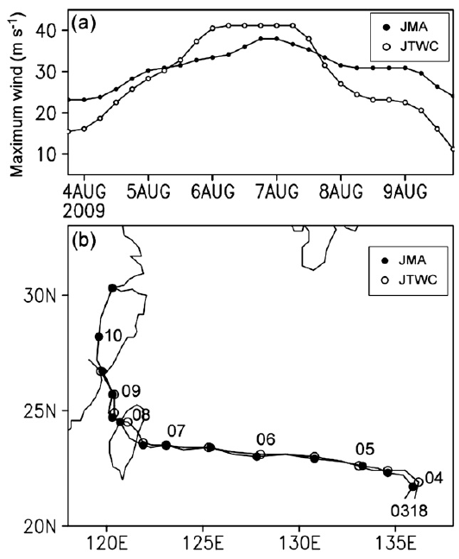
Typhoon Morakot
1800 UTC 3 Aug – 1200 UTC 10 Aug 2009
1200 UTC 4 Aug: severe tropical storm, > 48 kt (24.4 m/s)
1800 UTC 5 Aug: typhoon, > 64 kt (32.6 m/s)
peak intensity of 40 m/s
1200 UTC 7 Aug: landfall
1200 UTC 9 Aug: second landfall, degraded into tropical storm
stay about 12 h
took 9 h to cross island
took 31 h to cross Taiwan strait
52 h in vicinity of Taiwan

Slide 6
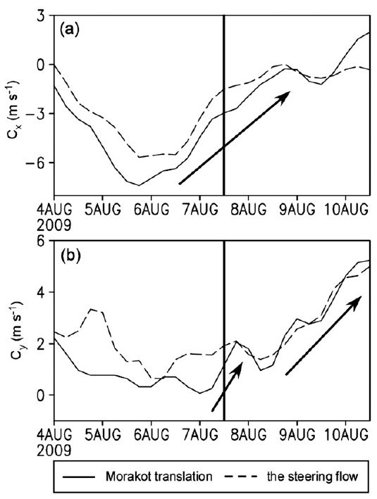
Zonal translation speed
accelerate westward
moved very slowly when it entered the Taiwan Strait
decelerate
accelerate northward
located to the east of Taiwan
steering flow: mass-weighted mean wind averaged within a radius of 440 km (4º latitudes) between 850 and 300 hPa

Slide 7
Zonal translation speed
Segment 1
Seg. 2
Seg. 3
Three segments
generally westward movement from 4 to 7 August
crossing Taiwan Island and the Taiwan Strait from 7 to 9 August
making a second landfall over mainland China from 9 to 10 August
Corresponding mean translation speeds
5.4 m/s
2.6 m/s
4.4 m/s
decelerate
cause Morakot stayed more than 2 days in the vicinity of Taiwan Island
the slow-down of Morakot’s movement and the northward deflections of its track during 7–9 August were mainly a result of the change in the steering flow.

Slide 8
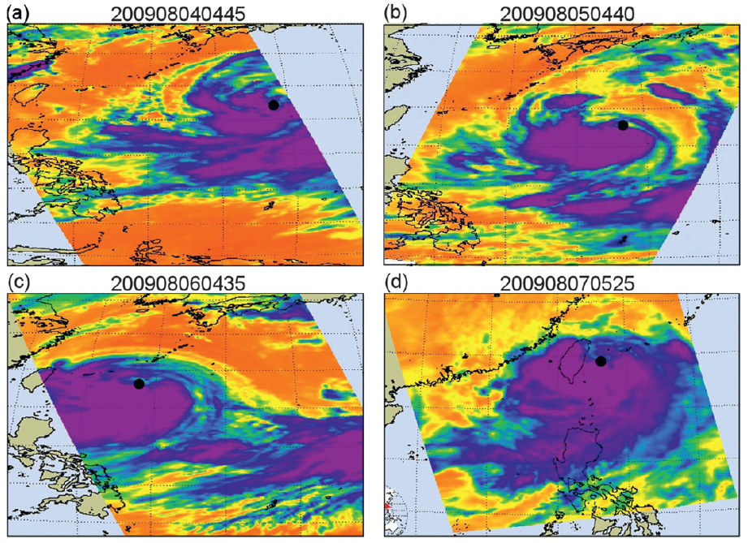
AIRS cloud-top temperature (associated with deep convection)
4 Aug
5 Aug
deep convection in south of center
850 km
6 Aug
7 Aug
convective asymmetry

Slide 9
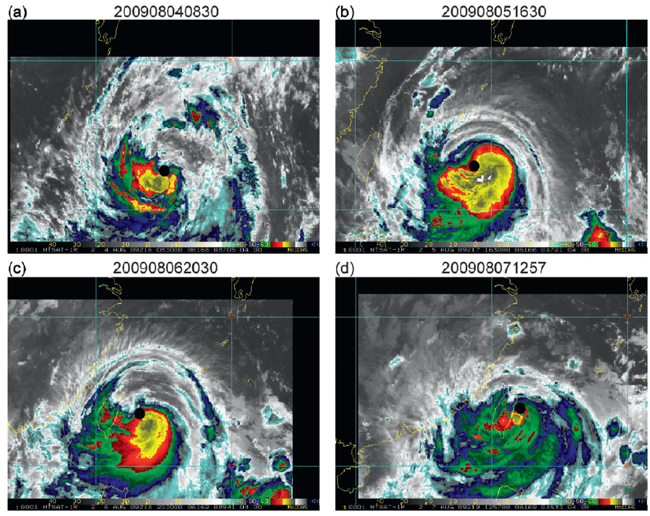
NOAA infrared satellite imagery (~11 mm) of five geostationary satellites
4 Aug
5 Aug
Southern side
significant
Blue area < 223K
6 Aug
7 Aug
Separate cloud band

Slide 10
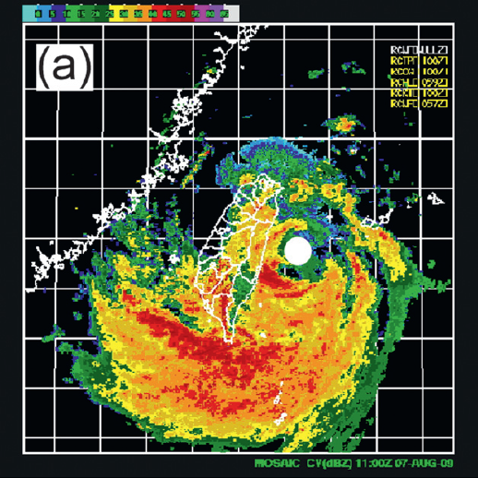
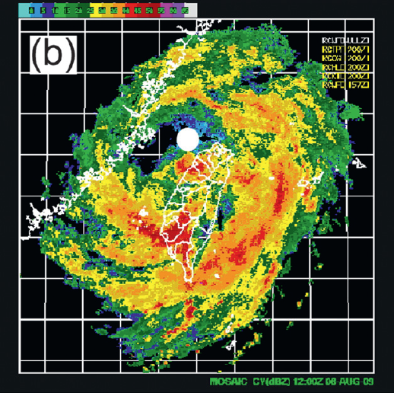
Radar reflectivity
1100 UTC 7 Aug
1200 UTC 8 Aug
No closed eyewall
High asymmetric rainbands on the southern side
significant precipitation occurred in the outer rainbands

Slide 11
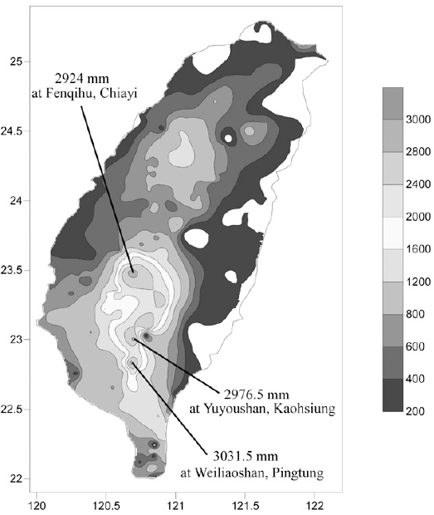
Accumulated rainfall
(00Z 4 Aug – 00Z 13 Aug)
奮起湖，嘉義
6 Aug | 286.5 mm | 24 h before landfall
7 Aug | 1003.5mm | landfall
8 Aug | 1402.0mm | crossed
9 Aug | 963.0mm | move into strait
10 Aug | 423mm | second landfall
previous record is 1736 mm, created by Typhoon Herb (1996)
御油山，高雄
尾寮山，屏東

Slide 12
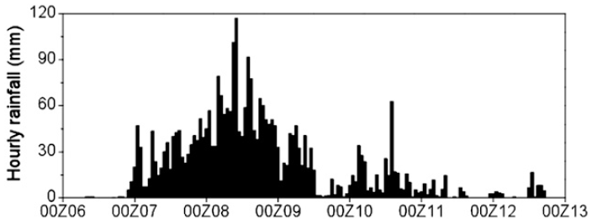
00Z 4 Aug – 00Z 13 Aug
1200 UTC 8 Aug
115 mm
10Z 8 Aug
60 mm
14Z 10 Aug

Slide 13
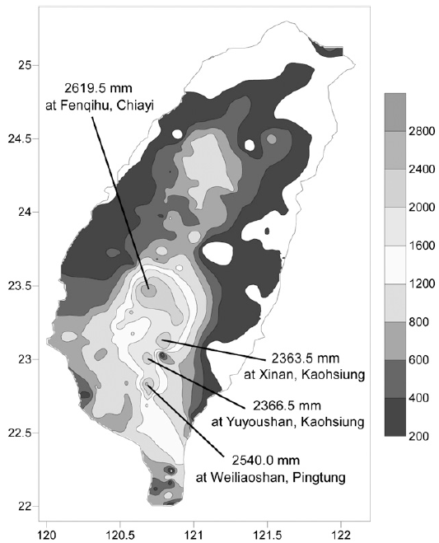
00Z 4 Aug – 00Z 13 Aug
00Z 7 Aug – 00Z 9 Aug
83.8%
its unusually long residence time in the vicinity of Taiwan and highly asymmetric convective structure are responsible for the extreme rainfall event associated with Morakot in southern Taiwan.

Slide 14
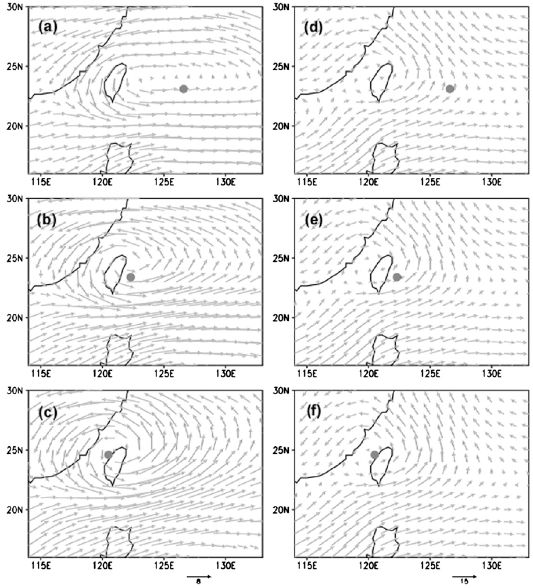
QBW
MJO
Coalescence processes
0600UTC 6 Aug
0600UTC 7 Aug
0600UTC 8 Aug

Slide 15
QBW
MJO
Coalescence processes
0600UTC 6 Aug
0600UTC 7 Aug
0600UTC 8 Aug
maximum hourly rainfall was observed on 8 August when Morakot was nearly collocated with the MJO and QBW gyres

Slide 16
1200UTC 6 Aug
1200UTC 8 Aug
1200UTC 7 Aug
asymmetric
enhanced southwesterly winds
peak intensity
relatively symmetric

Slide 17
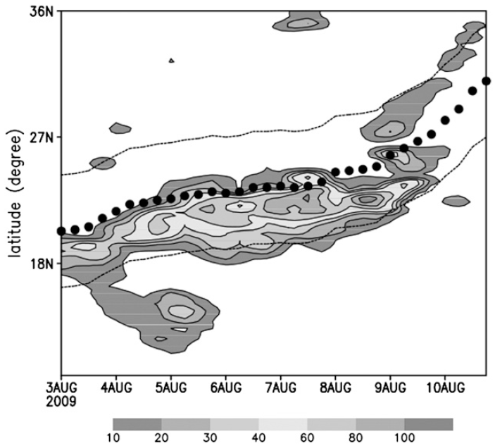
Contribution of different time-scale steering flows
6-h TRMM rainfall along center
synoptic-scale steering flow
Cx |  | Cy
6 Aug | 9 Aug | 6-7 Aug | 8-10 Aug
reduce westward | become eastward | reduce southward | enhance northward
← | → | ↓ | ↑

Slide 18
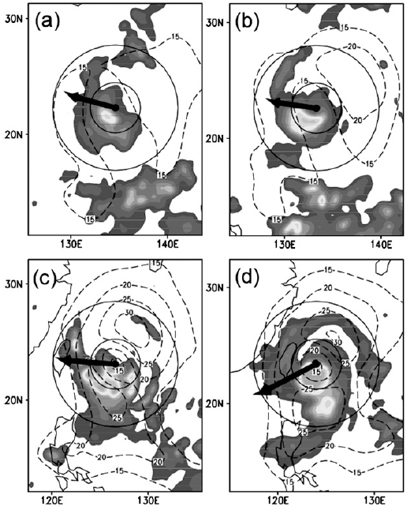
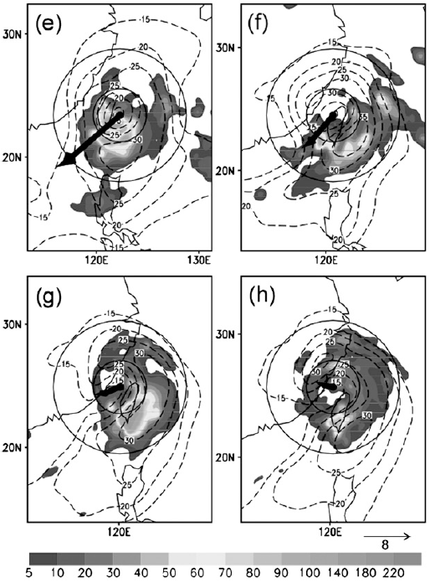
6-hTRMMaccumulated rainfall, 700-hPa FNL wind speeds, vertical wind shear
06Z 7 Aug
00Z 8 Aug
12Z 4 Aug
00Z 5 Aug
06Z 6 Aug
18Z 6 Aug
18Z 8 Aug
00Z 9 Aug
vertical wind shear decreased
upward motion and precipitation shifted to the downshear-left quadrant

Slide 19
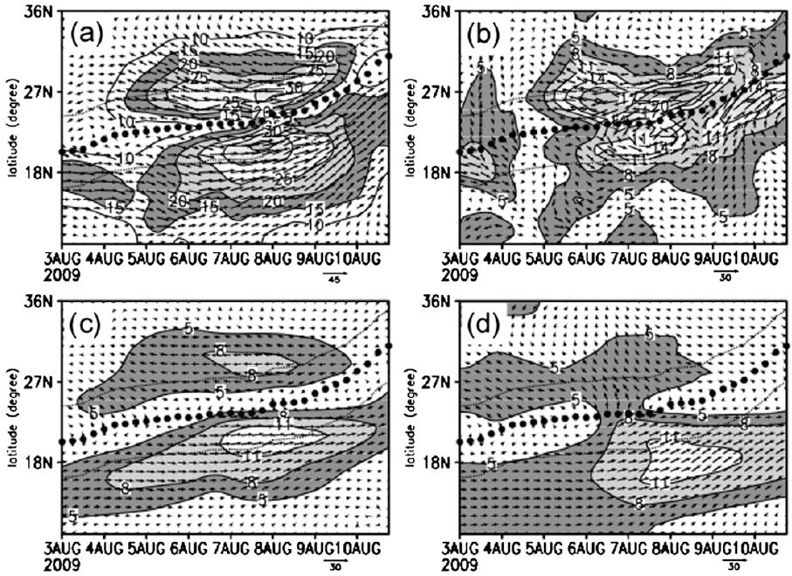
Why did the primary rainfall area remain in southern Taiwan?
Why did the maximum rainfall shift outward while Morakot made landfall, crossed Taiwan Island, and entered the Taiwan Strait during 7–9 August?
unfiltered
10-day high-pass
dominate northern side
concentric with gyres
prior to the landfall
10-20-day bandpass
20-day low-pass
enhanced synoptic-scale flow on the southern side of the typhoon

Slide 20
Why did the primary rainfall area remain in southern Taiwan?
Why did the maximum rainfall shift outward while Morakot made landfall, crossed Taiwan Island, and entered the Taiwan Strait during 7–9 August?
unfiltered
10-day high-pass
10-20-day bandpass
20-day low-pass
The enhanced area of the low-frequency flows did not shift northward.
The increase in the relative distance of the enhanced low-frequency flows to the typhoon center is consistent with the relative shift in the main rainfall area

Slide 21
Summary
This study examined observationally the interaction of Morakot with the low frequency flows and the associated influence on the movement and precipitation structure of Morakot.
Two roles of the interaction in the extreme typhoon-related rainfall event:
northward shift in its track and slowing down in its translation
coalescence process with QBW-scale and MJO-scale cyclonic gyres
coalescence enhanced the synoptic-scale southwesterly winds on the southern side of Morakot and reduced its westward movement, leading to an unusually long residence time of the typhoon in the vicinity of Taiwan.
the resulting slow movement and collocation with the ISO gyres maintained the major rainfall in the southern Taiwan
QBW-scale flows on the southern side increased steadily as the typhoon underwent a coalescence process with the QBW-scale cyclonic gyre
MJO-scale flows increased quickly when the typhoon approached the center of the MJO gyre in the Taiwan Strait
The interaction maintained the major rainfall area in the southern Taiwan through reducing the translation speed, shifting Morakot northward and enhancing the low-frequency flows on the southern side of the typhoon.

