Slide 1
Reducing the Biases in Simulated Radar Reflectivities from a Bulk Microphysics Scheme : Tropical Convective Systems
Lang, S. E., W.-K. Tao, X. Zeng, and Y. Li, 2011: J. Atmos. Sci., 68, 2306-2320
20120522

Slide 2
Introduction (I)
One-moment bulk microphysical schemes that have been around for 30 yr are still a valuable component in the numerical simulation and study of cloud systems because they are computationally more efficient than two-moment or multimoment schemes
Mesoscale and regional-scale models and longer-term or larger-scale CRM (cloud-resolving model)simulations, bulk schemes are also well suited for application in a multiscale modeling framework
Be made more accurate by reducing some of their well-known biases especially since simulated cloud characteristics

Slide 3
Introduction (II)
Its ability to replicate the basic observed cloud structure or organization such as a convective leading edge and a trailing stratiform region (Fovell and Ogura 1988; Tao and Simpson 1989; Tao et al. 1991; Redelsperger et al. 2000)
Specific observed features such as propagation speed, cold pool intensity (Nicholls 1987; Caniaux et al. 1994; Trier et al. 1996)
With long-term simulations, the approach has typically been to evaluate models by comparing basic mean profiles (T, q) or integrated quantities (precipitable water, OLR, RH, and surface rainfall) with similar observed quantities or even limited cloud observations in a time series or mean sense (Xu and Randall 1996; Xu et al. 2002; Zeng et al. 2007)

Slide 4
Introduction (III)
Rutledge and Hobbs scheme was better suited for simulating tropical convection than the Lin scheme based mainly on the fact that it produced a higher stratiform percentage and larger simulated rain area at the surface and a better radar bright band (McCumber et al. 1991).
The CRM scattering signatures were excessive and not well representative of actual observed distributions (Panegrossi et al. 1998; Bauer 2001; Olson et al. 2006), an indication that the models were producing excessive amounts of large precipitation-sized ice particles.
The simulations have an overabundaance of stronger reflectivities aloft due to excessive precipitation-sized ice, these biases could be due to excessive graupel and/or snow amounts, sizes, densities.
Lang et al. (2007) by further improving the model’s radar reflectivity in conjunction with reducing the bias in the overly deep penetration of strong reflectivities to upper levels.

Slide 5
Microphysics improvements
The bulk scheme required further modification (Lang et al., 2007) aloft with excessive probabilities at higher reflectivity values and peak values that were too strong (too much graupel and snow)
not allowing dry growth following Lang et al. (2007) graupel amounts were reduced (lowing the riming efficiency) tightening the thresholds (rimed snow to graupel) allowing graupel to sublimate outside of cloud (was not allowed in original) to reduce the amount of graupel (resulted in more snow)
Graupel amounts were also reduced indirectly by reducing the amount of supercooled cloud water available for riming.
Outside of riming (cloud liquid water to ice, -12~-18 ℃) (not in original)

Slide 6
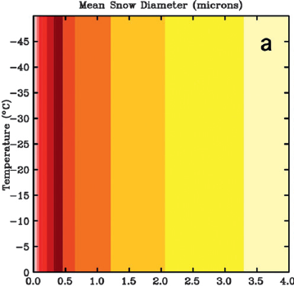
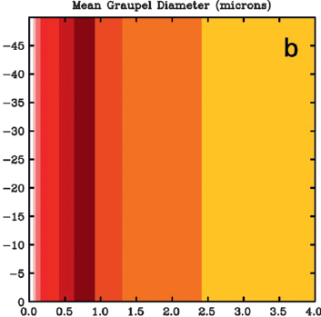
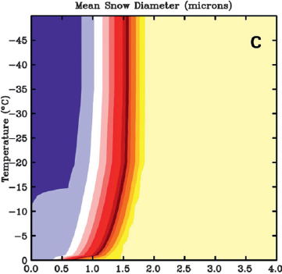
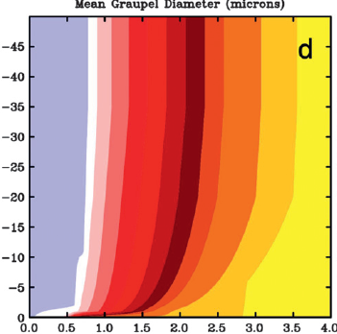
Original
snow
graupel
Modified
g/m³
120E
snow
120E
graupel

Slide 7
Case study
LBA 1999/02/23
KWAJEX 1999/08/11 ~ 08/12

Slide 8
Tropical Rainfall Measuring Mission (TRMM) Large-Scale Biosphere–Atmosphere Experiment in Amazonia (LBA)
Tropical Rainfall Measuring Mission (TRMM) Large-Scale Biosphere–Atmosphere Experiment in Amazonia (LBA)亞馬遜地區大尺度的生物圈及大氣圈實驗
南美洲亞馬遜河區域所發生對流的特性。研究顯示( Halverson et al. 2002 ; Petersen et al. 2002 )在南美洲亞馬遜河區域低層的風場會隨季節變化而改變，這現象迫使南美洲大尺度環流和南大西洋輻合區的位置隨之改變
在低層風向為偏東風期間產生對流時，環境的CAPE和垂直風切的數值，與低層風向為偏西風所產生對流時的大氣環境有明顯的不同。當低層為偏東風條件所產生之對流，CAPE 值與垂直風切較大；並有較強的上升運動、水氣較潮濕等等(Petersen et al. 2002 and Williams et al. 2002)。
Cifelli et al. (2004)利用TRMM-LBA 資料在南美洲亞馬遜河地區的濕季進行研究，發現低層流偏東風和偏西風與對流發展強度有很大的關聯，當低層流偏東風時所產生的對流在雷達上的回波較強。

Slide 9
Case study (1999/02/23) A Continental Convective: TRMM LBA
A good case for diurnal growth.
Convection began in the late morning **weak environmental winds became only weakly organized by early afternoon into SE-NW transient lines parallel to the deep tropospheric shear vector before dying out by evening.
Numerical model simulations
The 3D version of the GCE model **Original: Lang et al. (2007) **128 × 128 km² grid points with dx=250 m **H ~ 23 km (70 levels)

Slide 10
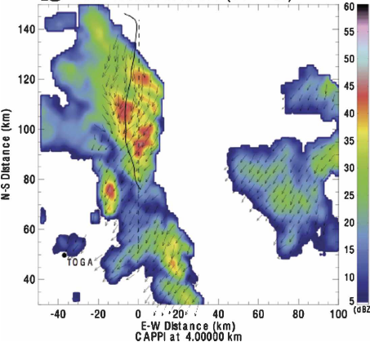
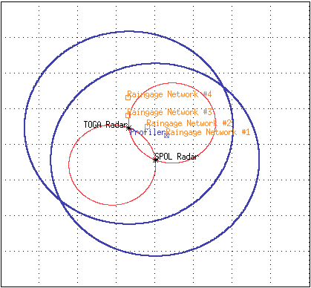
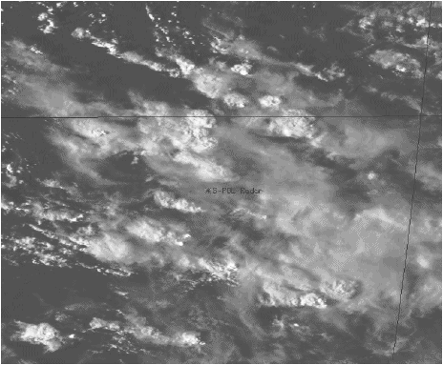
LBA 990223: 2050 UTC (SR Winds)
10 S
11 S
12 S
63 W
62 W
61 W
10 S
SPOL
60 W

Slide 11
Case study (1999/08/11 ~ 12) An Oceanic Convective System: KWAJEX
Kwajalein Experiment (KWAJEX) was gathered data on and characterizing oceanic clouds and convection in support of the TRMM satellite mission (Yuter et al. 2005) ** a TRMM field campaign 11-12 August 1999 in association with the interaction between a mixed Rossby gravity wave and a Kelvin wave (Sobel et al. 2004)
Numerical model simulations
The 3D version of the GCE model **Original: Li et al. (2008)
**128 × 128 km² grid points with dx=500 m **H ~ 23 km (70 levels) **72h starting at 0000 UTC 11 August

Slide 12
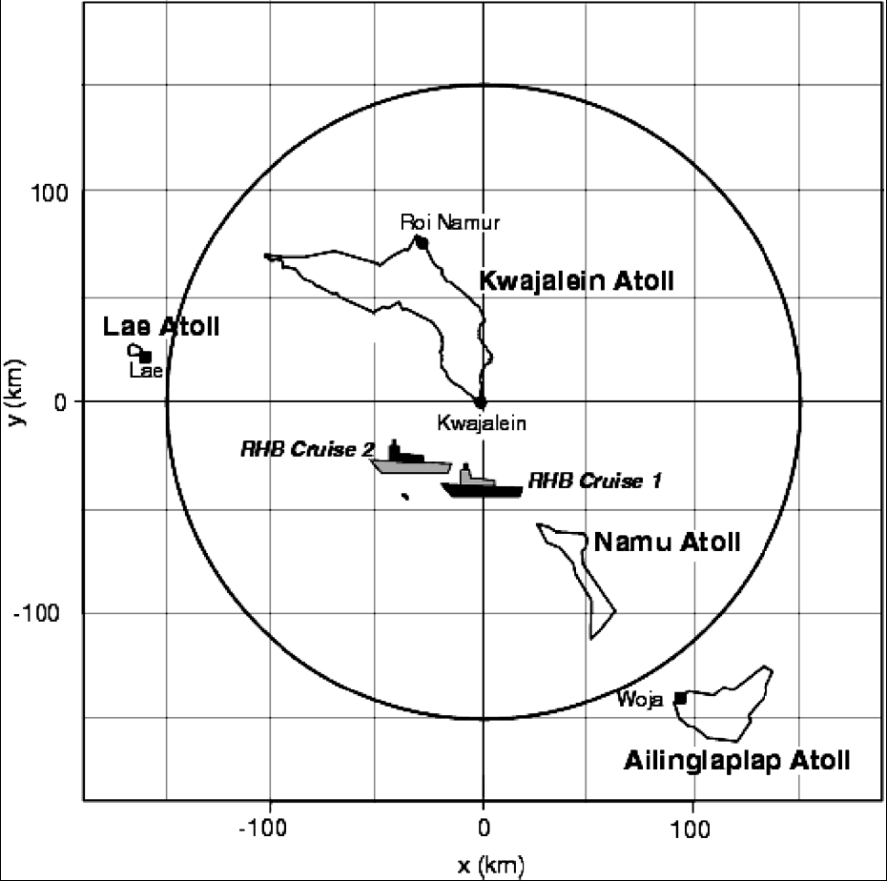
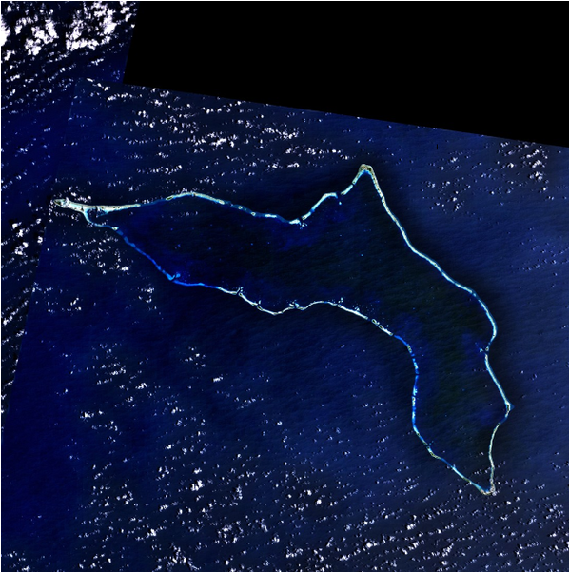
http://www4.ncsu.edu/~seyuter/
southwest of Honolulu, Hawaii , at 8.72N, 167.73E

Slide 13
Simulation results and validation

Slide 14
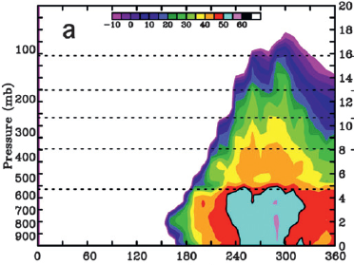
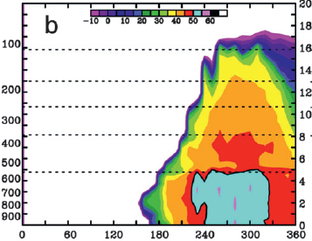
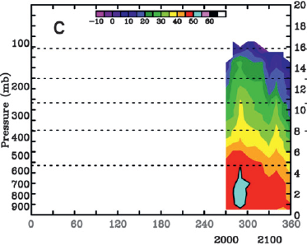
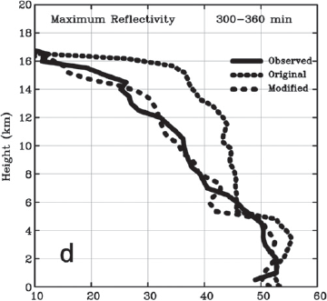
LBA: 1999/02/23
Modified
Original
-80℃
-80℃
-60℃
-60℃
-40℃
-40℃
-20℃
-20℃
0℃
0℃
Obs
-80℃
-60℃
-40℃
-20℃
0℃
UTC
dBZ

Slide 15
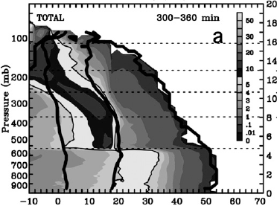
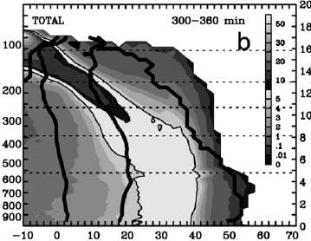
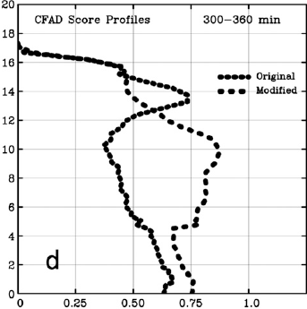
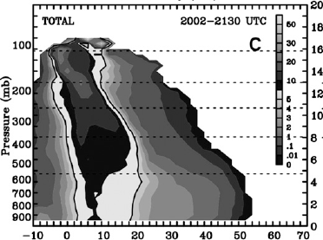
LBA: 1999/02/23
Modified
Original
-80℃
-60℃
-40℃
-20℃
0℃
dBZ
dBZ
Obs
dBZ
PDF

Slide 16
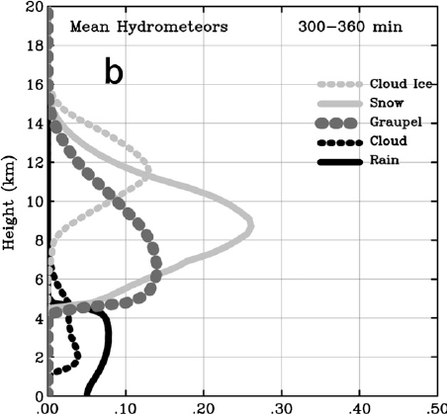
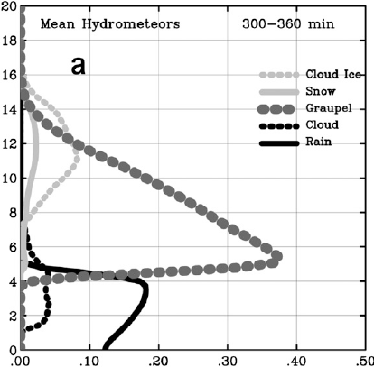
LBA: 1999/02/23
Modified
Original
g/m³

Slide 17
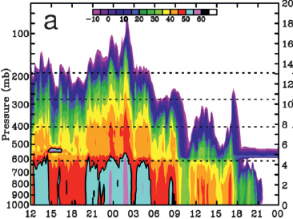
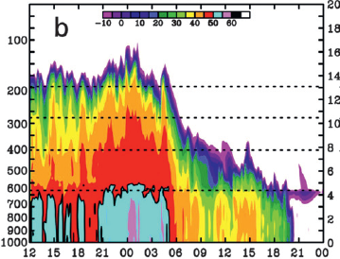
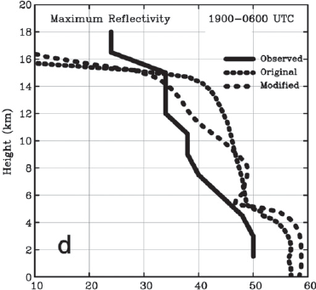
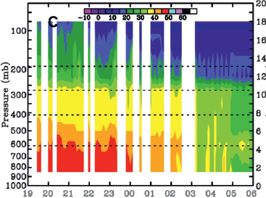
KWAJEX : 1999/08/11 ~ 08/12
Modified
Original
-60℃
-40℃
-20℃
0℃
08/11
08/12
UTC
Obs
UTC
dBZ

Slide 18
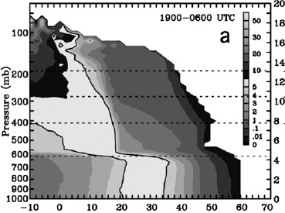
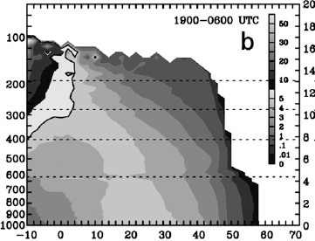
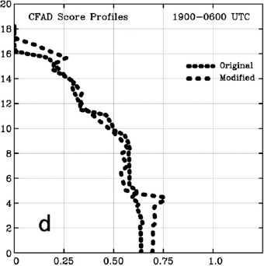
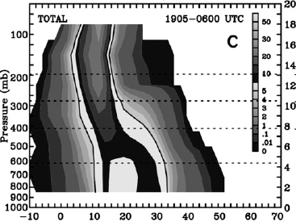
KWAJEX : 1999/08/11 ~ 08/12
Modified
Original
dBZ
dBZ
Obs
-60℃
-40℃
-20℃
0℃
dBZ
PDF

Slide 19
Summary and conclusions
The Rutledge and Hobbs-based three-class ice scheme (cloud ice, snow and graupel) was modified to reduce the unrealistic penetration of high reflectivity values in to the middle and upper troposphere in simulations of tropical convection systems using the Goddard Cumulus Ensemble CRM.
Original: producing too much large precipitation-sized ice aloft. Modified: more realistically simulate the transition of cloud water to cloud ice; cloud ice fall speeds were added; lowering the size of snow and graupel particles at colder temperatures
TRMM LBA and KWAJEX cases, the penetration of strong echoes ( > 40 dBZ) into the middle and upper troposphere was notably reduced.

Slide 20
The biggest challenge to the mapping is that there may be considerable variation in particle size for a given mixing ratio and temperature depending on the environment or cloud history

