Slide 1
The Experimental HWRF System: A Study on the Influence of Horizontal Resolution on the Structure and Intensity Changes in Tropical Cyclones Using an Idealized Framework
Yu-Fen Huang
Gopalakrishnan, Sundararaman G., Frank Marks, Xuejin Zhang, Jian-Wen Bao,
  Kao-San Yeh, Robert Atlas, 2011: The Experimental HWRF System: A Study on the Influence of Horizontal Resolution on the Structure and Intensity Changes in Tropical Cyclones Using an Idealized Framework. Mon. Wea. Rev., 139, 1762–1784.

Slide 2
The Experimental HWRF System: A Study on the Influence of Horizontal Resolution on the Structure and Intensity Changes in Tropical Cyclones Using an Idealized Framework
The Experimental Hurricane Weather Research and Forecasting (HWRF) system became operational at NCEP(National Centers for Environmental Prediction) in 2007.
Notes:
Description of HWRF
The Hurricane Weather Research and Forecast system (HWRF) became operational at NCEP in 2007. This advanced hurricane prediction system was developed at the NWS/NCEP's Environmental Modeling Center (EMC), in collaboration with NOAA GFDL and the University of Rhode Island, taking advantage of the WRF model infrastructure developed at NCAR. HWRF is a state-of-the-art hurricane model that has the capability to address the intensity, structure, and rainfall forecast problems.
The HWRF model is a primitive equation non-hydrostatic coupled atmosphere-ocean model with the atmospheric component formulated with 42 levels in vertical. The model uses the Non-hydrostatic Mesoscale Model (NMM) dynamic core, including its rotated latitude-longitude projection with E-grid staggering. The model has an outer domain spanning about 75° x 75° , with a two-way interactive nest domain of about 6x 6° which moves along with the storm. The stationary parent domain has a grid spacing of 0.18° (about 27 km) while the inner nest domain 0.06° (about 9 km).
The model physics is based primarily on physics similar to that in the GFDL hurricane model which includes a simplified Arakawa-Schubert scheme for cumulus parameterization and Ferrier cloud microphysics package for explicit condensation. The Global Forecast System (GFS) planetary boundary layer parameterization is used. The GFDL model scheme is used for surface flux calculations with an improved air-sea momentum flux parameterization in strong wind conditions and a one-layer slab land surface model. Radiation physics are evaluated by the GFDL scheme, which is also used in the NCEP North-American Mesoscale (NAM) model.
The NCEP GFS global analysis and the storm message provided by NHC are used to generate initial conditions for the hurricane model. The HWRF system does not use a bogus vortex. Instead, it contains a forecast/analysis cycle in which a 6-h HWRF forecast from the previous cycle provides a first guess to a 3DVAR data assimilation system. The first guess field is relocated and modified so that the initial storm position, structure and intensity conforms to that estimated from the NHC storm message. The initial conditions are calculated by adding the assimilated storm structure back onto the GFS environmental analysis fields. The GFS forecasted fields every 6 hours are used to provide lateral boundary conditions during each forecast.
The hurricane model is coupled with a version of the Princeton Ocean Model (POM-TC). In the Atlantic, the POM -TC is configured with 1/6° horizontal grid spacing and 23 vertical sigma levels. The POM-TC is initialized by a diagnostic and prognostic spinup of the ocean circulations using available climatological ocean data in combination with real-time sea surface temperature and sea surface height data. During the ocean spinup, realistic representations of the structure and positions of the Loop Current, Gulf Stream, and warm- and cold-core eddies are incorporated.
At this time, the Developmental Testbed Center (DTC) supports the following components of HWRF:
WRF V 3.3a (contains the 2011 operational capability with additional bug fixes)
WRF Preprocessing System (WPS)
Vortex Initialization
Gridpoint Statistical Interpolation variational data assimilation system
NCEP Coupler
POM-TC and its initialization
HWRF Post-processing
GFDL Vortex Tracker
For more information, please refer to the operational HWRF page.

Slide 3
HWRF
The NMM-WRF nonhydrostatic system of equations is formulated on a rotated latitude-longitude Arakawa E grid.
Parameterization:
Simplified Arakawa-Schubert (SAS)
Ferrier cloud microphysics
The Global Forecast System (GFS) planetary boundary layer and GFDL hurrican model surface layer scheme.
GFDL scheme (Here we use NCAR package)
Notes:
非靜力平衡系統
The GFDL model scheme is used for surface flux calculations with an improved air-sea momentum flux parameterization in strong wind conditions and a one-layer slab land surface model.

Slide 4
The fundamental features
Extreme events
Sensitivity experiment

Slide 5
The fundamental features
Time series of the vortex developments

Slide 6
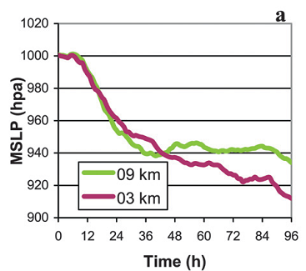
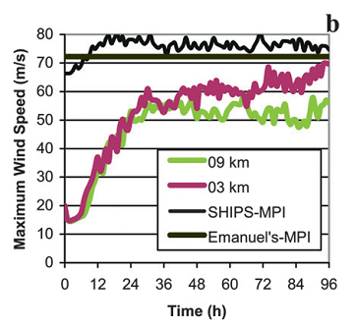
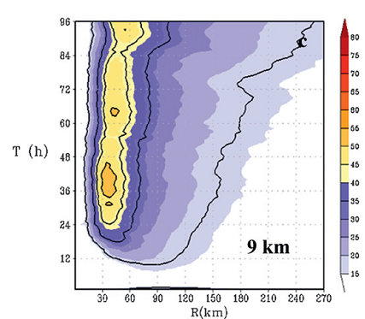
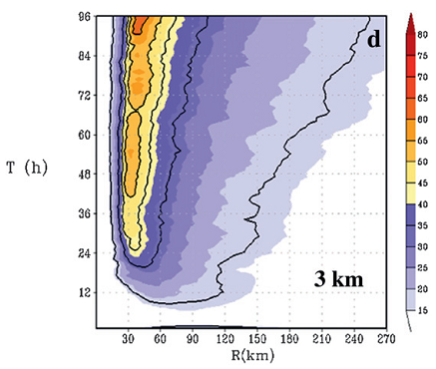
Notes:
10-m height. Tangential wind speed, 17.2, 33, 43, 50, 59 m/s
一開始加強很快，24h後強度增加速率減緩
24h以後不同的解析度開始有差別 (解析度較低的較弱)
>> 高解析度對於熱帶氣旋強度的變化有明顯的影響

Slide 7
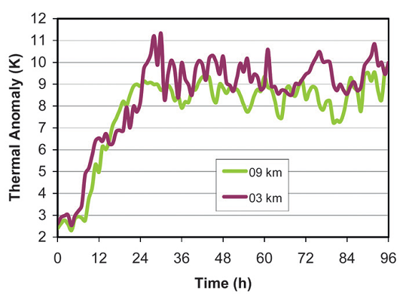
Notes:
中高層的 tangentially averaged maximum temperature anomaly(K) respect to the far-field environmental temperature
暖心發展使TC迅速增強
24h 前氣旋迅速增強 ，24h後趨於緩慢
迅速加強的階段並沒有解析度的差別，而到了成熟期則開始有差別 (可參照2a,b)
A thermal plume is one which is generated by gas rising above heat source. The gas rises because thermal expansion makes warm gas less dense than the surrounding cooler gas.

Slide 8
The fundamental features
Time series of the vortex developments
Rapid intensification stage

Slide 9
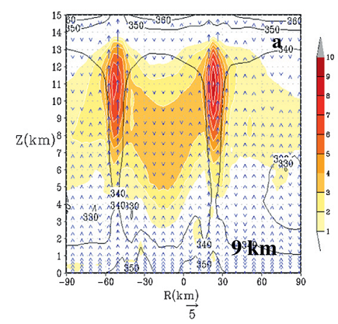
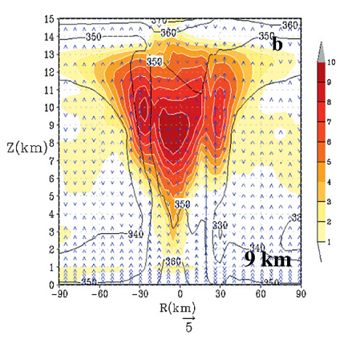
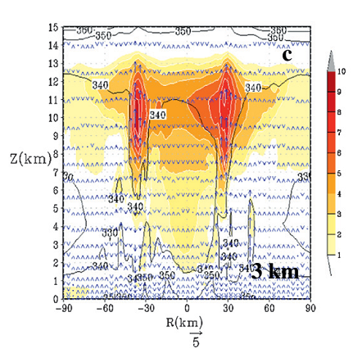
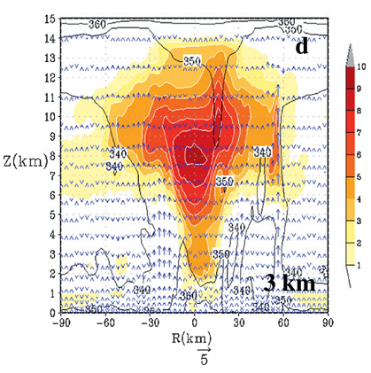
9h
24h
Emanuel, 2003: Updrafts near the top of the boundary layer transport moisture and heat into the upper troposphere
Notes:
Thermal anomaly cross section (x-z) (color shaped)
Contours are θ_{e}
在9到24小時內非常迅速地增強
發展後的結構大致相同 (agree with the reported by Ritchie et al. (2003) for the case of Hurricane Floyd (1999))
雖然C03和C09在結構上可能有些許差異，但在增強的過程中幾乎是一致的
上升氣流會把boundary layer附近的 moisture 和 heat (higher θ_{e} ) 往上傳遞 (Emanuel 2003)

Slide 10
The fundamental features
Time series of the vortex developments
Rapid intensification stage
Mature stage

Slide 11
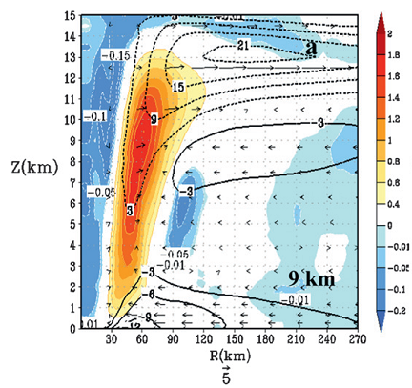
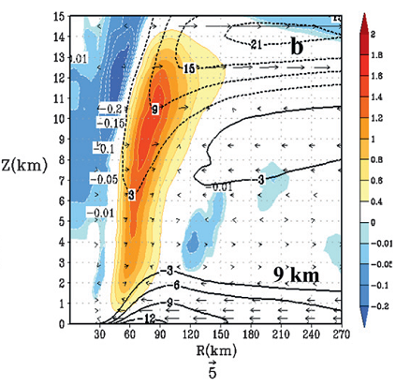
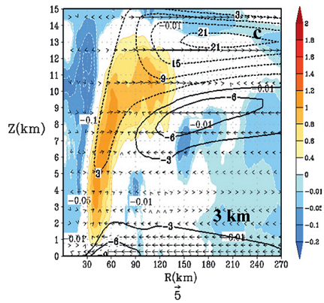
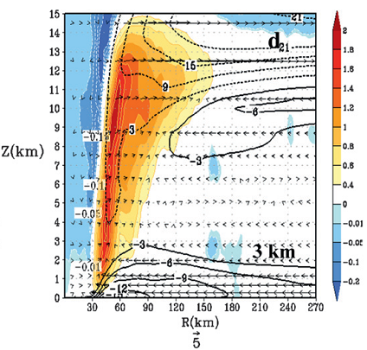
21h
93h
Notes:
每6小時平均的二次環流，radial-height cross secion, 色標>>上升速度
At 21h, C09比C03更具完整結構
Smith(1980) 發現絕熱增溫中的浮力會對inward(from the eye wall to the eye)的壓力梯度有反作用。在中高層眼牆附近會有強烈的下沉。
這樣的下沉氣流使颱風眼變得明顯

Slide 12
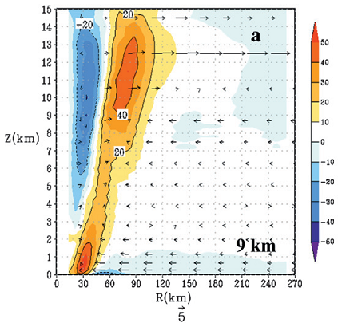
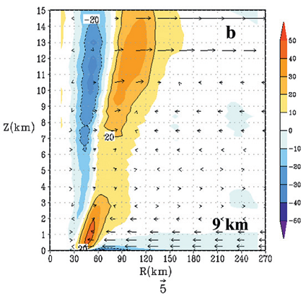
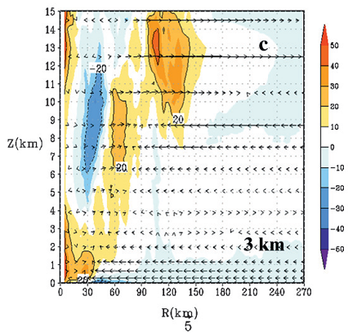
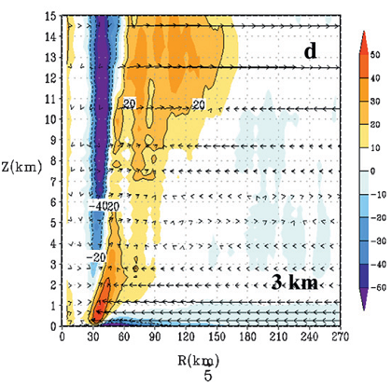
21h
93h
Notes:
[Eq1] Color: blue>subgradient; red>supergradient
在ABL中，subgradient的風在inflow消失之處變成supergradient
在inflow減弱處的supergradient tangential wind 會隨著上升氣流和outflow加強眼牆的雲

Slide 13
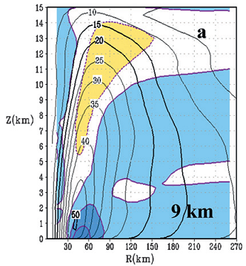
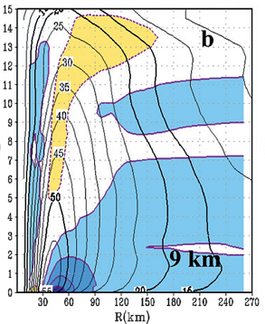
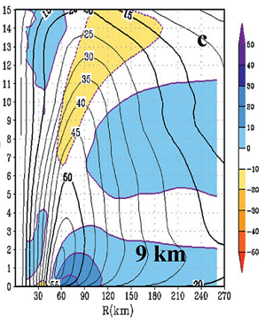
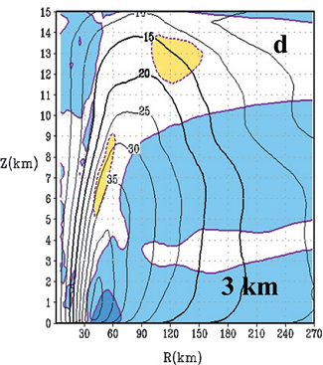
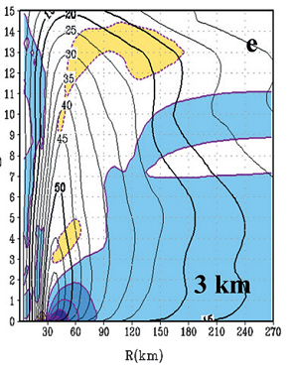
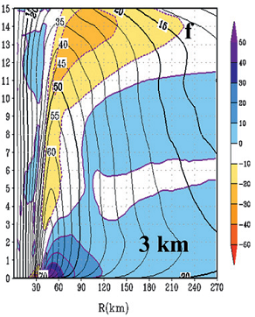
21h
45h
93h
Notes:
[Eq.2] contour >> maximum tangential wind
color shaped >> net tangential forcing with frictional effect related to the primary circulation term in Eq. (2)
在45h和93h,C09的最大風速隨高度傾斜較C03嚴重，代表C03的vortex較深較牢固
在inner-core的部分兩者的最大風速較大，但在較外圈(ex: 210 km)兩者差異不大
在兩個CASE中，正貢獻有助於vortex的spinup，但C03在45h和93h近地面的貢獻強於C09
C03比C09還持續增強 >> 解析度對於Coriolis term較敏感，特別是在成熟期
切線風較徑向風對於解析度還要敏感

Slide 14
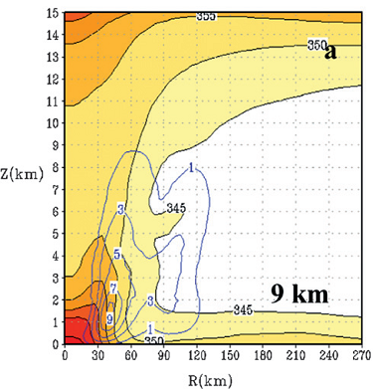
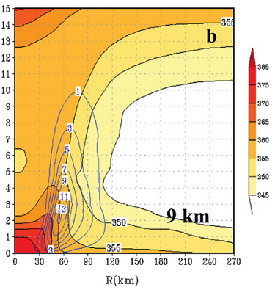
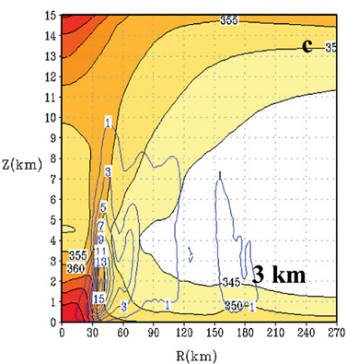
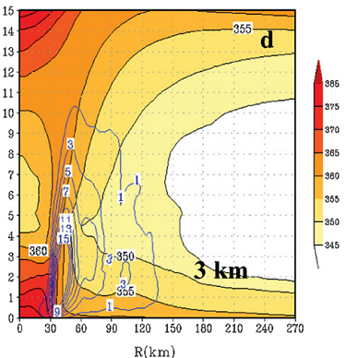
69h
93h
Notes:
C09和C03在69h和93h (for the analysis of a mature storm)的熱力結構
Color shaded >> mean 相當位溫
Blue contour >> moisture fluxes
C03比C09還暖
當core越暖，氣壓就越低，而風也越強(?)
越細的解析度在眼牆不只表現出較強的輻合和近地面較強的tangential wind，還提供了更密、更好的moisture flux gradients(?)

Slide 15
Extreme events

Slide 16
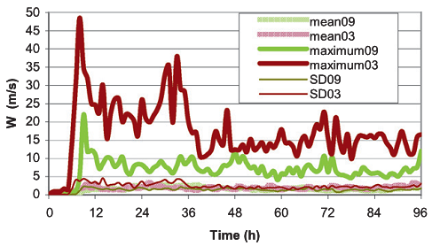
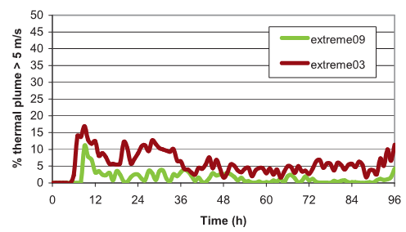
Notes:
Mean09和mean03的平均上升速度沒有太大的差別
但是瞬間的上升速度最大值卻差了一倍
然而在門檻超過 5 m/s的extreme03 只佔了15%
C09在過了第12h以後大於門檻值的幾乎都低於5%，代表之後是隨著平均垂直速度2+-(2~3, 標準差)m/s，從boundary layer帶上來的moisture和heat
低解析度通常都較晚才開始增強as well as 軸對稱model (Rotunno and Emanuel 1987)

Slide 17
Stronger storm
Bigger storm
Convective parameterization
Description | Initial vortex strength (m/s) | Initial radius of max wind (km) | Convection scheme for the nest | Specification
Control | 20 | 90 | Yes | C09,C03
Strong | 30 | 90 | Yes | S09,S03
R0 | 20 | 120 | Yes | R09,R03
No SAS | 20 | 90 | No | SAS09,SAS03
Sensitivity experiment

Slide 18
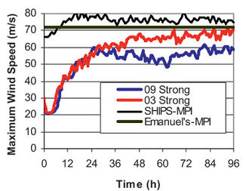
Stronger storm
Bigger storm
Convective parameterization
Notes:
S03比起S09增強較多

Slide 19
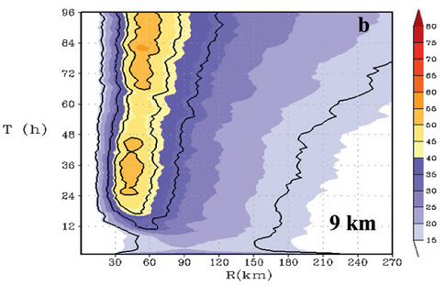
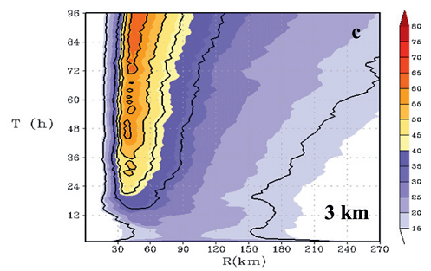
Stronger storm
Notes:
S03比起S09的inner-core增強較多
兩者的size都比control的還要大

Slide 20
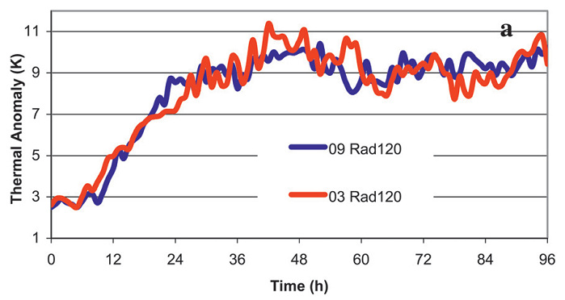
Bigger storm
Notes:
加大後，R03和R09的Thermal Anomaly幾乎一樣

Slide 21
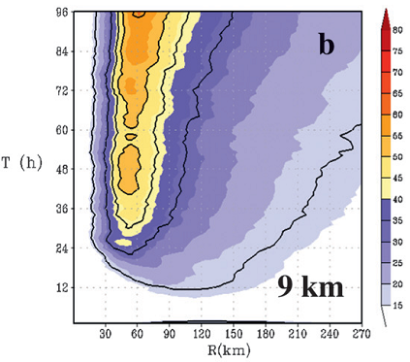
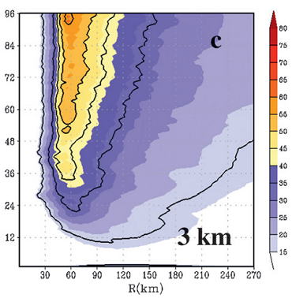
Bigger storm
Notes:
比起R03，R09的增強反而較C09好一些

Slide 22
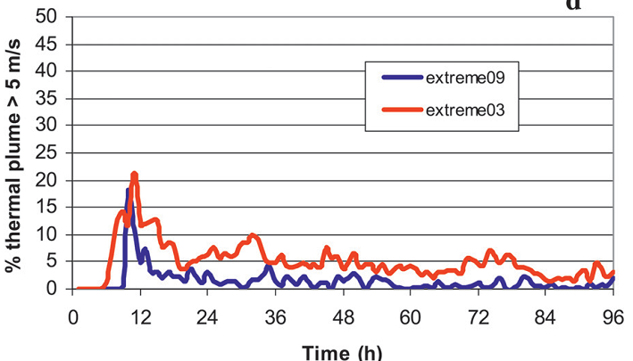
Bigger storm
Notes:
雖然在強度上看起來S09和S03差不多，但是在極值方面仍然比不過S03
極值所造成的不對稱並不影響storm的增強

Slide 23
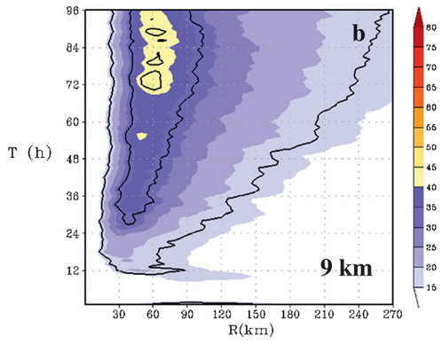
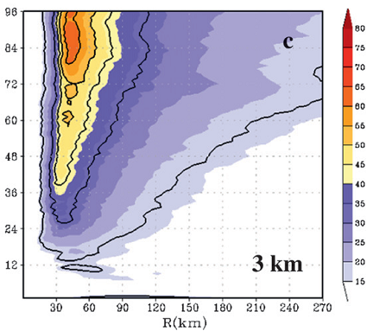
Convective parameterization
Notes:
在SAS09中，Microphysical heating太弱以至於無法維持SAS09的強度
SAS03到後期才有較強的強度

Slide 24
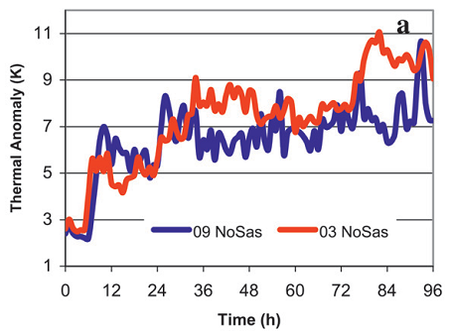
Convective parameterization
Notes:
SAS 提供了額外的heating
在有SAS的情況下增強較快速，SAS03到後期才有與C03前期一樣的強度
在模式中SAS convection scheme不能被忽略

Slide 25
Conclusions
6h→36h →96h
updraft
rapid
slow
Conclusions
Conclusions
Conclusions
Conclusion
6h→36h →96h
X
resolution impact
O
resolution impact
resolution
extreme event
Notes:
Vortex的發展、增強可以分為快速發展期和成熟期，成熟期的發展速度慢
解析度對一開始迅速增強並沒有太大的影響，但到了後期便有明顯的區別
上升運動是迅速增強的過程中的主角
解析度對模擬出的極值有一定的影響

Slide 26
Thanks for your listening.

Slide 27
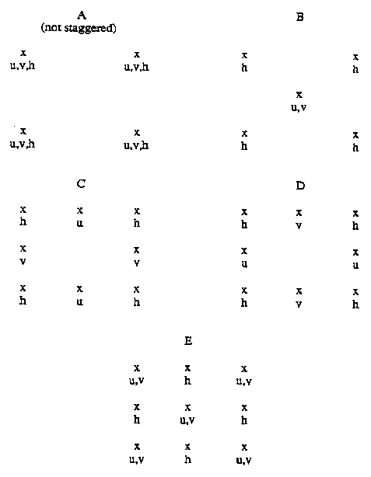
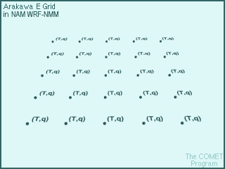
d
d
d
d
d

Slide 28
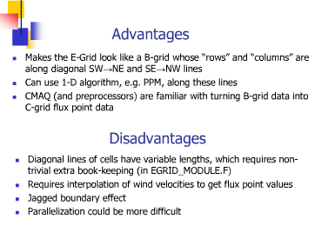

Slide 29
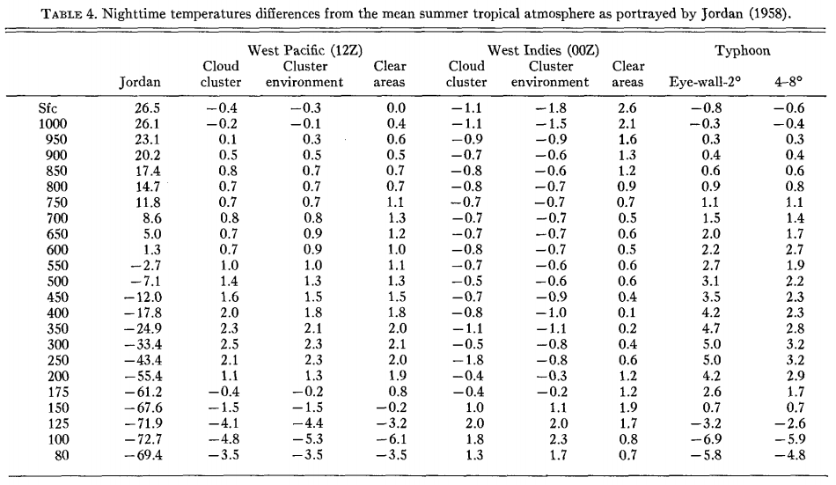

Slide 30
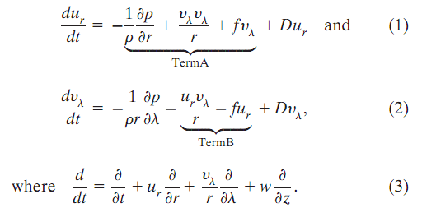

Slide 31
Net tangential forcing

Slide 32
