Slide 1
A modeling study of orographic convection and mountain waves in the landfalling typhoon Nari (2001)
Xiao-Dong Tang, Ming-Jen Yang and Zhe-Min Tan
2011/11/15

Slide 2
Introduction (I)
Mountain waves and orographic convection may play an important role in the formation of orographic precipitation through different mechanisms condensation ( Hill et al., 1981; Hill, 1983; Pandey et al., 1999) seeder–feeder processes (Bergeron, 1965;Browning, 1980; Carruthers and Choularton, 1983; Smithet al., 2009a) upstream convection triggered or enhanced by terrain blocking (Grossman and Durran, 1984) windward slope triggering of convection (Smith et al., 2009b) thermal triggering of convection, lee-side convergence (Mass, 1981) lee-side enhancement of convection (Tripoli and Cotton, 1989).

Slide 3
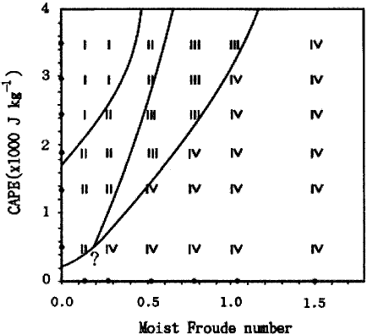
Introduction (II)
For a conditionally unstable flow passing over a two- or three-dimensional mesoscale mountain ridge, three or four flow regimes, based on the moist Froude number (Fr_{w}) and convective available potential energy (CAPE), are proposed by studies of idealized simulations (Chu and Lin, 2000; Chen and Lin, 2005a, 2005b).
An upward-propagating mountain wave can be produced by the strong basic flow in the higher Fr_{w} regimes (Chen and Lin, 2005a).
U : basic wind h: terrain height
N_{w}: Brunt-Vaisala frequency

Slide 4
Introduction (III)
Moist static instability or nearly neutral stratification, and negative vertical shear of horizontal wind usually exist at low levels in the environment of landfalling typhoons (Blackwell, 2000; Chan and Liang, 2003).
In landfalling typhoons, mountain-induced gravity waves (MGWs) were also found, and could further transport precipitation particles to the lee side and lower levels (Misumi, 1996; Fudeyasu et al., 2008).
The impacts of mountain waves and convection over the steep terrain on precipitation are seldom discussed from a dynamical–microphysical perspective, especially in the landfalling typhoon environment.

Slide 5
Introduction (IV)
How does the propagation of orographic convective cells affect the evolution of mountain waves in the distant rain bands of typhoon Nari ?
How do mountain waves and orographic convection influence the microphysical processes and the formation of precipitation ?
What are the differences of mountain effects over different regions of a landfall typhoon (the distant rain band & eyewall)

Slide 6
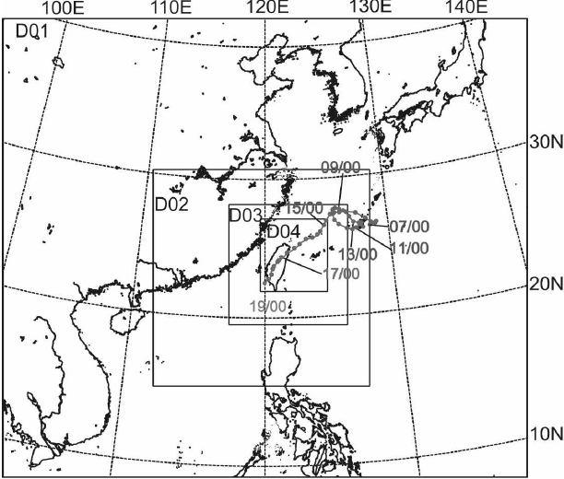
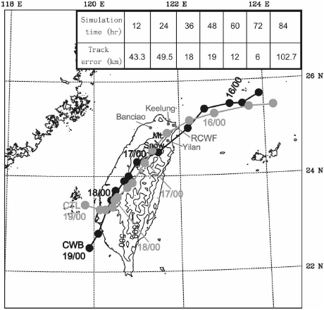
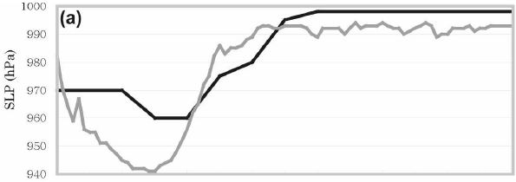
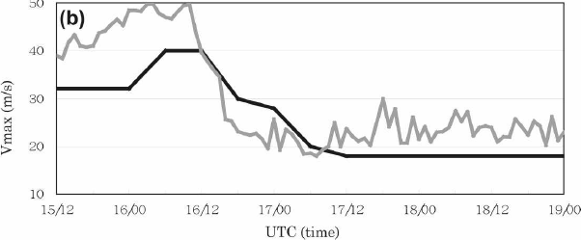
Model set-up and experiment design
54/18/6/2 km
32 sigma (σ) levels
Radiative BC: Klemp and Durran (1983)
Cumulus: Grell (1993) used on 54/18 km
Microphysics: Reisner et al. (1998)
PBL: MRF Hong and Pan (1996)
IC/BC: ECMWF 1.125º lat/lon
1st : 09/16 06-18 UTC 2nd: 09/18 03-05 UTC
No Latent Heat (NLH): latent heat release was turned off starting from 09/18 0300 UTC
No terrains over Taiwan (NTR)
Yang et al. (2008)

Slide 7
Wavelet analysis (Morlet Wavelet)
Morlet wavelet analysis is effective in the analysis of periodical phenomena like convection and gravity waves (Chagnon and Gray, 2008; Kuester et al., 2008)
x : the independent spatial or temporal coordinate
s: a spectral parameter
wavelet power spectrum defined as shows the amplitude of any features versus the scale and how this amplitude varied with space of time.

Slide 8
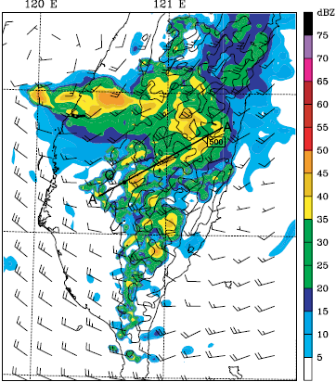
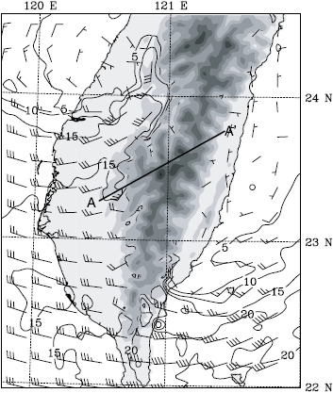
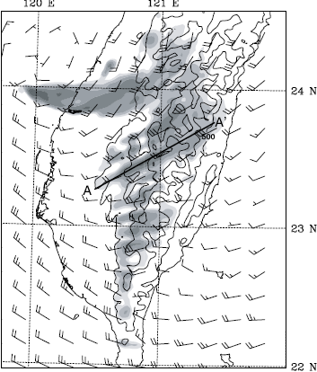
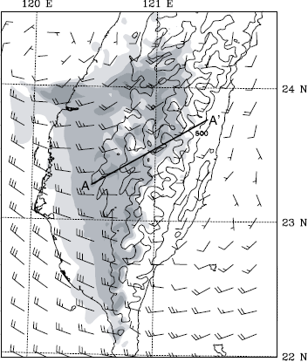
dBZ & wind at H= 4 km 09/18 04 UTC
wind at H= 1 km 09/18 03 UTC
2 h rainfall during 09/18 03~05 UTC
CTL
NLH
wind at H= 4 km 09/18 05 UTC

Slide 9
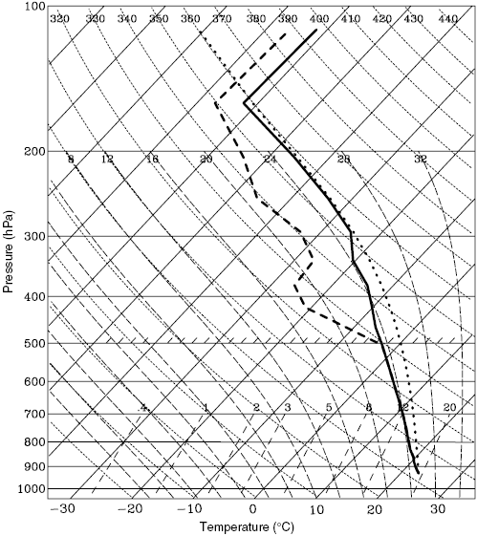
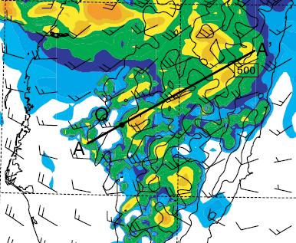
09/18 03 UTC
120E
121E
23N

Slide 10
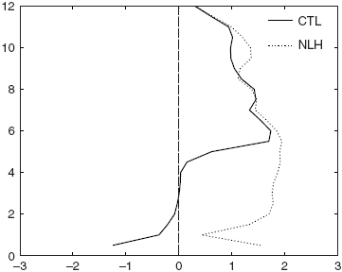
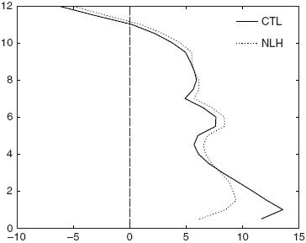
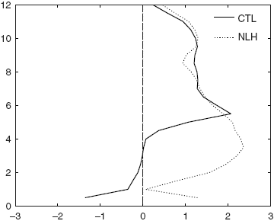
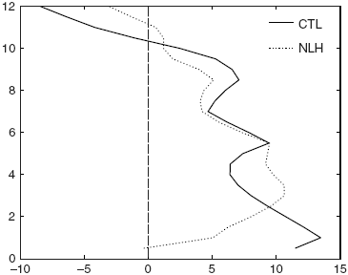
1h averaged at 09/18 03~04 UTC
CTL: the convectively unstable stratification
Negative vertical shear
1h averaged at 09/18 04~05 UTC

Slide 11
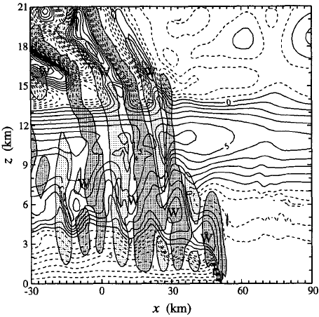
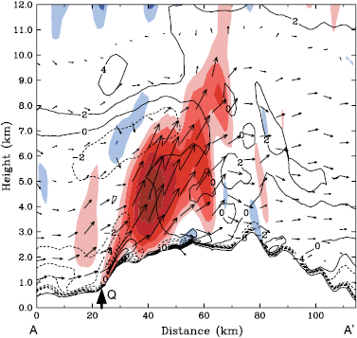
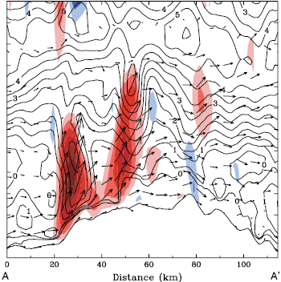
Yang and Houze (1995)
09/18 0300 UTC convective instability ( )
09/18 0348 UTC Θ’(the deviation of initial value)
m s⁻¹

Slide 12
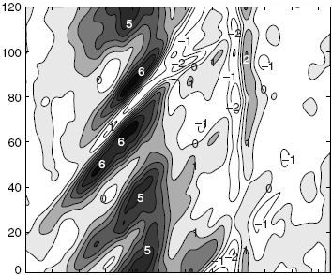
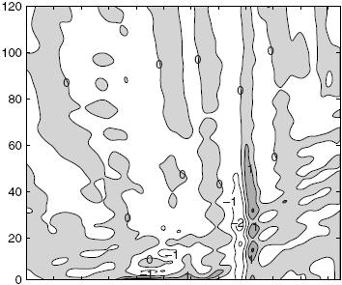
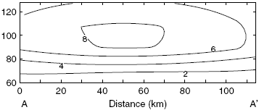
CTL
w 09/18 03~05 UTC at H = 4km
NLH
Morlet wavelet power spectrum of terrain height (unit: km²)

Slide 13
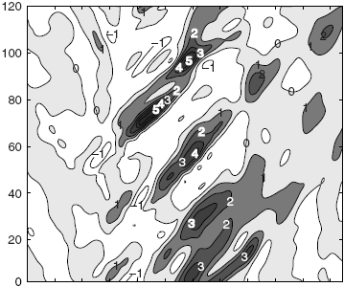
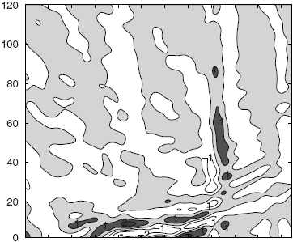
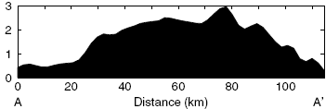
CTL
w 09/18 03~05 UTC at H = 8km
NLH

Slide 14
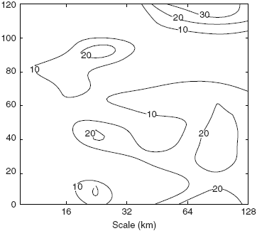
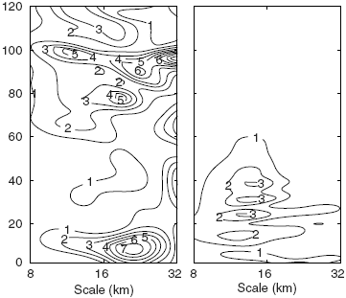
w 09/18 03~05 UTC at H = 4km
UU’ (30~55 km) at H=4 km
CTL
PP’ (75~85 km)
NLH
~20 km
Morlet wavelet power spectrum of vertical velocity (m² s⁻²)
Morlet wavelet power spectrum of terrain height (unit: km²)

Slide 15
Influence of convection to mountain waves

Slide 16
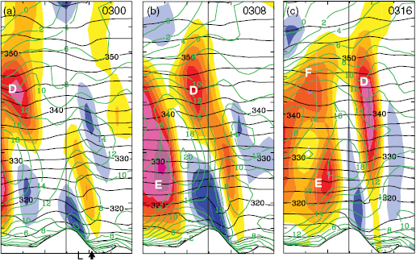
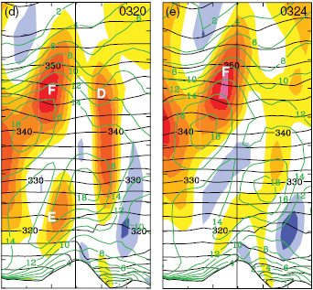
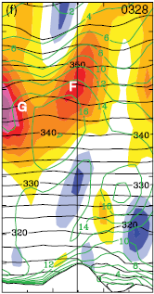
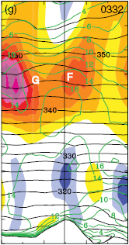
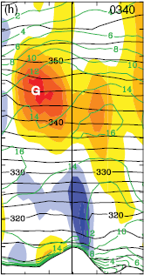
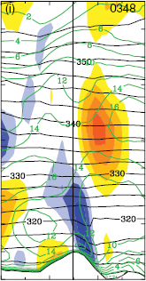

Slide 17
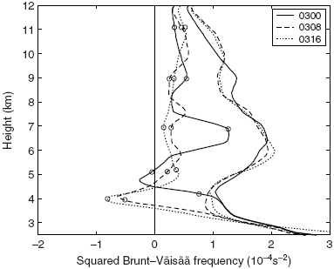

Slide 18
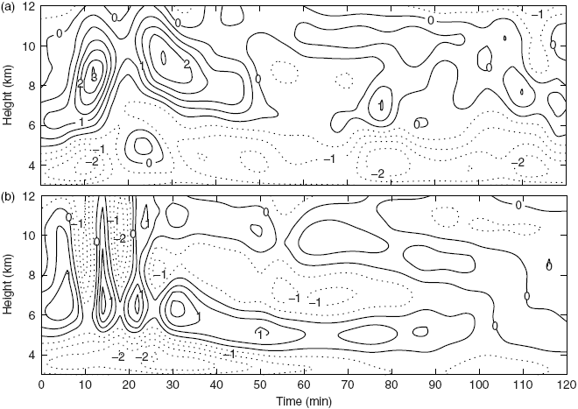
09/18 03~05 UTC
CTL
NLH
w at the mountain peak along the AA’

Slide 19
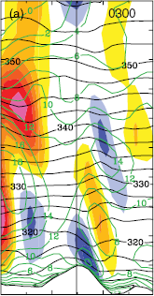
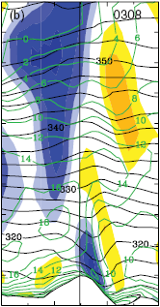
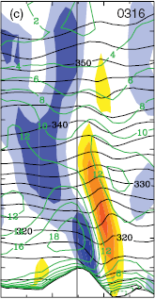
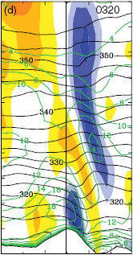
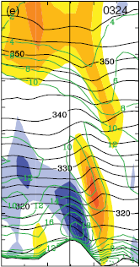
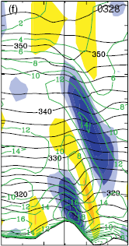
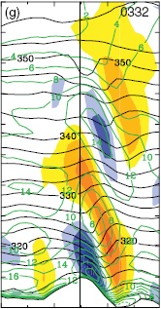
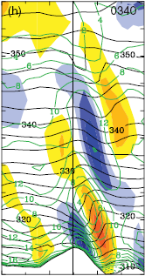
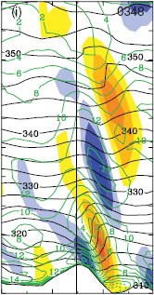

Slide 20
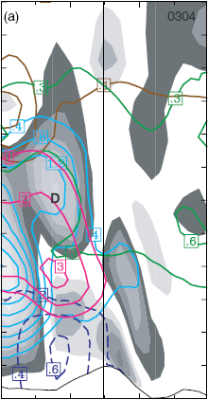
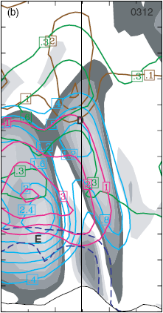
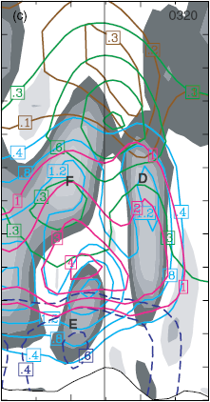
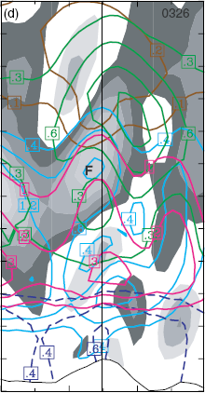
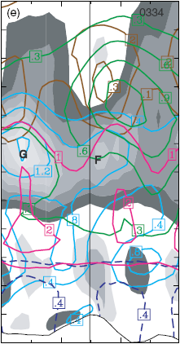
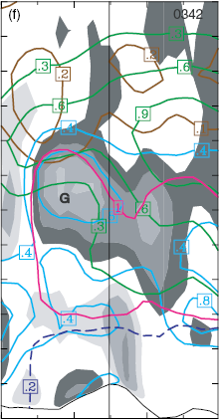
0304
0312
0320
0326
0334
0342
0
10
20
(km)
0
10
20
(km)
0
10
20
(km)

Slide 21
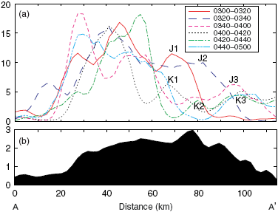
Precipitation (mm)
Height (km)

Slide 22
Mountain waves in the inner core
Yang et al. (2008)
CTL
R=200 km averaged horizontal wind at 09/16 12 UTC
120E
122E
124E
26N
24N
NTR
22N
24h rainfall at 09/16
Variable | CTL | NTR
Percentage wrt CTL (%) | 100 | 51.9

Slide 23
CTL-NTR
rt12h (09/16 06 to 18 UTC)
CTL
20
40
80
160
320
640
(mm)
NTR
0
1000
2000
3000
(m)
CTL-NTR
rt2h (11 to 13 UTC)
rt2h (10 to 12 UTC)

Slide 24
CTL 09/16 11~13 UTC
W at H = 4km
NTR 0916 10~12 UTC
Time (min)
Rainfall of 2min
Time (min)
CTL NTR
Height (km)
Rainfall (mm)

Slide 25
CTL Run
1110 UTC
1130 UTC
1150 UTC
NTR Run
1010 UTC
1030 UTC
1050 UTC
Θ’(the deviation of initial value) w (vertical velocity)
-6
-5
-4
-3
-2
-1
0
1
2
3
4
5
6
7
ms⁻¹

Slide 26
CTL Run
1210 UTC
1230 UTC
1250 UTC
NTR Run
1110 UTC
1130 UTC
1150 UTC
-6
-5
-4
-3
-2
-1
0
1
2
3
4
5
6
7
ms⁻¹

Slide 27
Discussion and summary (I)
On the windward slope of CMR, convective cells were frequently triggered at the steep upslope in the environment with negative vertical shear of horizontal wind and low-level instability
Latent heat release by orographic convections helped the airstream to flow over the CMR rather than to flow around it. Convective cells scale ~20 km.
The updraft branches of MGWs were sometimes enhanced by latent heat released by the convective cells advected downwind.
Thus the in-phase superposition of convection and MGWs would increase the amplitude of MGWs on the lee side.

Slide 28
Discussion and summary (II)
The convective cells on the windward slope were triggered, the coalescence and riming processes resulted in precipitation enhancement on the windward slope, more cloud ice and snow particles were produced aloft over the peak and were advected downstream to seed the flow over the lee side. The coalescence and riming processes are responsible for the secondary precipitation maximum on the lee side.
The small-scale accumulated rainfall variations are contributed by both the larger-scale mountain lifting and the smaller-scale MGWs–convection interaction, which were comparably important.
The important interaction between the MGWs and orographic convection within a landfalling typhoon can modulate precipitation over the rugged terrain.

Slide 29
Discussion and summary (III)
The mechanism for enhanced rainfalls over the mountain in the distant rain band (09/18 03~05 UTC) is due to the terrain-induced convection rather than the ‘seeder–feeder’ mechanism
The Nari eyewall and principal rain band (09/16 11~13 UTC) passed over the northern CMR, the steep terrain greatly enhanced upward motion at the upslope, accompanied by the release of a tremendous amount of latent heat, leading to a doubled accumulated rainfall maximum near the main peak. The strong impinging flow produced a strong stationary downdraft branch of the mountain wave on the lee side, inducing an evident rain shadow. The updraft branch of the mountain wave also generated a localized rainfall maximum on the lee side.

