Slide 1
Evolution of Multiscale Vortices in the Development of Hurricane Dolly (2008)
Paper
discussion
Reference : Fang, J., and F. Zhang, 2011: Evolution of multiscale vortices in the development of Hurricane Dolly (2008). J. Atmos. Sci., 68, 103–122.
Yi Zhang
2011.05.25

Slide 2
Contents
Introduction
An overview of multiscale features in the development of Hurricane Dolly
Quasi-balanced evolution of Hurricane Dolly in the system scale
Convective-scale processes occurred in the development of Hurricane Dolly
Cluster-scale processes occurring during the developing stage of hurricane Dolly
Concluding remarks

Slide 3
1. Introduction
More and more small-scale (several to a few tens of kilometers) features and processes associated with TCs have been identified
Observational analysis:
Marks and Houze (1984): Identified smallscale vortices in the eyewall of a TC using airborne Doppler radar data. Small-scale vortices played significant roles in the storm’s dynamics.
Marks et al. (2008): presented a detailed observational view of a vortex in the eyewall of Hurricane Hugo (1989). The intense cyclonic vorticity maximum adjacent to the strongest convection in the eyewall was roughly 1 km in diameter with a magnitude of 1.25* 10⁻¹ s⁻¹.
Reasor et al. (2005) and Sippel et al. (2006): provided observational evidence for the existence and interactions of intense vortices associated with individual cumulonimbus clouds of varying scales and intensities in developing cyclones.

Slide 4
1. Introduction
Numerical studies:
Small-scale processes and their subsequent roles in the development and evolution of TCs [e.g. Hendricks et al.(2004), Montgomery et al. (2006)]
A new paradigm on TC genesis: which occurs within a vorticity-rich environment via VHTs and their aggregate effects. The existence of sufficient CAPE and low-level cyclonic vorticity in pre-TC environments facilitates the formation of VHTs by deep convective processes, which serve as the primary building blocks of the TC vortex.
Notes:
Earlier investigators suggested that the cooperative interaction between deep convection and the surface large-scale circulation is a positive feedback process, by which an incipient tropical disturbance can be intensified and ultimately developed into a TC; this positive feedback process was coined conditional instability of the second kind (CISK; Charney and Eliassen 1964; Ooyama 1964).

Slide 5
1. Introduction
The small-scale vortices, such as VHTs, and their aggregate effects are also argued to play a prominent role in the rapid intensification of TCs
CISK: [ Charney and Eliassen (1964), Ooyama (1964) ]
The cooperative interaction between deep convection and the surface large-scale circulation is a positive feedback process, by which an incipient tropical disturbance can be intensified and ultimately developed into a TC
WISHE: [Emanuel (1986) , Rotunno and Emanuel (1987)]
A positive feedback between the azimuthal-mean boundary layer equivalent potential temperature and the azimuthal-mean surface wind speed underneath the eyewall of the storm fuels the intensification of the TC vortex
Futher discussions about WISHE: [Nguyen et al. (2008), Montgomery et al. (2009)]
VHTs are able to extract surface moisture fluxes that are locally sufficient for growth without the wind–moisture feedback that typifies WISHE, and therefore the WISHE feedback mechanism is much less of a constraint on the development of TCs in three dimensions.

Slide 6
1. Introduction
The evolution of negative vorticity anomalies in the development of TCs is another interesting issue associated with small-scale vortices.
Montgomery and Enagonio (1998) : vortex intensification was preceded by the ingestion of like-signed PV anomalies into the parent vortex and expulsion of opposite-signed PV anomalies during the axisymmetrization process
Nolan et al. (2001) : demonstrated that the low vorticity core moves radially outward toward the outer edge of the eyewall
Nguyen et al. (2008) : cyclonic vorticity anomalies will tend to move toward the center, while anticyclonic anomalies will tend to move away from the center.
Expulsion of the negative vortices!

Slide 7
Motivation
The current study focuses mainly on the evolution of the low-level vorticity associated with CVAs
Examines in detail the evolution and multiscale interactions of these CVAs along with their impacts on the genesis and development of Hurricane Dolly(2008)
CVAs (Convectively induced vorticity anomalies ): active VHTs, decayed VHTs, or VHTs to be

Slide 8
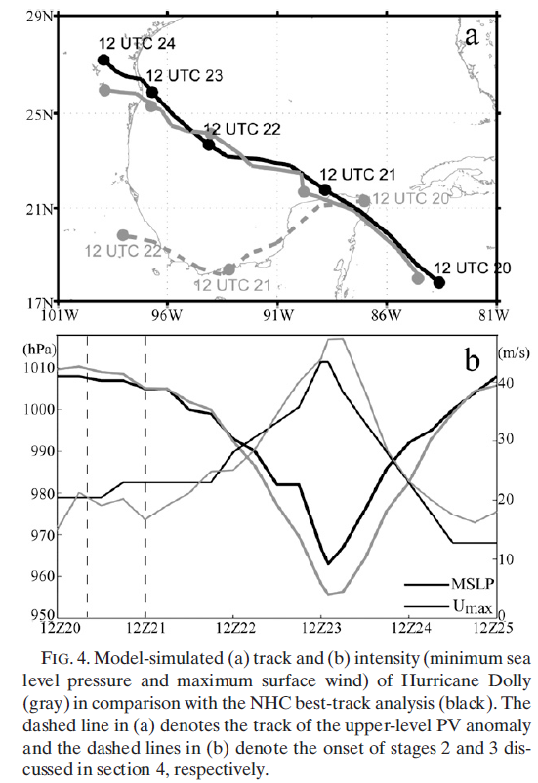
At around 1200 UTC 20 July, a well-defined low-level circulation center was centered about 500 km east of Chetumal, Mexico. However, the system soon became disorganized and the circulation center temporarily became difficult to track.
After 1200 UTC 21 July, when the system was to the north of the Yucatan Peninsula, it reorganized and finally strengthened into a hurricane by 0000UTC 23 July

Slide 9
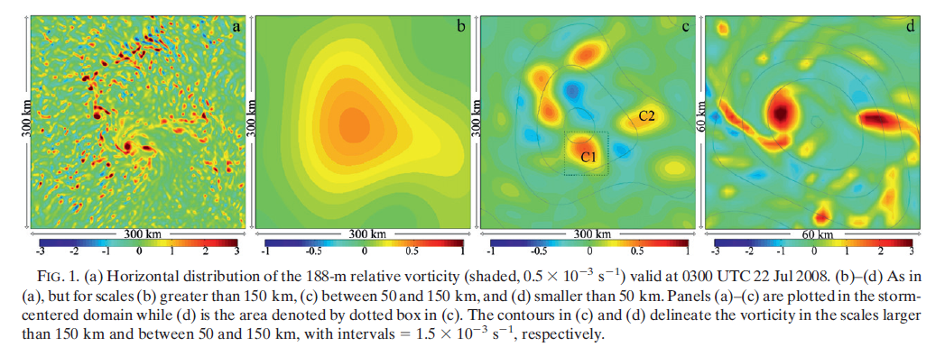
2. An overview of multiscale features in the
development of Hurricane Dolly
L>150km: system-scale, well-organized but relatively weak vorticity disturbance
50km<L<150km: cluster-scale, circulate around the primary system-scale vortex
L<50km: convective-scale, induced by moist convection; each of the intermediate-scale vorticity anomalies may be regarded as a cluster of convective scale CVAs
Notes:
Separation of the scales is achieved with a two-dimensional spectral decomposition based on fast Fourier transformation (FFT) in Matlab
well-organized but relatively weak vorticity disturbance

Slide 10
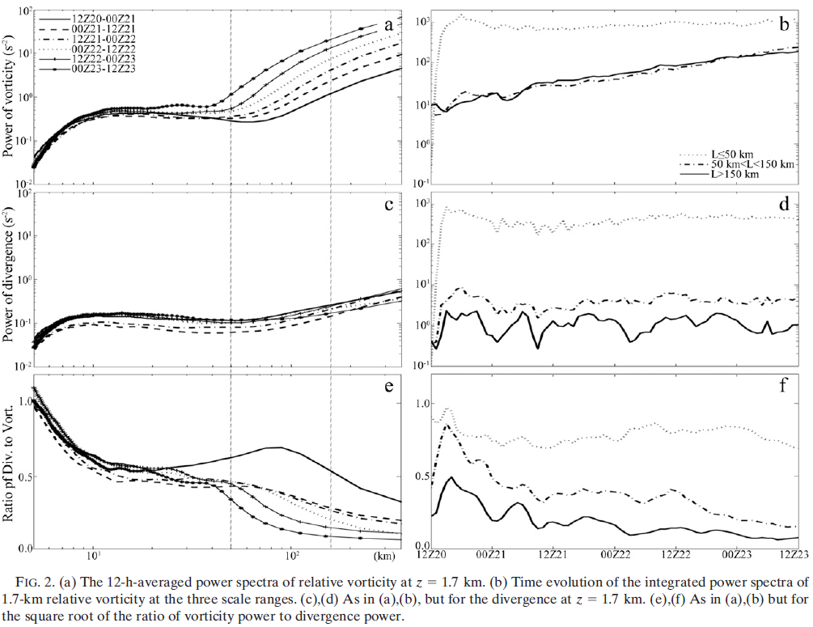
2. overview of multiscale features
CONVECTIVE
CLUSTER
SYSTEM
Saturation of the vorticity at convective scales implies that the continuous production of vorticity through convection, such as VHTs, at these small scales will be transferred immediately upscale to the cluster or system scales.
The persistent increase in vorticity and the nearly steady divergence in the cluster and system scales imply that the cluster- and system-scale processes become more rotationally dominant during the development of Dolly.
The ratio is much smaller than 0.5 at the system scale during most of the spinup period, suggesting that the simulated system-scale vortex is in approximate balance throughout the developing stage.
L=50
L=150
Notes:
power spectrum 定义： 描述信号功率随频率变化的函数
(1) At nearly all scales below 50 km (i.e., the convective scales) becomes saturated within the first 12 h and remains nearly constant
(2) while the amplitudes of the vorticity at the intermediate (cluster scale,50–150 km) and system (L>150 km) scales increase steadily throughout the development of Dolly.
(3)Different from vorticity, the spectral power of horizontal divergence at z =1.7 km reaches near saturation at all scales within the first few hours and maintains a similar amplitude throughout the developing stage
(4)The square root of the ratio of the divergence power to the vorticity power (scaled as the Rossby number) exhibits an obvious reduction at the cluster and system scales.

Slide 11
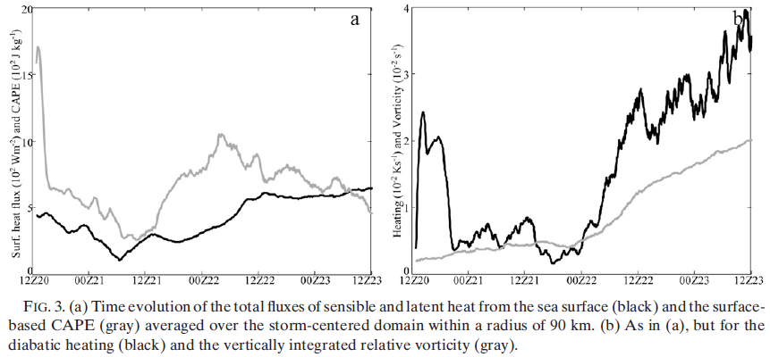
3. Quasi-balanced evolution of Hurricane Dolly
in the system scale
CAPE
Diabatic heating
Relative vorticity
Total heat flux
How the balance is maintained in such a strong convectively driven
system with strong surface heat fluxes, CAPE, and diabatic heating is an interesting issue.

Slide 12
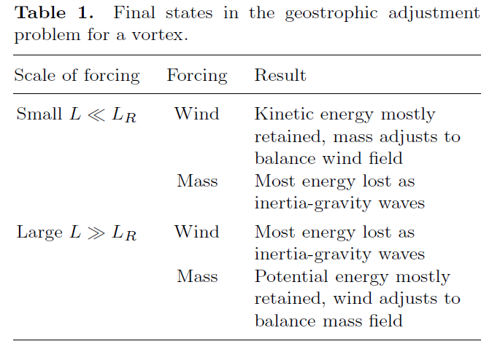
3. Quasi-balanced evolution in the system scale
a. Rossby radius of deformation and geostrophic adjustment
Rossby deformation radius:
where
Brunt-Vaisala frequency
Inertial frequency
Schubert et al. (1980)
Notes:
where f is the Coriolis parameter; ζ, V, N, and I, are the
mean vertical components of the relative vorticity, tangential
velocity, Brunt–Va¨isa¨la¨ , and inertial frequencies,
respectively; and H and R denote the scale height and
horizontal scale of the system

Slide 13
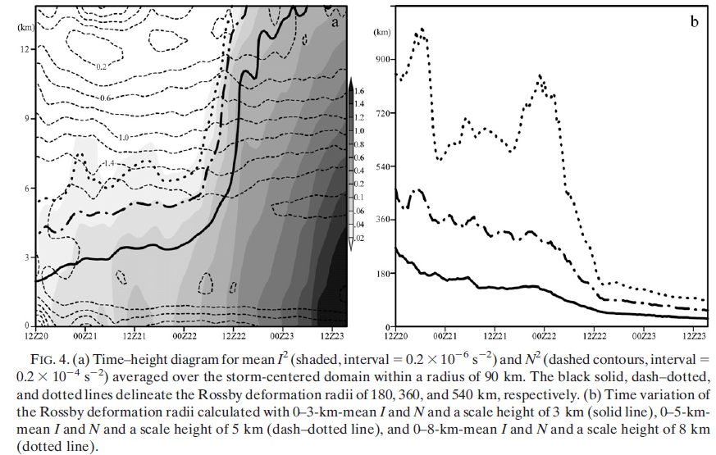
3. Quasi-balanced evolution in the system scale
0-8km mean
LR=540
LR=360
LR<<L
0-5km mean
LR=180
LR<=L
L=150km
0-3km mean
Before 0000UTC 22: low-level wind field adjusts to balance thermodynamic perturbations, therefore, the system-scale vorticity is enhanced gradually at first in the low levels
Following 0000 UTC 22: the convective heating released into the troposphere can be effectively trapped within the system-scale vortex and, thus, fuels the storm more efficiently. This results in Dolly’s rapid spinup.
Notes:
I²: before 36h, confined to the lower troposphere, slow growth; after 36h, increase sharply
With no substantial variations in system-scale mean static stability, the reduction of the Rossby deformation
radius mainly results from the increase of the mean inertial stability. This is consistent with the heat trapping concept
elucidated by Schubert andHack (1982) and Hack and Schubert (1986), who demonstrated that the conversion of
heat energy to kinetic energy becomes more efficient with an increase in the inertial stability of the TC vortex as a whole.

Slide 14
3. Quasi-balanced evolution in the system scale
b. Secondary transverse circulation and system-scale development
Under the constraint of the hydrostatic and gradient wind balance, Sawyer–Eliassen equation for the toroidal streamfunction c in the vorticity-centered domain can be written as (Montgomery et al. 2006)
Equation (2) implies that, under the constraint of thermal wind balance, the heating and momentum forcing will induce the secondary circulation, which plays a vital role in the intensification of TCs.
azimuthal-mean diabatic heating rate
Eddy fluxes and subgrid processes

Slide 15
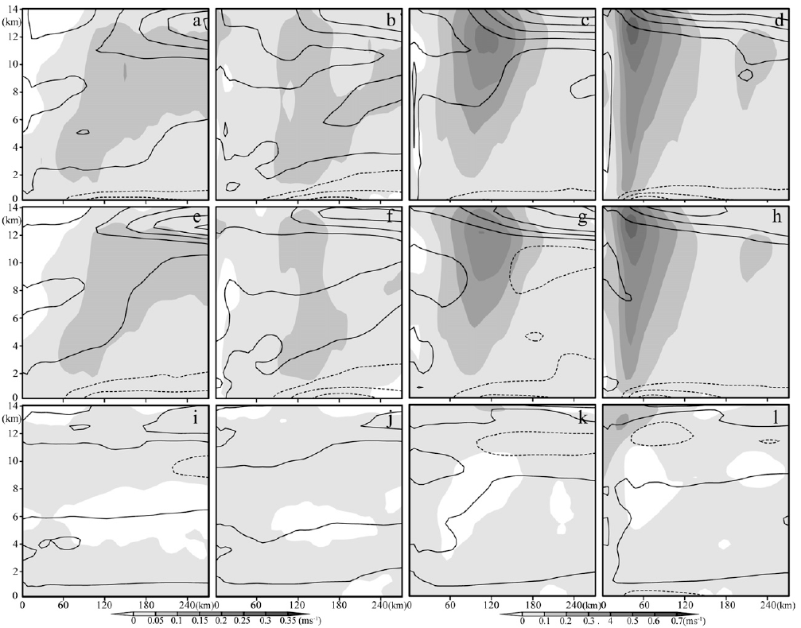
3. Quasi-balanced evolution in the system scale
0000–1100 UTC 21
1200–2300 UTC 21
0000–1100 UTC 22
1200–2300 UTC 22
WRF Simulate
Derived from SE eq.
The system scale vortex of Dolly maintains approximate gradient balance
SE eq. forced by eddy fluxes and subgrid processes
The spinup of the system-scale secondary circulation mainly
results from the axisymmetric diabatic heating

Slide 16
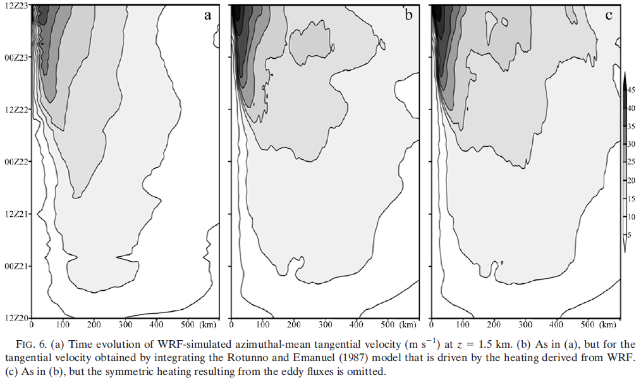
3. Quasi-balanced evolution in the system scale
Two idealized simulations based on the axisymmetric hurricane model developed by Rotunno and Emanuel (1987):
Exp.1:
Exp.2:
(1) Further demonstrates that the system-scale diabatic heating plays a vital role in the development of Dolly
(2) asymmetric forcing has a very small and most often negative impact on the intensity of the system-scale vortex
WRF Simulate
RE model forced by WRF heating
RE model forced by WRF symmetric heating
Notes:
In these idealized experiments, the initial vortex is in thermal wind balance, with the tangential velocity being equal to the
azimuthal-mean tangential velocity derived from the WRF at 1200 UTC 20 July. The axisymmetric hurricane model
is forced directly by the heat forcing estimated from the WRF simulation.

Slide 17
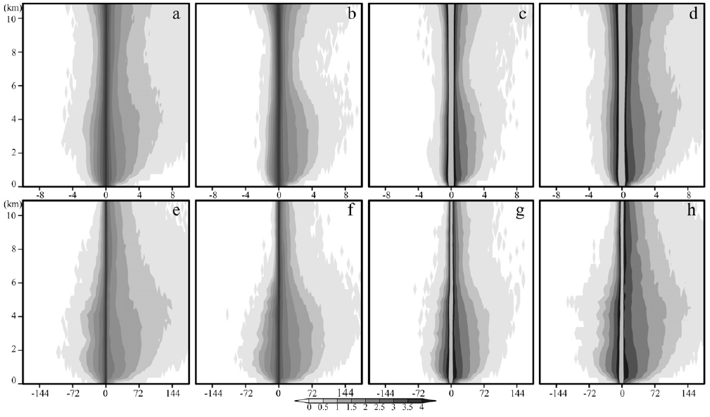
3. Quasi-balanced evolution in the system scale
C. Relation between smaller-scale convection and system-scale CAPE and diabatic heating
1200–2300 UTC 20 July
0000–1100 UTC 21 July
1200–2300 UTC 21 July
0000–1100 UTC 22 July
vertical
velocity
diabatic
heating
vortex pass over the warm ocean surface
cool and dry midlevel air descend to surface
vigorous convection
renew
Smaller-scale processes, including individual convective towers, are vital elements of the developing system and may contribute significantly to the collection, conversion, release, and transfer of heat (thermal energy) to the system scale
Notes:
In the first 12-h simulation, as the vortex winds pass over the warm ocean surface, heat and moisture are transferred into the atmosphere and produce locally higher conditional instability and, subsequently, convection and latent heat release
However, as the cool and dry midlevel air descends to the surface from the mid- to upper-level dry-air intrusion (FZ10), convective activity slows and the release of CAPE and diabatic heating becomes weak
In the period from 1200 UTC 21 July to 0400 UTC 22 July, the surface-based CAPE accumulates as a result of the surface heat and moisture fluxes (Fig. 3a). Renewed vigorous convection then produced condensational heating, which enhanced the system-scale vortex throughout the troposphere

Slide 18
the surface-based CAPE accumulates as a result of the surface heat and moisture fluxes
CAPE
Diabatic heating
Relative vorticity
Total heat flux

Slide 19
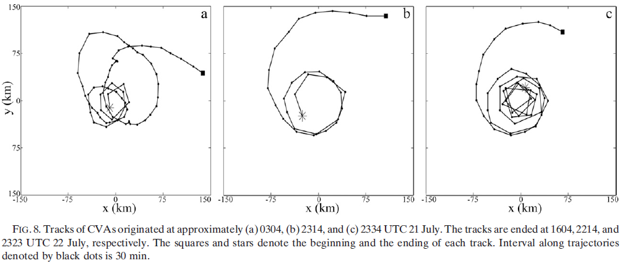
4. Convective-scale processes occurred in the
development of Hurricane Dolly
CVA2314
CVA2334
CVA0304
Unlike a typical VHT that has a lifespan on the order of 1 h, these CVAs can be long lived through repeated cycles of convective development as well as decay or through merger
Notes:
CVA304 initially spirals radially inward,then outward, and later inward again, before eventually wrapping itself around the storm center at a radius of less than 50 km.

Slide 20
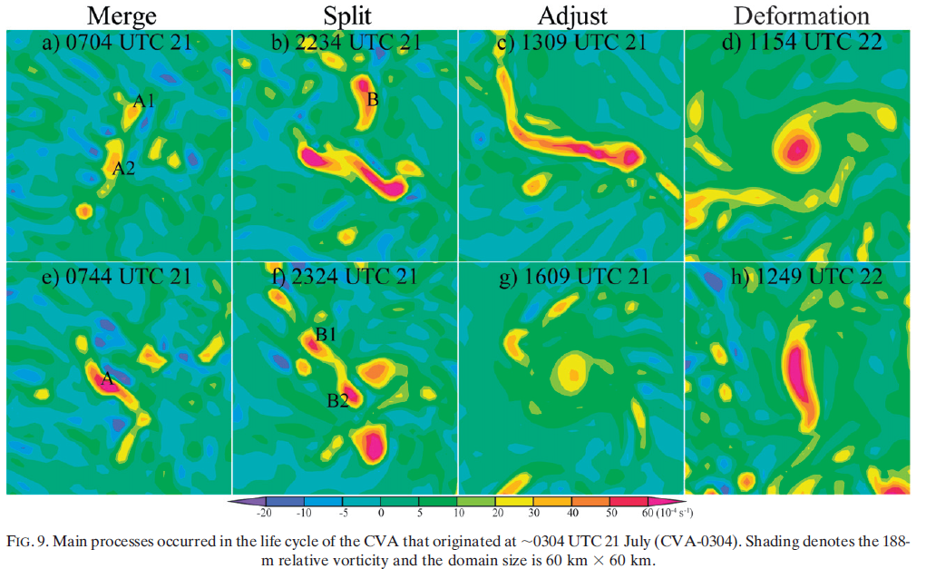
4. Convective-scale processes
CVA-0304
Notes:
Figure 9 summarizes a variety of processes that occurred during the life cycle of CVA-0304 and the corresponding evolution of vorticity, respectively.

Slide 21
4. Convective-scale processes
a. Merger of VHTs and its relation to the moist convection
horizontal advection
of absolute vorticity
vertical
adv.
stretching
tilting
Subgrid-scale
flux
For simplicity, only the vorticity at z=188 m is considered in the vorticity budget.
The distinct positive and negative vorticity tendencies induced by the horizontal advection were exactly situated on the downwind and upwind sides of the maximum cyclonic vorticity center, respectively. This implies that the effects of horizontal advection on CVA-0304 and the vorticity anomalies nearby act to advect them downwind.
The superposition of the diabatic heating and stretching effects with the evident vorticity implies that the moist convection makes a vital contribution to the enhancement of the CVA’s vorticity during the merging process through stretching
It can be found that the merger of the original CVA-0304 with A2 is mainly ascribed to the moist convection burst between them, which facilitates the merger through the concomitant low-level convergent flow(Hendricks et al. 2006) and enhancement of the vorticity between the CVAs.
Notes:
The superposition of the diabatic heating and stretching effects with the evident vorticity implies that the moist convection makes a vital contribution to the enhancement of the CVA’s vorticity during the merging process through stretching

Slide 22
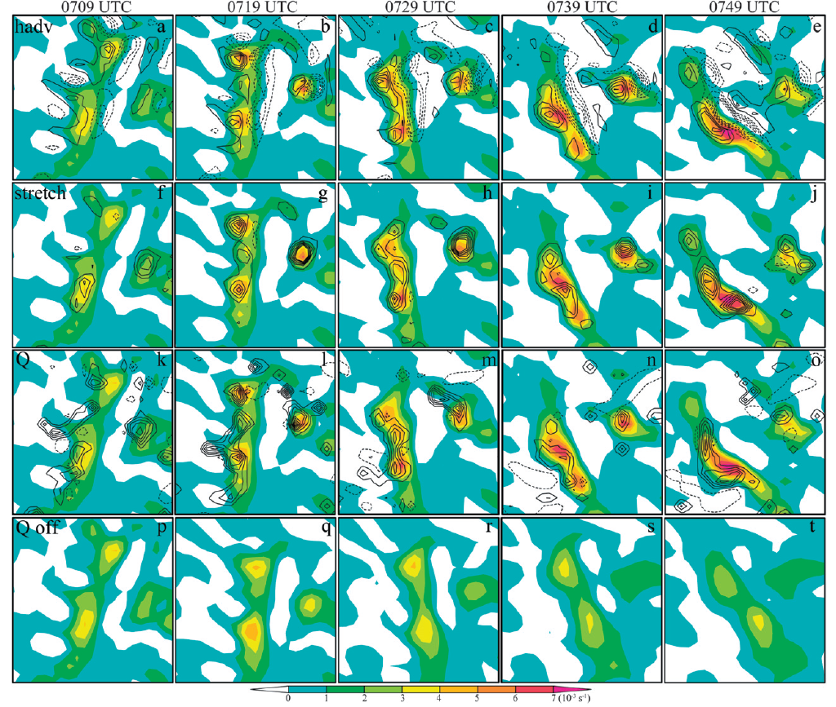
4. Convective-scale processes
CVA-0304
A2
Turn off mosit process after 0704

Slide 23
4. Convective-scale processes
CVA-0304
Notes:
Figure 9 summarizes a variety of processes that occurred during the life cycle of CVA-0304 and the corresponding evolution of vorticity, respectively.

Slide 24
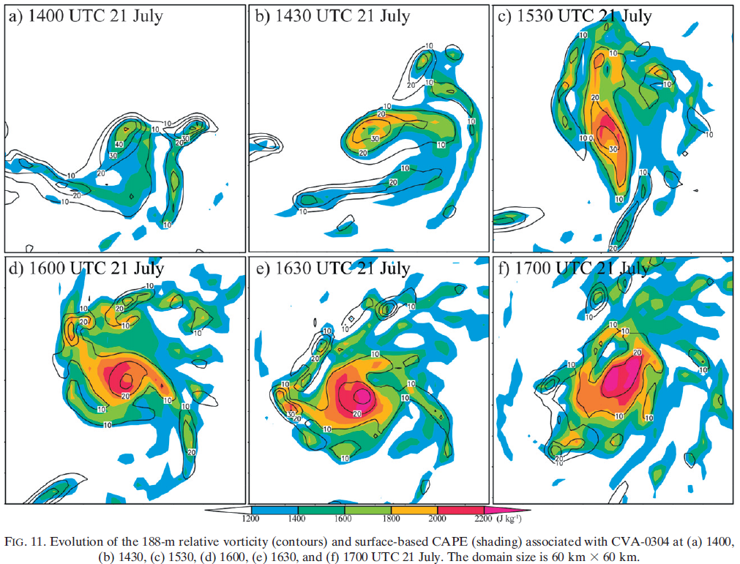
4. Convective-scale processes
b. Adjustment and deformation of the CVAs
It is argued that the cyclonic circulation associated with CVA-0304 spreads horizontally along with the adjustment process (Fig. 9g) and, subsequently, leads to a considerable increase in CAPE in the ambient environment of CVA-0304 via the air–sea interaction
(Emanuel 1986).
Notes:
It is argued that the cyclonic circulation associated with CVA-0304 spreads horizontally along with the adjustment process (Fig. 9g) and, subsequently, leads to a considerable increase in CAPE in the ambient environment of CVA-0304 via the air–sea interaction
(Emanuel 1986).

Slide 25
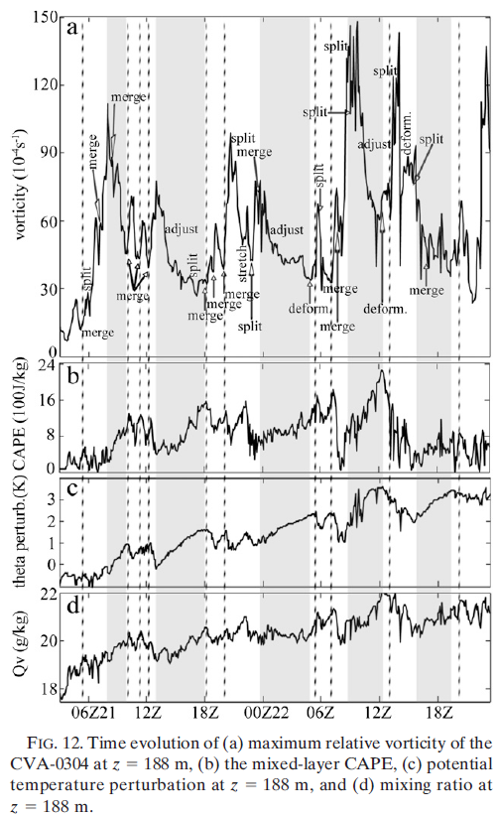
(1) maximum vorticity demonstrates considerable undulation instead of the persistent enhancement
(2) The sharp strengthening of the CVA is usually accompanied by a sudden decrease in CAPE (dash line) and followed by a considerable reduction in the maximum vorticity of the CVA (shaded) associated with the adjustment process
(3) During the adjustment, the low-level potential temperature, mixing ratio, and CAPE increase gradually as a result of the air–sea interaction and surface fluxes

Slide 26
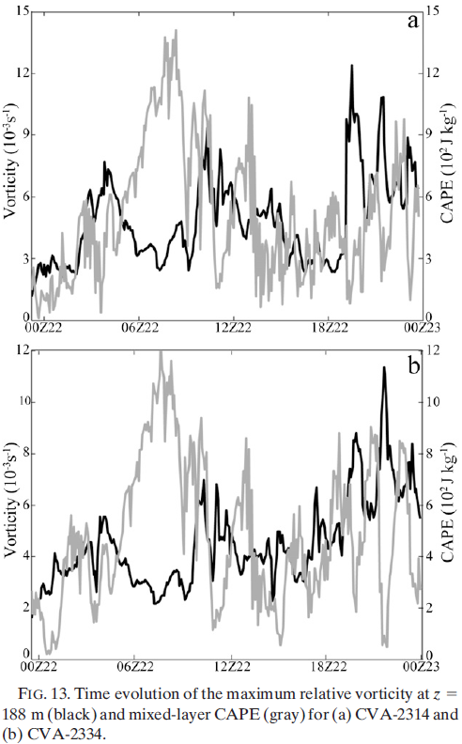
CVA-2314
The negative correlation of the maximum
vorticity and CAPE can also be identified in
the evolution of CVA-2314 and CVA-2334
Many complicated processes may take place during the lifetime of robust CVAs. Along with these processes, CVAs strengthen and decay alternatively, in coincidence with the release and accumulation of CAPE
CVA-2334
Notes:
The above examples of CVA-0304, CVA-2314, and CVA-2334 indicate that many complicated processes may take place during the lifetime of robust CVAs. Along with these processes, CVAs strengthen and decay alternatively, in coincidence with the release and accumulation of CAPE.

Slide 27
CAPE
Diabatic heating
Relative vorticity
Total heat flux
The adjustment process mentioned above is also evident for the system-scale vortex.
The individual convective cells can lead to the transient enhancement of CVAs and facilitate the merger of CVAs via the self-induced convergent flow is similar to what occurred on the system scale
Notes:
The adjustment process mentioned above is also evident for the system-scale vortex in Fig. 3, which shows that the volume-integrated vorticity on the system-scale increases gradually, coinciding with the release of CAPE in the first 24 h, and then experiences a brief reduction accompanying the sharp increase of CAPE. After around 0400 UTC 22 July, the release of system-scale CAPE occurs again and the system-scale vorticity demonstrates a significant enhancement accordingly.

Slide 28
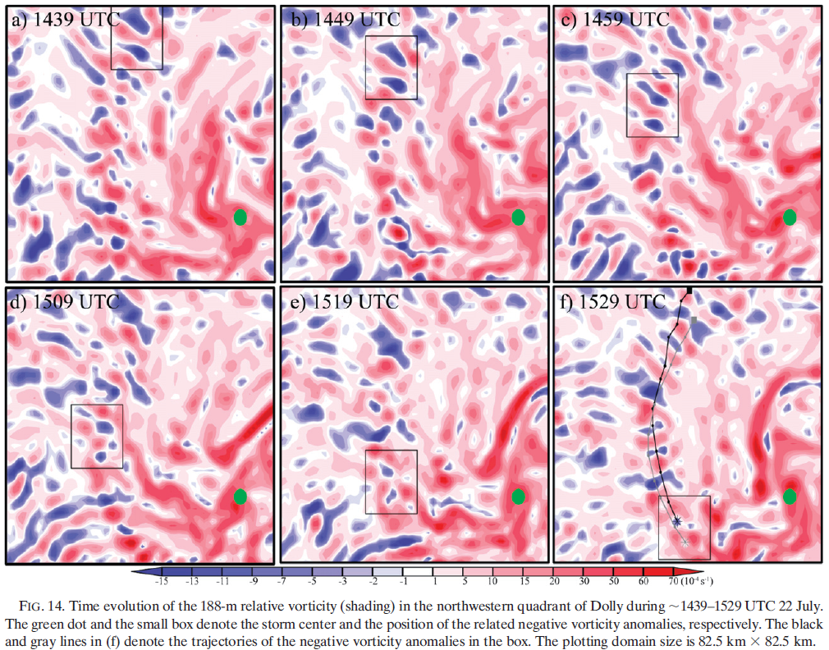
4. Convective-scale processes
c. Evolution of negative vorticity anomalies
Instead of moving away from the storm center, both negative CVAs spiral toward the storm center.

Slide 29
4. Convective-scale processes
advection of perturbation vorticity by the background flows
advection of perturbation vorticity by the perturbation flows
advection of the background vorticity by the perturbation flow
If a negative vorticity perturbation is imposed on an axisymmetric cyclonic vortex, the third term on the right-hand side of Eq. (5) will lead to a negative (positive) vorticity tendency on the left (right) side of the original perturbation facing the axisymmetric vortex center.
Through the second term on the right-hand side, the newly produced vorticity anomalies tend to drive the negative vorticity perturbation away from the axisymmetric vortex center.
Therefore, the spiraling inward motion of the negative vorticity anomalies shown in Fig. 14 implies that the advection of the perturbation vorticity by the background inflow [term 1 on rhs of Eq. (5)] dominates over the interaction between vorticity anomalies [term 2 on rhs of Eq. (5)].

Slide 30
-
+
x

Slide 31
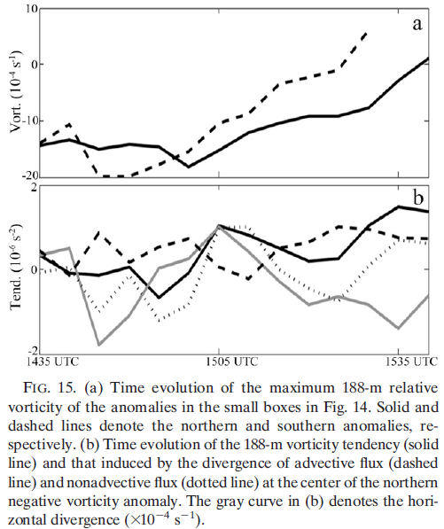
Compared to the cyclonic CVAs, the negative vorticity anomalies are usually weaker and shorter lived as they move toward the storm center
Southern CVA
Northern CVA
vorticity tendency
advective flux
nonadvective flux
horizontal div.
advective flux + subgrid-scale process
>
nonadvective flux
decay of negative CVA
nonadvective flux
z
Divergence of advective flux

Slide 32
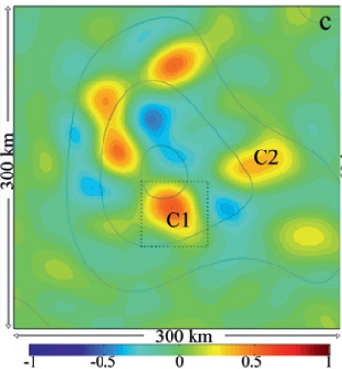
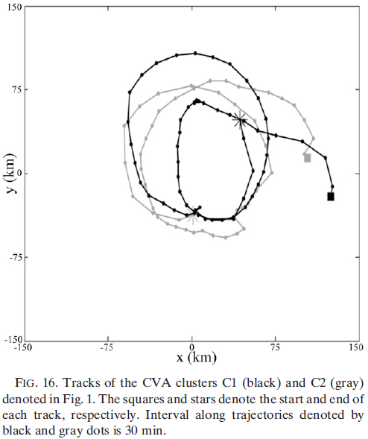
5. Cluster-scale processes occurring during the
developing stage of Hurricane Dolly
0300 UTC 22 Jul
0200 UTC 21 Jul
Notes:
circles around the storm center

Slide 33
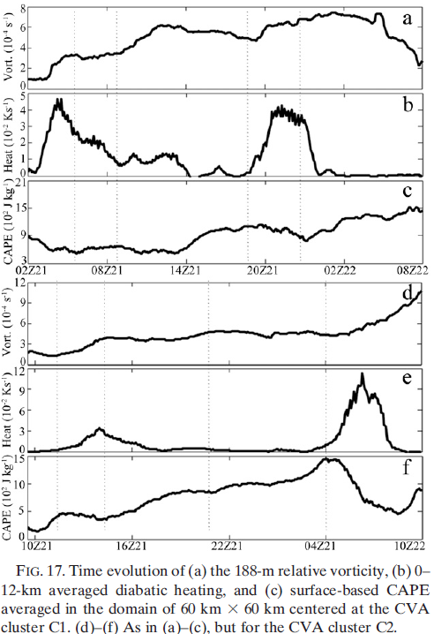
5. Cluster-scale processes
188-m relative vorticity
0–12-km averaged diabatic heating
surface-based CAPE
The significant increase in vorticity is usually accompanied by a decrease in CAPE and an increase in diabatic heating;
While in the episode that the vorticity is nearly stationary or decreasing, the CAPE usually accumulates and the diabatic heating is simultaneously reduced
Similar relationships between patterns of vorticity and CAPE on the cluster and convective scales indicate that there are self-similarities that exist in the vortex at different scales

Slide 34
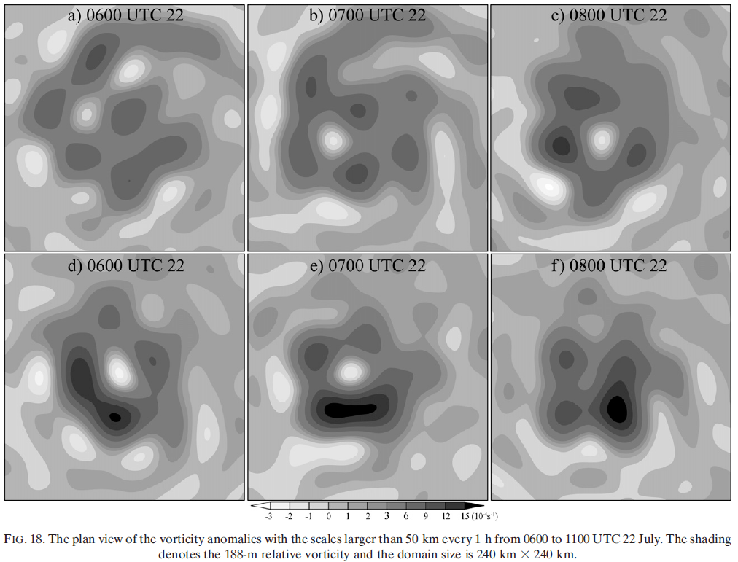
5. Cluster-scale processes
0600 UTC 22
0700 UTC 22
0800 UTC 22
0900 UTC 22
1000 UTC 22
1100 UTC 22
Instead of moving outward from the storm-centered area, the negative vorticity anomaly surrounded by the positive vorticity anomalies decays gradually and finally disappears

Slide 35
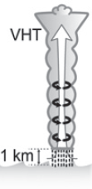
6. Concluding remarks
The system-scale vortex enhances gradually within the framework of balanced dynamics while the convective-scale vortices are largely unbalanced and are nearly saturated soon after the initial burst of convection.
The role of convection in the development of Dolly is further explored:
diabatic heating
secondary circulation
aggregates Vor.
merger of the CVAs
vortex spinup
Notes:
In the system scale, the macroscopic effects of convection (i.e., diabatic heating) form a persistent thermal forcing and then result in a secondary circulation to implement the adjustment of the momentum fields to the forcing. The horizontal branch of the secondary circulation (i.e., the significant
low-level inflow) aggregates the ambient vorticity, cluster-, and convective-scale CVAs into the storm center region, which facilitates the merger of the CVAs. Continuous projection and conversion of smaller-scale vorticity into the larger scales will eventually lead to the spinup
of the system-scale vortex.

Slide 36
6. Concluding remarks
Inspection on the evolution of CVAs shows that the maximum cyclonic vorticity of the long- lived CVAs generally exhibits an obvious negative correlation with CAPE
During the development of Dolly, the expulsion of the negative vorticity anomalies is not as evident as that suggested by previous idealized simulations. Instead, under the effect of system-scale convergent flow, the negative vorticity anomalies also move toward the central storm area

Slide 37
Thanks

