Slide 1
Kinematic structure of convective-scale elements in the rainbands of Hurricanes Katrina and Rita
Reporter : Chen Deng-Shun
Hence, D. A., and R. A. Houze Jr. (2008), Kinematic structure of convective-scale elements in the rainbands of Hurricanes Katrina and Rita (2005), J. Geophys. Res., 113, D15108, doi:10.1029/2007JD009429.

Slide 2
Contents
Introduction
Data description
Principal Rainbands of Katrina and Rita
Convective-scale updrafts within the rainband
Validation of the Barnes et al. [1983, hereafter BZJM] conceptual model
Extension of the BZJM updraft model
Effects of rainband convective updraft in the SHWM
Downdraft
Structure of the upwind and downwind ends of principal rainbands
Vertical mass transports in the upwind, middle and downwind regions of principal rainbands
Conceptual model of convection in the principal rainband
Conclusions

Slide 3
Objectives
Validate the existence of the convective-scale circulation features postulated by BZJM.
Show how the structure of these features varied along the band.
Determine how these features may have affected the structure of principal rainband and the overall intensity of the hurricane.

Slide 4
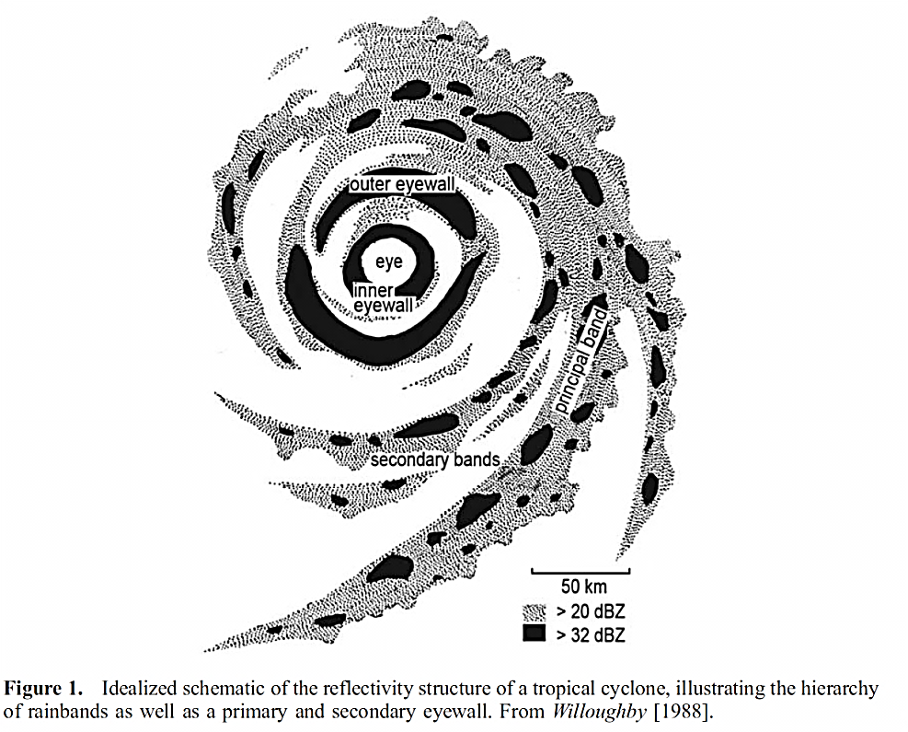
Introduction
Willoughby et al. [1984] described the different types of rainbands that tend to be persistent within a mature tropical cyclone
eye
Outer eyewall
Inner eyewall
Principal band
Secondary bands

Slide 5
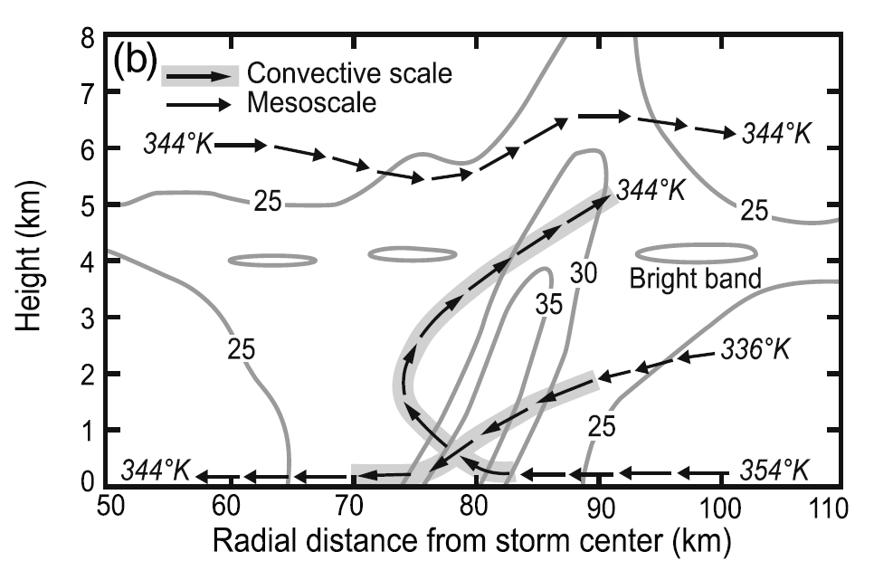
Introduction
Barnes et al. [1983, hereafter BZJM] noted that the low-level radial inflow slowed in the rainband and suggested from that observation that rainbands may provide a ‘‘partial barrier’’ to the moist inflow to the storm.
they further deduced that the convective elements within a rainband consist of two circulations: a radially outward leaning updraft, and a descending radial inflow that brings low-$θ$e air to lower levels.

Slide 6
Introduction
The convective-scale circulations have potential to influence the intensity of the tropical cyclone, they may weaken the cyclone in two way:
The updraft turns the low-level moist radial inflow up and away from the storm center before it reaches the eyewall area.
the downdraft reduces the moist static energy of the low-level radial flow.
Franklin et al. [2006] extended May and Holland [1999] via full-physics modeling, finding that PV generation within the stratiform regions could affect the intensity of the overall vortex. Convective-scale processes may also be important.
This upscale feedback may reside in the interaction between the small-scale convective circulations and the secondary horizontal wind maximum (SHWM) of a rainband, an interaction that has not been extensively investigated observationally.

Slide 7
Data description
Hurricane Rainband and Intensity Change Experiment (RAINEX)
NOAA 43 P-3 (N43) - X-band dual-Doppler radar system
Using a single antenna that rapidly alternated viewing angles between 20º fore and 20º aft of the vector normal to the ground track of the aircraft.
Along-track resolutions = 1.5 km
Allowed horizontal wavelength = 8 km
NCAR Electra Doppler Radar (ELDORA) aboard the Navy Research Laboratory P-3 aircraft (NRL) – X-band dual-Doppler radar
Using two antennas electronically fixed that at 20º fore and 20º aft.
Along-track resolutions = 0.5 km
Allowed horizontal wavelength = 2 km

Slide 8
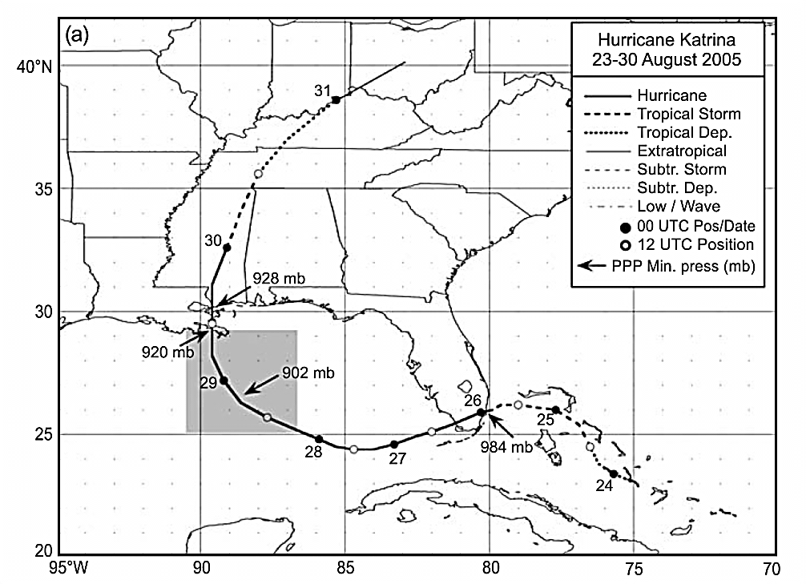
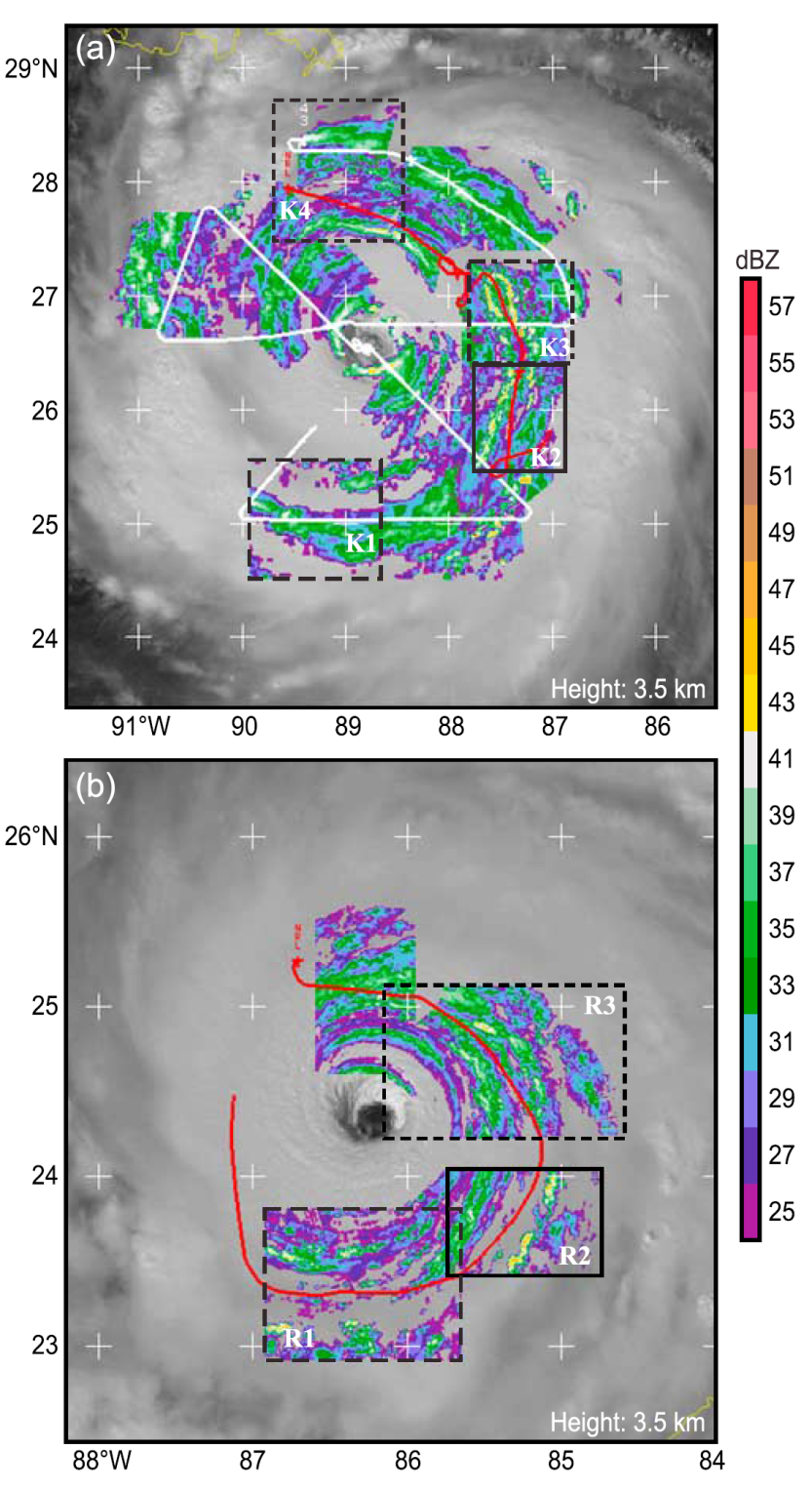
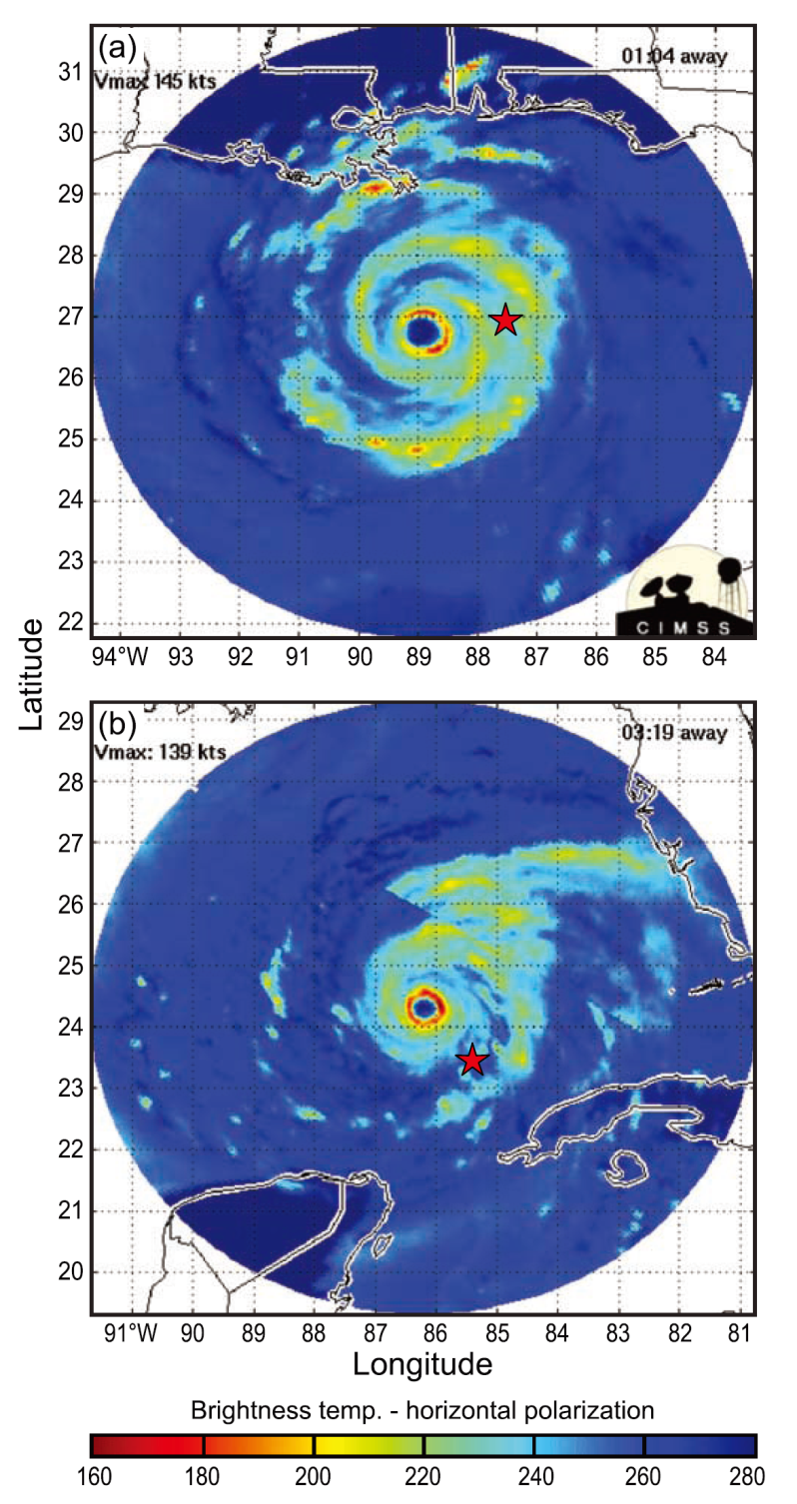
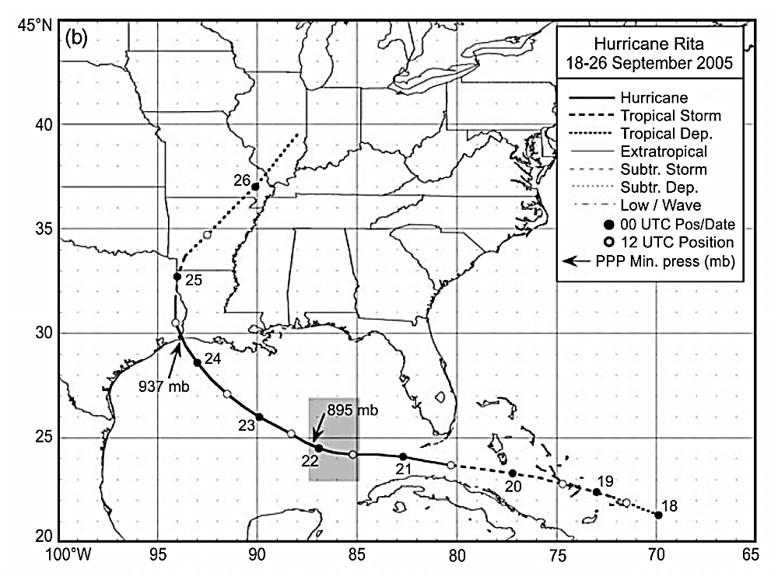
Katina
Rita
Notes:
Karina :
Maximum sustained wind = 75 m/s
Minimum sea level pressure = 902 hPa
The narrow ring of bright elements around the storm center correspond to the eyewall precipitation surrounding the eye of the storm.
Rita :
Maximum sustained wind = 77 m/s
Minimum sea level pressure = 897 hPa (hecto-Pascal)
The PCT (ice scattering) in the MIMIC product (Figure 4b) suggests a lesser degree of strong, active convection in the principal rainband than in Hurricane Katrina on 28 August 2005 (Figure 4a).
--------------------------------------------------------------------------------------------------------------------
1 ) ELDORA radar data obtained in this region also indicate fewer active convective elements in Rita compared to Katrina (Figures 5a and 5b).
2 ) The principal rainband of Rita spirals more tightly around the storm on this day than the principal rainband of Katrina on 28 August 2005.

Slide 9
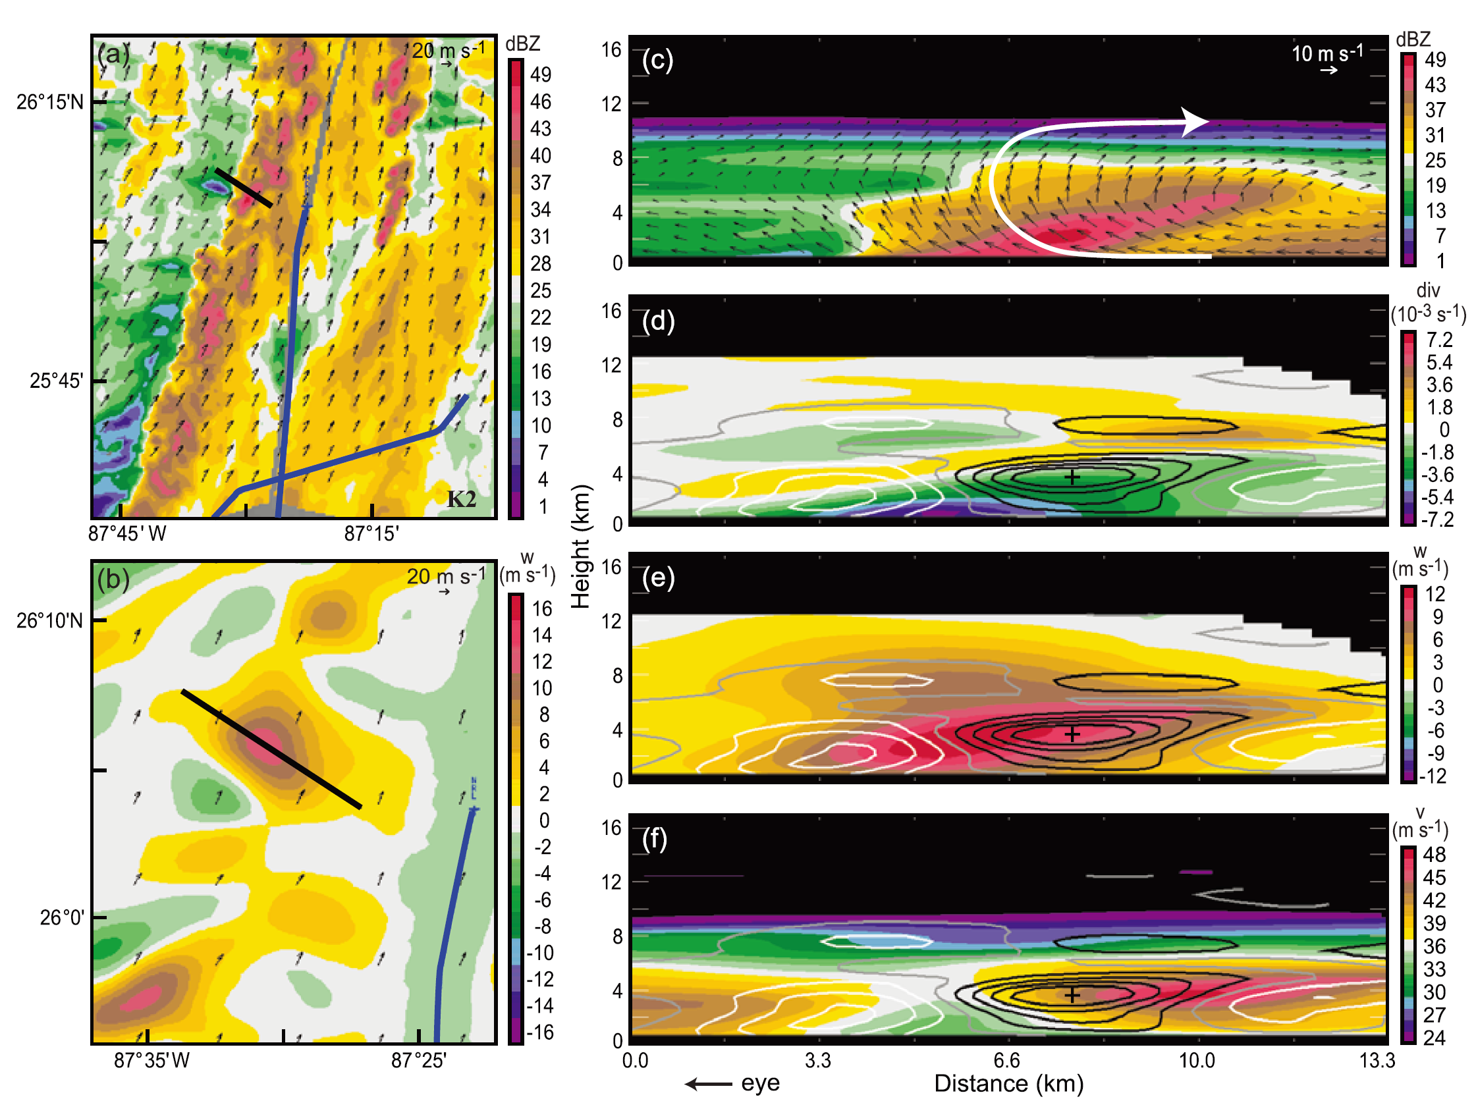
Katrina
The updraft extended from near the bottom to about 8 km.
Shows a larger of strong convergence, which was smallest and most intense at the base of the sloping reflectivity core.
Convergence and divergence are also sloped outward and upward, divergence capped the low-level convergence in the region of the convective cell
Shows the wind component normal to the cross section, which may also be regarded as an approximation to the long-band component of the wind relative to the principal band
dBZ
div
W
V
eye
SHWM
Notes:
Contour →vertical vorticity
Fig b the updraft has > 14 m/s, a weaker downdraft was located slightly upwind
Fig c the updraft extended from near the bottom to about 8 km
On a small, local scale this circulation mimic the in, up and out circulation behavior of an eyewall, and produced a echo cell on radar which slopes outward in a manner similar to a well-developed eyewall
The ELDORA data thus show a convective-scale updraft circulation embedded in Katrina rainband that confirms the structure hypothesized by BZJM
Fig d shows a larger of strong convergence, which was smallest and most intense at the base of the sloping reflectivity core
Convergence and divergence are also sloped outward and upward
divergence capped the low-level convergence in the region of the convective cell
Fig f shows the wind component normal to the cross section, which may also be regarded as an approximation to the long-band component of the wind relative to the principal band

Slide 10
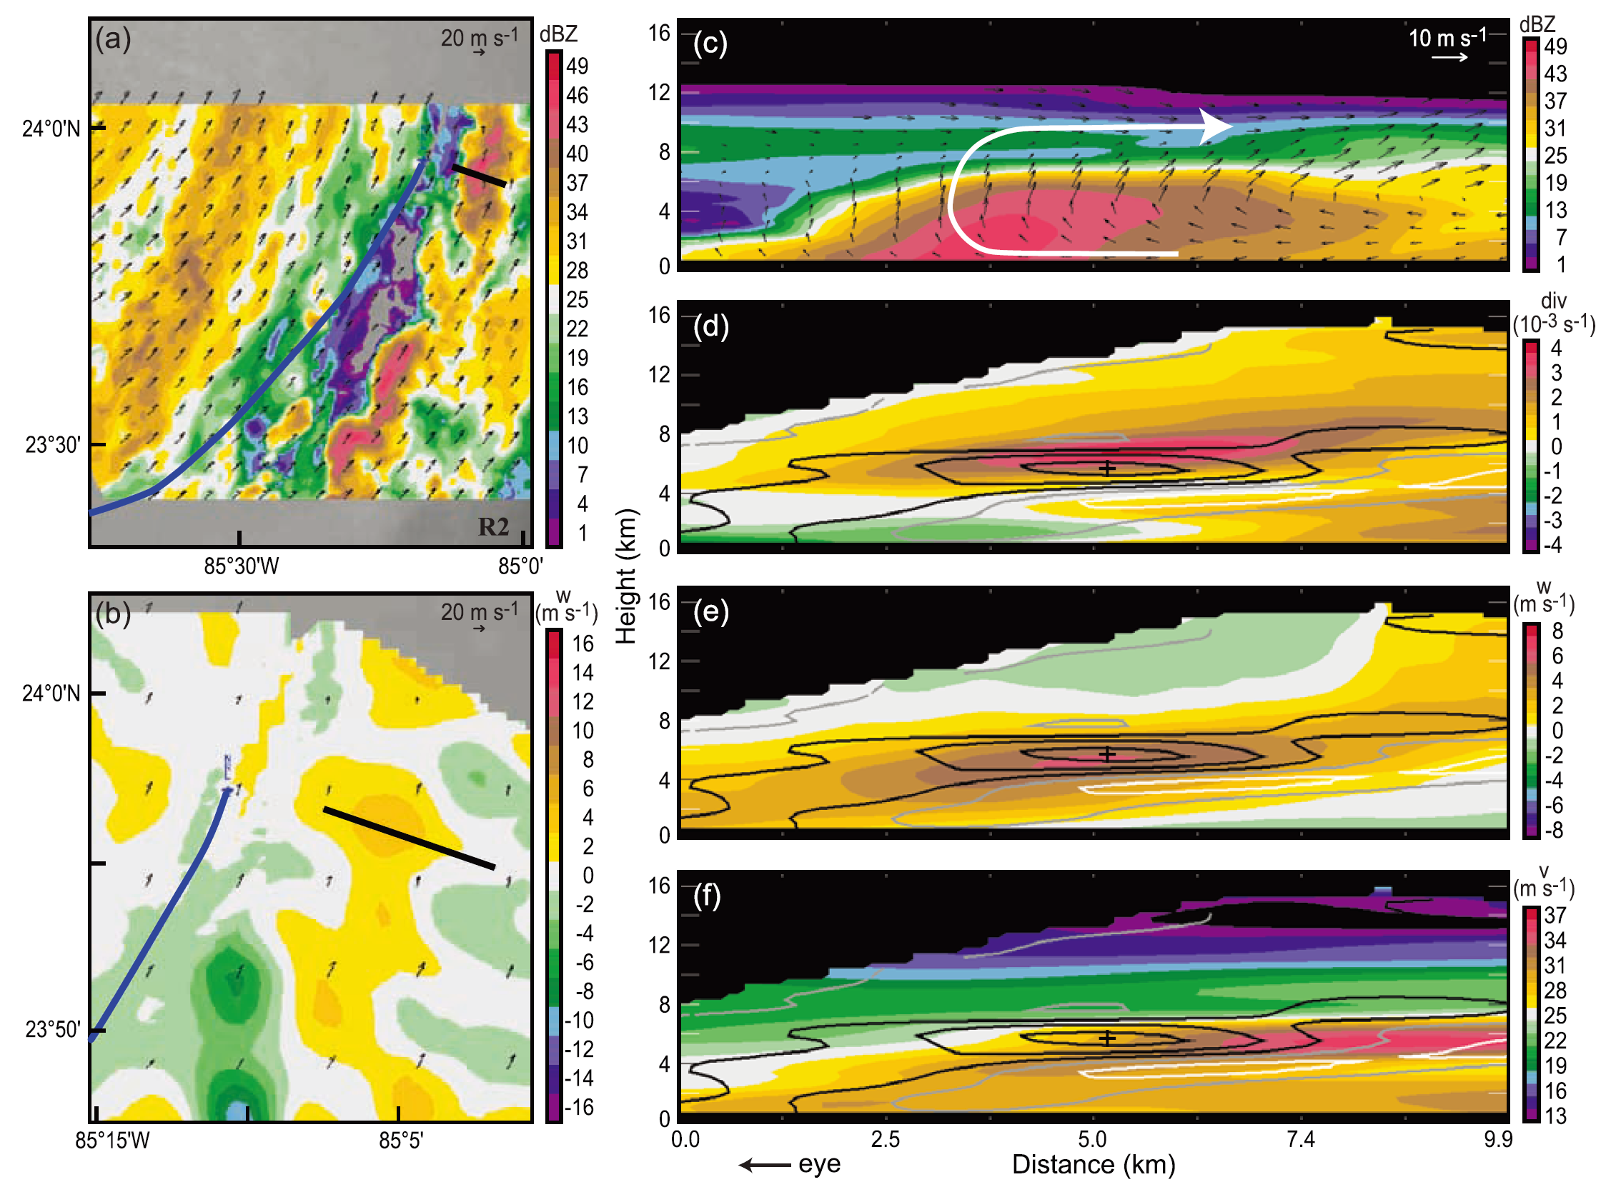
Rita
The vertical velocity were stronger about 3.5 km level and show the in, up, and outward flow within an associated radially outward leaning reflectivity core.
Fig d again show an outward sloping divergence pattern aloft, centered around 7 km, within a divergence at lower levels.
Fig e this divergence/ convergence pattern is associated with an outward sloping updraft
Fig f the SHWM was also situated at a somewhat higher level than in Katrina. The jet was capped by a very sharp vertical gradient of cross section-noraml wind above 6 km.
dBZ
div
W
V
eye
SHWM
Notes:
Fig a Shows overall a lesser presence of active convection within Rita’s principal rainband
Fig b
Fig c indicate that the vertical velocity were stronger about 3.5 km level and show the in, up, and outward flow within an associated radially outward leaning reflectivity core.
this features again exhibited an updraft structure of the type hypothesized by BZJM
the BZJM overturning updraft structure is seen repeatedly, both with in the principal rainband of a given storm and from one storm to another
Fig d again show an outward sloping divergence pattern aloft, centered around 7 km, within a divergence at lower levels.
Fig e this divergence/ convergence pattern is associated with an outward sloping updraft
Fig f the SHWM was also situated at a somewhat higher level than in Katrina. The jet was capped by a very sharp vertical gradient of cross section-noraml wind above 6 km.
The positive vorticities associated with the SHWM was again directly situated over the updraft, and just below the large max. divergence

Slide 11
Updraft
Thus the BZJM overturning updraft structure is seen repeatedly, both within the principal rainband of a given storm and from one storm to another. The RAINEX ELDORA data verify via direct observation the existence of the convective-scale circulations suggested by BZJM and Powell [1990a].
Thus in the principal rainbands of both Katrina and Rita, the updraft maximum was collocated with the region of maximum positive vorticity
This process would be a negative feedback to the eyewall circulation if it extracted energy from the boundary layer before it could be consumed by the secondary circulation in the eyewall region [Powell, 1990b].
Notes:
BZJM and Powell [1990a] suggested that the boundary layer radial inflow toward the storm center would be diverted upward in the rainband’s convective updrafts.

Slide 12
Updraft
note that where the low-level air flowed radially inward under the SHWM, it had strong horizontal vorticity $η$, which was subsequently tilted to form vertical vorticity ($ζ$) where the flow turned upward at the inner edge of the convective cell
After turning upward, the vortex tube was stretched by low-level convergence. The positive vorticity was accumulating radially inward of the jet.

Slide 13
Downdrafts
A lower-level downdraft enters from radially outside of the cell and subsides into the base of the reflectivity core.
This downdraft corresponds to the low-level downdraft circulation hypothesized by BZJM. This circulation has the potential to lower the moist static energy of the flow within the boundary layer (BZJM [Powell, 1990a, 1990b]).
Notes:
We now turn to the downdraft component of the BZJM model. In studies such as BZJM (Figure 2b) and Powell ([1990a, 1990b] Figure 2c) the lower-level downdrafts of the convective-scale circulations have received some attention regarding their ability to modify the moist static energy of the radial inflow, and hence the eyewall circulation.
A lower-level downdraft enters from radially outside of the cell and subsides into the base of the reflectivity core. This downdraft corresponds to the low-level downdraft circulation hypothesized by BZJM (see Figure 2b). This circulation has the potential to lower the moist static energy of the flow within the boundary layer (BZJM [Powell, 1990a, 1990b]).
Another downdraft extending from upper levels is seen radially inside the reflectivity cell, likely induced by heating from the convective-scale updraft.

Slide 14
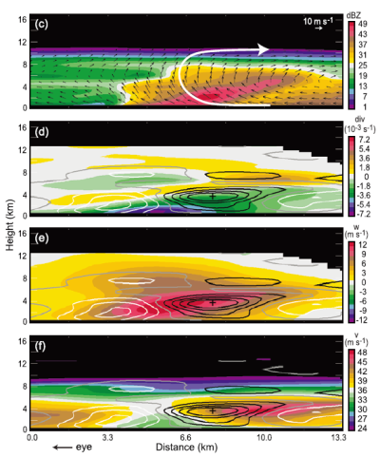
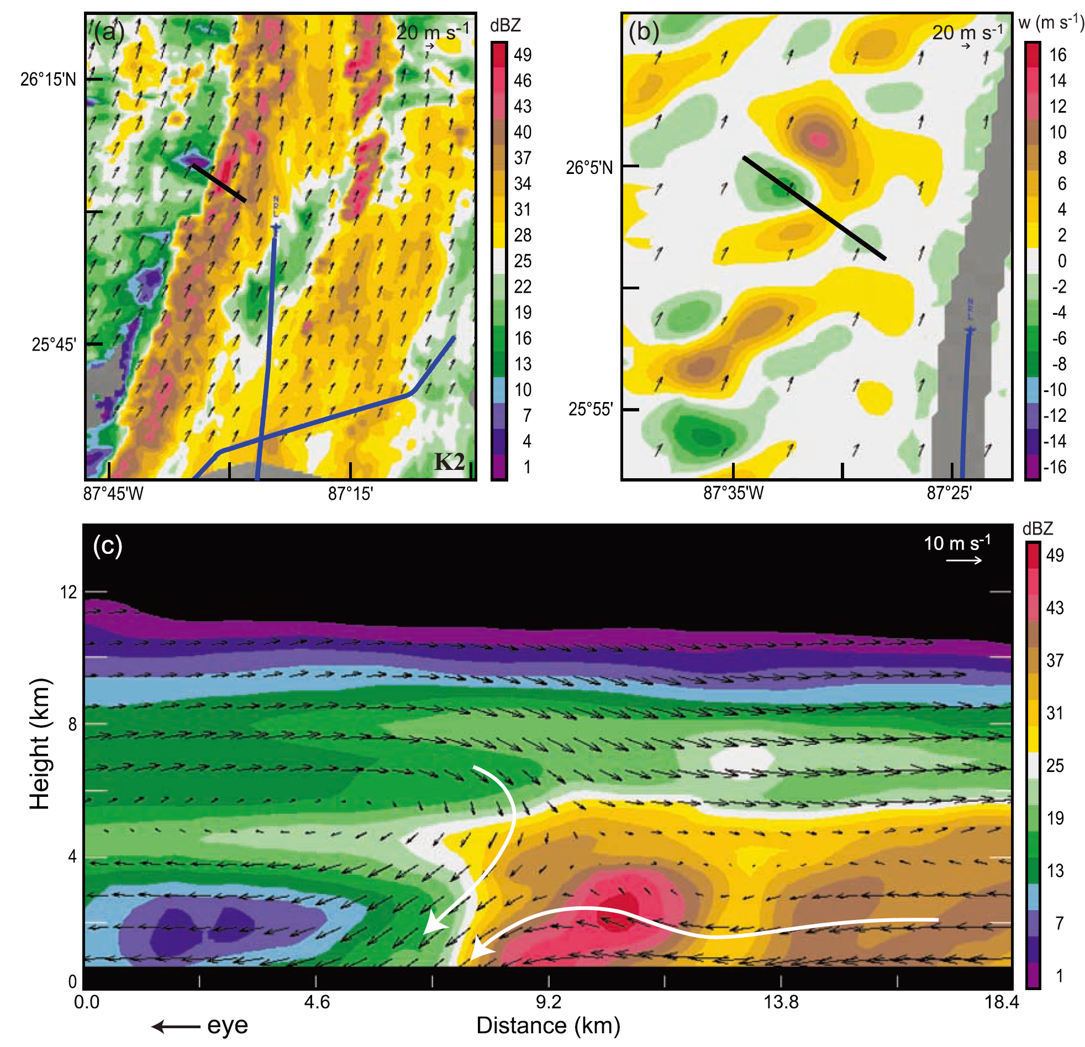
Katrina
Notes:
A lower-level downdraft enters from radially outside of the cell and subsides into the base of the reflectivity core. This downdraft corresponds to the low-level downdraft circulation hypothesized by BZJM (see Figure 2b). This circulation has the potential to lower the moist static energy of the flow within the boundary layer (BZJM [Powell, 1990a, 1990b]).
Another downdraft extending from upper levels is seen radially inside the reflectivity cell, likely induced by heating from the convective-scale updraft.
The lower-level downdraft again entered from radially outside the sloping reflectivity cell, descended to the base of the cell and likely carried low moist static energy air in toward the center of the storm, as a negative feedback to storm intensity. The downdraft originating at upper levels again entered from radially inside the cell and descended, combined with a larger area of descent aloft.

Slide 15
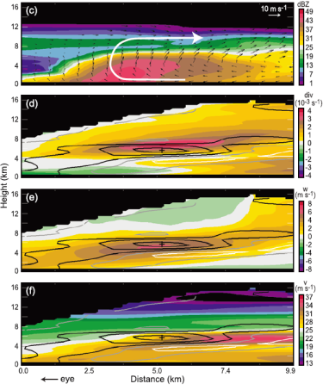
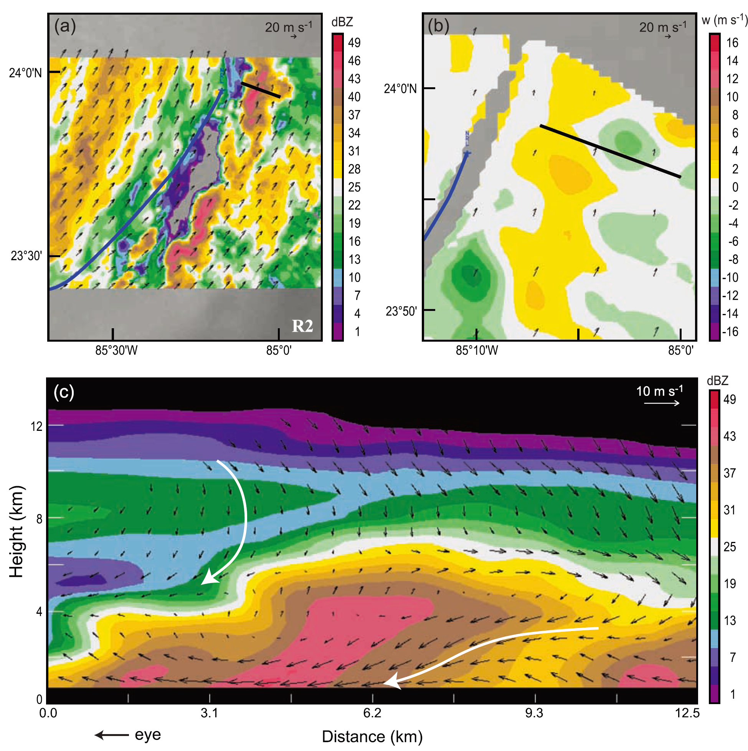
Rita

Slide 16
Upper-level downdrafts
These upper-level downdrafts are likely the reason that the inside edge of the principal rainband segments in Figures 6a, 7a, 8a, and 9a are marked by a sharp gradient of reflectivity with very weak echo immediately radially interior to the principal rainband.

Slide 17
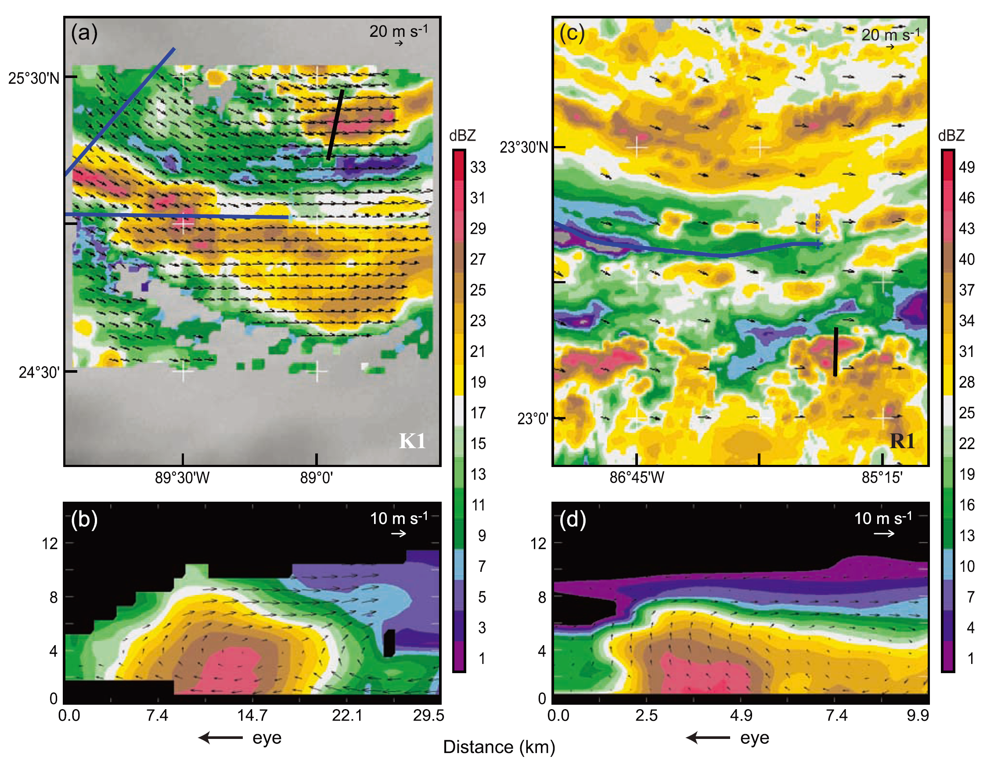
Upwind area
Katrina
Rita

Slide 18
Upwind
The plan view of the upwind portions of both the Katrina and Rita principal rainbands show that the convective cells were less well defined than nearer the midpoint of the rainbands, as exemplified by Figures 6 and 8..
Nonetheless, Figures 10b and 10d indicate that the updrafts of the cells exhibited much the same behavior as the updrafts of the cells in the middle sections of both principal rainbands.

Slide 19
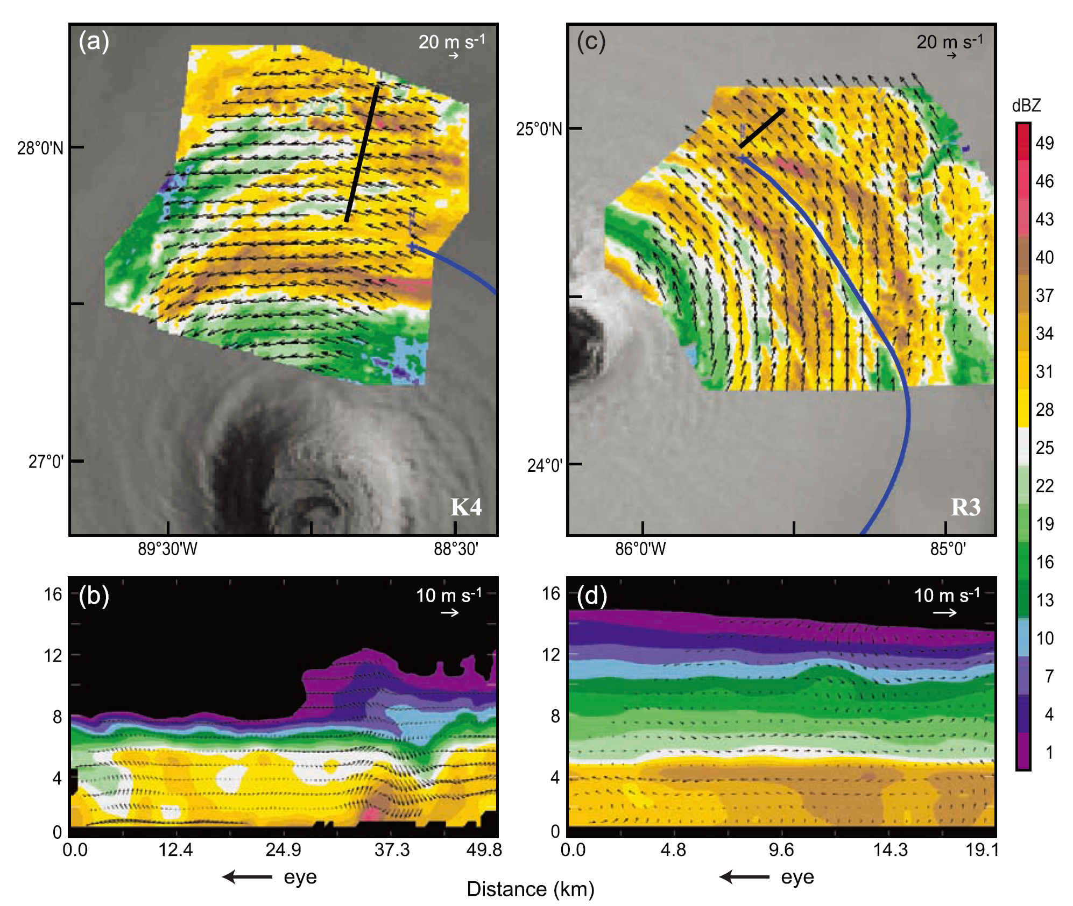
Downwind area
Katrina
Rita

Slide 20
Downwind
The downwind portions of the principal rainbands in both Katrina and Rita were dominated by collapsing convection.
Cells were frequently seen to have been collapsing into stratiform precipitation with bright bands becoming.
In the process discussed by Houze [1997], these collapsing cells evidently accumulated to form a broad region of stratiform precipitation in the downwind portion of the principal rainband

Slide 21
Vertical Mass Transports
The generation of the vertical component of PV is proportional to the vertical gradient of latent heating, and is thus approximately proportional to the slopes of the vertical profiles of mass transport [Haynes and McIntyre, 1987].
We will see that convective up- and downdraft motions dominate this vertical transport, and that all three types of drafts: updrafts, lower-level downdrafts, and upper-level downdrafts affect the net mass transport profile.

Slide 22
Vertical Mass Transports
Yuter and Houze [1995a, 1995b] found upper-level downdrafts in squall-line convection; those drafts were likely a response to the buoyant updrafts.
The upper-level downdrafts observed in the principal rainbands are likely induced by the heating within the convective cells.
They strongly affect the net vertical mass transport at upper levels in the vicinity of the principal rainband.

Slide 23
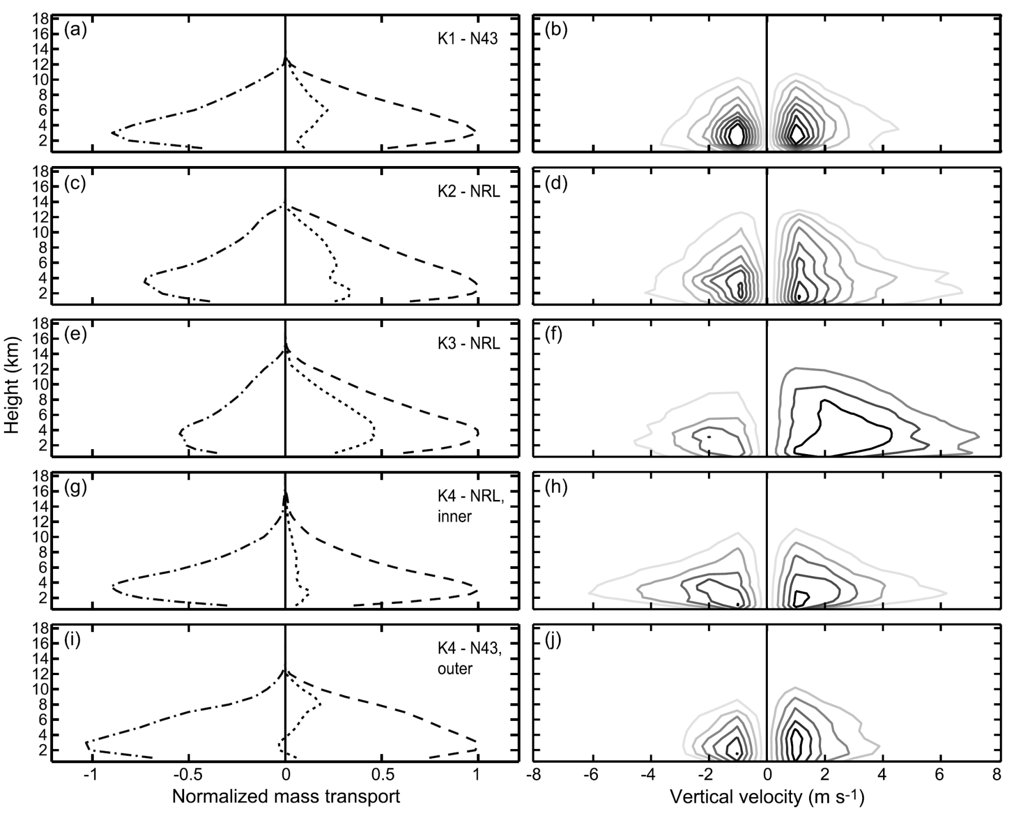
Upwind
Middle
Downwind

Slide 24
Upwind Region
In this particular upwind region, the downdrafts nearly canceled the updrafts at the lowest levels, so that the maximum net upward vertical mass transport was in midlevels.

Slide 25
Middle Region
The net upward vertical mass transport is even stronger within middle region, Despite having a fairly significant amount of stratiform precipitation in these regions, the profiles still exhibit a classic convective profile in the sense that the net vertical mass transport is positive at all levels.
In terms of PV generation, the change in slope of these mass transport profiles at 3–4 km implies that the drafts are producing a net increase of PV below this level, and a decrease above.
the overturning convective updraft circulation of cells in the middle sector of the principal rainband tends to concentrate positive vorticity in the lower troposphere via stretching.

Slide 26
Downwind Region
The vertical mass transports by convective cells are noticeably weaker in the downwind section of the principal rainband, where we have seen that the cells tend to be in a collapsed and more stratiform state
At low levels, downdrafts outweighed updrafts to give a slightly negative (but near zero) mass transport. At upper levels the updrafts outweighed downdrafts to produce a net positive mass transport.
This structure is expected in areas of stratiform precipitation [Houze, 1982, 1989], especially if the stratiform precipitation has been formed by collapsing and weakening convection [Houze, 1997].

Slide 27
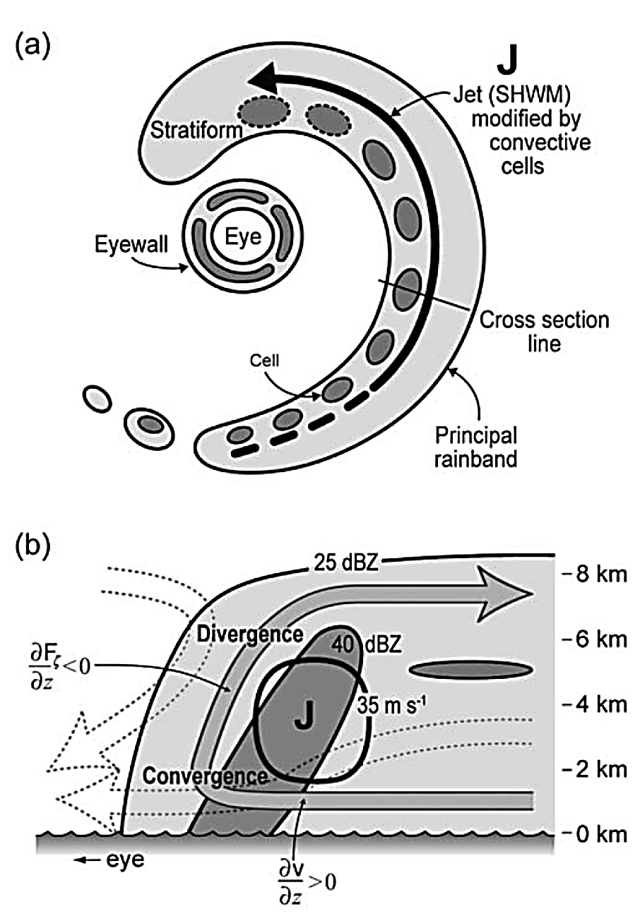
Early stages of development
Upwind
Middle
Fully developed
Downwind
Collapsing into a weaker, more stratiform structure

Slide 28
Conclusions
High-resolution reflectivity and velocity data collected with the NCAR ELDORA system on the NRL P3 in RAINEX in the principal rainbands of hurricanes Katrina and Rita confirm the existence of the convective-scale up- and downdraft structures of the type hypothesized by BZJM and Powell
These observations further indicate how these small-scale features may affect the larger storm circulation.
the circulation not only exhibits the overturning updraft and low-level downdraft shown by BZJM approaching from radially outside the rainband and crossing within the rainband zone,
but also that the radially inward edge of the rainband was bounded by a strong downdraft originating in upper levels, likely in response to the heating in the convective cells.

Slide 29
Conclusions
The Doppler observations provide threedimensional kinematic fields from which we have determined (Figure 13b) that, within the overturning updraft, horizontal vorticity below the SHWM is tilted into vertical vorticity, then stretched by the low-level convergence corresponding to the updraft.
This concentrated vorticity is then advected upwards to midlevels, strengthening the existing vorticity anomaly adjacent to the SHWM.
vorticity transport by convective cells lying just radially inward of the SHWM can substantially increase the intensity of the SHWM over the course of several hours.

Slide 30
Thanks

