Slide 1
Quantifying Environmental Control on Tropical Cyclone Intensity Change
魏士偉
Reference: Hendricks, E. A., et al., 2010: Quantifying Environmental
Control on Tropical Cyclone Intensity Change,
Mon. Wea. Rev., 138, 3243-3271

Slide 2
大綱
Introduction
Data and methods
Composite
Synthesis
Environmental variability of rapidly intensifying TCs
Conclusions

Slide 3
Introduction
Two important questions about TC intensity:
What is the maximum intensity a TC may achieve in a given environment? MPI.
At what rate will a TC change its intensity in that environment? Many factors.
Recently there has been considerable interest in understanding the physical and dynamical processes responsible for rapid intensiﬁcation (RI).
Many discussions about RI, but there are multiple pathways to RI.

Slide 4
Introduction
For quantifying environmental control on TC intensity change, they use the JTWC and NHC best-track from 2003 to 2008, and define 4 separate intensity change bins in ATL and WPAC:
(i) rapidly intensifying, (ii) intensifying, (iii) neutral, and (iv) weakening.
And use NOGAPS and TRMM’s data to composite environment around TC for each bin.
Through these composites, they’ll show the characteristics that differentiate intensifying versus weakening TCs, as well the characteristics that differentiate intensifying versus rapidly intensifying TCs.

Slide 5
Data and methods
a. Data used
b. Selection of intensity change bins
c. Composite variable selection
d. Compositing procedure
e. Filtering

Slide 6
a. Data used
In this study used:
(i) NOGAPS daily 0000 and 1200UTC global analysis
1º x 1º horizontal resolution
(ii) JTWC and NHC best-track data
4 times a day: 0000 0600 1200 1800 UTC
(iii) TMI data
0.25º x 0.25º horizontal resolution
SST and rain-rate data were used
All data were collected for the period 2003–08.

Slide 7
b. Selection of intensity change bins
Using the best-track data, +24 h (24 h into the future) intensity changes were calculated and recorded at each 0000 and 1200 UTC synoptic time.
Removed the data that TC had any land interaction within +24h.
Positioned above 30ºN were removed too.
The filtered dataset yield 732 and 1424 intensity change estimates for ATL and WPAC basin.

Slide 8
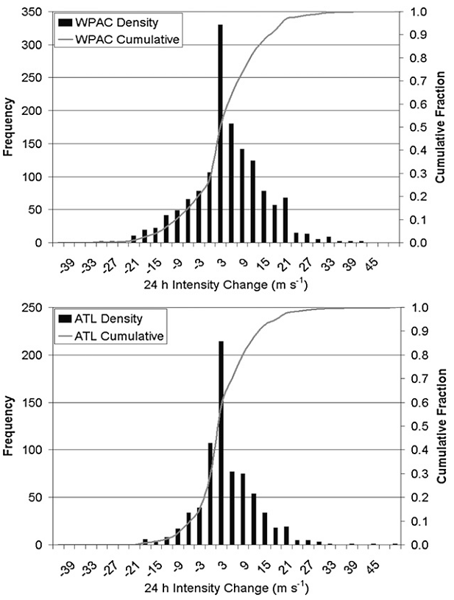
b. Selection of intensity change bins
Probability density and cumulative distribution functions.
Intensifying cases are more than weakening cases, because of land interaction cases were removed.

Slide 9
b. Selection of intensity change bins
Using 95 percentile to get the maximum sustained wind threshold for rapid intensification for each basin.
Then define the intensity change categories with equal-size bins.

Slide 10
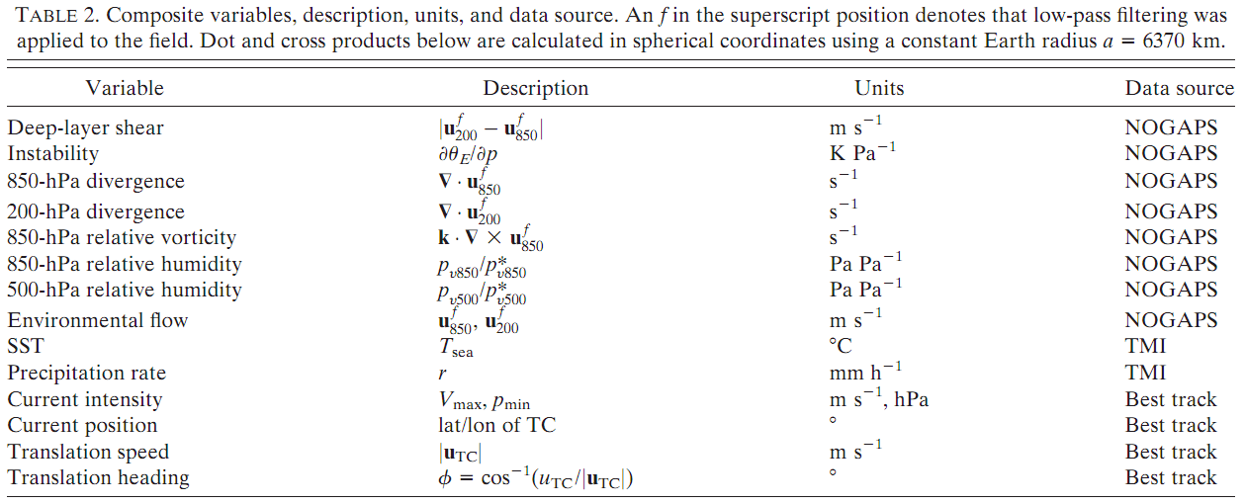
c. Composite variable selection

Slide 11
d. Compositing procedure
Using JTWC and NHC best-track data, composites were made in a 20º x 20º box at the initial TC position.
Didn’t make rapidly weakening composite, because the sample size was very small.
These composites show, on average, the large-scale environmental conditions present at t=0 h, from which a given intensity change occurred in the next 24 h.

Slide 12
e. Filtering
A 15-day low-pass ﬁlter was applied to the NOGAPS winds in order to separate the TC from the environment for these cases.
Filtered field broadly captures the environment in which the TC is embedded.

Slide 13
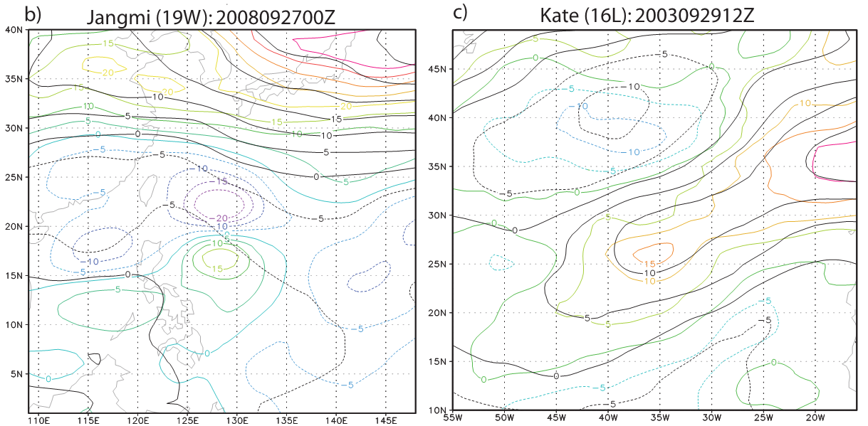
e. Filtering
In the instantaneous snapshot can see the effectiveness of filter.

Slide 14
Composites
a. Position, speed, and heading
b. Intensity life cycles
c. Initial intensity
d. Vertical wind shear
e. Sea surface temperature
f. Instability
g. Low-level relative humidity
h. Midlevel relative humidity
i. Upper- and low-level divergence
j. Background relative vorticity
k. Rain rate
l. TC outﬂow

Slide 15
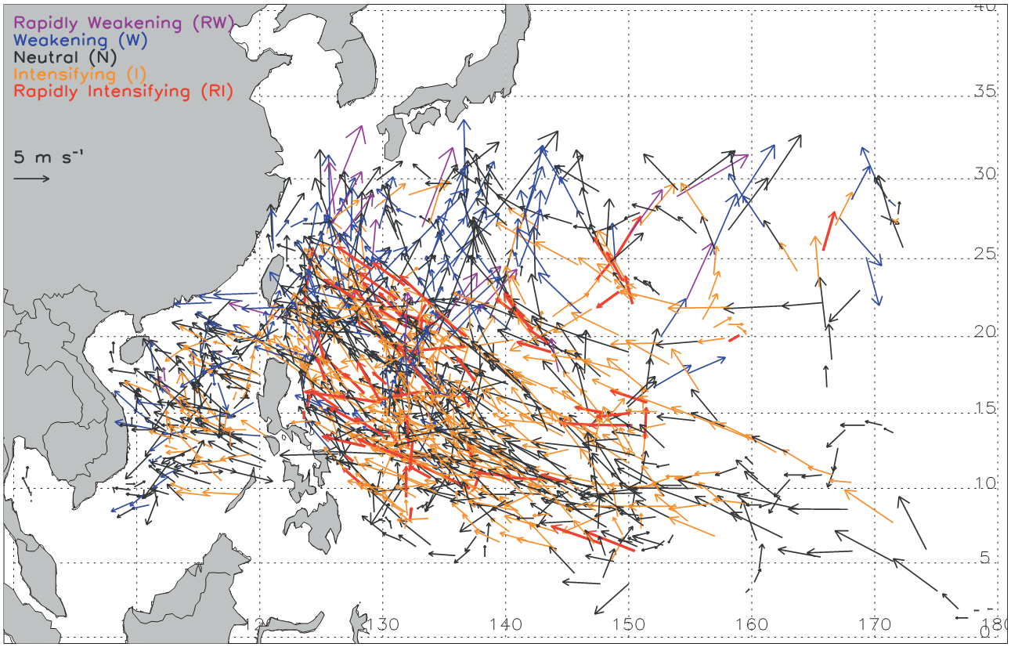
a. Position, speed, and heading
RI events on average happen slightly farther east than neutral or weakening events.
RI events happen slightly farther north than intensifying or neutral events.
Weakening events occur farther north and west than the other groups.
RI hotbed in this box, and there are no RI events in the SCS.
Neutral events occur in all portions of the basin.

Slide 16
a. Position, speed, and heading
Each group had the similar average speed.
For heading, weakening group average move NNW, while all other groups move WNW to WN.

Slide 17
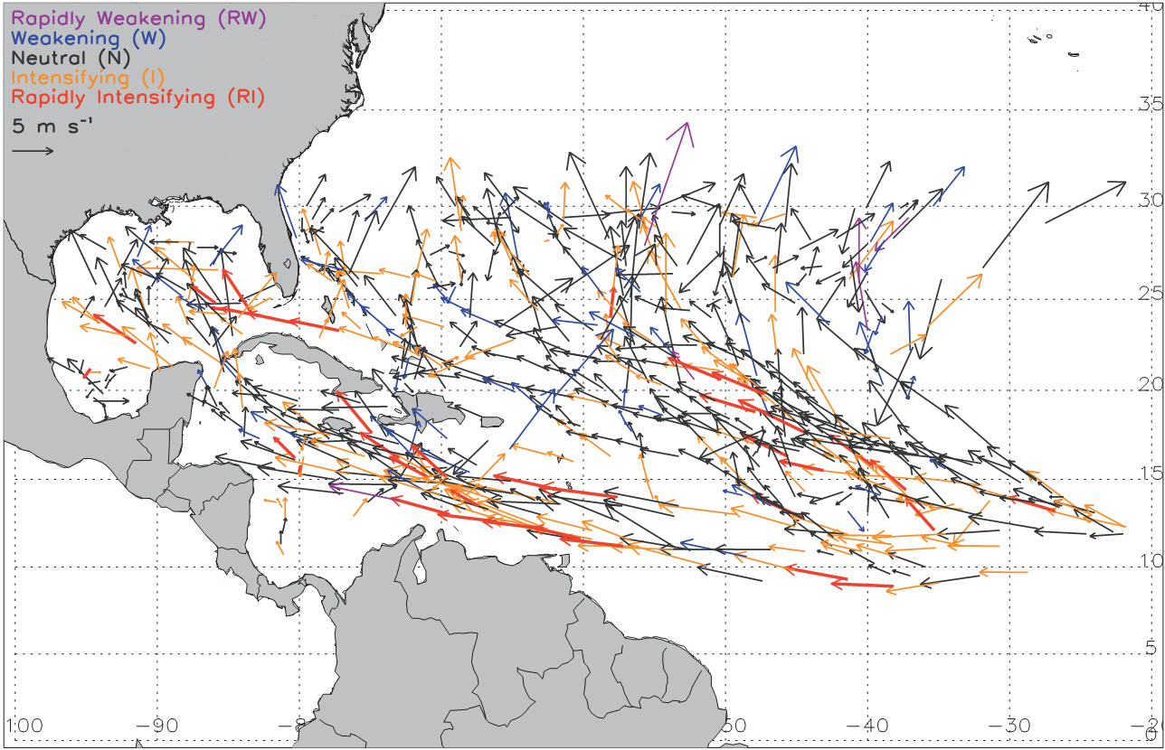
a. Position, speed, and heading
RI events occur farther south than all other categories.
RI events happen farther west than on average than neutral or intensifying events.

Slide 18
a. Position, speed, and heading
RI storms has the fastest average speed, followed by intensifying, neutral, weakening storms.
RI storms move W to WNW, neutral and intensifying storms move WNW, weakening storms move WN.

Slide 19
a. Position, speed, and heading
In comparing the two basins across each intensity change bin, TCs in the ATL typically move faster and in a more westward direction than in the WPAC.

Slide 20
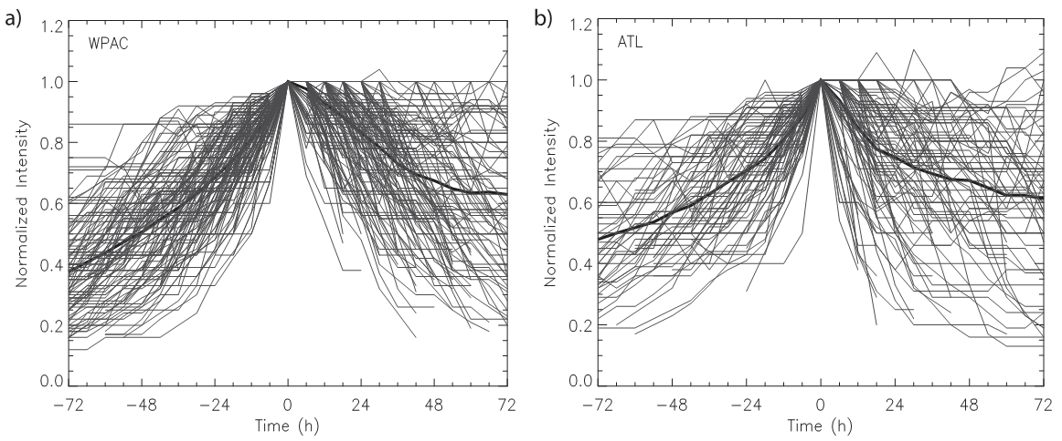
b. Intensify life cycles
There is a signiﬁcant amount of scatter between individual TCs, and more scatter exists in the weakening phase.
TCs in the ATL weaken quicker then in the WPAC.

Slide 21
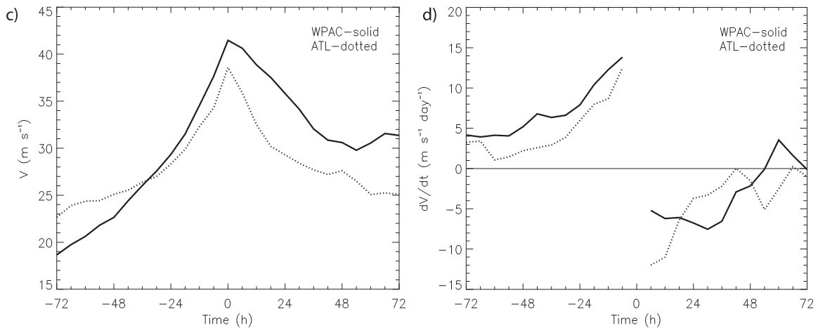
b. Intensify life cycles
Initial intensity: WPAC < ATL
1st maximum intensity: WPAC > ATL
After 1st max. intensity 72h intensity: WPAC > ATL
Intensify speed: WPAC > ATL
Weaken speed: WPAC < ATL
In both basin, weakening rate become less with time.

Slide 22
c. Initial intensity
This result indicates that when TCs initially form, they tend to intensify more slowly at ﬁrst, until they reach a certain threshold, from which they subsequently rapidly intensify.
TCs about to weaken were most intense.
There is no significant difference in the N and I storms between two basins.(Early in the TC life cycle)
Comparing two basins:
Min. SLP: WPAC < ATL
Max. sustained wind: WPAC > ATL (RI events slightly less intense than ATL)

Slide 23
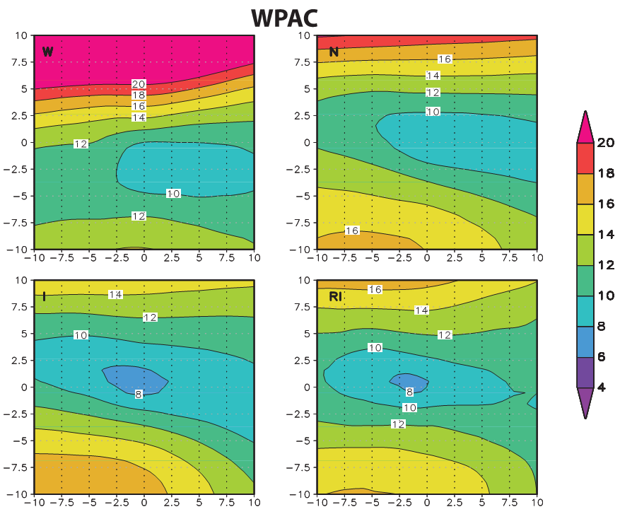
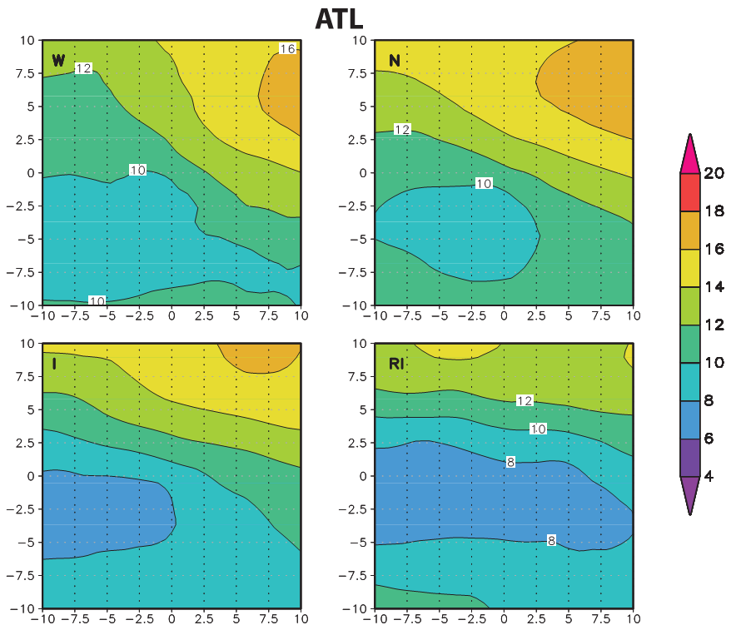
d. Vertical wind shear
In the WPAC, vertical wind shear: W > N > I ≈ RI
In the ATL, vertical wind shear: W ≈ N > I > RI
Comparing two basins:
In I and RI composite: WPAC > ATL
In N composite: WPAC ≈ ATL (magnitudes are similar, phasing is not.)
In W composite: WPAC > ATL

Slide 24
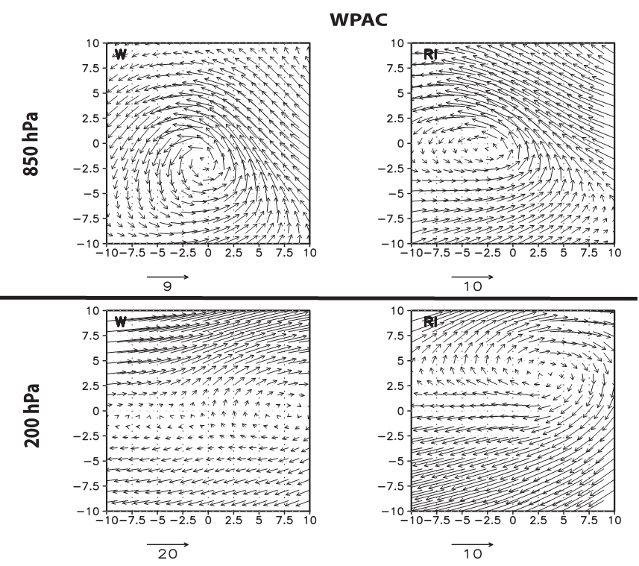
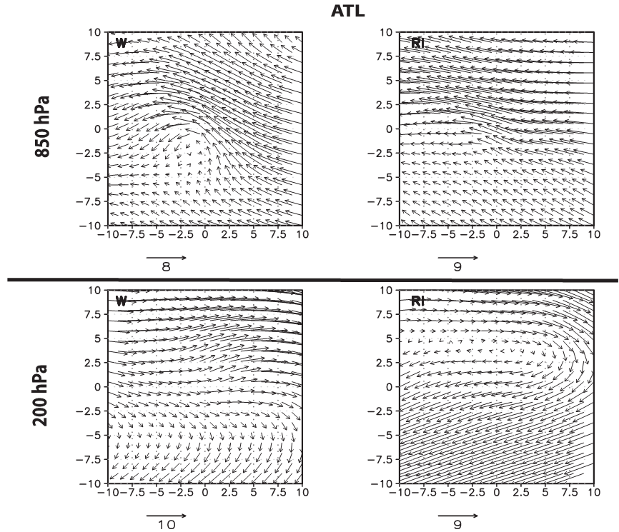
d. Vertical wind shear
In the WPAC, there exists a large-scale monsoon gyre. RI has anti-cyclone, W is not pronounced.
In the ATL, there both exists open-wave. Also has anti-cyclone at upper level.
The RI composite has more easterly ﬂow at upper levels than the weakening composite.

Slide 25
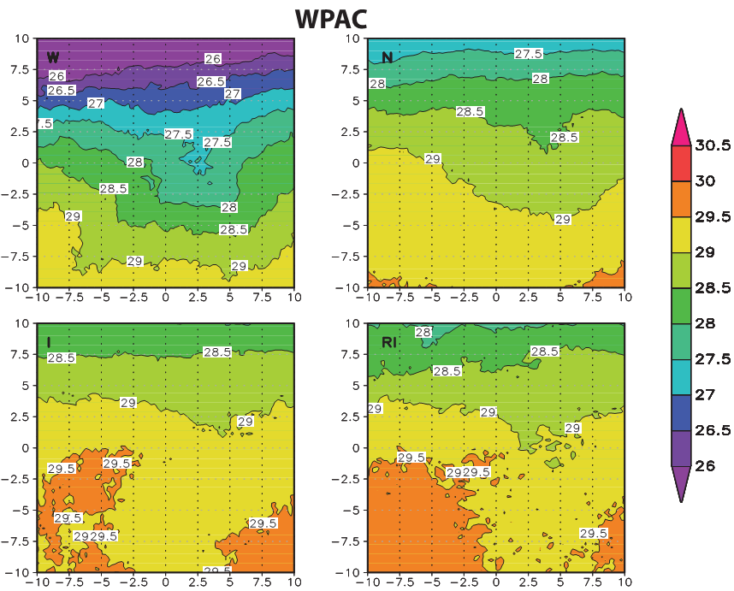
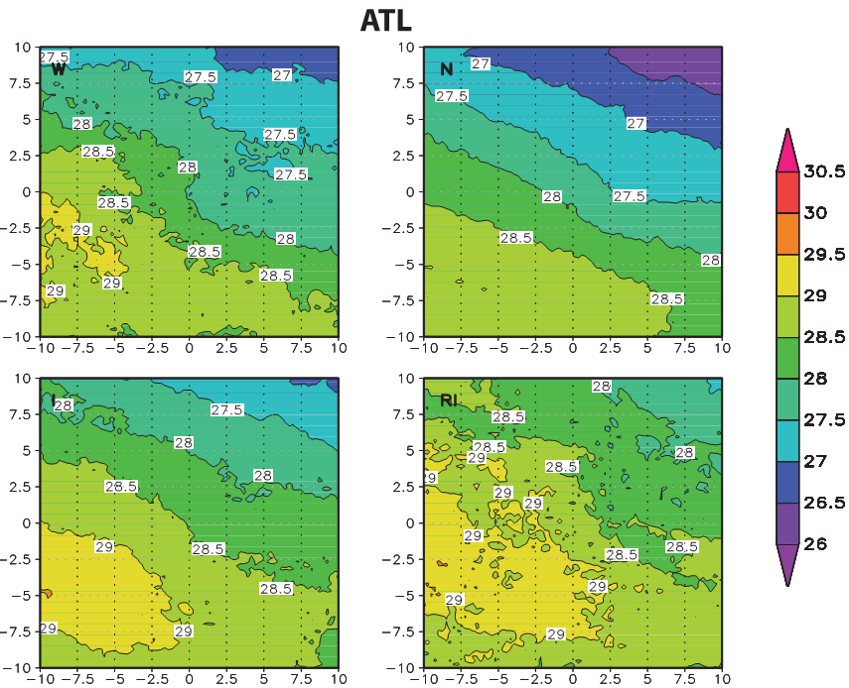
e. SST
In the WPAC: SST for W cooler than other categories. And has strong NS gradient(from 26ºC~29ºC).
The SSTs for I and RI are similar.
In the ATL, similar to WAPC, there is not much different between I and RI.
Comparison both basins:
SST: WPAC > ATL (except W)
It’s due to WPAC storms weakening at higher latitude.
ATL weakening events happen broader range of latitude.

Slide 26
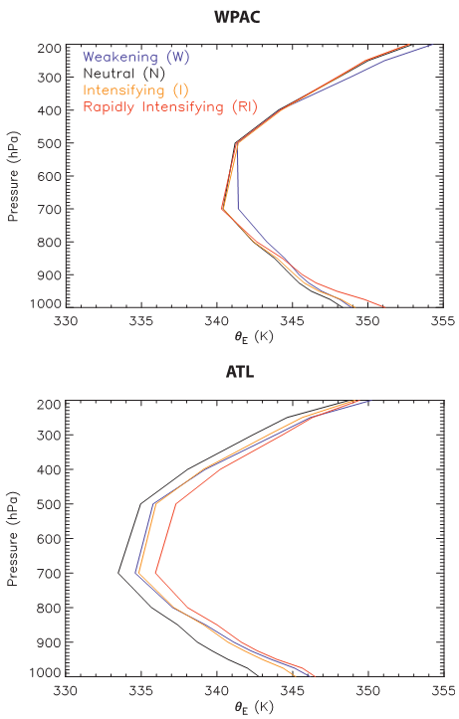
f. Instability
∂θ_{E} ∕ ∂p↑=> more vigorous deep convection and vortex intensiﬁcation.
In the WPAC, the largest instability is for RI. I and N had similar instability, and W had the smallest.
In the ATL, RI and I and N all have similar instability.
Comparing both basins:
Instability: WPAC < ATL
Results show the different between RI and I in the WPAC, but not in the ATL.

Slide 27
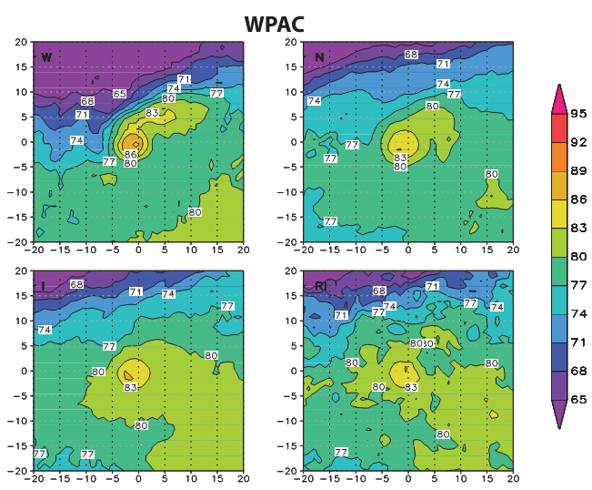
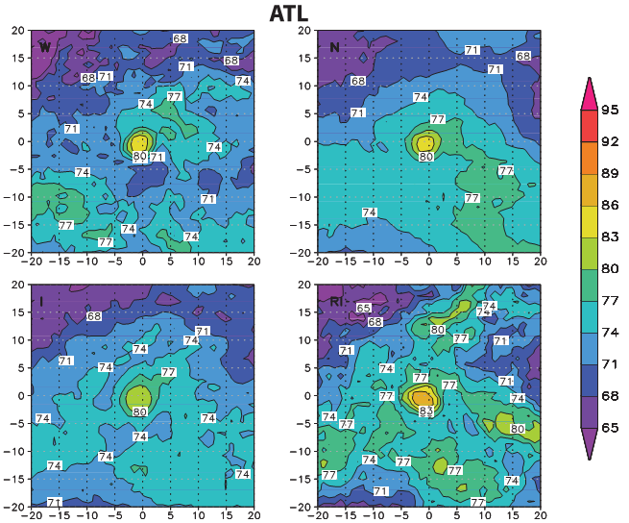
g. Low-level RH
W
N
In the WPAC, there is drier air at north periphery of W storms. And W storms have the largest core RH because on average they are more intense.
In the ATL, W storms also have drier air at west portion, other composites is not pronounce as W events. And RI storms slightly more humid around TC.
In both basins, W composite drier than RI~2.5%.
WPAC is moister than ATL, likely due to moisture convergence from monsoon gyre and trough.
I
RI
W
N
I
RI

Slide 28
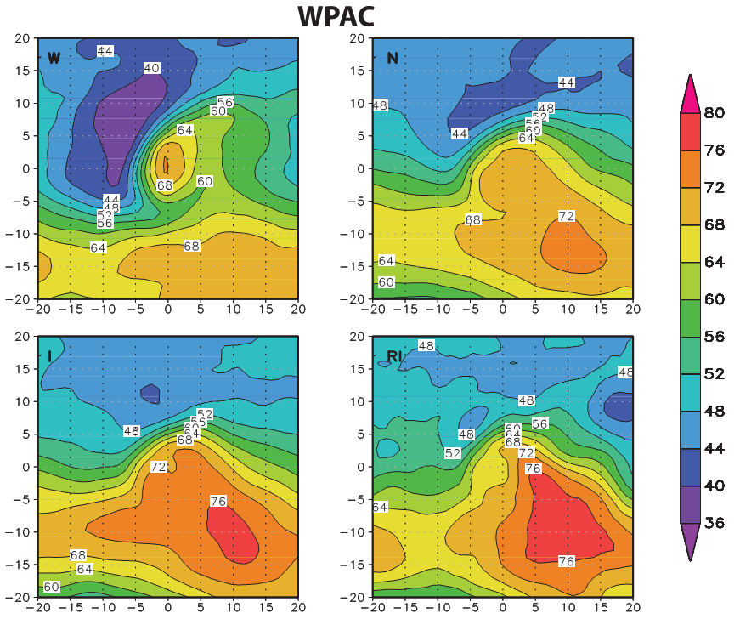
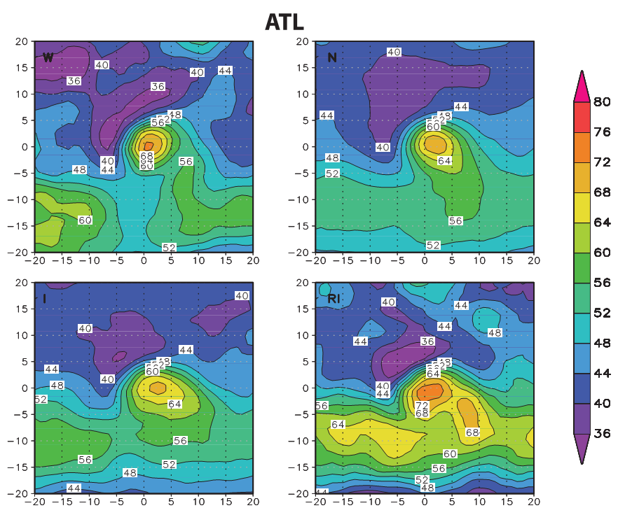
h. Midlevel RH
W
N
In both basins, RH is higher from W to RI.
In the WPAC, the drier air is wrapping into storms in W and N(not as W much). And I is similar to N, RI is slightly moister than I.
In the ATL, similar to WPAC W, even drier than that. RI is also the most moist. Interestingly, the RI composite also exists dry air north of TC.
Comparison both basin:
WPAC is more moist than ATL.
I
RI
W
N
I
RI

Slide 29
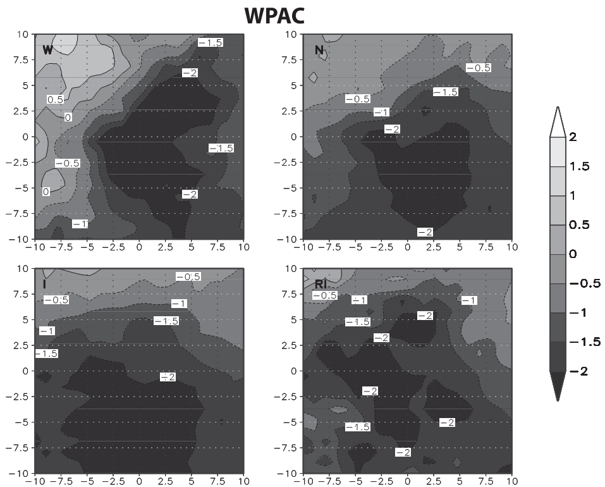
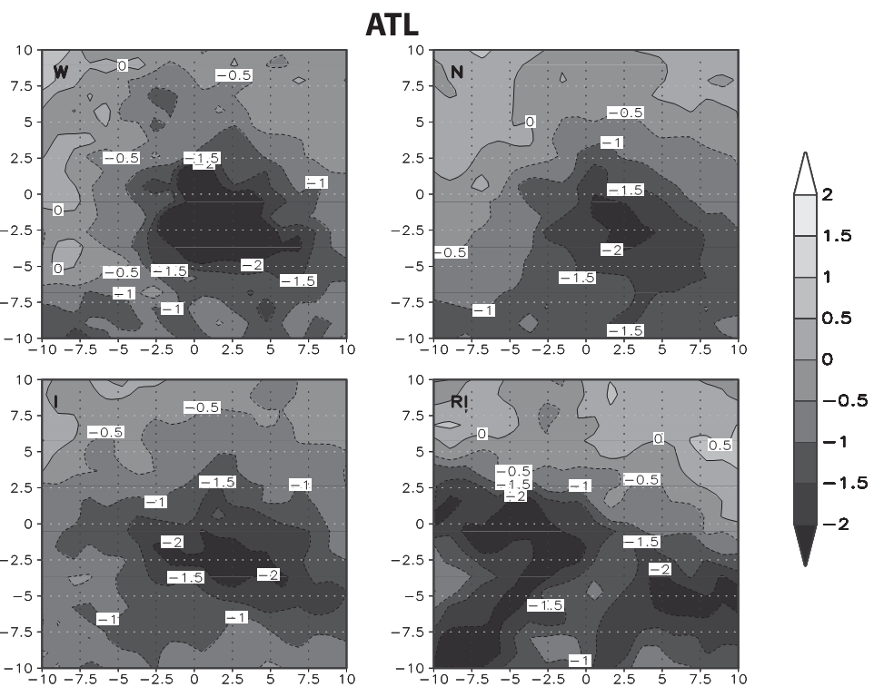
i. Upper- and low-level divergence
In the WPAC, there exists low level convergence at four categories.(due to storms majority located within monsoon gyre and trough)
In the ATL, low level convergence is weaker, and there exists a little divergence north of TCs.(RI composite more pronounce)
Comparing two basins, WPAC has larger areal and magnitude convergence than ATL.

Slide 30
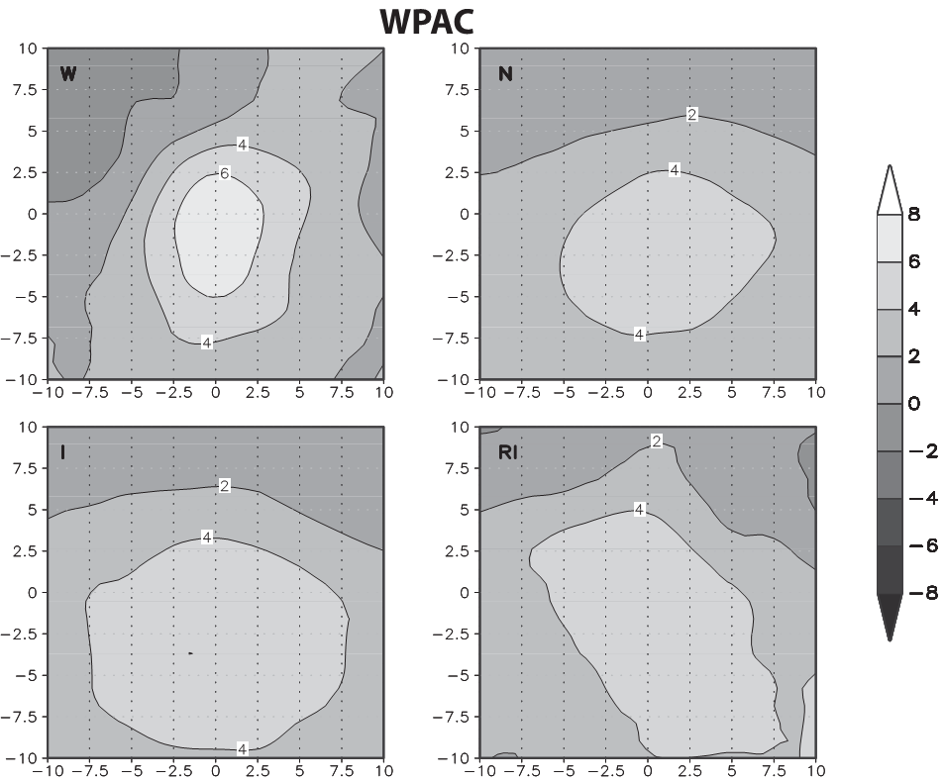
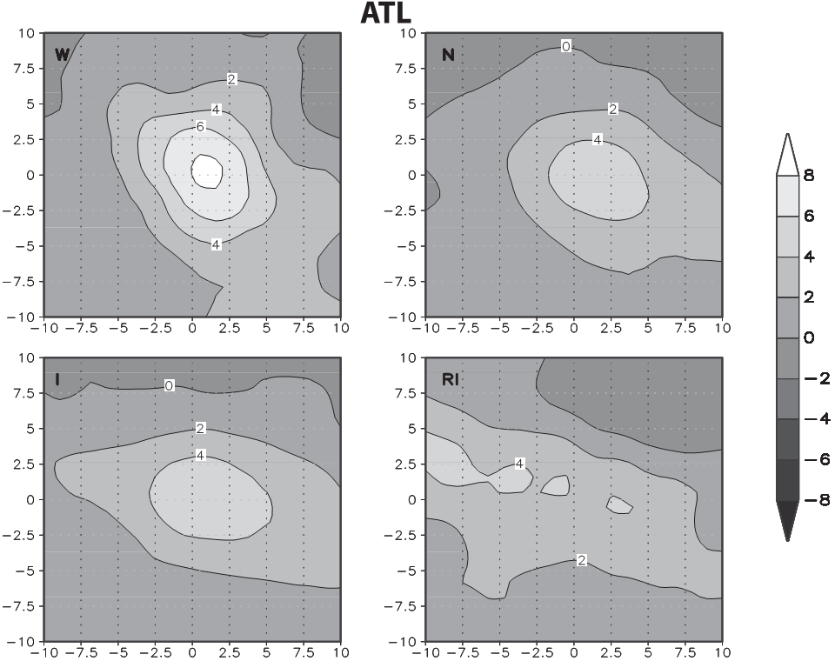
i. Upper- and low-level divergence
In the WPAC, W has the largest divergence, N, I and RI are similar.
In the ATL, similar to WPAC, but RI are smaller than other groups.
The larger divergence in W can be attributed by two factor
weakening TCs often are interacting with upper-level troughs.
weakening TCs are on average signiﬁcantly more intense than the other groups.
Comparing two basins, WPAC has a larger magnitude and areal extent of the upper-level divergence than the ATL.

Slide 31
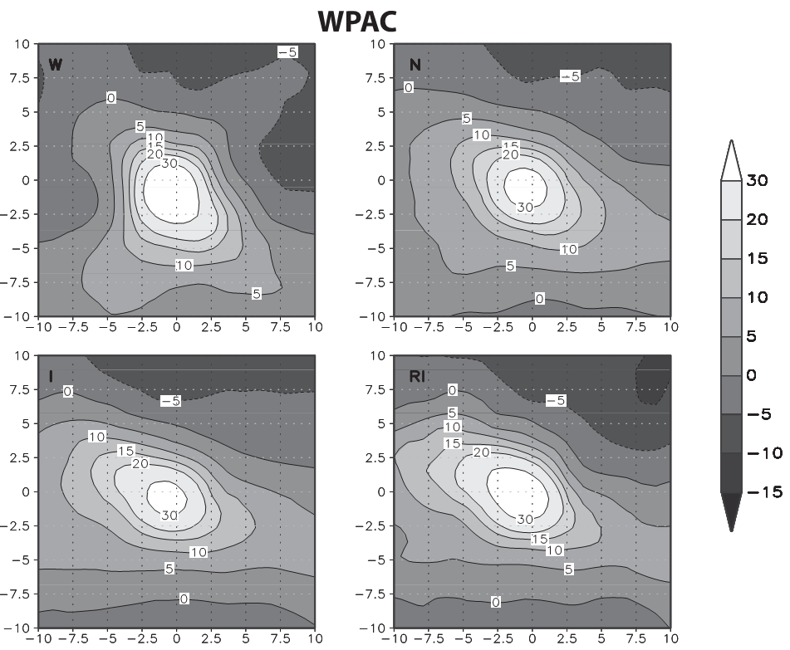
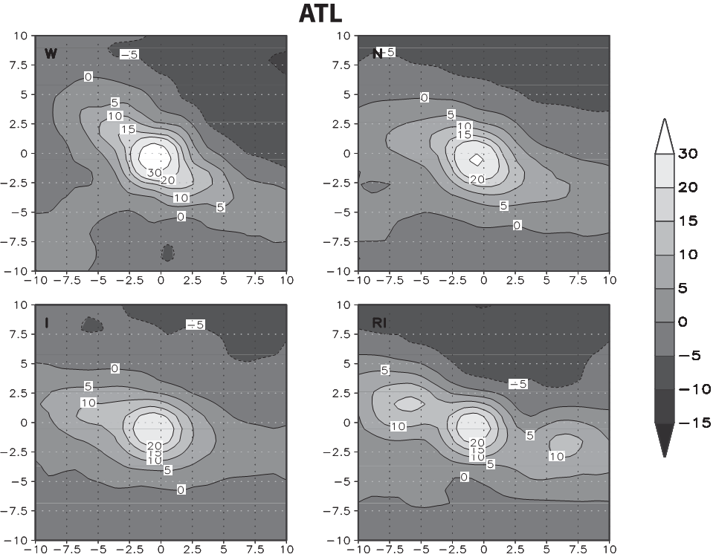
j. Background relative vorticity
There are no significant difference between the intensity change bins.
In comparison of two basins, WPAC has a larger magnitude and areal extent of its relative vorticity pool in comparison to the ATL.

Slide 32
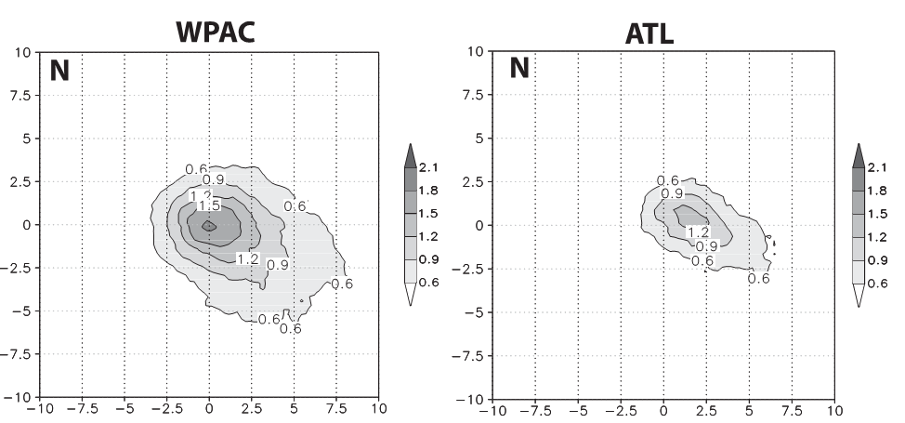
k. Rain rate
In two basins, W composite has largest rain rate, followed by RI composite, the N and I had the similar rain rate.
And in the WPAC rain rate were 25~50% higher than in the ATL.
Diameter of 0.6 mm/h in the WPAC were twice large than in the ATL, and the peak rain rates in the WPAC(1.8mm/h) is also larger than in the ATL(1.2mm/h).

Slide 33
l. TC outflow
Merrill, 1988b :
Intensifying TCs: upper outflow exhibited open streamline.
Non-intensifying TCs: closed streamline exists.
A similar result in this compositing study. The RI composite exhibited strong upper-level ridging to its east with more open streamlines than the neutral(non-intensifying) composite.

Slide 34
Synthesis
In this section, statistical tests are performed in order to quantify whether or not there exists statistically signiﬁcant differences between the RI TCs and the other groups.
a. Climatology and persistence data
b. Environmental data
c. Comparison to other RI studies

Slide 35
a. Climatology and persistence data
The RI storms are initially more intense than I storms in both basins.
Similar to RI–N comparison in the WPAC, there are no statistically signiﬁcant differences with respect to average latitude, longitude, speed, and heading.
In the ATL, RI storms are farther south than intensifying storms, move faster, and have a more westward component to the heading.
In both basins, RI storms initially weaker, farther south, more westward motion. And RI events happen farther east. ATL RI storms move faster. RI events are more intense than N and I in both basins.
In the WPAC, there are no significant statistical difference between RI and N in average latitude, longitude, speed, and heading.
In the ATL, RI storms are farther south than neutral storms, move faster, and have a more westward component to the heading.

Slide 36
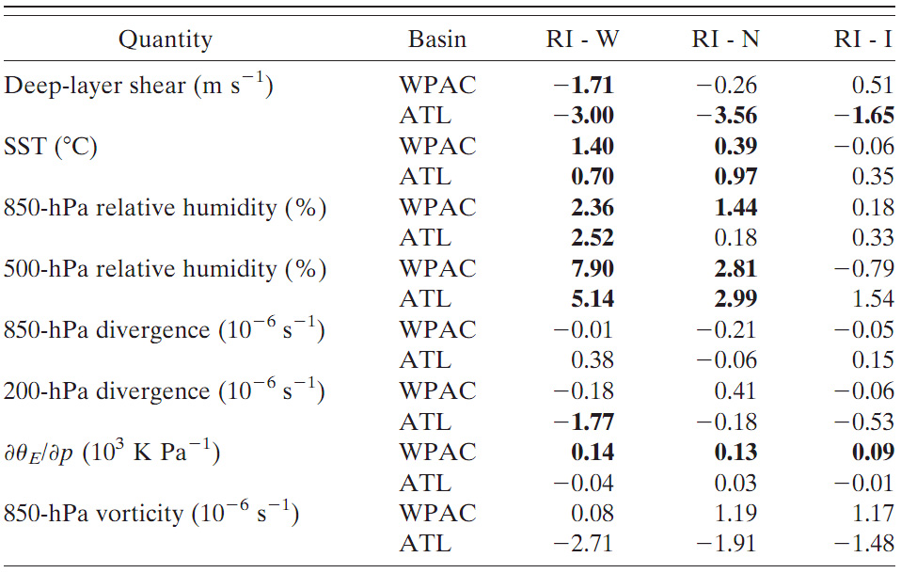
b. Environmental data
In the ATL and WPAC, the SSTs are warmer. Both basins have similar low-level vorticity and low- and upper-level divergence.
In the WPAC, RI storms have a larger instability while the vertical wind shear is similar.
In the ATL, RI events happen in weaker wind shear, while the instability is similar.
In the ATL, RI storms have larger low-level relative humidity and smaller upper-level divergence, while the low-level convergence, instability, and low-level vorticity are similar.
In the WPAC, RI storms have signiﬁcantly larger instability, while the low-level humidity, low- and upper-level divergence, and low-level relative vorticity are similar.
In the WPAC, the instability is larger, while the vertical shear is similar.
In the ATL, the vertical shear is weaker, while the instability is similar. The low- and midlevel relative humidity, low-level vorticity, and low- and upper-level divergence are similar.

Slide 37
c. Comparison to other RI studies
Kaplan and DeMaria(2003) and Kaplan et al.(2010) also studied the environmental characteristics of rapidly intensifying(RI).
There are some discrepancies between that two studies and this, authors think that due to they filtered the wind field.

Slide 38
Environmental variability of rapidly intensifying TCs
Do TCs rapidly intensify only when all the environmental parameters discussed here are very favorable?
Or are there compensating factors, such as very weak shear compensating for marginal SSTs, or large instability compensating for strong shear?
To answer the two questions, authors selected deep-layer shear, SST, 200-hPa divergence, and instability to illustrate some of the environmental variability that exists in RI storms.

Slide 39
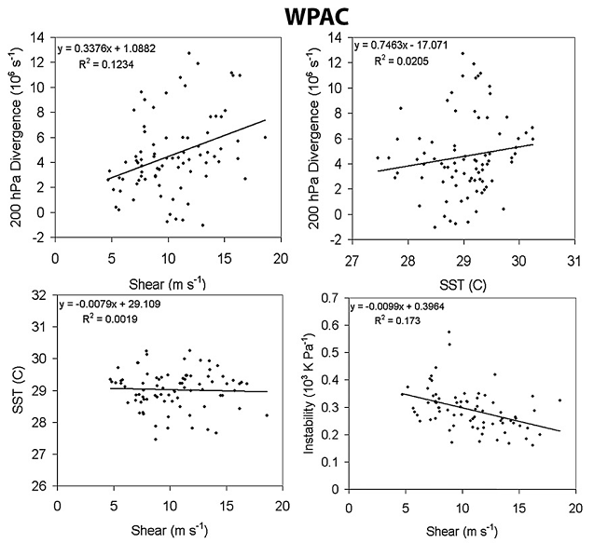
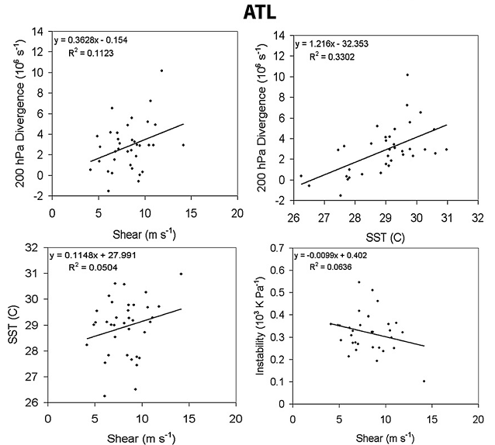
In both basins, upper-level divergence is found to be positively correlated with deep-layer shear.
In both basins, upper-level divergence was also found to be positively correlated with SST.
In the WPAC, there was found to be no trend between SST and deep-layer shear.
In the ATL, however, SST was found to be positively correlated with deep-layer shear.
In both basins, instability was negatively correlated with deep-layer shear.

Slide 40
Environmental variability of rapidly intensifying TCs
In the ATL, Katrina had warmest SSTs, highest midlevel humidity, and largest instability. Rita had the weakest deep-layer shear and low-level relative humidity. Wilma had the largest low-level convergence, upper-level divergence, and low-level relative vorticity.
In the WPAC, Sinlaku had very weak shear, warm SSTs, large upper-level divergence, and higher midlevel relative humidity. Chaba had the largest low-level convergence and low-level environmental relative vorticity in the group. Nesat had weak vertical wind shear.

Slide 41
Conclusion
This study quantify the differences in environmental parameters between RI and W, N, and I.
The environment of RI TCs and I TCs was found to be quite similar.
TC moves over a warm ocean anomaly, it is equally likely to intensify slowly or rapidly.
The TCs about to undergo an RI episode were more intense initially in both basins than the TCs about to undergo a neutral or intensifying episode.

Slide 42
Conclusion
In comparing the two basins among the intensifying and RI categories, it was found that the WPAC had more favorable environment for TC intensiﬁcation than the ATL, consistent with past work.
It can reasonably be concluded that rapid intensiﬁcation is mostly controlled by internal dynamical processes, provided that a preexisting favorable environment exists.
These relative roles of internal and external processes (as well as scale interactions) in TC intensity change will be further tested.

Slide 43
The End

Slide 44
Page 20
Weakening due to landfall, and quasi-neutral behavior in a favorable environment due to the TC reaching its MPI.
Weakening due to a less favorable environment or unfavorable internal dynamics, such as eye-wall replacement cycles.
Some storms quickly intensify to maximum intensity. Similarly, a variety of oceanic, atmospheric and internal processes dictate the variability in these curves during this phase.

Slide 45
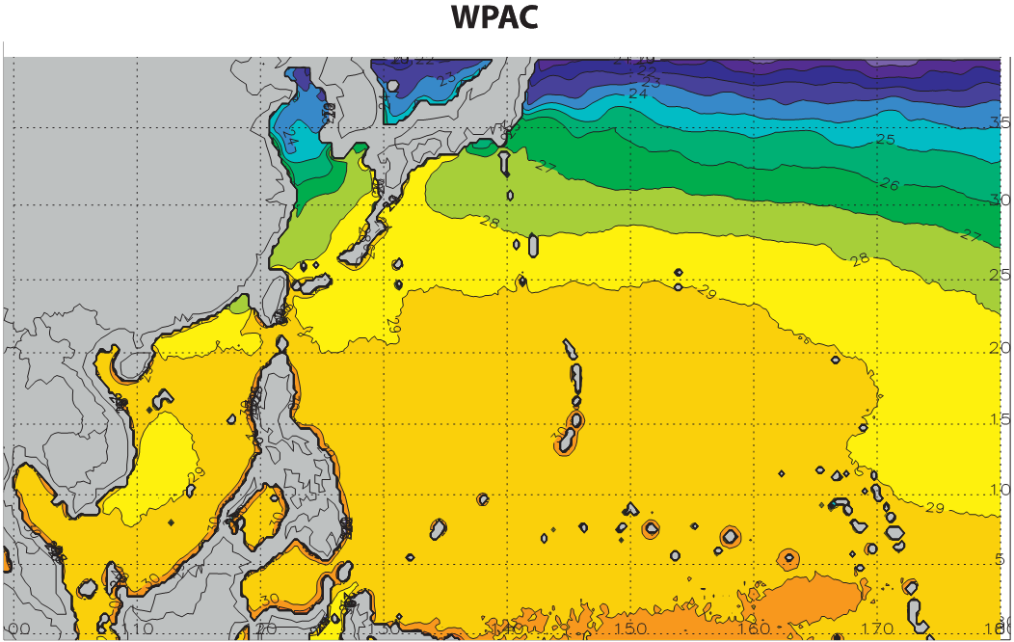
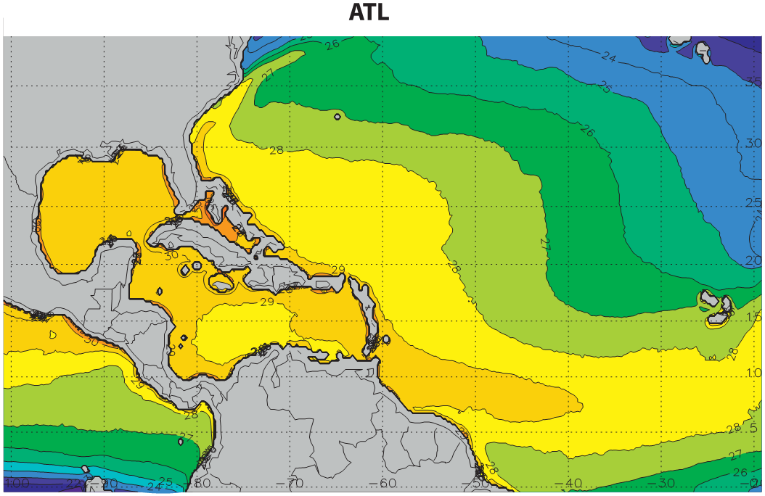
e. SST
Mean SST for 03-08 July to October.
Area > 29ºC: WPAC > ATL
In the WPAC, SSTs vary signiﬁcantly meridionally (particularly at higher latitudes), but only weakly zonally.
There exists a strong zonal variance in the ATL SSTs, with temperatures cooling toward the east.

