Slide 1
Quasi-Lagrangian Vorticity Budget (Chen and Bosart, 1979)
where is the local tendency following the motion of the system, is the horizontal system velocity. The represents the vertical motion of the quasi-Lagrangian isobaric coordinate system.
(1)
where is the absolute vorticity. Terms (2A) and (2B) are horizontal and vertical advection terms; terms (2C) and (2H) are the corresponding advection terms due to the motion of the system; and terms (2D) and (2E) are the divergence and tilting terms. Terms (2H) is generally two to three orders of magnitude smaller than the remaining terms in Eq. (2), and is neglected hereafter. Term (2F) represents dissipative and subgrid-scale processes.
(A) (B) (C) (H)
(D) (E) (F)
(2)
tendency
advection
advection due to moving system
divergence
tilting
residual

Slide 2
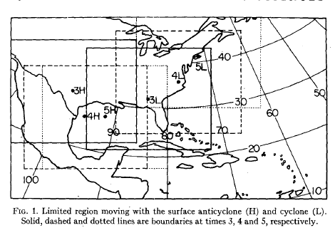
for tendency term:
T = 0
T = -1
T = -2
dt1
dt2
for other terms:

Slide 4
Tendency term
Advection term
Divergence term
Tilting term
Residual term
 | Tendency | Advection | Divergence | Tilting term | Residual term
TC A | 7.01 | -15.50 | 25.40 | -1.29 | -1.60
TC B | 15.40 | -12.62 | 9.02 | -7.26 | 26.26
TC C | 7.50 | -12.20 | 7.51 | -5.26 | 17.45
TC D | 20.34 | 2.08 | 23.39 | -3.08 | -2.05
TC E | 10.49 | -4.13 | 13.38 | -0.11 | 1.35
0 -15
0 -9
+1 -10
0 -9
0 -12

Slide 6
Tendency term
Advection term
Divergence term
Tilting term
Residual term
 | Tendency | Advection | Divergence | Tilting term | Residual term
TC A | 22.44 | -15.06 | 19.41 | -5.89 | 23.98
TC B | 30.26 | -20.38 | 14.48 | -8.52 | 44.68
TC C | 17.54 | -18.56 | 9.27 | -7.90 | 34.72
TC D | 76.88 | -4.90 | 29.01 | -7.16 | 59.93
TC E | 26.39 | 2.64 | 10.70 | -1.96 | 15.00
* | 1.97 | -0.42 | 5.33 | -2.82 | -0.12
-3 -6
0 -4
-3 -8
-6 -8
-4 -8
*an anti-cyclone case is calculated to check the calculation is correct.

Slide 7
Tendency term
Advection term
Divergence term
Tilting term
Residual term
Considering
D1 D2 D3 DD
T1 T2 T3 TD
You may check the following speculations
1.
2.
D1+T1
D2+D3+T2+T3 +DD+TD+R
Balanced dynamics Aggregate by convective vortices

Slide 8
Wave Dynamics
 |  |  |  | D1+T1 (D1) |  |  |  | difference
TC A | 2.75 |  | (4.48) | 3.15 |  | (4.85) |  | -0.40
TC B | 3.01 |  | (4.01) | 3.04 |  | (3.70) |  | -0.03
TC C | 9.45 |  | (1.00) | 8.35 |  | (8.53) |  | 1.10
TC D | 24.20 |  | (8.44) | 25.08 |  | (23.92) |  | -0.88
TC E | 11.30 |  | (6.33) | 10.42 |  | (10.83) |  | 0.88
TC A Balanced
TC B Agg
TC C Agg
TC D Wave
TC E
D2+D3+T2+T3 +DD+TD+R
 | Eddy vorticity tendency |  |  |  | Balanced dynamics |  |  |  | Aggregate by convective vortices
 |  |  |  |  | D2+D3+T2+T3 |  | (D2+D3) |  | DD+TD+R (R)
TC A | 19.76 |  | (2.53) |  | 15.35 |  | (11.54) |  | 4.41 |  | (-1.60)
TC B | 25.01 |  | (11.39) |  | 1.80 |  | (4.55) |  | 23.21 |  | (26.26)
TC C | 10.26 |  | (6.50) |  | 5.43 |  | (7.14) |  | 4.83 |  | (17.45)
TC D | -5.94 |  | (11.90) |  | 9.83 |  | (7.50) |  | -15.78 |  | (-2.05)
TC E | 3.33 |  | (4.16) |  | 5.49 |  | (4.92) |  | -2.16 |  | (1.35)

Slide 9
Next:
Explain the contributions of each term in vorticity budget for each TC formation,
Describe the behavior of waves when wave dynamic or balance dynamic is important,
Compare the results of vorticity budget with our past observation analysis.

Slide 10
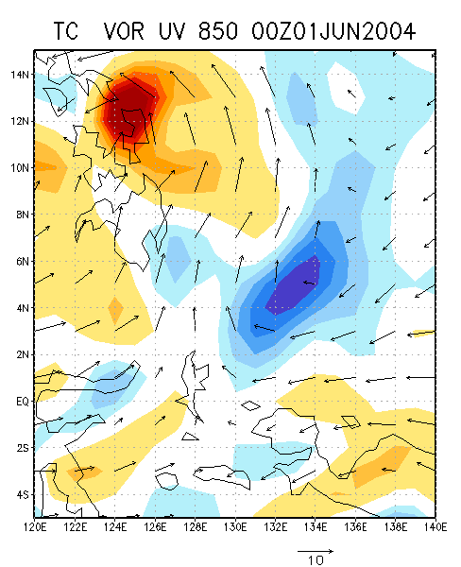
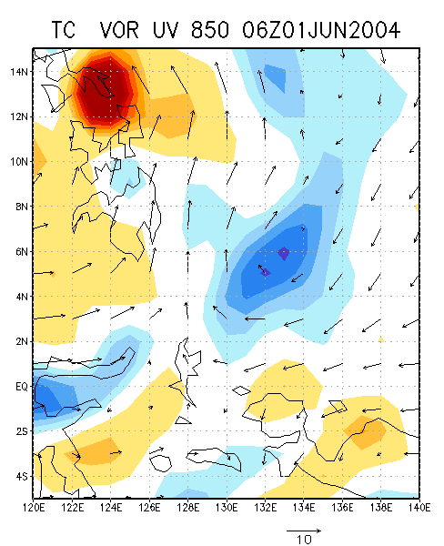
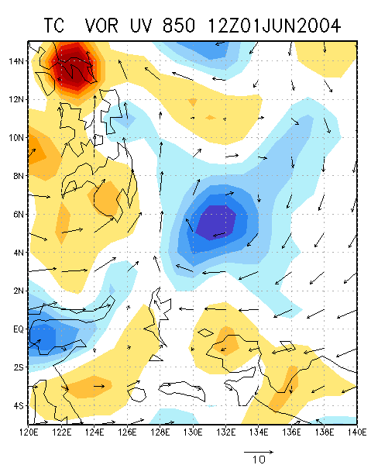
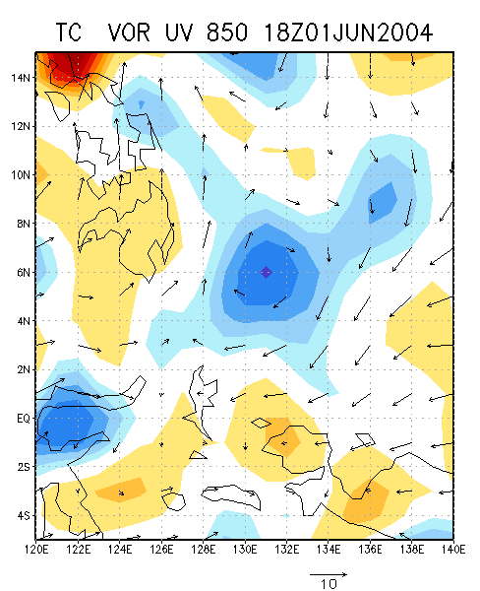
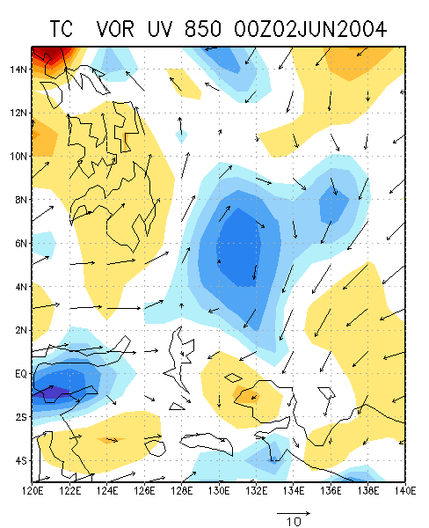
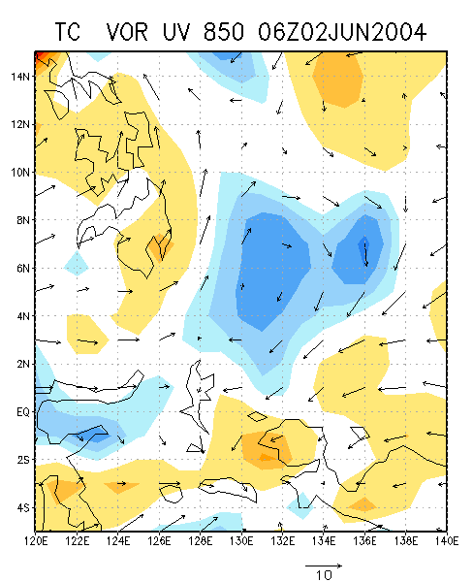
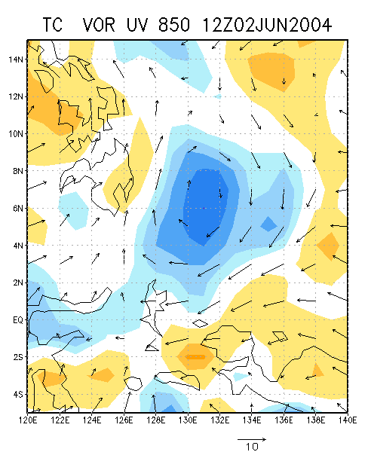
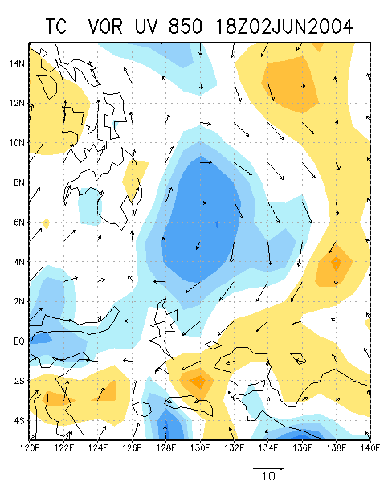
an anti-cyclone case is calculated to check the calculation is correct.
Tend | ADVh | ADVv | ADVc | DIV | Tilting | Residual
1.97 | -2.80 | -0.93 | 3.31 | 5.33 | -2.82 | -0.12

