Slide 1
Comparison of Evaporation and Cold Pool Development between Single-Moment (SM) and Multi-moment (MM) Bulk Microphysics Schemes
In Idealized Simulations of Tornadic Thunderstorms
Deng-Shun Dennis Chen
5 Oct. 2010 S1-803
Dawson, D. T. II, M. Xue, J. A. Milbrandt, and M.-K. Yau, 2010: Comparison of evaporation and cool pool development between single-moment and miltimoment bulk microphysics in idealized simulations of tornadic thunderstorms. Mon. Wea. Rev., 138, 1152–1171.
Milbrandt, J. A., 2005:A multimoment Bulk Microphysics Parameterization, Part I : Analysis of the Role of the Spectral Shape Parameter, J. Atmo. Sci., 62, 3051-3064

Slide 2
Content
Introduction
  DSD
  Moments
Overview cases
Experiment design
  Sounding used for idealized experiments
  Idealized experiments
Result and discussion
  Cold pool and reflectivity structure
  Budget analysis
  Spatiotemporal structure of rain evaporation and effects of DSD variation
  Cold bias in SM evaporation as revealed through comparison with MM
  1D column model tests
Conclusions
Notes:
Expectation mutil moment scheme lead to weaker cold pool and better reflectivity structure
What author want to see
1.Compared multimoment with single moment scheme specificaLLY RAIN ECAPORATION AND SIZE SORTING
2.Cold pool strength and structure
3.Overall reflectivity structure

Slide 3
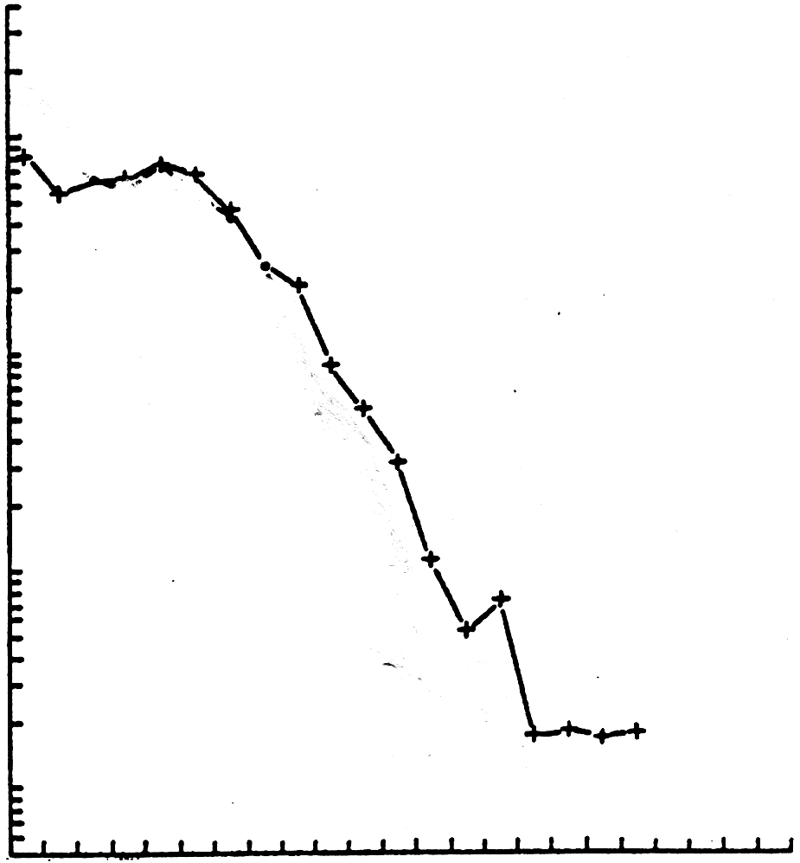
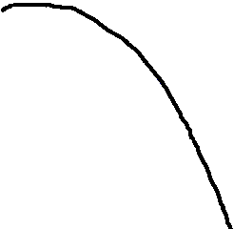
Representing the size spectrum
ANAYLTICAL FUNCTION
10¹
N (D)
10⁰
[m⁻³ μ m⁻¹]
10⁻¹
10⁻²
0
20
40
60
80
100
D [μ m]
1 m³
(unit volume)
BULK METHOD
[e.g. Cloud droplets]

Slide 4
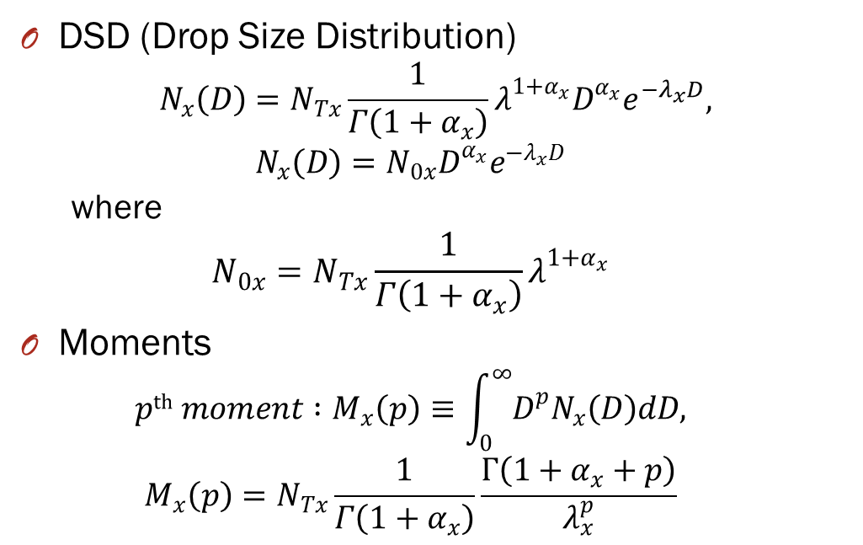
Introduction
DSD (Drop Size Distribution)
$$N_{x}\left(D\right)=N_{Tx}\frac{1}{Γ\left(1+α_{x}\right)}λ^{1+α_{x}}D^{α_{x}}e^{{−λ}_{x}D},$$
  $$N_{x}\left(D\right)=N_{0x}D^{α_{x}}e^{{−λ}_{x}D}$$
  where
  $$N_{0x}=N_{Tx}\frac{1}{Γ\left(1+α_{x}\right)}λ^{1+α_{x}}$$
Moments
  $$pth moment :M_{x}\left(p\right)≡\int_{0}^{∞}{D^{p}N_{x}\left(D\right)dD,}$$
  $$M_{x}\left(p\right)=N_{Tx}\frac{1}{Γ\left(1+α_{x}\right)}\frac{Γ\left(1+α_{x}+p\right)}{λ_{x}^{p}}$$

Slide 5
BULK METHOD
Example of Moments:
Total number concentration, N_{Tx}
10¹
10⁰
N (D)
10⁻¹
Hydrometeor
Category x
Mass mixing ratio, q_{x}
10⁻²
0
20
40
D
60
80
100
Radar reflectivity factor, Z_{x}
Size Distribution Function:
p^{th} moment:
(Milbrandt and Yau, 2005)

Slide 6

Previous study
The multi-moment (MM) schemes have a number of advantages over single-moment (SM)schemes.
  Accretion
  Diffusion
  Evaporation
  Sedimentation
MM schemes allow for size sorting mechanism, which is physically equivalent to larger particles falling faster than smaller ones.
SM schemes only have a single fall speed, which is the mass-weighted for the predicted hydrometeors.
$$\left(N_{Tx }and q_{x} are very independently\right)$$

Slide 7
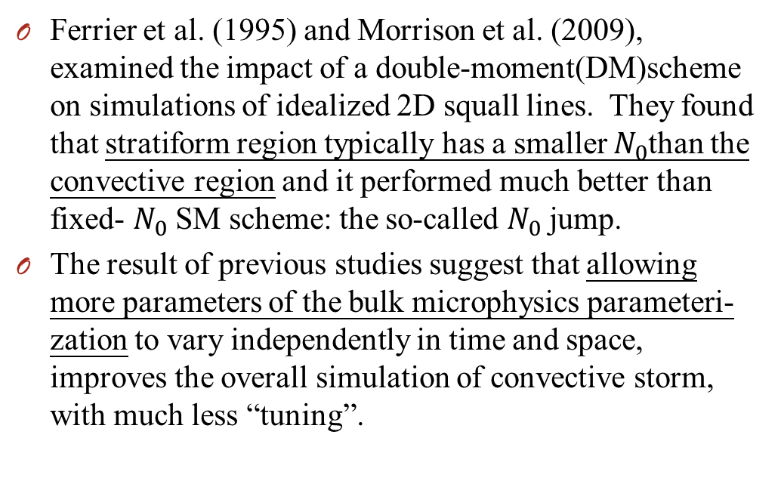
Previous study
Ferrier et al. (1995) and Morrison et al. (2009), examined the impact of a double-moment(DM)scheme on simulations of idealized 2D squall lines. They found that stratiform region typically has a smaller $N_{0}$than the convective region and it performed much better than fixed- $N_{0}$ SM scheme: the so-called $N_{0}$ jump.
The result of previous studies suggest that allowing more parameters of the bulk microphysics parameteri-zation to vary independently in time and space, improves the overall simulation of convective storm, with much less “tuning”.

Slide 8
Motivation
Many past numerical simulations of supercell convec-tion produce cold pools that are too large and intense.
Gilmore and Wicker (1998)found large and strong cold pools though numerical simulations. Only use warm-rain scheme and do not investigate the impact of microphysics.
James and Markowski (2010), who found that ice microphysics(both SM and DM) generally resulted in stronger (weaker) cold pools for a moist (dry) sounding, in contract to Gilmore and Wicker (1998).

Slide 9
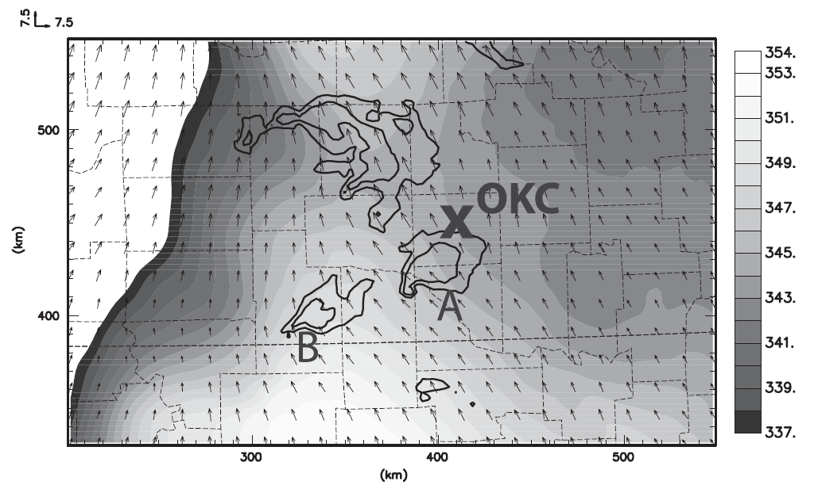
Overview of the case
Date | Episode | Location
3 May 1999 | Tornado outbreak | Central Oklahoma
Producing over 70 tornados in Oklahoma alone
Cold pool
Notes:
70

Slide 10
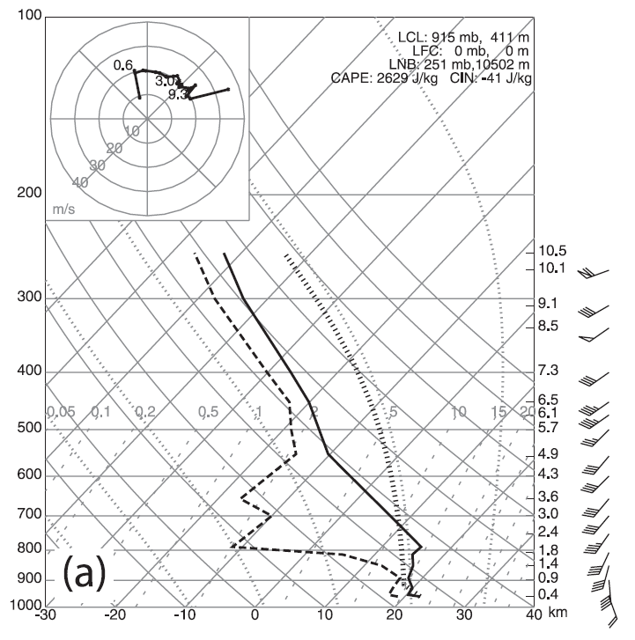
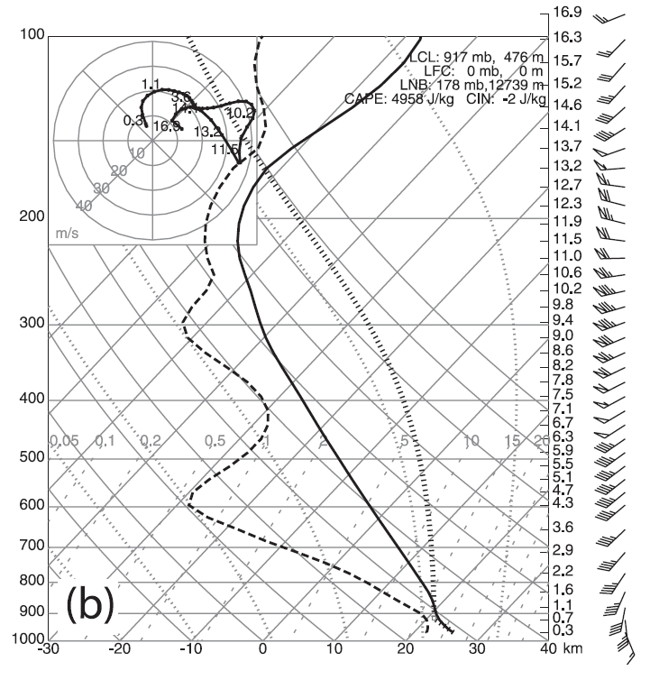
Experiment design
  Sounding used for idealized experiments
CAPE:2629 J/kg
CAPE:4985 J/kg
OBS
SIM
Notes:
No surface physical process , the role of surface flux is not taken in account .
OBS : 0000UTC 4 May 1999 SIM:
1 hour integration LINA-3km
作者過去使用3公里解析度的模擬在每個雲為物理參數設定下皆有冷池太強的現象
他認為亂流混和過程可以減緩下沉氣流的強度和雨的蒸發
而在粗網格卻很難模擬出來
故使用細網格
這是一個可能冷池太強的原因

Slide 11
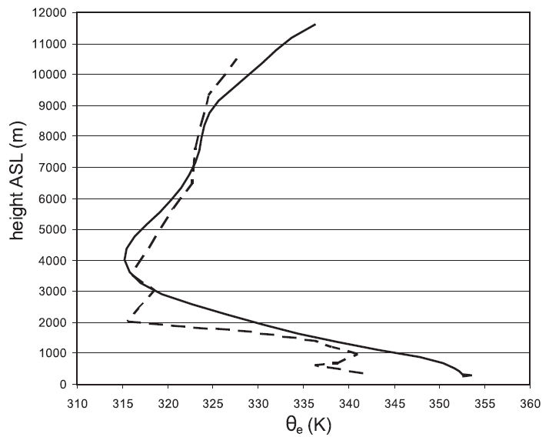
Experiment design
  Sounding used for idealized experiments
SIM
OBS
Notes:
No surface physical process , the role of surface flux is not taken in account .
1 hour integration LINA-3km

Slide 12
Experiment design
  Idealized experiments
y
128km
Integrate 2 hours
35km
25km
x
175km
1.5km
z
10km
4k (8k or 2k ??)
1.5km
x
Notes:
1km 500-m 250-m grid size , 53 vertical levels (20m→ 800m ) , model top = 20km
Below 1 km have 6 levels , below 2 km have 10 levels
Initial is a thermal bubble of maximum potential temperature
LINA = purdo Lin et al.(1983)
LINB = Gaddard (Tao and Simpson, 1993)
MY1 = Milbrandt and Yau (2005) – single moment scheme
MY2 = Milbrandt and Yau (2005) – single moment scheme with alpha is fixed
MY2DA = Milbrandt and Yau (2005) – double moment scheme with alpha is diagnostic
MY3 = Milbrandt and Yau (2005) – triple moment scheme

Slide 13
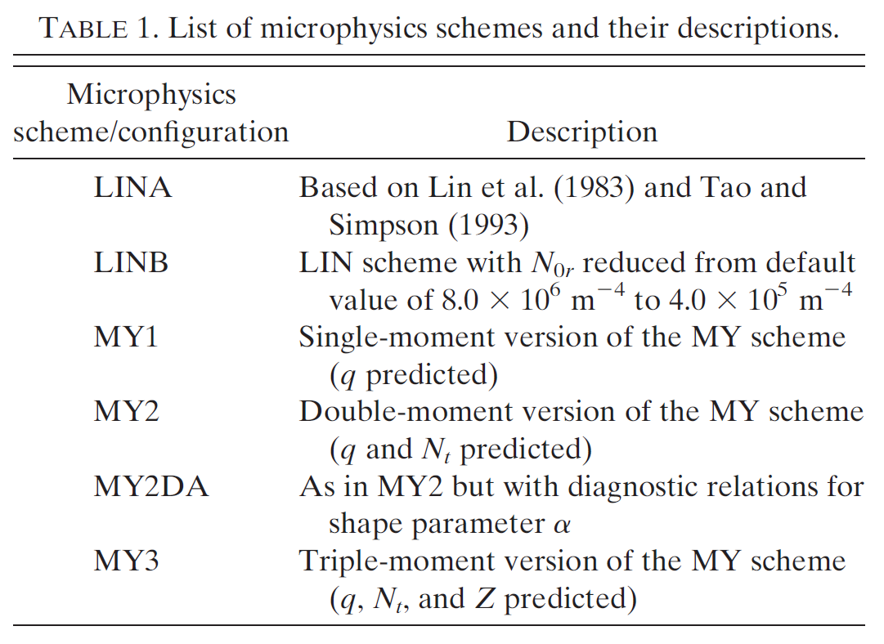
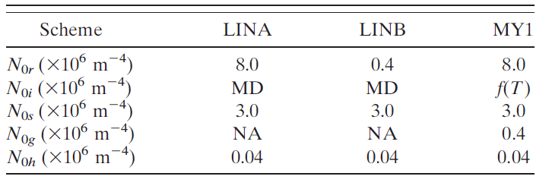
Experiment design
  Idealized experiments
Notes:
1km 500-m 250-m grid size , 53 vertical levels (20m→ 800m ) , model top = 20km
Below 1 km have 6 levels , below 2 km have 10 levels
Initial is a thermal bubble of maximum potential temperature
LINA = purdo Lin et al.(1983)
LINB = Gaddard (Tao and Simpson, 1993)
MY1 = Milbrandt and Yau (2005) – single moment scheme
MY2 = Milbrandt and Yau (2005) – single moment scheme with alpha is fixed
MY2DA = Milbrandt and Yau (2005) – double moment scheme with alpha is diagnostic
MY3 = Milbrandt and Yau (2005) – triple moment scheme

Slide 14
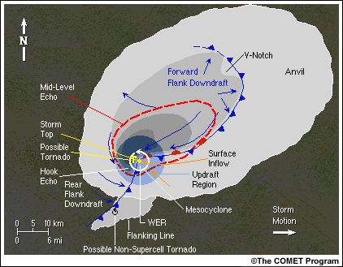
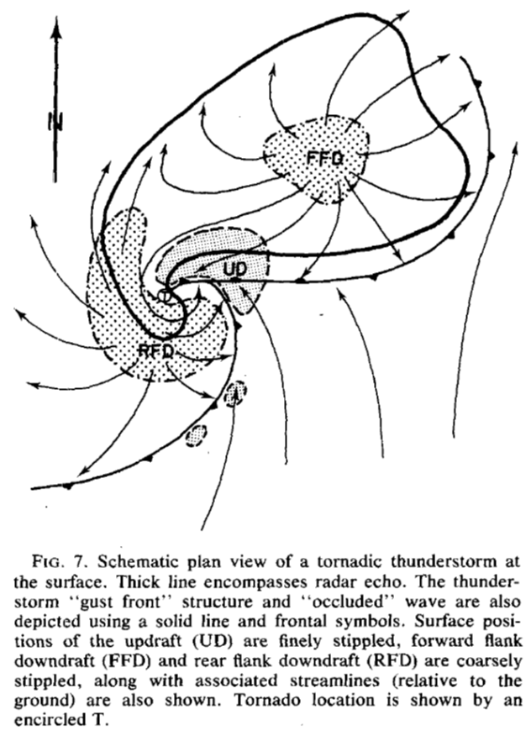
Supercell conceptual model
Lemon and Doswell (1979)

Slide 15
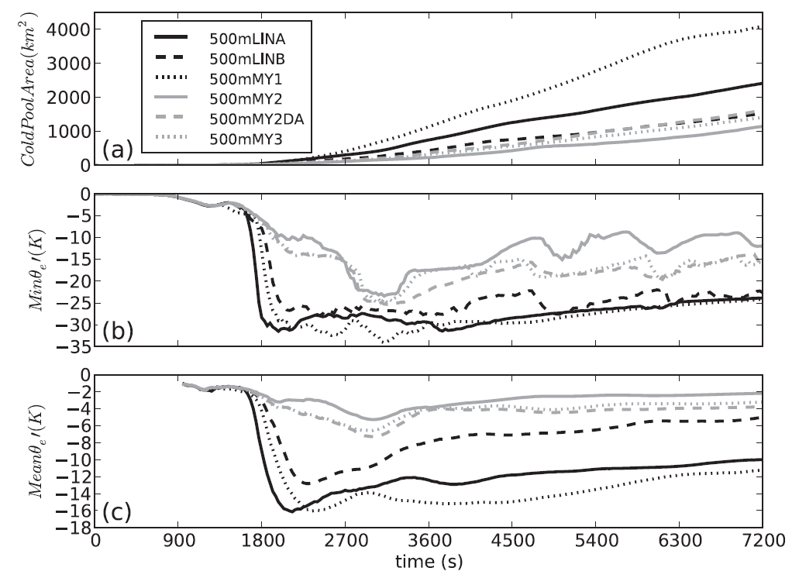


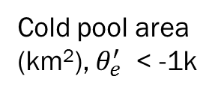
Result and discussion
  Cold pool and reflectivity structure
Cold pool area
(km²), $θ_{e}^{′}$ < -1k
Min $θ_{e}^{′}$(k)
Mean $θ_{e}^{′}$(k)
Notes:
$θ_{e}^{′}$ < -1 Kelvin
假設空氣塊沿等商面移動 利用軌跡線分析
#SM source height 2 to 3 km AGL
#MM source height 1 km AGL
# 500m-LINB is overall potentially colder than perturbations (approximately -2 to +2 K) to the MM runs.
# after 3600s overall weaken trend to the leveling off of the storm intensity after 1-hour of simulation

Slide 16
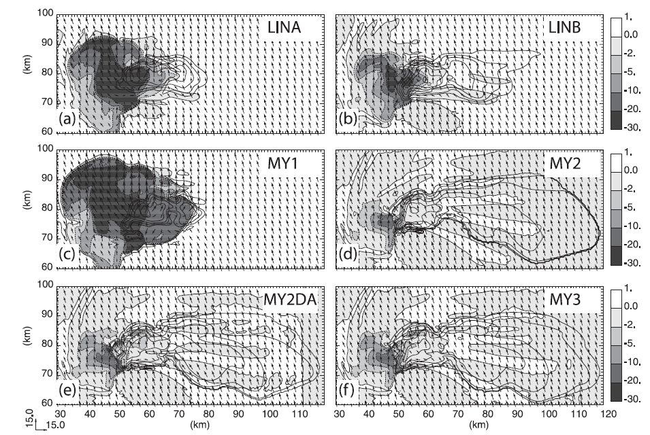

Result and discussion
  Cold pool and reflectivity structure(Simulation at 1 hour)
Contour : radar reflectivity
shading : $θ_{e}^{′}$
Notes:
# Nor

Slide 17
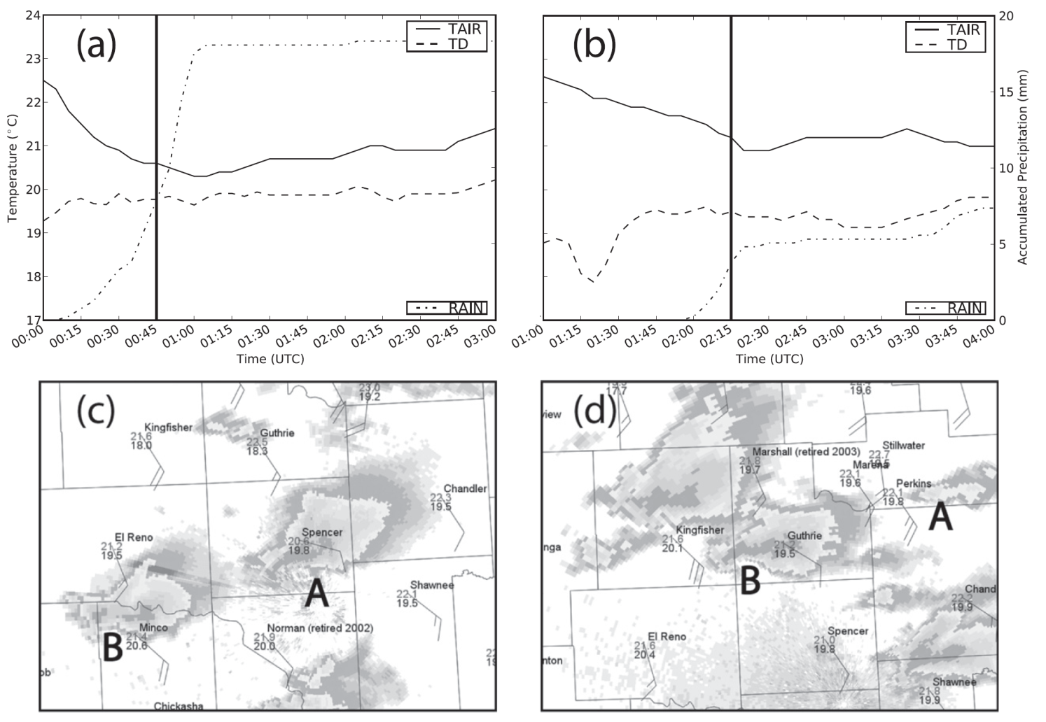


Result and discussion
  Cold pool and reflectivity structure(OBS. at 00Z-04Z 4 May 1999)
$$∆T≈2k$$
$$∆T≈5k$$
Notes:
# Nor

Slide 18
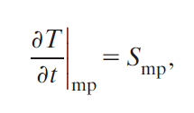
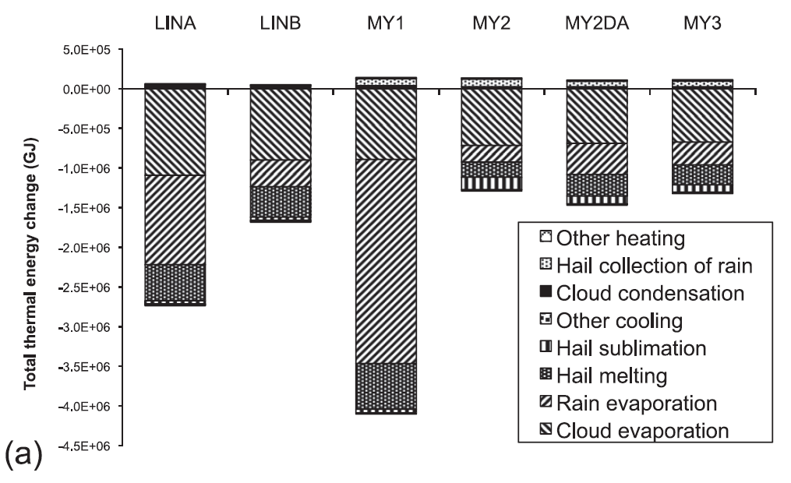
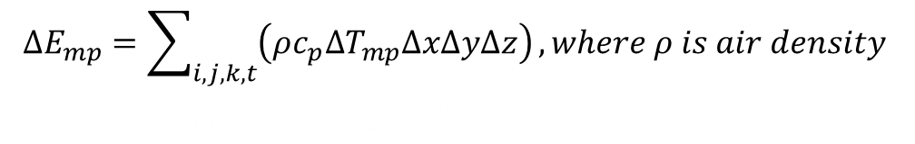
Result and discussion
  Budget analysis
3600s
$$∆E_{mp}=\sum_{i,j,k,t}{\left(ρc_{p}∆T_{mp}∆x∆y∆z\right)}, where ρ is air density$$
$$∆T_{mp}=\left(L_{v}/c_{p}\right)∆q, where L_{v} is laten heat$$

Slide 19
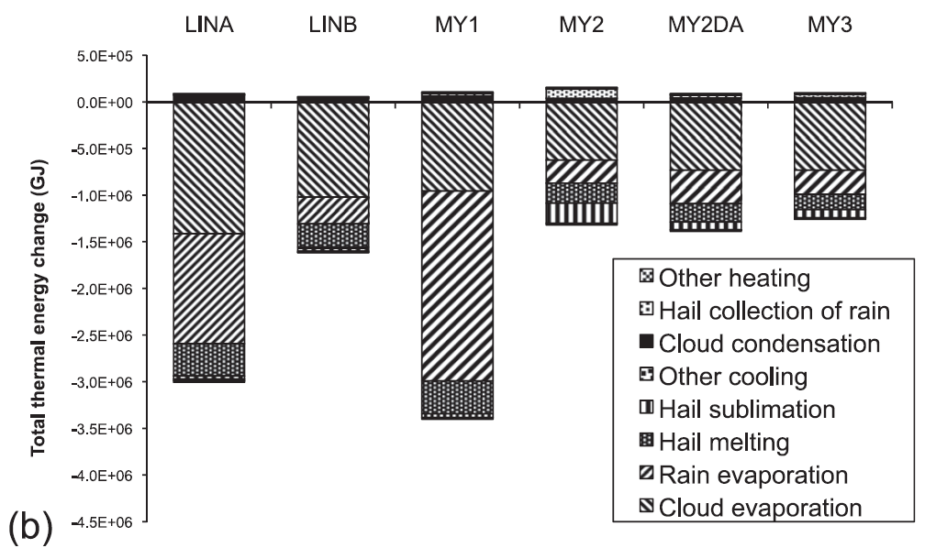
Result and discussion
  Budget analysis
5400s
$$∆E_{mp}=\sum_{i,j,k,t}{\left(ρc_{p}∆T_{mp}∆x∆y∆z\right)}, where ρ is air density$$
$$∆T_{mp}=\left(L_{v}/c_{p}\right)∆q, where L_{v} is laten heat$$
Notes:
Restricted regions below 4 km AGL and has W<-0.5 m/s

Slide 20
Budget analysis
In general, evaporation of cloud, evaporation of rain, and melting of hail are the three most important processes contributing to cooling in the low level(blow 4 km) downdraft(W < -0.5 m/s).
Consistent with a pervios numerical modeling study Straka and Andersoon (1993)

Slide 21
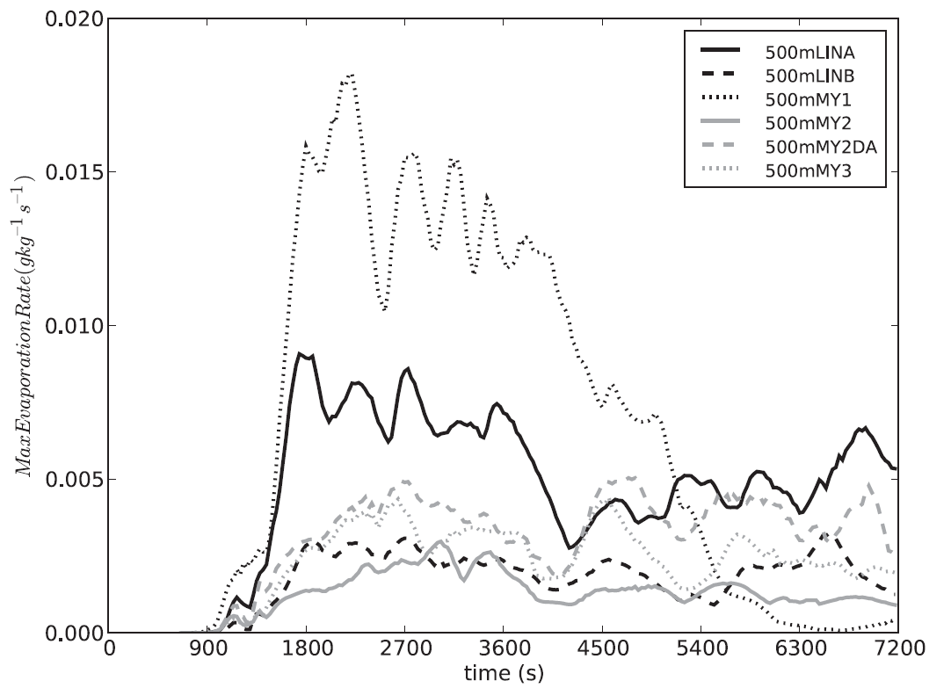
Result and discussion
  Spatiotemporal structure of rain evaporation and effects of DSD variation
Low-level (< 4km AGL) evaporation rate for each runs
Notes:
Consist with water budget result the MY1 have large evaporation of rain
Transition:
Different from MY2 to MY3 to MY2DA why it have this difference in evaporation between the simulation
We turn to an examination of the rain DSD parameters

Slide 22
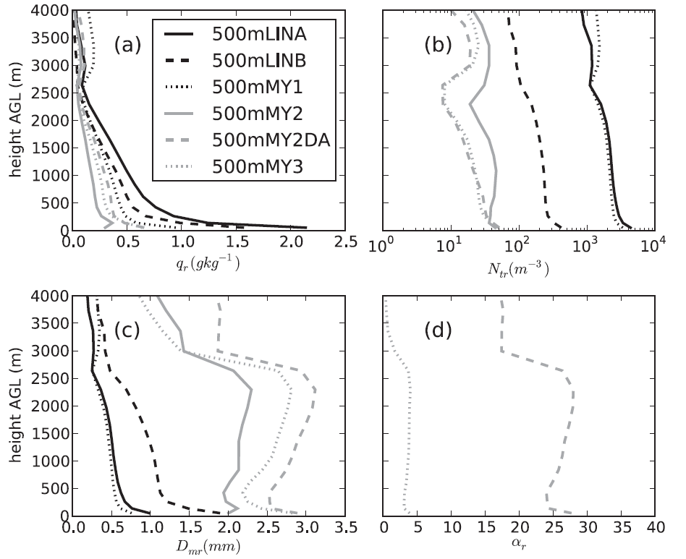




Result and discussion
  Spatiotemporal structure of rain evaporation and effects of DSD variation
$q_{r}$(gkg⁻¹)
$N_{tr}$(m⁻³)
$$D_{mr}$$
$$α_{r}$$
Notes:
In the low-level downdrafts in the MM case
1) Small mass content of rain drop
2) Larger diameter of rain drops which limit the evaporation potential (due to the smaller surface area to volume ratio)

Slide 23
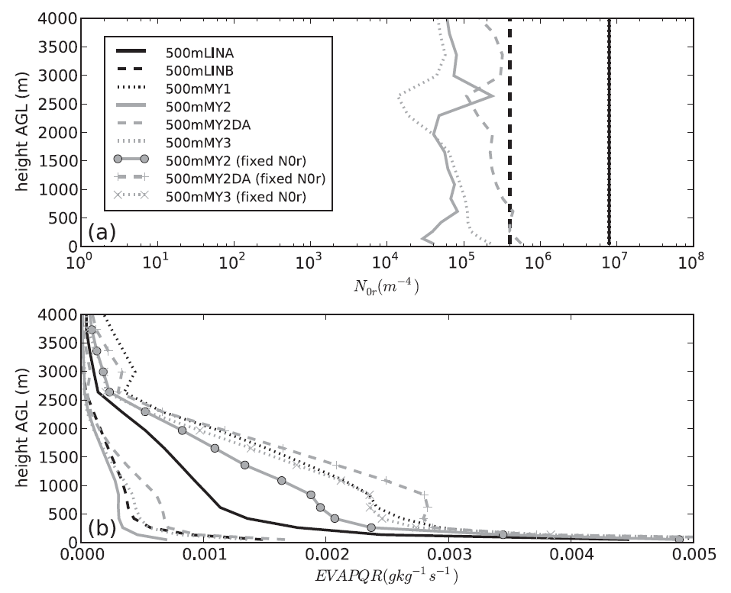
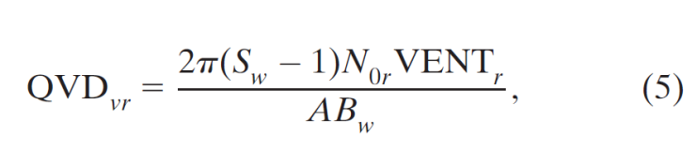
Result and discussion
  Spatiotemporal structure of rain evaporation and effects of DSD variation
Notes:
Ventilation coefficient 通風係數
S_{w}=飽和比
Ab_{w}=thermodynamic function
雖然較大的粒徑會增加通風係數加強雨滴的蒸發
但是掉落的速度太快所以並不會有太大的影響

Slide 24
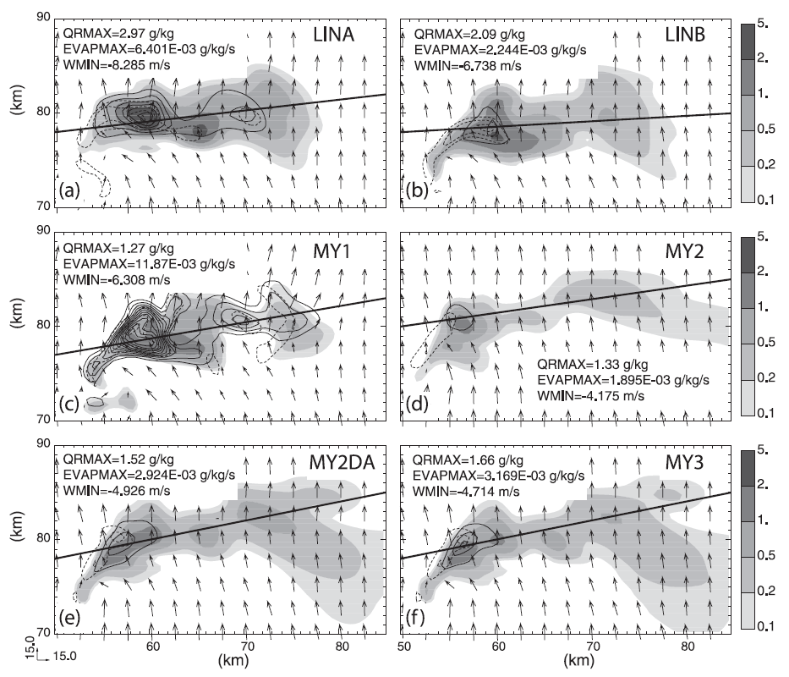
Result and discussion
  Spatiotemporal structure of rain evaporation and effects of DSD variation
Shading : q_{r}
Solid line: evaporation rate
Dash line: downdraft
cc
Notes:
SM strong cold poor compared with DM TM

Slide 25
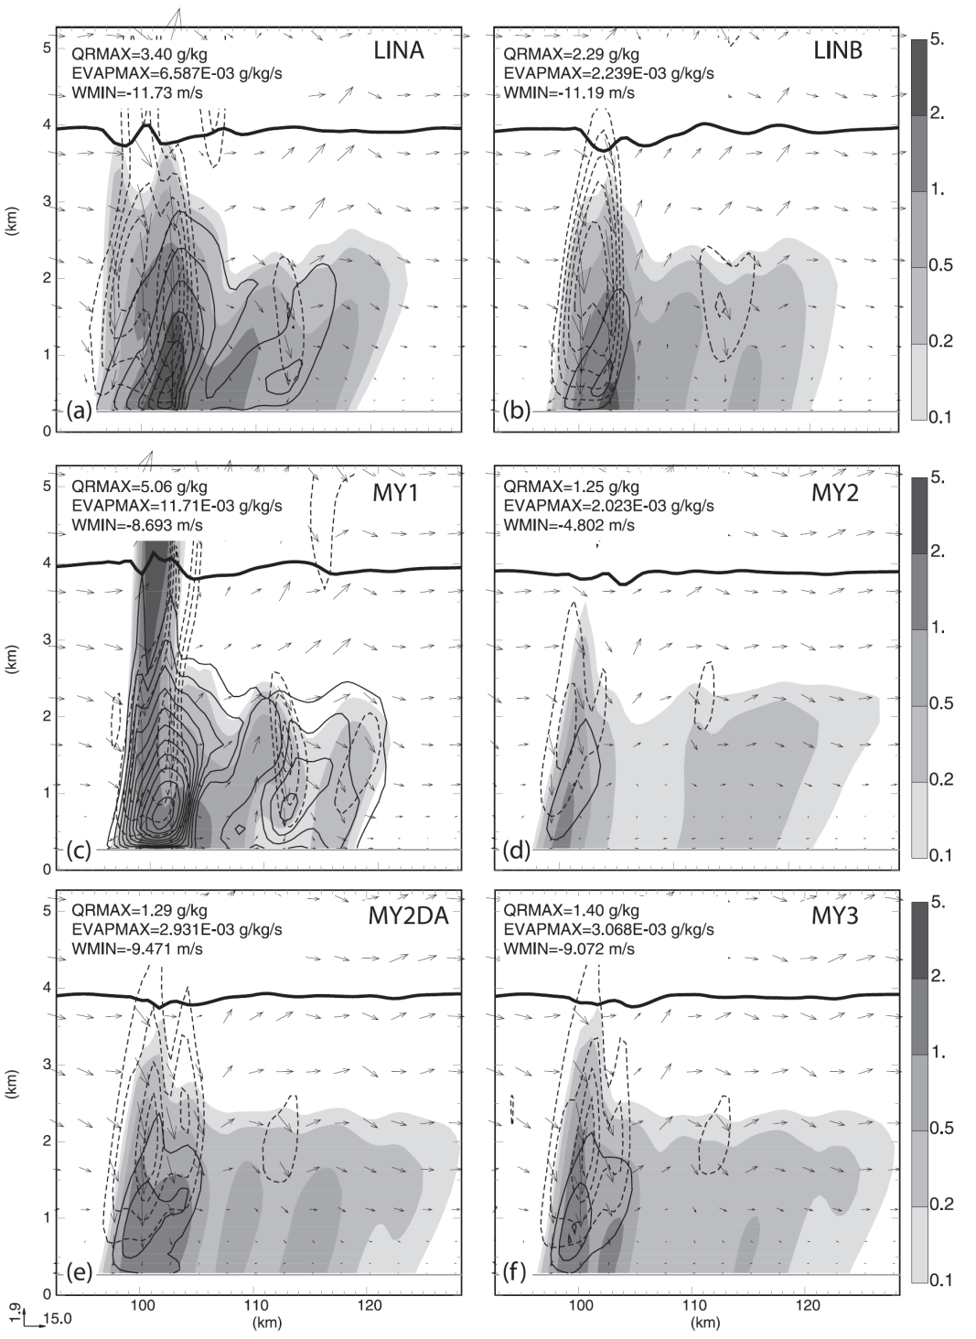
Shading : q_{r}
Solid line: evaporation rate
Dash line: downdraft
c
FFD do not reach to the surface
c
c

Slide 26
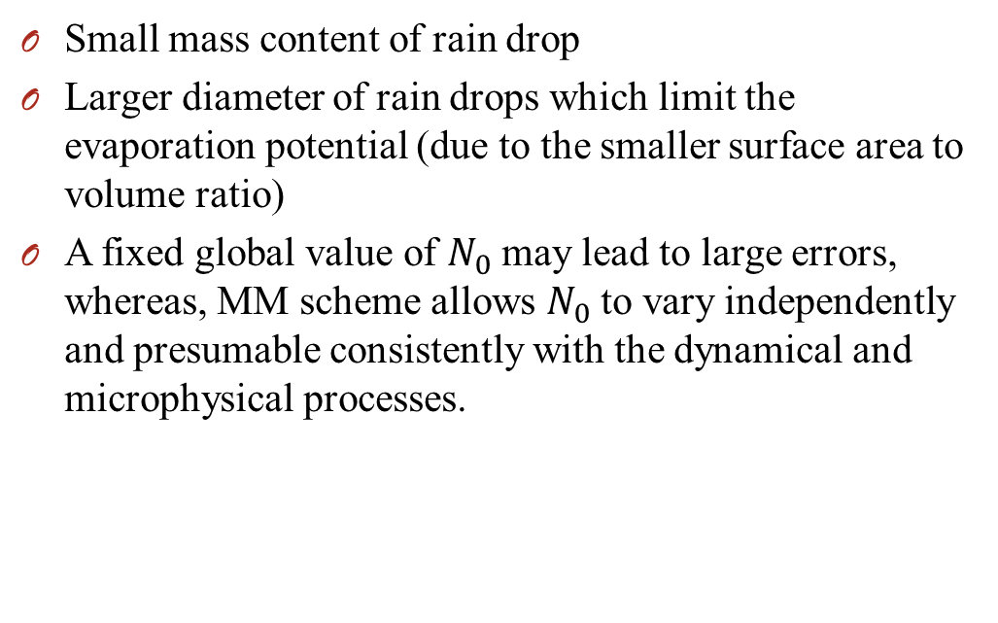
Rain Evaporation and effect of DSD
Small mass content of rain drop
Larger diameter of rain drops which limit the evaporation potential (due to the smaller surface area to volume ratio)
A fixed global value of $N_{0}$ may lead to large errors, whereas, MM scheme allows $N_{0}$ to vary independently and presumable consistently with the dynamical and microphysical processes.

Slide 27
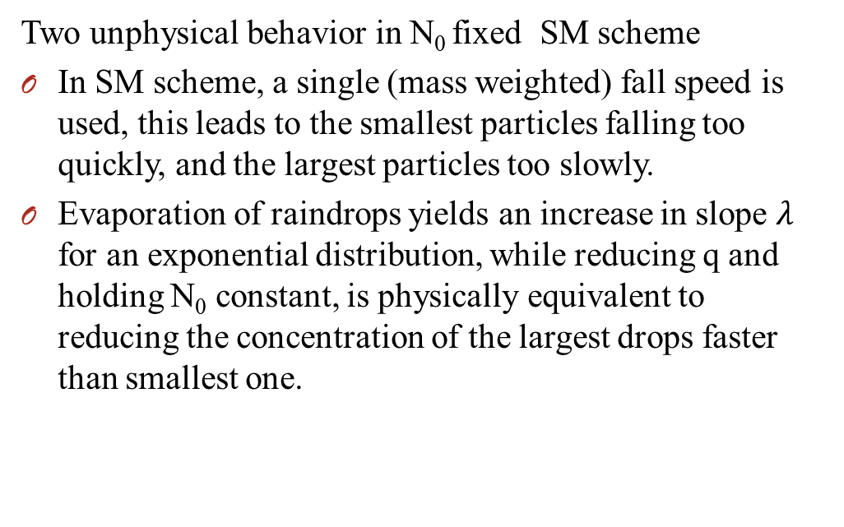
Result and discussion
  Cold bias in SM evaporation as revealed through comparison with MM
Two unphysical behavior in N₀ fixed SM scheme
In SM scheme, a single (mass weighted) fall speed is used, this leads to the smallest particles falling too quickly, and the largest particles too slowly.
Evaporation of raindrops yields an increase in slope $λ$ for an exponential distribution, while reducing q and holding N₀ constant, is physically equivalent to reducing the concentration of the largest drops faster than smallest one.

Slide 28
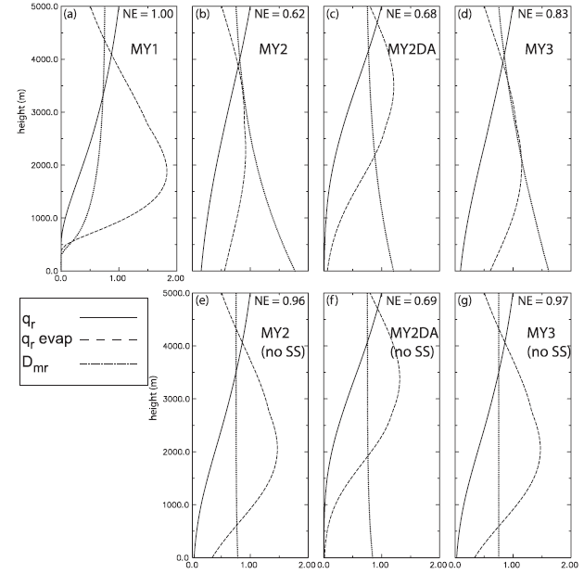
Result and discussion
  1D column model tests
Only the process of rain evaporation and
sedimentation

Slide 29
Conclusions
The goal of this study was to test the impact of a new multimoment (MM) microphysics scheme on the evolution of the storm, and particular on the rain DSD and its impact on the downdraft and cold pool properties.
MM scheme performed better than the SM counterparts employing typical value of intercept parameters, (N_{0r}=8.0 X 10⁶ m⁻⁴)
Evaporation process and size sorting mechanism significantly affect the DSD in the low level downdrafts and cold bias.

Slide 30
Conclusions
Though a budget analysis that the MM schemes yield less water mass in the low-level (z<4km) downdraft (w<-0.5m/s) and large drop sizes, both of lead to lower amounts of evaporation and diabatic cooling
Evaporation of cloud, evaporation of rain, and melting of hail are the three most important processes contributing to cooling in the low level(blow 4 km) downdraft(W < -0.5 m/s).
The change in the DSD during evaporation is handled in a more physically realistic manner in the MM scheme by allowing N₀ to decrease during the evaporation process, while SM schemes hold it fixed.

Slide 31
Thanks for your attention !!

Slide 32
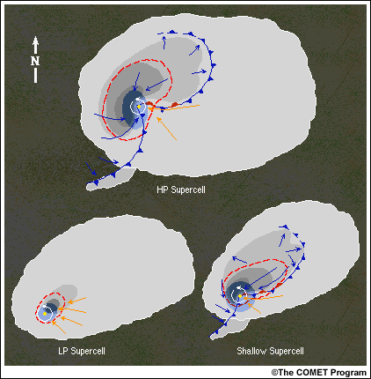
Classic supercell
HP: high precipitation
LP: Low precipitation

Slide 33
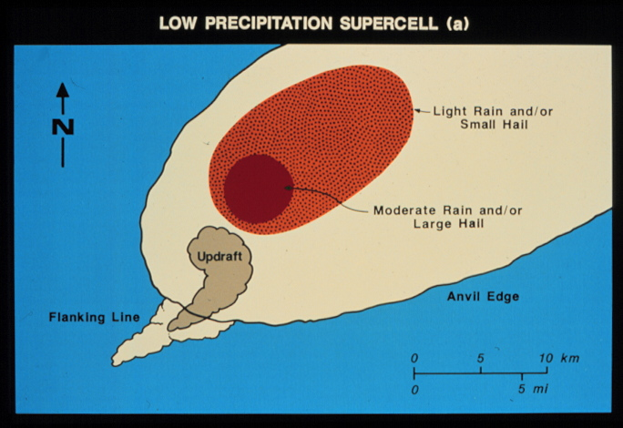
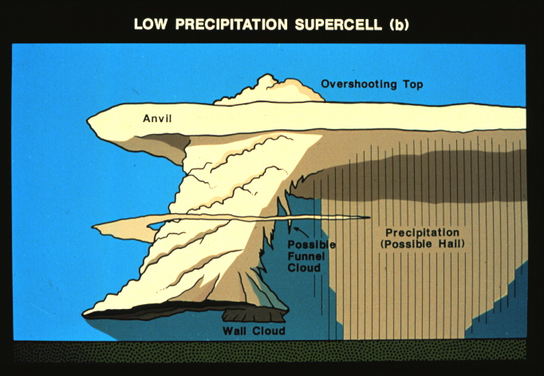
Low precipitation supercell

Slide 34
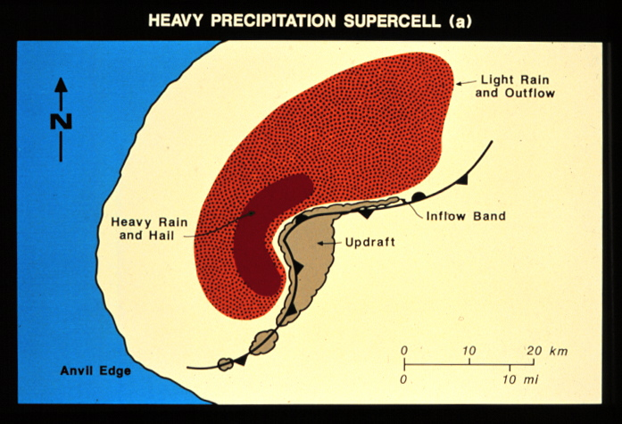
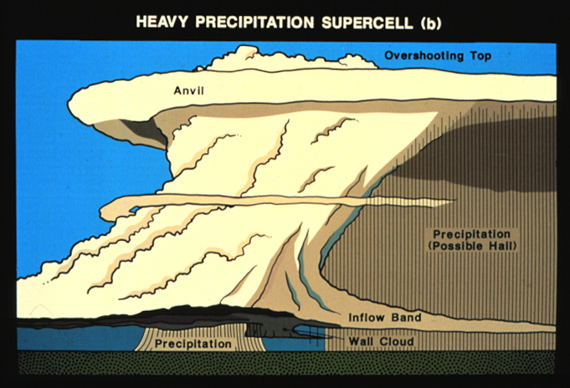
high precipitation supercell

Slide 35
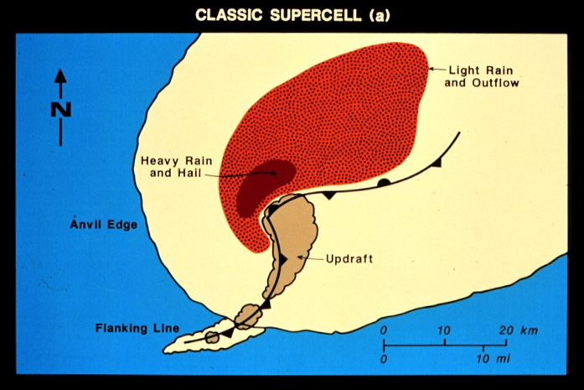
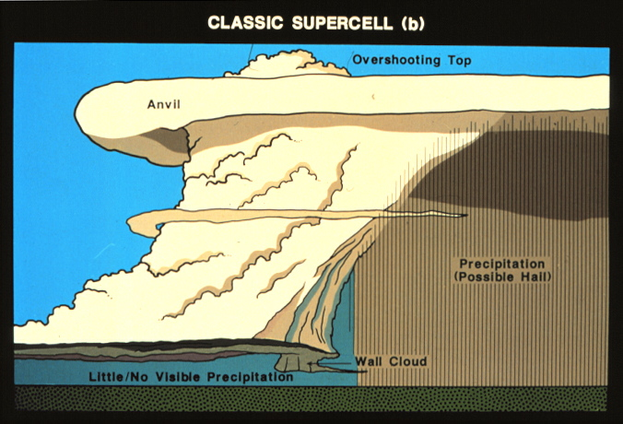
Shallw precipitation supercell

Slide 36
Lemon and Doswell (1979)

Slide 37
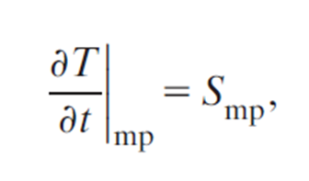
The time rate of temperature change due to phase changes of water
 | Water Vapor | Cloud Water | Cloud Ice | Snow, Graupel, and Hail | Rain
Evaporation |  |  |  |  | 
Condensation | All but LIN &MY |  |  |  | 
Melting and freezing |  |  |  |  | 
Collection of cloud and rain (freezing) |  |  |  |  | 
→back

