Slide 1
Sensitivity of Tropical Cyclone Inner-Core Size and Intensity to the Radial Distribution of Surface Entropy Flux
Wang, Y., and Xu, 2010: Sensitivity of Tropical Cyclone Inner-Core Size and Intensity to the
Radial Distribution of Surface Entropy Flux. J. Atmos. Sci., ACCEPTED.

Slide 2
Outline
Introduction
Model and experimental design
Sensitivity to surface entropy flux in the eye
Sensitivity to surface entropy flux outside the eyewall
Storm intensity
Storm inner-core size
Dynamical mechanisms
Discussion
Conclusions

Slide 3
Introduction
BR09 showed that this removal of high entropy anomaly in the eye only resulted in a reduction of about 4% in the maximum tangential wind speed.
The only possibility for the additional energy source for the TC should therefore be the energy input from outside of the eyewall. (Wang and Xu 2010, WX10)
The frictional dissipation rate is generally larger than the energy production rate under the eyewall.

Slide 4
Introduction (continue)
Lagrangian and a control volume equivalent potential temperature budget analyses that frictional dissipation under the eyewall is partly balanced by the inward transport of energy from outside of the eyewall.
A sensitivity experiment that the storm maximum intensity can be reduced by 13.5% if the surface entropy fluxes outside 30-45 km away from the storm center were removed.
The storm inner-core size in their sensitivity experiment is greatly reduced compared to the control experiment that includes the surface entropy fluxes outside the eyewall.

Slide 5
Motivation
How far the surface entropy fluxes from the storm center are effective to affect the storm inner-core size and maximum intensity?
What physical mechanisms are involved?

Slide 6
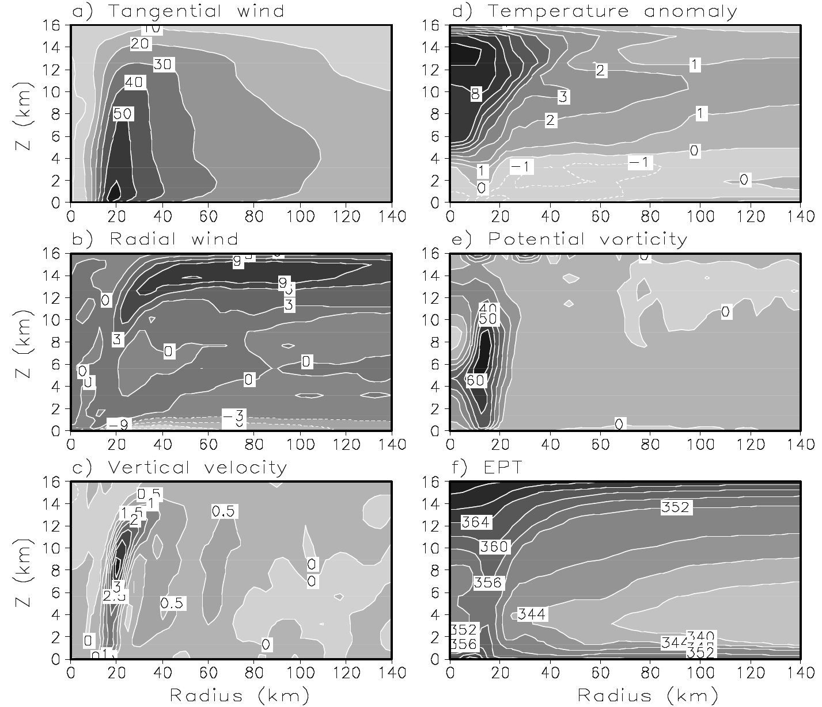
Model and experimental design

Slide 7
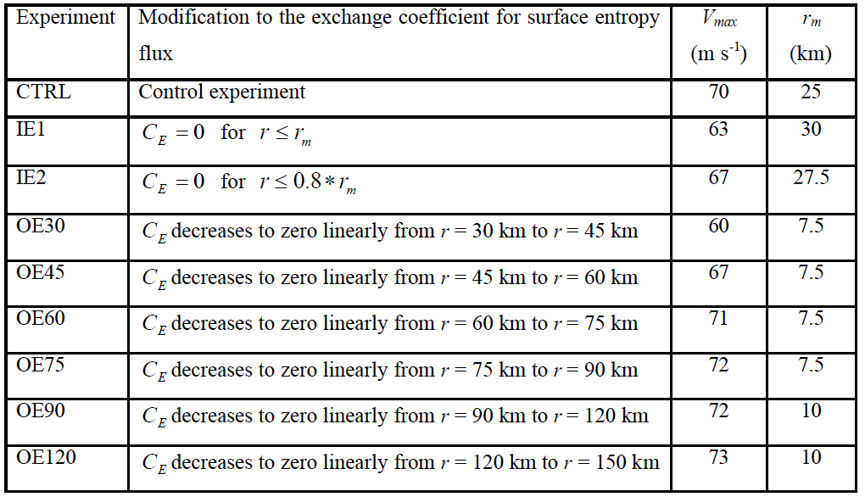
Summary of the numerical experiments performed in this study
Experiments OE30-OE120 (Table 1, hereafter also OEs in brief) were designed to understand how significant the surface entropy fluxes outside the eyewall would be to the simulated TC inner-core size and intensity.
Experiments IE1 and IE2 were designed to examine the possible contribution of the near-surface high-entropy air in the eye to the model TC intensity as done in BR09 but in a three-dimensional model and also the effect on the model TC eyewall size.

Slide 8
Sensitivity to surface entropy flux in the eye
70m/s
About 10% (4.3%) weaker in the maximum azimuthal mean wind speed.
67m/s
63m/s
Surface entropy fluxes in the eye contribute positively to the storm intensity.
928hPa
915hPa
906hPa

Slide 9
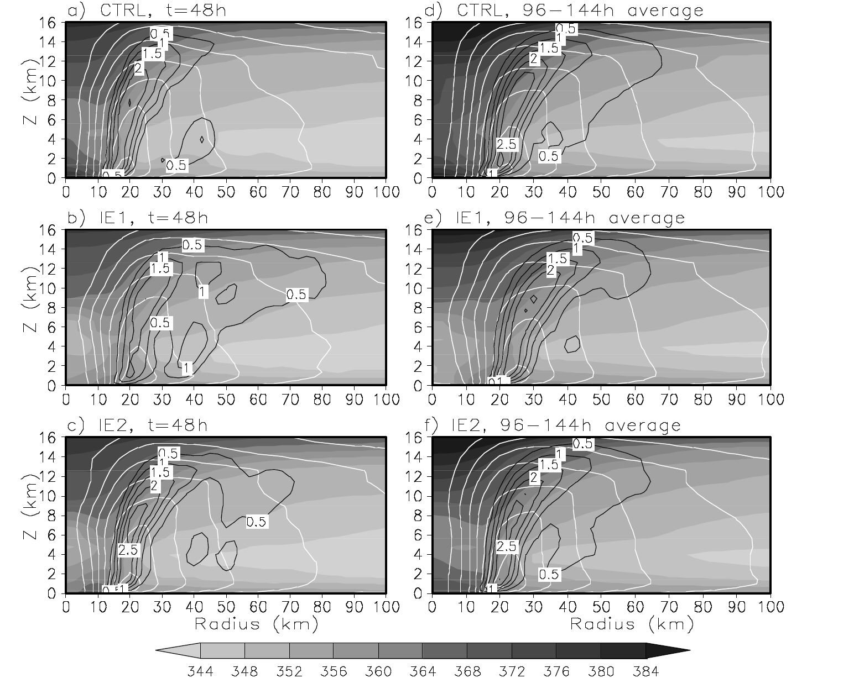
Developing
stages
Mature
stages
15K
highest
highest
highest

Slide 10
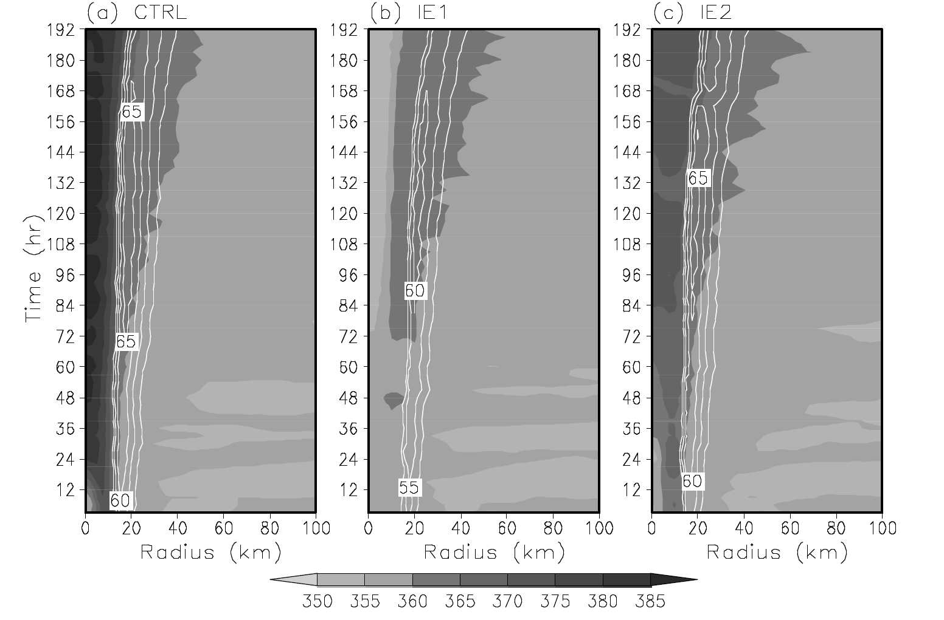
Again high and uniform in the eye region, but lower than CTRL 10K
4.3%
Could not be a major energy source for the storm
The highest slightly inside the RMW

Slide 11
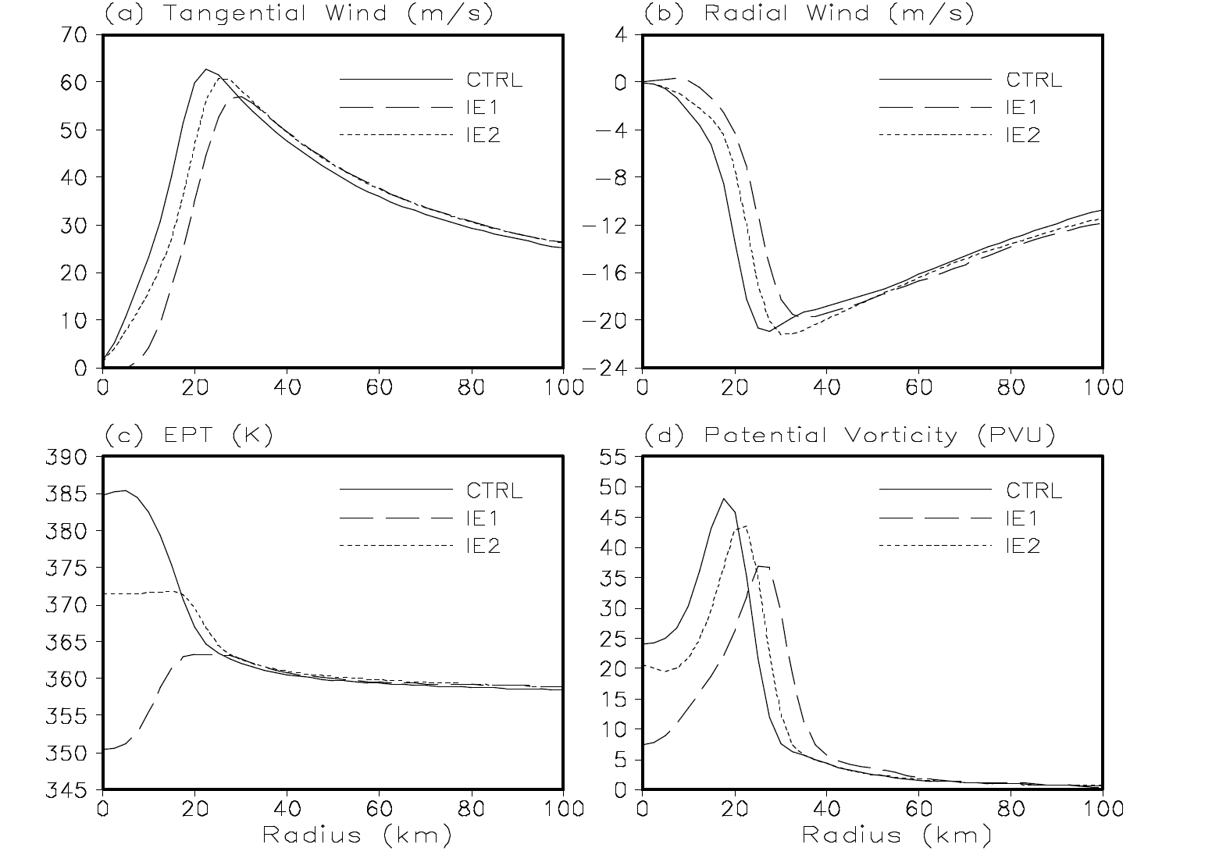
168-192hr
20%
10%
Eye lower than
eyewall 12 K

Slide 12
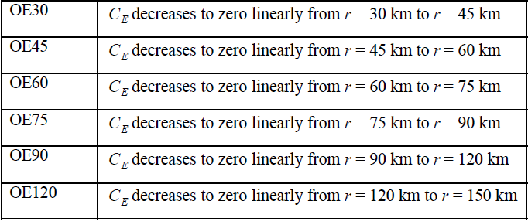
Sensitivity to surface entropy flux outside the eyewall
a. Storm intensity
Purpose : how far the surface entropy fluxes from the storm center could effectively affect the storm inner-core size and maximum intensity.

Slide 13
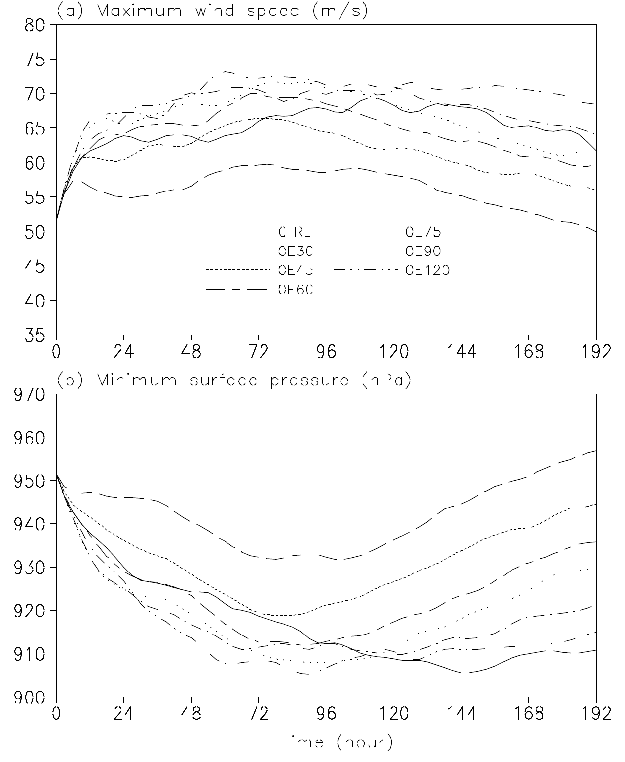
Surface entropy fluxes outside a radius of about 60 km may suppress the TC intensification in the early development stage of the TC in the simulation
OE 120
Quasi-steady
OE30
OE45
CTRL form an annular structure
OE30
Surface entropy fluxes outside a radius of about 90 km could reduce the maximum TC intensity.

Slide 14
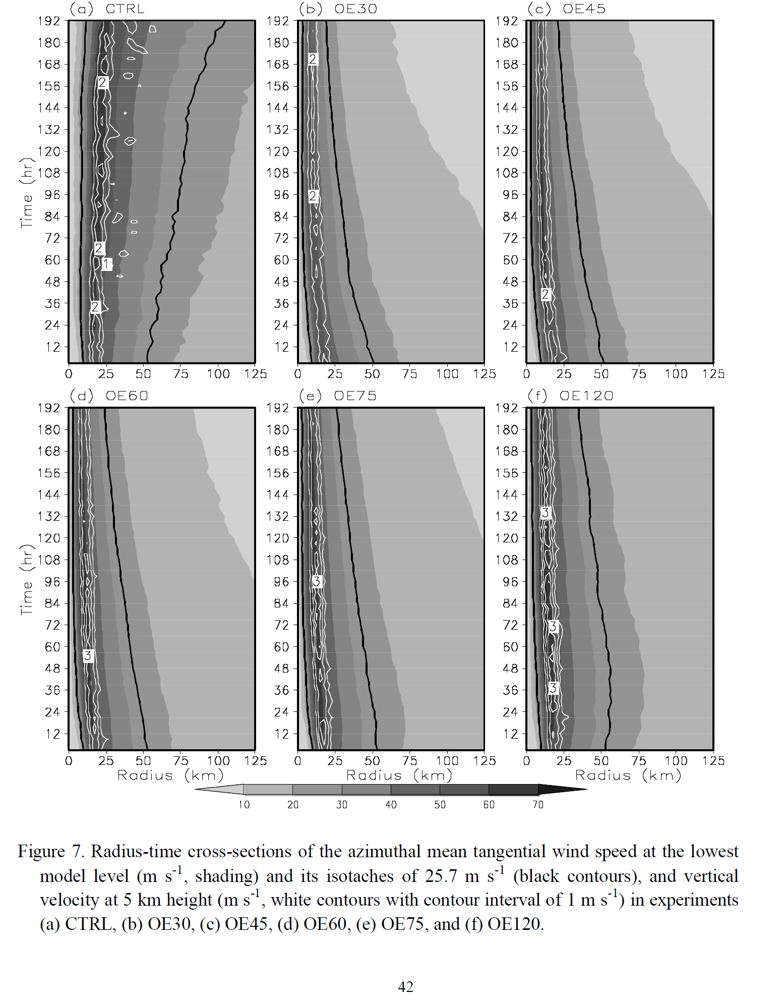
b. Storm inner-core size
similar increase in the inner-core size
25.7m/s
radius of
damaging
wind (RDW)
The smaller the radius outside which the surface entropy fluxes were removed,
the smaller the inner-core size of the storm.

Slide 15
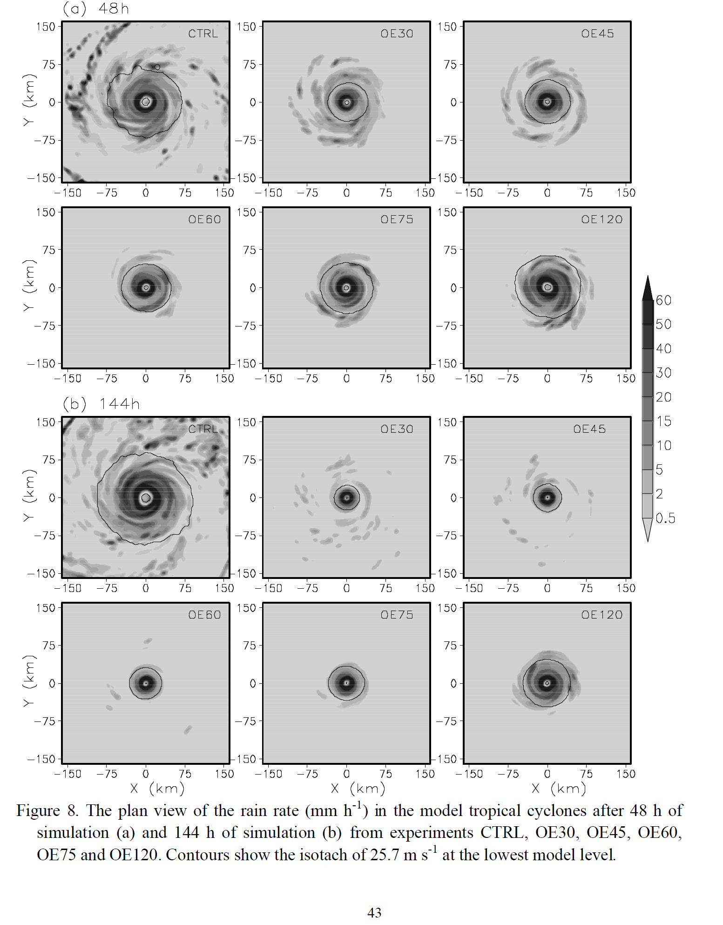
Intensifying, but the eyewall size decreased considerably as
inferred from the heavy precipitation.
RMW 7.5km
Absence of active outer spiral rainbands

Slide 16
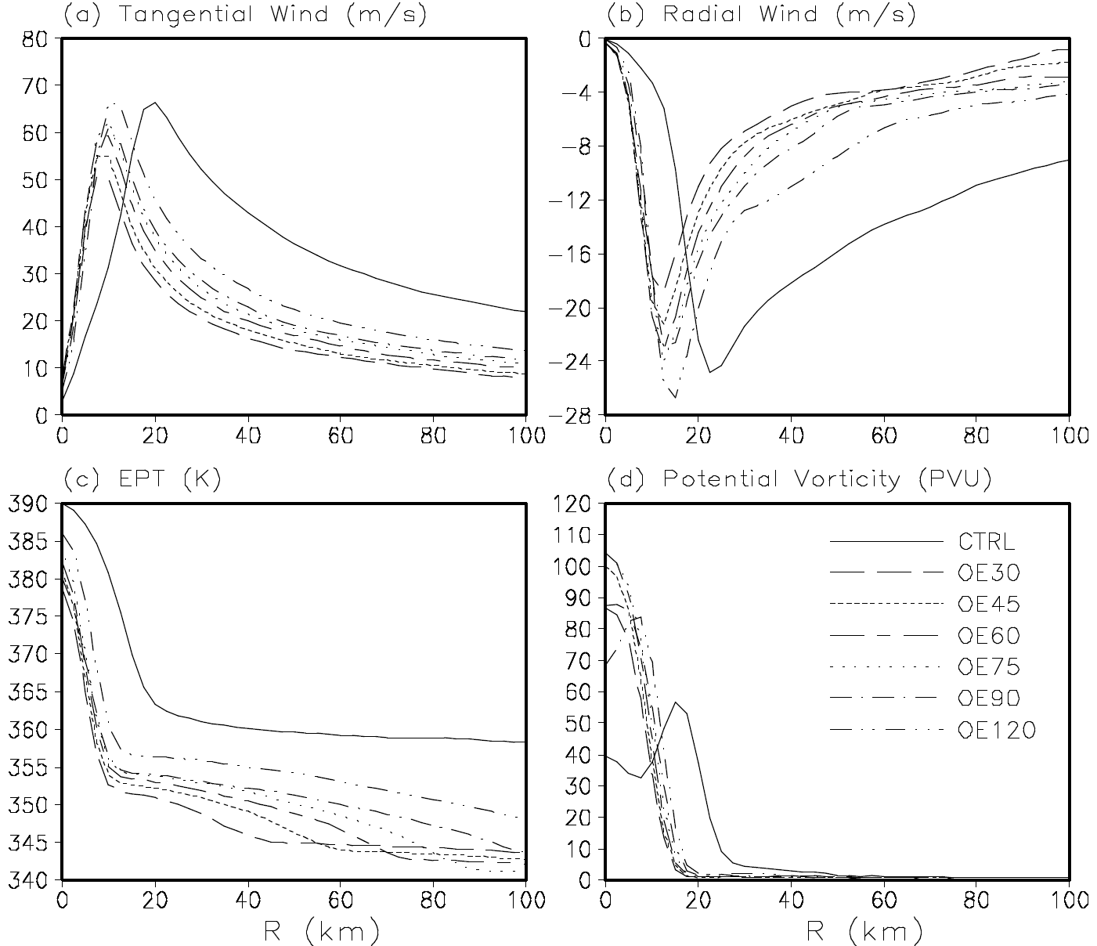
Monotonic(hollow) PV distribution implies a barotropically stable (unstable) eyewall structure(Schubert et al 1999).
decreases rapidly
Development of asymmetries in the eyewall

Slide 17
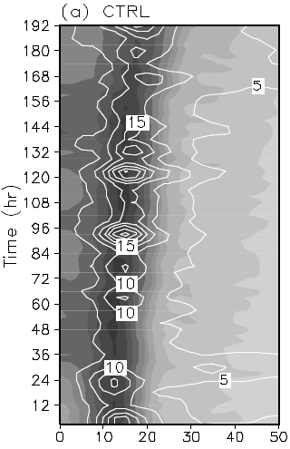
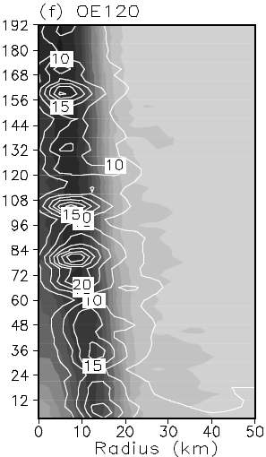
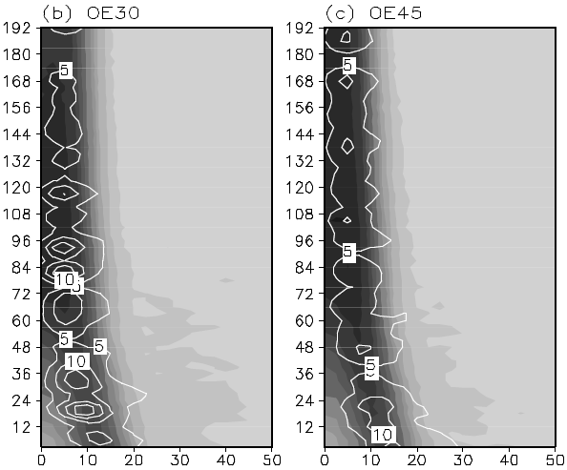
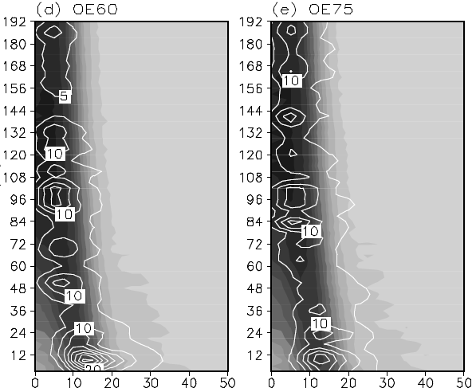
Azimuthal mean PV
and
eddy kinetic energy
(EKE)
Asymmetries could develop more quickly in storms having a hollow PV structure with larger eyewalls (Schubert et al. 1999).

Slide 18
c. Dynamical mechanisms
Wang (2009) demonstrated that diabatic heating in active spiral rainbands plays a critical role in TC structure and intensity changes.
Surface entropy fluxes can affect the activity of spiral rainbands and thus diabatic heating outside the eyewall.
How spiral rainbands respond to the modification of surface entropy fluxes in different experiments.

Slide 19
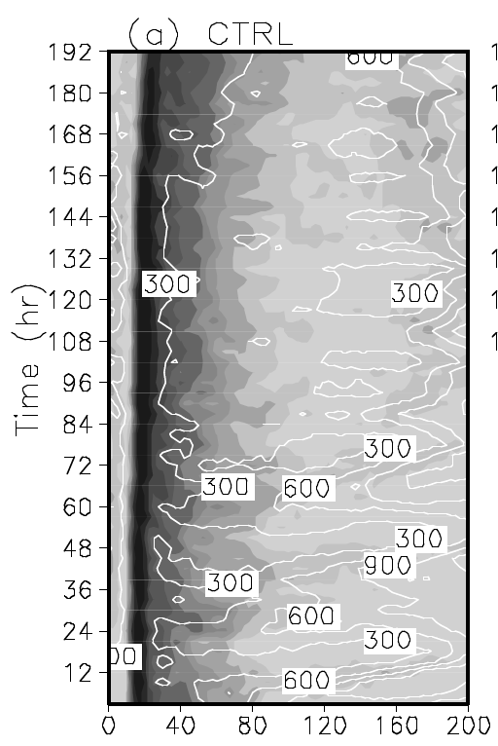
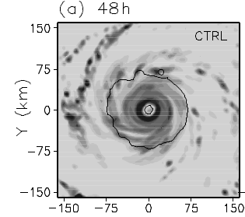
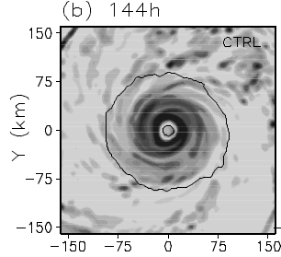
The large surface entropy fluxes outside the eyewall were responsible for the high CAPE and thus the active spiral rainbands

Slide 20
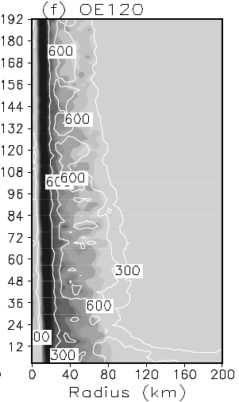
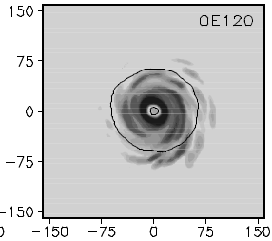
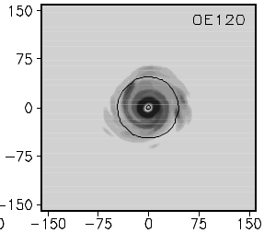
Rainfall still occurred between the eyewall and the radius of 80 km due to active inner spiral rainbands that are closely related to the convectively coupled vortex Rossby waves.

Slide 21
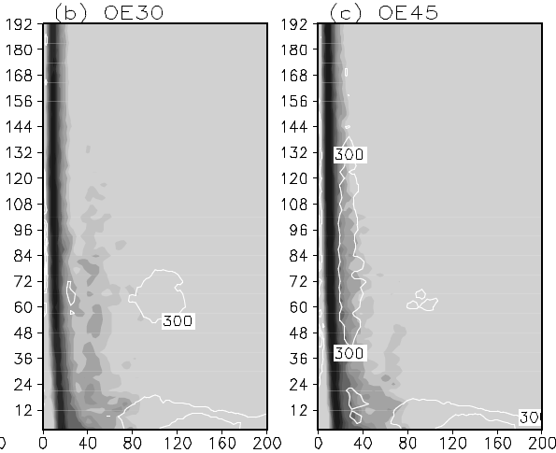
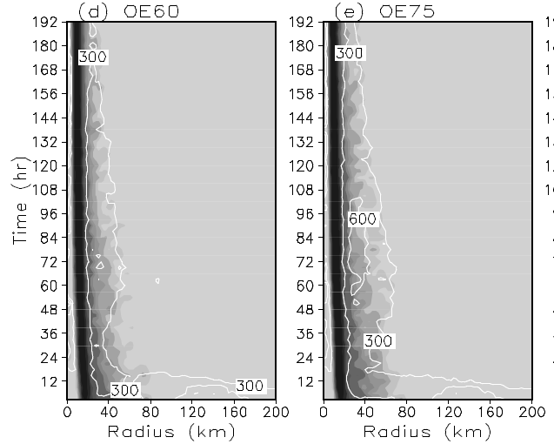
Remove surface entropy fluxes => Reduced CAPE & Suppressed activity of spiral rainbands
Diabatic heating outside the eyewall is the key to understanding the various inner-core sizes.

Slide 22
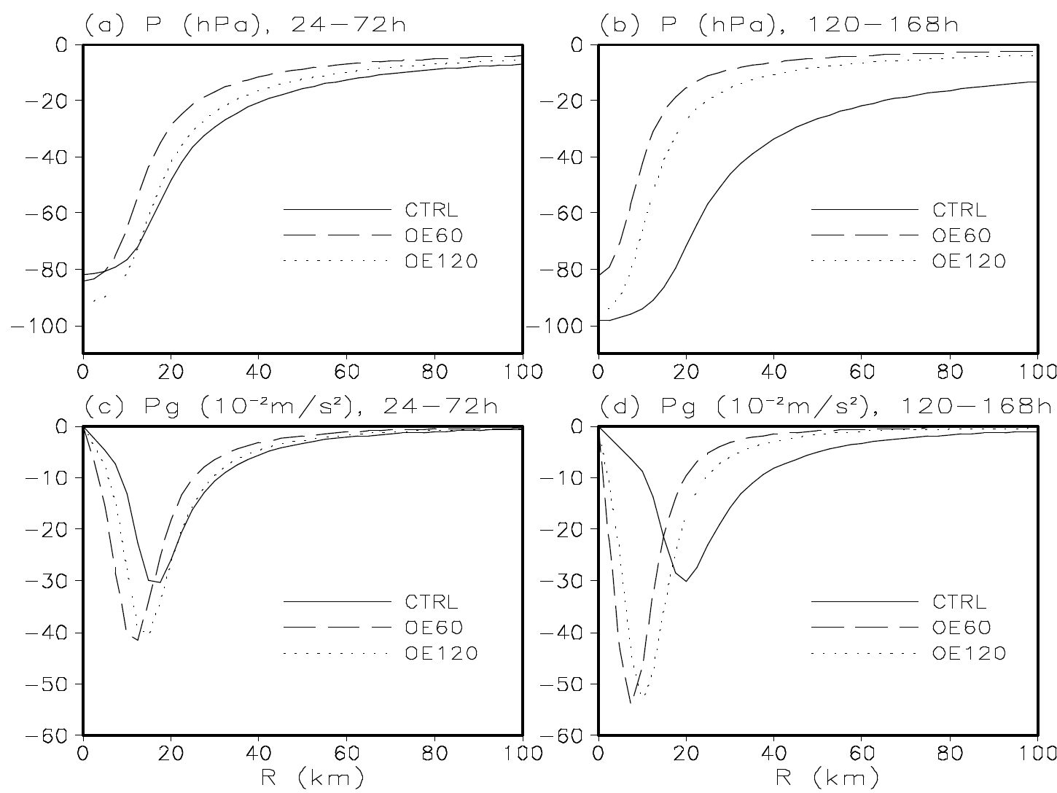
As shown by Wang (2009), diabatic heating in active spiral rainbands could lower the surface pressure outside the RMW and reduce the pressure gradient across the RMW and thus, weaken the storm but increase the inner-core size of a TC.
To understand how the storm inner-core size responds to changes in the radial pressure gradient associated with diabatic heating in spiral rainbands, we performed a momentum budget analysis.

Slide 23
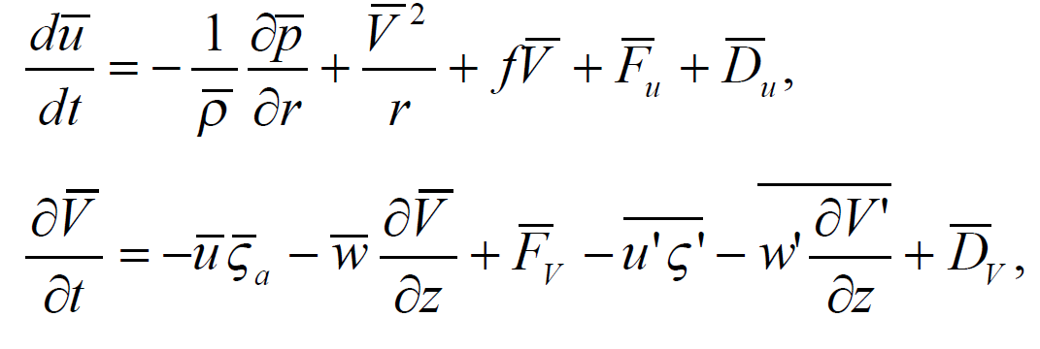
PGF
CeF
CoF
radial advection
eddy radial and vertical advections
Vertical advection
r : radius,
z : height,
: azimuthal mean radial and tangential winds and vertical motion,
: vertical absolute vorticity of the azimuthal mean flow,
: air density and pressure,
f : is the Coriolis parameter,
: radial, vertical, tangential winds, and vertical relative vorticity.
: vertical diffusion, including surface friction, of radial and tangential winds, and the horizontal diffusion of radial and tangential winds.

Slide 24
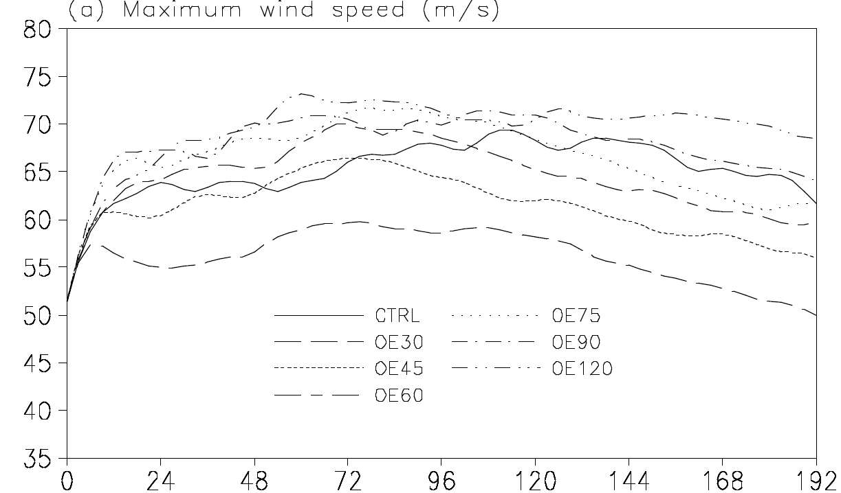
Developing
stage
Mature stage

Slide 25
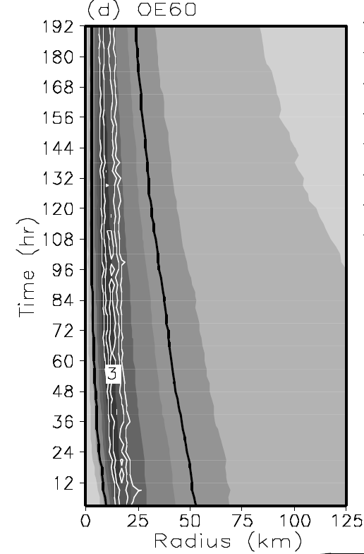
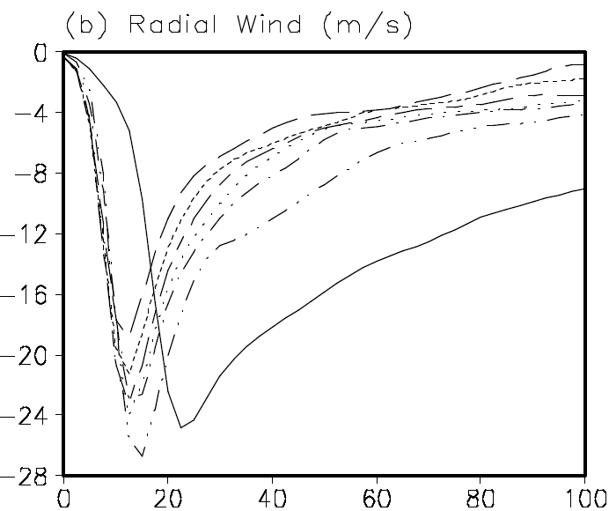
Increased radial PGF
Eyewall contraction
accelerating
boundary layer inflow

Slide 26
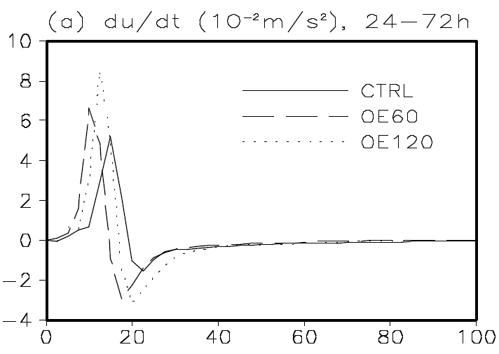
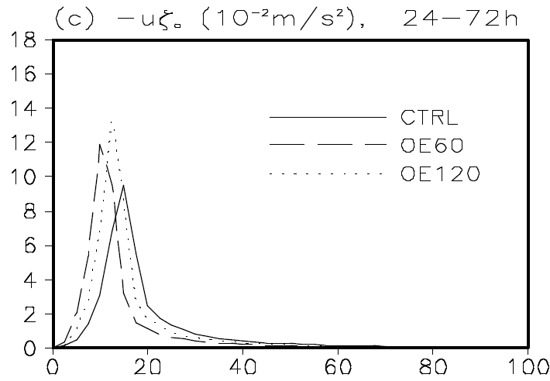
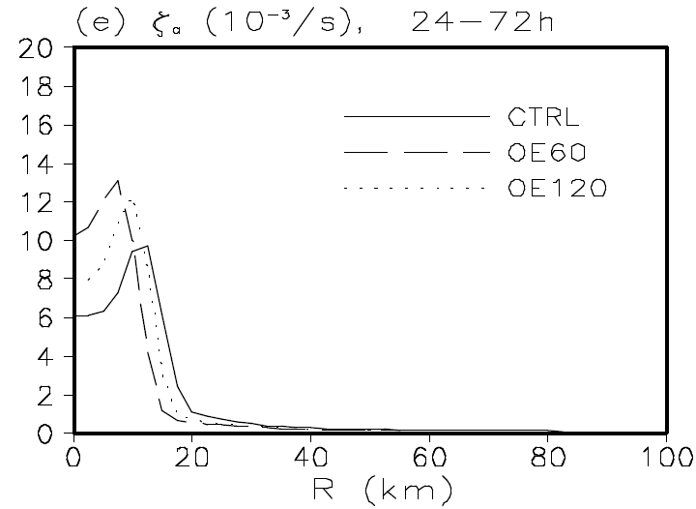
elevated absolute vorticity inside the RMW
A large centrifugal force, a deceleration of the boundary layer inflow, and induction of a supergradient wind, preventing further contraction of the RMW.
A positive feedback controlling the contraction of the RMW.

Slide 27
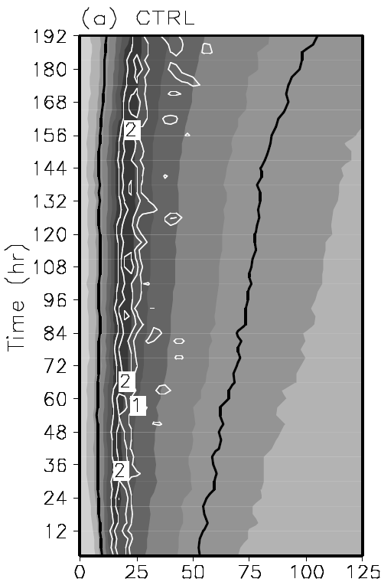
Large inflow
Relatively
large vorticity

Slide 28
Developing
stage
Mature stage

Slide 29
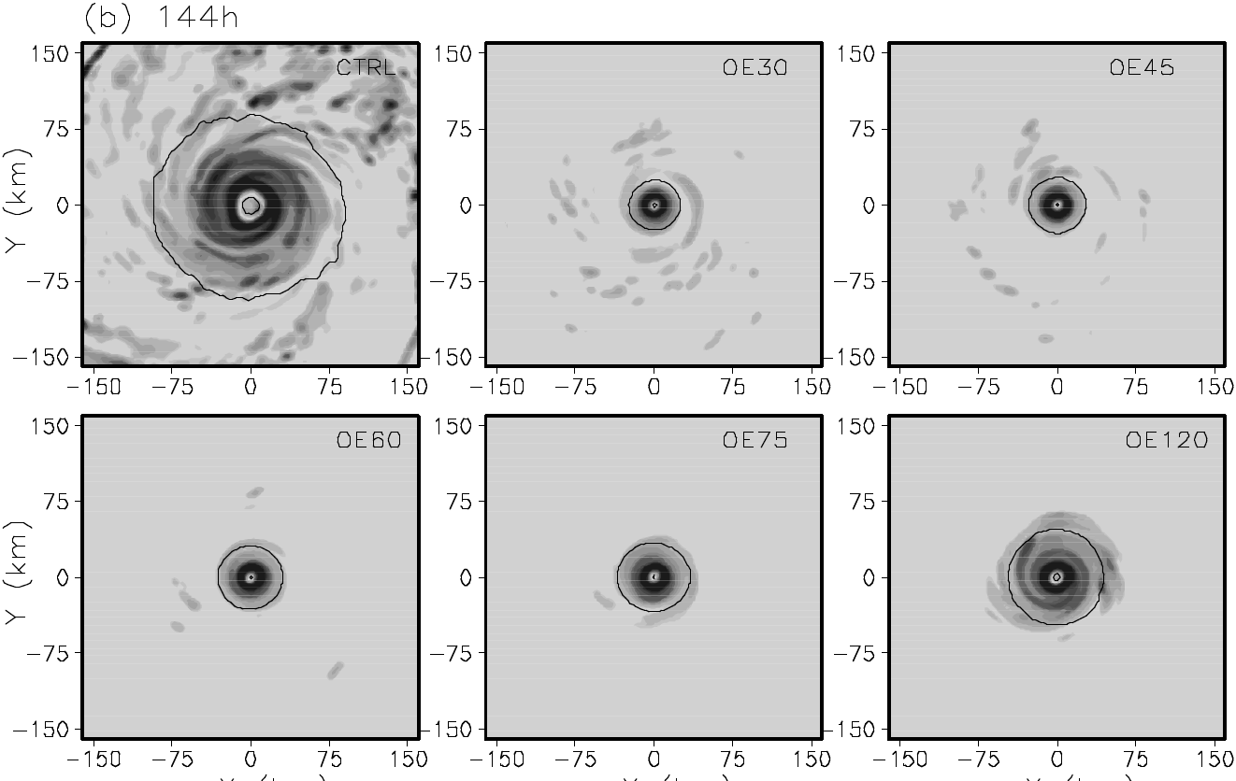
active spiral rainbands
suppressed
suppressed
active inner
spiral rainbands
suppressed
suppressed

Slide 30
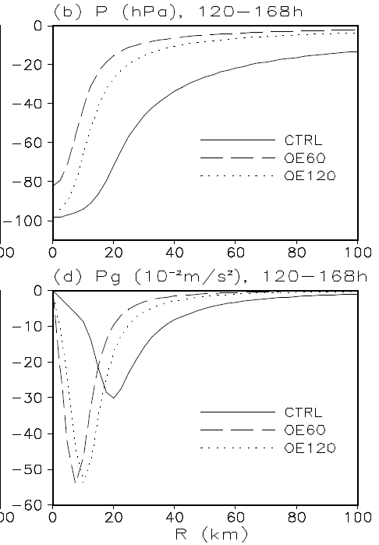
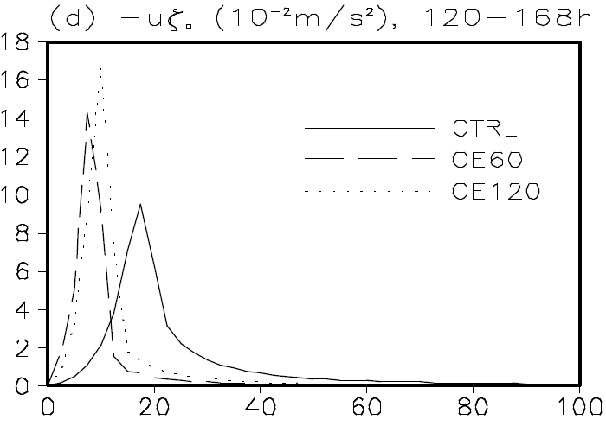
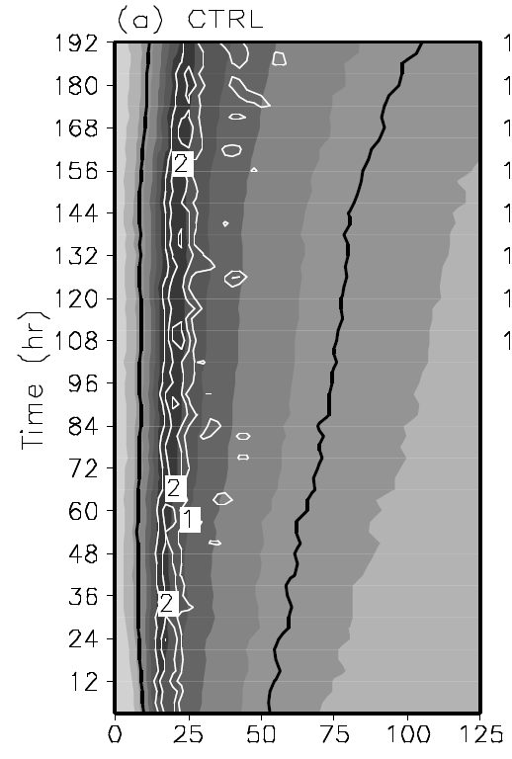
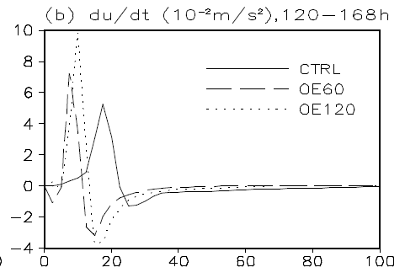
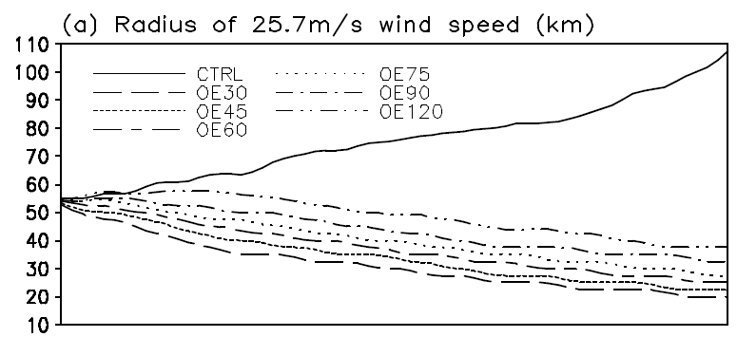
Increase in the inner-core size &
diabatic heating in active spiral rainbands
Positive contribution
High centrifugal force, which was largely balanced by the large pressure gradient force and deceleration of radial wind.

Slide 31
The boundary layer inflow and its induced acceleration of tangential winds outside the eyewall are critical to the increase in the inner-core size of the simulated storm in CTRL.
In turn, the boundary layer inflow, in particular that outside the eyewall, was dominantly controlled by diabatic heating in spiral rainbands.
Therefore, a positive feedback exists between active spiral rainbands and the increase in the inner-core size of the storm in CTRL.

Slide 32
OEs reduced the CAPE outside the eyewall and suppressed spiral rainbands, which, in turn, reduced diabatic heating outside the eyewall.
This greatly reduced the boundary layer inflow outside the eyewall, limiting the outward expansion of tangential wind fields.
In the intensifying stage, this positive feedback explains the contraction of both the RMW and wind fields in all OEs.
In the mature stage, this positive feedback helped maintain the small inner-core size in all OEs while contributed to the outward expansion of tangential wind fields in CTRL since the storm in CTRL developed active spiral rainbands.

Slide 33
Discussion
The changes in the inner-core strength often occur independently from those in the outer-core strength (Merrill 1984; Holland and Merrill 1984; Weatherfort and Gray 1988b; Cocks and Gray 2002).
In this study, the inner-core size varies with time for a given storm by our definition.
Maclay et al. (2008) found two processes that may lead to the growth of TC inner-core size: (1) secondary eyewall formation and eyewall replacement cycles and (2) external forcing from the synoptic environment, such as the vertical shear.

Slide 34
Discussion (continue)
Hill and Lackmann (2009) demonstrated that diabatic PV generation in spiral rainbands and subsequent radial transport are critical to the outward expansion of wind fields and thus the increase in the inner-core size of the simulated storm in a relatively moist environment.
In our simulations, the smaller inner-core size of the simulated TCs in OEs as compared to that in CTRL is due to the lack of active spiral rainbands, which is consistent with the PV thinking.

Slide 35
Conclusions
Surface entropy fluxes :
In the eye region of a TC are found to contribute little to the storm intensity while slightly reduce the eye size by lowering the surface pressure in the eye.
Under the eyewall contribute greatly to the storm intensity.
Outside the eyewall up to a radius of about 60 km (or about 2-2.5 times the RMW) are also important.
Further outward, surface entropy fluxes are found to be critical to the growth of the inner-core size but limit the maximum intensity of a TC.

Slide 36
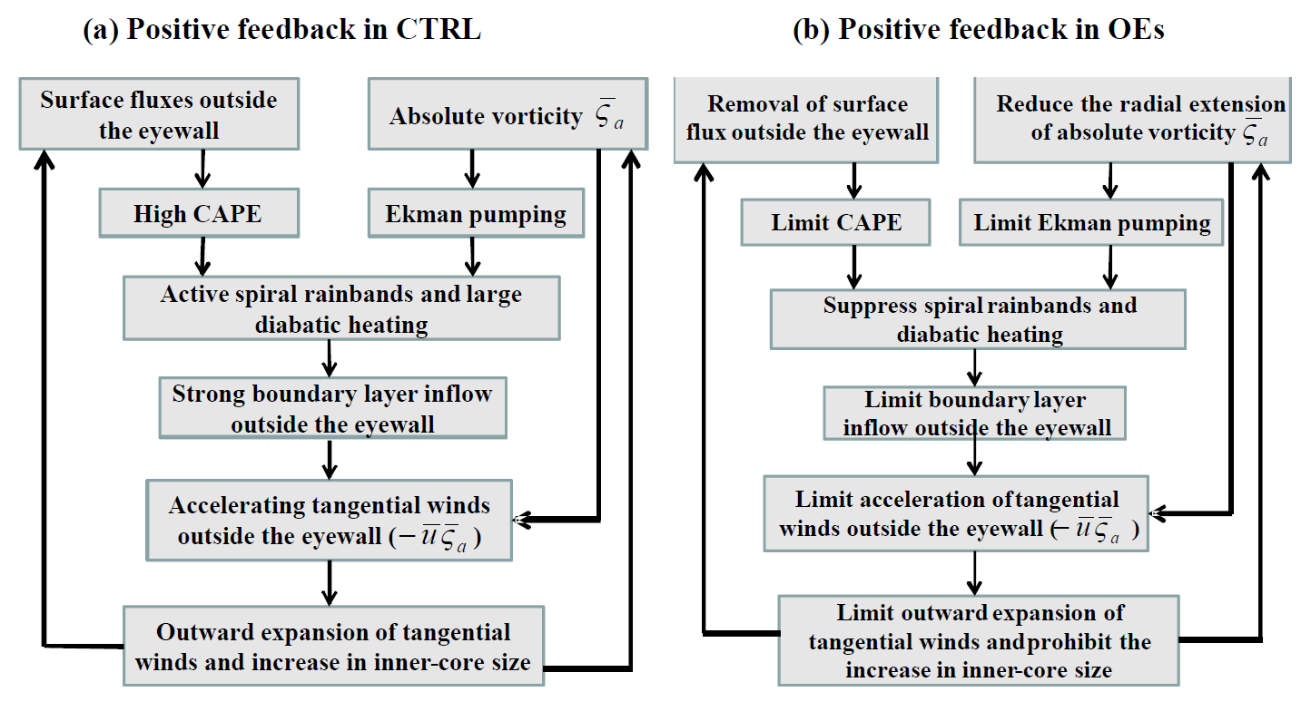
Conclusions (continue)
Surface entropy fluxes outside the eyewall plays a critical role in maintaining active spiral rainbands.

Slide 37
THE END

Slide 38
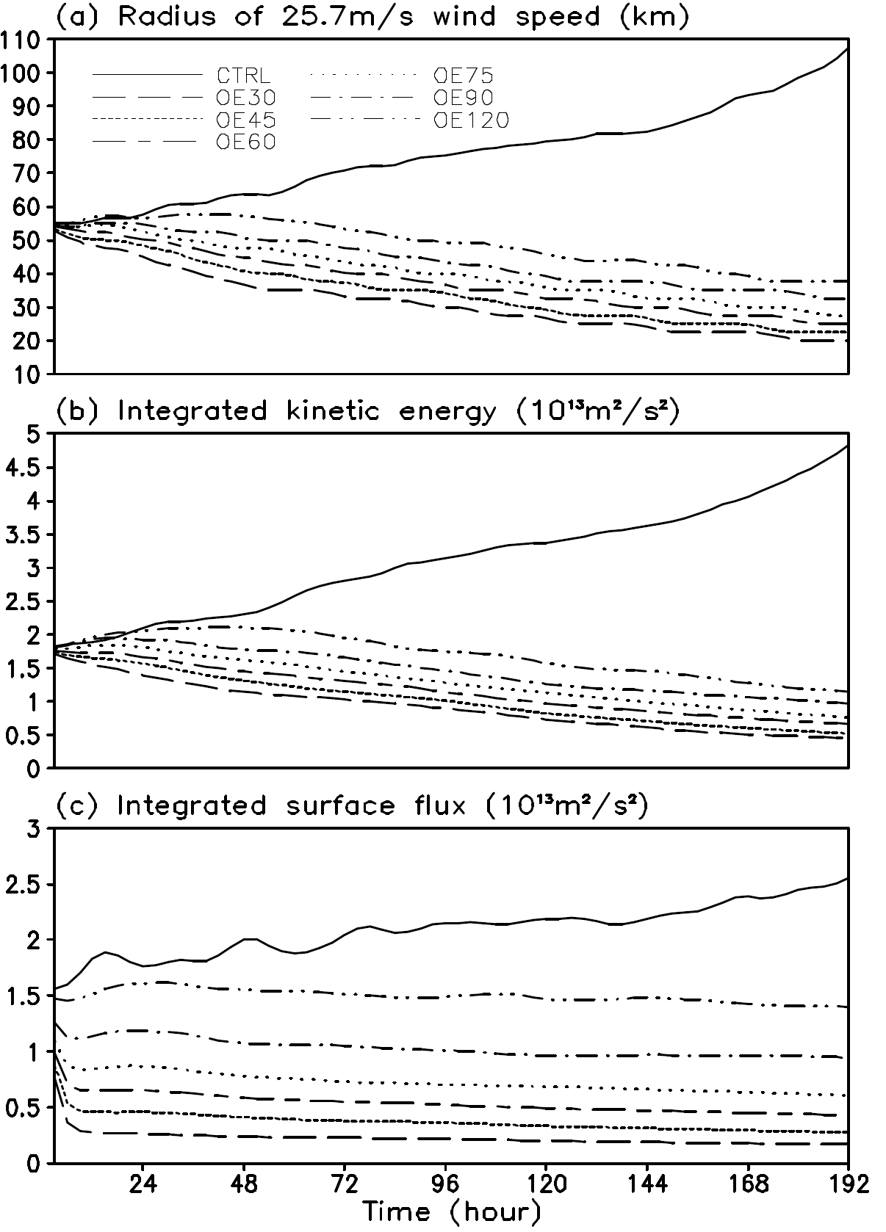
OE120 increased
4 to 8 times
The storm inner-core intensity is not only determined by the energy production under the eyewall but is contributed considerably by the energy production outside the eyewall

