Slide 1
Energy Production, Frictional Dissipation, and Maximum Intensity of a Numerically Simulated Tropical Cyclone
4/27 2010
蘇炯瑞
Wang, Y., and J. Xu, 2010: Energy production, frictional dissipation,
and maximum intensity of a numerically simulated tropical cyclone.
J. Atmos. Sci., 67, 97–116.

Slide 2
OUTLINE
Introduction
Model and experimental design
An overview of the simulated TC
Energy production and dissipation in the simulated TC
Interpretation: a. A Lagrangian θ_{e} budget b. A control volume θ_{e} budget c. A sensitivity experiment
Summary

Slide 3
Introduction
Emanuel (1995, 1997) assumed that at steady state, namely when the storm reached its MPI, the rate of entropy production from the ocean should be approximately balanced by the surface frictional or mechanical dissipation to the ocean

Slide 4
r is the radius, r_{m} is the radius of the eyewall and roughly the radius of
maximum wind (RMW)
r₀ is an outer radius far away from the RMW
ρ is the air density of the subcloud layer T_{s} is the SST |V| is the near-surface wind speed s₀* is the saturation entropy of the ocean surface
s_{b} is the entropy of subcloud-layer air C_{k} is the exchange coefficient of the entropy flux from the ocean
C_{D} is the surface drag coefficient
ε is the thermodynamic efficiency of the heat engine, which is defined as ;T₀ is the outflow-layer air temperature.

Slide 5
The maximum wind speed, namely, the MPI:
“m” Indicates that the value is evaluated near the RMW
Maximum wind speed can be calculated by specifying a value of the relative humidity of the subcloud layer outside of r_{m}, SST, and the ratio of the exchange and drag coefficients.

Slide 6
Introduction
Although earlier numerical results from axisymmetric TC models demonstrated that the E-MPI can give an excellent estimation of the model TC maximum intensity (Rotunno and Emanuel 1987; Emanuel 1995, 1997).
Recent studies show that the numerically simulated TC maximum intensity can exceed the E-MPI when very high resolution models are used (Persing and Montgomery 2003, 2005; Cram et al. 2007; Yang et al. 2007; Bryan and Rotunno 2009a), higher than the E-MPI by asmuch as 10%–50%.
Near-surface high-entropy air in the eye region could serve as an additional source of energy for the TC heat engine, if the air is transported into the eyewall, and thus considerably increase the TC intensity(Cram et al. 2007).

Slide 7
Introduction
Removal of the high-entropy anomaly in the eye only resulted in a slightly weaker storm as evidenced by the maximum tangential wind speed (reduced by about4%on average). (Bryan and Rotunno 2009a, BR09).
Bryan and Rotunno (2009c) presented a more complete analytic model and demonstrated that the unbalanced flow in the boundary layer could contribute significantly to TC maximum intensity.
From an energy balance point of view, E-MPI expression (1) does not include any approximation for the boundary layer flow.

Slide 8
Motivation
To understand why the E-MPI considerably underestimates the maximum intensity of TCs in numerical simulations and observations.
Show how surface entropy fluxes outside the eyewall contribute to the energy budget in the eyewall and thus the maximum intensity of a TC.

Slide 9
Model and experimental design
Fully compressible,nonhydrostatic equation model TCM4, Wang (2007).
The model has 26 vertical levels : Surface pressure of 1010 hPa and with its top at about 38 km.
Horizontal grid sizes of 67.5, 22.5, 7.5, and 2.5 km have domain dimensions of 251X151, 109 X109, 127X127, and 163X163 grid points.
No large-scale environmental flow.
Convection is mainly active in both the inner-core region and spiral rainbands(200Km).
Cumulus parameterization is not considered even in the two outermost meshes in this study.

Slide 10
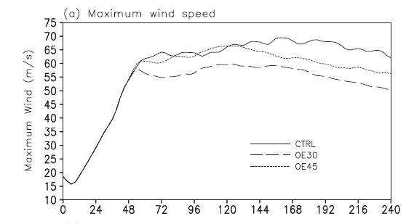
An overview of the simulated TC
Vmax 68.2m/s

Slide 11
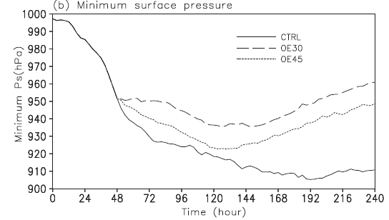
Psmin 913.5hPa

Slide 12
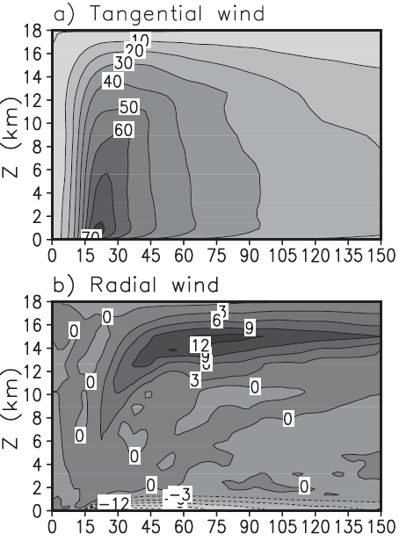
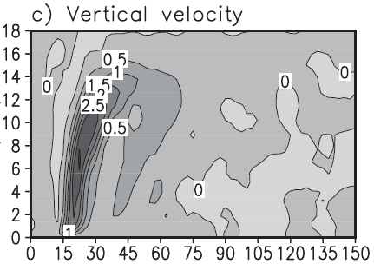
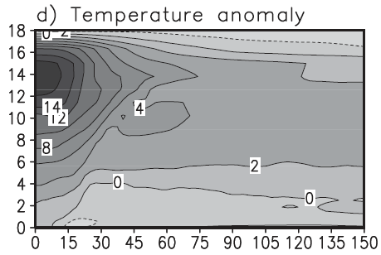
After 168 h of integration in the control experiment
80m/s
W

Slide 13
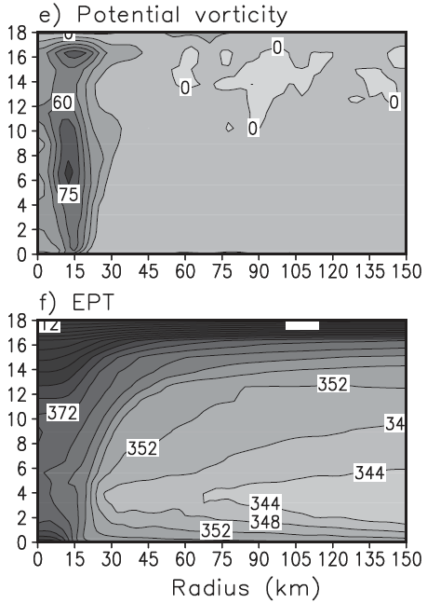

Slide 14
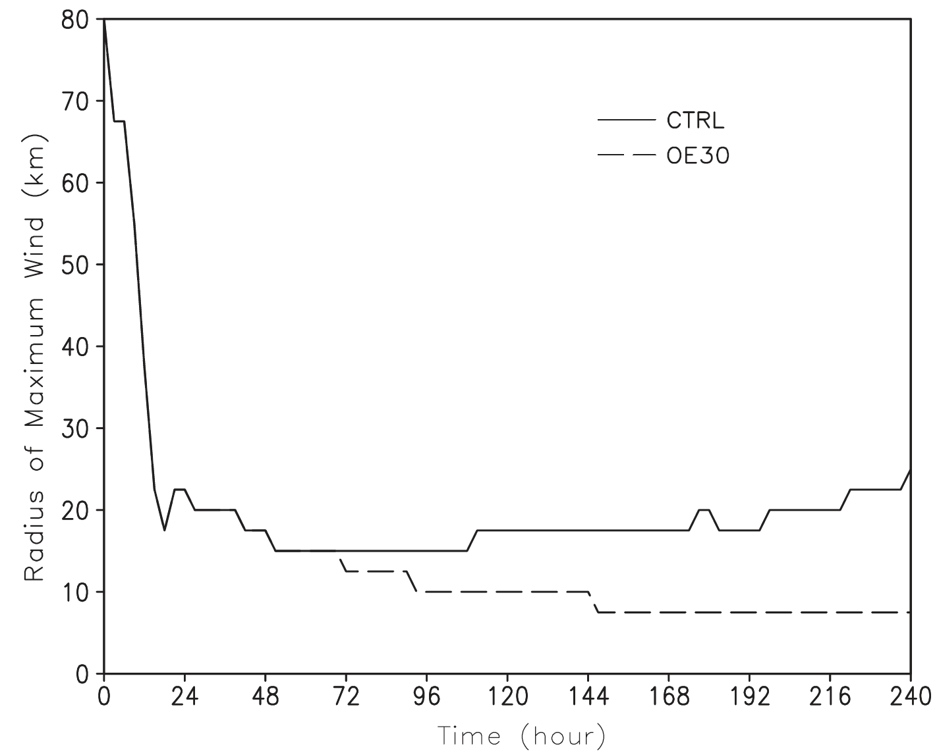
15 km
From a regular hurricane structure
to an annular hurricane structure.(Knaff et al.2003)

Slide 15
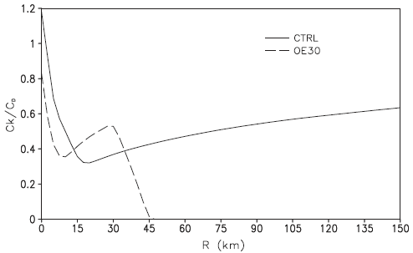
RMW
Vmax 68.2m/s
0.32
0.4
averaged between 144 and 192 h
7% stronger
39% weaker
33% weaker

Slide 16
Energy production and dissipation in the simulated TC
Total energy production rate (PROD)
,
P_{D}: Azimuthal mean energy production
SH: Sensible heat flux
LH: Latent heat flux
DHT: Column-integrated dissipative heating rate
RAD: Column-integrated heating-cooling rate

Slide 17
Frictional dissipation rate (DISS)
D_{s}: Azimuthal mean frictional dissipation

Slide 18
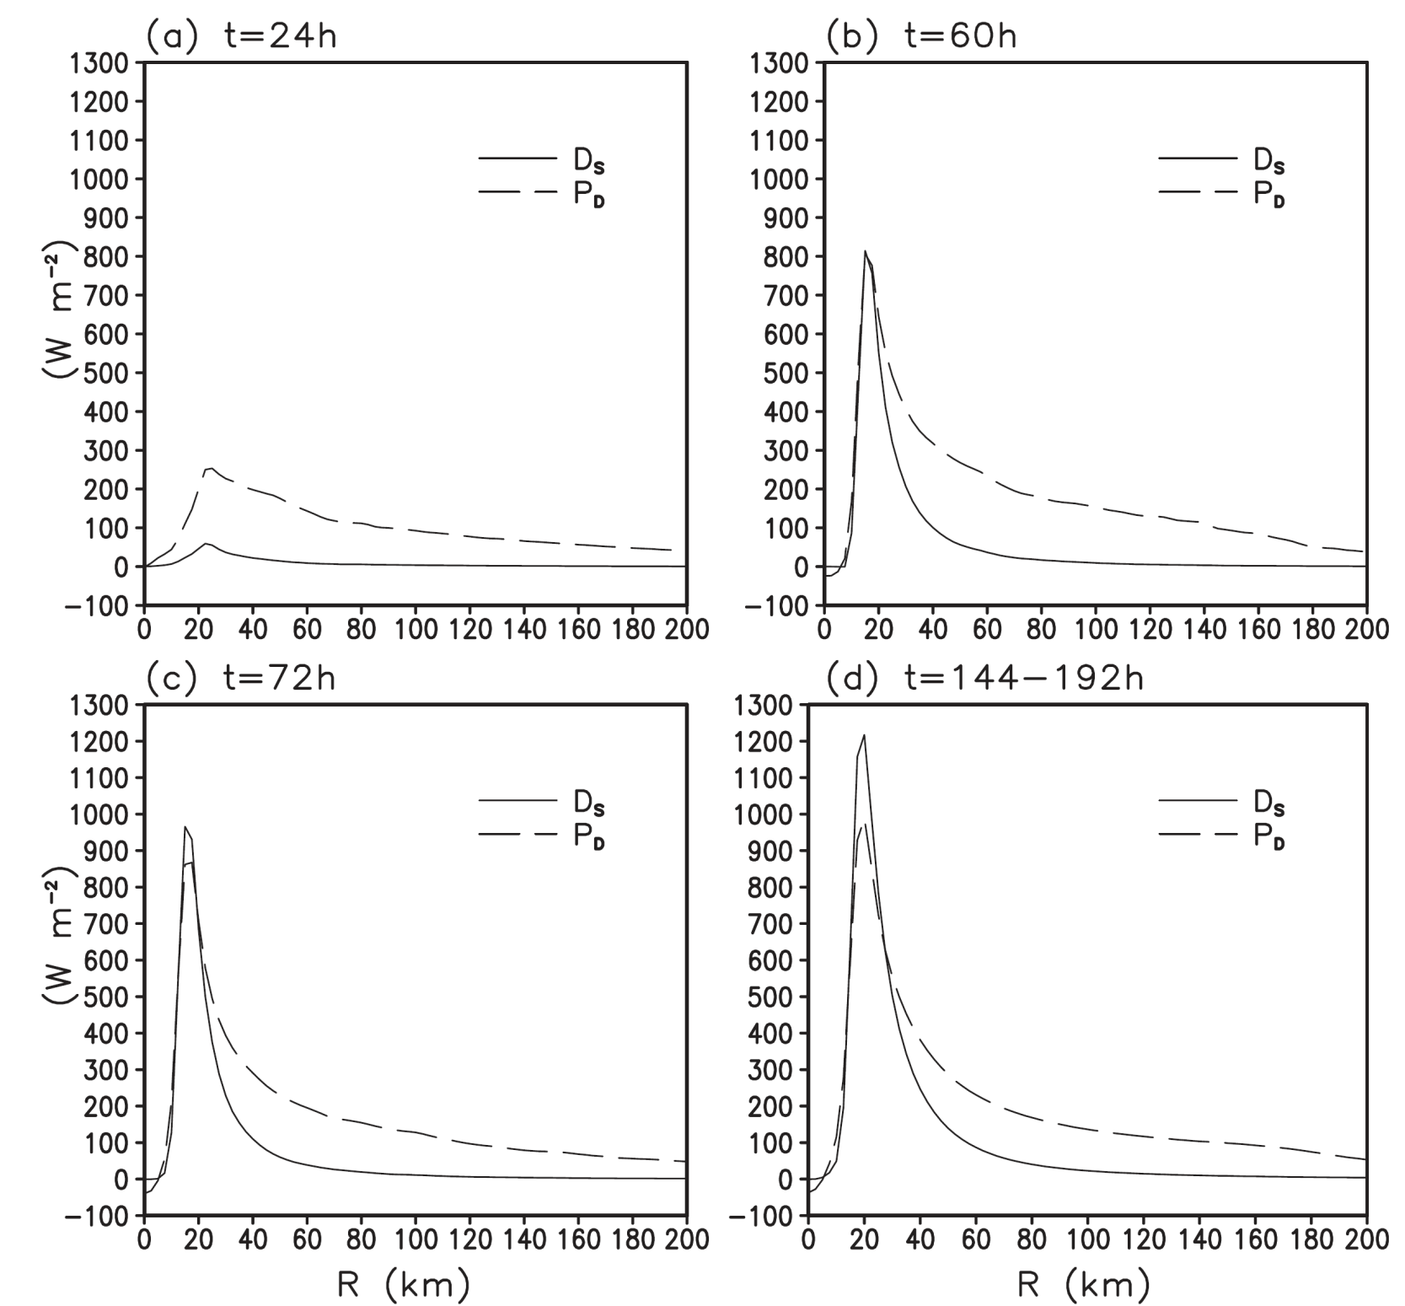
Developing stage
61.4m/s
Notes:
T=60的時候強度只有144-196的90%，中心最低海平面氣壓也高28.5pha。但是圖一144小時之後卻有緩慢的增加強度，因為frictional dissipation rate 成長較快，因此有多餘的能量在眼牆下產生。
DS 大於 PD 11% (72HR) ； 25% (144-192hr)

Slide 19
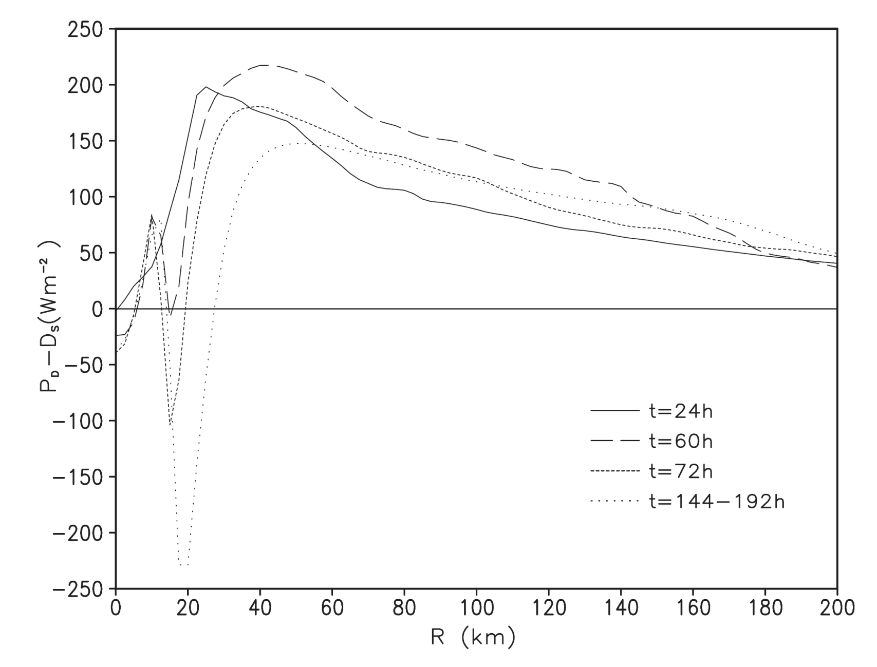
Notes:
上述結果表示從EMPI 方程式一近似而來的方程式三 會低估最大強度

Slide 20
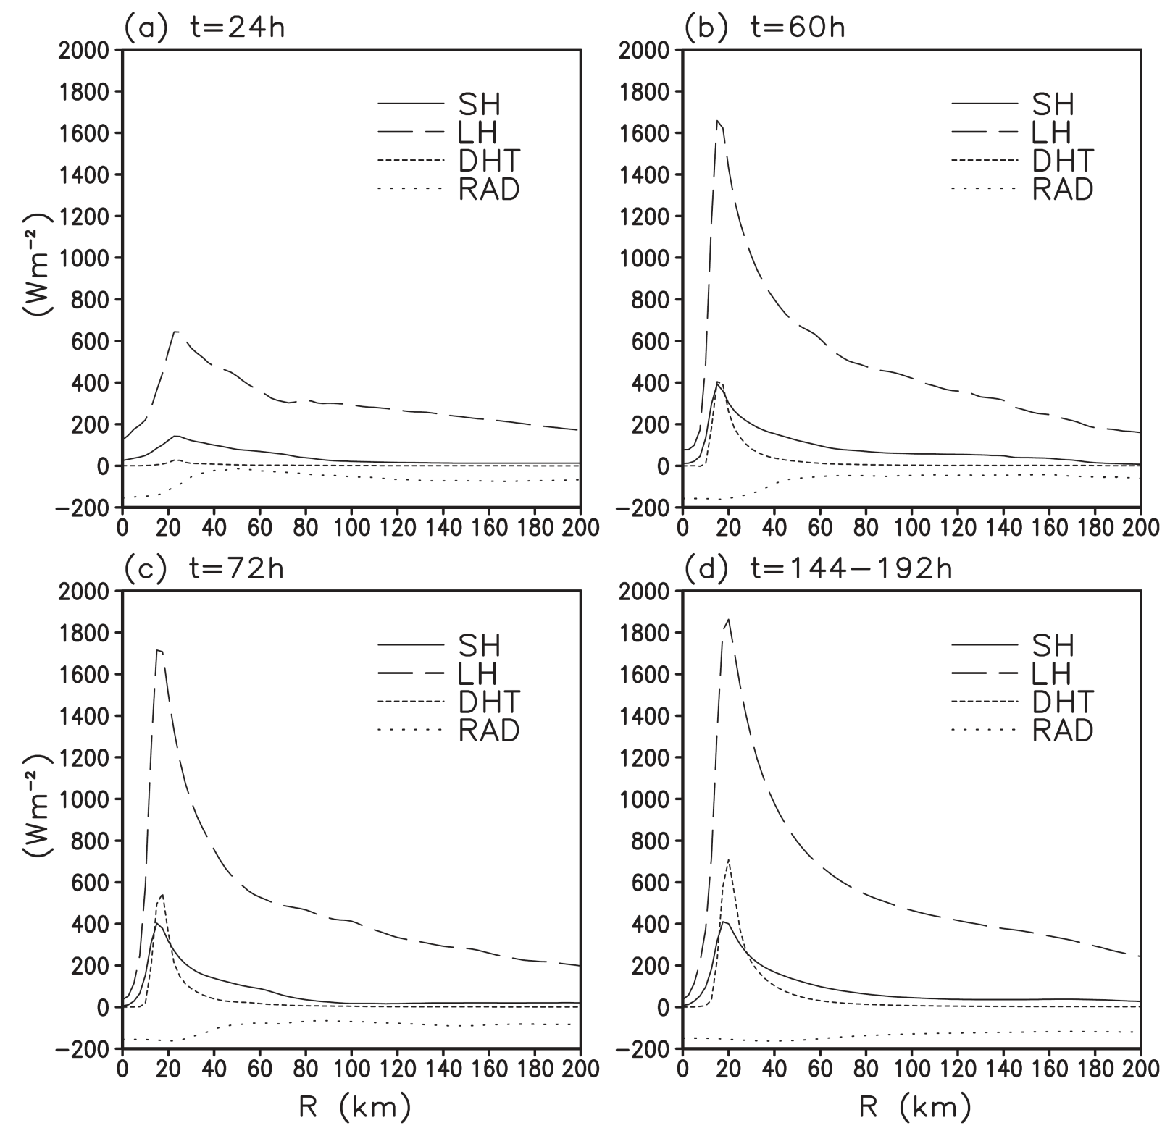

Slide 21
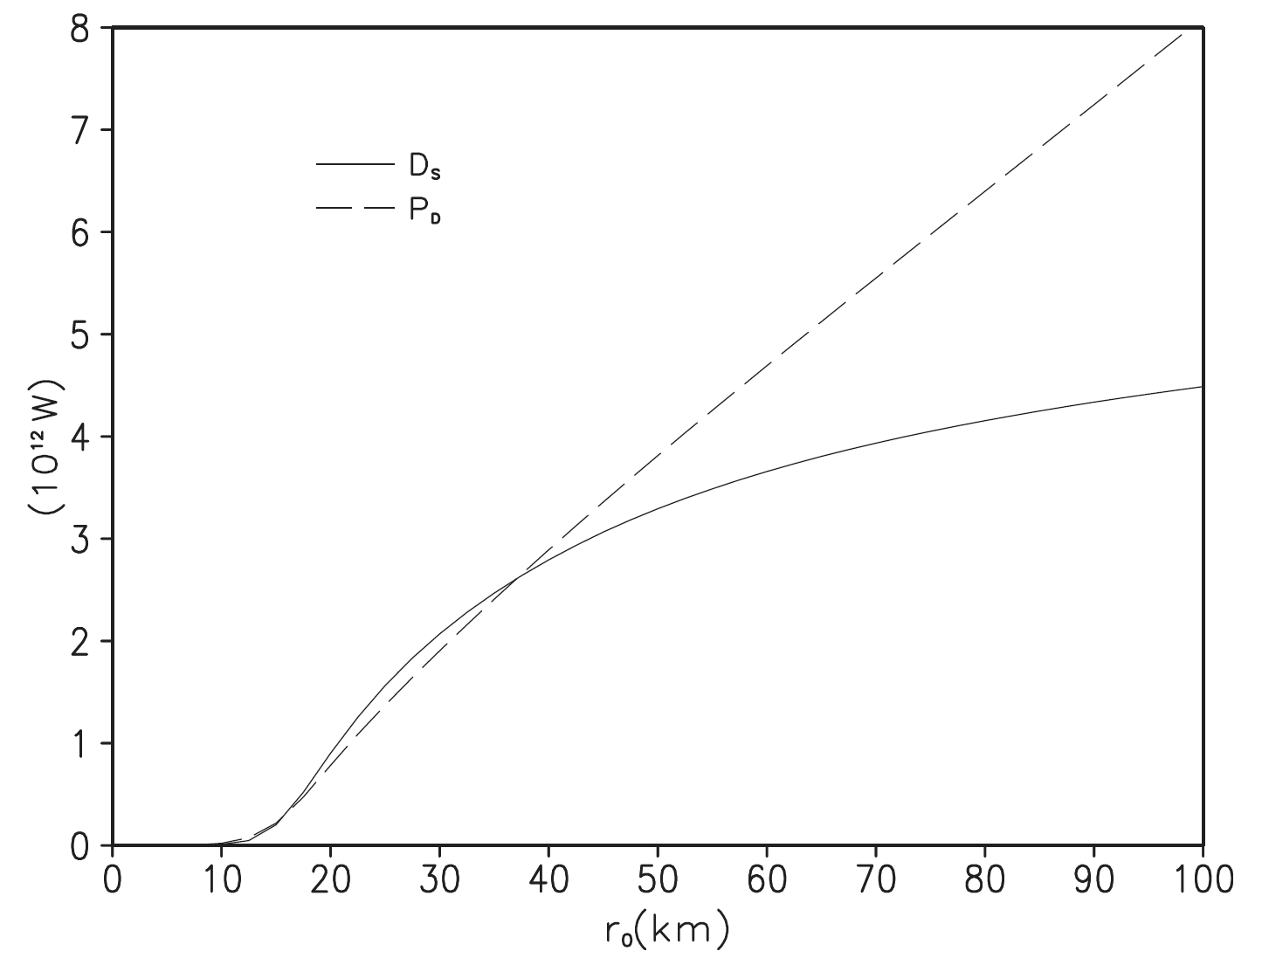
HOW FAR CAN BALANCE
Area-integrated & averaged between 144-192h
RMW 17.5km
37.5km

Slide 22
Interpretation
A Lagrangian θ_{e} budget
D : horizontal diffusion
F : vertical mixing
D_{H} : the dissipative heating rate
R_{H} : the Newtonian cooling rate
Notes:
目的為了瞭解眼牆外能量如何傳入眼牆並且增強颱風強度

Slide 23
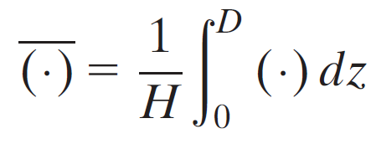
Steady stage flow
The vertical motion can be ignored outside the eyewall.
PS:
; D=212m

Slide 24
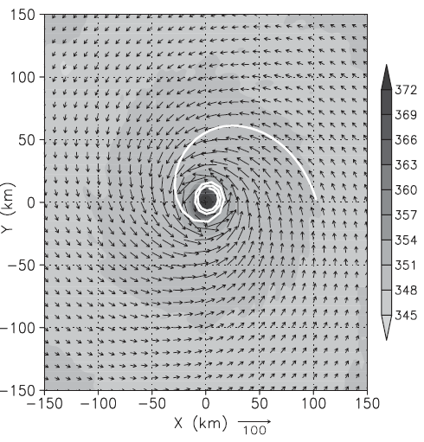
1.5h

Slide 25
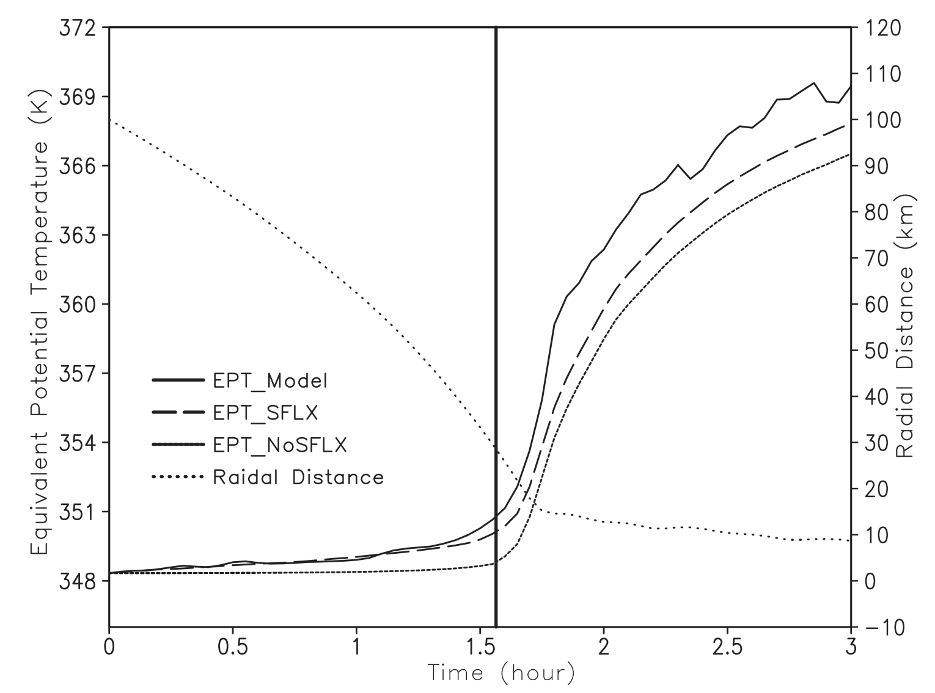

Slide 26
Interpretation
A control volume θ_{e} budget
Replace A with θ_{e} :
HD+VD+DH+RC
Lateral and top
Notes:
眼牆外SFLX造成高相當位溫如何影響眼牆
表示說眼牆外向內傳送的能量應該會提供眼牆能量
所以我們做了控制體積的質量位溫收支

Slide 27
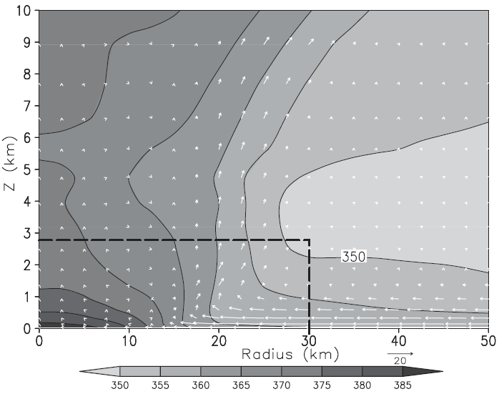
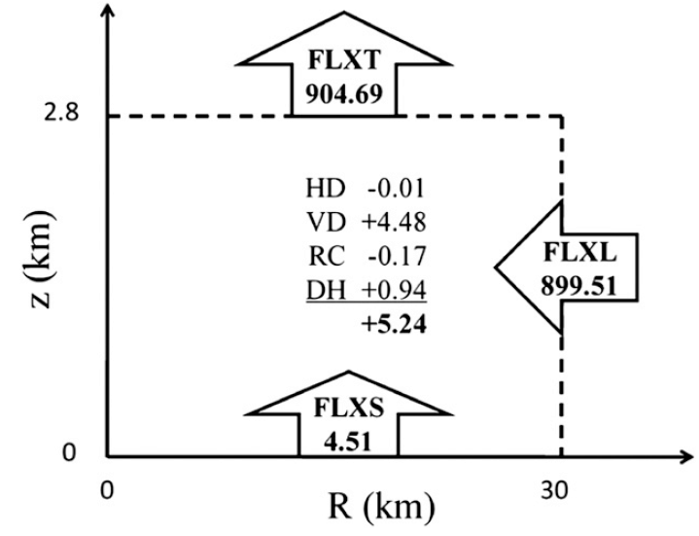

Slide 28
Reduction 0.5K in θ_{e} below 1100m reduced the FLXL 1.39 × 10⁹ K kg/s.
Although this is small compared with FLXS about 31% or with all local processes in the control volume about 26.5%.
If the air entering the eyewall is a mixture of air parcels with different radial origins, the FLXL can result 0.5-1K increases in θ_{e} .
The surface entropy fluxes outside the eyewall do contribute significantly to the energy budget in the eyewall.

Slide 29
Interpretation
A sensitivity experiment (OE30)
With the surface exchange coefficient (and thus the surface entropy flux) linearly reduced from 100% at a radius of 30 km, corresponding to the eyewall to zero at and outward of radius 45 km.
To quantify the significance of the energy production outside the eyewall and its contribution to the maximum intensity of the simulated TC.

Slide 30
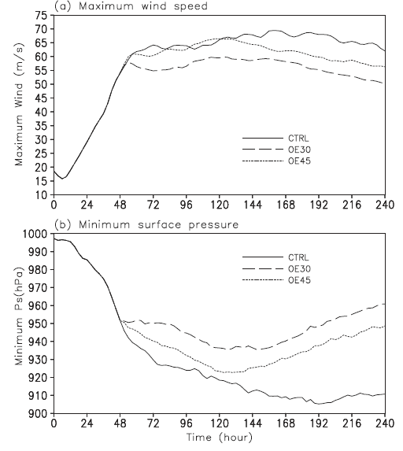
13.5% low
26 hPa high
Notes:
說明眼牆外的能量對颱風強度有明顯的貢獻且不能被忽略

Slide 31
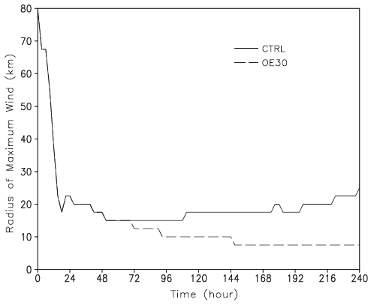
7.5 km

Slide 32
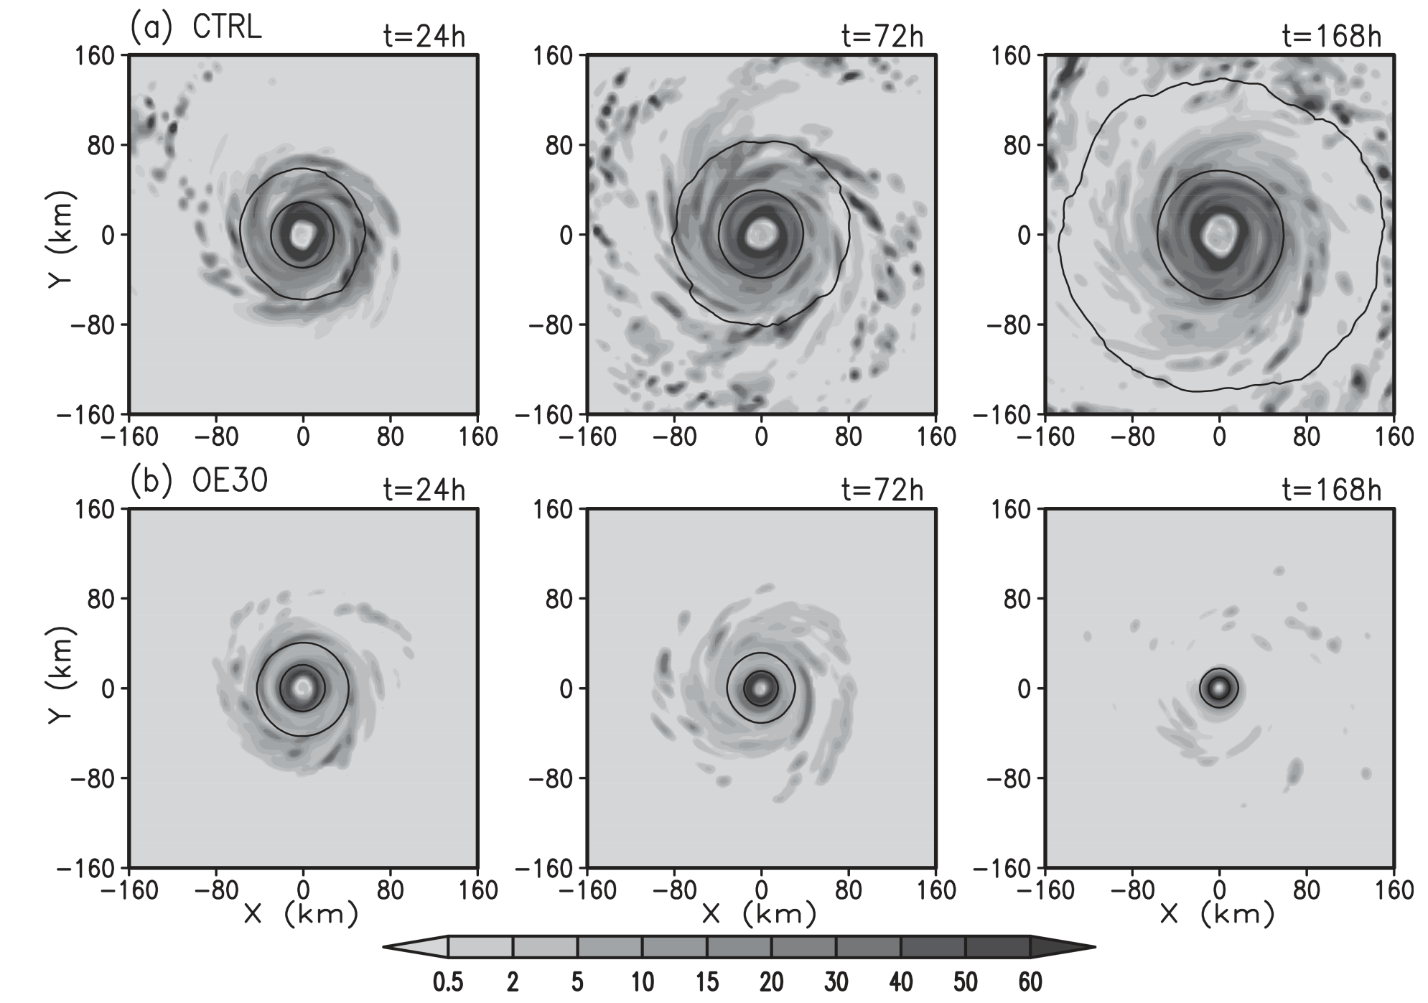

Slide 33
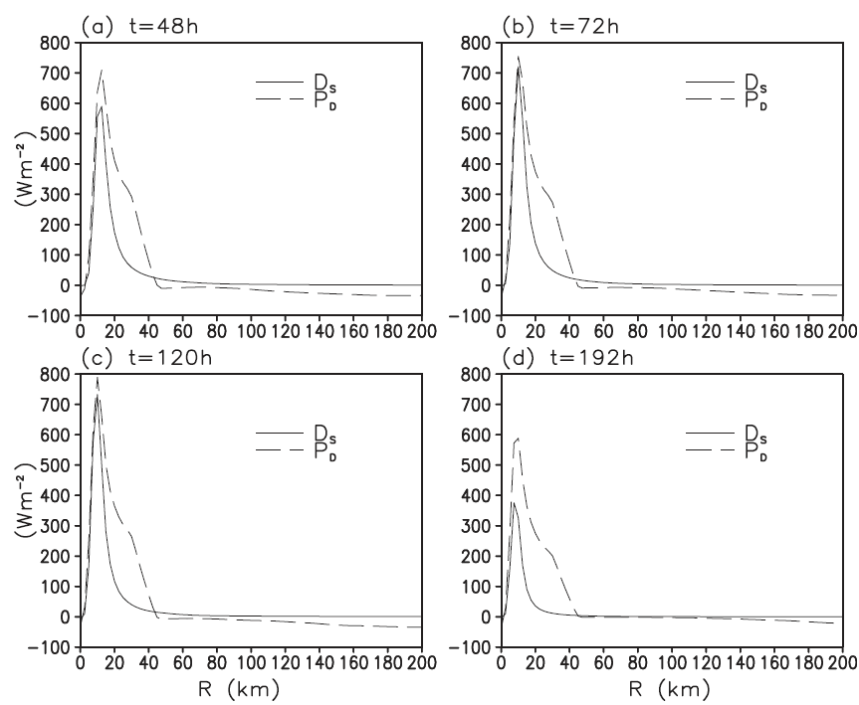

Slide 34
It seems that there exists a positive feedback between the surface fluxes outside the eyewall and the inner-core size of the storm.
Removal of the surface fluxes outside the eyewall would reduce the storm intensity, suppress convection outside the eyewall, and thus reduce the storm size (Wang 2009).
Energy production outside the eyewall contributes considerably to both the size and maximum intensity of the TC in the simulation.

Slide 35
Summary
Energy production rate and surface frictional dissipation rate are balanced near the radius of maximum wind (RMW) at the time when the storm reaches its MPI (E-MPI). (Underestimate)
Lagrangian θ_{e} budget : air parcel in the surface-layer inflow can gain considerable energy from the underlying ocean due to surface entropy flux as it spirals cyclonically inward toward the eyewall.
The control volume mass-weighted θ_{e} budget : a small change in θ_{e} of the air entering the eyewall in the boundary layer inflow considerably affects the energy budget in the eyewall.

Slide 36
Summary
The underestimation by E-MPI of the maximum intensity of the simulated TC is primarily due to ignoring energy production outside the eyewall as energy production within about 2–2.5 times the RMW is required to balance the surface frictional dissipation under the eyewall.
Sensitivity experiments also show that energy production outside the eyewall is critical not only to the maximum intensity but also to the inner-core size of the simulated storm.

Slide 37
THANKS

