Slide 1
Investigation of Microphysical Parameterizations of Snow and Ice in Arctic Clouds during M-PACE through Model-Observation Comparisons
Prudence Chien
2010/4/6
Reference:
Solomon, A., H. Morrison, O. Persson, M. D. Shupe, and J.-W. Bao, 2009: Investigation of microphysical parameterizations of snow and ice in Arctic clouds during M-PACE through model-observation comparisons. Mon. Wea. Rev., 137, 3110–3128

Slide 2
OUTLINE
Introduction
Observations
Model description
Results
Conclusions

Slide 3
Introduction
1960s’ observation data & SHEBA experiment => Supercooled liquid water in Arctic clouds
Mixed-phase Arctic clouds are observed over 40% of the time, with maximum frequency observed during spring and fall, but most weather and climate models fail to produce Arctic clouds that maintain liquid water at low temperature.
Liquid water in Arctic clouds plays a dramatic impact on the surface energy budget.
2-moment scheme allows for the maintenance of liquid water in the cloud.

Slide 4
Introduction
Reisner et al. (1998):
The presence of water in the clouds was sensitive to the treatment of the number concentration of snow. (also in Morrison and Pinto 2006)
An overestimate of snow number concentration resulted in conversions of water vapor to snow (deposition growth) and cloud water to snow (riming).
Use a diagnostic relationship equation between N_{0s} and snow mixing ratio or a prognostic equation for N_{0s} adequately simulated the observed values of N_{0s} and were therefore better able to reproduce the observed cloud water content. => estimate N_{0s} of differ from case to case and vary in space and time

Slide 5
Introduction
Case study
Purpose: Verify the microphysical characteristics of the model’s simulation of Mixed-phase Arctic clouds (MPCs)
During M-PACE (Mixes-Phase Arctic Cloud Experiment)
9-12 Oct 2004
Observation data: ground, remote sensing, aircraft, and radiosonde measurements
Two sites: Barrow and Atqasuk

Slide 6
Observations
Synoptic-scale features
Cloud properties
Aircraft measurements: 71% clouds were in mixed phase.
MPCs were typically dominated by liquid drops with precipitating ice below cloud base.
McFarquhar et al. (2007):
The size of water droplets increased from the cloud base to the cloud top => condensational growth & collision-coalescence (@cloud top)
Most of the ice mass is contained in sizes greater than 1 mm.
The median mass dimension of the ice increased from the cloud top to the cloud base=> Ice crystals grew as they fell through the cloud and may have grown by aggregation below the cloud base.

Slide 7
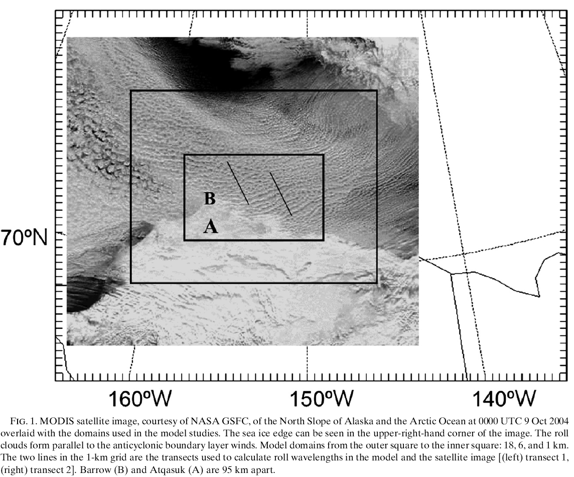
Barrow
Atqasuk

Slide 8
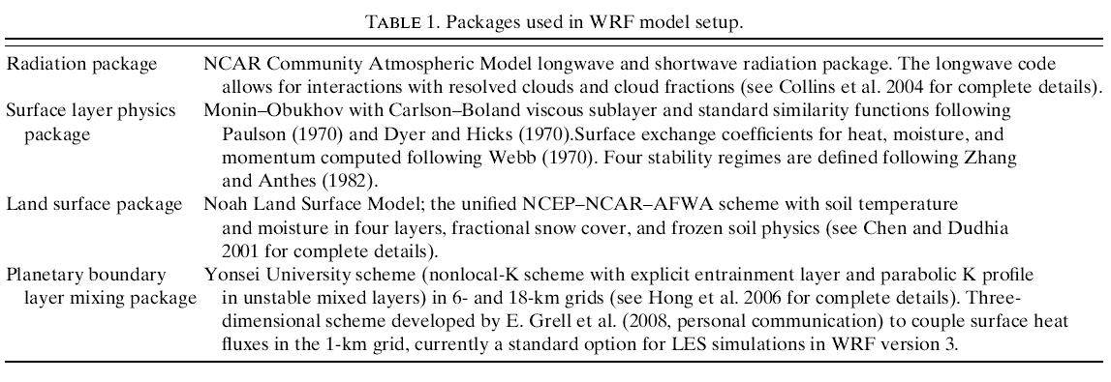
Model description
Model setup
Horizontal grid-space: 18, 6, and 1 km boundary layer (below 800hPa): 20 pressure levels
Spin-up time: 1200 UTC 8 Oct~ 1200 UTC 9 Oct
Analysis period: 1200 UTC 9 Oct~ 1100 UTC 10 Oct
IC & BC: NCEP

Slide 9
Microphysical parameterizations
Experiment design
Include: cloud droplets, rain, ice, snow, and graupel

Slide 10
Results

Slide 11
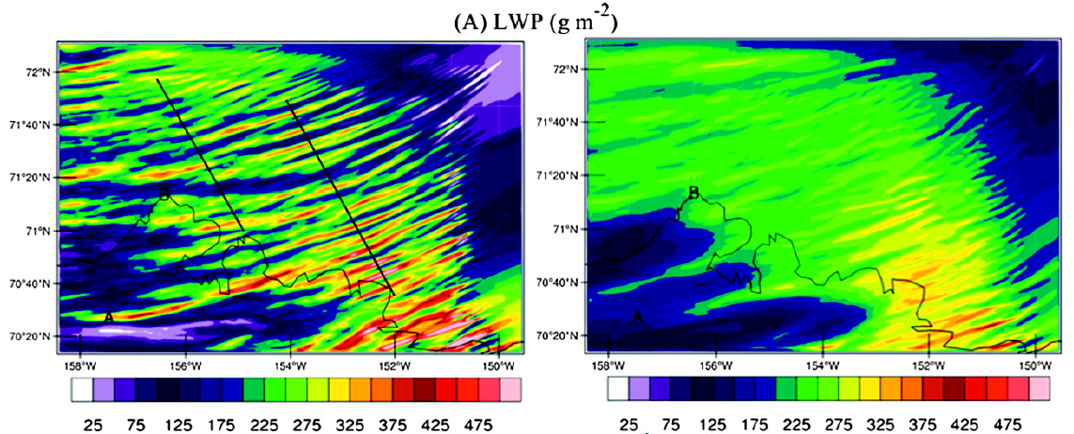
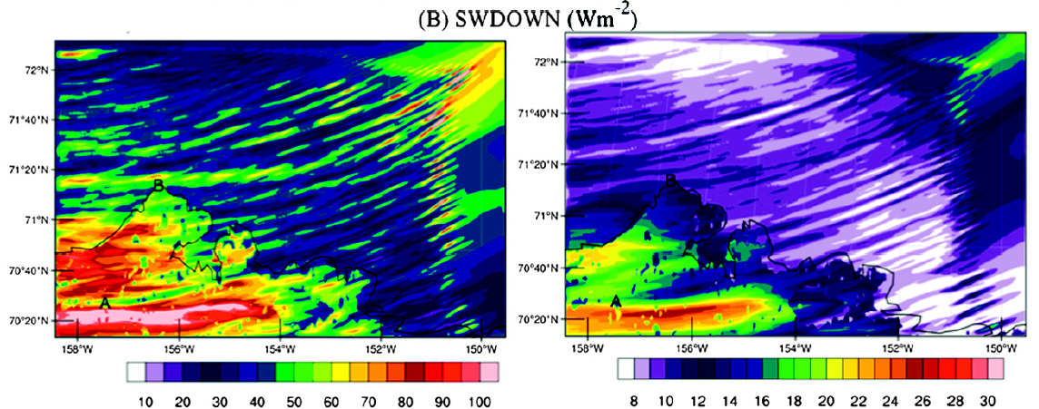
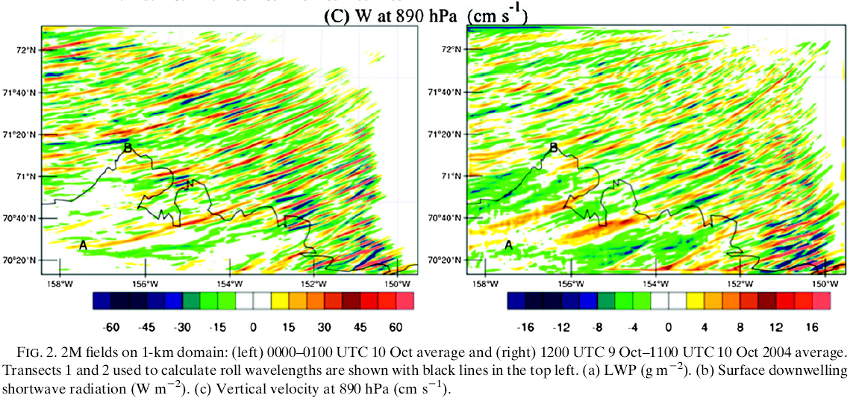
0000-0100UTC
10 Oct (1h avg.)
1200UTC 9 Oct-1100UTC
10 Oct (24h avg.)
Liquid water path
Surface downwelling shortwave radiation
Vertical velocity

Slide 12
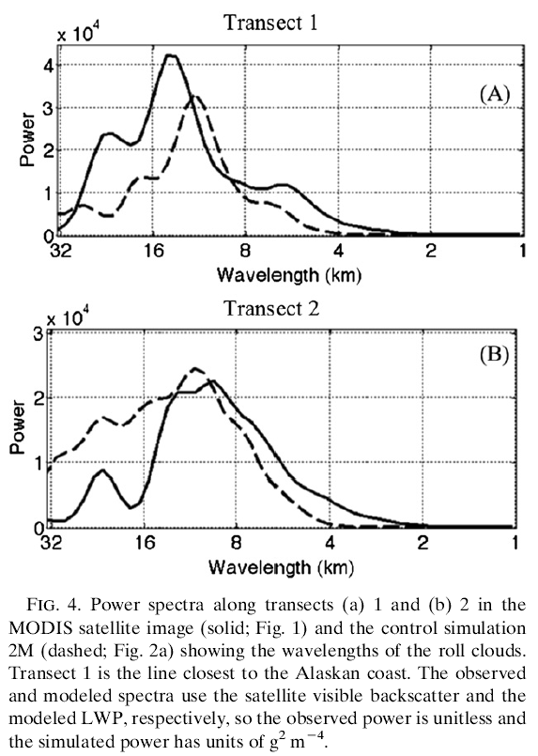

Slide 13
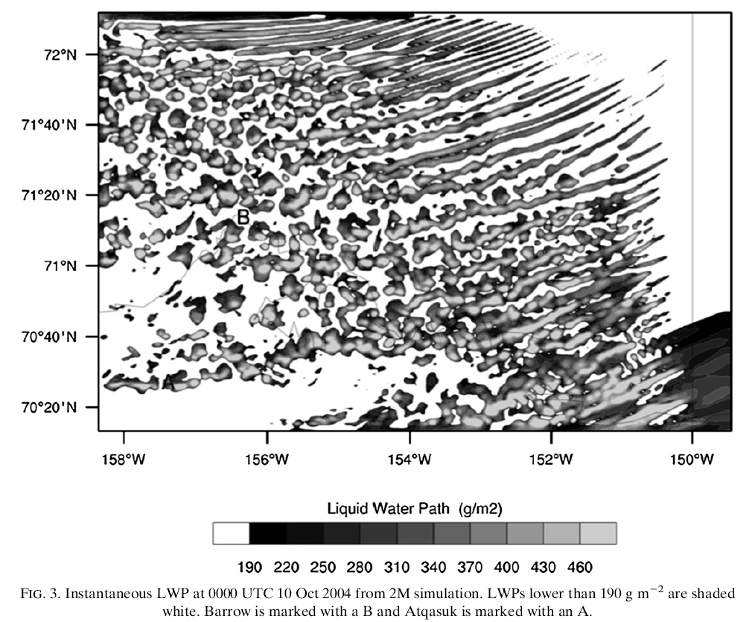

Slide 14
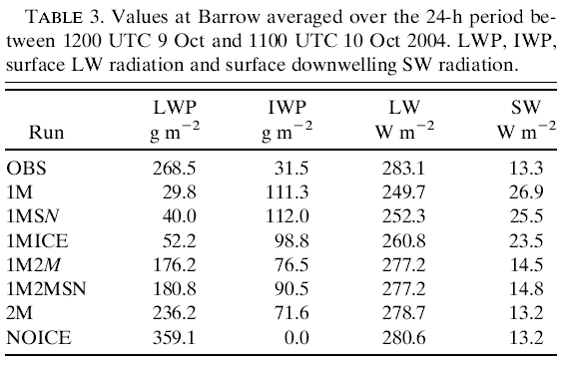
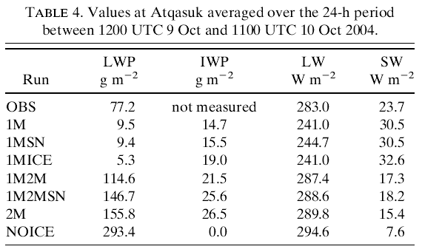
@ Barrow
@ Atqasuk
The sensitivity of the surface longwave and shortwave radiation to the liquid water in the clouds.
The critical value of LWP: 150g m⁻²

Slide 15
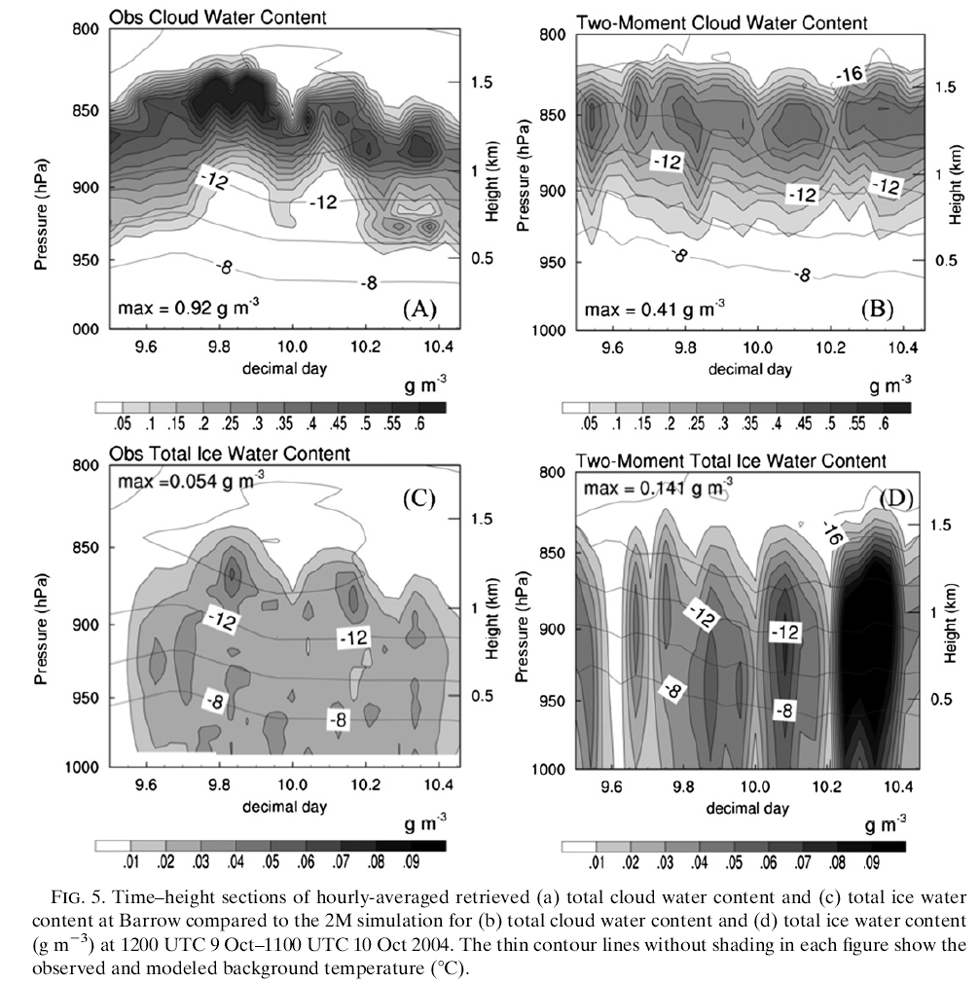
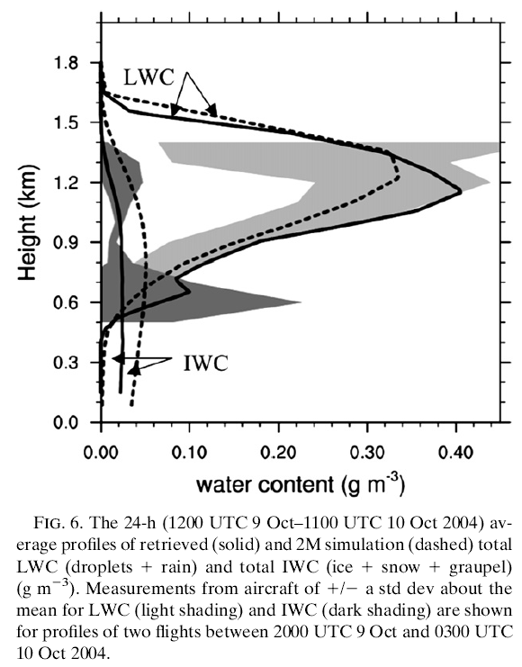
Hourly-averaged LWC & IWC @ Barrow
The importance of uncertainties in representation of ice and snow

Slide 16
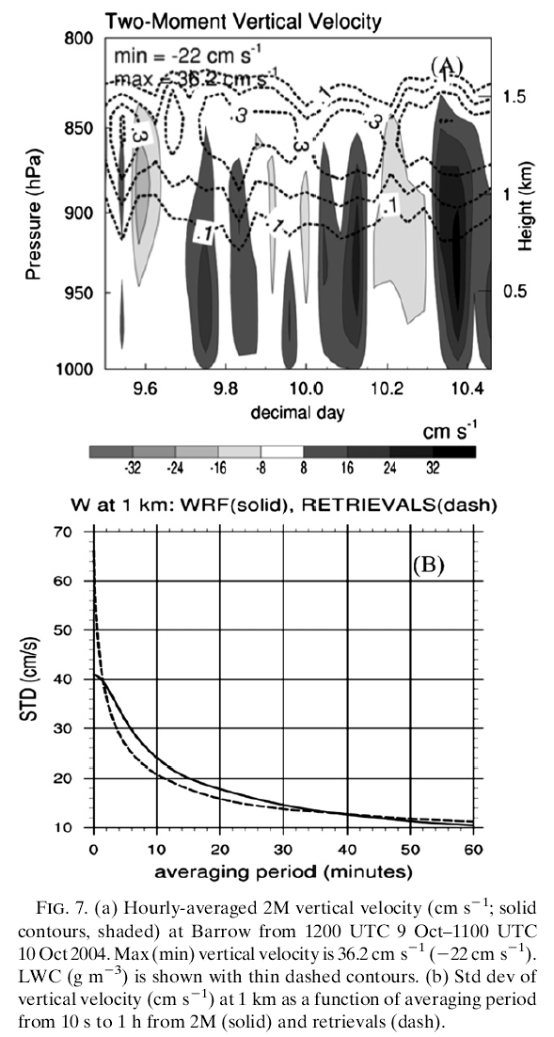
The variability of cloud condensate is closely coupled with oscillations in the vertical velocity.
The retrievals (dash line) have larger variability on time scales shorter than 2 min while the model (solid line) has variability somewhat larger than observed for time scales between 2 and 35 min.
Model cannot resolve turbulent motion, so it is not able to capture the variability over time scales <2min.

Slide 17
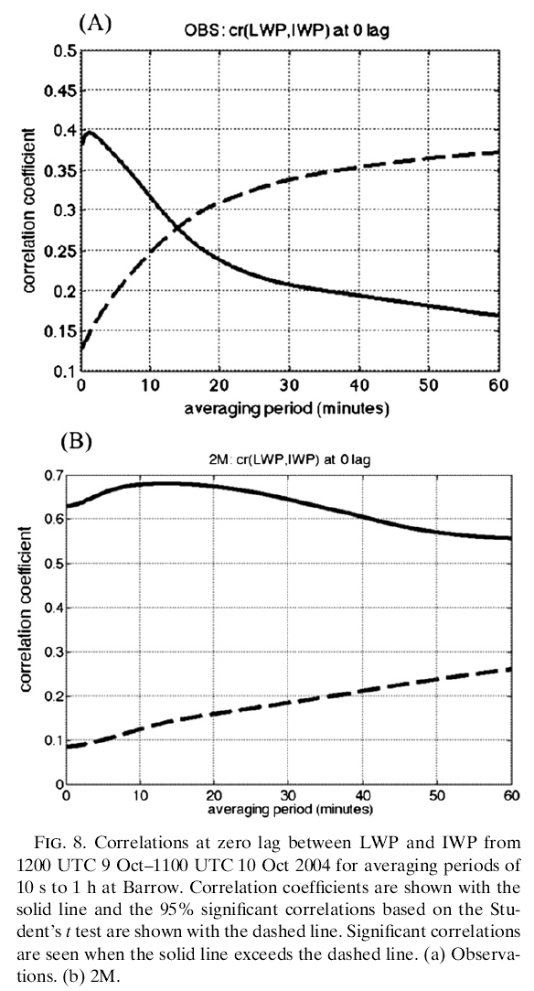
To quantify the relationship between the fluctuations in IWP and LWP.
The model shows a highly significant correlation between IWP and LWP for all averaging periods.
The retrievals show the correlation between LWP and IWP for averaging periods less than 14min.
=> The model cannot resolve the energy spectra at scales less than the effective resolution of about 5-7km.
Notes:
實線：相關係數
虛線：有95%明顯相關的相關係數

Slide 18
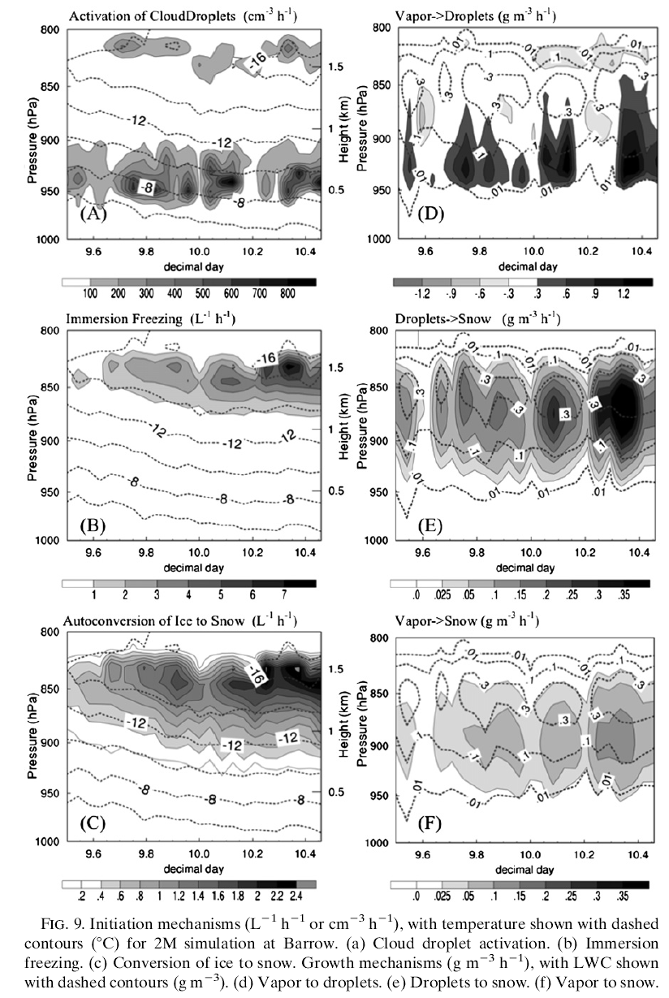
Compare the dominant growth and initiation mechanisms for droplets, ice, and snow
@ Barrow
Notes:
虛線:溫度
A&D : activation of cloud droplets主要開始於雲底，再上升區由condensation的作用成長，在下沉區因evaporation的作用而使LWC減少
B&E : model裡面 產生ice最主要的作用是immersion freezing(浸泡冷凝)，即在接近雲頂的過飽和區將較大的雲滴轉換成冰或冰晶
C&F : snow的初始是由autoconversion的作用，將雲冰轉成雪
冰和雪都在接近雲頂處形成，但是雪的初始位置較低，並且雪的成長和上升運動有關。

Slide 19
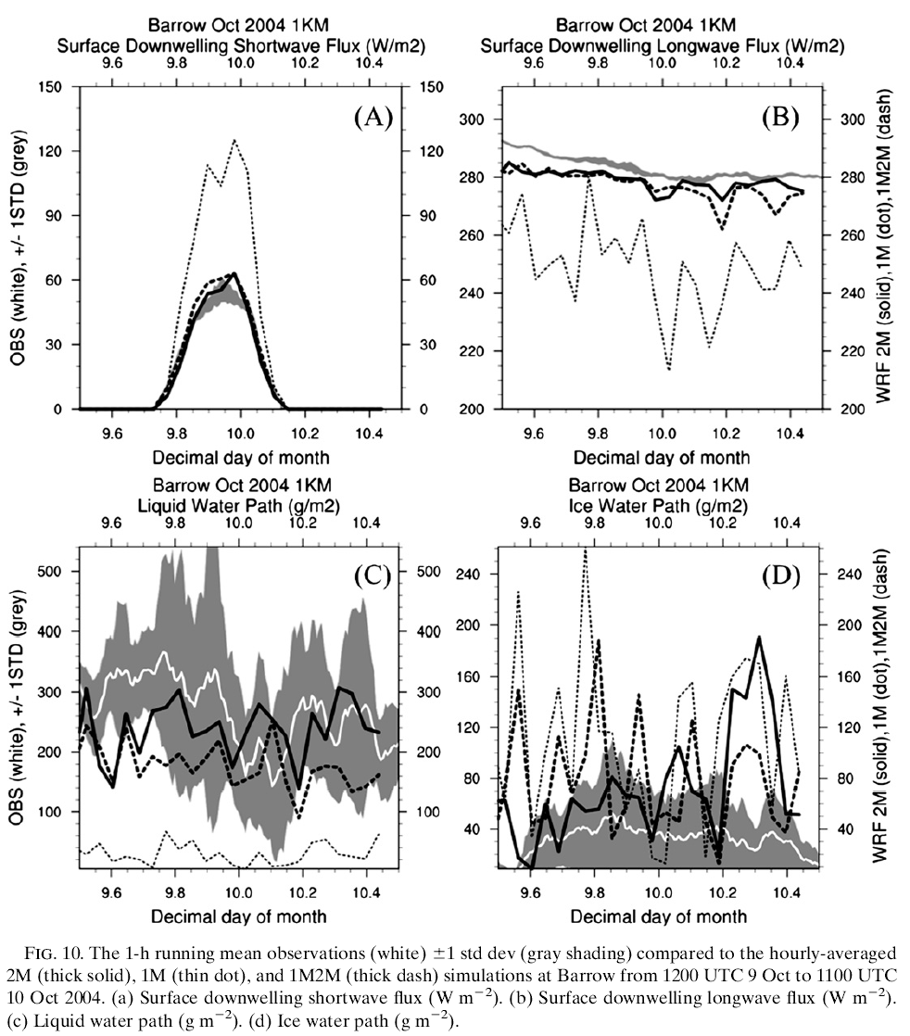
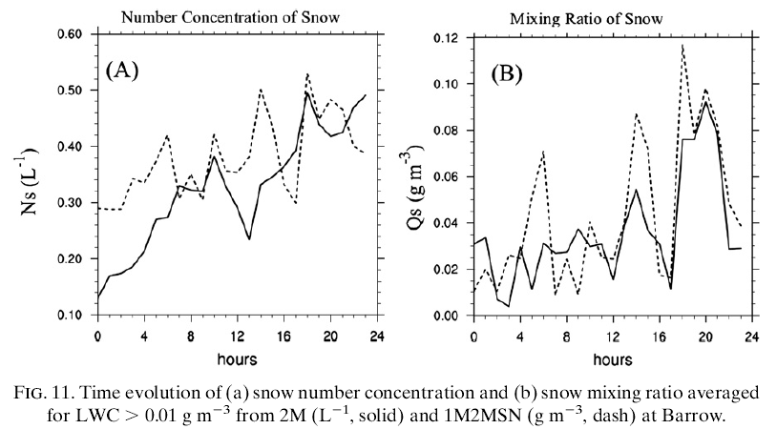
Compare the 2M simulation with simulations of 1M and 1M2M.
@Barrow
Notes:
10d顯示所有模式的IWP變異量都比觀測大很多
然而cloud water droplets是由condensation成長，所以增加N0s會造成更多vapor 變成snow(10d)，就使得變成cloud droplets的vapor減少 (10c)
所以一開始給定較大的N0s會使LWC減少，因為vapor和cloud droplet會被拿去變成snow

Slide 21
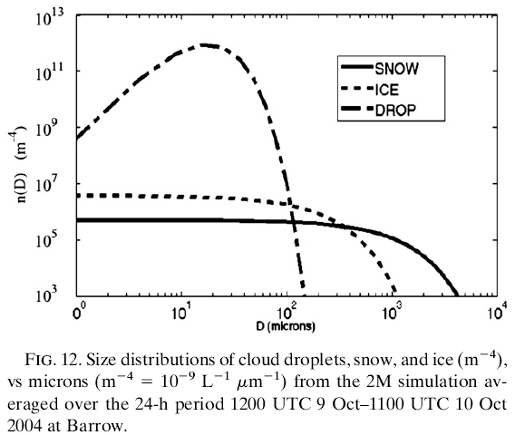
To identify why the 2M simulation is able to reproduce the observed LWP while the 1M simulation is not.
2M Mean N0s = 7.5*10⁵ m ⁻⁴ => to be reasonable compared to observations.
1M N0s = 1*10⁷ m ⁻⁴

Slide 22
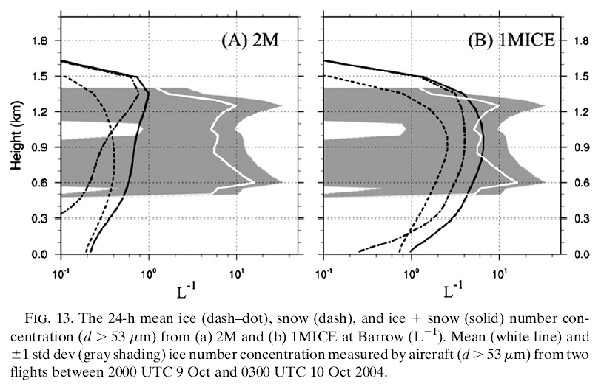
To identify the sensitivity of the simulation to ice concentration.
1MICE run: produced a 78% reduction in the mean LWP @ Barrow

Slide 23
Conclusions
The baseline simulation of hourly-averaged cloud top, cloud base, LWC, longwave and shortwave surface downwelling radiation closely approximated the ground-base observations, while the IWC was found to be 2 times larger and more variable compared to observations.
The snow and ice number concentrations were approximately an order of magnitude smaller than observed.
The cloud dynamical–microphysical structure is in good agreement with the conceptual model for these clouds developed from observations (Shupe et al. 2008a).
The model’s simulation of MPCs is sensitive to the snow intercept parameter, N0s, similar to the studies of Reisner et al. (1998) and Morrison and Pinto (2006).
Typical values of N0s used in one-moment schemes caused the conversion of cloud droplet to snow to occur too rapidly, depleting the cloud liquid water.
Fixing the snow intercept parameter to a value taken from the two-moment integration resulted in a mean LWP that was 20% smaller than the two-moment simulation.

Slide 24
Conclusions
The two-moment scheme produced mean snow size spectra that were similar to observations.
The liquid water is dependent upon assumptions made about both the snow and ice intercept parameters.
The substantial underprediction of LWP and overprediction of IWP in the simulation with the ice number concentration constrained to be similar to observations indirectly suggests that the growth of ice in the model may be unrealistic, assuming that there are no large, undiagnosed errors in the measurements that would lead to observed crystal concentrations significantly larger than in reality.
If ice is the driver for depletion of cloud liquid water, then the results of this study suggest that the feedbacks between ice–snow–cloud liquid water may be misrepresented in the model.

