Slide 1
Impacts of Evaporation From Raindrops on Tropical Cyclones
Evolution and Axisymmetric Structure
Deng-Shun Dennis Chen
Reference :
Sawada, M., and T. Iwasaki, 2010: Impacts of Evaporation from Raindrops on Tropical Cyclones. Part I: Evolution and Axisymmetric Structure. J. Atmos. Sci., 67, 71–83.

Slide 2
Contents
前言
模式簡介
結果
角動量收支
結論

Slide 3
前言
Yamasaki(1983)指出蒸發冷卻會在邊界層產生一個冷池，會加強中尺度對流(外圍雨帶)。
Lord et al.(1984)說明外圍對流雨帶會抑制低層入流且會使熱帶氣旋發展延後。
Wang(2002)的研究認為，缺少由蒸發、溶解和昇華的非絕熱冷卻，會減少下沉運動且使邊界層變得不穩定。
Zhang(2006)和Pattnaik and Krishnamurti (2007)利用模擬一個真實颶風的敏感度實驗，發現蒸發、溶解和昇華的飛絕熱冷卻會抑制熱帶氣旋的發展。
Sawada and Iwasaki (2007)發現溶解和昇華的非絕熱冷卻，會抑制二次環流且使熱帶氣旋收縮。

Slide 4
模式簡介（一）
由日本氣象廳發展的非靜力模式。(Saito et al. 2006)
網格大小為2000公里 X 2000公里，水平網格間距為2公里。
邊界條件使用雷利阻尼（Rayleigh damping）。
36層垂直層，模式頂層為24.5公里高，最低層為40公尺。海綿層則設置在17.42公里高。
雲微物理使用由Murakami (1990)發展的two-moment scheme。

Slide 5
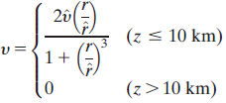
模式簡介(二)
此熱帶氣旋的模擬設置在沒有環境流場，且科氏參數假設在北緯15度的f面上。
所有模式的區域中，海平面溫度固定在303K，是由NOAA海溫資料統計之平均。
初始渦旋切線風速的設定由地面線性遞減到十公里高。

Slide 6
模式簡介（三）
CNTL
沒有更改任何的雲微物理參數化法
NOEVP
不包含由雨滴蒸發所產生的非絕熱冷卻，但還是容許蒸發(雨滴轉換城水蒸氣)。

Slide 7
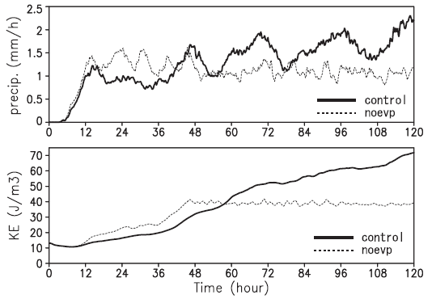
Predevelopment stage
Mature stage
Development stage
Notes:
半徑300 km 區域平均

Slide 8
Development stage
Mature stage
Notes:
NOEVP experiment suppress the development of outer rain band
切線風
虛線：最大上升速度的位置
Evaporation cooling extend the size of strong wind area around the melting layer

Slide 9
This corresponds to outward propagation of rainbands produced by cold pools and downdrafts associated with evaporative cooling, which play an important roles in the convection initiation and the maintenance of convective cells.
Notes:
The precipitation display an outward propagation in CONL and the vertical and azimuthally averaged wind extend its area
在conl實驗中還是持續在發展中

Slide 10
EPT
Predevelopment stage
Development stage
Mature stage
EPT cooling can be decomposed into the drying and cooling
Notes:
Control noeap
predevelopment 增加 1k 6k
Mature 增加 5k 13k
Evaporation cooling stabilizes the PBL
下降濕度-3 g/kg 可以使得 相當位溫下降9k
在成熟階段，乾空氣的溢入主要造成叫低的相當位溫

Slide 11
CAPE
 | CONL | NOEVAP
Predevelopment stage | 670 J/kg | 1030 J/kg
Development stage | almost the same value and higher
Mature stage | 700 J/kg | 910 J/kg
The CAPE near the eyewall (radius of 20-50 km)

Slide 12
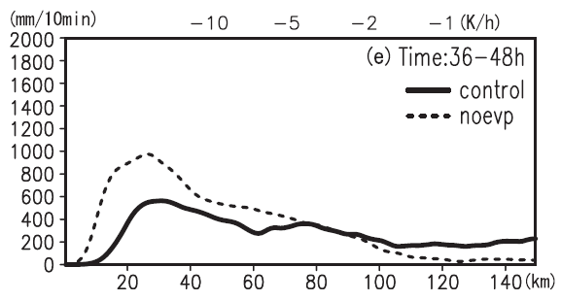
diabatic heating and cooling rates
Lack of rainband
Development stage
Notes:
肥絕熱

Slide 13
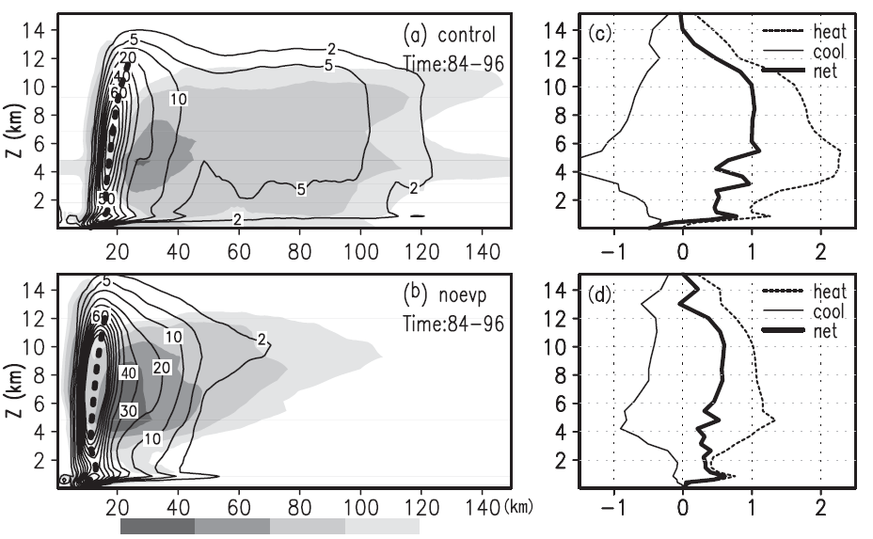
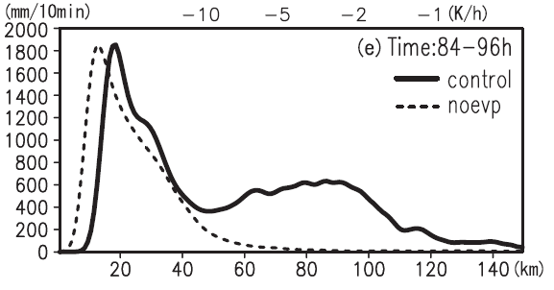
diabatic heating and cooling rates
Lack of rainband
Mature stage
Notes:
眼牆外的降水conl 與 noevp相比約有四倍大

Slide 14
slowly develop
Barrier effect
Development stage
rapid intensified
Large condensation heating
Still develop
Mature stage
intensity maintained
Frictional dissipation
Notes:
The TC size is closely related to a transport of absolute angular momentum (AAM) through a secondary circulation of the TC (Holland 1983; sawada and iwasaki 2007)
在發展階段 NOEVP很快的傳送大量的AAM 到

Slide 15
Angular Momentum Budget
Vertically integrated
Tuleya and Kurihara (1975)

Slide 16
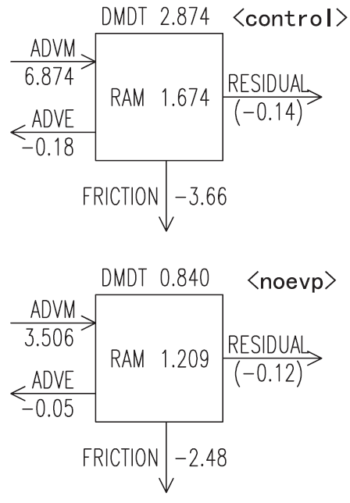
Mature stage

Slide 17
結論
在初期階段，控制實驗中模擬的熱帶氣旋之發展比起NOEVP實驗要來的慢。
在成熟階段，蒸發冷卻會使得眼牆周圍的CAPE減小，但是在眼牆外部區域扔會增加降水。
由蒸發冷卻所造成的下沉運動有效的產生外圍雨帶且在眼牆外部區域產生很多降水。
較多的非絕熱加熱會加強二次環流且會使得向內傳送的絕對角動量增加。
在控制實驗中，垂直積分後的平均角動量通量比NOEVP實驗要來的大，並且使得動能穩定的增加和使得熱帶氣旋的大小增加。

Slide 19
Precipitation rate
Development stage
Mature stage

Slide 20
Three Stages of TC evolution
Predevelopment
Development
Mature

Slide 21
Introduction
Wang(2002)showed that the absence of evaporative cooling and melting/sublimation cooling decreases downdrafts and produces a statically unstable layer in the PBL.
Zhang(2006)and Pattnaik and Krishnamurti (2007) have conducted sensitivity experiments of actually hurricanes to evaporative cooling and melting/sublimation cooling and found that both types of cooling suppress TC development.
Sawada and Iwasaki (2007) showed that melting/sublima-tion cooling suppresses the secondary circulation, which shrinks the TC size.
Notes:
Evaporation cooling and melting/sublimation cooling inhibit TC development

Slide 22
Model Description I
The nonhydrostatic model developed by the Japan Meteorological Agency–Meteorological Research Institute (JMA-NHM).(Saito et al. 2006)
2000 km X 2000 km and horizontal grid spacing of 2 km
Rayleigh damping is applied to boundary conditions
36 vertical layers, the model top height is 24.5 km and lowest level is 40 m, sponge layer is placed over the uppermost level at 17.42 km
Two-moment cloud-microphysics scheme by Murakami (1990)
Notes:
雷利阻尼（Rayleigh damping）

Slide 23
Model Description II
TC simulations are conducted under a quiescent environment in which the Coriolis parameter f is assumed to be constant at 15°N (f plane).
The sea surface temperature (SST) is fixed at 303 K over the whole region.
The tangential wind speed
decreases linearly form the
surface to 10 km

Slide 24
Model Description III
CNTL
are no changes be made in the cloud-microphysics scheme.
NOEVP
excludes evaporative cooling from rainwater, although it still allows evaporation (conversion form rainwater into water vapor)

Slide 25
Conclusions I
The TC development is much slower in the control experiment than in the NOEVP experiment at early stage of TC formation
Evaporation cooling reduces CAPE, but it nevertheless increases precipitation outside the eyewall in the mature stage .
Downdrafts caused by evaporation cooling effectively form rainbands and induce precipitation outside the eyewall.

Slide 26
Conclusions II
Large diabatic heating drives the secondary circulation and enhances the inward transport of absolute angular momentum
Vertically accumulated mean flux of angular momentum is much larger in the control experiment than in the NOEVP experiment and results in a steady increase in KE and a great enlarge TC size.

