Slide 1
Orographic Modification of Convection and Flow Kinematics by the Oregon Coast Range and Cascades during IMPROVE-2
Reporter: Prudence Chien
2010/03/08
Reference:
Colle, B.A., Y. Lin, S. Medina, and B.F. Smull, 2008: Orographic Modification of Convection and Flow Kinematics by the Oregon Coast Range and Cascades during IMPROVE-2. Mon. Wea. Rev., 136, 3894–3916.

Slide 2
Outline
Introduction
Data & methods
Synoptic-scale evolution
Mesoscale precipitation and kinematics
Discussion
Conclusions

Slide 3
Introduction
Field studies: MAP, IPEX, and IMPROVE => advance understanding of moist dynamics and cloud microphysics associated with orographic precipitation and to improve bulk microphysical parameterizations in mesoscale models, which will help improve QPF.
Orographic precipitation is sensitive to the static stability and terrain variability.

Slide 4
Introduction
The case analyzed the 4-5 December 2001 IMPROVE-2 event(IOP6).
This paper: 1) Describe the flow kinematics, precipitation evolution, and orographic modification 2) Verify the WRF-simulated mesoscale flow and precipitation patterns using in situ and aircraft datasets 3) Highlight the intermittent nature of the convective precipitation and isolate the respective impacts of the Oregon Coast Range and narrow Cascade ridges on precipitation over this complex region

Slide 5
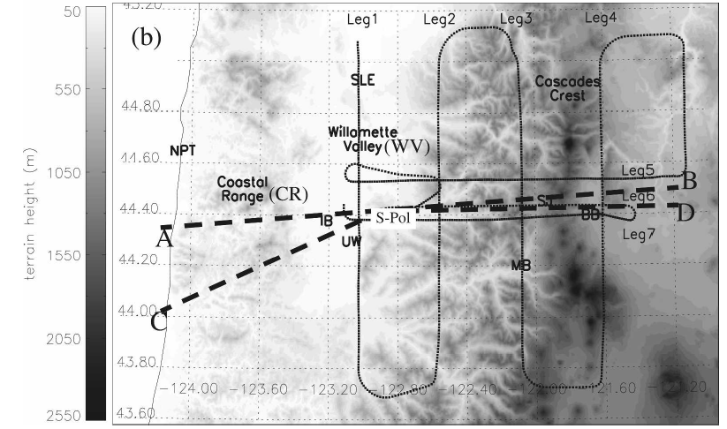
Data and methods
Observational datasets
NOAA P-3
ISS
Mobile sounding
S-Prof

Slide 6
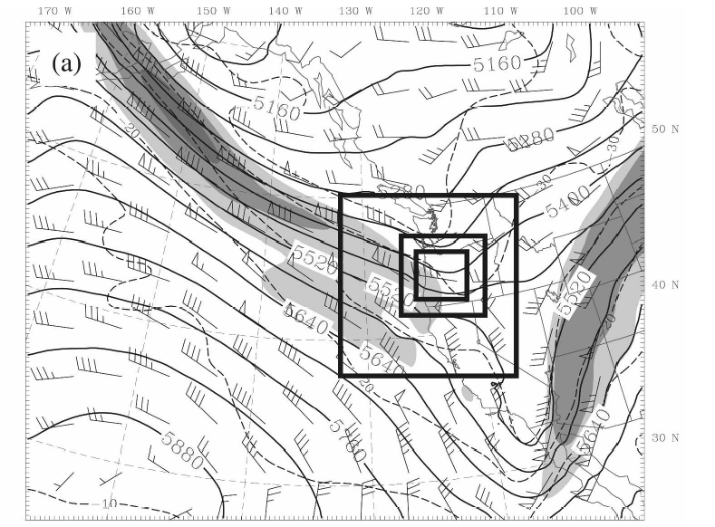
Data and methods
Model setup: WRF v2.2 4-5 Dec 2001 IC: NCEP GFS data mp: Reisner2 (Thompson) cp: Kain-Fritsch PBL: Eta-Mellor-Yamada-Janjic moist adv: Positive definite advection
36km
12km
4km
1.33km

Slide 7
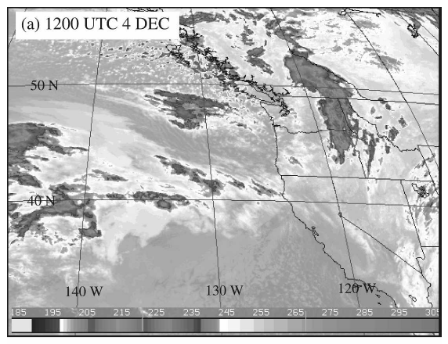
Synoptic evolution
Upper-level and surface analysis: 1200UTC 4 DEC
500mb
This baroclinic development was occurring in a relatively cold and unstable air mass left in the wake of the first short-wave trough.

Slide 8
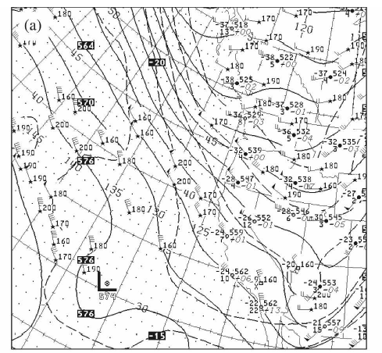
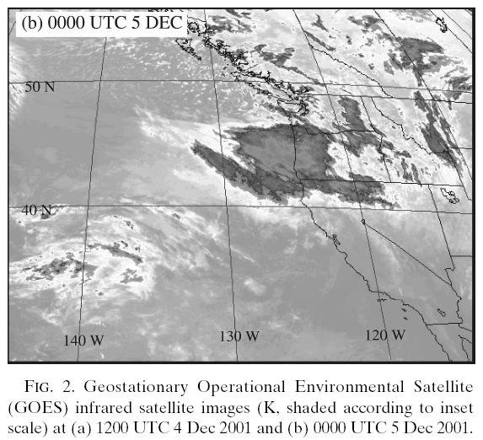
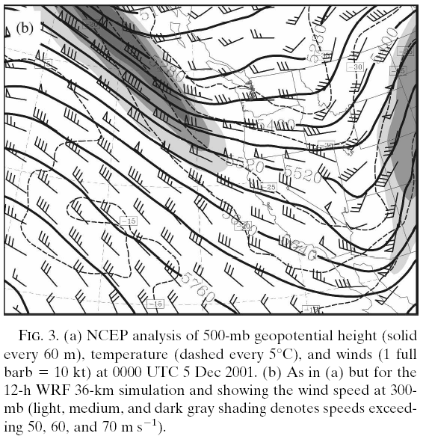
500mb
Upper-level and surface analysis: 0000UTC 5 DEC

Slide 9
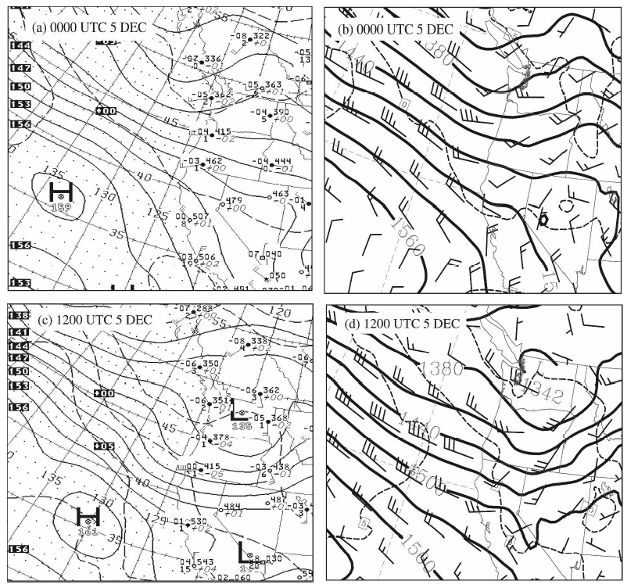
850mb trough

Slide 10
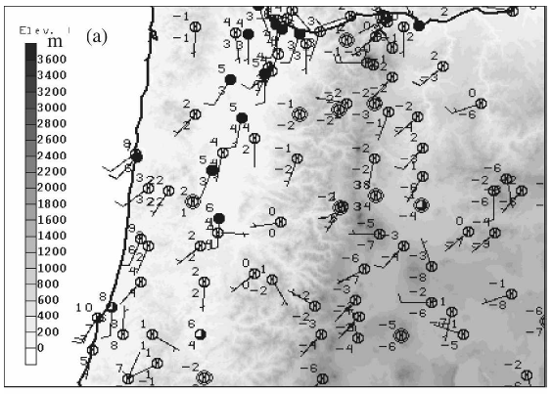
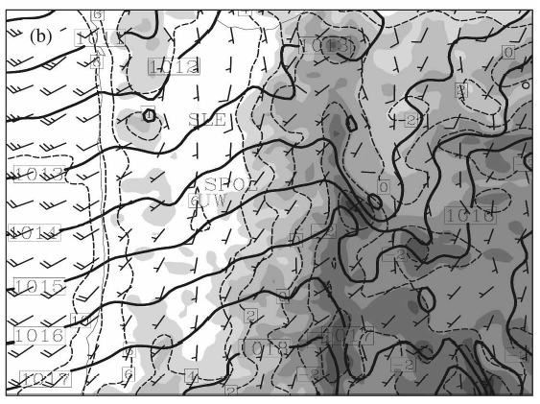
0000UTC 5 DEC
Surface wind (obs)
Surface wind (WRF)
Sea level pressure
Onshore flow merge with channeled flow

Slide 11
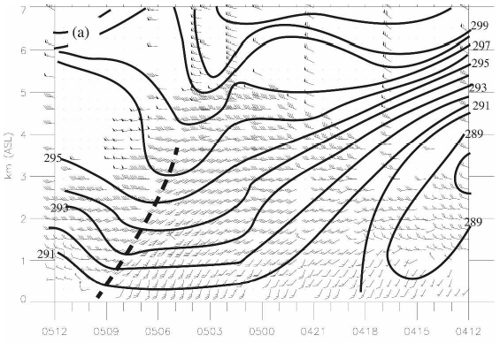
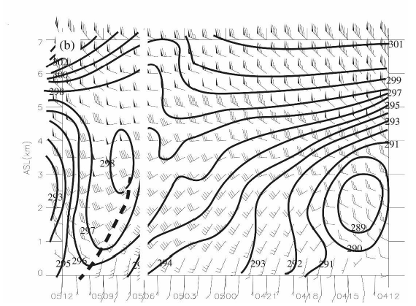
Vertical structure
Equivalent potential temperature & wind
04/1200~05/1200 UTC
ISS obs
WRF (dx = 1.33)
=> During the trough passage, the simulated θe were higher than those observed and the simulated stratification at low levels was weaker than what was observed.
Notes:
中低層模式的穩定度較大 d (theta e)/ dz ~0

Slide 12
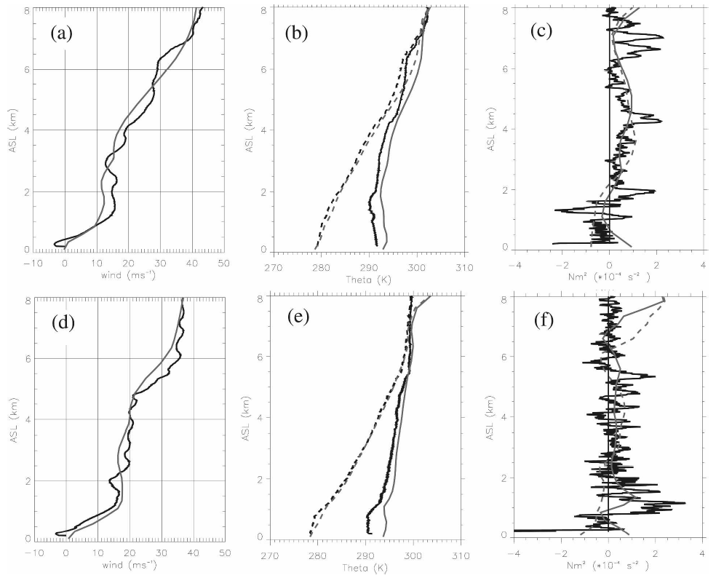
模式低估低層風切
模式較濕
0.7~2km MSL was potentially unstable
04/2100
05/0330
模式PBL太濕
Obs ~1km MSL moist static stability increase: melting and evaporation below this level
虛線：位溫
實線：相當位溫
Notes:
Moist Froude number & wind(U) => 過山的問題
F=U / N*hm

Slide 13
Mesoscale precipitation and kinematics

Slide 14
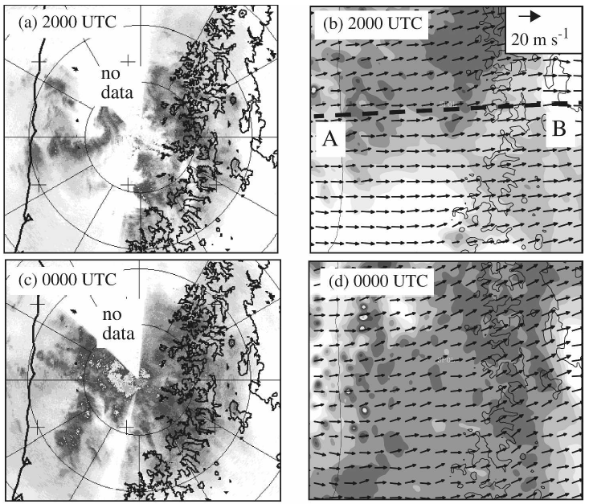
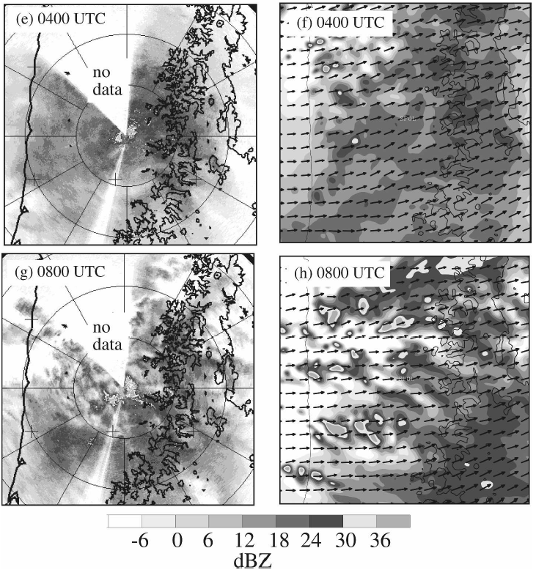
Precipitation evolution
Notes:
A->c->e 從回波可發現，降水的特性一開是偏向對流發展，之後轉成層狀降水為主
G 由於中層槽線通過，因此降水特性轉為胞狀

Slide 15
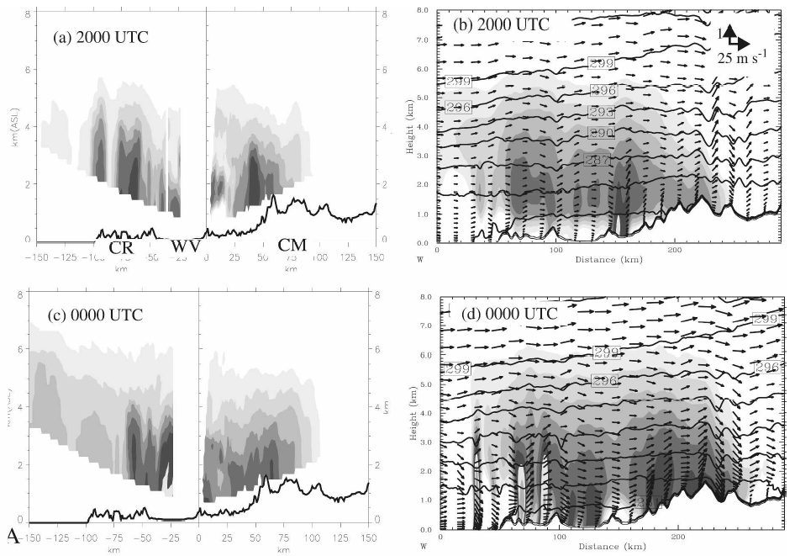
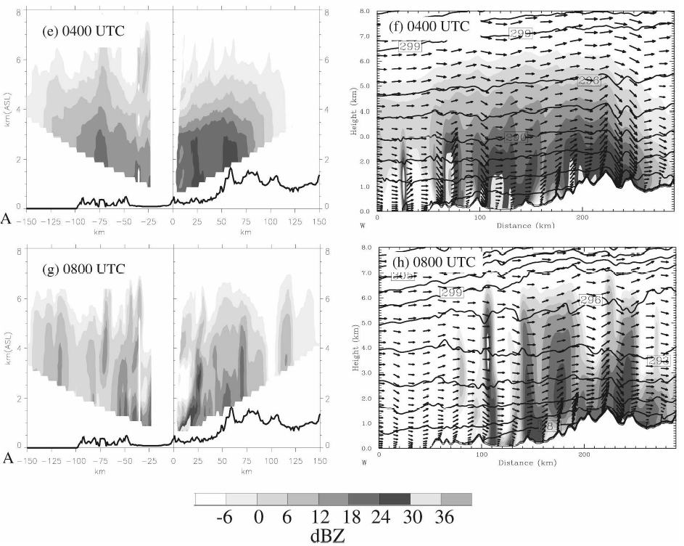
The cells intensified as the airflow ascended over the Coast Range, releasing potential instability at low levels.
Notes:
上層槽線通過CR區，使該區降水增強，之後槽線往東通過，使山區的降水也變強。

Slide 16
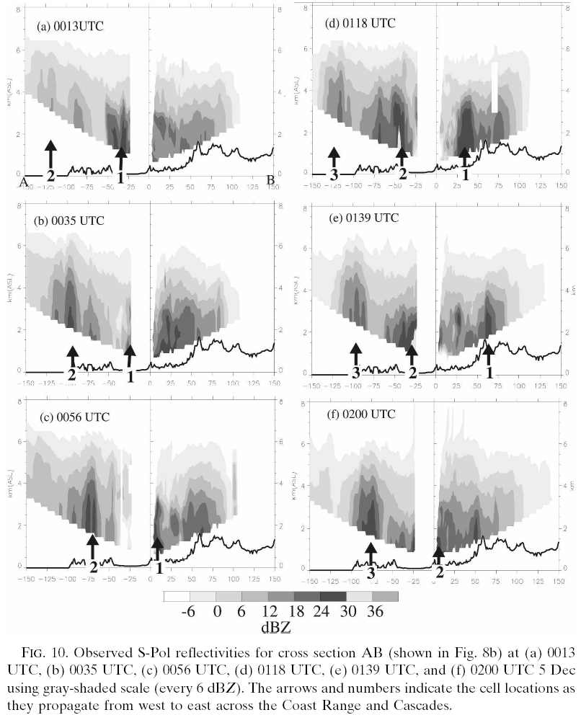
Notes:
要看短暫增強的對流胞=> 都是在登陸後CR區增強，之後消散

Slide 17
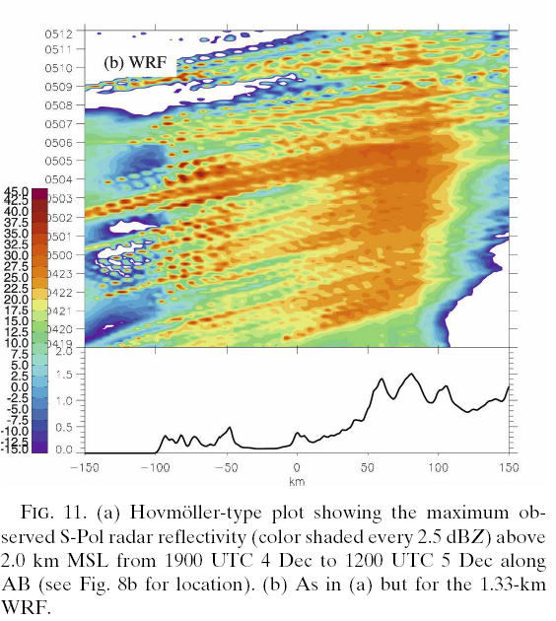
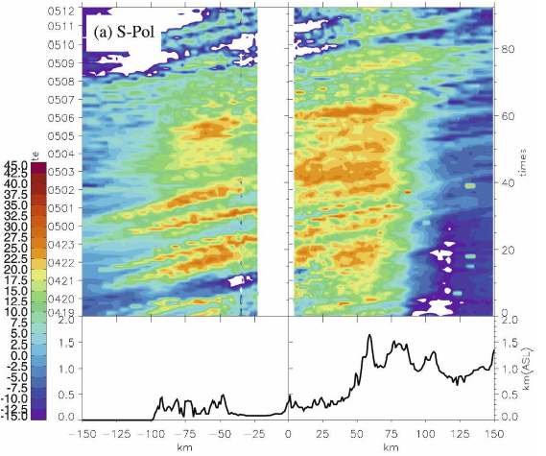
Model have produced too much precipitation and spillover beyond the crest
widespread
Notes:
利用回波來分析降雨時序的特性(0~2km的最大回波作圖，可以屏除亮帶因素並涵蓋地形降水的特徵)
發現有兩波增強=> CR 和 山區

Slide 18
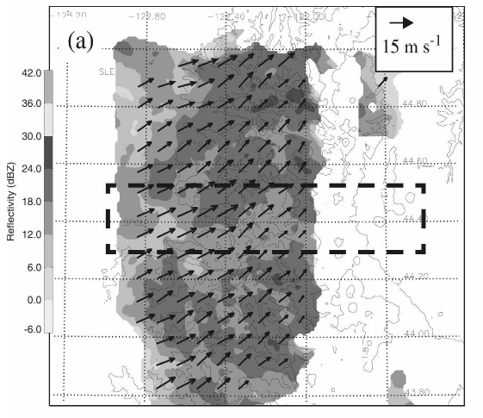
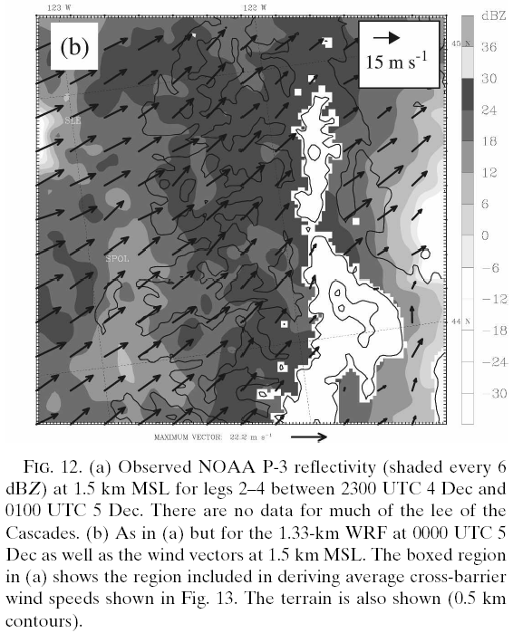
NOAA P-3 observations

Slide 19
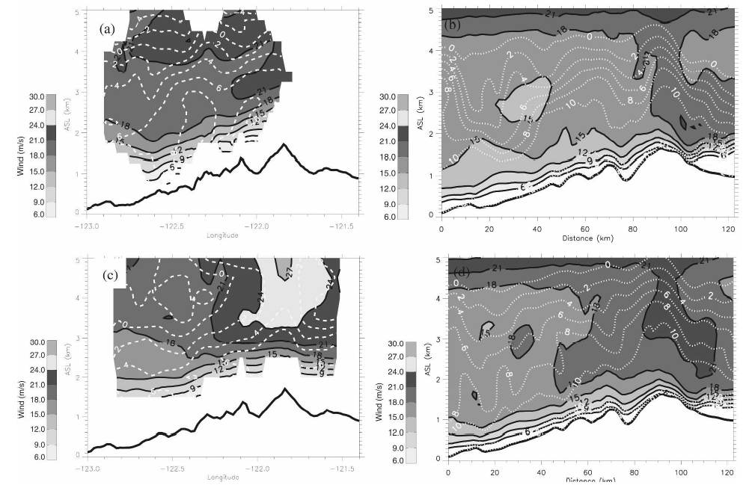
Notes:
迎風面上的最大風速相似，但是模式的風切層太淺=>PBL法的問題

Slide 20
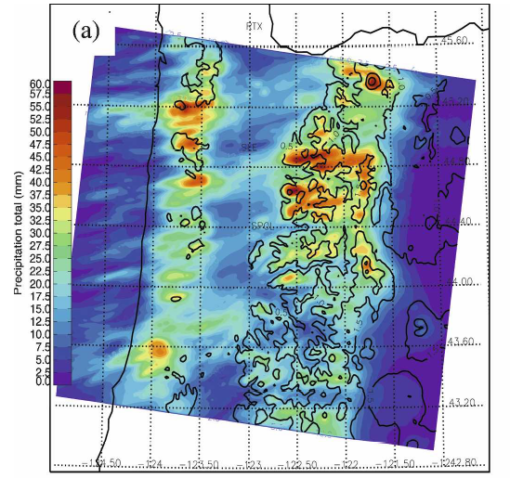
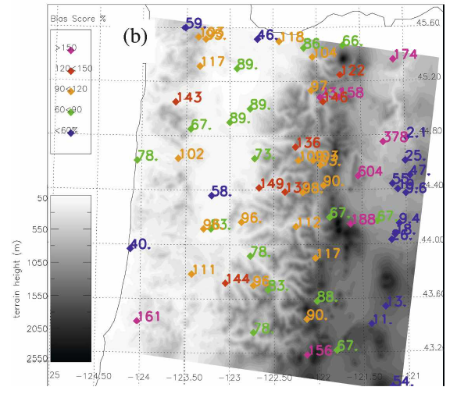
模式降水
觀測降水
Notes:
模式大致上並不會高估降水

Slide 21
discussion

Slide 22
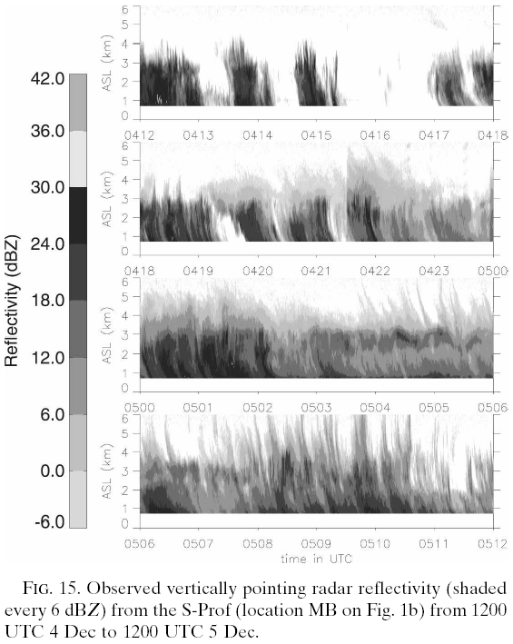
High-resolution reflectivity evolution
Notes:
一開始是氣旋帶來的降水，較為間斷性；但是後來高層槽線抵達時，降水變得較為連續，且地形雲發展較深
前人研究中指出，山岳波會使回波增強

Slide 23
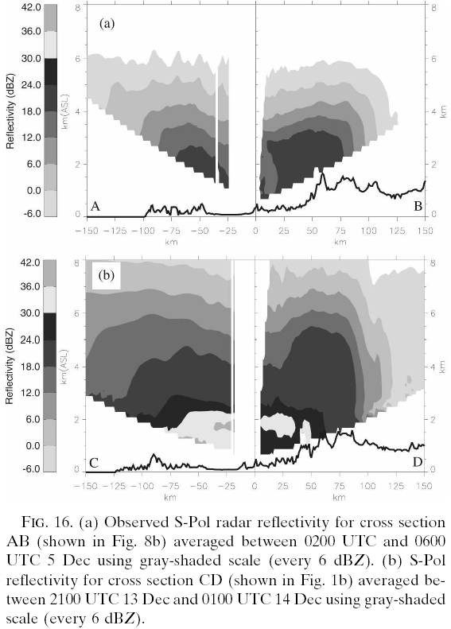

Slide 24
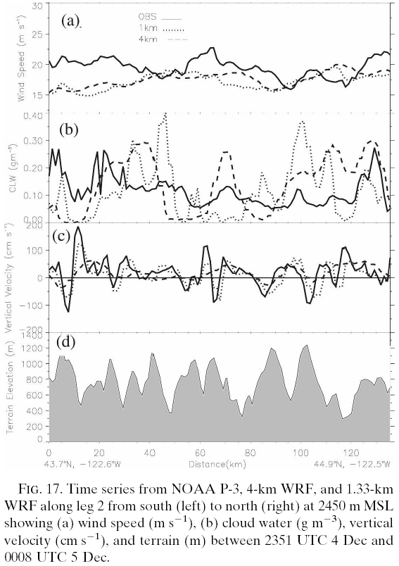
Gravity wave impacts on precipitation
&
Coast Range impacts

Slide 25
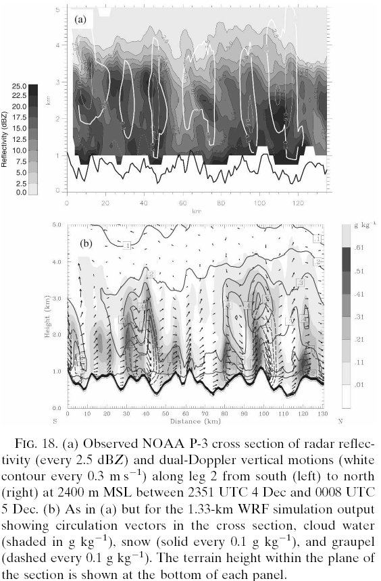
Narrow ridges along the windward slopes were not particularly important in modulating the development or evolution of the convective precipitation in this case.
Notes:
=> Gravity wave vertical motion & relatively low freezing level

Slide 26
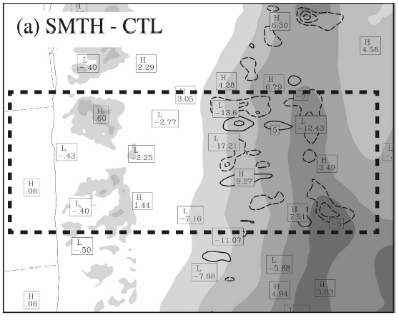
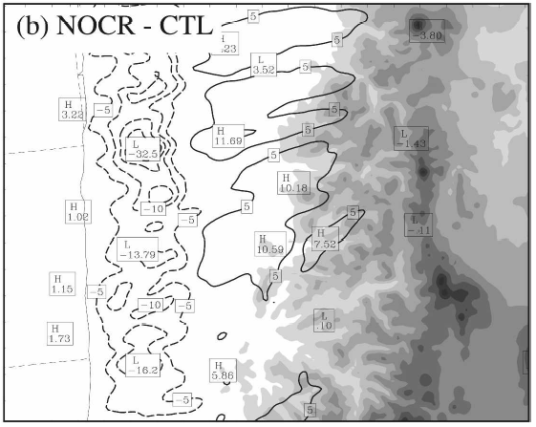
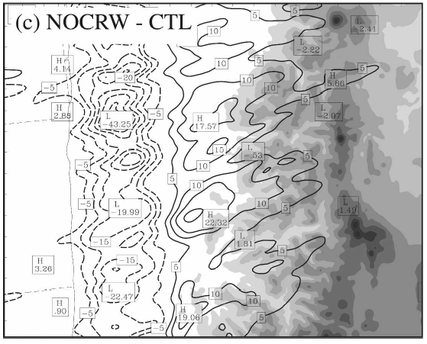
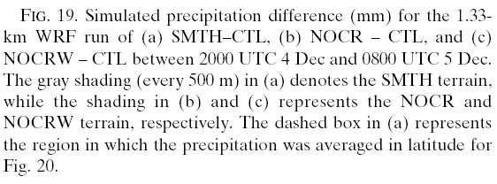

Slide 27
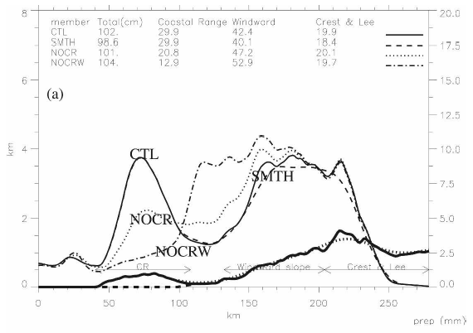
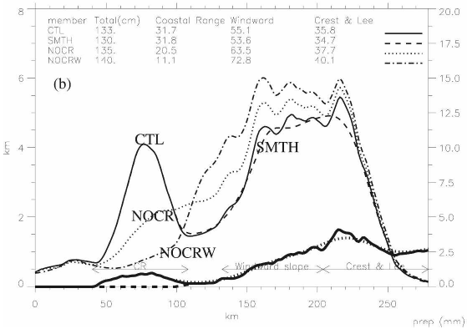
04/2000~05/0200
05/0200~05/0600

Slide 28
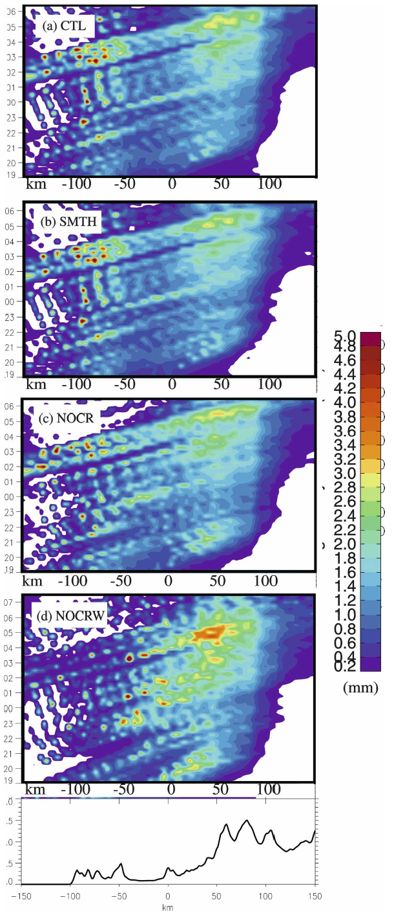
1) Lifting induced by the presence of an elevated terrain profile corresponding to the coastal mountains 2) differential land-sea friction and associated low-level convergent forcing tied to the Pacific coastline

Slide 29
Conclusions
Observation
This event featured a landfalling baroclinic wave, which developed within a colder air mass and was accompanied by comparatively weak cross-barrier flow and thermodynamic stratification.
Initial : relatively weak warm advection
Over the coast: onshore flow was relatively unstable, and supported embedded convective cells
The upper-level trough approached: precipitation increased in coverage and intensity; and greater precipitation accompanied increasing cross-barrier flow and overall orographic cloud depth.

Slide 30
Conclusions
Simulation results
The model realistically simulated the 3-D thermodynamic, kinematic, and precipitation structures.
The simulation results:
underestimated cross-barrier flow and the depth and strength of an associated shear layer over the windward slopes
Smooth terrain(Cascades) had a relatively small impact on the net precipitation given the lack of riming and the relatively low freezing level.
Larger surface friction: the broader circulation tied to the larger mountain wave anchored over the Cascades crest enhanced the precipitation well (~100km) upstream of this more major barrier.
Coastal Range triggers convective cells and enhances local precipitation.
Net effect of the coastal range: 1) the lifting of the flow over the elevated terrain profile 2) the low-level convergence induced by the land-sea frictional contrasts across the coastline => significant decrease(20%-30%) of precipitation over the Cascades

